Slide 1
Mathematical Induction
Very important technique of mathematical proof, normally used to establish a given statement for all natural numbers n = 1, 2, 3, ...
Is also used to prove properties of structures such as trees and graphs.

Slide 2
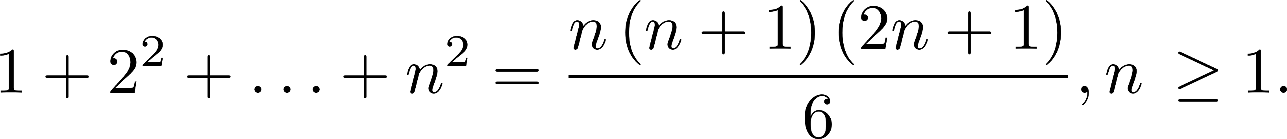
Mathematical Induction
Suppose you are given a statement, S , that depends on a variable n; for instance,
Let n₀ be the first value of n for which S applies, and prove the statement true. This is called the basis step. For our example, n₀ =1 .

Slide 3
Mathematical Induction
Now, assume S is true for some n ≥ n₀ and prove that this implies the S is true for n+1. This is called the inductive step. Then
S is true for n₀, so it is true for n₁ = n₀ + 1.
S is true for n₁, so it is true for n₂ = n₁ + 1.
S is true for n₂, so it is true for n₃ = n₂ + 1.
...
This sequence can be continued indefinitely, so S is true for all n ≥ n₀.

Slide 4
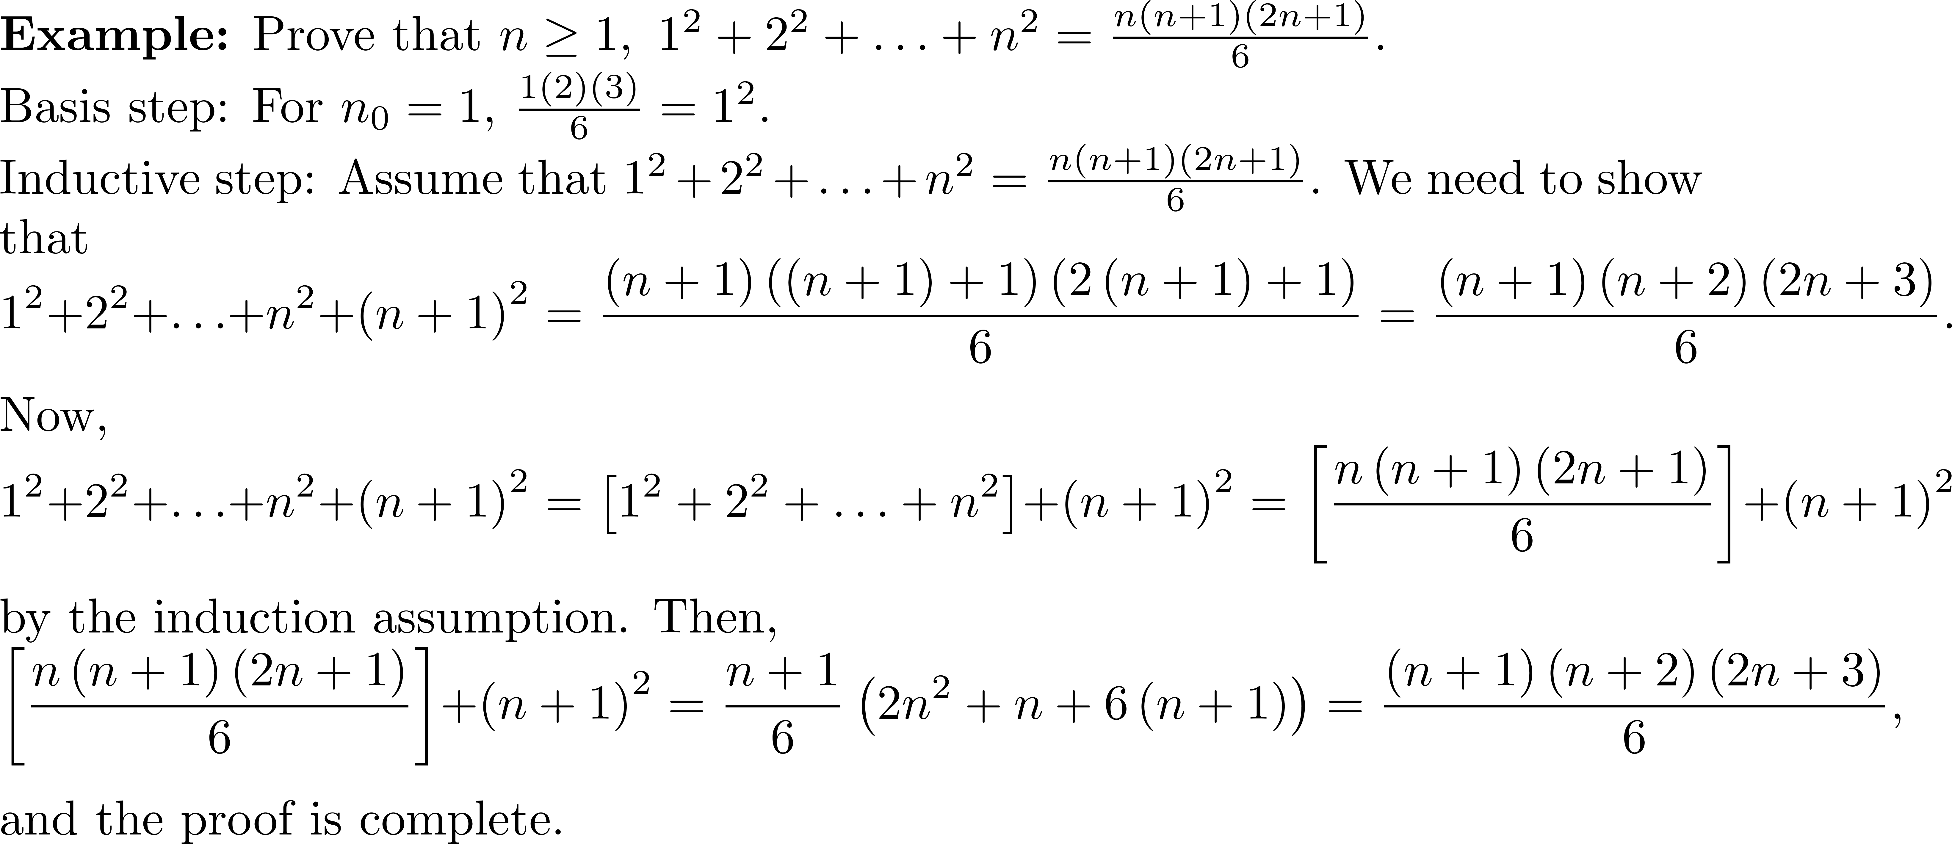
Example 1

Slide 5
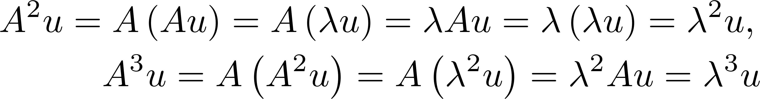
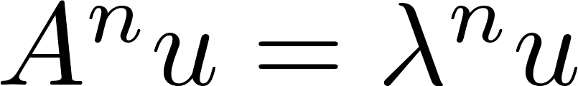
Mathematical Induction
Suppose you have an eigenvalue/eigenvector pair, λ/u , so that Au= λu , and you need a way to compute powers A^{n}u . Do some experimenting: There is a clear pattern: When some experimentation yields a pattern, mathematical induction is often the easiest way to prove a result.

Slide 6
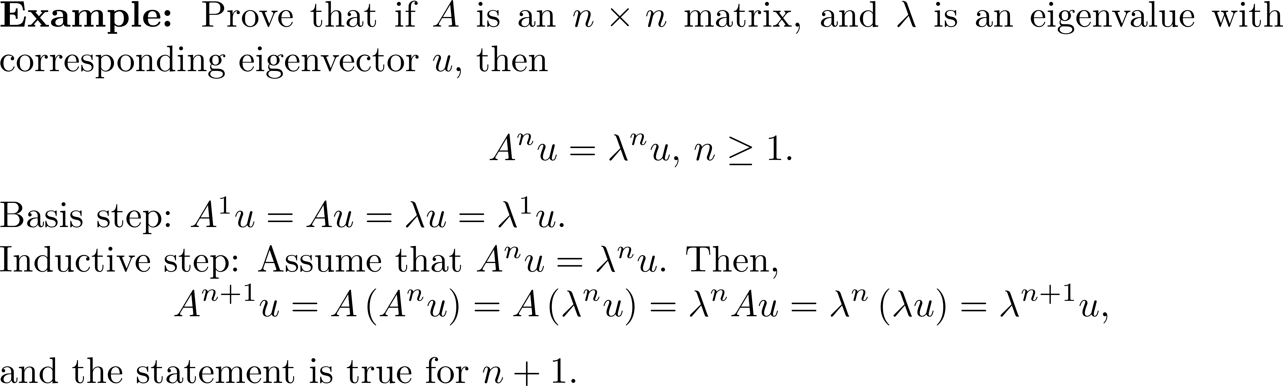
Example 2

Slide 7
Mathematical Induction
A geometric series is a series with a constant ratio between successive terms. For example, Since geometric series have important applications in science and engineering, the formula for the sum of a geometric series is a very useful result.

Slide 8
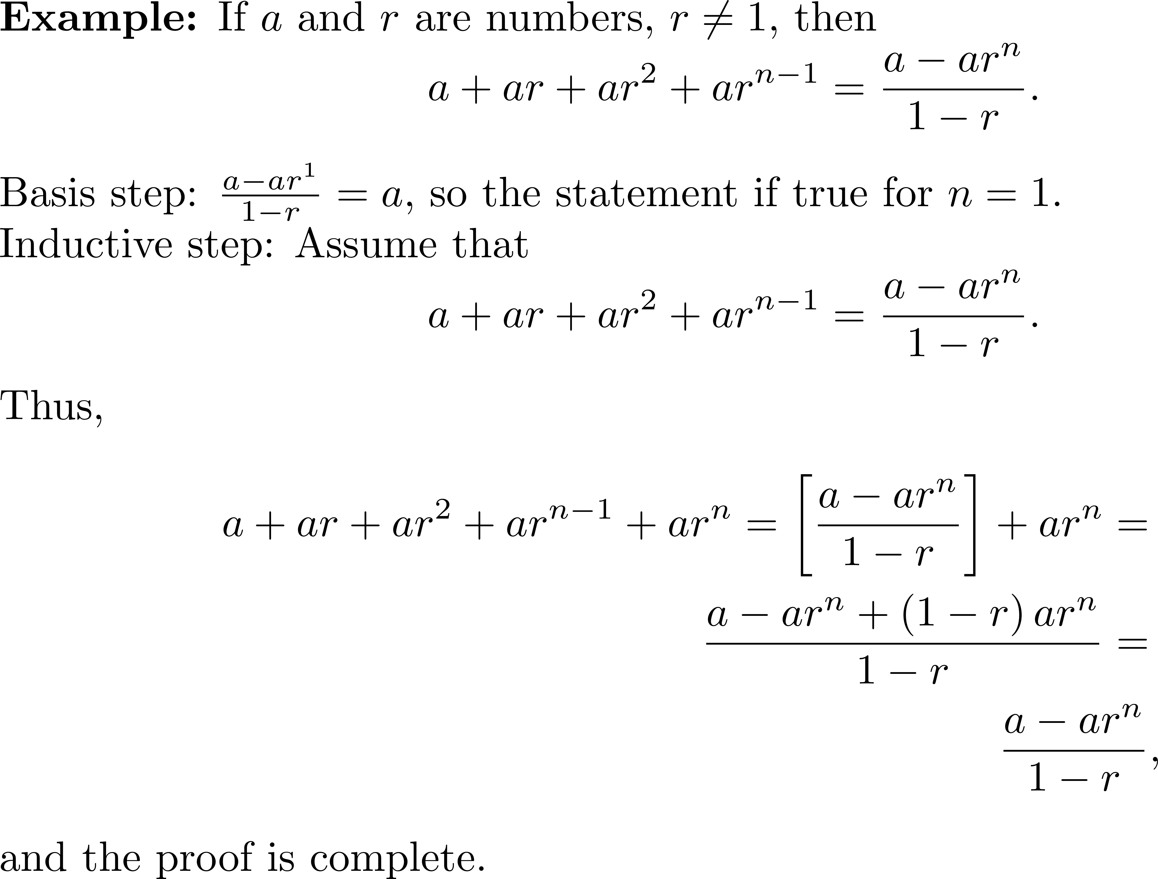
Example 3

Slide 9
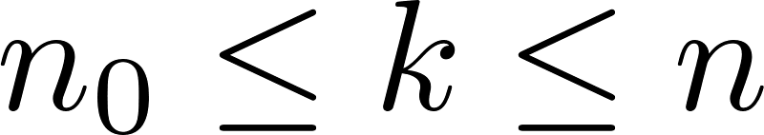
Strong Induction
It is sometimes necessary to use a variant of mathematical induction called strong induction. The basis case is as before
Let n₀ be the first value of n for which statement S applies, and prove the statement true.
The inductive step is
Assume S is true for all . Prove S is true for n+1.

Slide 10
Strong Induction
Use this form of induction when the assumed truth for n is not enough. This occurs when when several instances of the inductive hypothesis are required to prove the statement true for n+1 .

Slide 11
Strong Induction
Note that 2, 3, 5, 7, 11, ... are prime. Take a composite number such as 24. We can write 24 as 24 = 2³(3). In the case of 3500, 3500 = 2²5³(7).
The Fundamental Theorem of Arithmetic says that every integer can be written as a product of prime numbers and that the primes are unique.
The next example uses strong induction to prove the existence of the factorization. Proving uniqueness is more difficult.

Slide 12
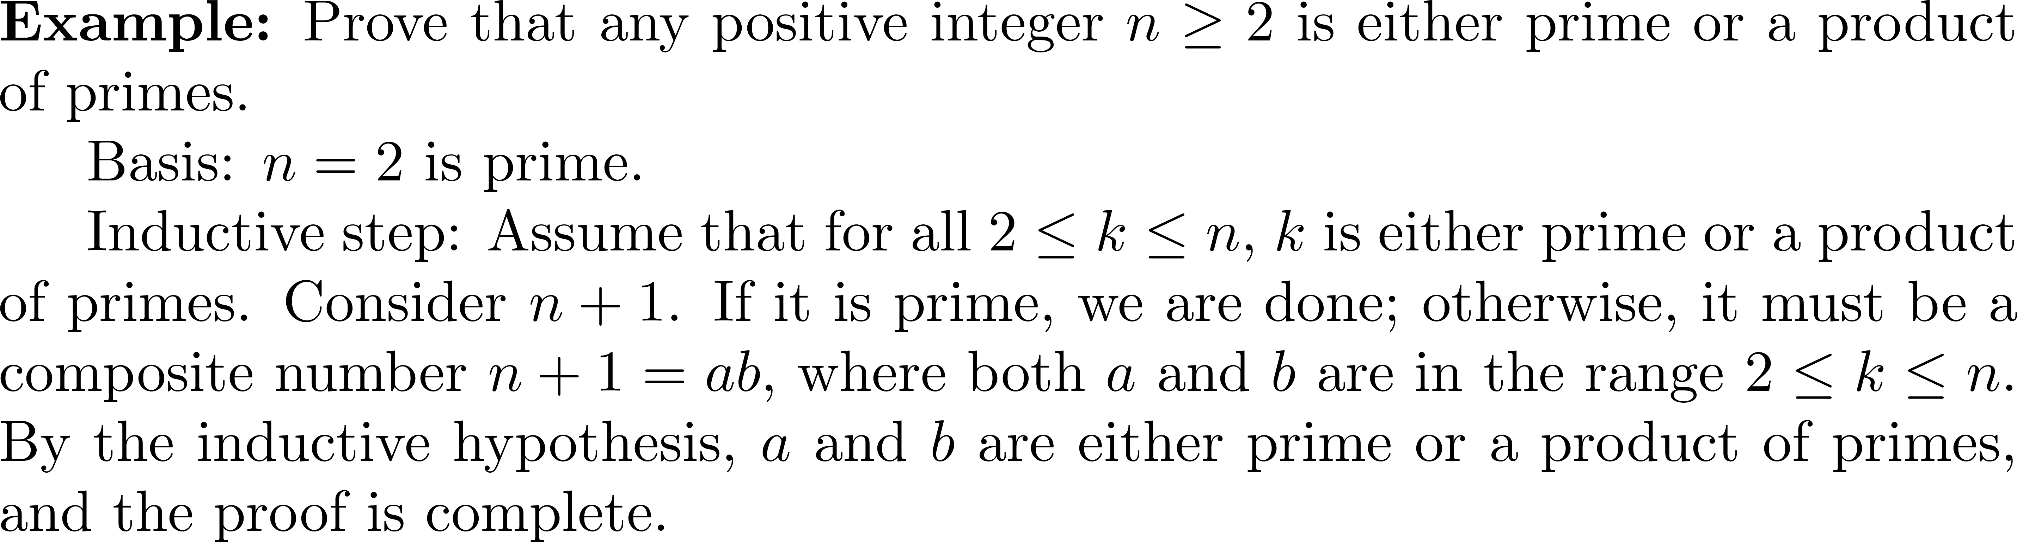
Example 4

