Slide 1
Why Study Numerical Linear Algebra?
Design and analyze load-bearing structures such as bridges.
Vibration analysis.
Analysis of electrical circuits.
Image enhancement and compression.
Tomography
Solution of ordinary and partial differential equations.
TexPoint fonts used in EMF.
Read the TexPoint manual before you delete this box.: AAAAAAAAA

Slide 2
Matrix
A matrix is a rectangular array of numbers arranged in m rows and n columns.
The symbol denotes the collection of all matrices whose entries are real numbers.
Matrices will usually be denoted by capital letters, and the notation specifies that the matrix is composed of entries located in the i-th row and j-th column of A.

Slide 3
Example 1
The formula for defines a matrix ,namely

Slide 4
Equality of Matrices
Equality of matrices: Matrices A, B are said to be equal if A and B have the same size and corresponding elements are equal; i.e., A and B have dimension , and ,with .

Slide 5
Matrix Addition
Addition of matrices: Let and be of the same size. Then is the matrix obtained by adding corresponding elements of A and B.

Slide 6
Scalar Multiple of a Matrix
Scalar multiple of a matrix: Let and be a number (scalar). Then is the matrix obtained by multiplying all elements of by ; that is

Slide 7
Negative of a Matrix
Negative of a matrix: Let .Then is the matrix obtained by replacing the elements of by their negatives; that is

Slide 8
Matrix Subtraction
Subtraction of matrices: Matrix subtraction is defined for two matrices and of the same size, in the usual way; that is

Slide 9
The Zero Matrix
The zero matrix: Each matrix, all of whose elements are zero, is called the zero matrix and is denoted by the symbol .

Slide 10
Matrix Operations
The matrix operations of addition, scalar multiplication, negation and subtraction satisfy the usual laws of arithmetic.

Slide 11



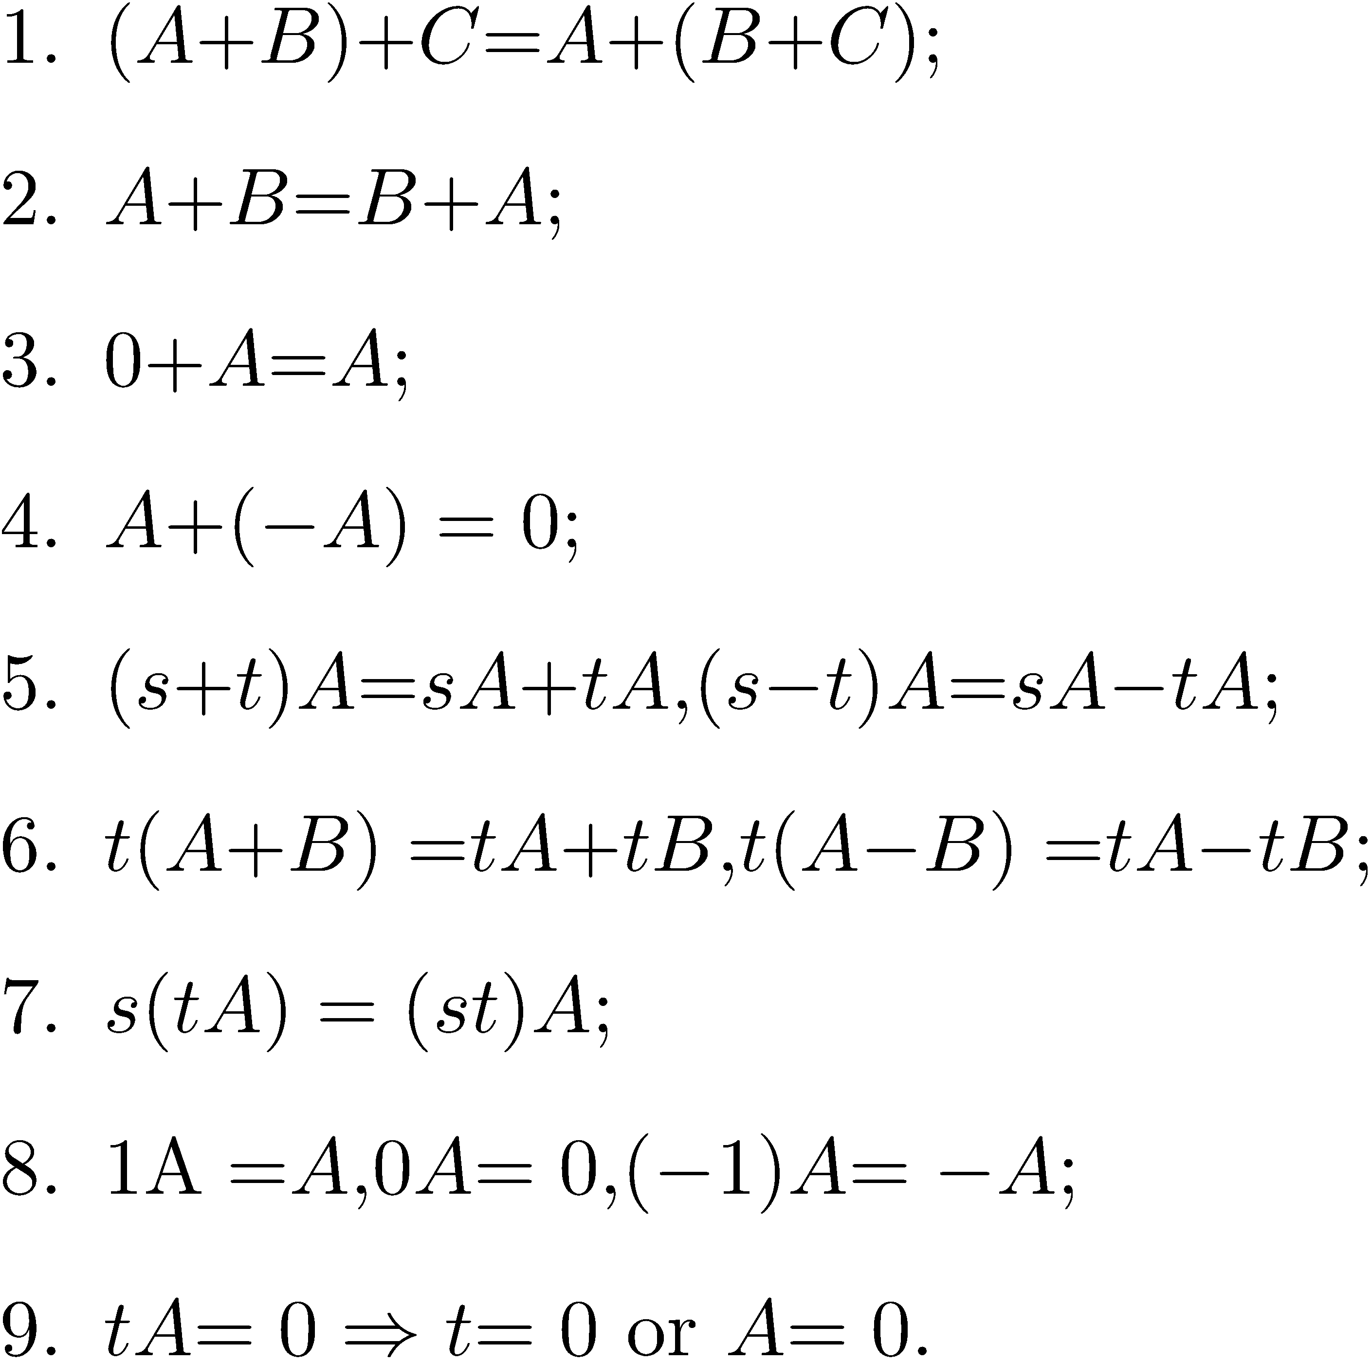
Matrix Operations
In what follows, and are arbitrary scalars and are matrices of the same size.

Slide 12
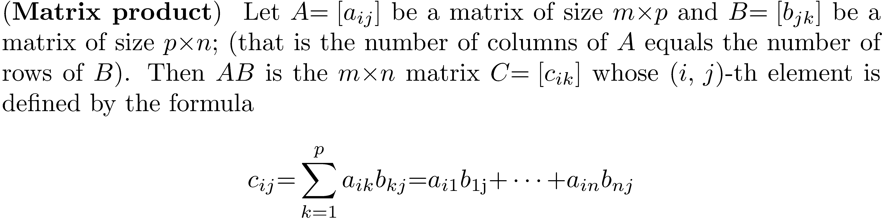
Matrix Multiplication

Slide 13
Matrix Multiplication
A way to look at this is that c_{ij} is the sum of the products of corresponding elements from row i of A and column j of B. Fix on row 1 of A. Form the sum of products of corresponding elements from row 1 of A and column 1 of B, then the sum of products of corresponding elements from row 1 of A and column 2 of B, and so forth, until forming the sum of the products of corresponding elements of row 1 of A and column n of B. This computes the first row of the product matrix C. Now use row 2 of A in the same fashion to compute the second row of C. Continue until you have all m rows of C.

Slide 14
Matrix Multiplication

Slide 15
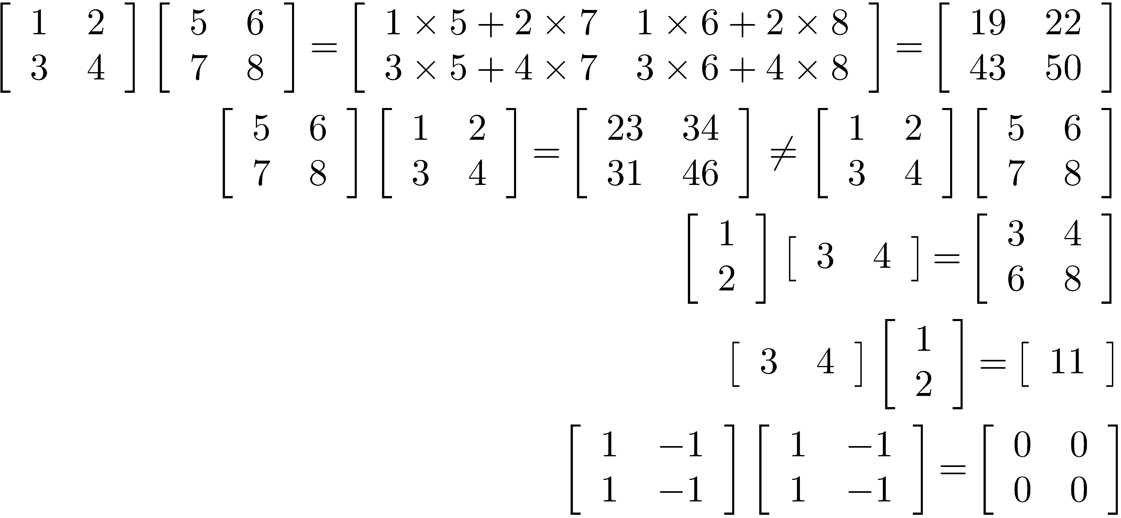
Examples of Matrix Multiplication

Slide 16
Cost of Matrix Multiplication
Computationally expensive.
If A is m × k and B is k × n, the total number of multiplications is m×k×n.
If A and B are n × n matrices, n³ multiplications are required.
To multiply two 100 × 100 matrices requires computing 10000 products.
If matrices are sparse (have a small percentage of nonzero elements), there are fast ways to perform multiplication (Chapter 21).

Slide 17
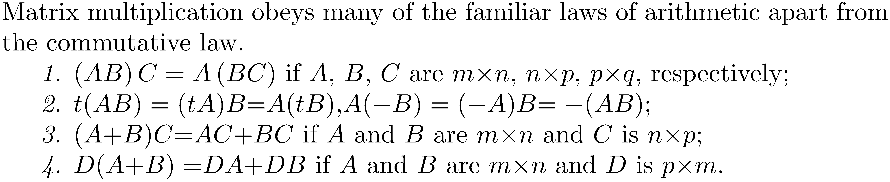
Laws of Matrix Multiplication

Slide 18
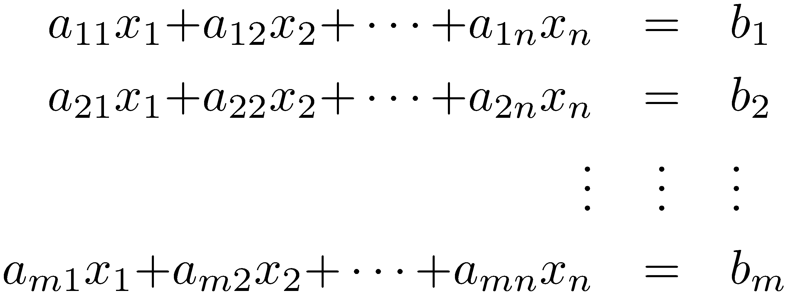
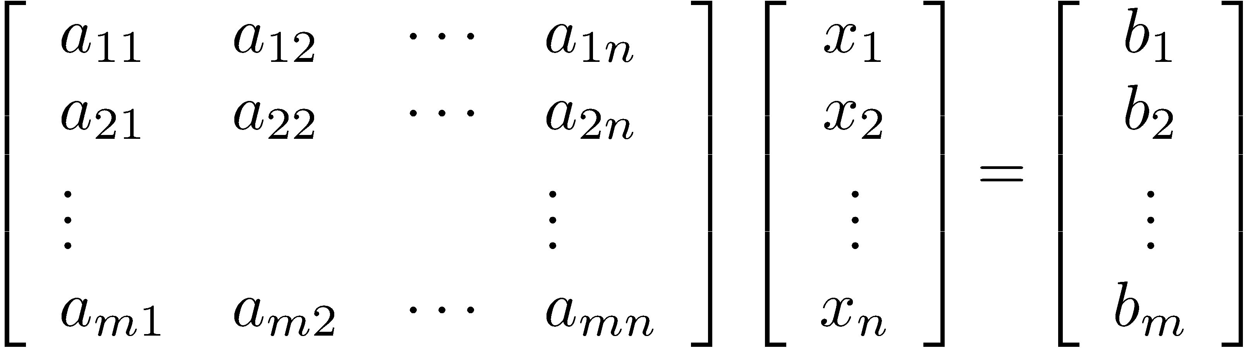
System of Linear Equations
System of m linear equations in n unknowns:
Equivalent matrix equation Ax=b.

Slide 19
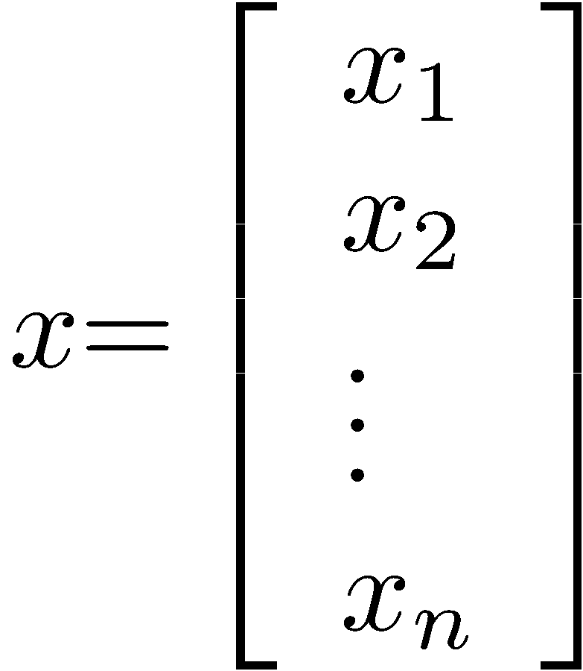
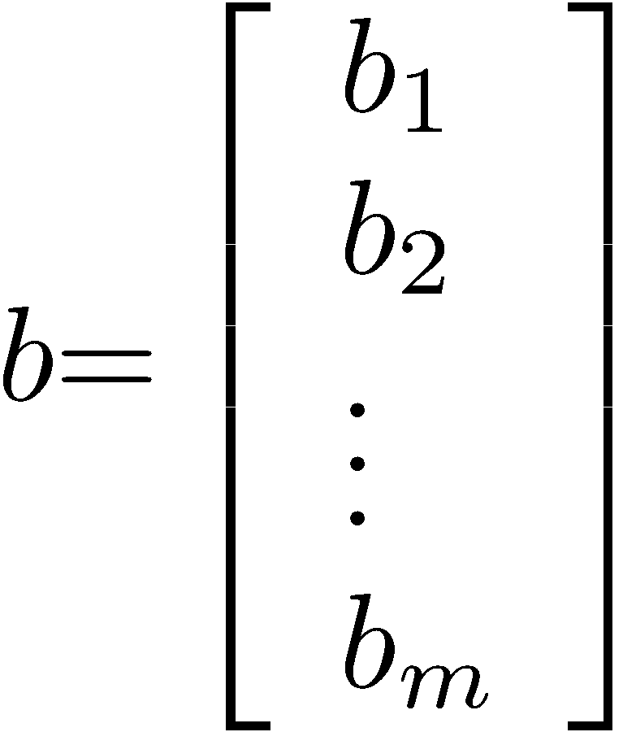
System of Linear Equations
A is the coefficient matrix
Vector or unknowns:
Vector of constants (right-hand side):

Slide 20
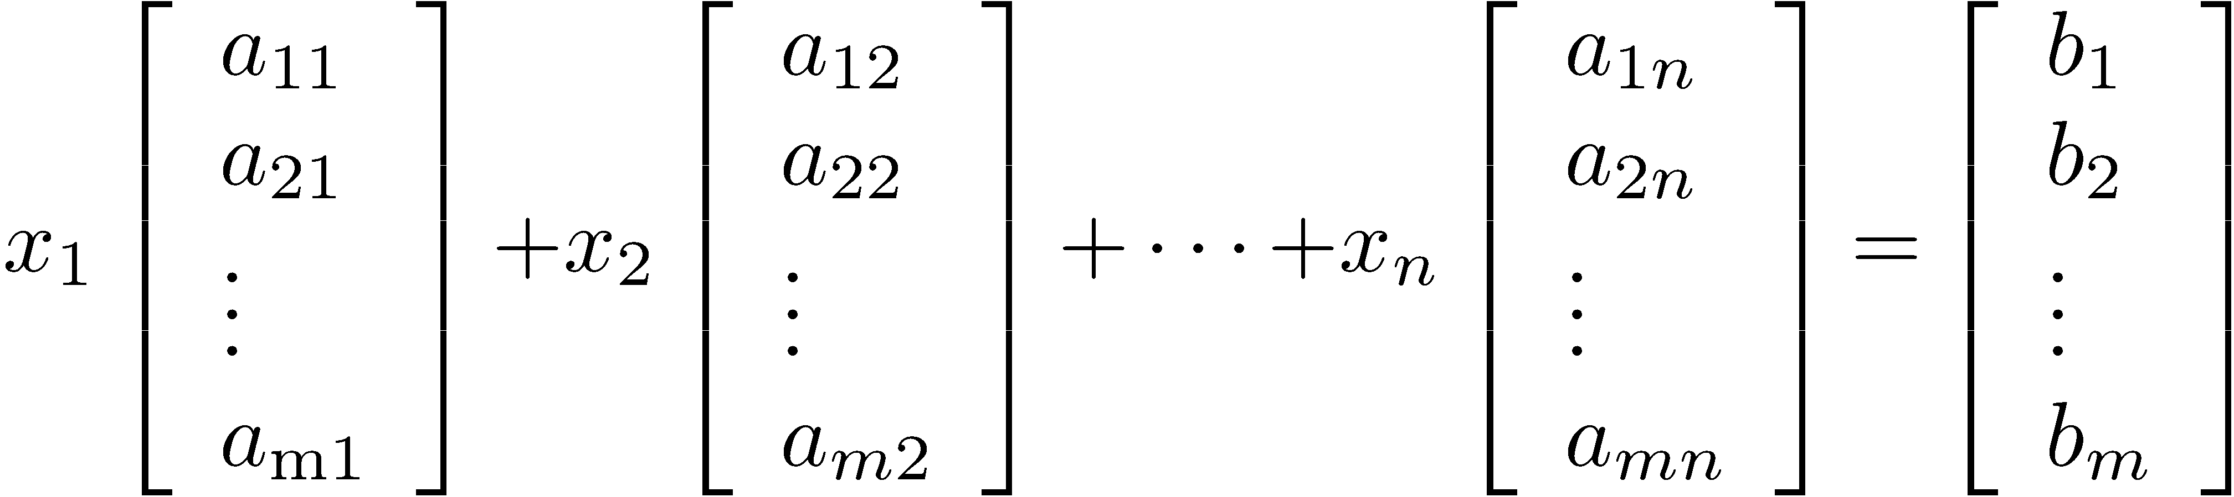
Equivalent Equation for Ax = b

Slide 21
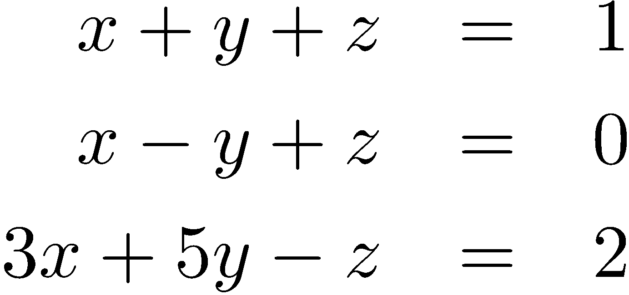
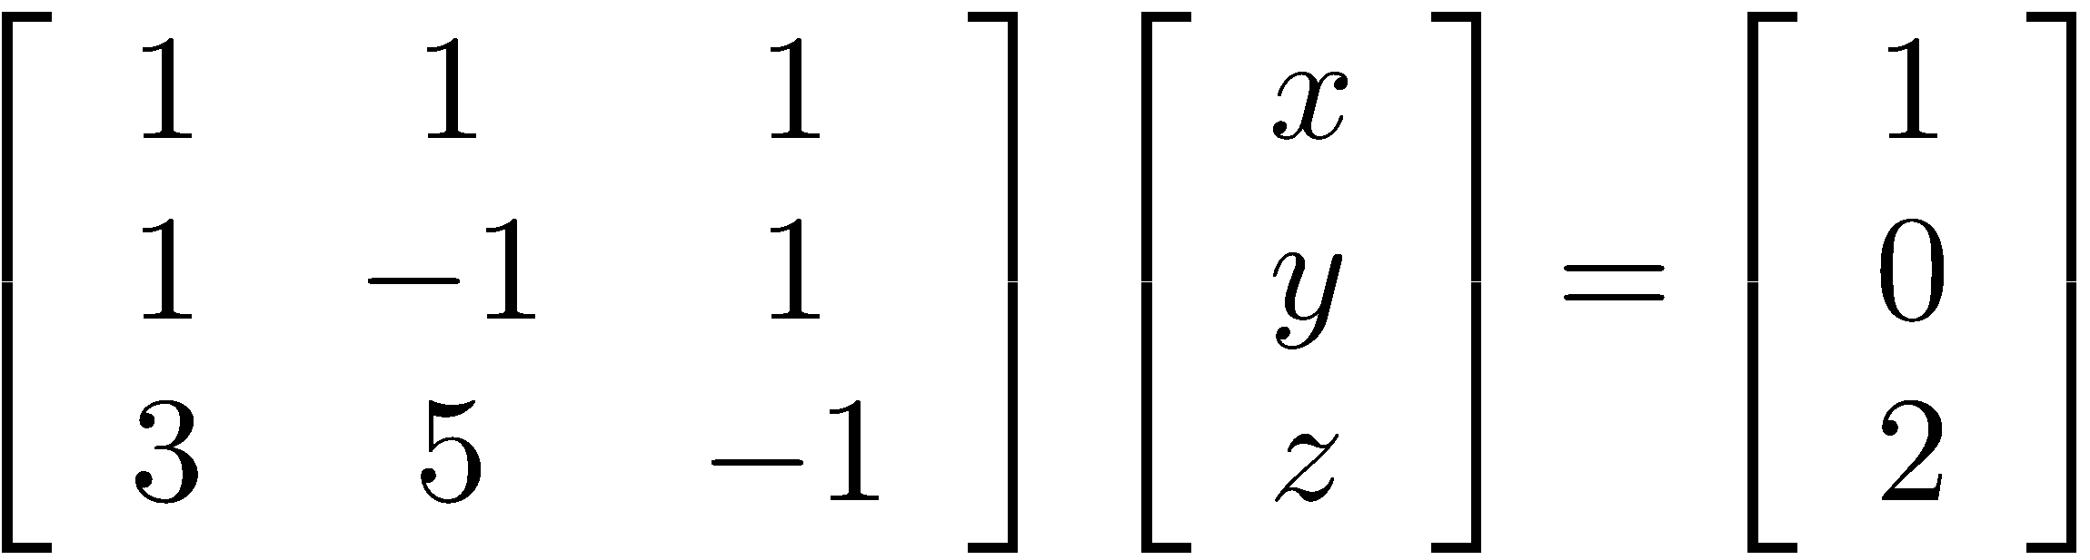
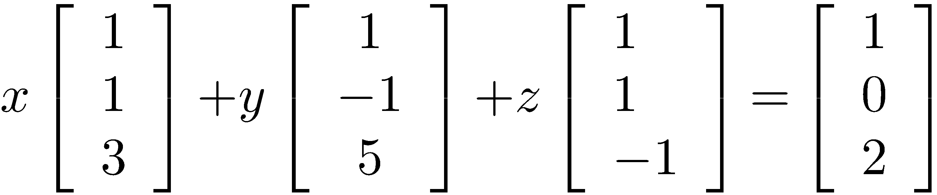
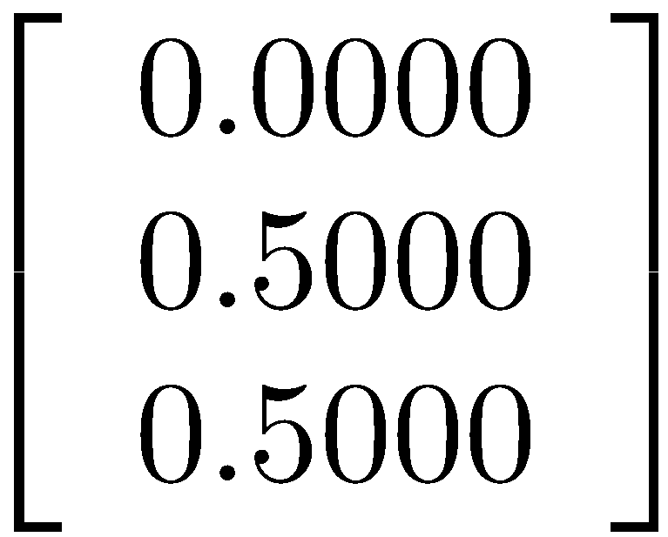
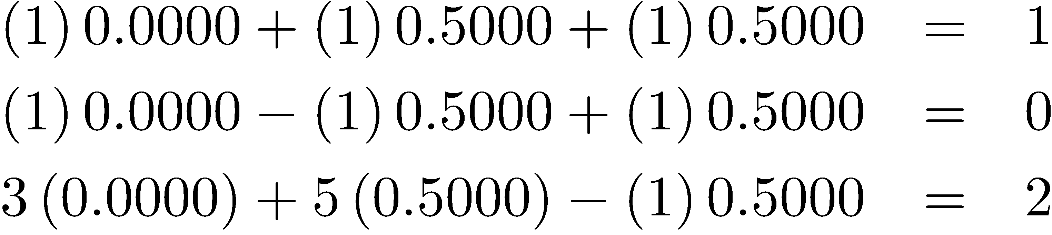
Example of a Linear System
System
Matrix form
Alternative form
Solution

Slide 22
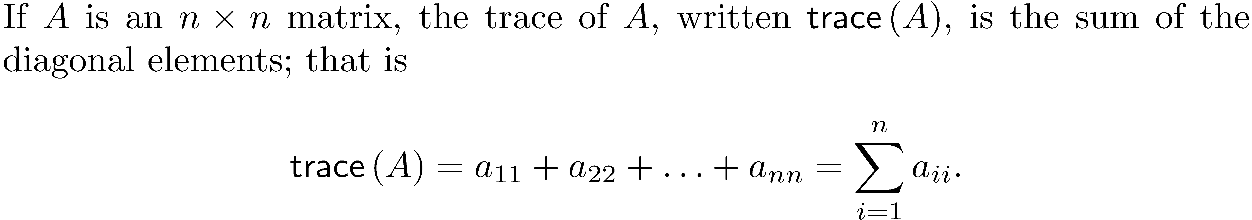
The Trace

Slide 23
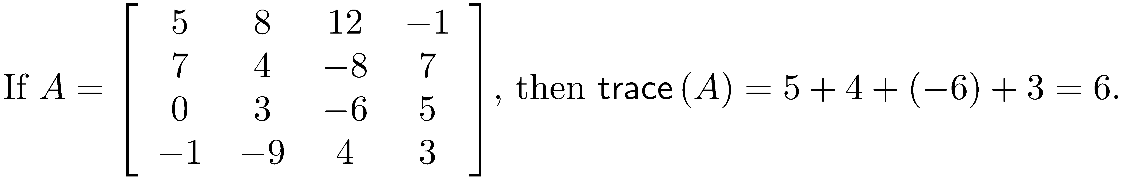
Example of the Trace

Slide 24
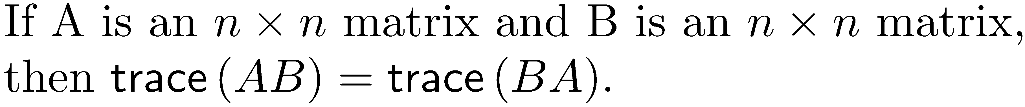
Properties of the Trace

Slide 25
MATLAB
There are numerous examples throughout the book that involve the use of MATLAB. It is fundamental to use of MATLAB that you are familiar with "vectorization”. When performing vector or matrix operations using the operators '*', '/', and '^', it may be necessary to use the dot operator ('.’) to perform element by element operations.

Slide 26
MATLAB Examples
>> A = [1 5 1;2 -1 6;1 0 3]
A =
1 5 1
2 -1 6
1 0 3
>> B = [2 3 0;3 -1 7;4 8 9]
B =
2 3 0
3 -1 7
4 8 9
>> 5*A -10*B + 3*A*B
ans =
48 13 137
55 170 101
7 1 6
>> trace(A + B)
ans =
13
>> 7*trace(A + B)
ans =
91
>> trace(A*B)
ans =
103
>> trace(B*A)
ans =
103
>> A.*B
ans =
2 15 0
6 1 42
4 0 27

Slide 27
Another MATLAB Example
It is a common mistake to forget using "." when dividing an expression into a constant.
>> v = [1 2 3 4 5]';
>> 1./v
ans =
1.0000
0.5000
0.3333
0.2500
0.2000

Slide 28
Linear Transformations
Basic property:

Slide 29
Rotations
Rotate the (x, y)-plane counterclockwise through θ radians.

Slide 30
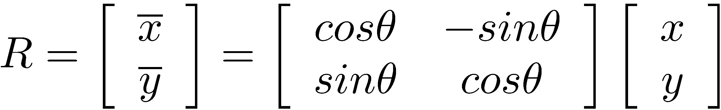
Rotations – Matrix Form

Slide 31
Rotation Example
Rotate the line y = 5x + 1 an angle of 30° counterclockwise.

Slide 32
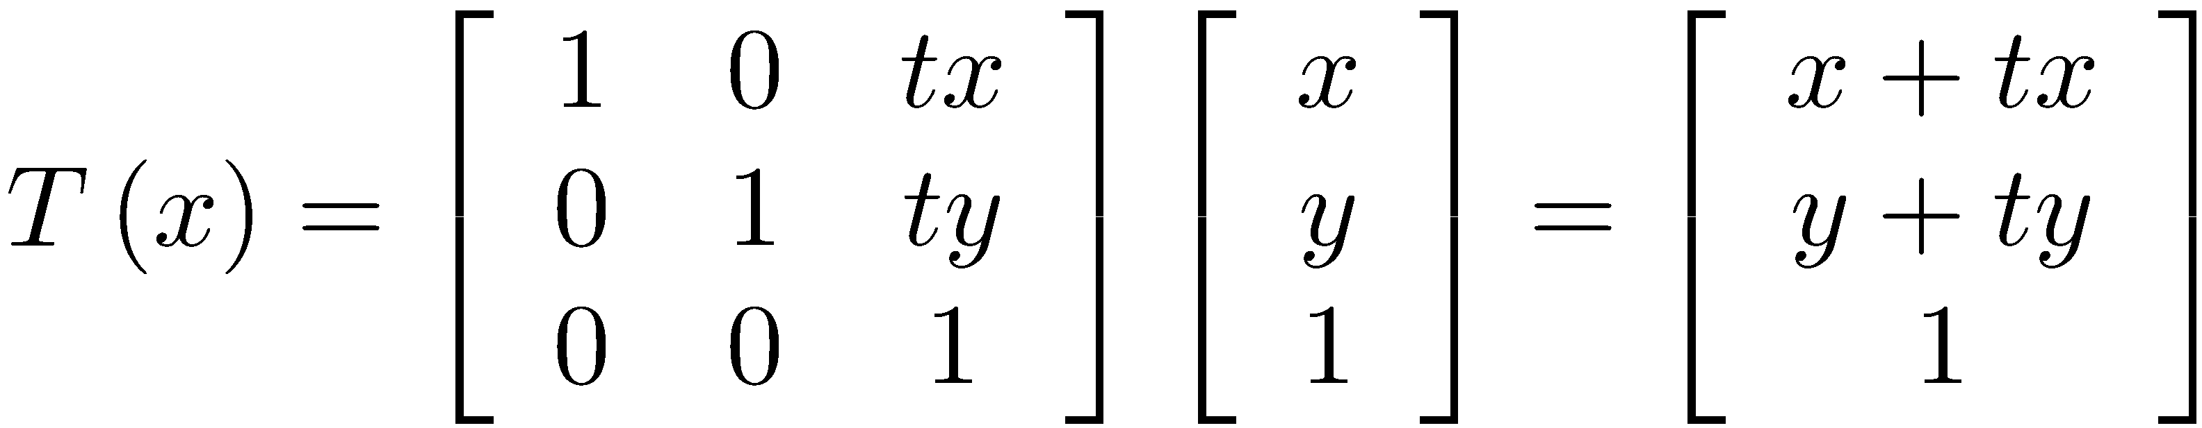
Translation
Reposition a point ( x, y ) along a straight line a distance of ( tx, ty ) , where t is a scalar. The new location of the point is ( x+tx, y+ty ) .
Linear transformation:

Slide 33
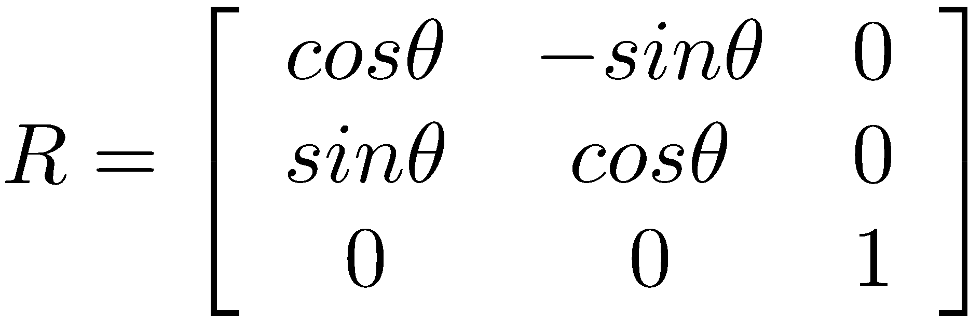
Rotations and Translations
A 3 × 3 matrix that performs a two-dimensional rotation:
If T is a translation matrix and R is a rotation matrix, the matrix RT translates and then rotates.

Slide 34
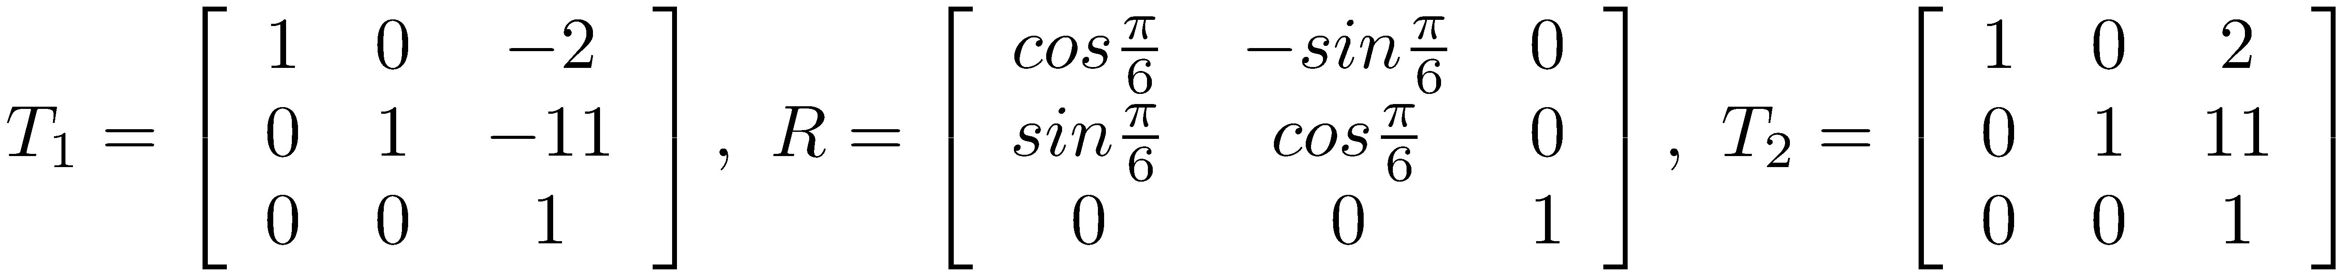
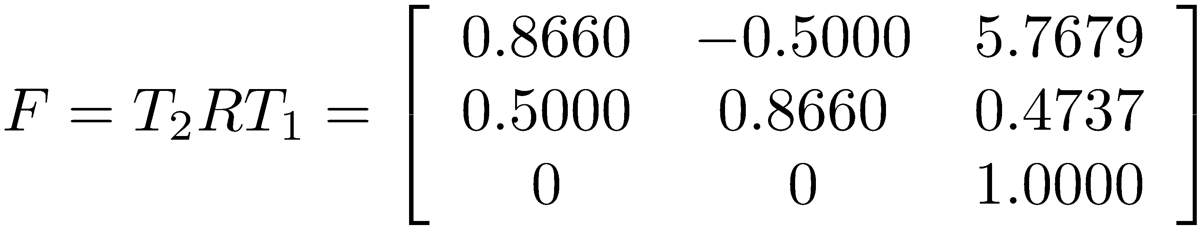
Rotations and Translations Example
Take the line y = 5x + 1 and rotate it 30° counterclockwise about the point ( 2, 11 ) .
First translate the point (2, 11) to (0, 0), rotate 30° counterclockwise, and then translate the point from the origin back to (2, 11).
The required matrices are:
Compute
Apply the transformation to a pair of points and graph the rotated line.

Slide 35
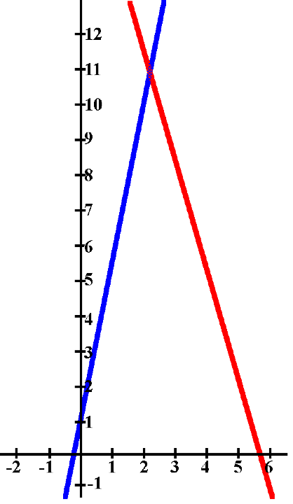
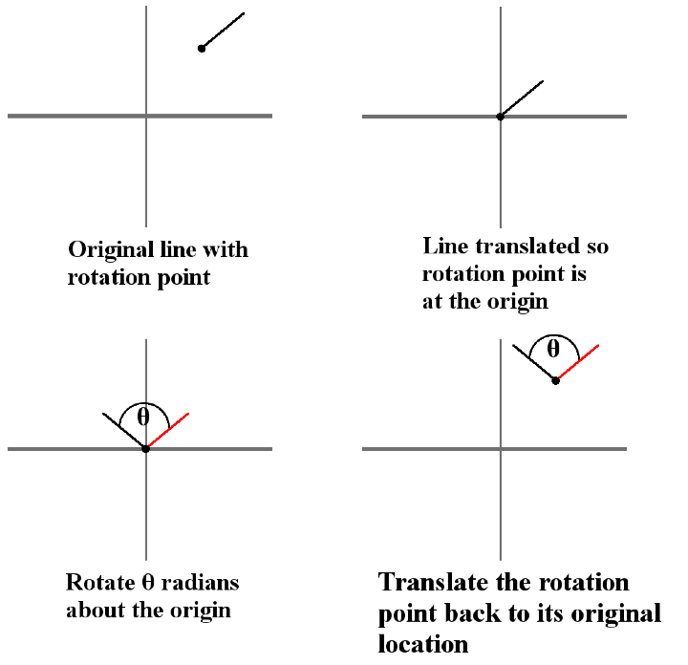
Rotations and Translations Example

Slide 36
MATLAB Exponentiation Operator
Operator '^'. When vectorization is used, you must use it in the form '.^'. For instance, if t is the vector t = 1.0:0.5:3.0 then y = t.^2 is the vector whose elements are the squares of those in t.

Slide 37
MATLAB Exponentiation Operator
>> t = 1.0:0.5:3.0
t =
1.0000 1.5000 2.0000 2.5000 3.0000
>> y = t.^2
y =
1.0000 2.2500 4.0000 6.2500 9.0000

Slide 38
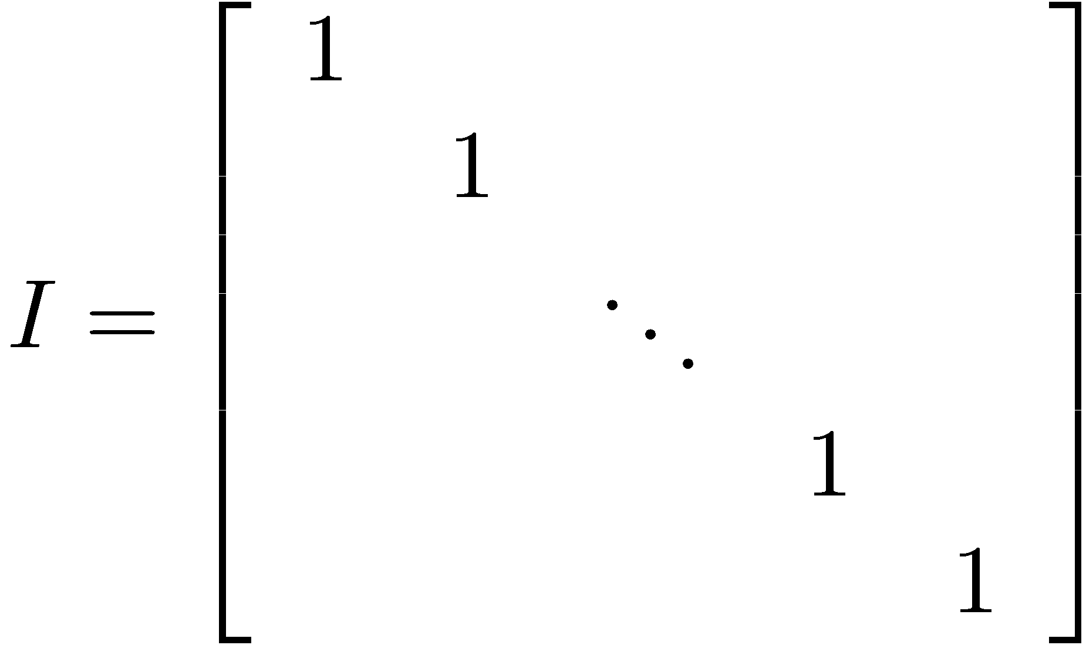
Powers of Matrices
The n × n identity matrix has ones on its diagonal and zeros in all other locations.
If A is an n × n matrix, A * I = I * A = A.

Slide 39
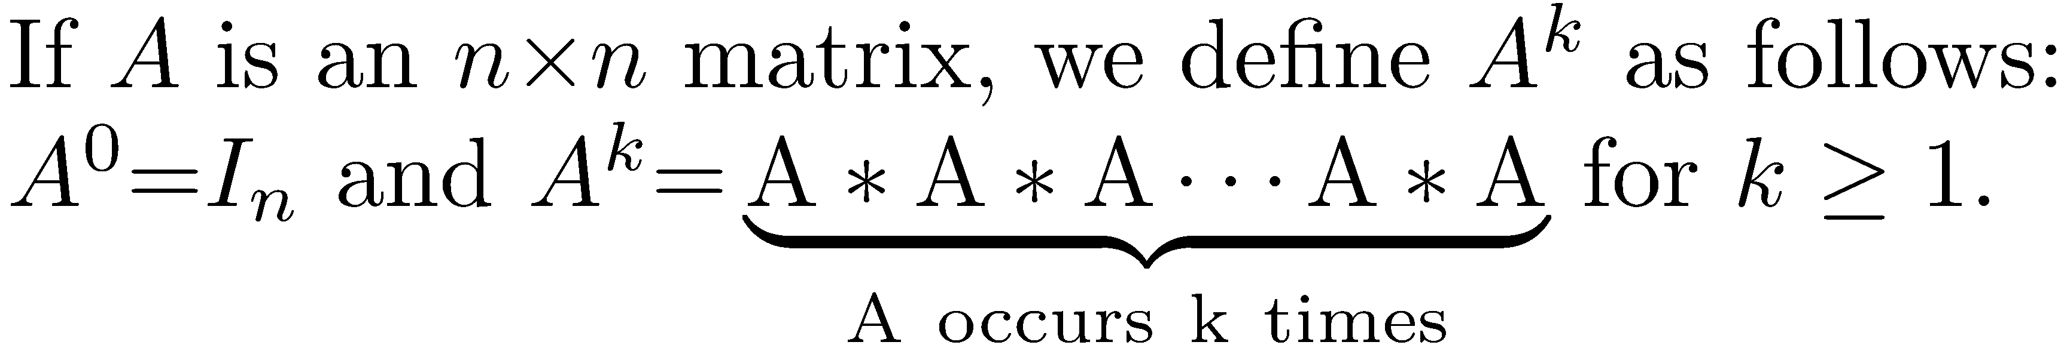
Powers of Matrices

Slide 40
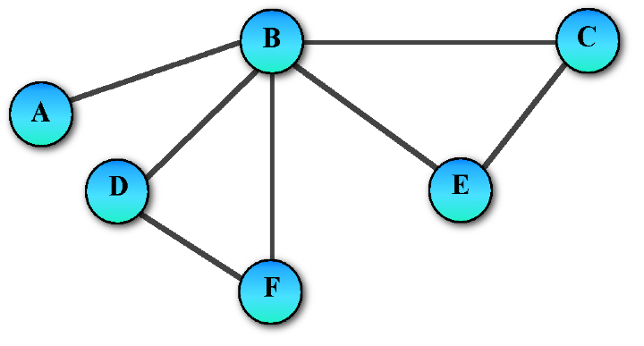
Application of Matrix Powers to a Graph
An undirected graph is a set of vertices and edges that connect pairs of vertices.
The adjacency matrix is an n × n matrix that specifies the location of edges.

Slide 41
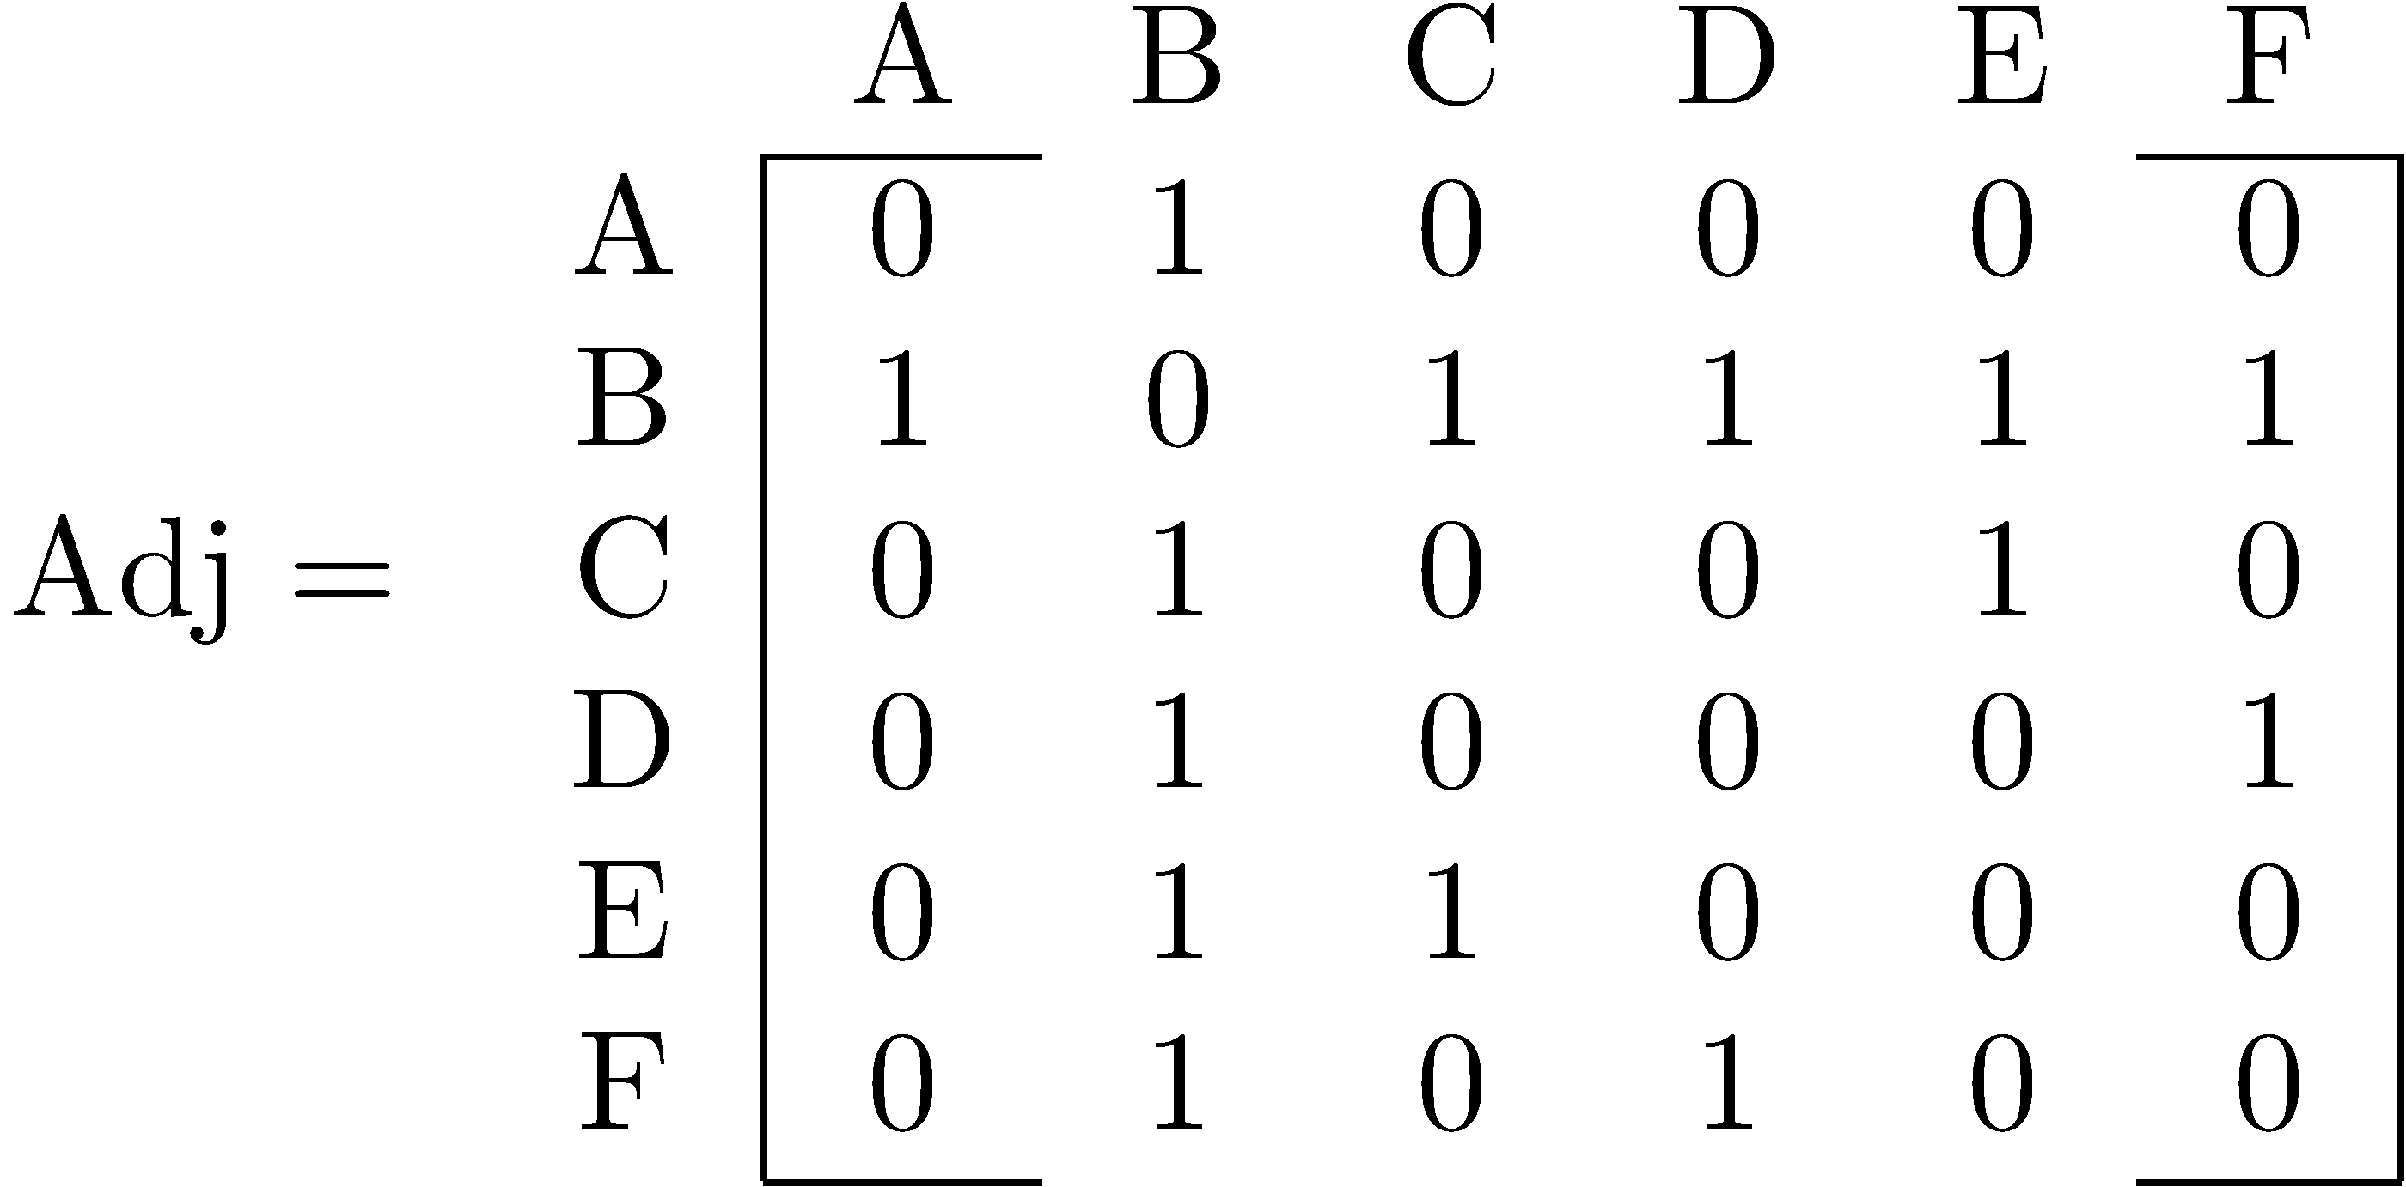
Application of Matrix Powers to a Graph
For the example graph, the adjacency matrix is
The length of a path in a graph is the number of edges traversed from the starting to the ending vertex.
If Adj is the adjacency matrix for a graph, then Adj^{k} defines the number of possible paths of length k between any two vertices.

Slide 42
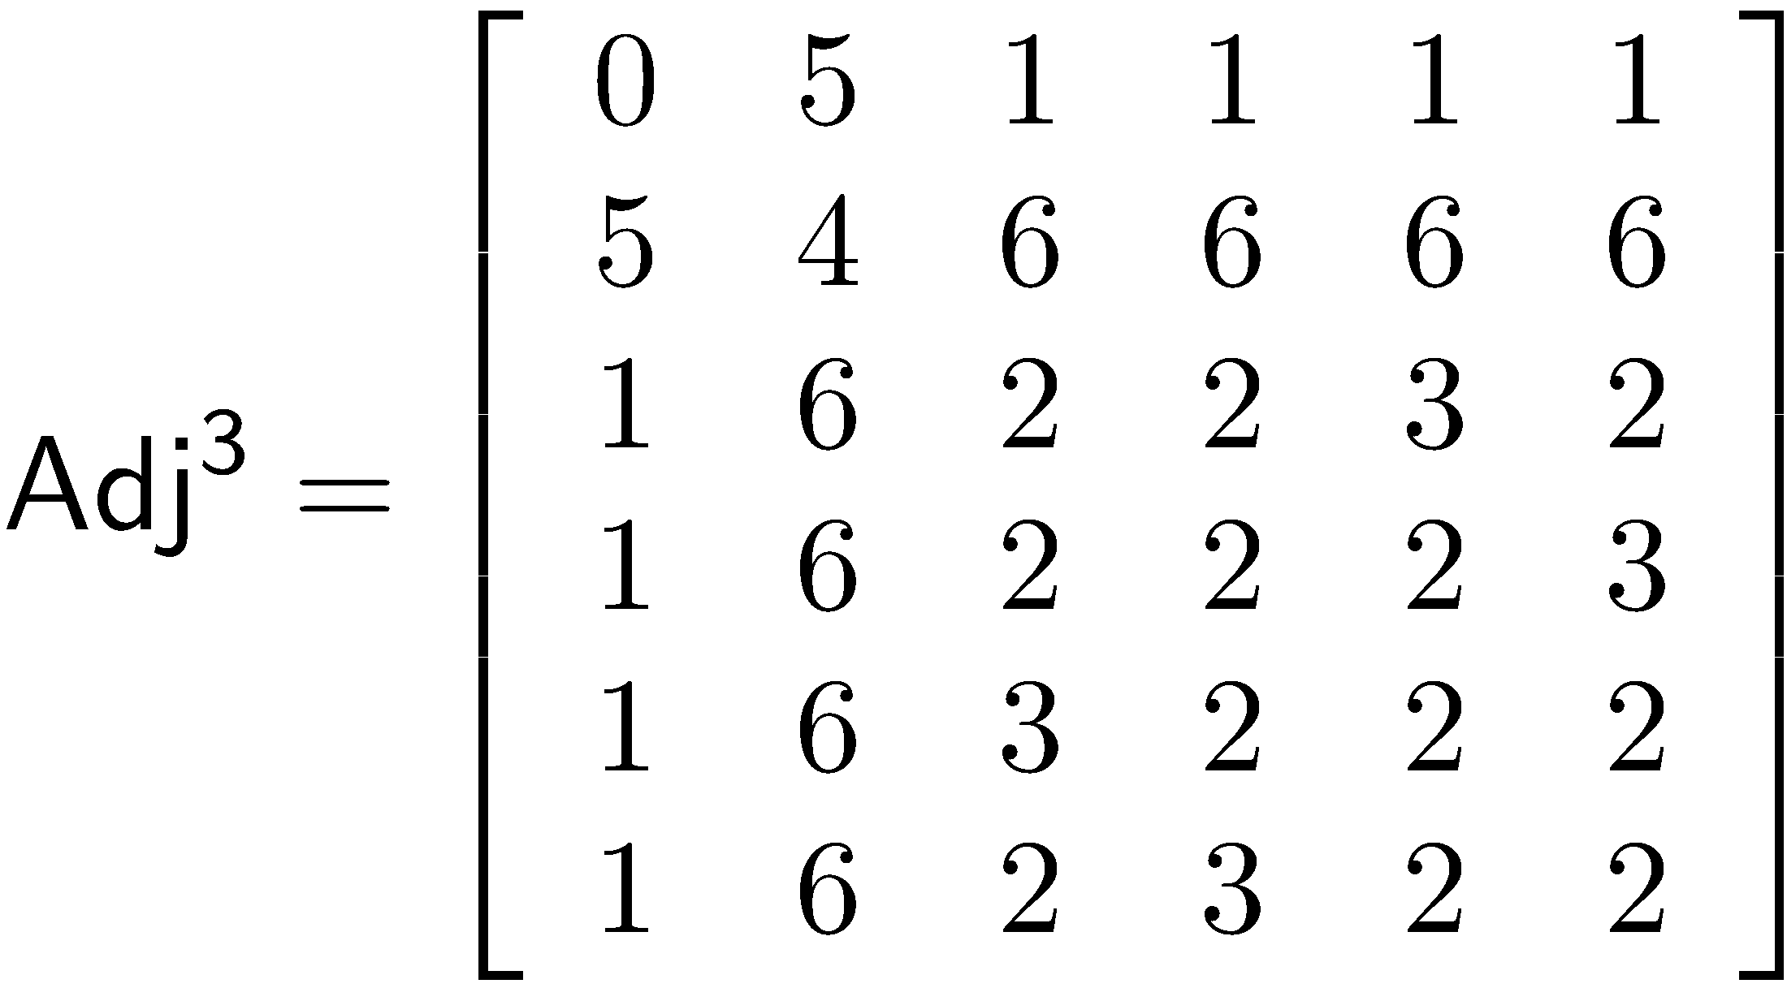
Application of Matrix Powers to a Graph
There are five (5) paths of length three between B and A (B-A-B-A, B-D-B-A, B-C-B-A, B-E-B-A, B-F-B-A).

Slide 43
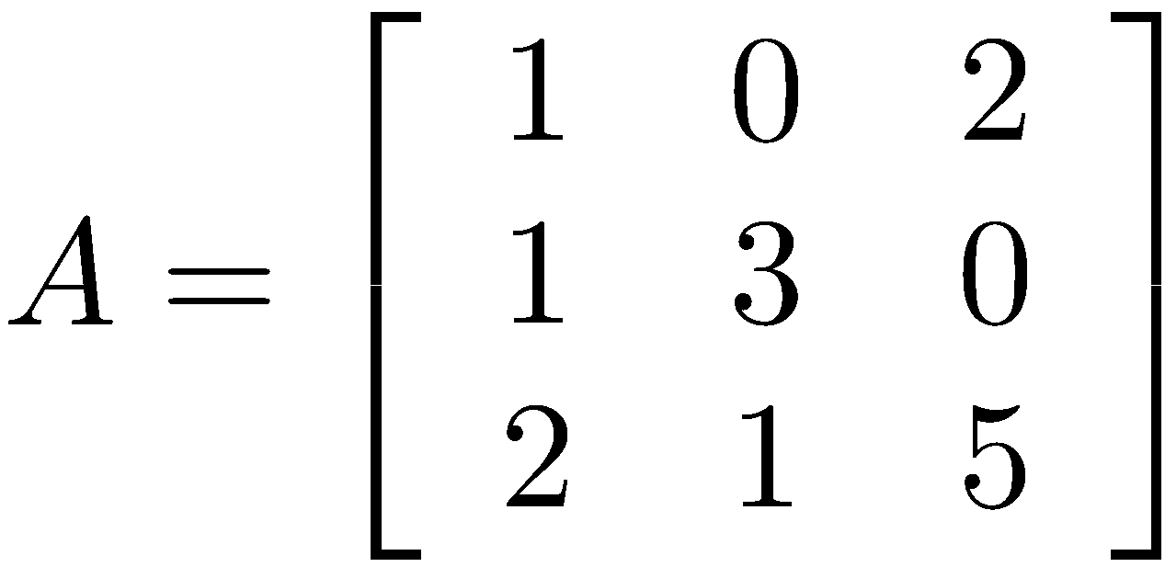
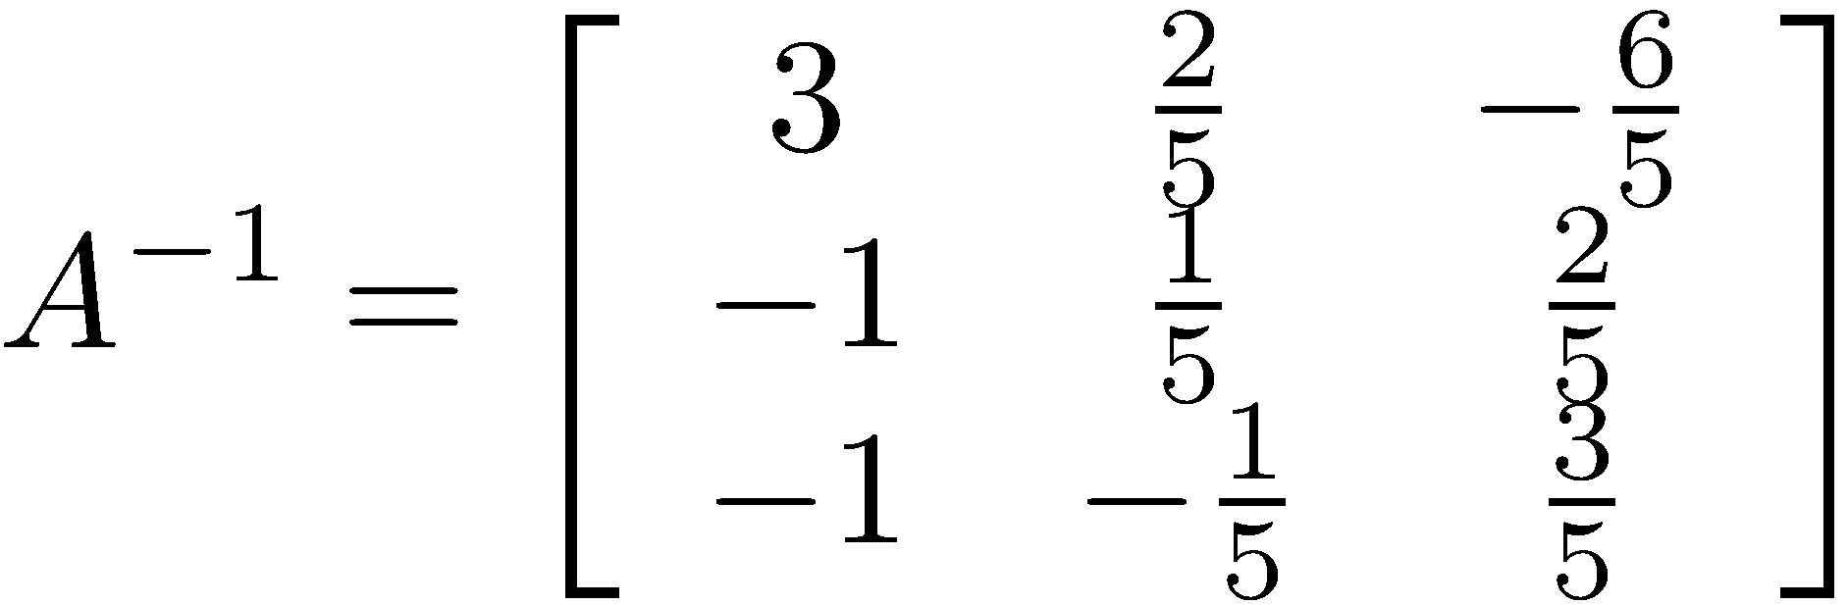
The Matrix Inverse
An n × n matrix A is invertible, or nonsingular, if there exists an n × n matrix denoted by A⁻¹ such that A*A⁻¹ = A⁻¹*A = I
For example if , then

Slide 44
Properties of the Matrix Inverse
A matrix A can have only one inverse.
If B is a matrix such that BA=I , then AB=I . Similarly, if AB=I , then BA=I ; in other words B = A⁻¹.
(AB)⁻¹ = B⁻¹ A⁻¹
(B⁻¹A⁻¹)(AB) = B⁻¹(A⁻¹A)B = B⁻¹(I)B = B⁻¹B = I
If the coefficient matrix, A, of an n × n linear system Ax = b has an inverse then the unique solution to the system is x = A⁻¹b

Slide 45
Computing the Inverse using MATLAB
Use the command inv.
>> A = [6 15 -1;12 9 -8;-1 2 3]
A =
6 15 -1
12 9 -8
-1 2 3
>> B = inv(A)
B =
-0.220512820512820 0.241025641025641 0.569230769230769
0.143589743589744 -0.087179487179487 -0.184615384615385
-0.169230769230769 0.138461538461538 0.646153846153846
>> A*B
ans =
1.000000000000000 -0.000000000000000 0
0 1.000000000000000 0
0.000000000000000 -0.000000000000000 1.000000000000000

Slide 46
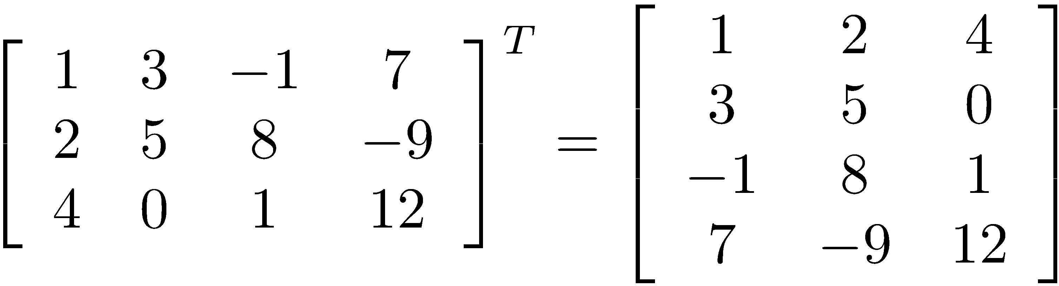
The Matrix Transpose
If A is an m × n matrix, the transpose A^{T} is the n × m matrix obtained by exchanging rows and columns. If A is the matrix [a_{ij}], then (A^{T} )_{ij} = a_{ji}.

Slide 47
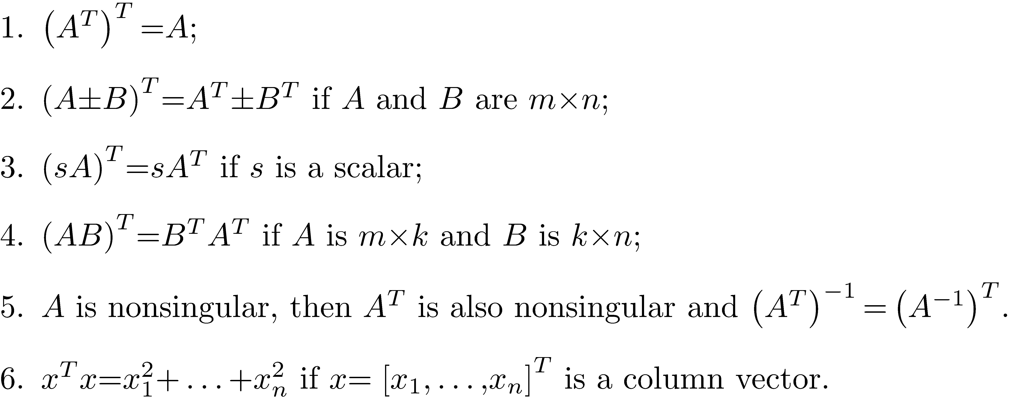
Properties of the Transpose

Slide 48
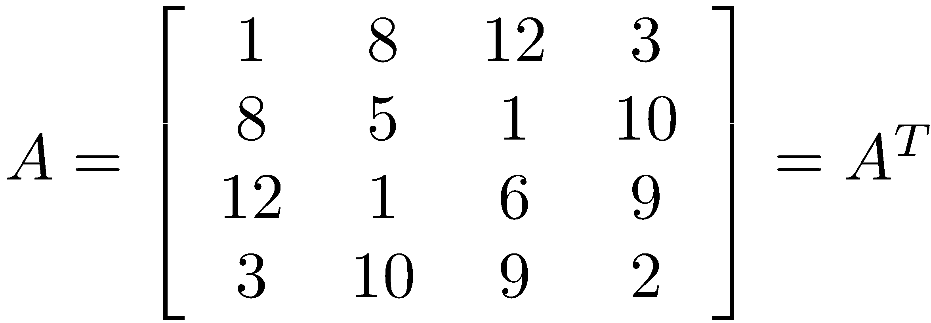
A Symmetric Matrix
An n × n matrix A is symmetric if A^{T} = A
Symmetric matrices appear very frequently in engineering and science problems.
Computations with symmetric matrices can normally be done faster than with nonsymmetric matrices.

Slide 49
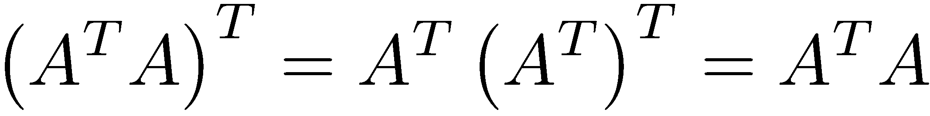
A Very Important Symmetric Matrix
If A is an m × n matrix then A^{T}A is an n × n matrix.
A^{T} is n × m, and an (n × m) times an (m × n) matrix has dimensions n × n.
If A is an m × n matrix, then A^{T}A is an n × n symmetric matrix.

Slide 50
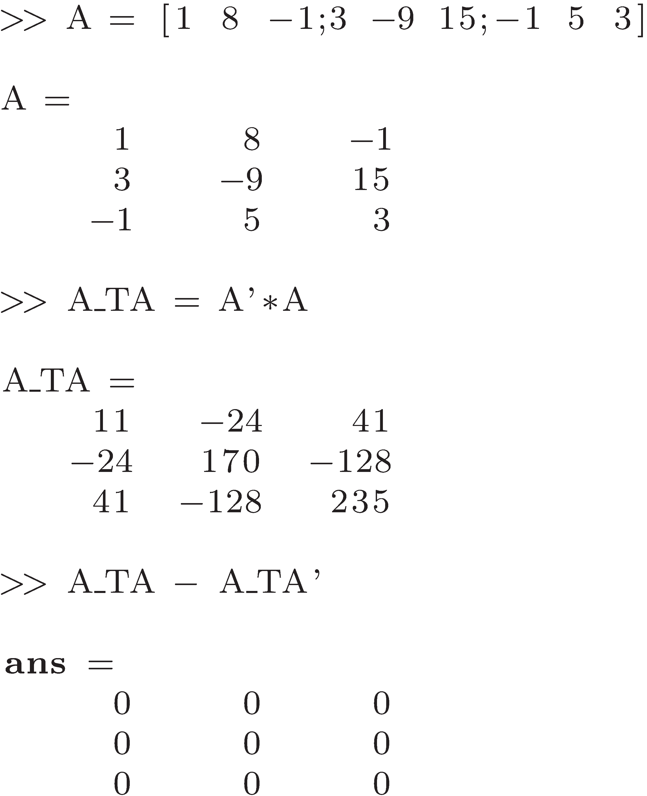
The Transpose in MATLAB
Use the operator '

