Slide 1
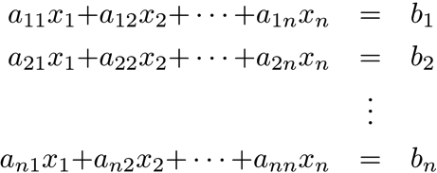
Square System of Linear Equations
A square system of n linear equations in n unknowns x₁, x₂, …, x_{n} is a family of equations
Determine if there are real numbers x₁, x₂, …, x_{n} that satisfy all the equations simultaneously. If so, the system is consistent.

Slide 2
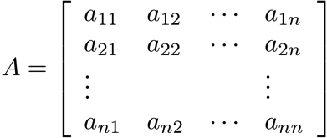
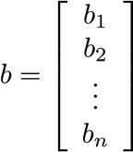
Matrix Form of a Square Linear System
Coefficient matrix
Right-hand side
Matrix equation Ax = b

Slide 3
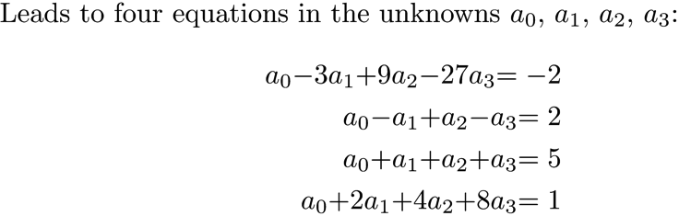
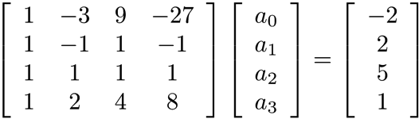
Problem
Matrix form:

Slide 4
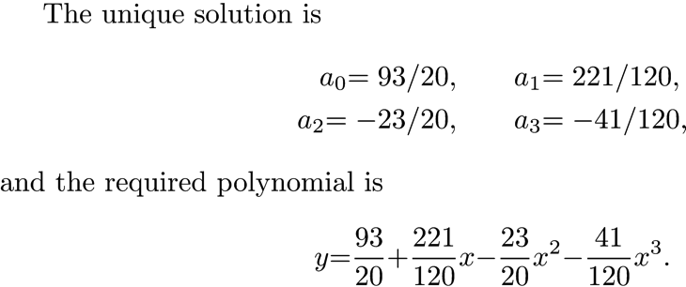
Problem

Slide 5
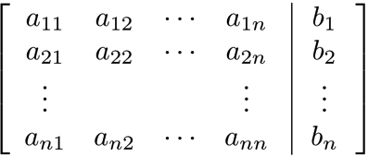
Augmented Matrix
The augmented matrix is a compact way to represent the linear system.
Linear system
Augmented matrix

Slide 6
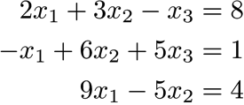
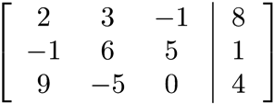
Example 1
Consider the 3 × 3 linear system
The augmented matrix for the system is

Slide 7
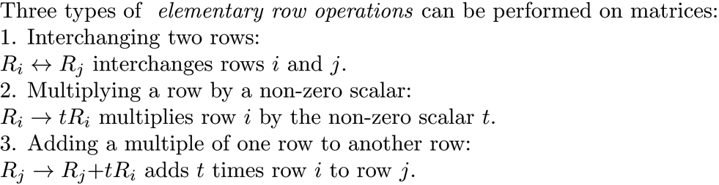
Elementary Row Operations
The following operations are the ones used on the augmented matrix during Gaussian elimination and will not change the solution to the system. Note that performing these operations on the matrix is equivalent to performing the same operations directly on the equations.

Slide 8
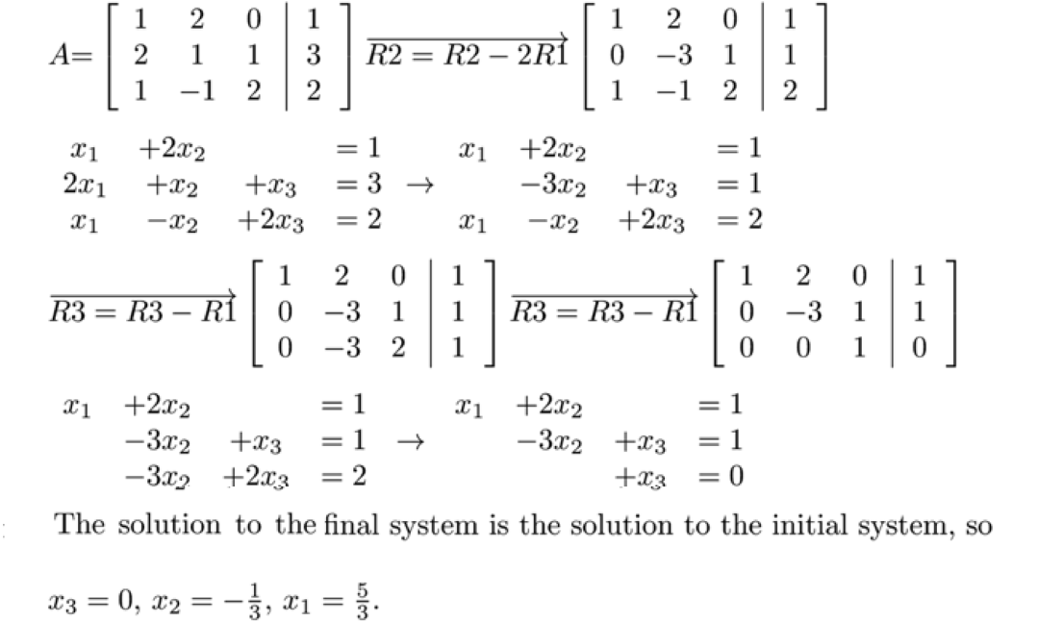
Elementary Row Operations Example

Slide 9
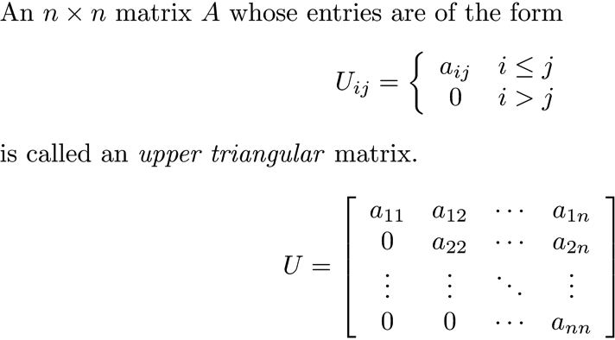
Upper Triangular Matrix

Slide 10
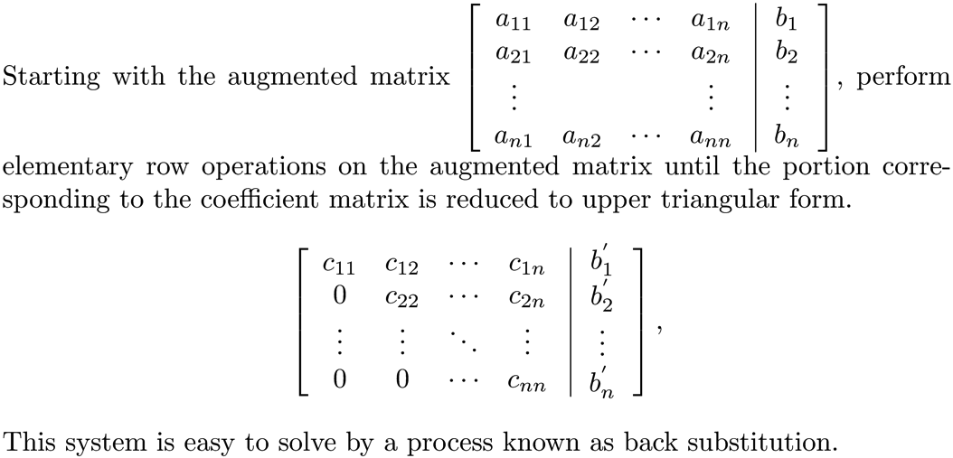
Transformation to an Upper Triangular Matrix

Slide 11
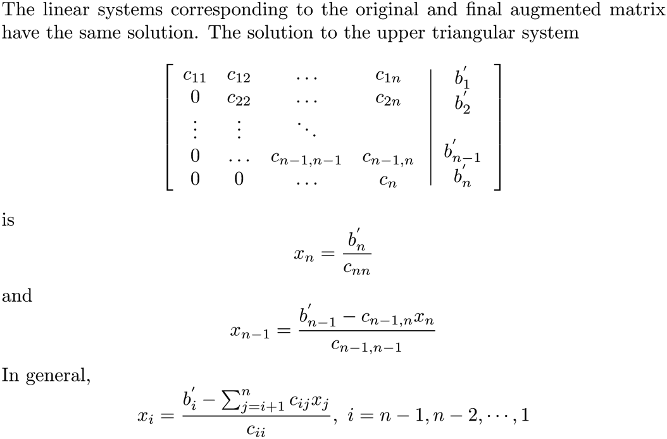
Back Substitution

Slide 12
Example 2

Slide 13
Gaussian Elimination to Solve Ax = b
Begin with n × n matrix A, form the augmented matrix B and apply elementary row operations to B until the portion of B corresponding to A is in upper triangular form. If there is a unique solution, apply back substitution to determine it.

Slide 14
Reduction to Upper Triangular Form
Begin with element a₁₁. If a₁₁ = 0, swap the first row with a row having a nonzero element in the first column. If this is not possible, there is no unique solution.
a₁₁ ≠ 0. Make all the elements in column 1 below a₁₁ zero by subtracting a multiple of row 1 from row i, 2 ≤ i ≤ n . The multiplier used for row i is .

Slide 15
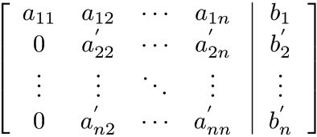
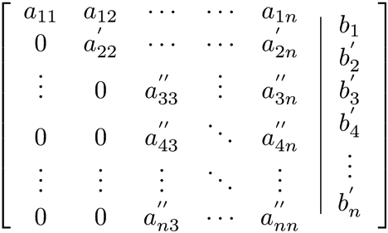
Reduction to Upper Triangular Form
The matrix is now in the form
Perform the same process of elimination by using and multipliers ,making a row exchange if necessary, so that all the elements below are 0.
Repeat this process until the matrix is in upper triangular form, and then execute back substitution to compute the solution.

Slide 16
The Pivot
During the process of reduction to upper triangular form, when dealing with column i and needing to zero-out elements a_{ki}, k ≤ i+1 ≤ n, the multipliers are .
The nonzero element a_{ii} is called the pivot.

Slide 17
General Equation for Row Elimination
Assume the position during row elimination is column i, with pivot a_{ii}. Rows i+1 to n are modified as follows:

Slide 18
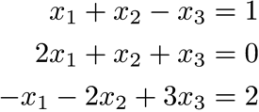
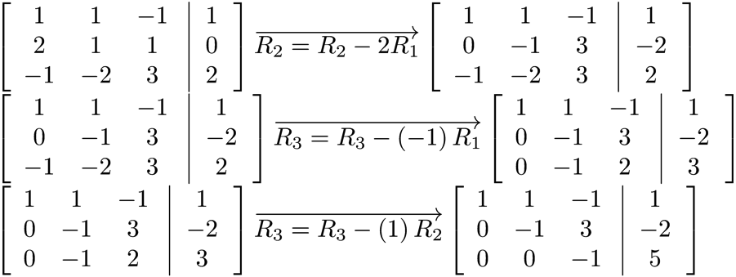
Gaussian Elimination Example
Solve the system .
Row reduce the augmented matrix to upper triangular form.

Slide 19
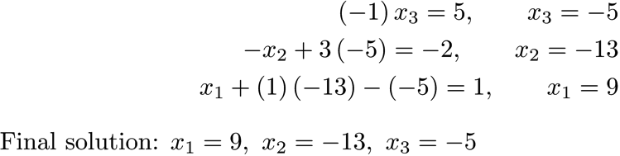
Gaussian Elimination Example
Execute back substitution.

Slide 20
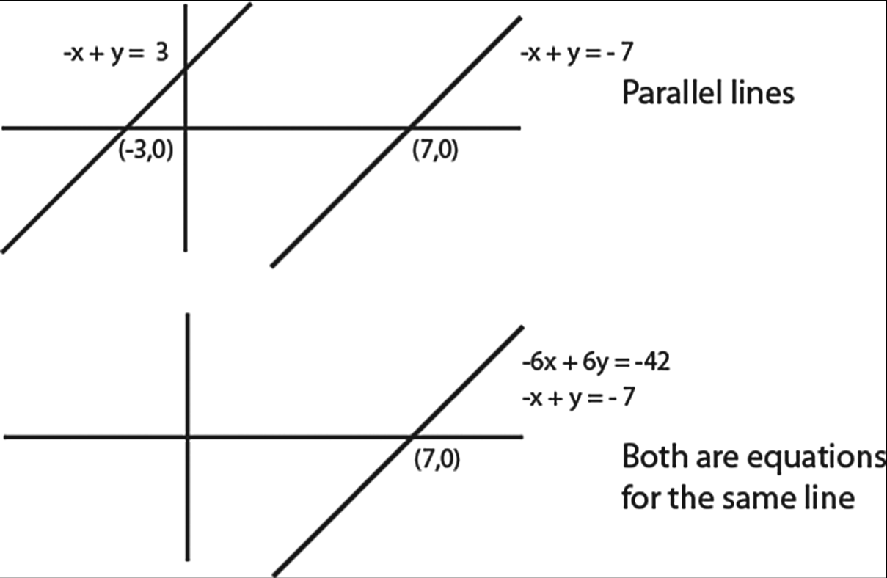
A System May Have a Unique Solution, Infinitely Many Solutions, or None
In R², there can be no solution or infinitely many solutions.
No solution
Infinitely many solutions

Slide 21
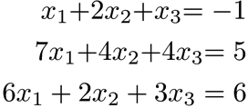
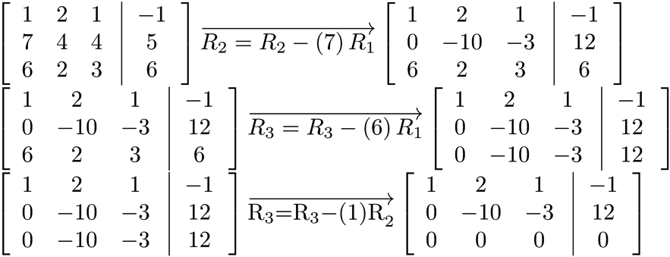
Example of Infinitely Many Solutions
Consider the system

Slide 22
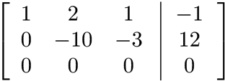


Example of Infinitely Many Solutions
Solution

Slide 23
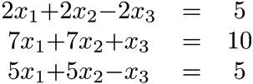
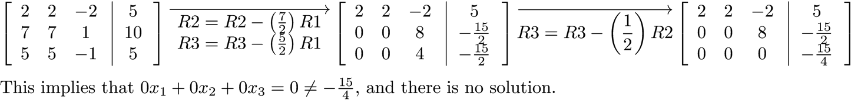
Example of No Solution
Consider the system

Slide 24
Using MATLAB to Solve a Linear System
Let A be an n × n system and b an n × 1 vector. The unique solution, if any, to Ax = b is found using the MATLAB operator '\'.
>> A = [7 -8 -7 -8 3;
9 -5 10 -2 -10;
-8 1 10 9 7;
9 10 0 6 9;
3 10 6 10 4];
>> b = [11 10 -4 6 -13]';
>> x = A\b
x =
-0.7968
4.3168
5.0413
-9.6400
3.0937

Slide 25
Computing the Inverse using Gaussian Elimination
NOTE: Computation of the inverse is discouraged in practice due to what is called roundoff error (Chapter 8). We will find ways around computing the inverse in the processes we develop.
To compute the inverse when it exists:
Attach the columns of I to the coefficient matrix and row reduce A to an upper triangular matrix. Then perform back substitution n times, once per column of the augmented data.

Slide 26
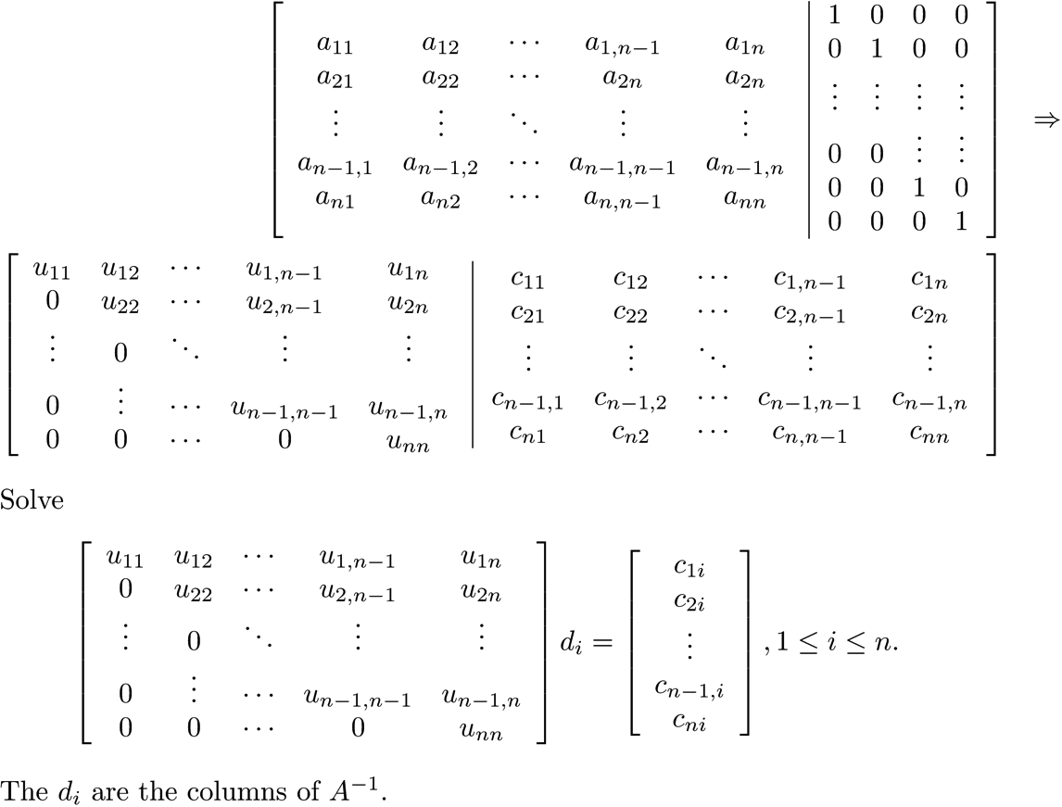
Computing the Inverse using Gaussian Elimination

Slide 27
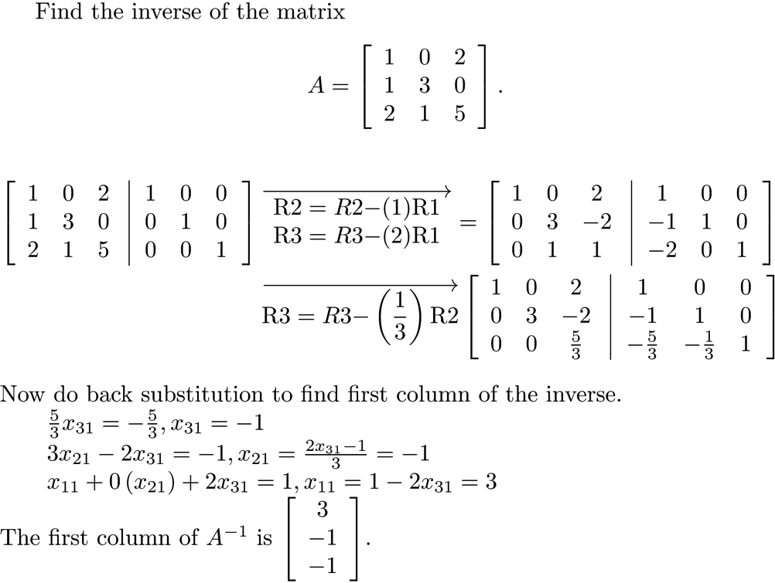
Finding the Inverse - Example

Slide 28
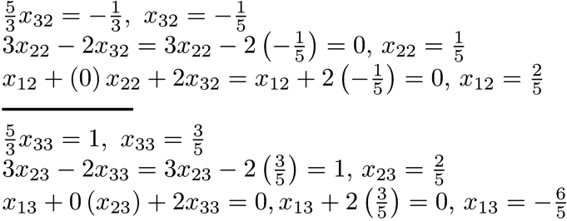
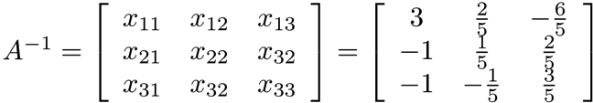
Finding the Inverse – Example

Slide 29
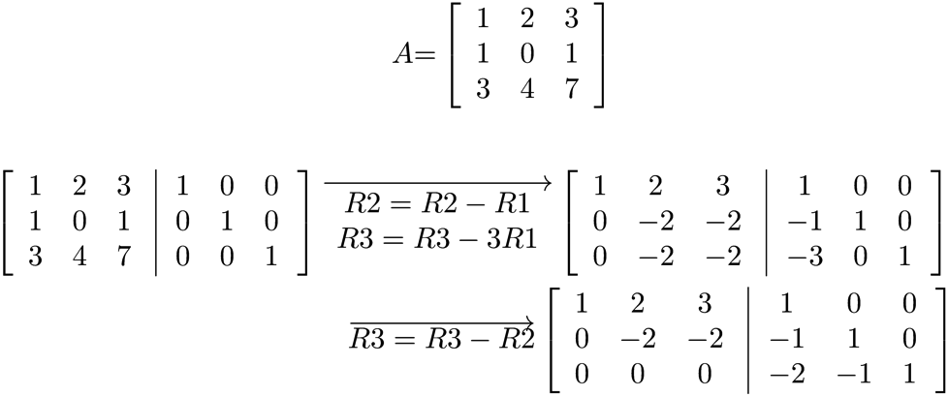
Not All Matrices Have an Inverse
The last row of zeros shows that each instance of back substitution has no solution, so A⁻¹ does not exist.

Slide 30
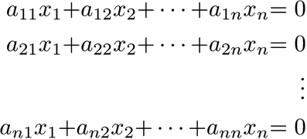
Homogeneous Systems
A linear system is homogeneous if the right-hand sides are all zero. Such a system always has the solution x = 0.
If A is nonsingular (invertible) then Ax = 0 has only the trivial solution x = 0, since if Ax = 0, A⁻¹(Ax) = A⁻¹0 = 0, and (A⁻¹A)x = Ix= x = 0.

Slide 31
Homogeneous Systems
If the matrix is singular, a homogeneous system has infinitely many solutions.
Solve the homogeneous system .
SOLUTION:

Slide 32
Homogeneous Systems
The homogeneous system Ax = 0 has only the solution x = 0 if and only if A is nonsingular.

Slide 33
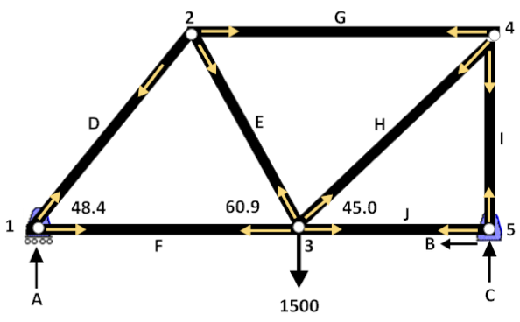
Application - Truss
Find the forces at the pins of the truss

Slide 34
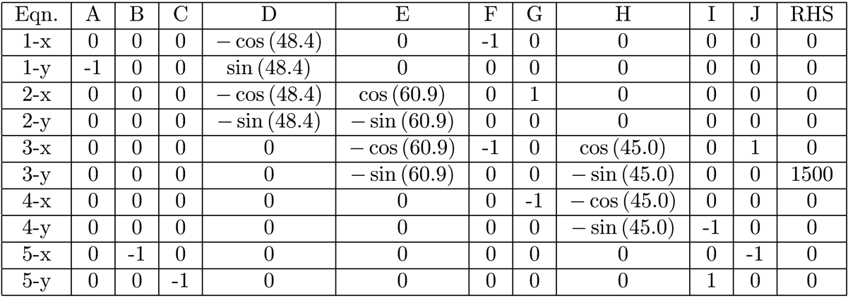
Application – Truss
Data

Slide 35
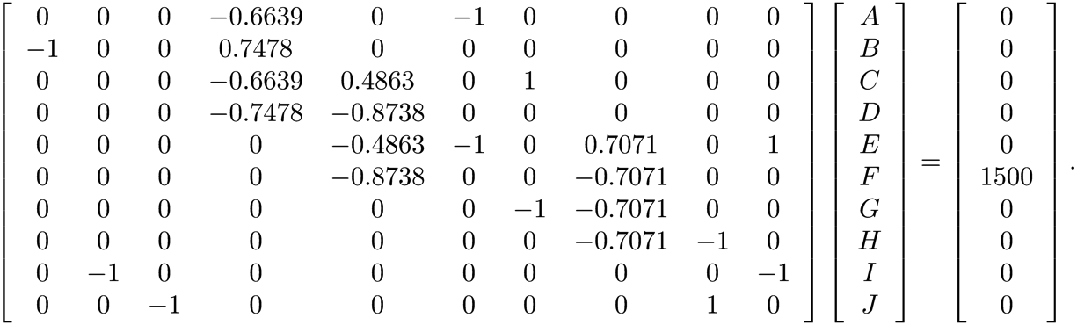
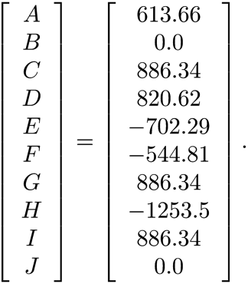
Application – Truss
Use the data, solve the system of equations
Solution

Slide 36
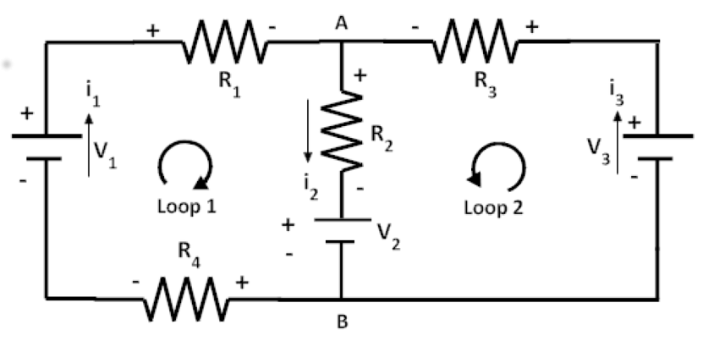
Application - An Electrical Circuit
Find the currents in the circuit

Slide 37
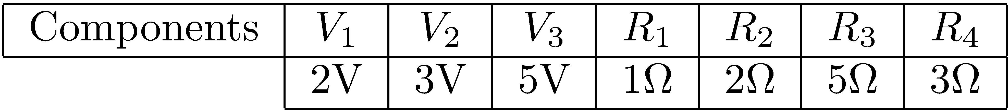
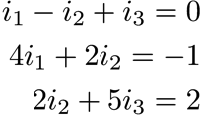
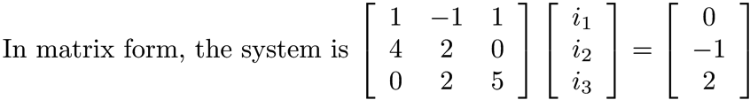
Application - An Electrical Circuit
Equations
Currents

