Slide 1
Notation
R^{n} is the set of n-dimensional column vectors with real-valued components.
The mathematical symbol means contained in.
For instance u R² means that u is a vector in the plane, so , where u₁ and u₂ are real numbers.

Slide 2
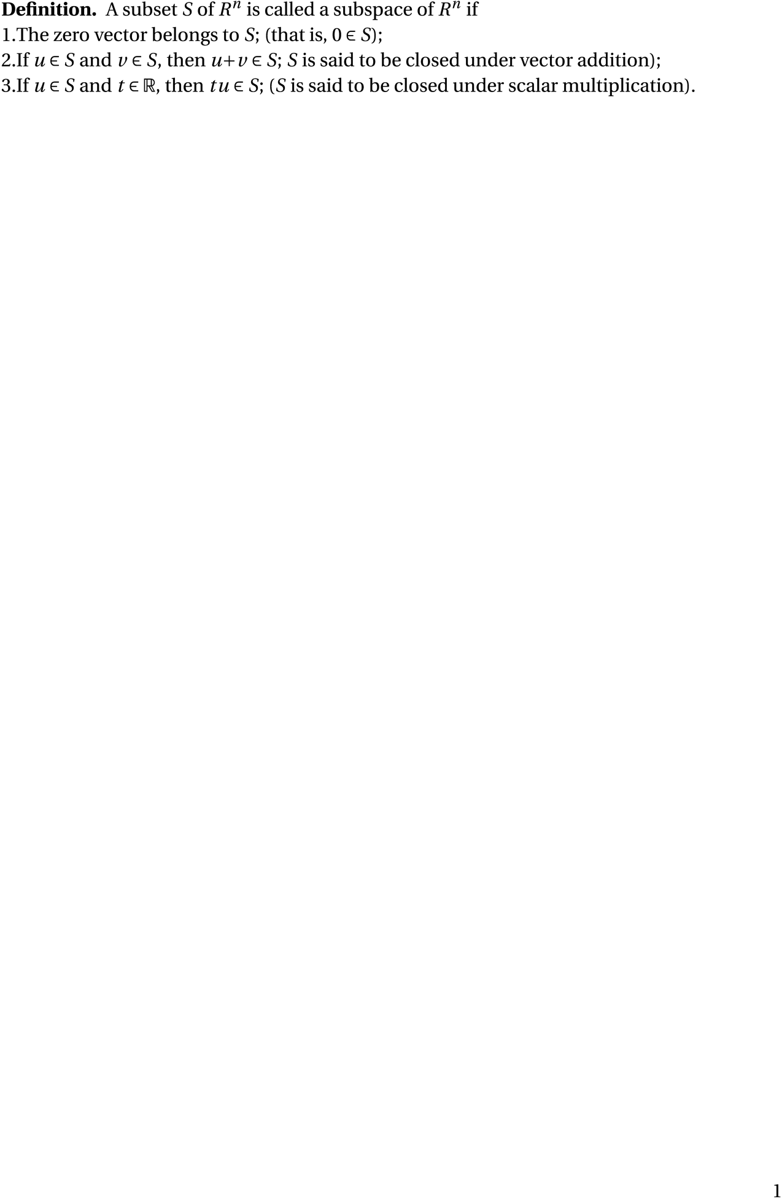
SUBSPACE

Slide 3
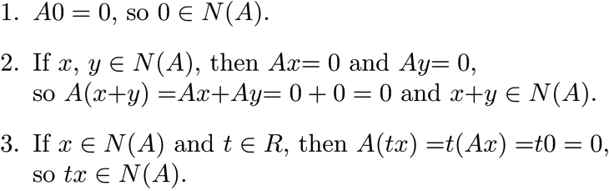
The Null Space
The null space of a matrix A, written N(A) is the set of all vectors x such that Ax = 0.
Proof:

Slide 4
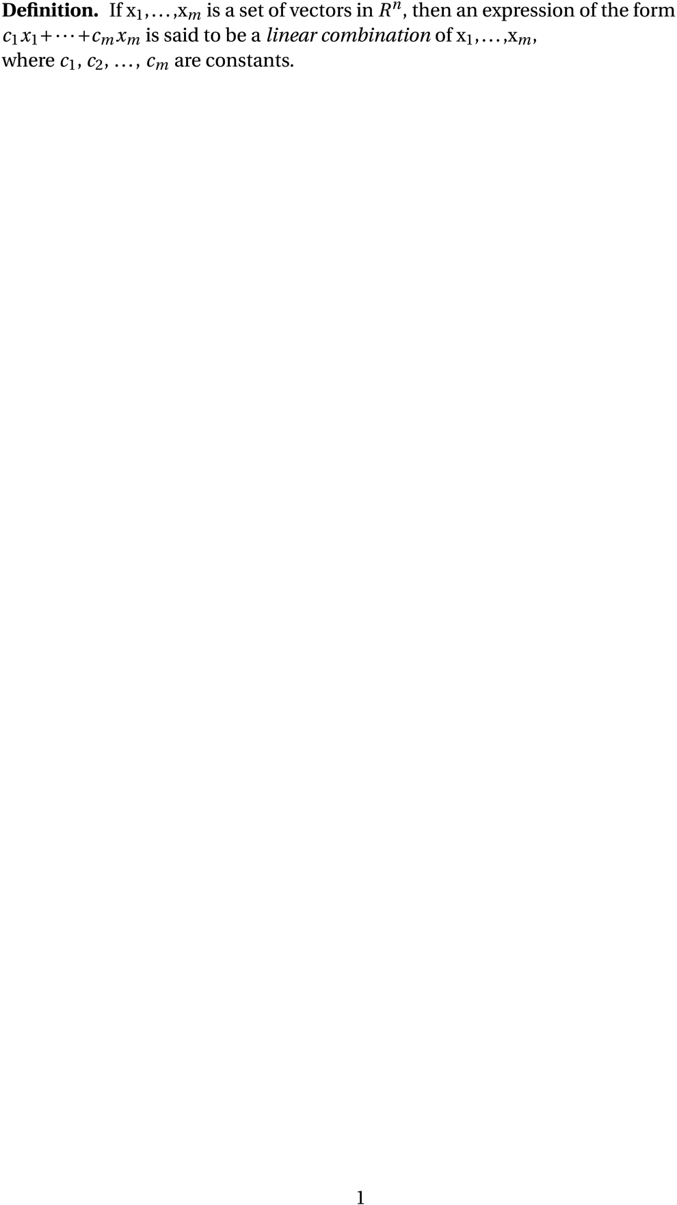
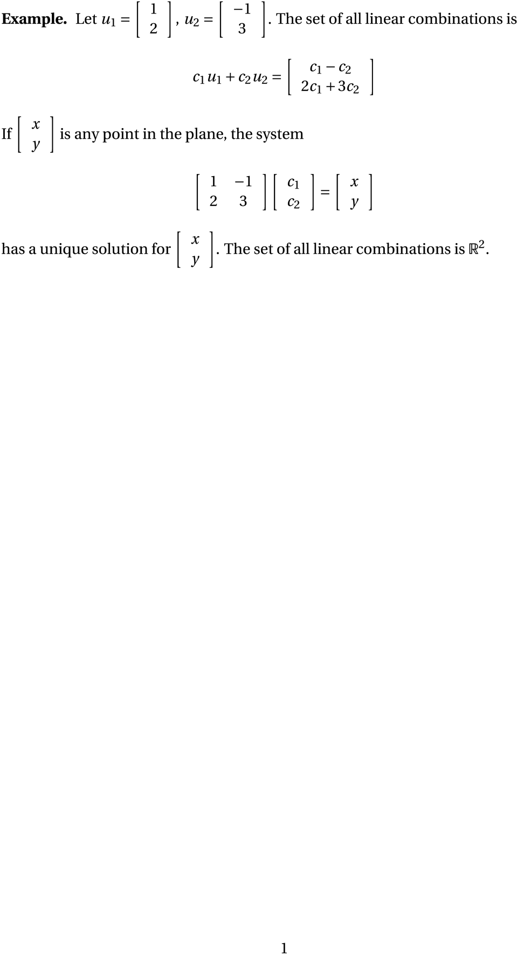
Linear Combination

Slide 5
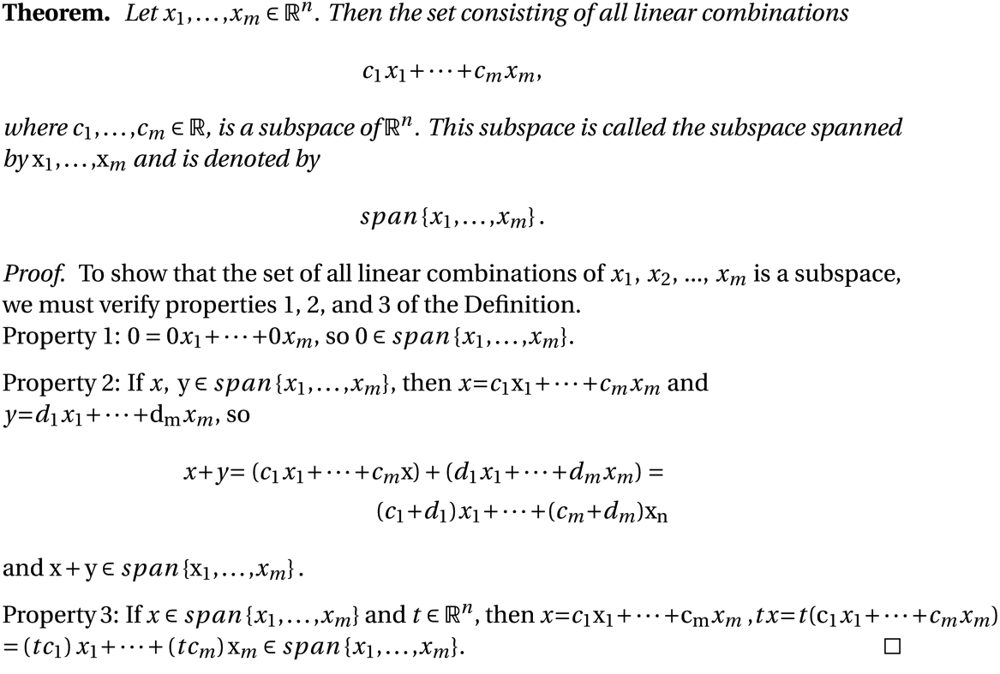
Subspace Spanned by a Set of Vectors

Slide 6
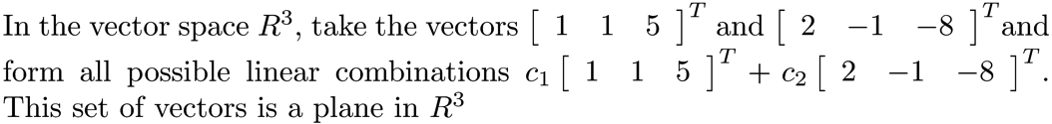
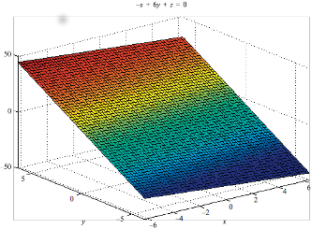
Example 1
NOTE: A set of k vectors in R^{n}, k < n, cannot span R^{n}.

Slide 7
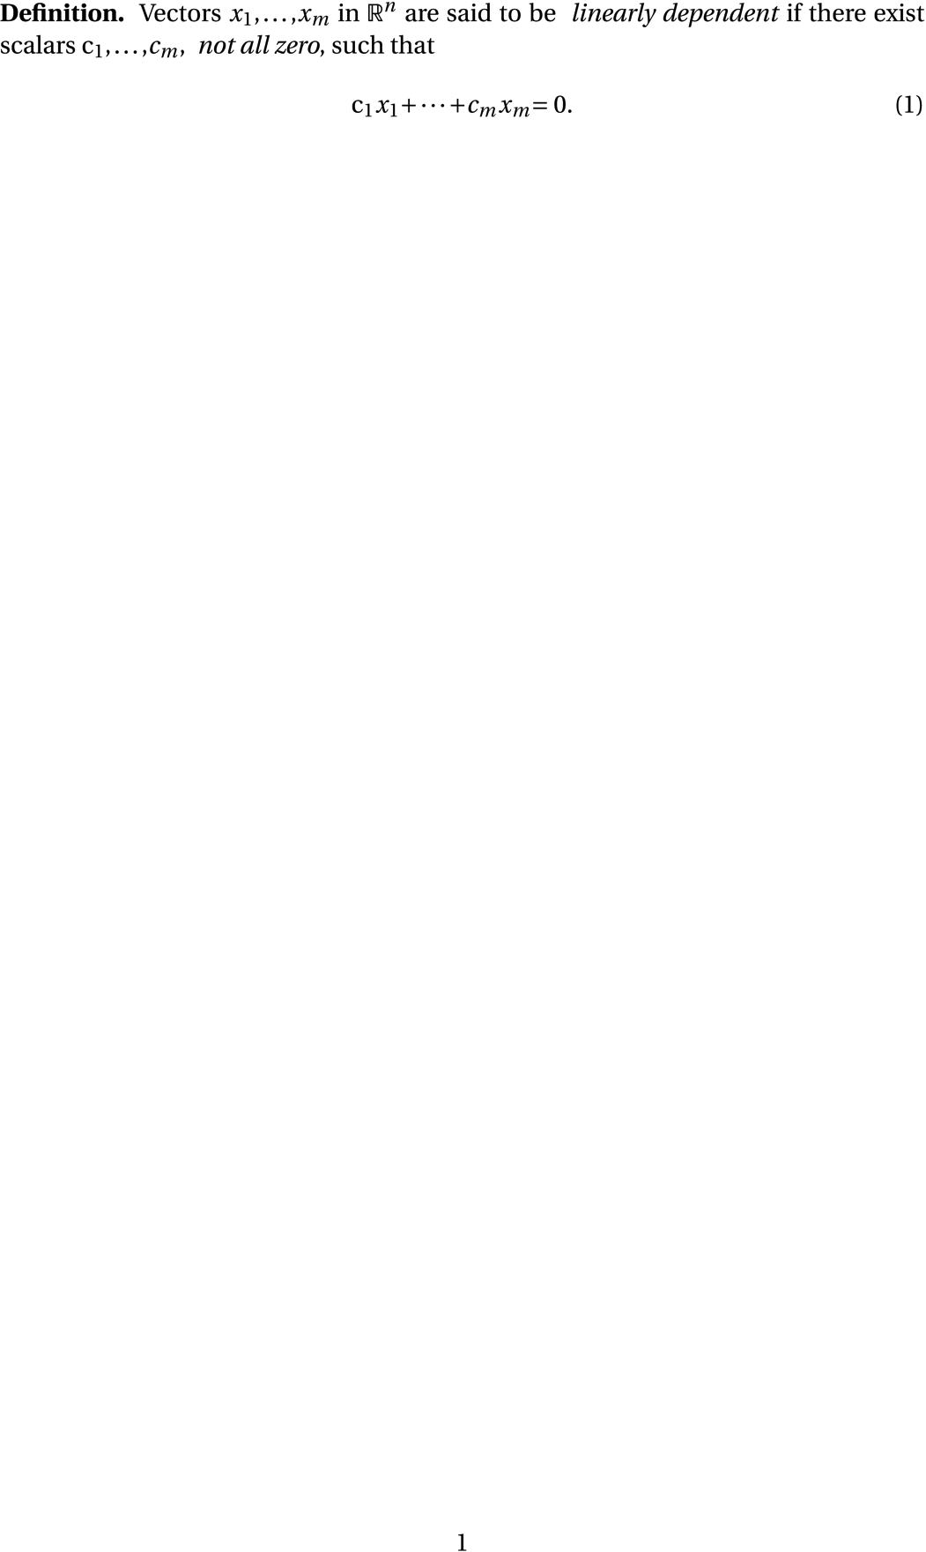
Linear Dependence

Slide 8
Linear Independence
A set of vectors u₁, u₂, , u_{k} is linearly independent if the only solution to c₁u₁ + c₂u₂ + +c_{k}u_{k} = 0 is c₁ = c₂ = = c_{k} = 0.
NOTE: No vector is a linear combination of the the others; in other words, they
are independent of each other.

Slide 9
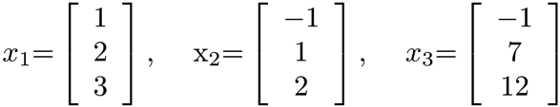
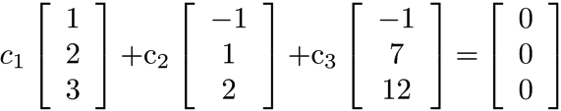
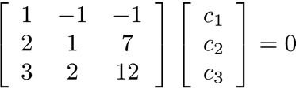
Linear Independence –Example
Vectors
Test for
linear
independence
Resulting linear
system
Infinitely many solutions. The vectors are linearly dependent.

Slide 10
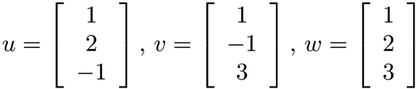
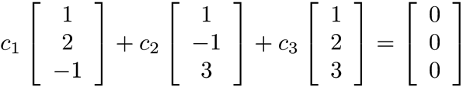
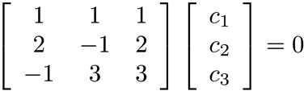
Linear Independence –Example
Vectors
Test for
linear
independence
Resulting linear
system
Unique solution. The vectors are linearly independent.

Slide 11
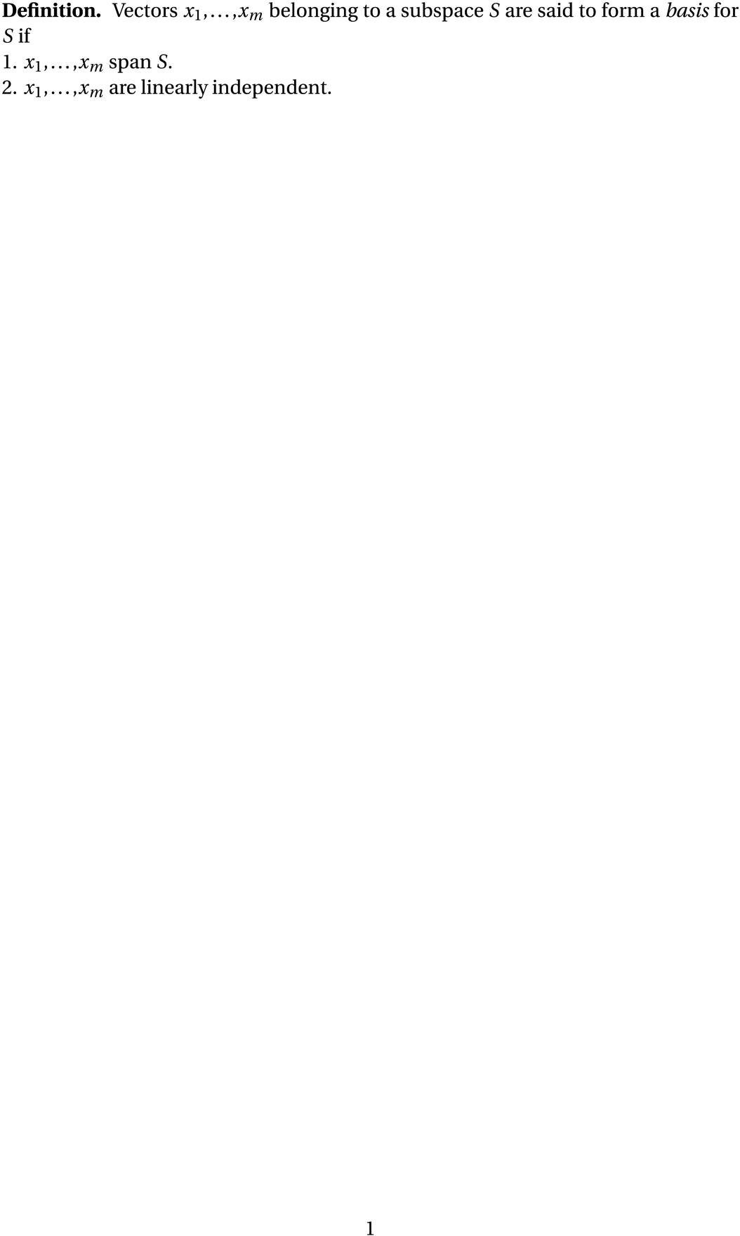
Basis

Slide 12
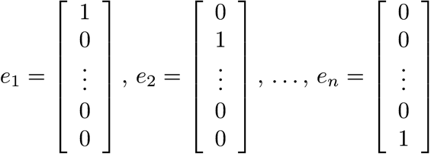
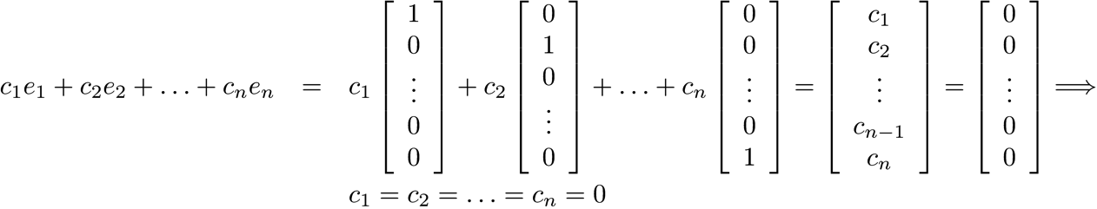
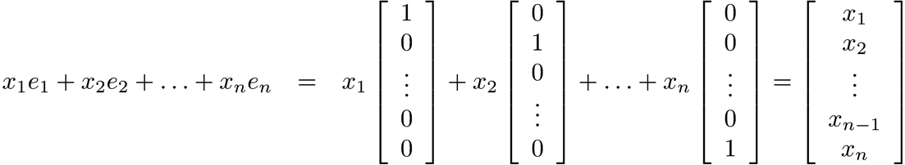
The Standard Basis Vectors e_{i}
Linearly
independent
Span
R^{n}

Slide 13
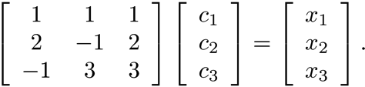
Basis - Example
From “Linear Independence – Example 2”, we know that the vectors are linearly independent.
The row reduction in the example shows that the vectors span R³, since has a unique solution.

Slide 14
Rank of a Matrix
The row rank of a matrix is the number of linearly independent rows of the matrix, and the column rank is the number of linearly independent columns of the matrix.
The rank of a matrix is its row rank.
It will be shown later that column rank = row rank!

Slide 15
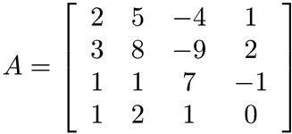
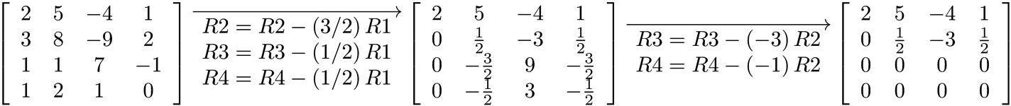
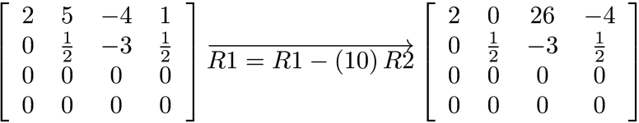
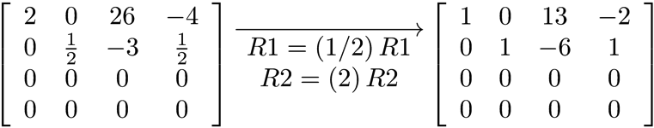
Matrix Rank - Example

Slide 16
Matrix Rank – Example
Find the column rank of
Basis for the column space
Transpose back.
Column rank = 2

Slide 17
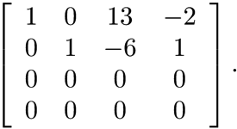

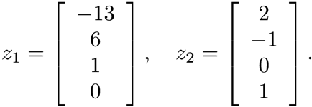
Finding the Null Space and Nullity
Use the results of the computations for
Row reduction results in the matrix and the equations
Basis for the
null space
Nullity = 2

Slide 18
Relationship between Rank and Nullity
rank + nullity = n
A matrix has full rank if its rank is n.
A full rank matrix has a null space consisting only of the zero vector.

Slide 19
MATLAB Determination of Rank and Null Space
rank(A) – returns rank of matrix A
null(A) – returns a matrix whose columns are a basis for the null space of A

Slide 20
MATLAB Example
>> A = [2 5 -4 1;3 8 -9 2;1 1 7 -1;1 2 1 0];
>> rank(A)
ans =
2
>> Z = null(A)
Z =
0.8997 0.1064
-0.4047 -0.1242
-0.0902 0.1420
-0.1365 0.9763
>> size(null(A),2)
ans =
2
>> A*Z
ans =
1.0e-14 *
-0.0749 -0.0222
-0.1388 -0.0444
-0.0416 0.0333
-0.0444 0.0028

Slide 21
Nonsquare Matrices
Recall that the row rank and column rank of a matrix are equal.
If A is an n × n matrix, the maximum rank is n.
If A is an m × n matrix with m > n, the maximum rank is n. The m rows are linearly dependent.
If A is an m × n matrix with m < n, the maximum rank is m. The n columns are linearly dependent.

Slide 22
Nonsquare Matrices
Rank = 3, columns linearly dependent
Rank = 3, rows linearly dependent
Rank = 3, rows and columns linearly dependent

