Slide 1
Determinants
The determinant of an n × n matrix is the sum of all possible products of n elements formed by choosing one element from each row in the order 1,2, … ,n along with the proper sign. The sign is found by writing down the sequence of column indices in each product and counting the number of interchanges necessary to put the column indices in the order 1,2, … ,n . If the number of interchanges is even, the sign is +; otherwise, the sign is −.

Slide 2

Computing a 2 × 2 Determinant
Let

Slide 3
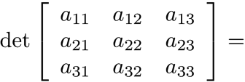
Computing a 3 × 3 Determinant
For an n × n matrix, n! products are required.
Does this seem like a good way to evaluate a determinant? Consider a 10 × 10 matrix.

Slide 4
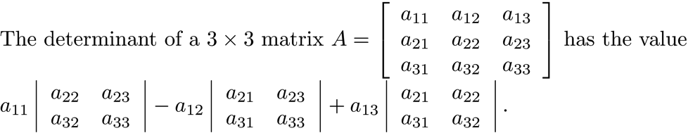
NOTE
det(A) can alternately be written |A|.
Looking at the formulas for the 2 × 2 and 3 × 3 determinant, note that The multipliers of the determinants move through row 1 in the order column 1, 2, and 3 and alternate in sign. Each term contains the determinant of the 2 × 2 matrix obtained by crossing out the row and column of the multiplier.

Slide 5
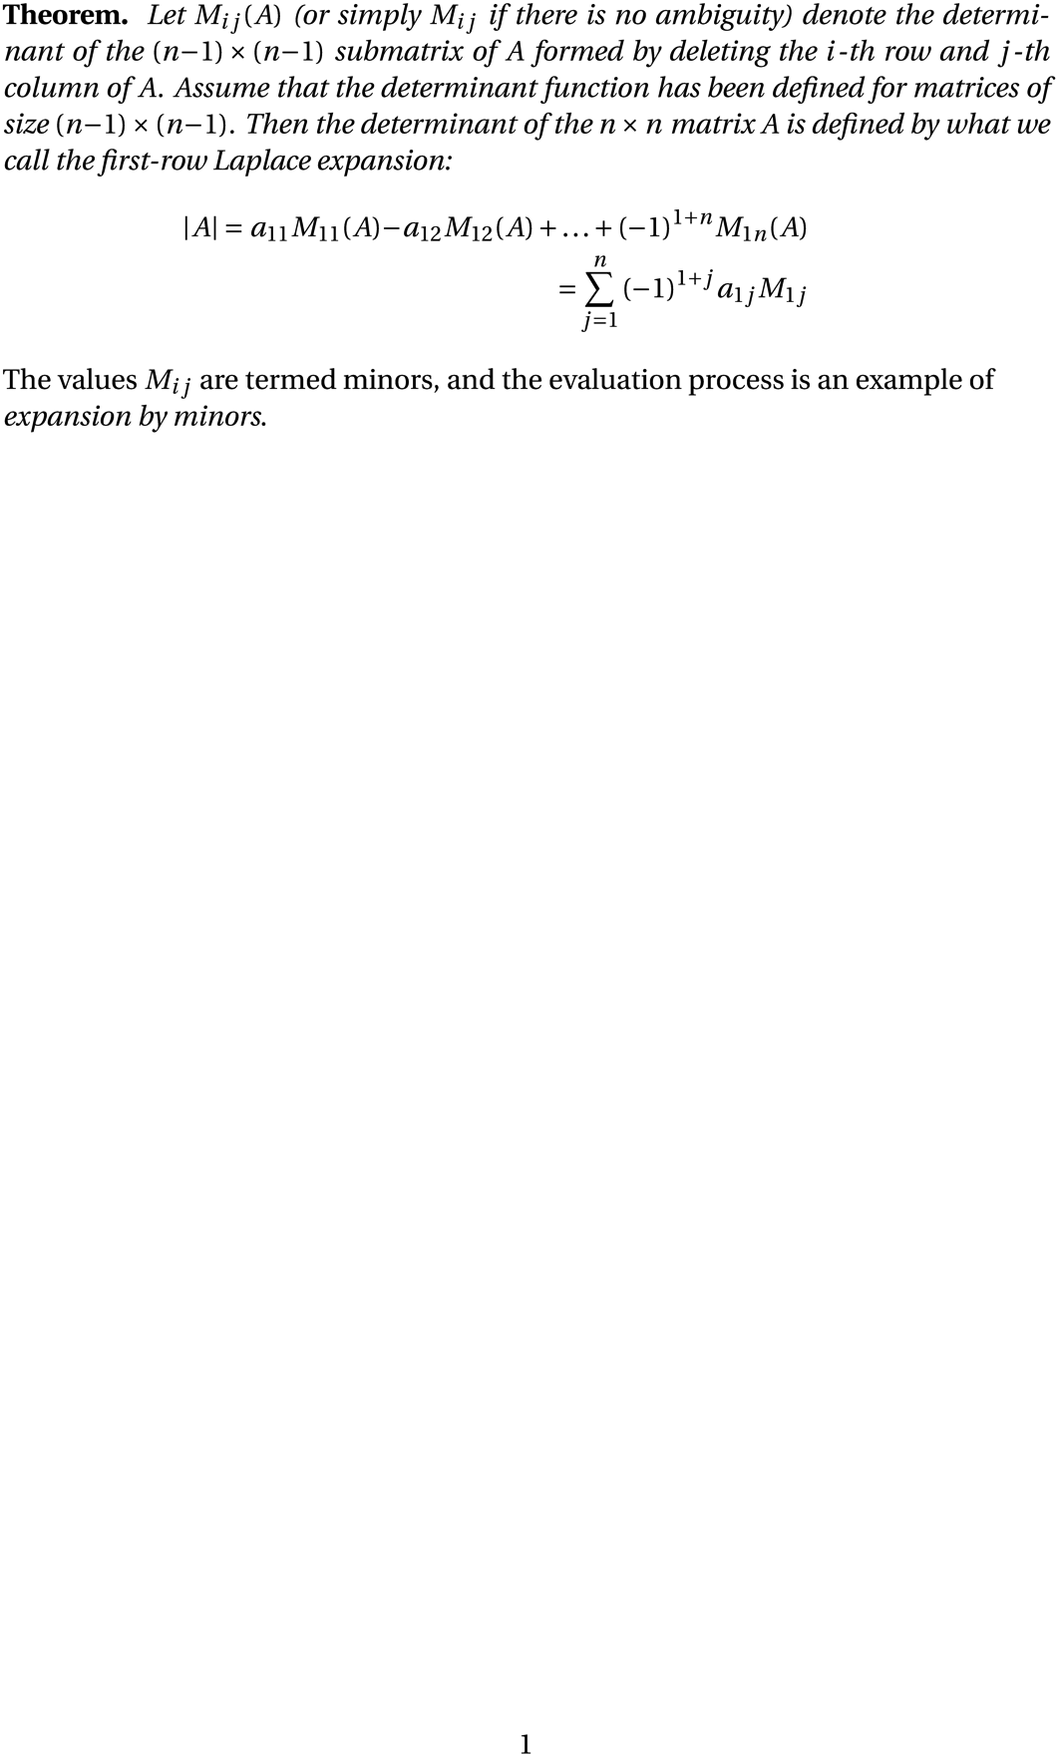
First-Row Laplace Expansion

Slide 6
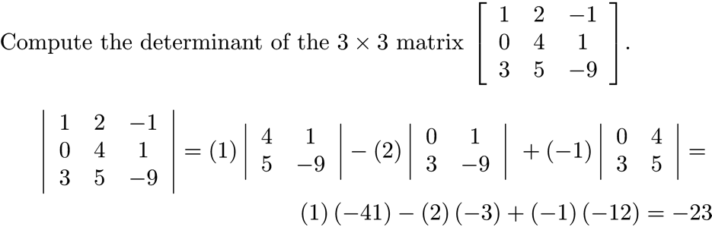
Example 1

Slide 7
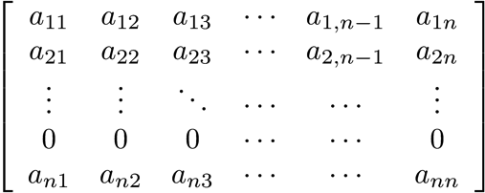
Properties of Determinants
A and A^{T} have the same determinant.
If a row of a matrix A is 0, then det(A) = 0.
Assume A has a row of zeros. Expand across the first row. Each (n-1) × (n-1) submatrix has a row of zeros. When evaluating the determinant of each (n-1) × (n-1) submatrix, each (n-2) × (n-2) submatrix has a row of zeros. Continue the process until obtaining a set of 2 × 2 matrices, each of which has a row of zeros. Each of these matrices has a determinant of zero.

Slide 8
Properties of Determinants
If a column of a matrix A is 0, then det(A) = 0.
det(A) = det(A^{T}), and A^{T} has a row of zeros.
det(A*B) = det(A)*det(B)

Slide 9
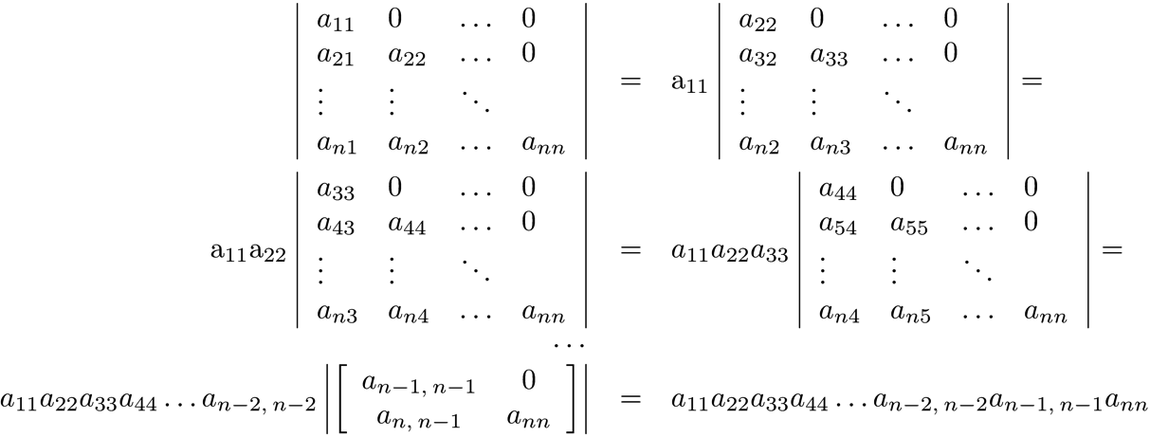
Determinants that are Simple to Evaluate
The determinant of a lower triangular matrix is the product of its diagonal elements.
The same is true for an upper triangular matrix.

Slide 10
Determinants that are Simple to Evaluate
The determinant of a diagonal matrix is the product of its diagonal elements.
A diagonal matrix is a lower triangular matrix.

Slide 11
Example 2
Let

Slide 12
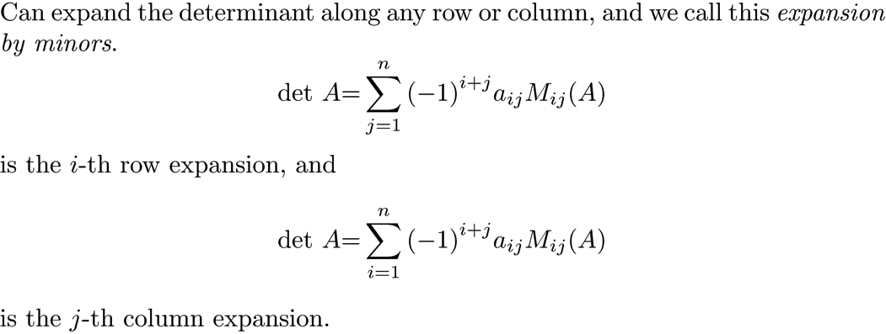
Expansion by Minors

Slide 13
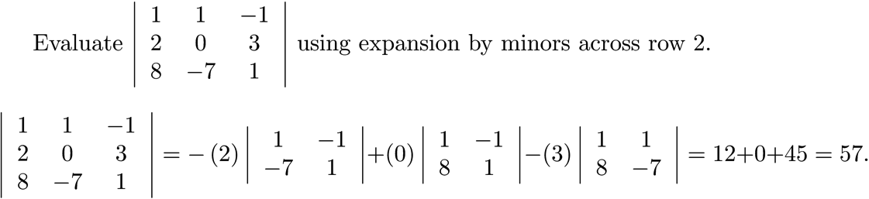
Example 3

Slide 14

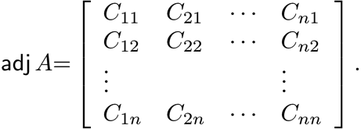
Cofactors and the Adjoint
Cofactors:
The adjoint is the transpose of the matrix of cofactors.

Slide 15
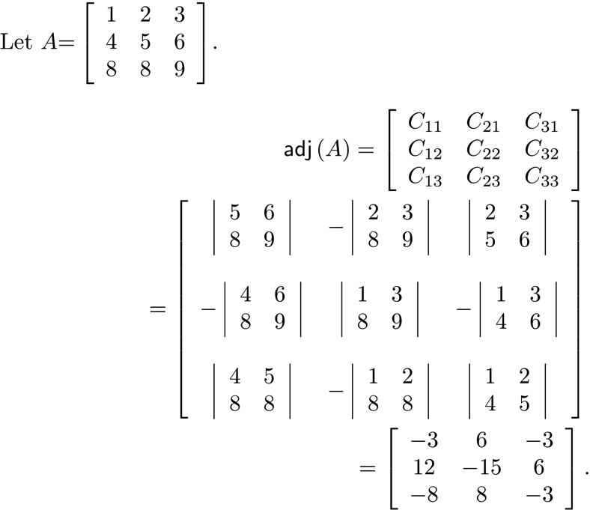
Example 4
This is a very messy calculation! The adjoint is a theoretical tool.

Slide 16
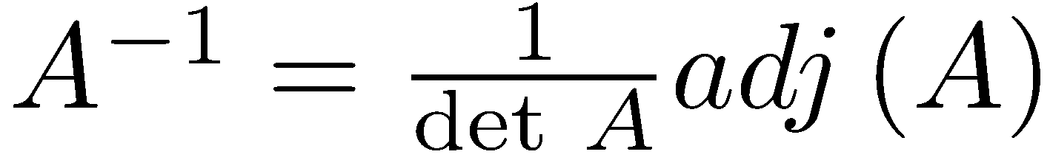
Relation between the Adjoint and the Matrix Inverse

Slide 17
Computing a Determinant Using Row Operations
Properties of a determinant that can be used to compute its value.
A determinant is a linear function of each row separately.
If two rows of a matrix are equal, the determinant is zero.
If two rows of a matrix are interchanged, the determinant changes sign.
If a multiple of a row is subtracted from another row, the value of the determinant is unchanged.

Slide 18
Computing a Determinant Using Row Operations
The application of these properties can be used to transform matrix A to an upper triangular matrix. The determinant is the product of the diagonal entries multiplied by any factors taken from a row and , where r is the number of row interchanges.

Slide 19
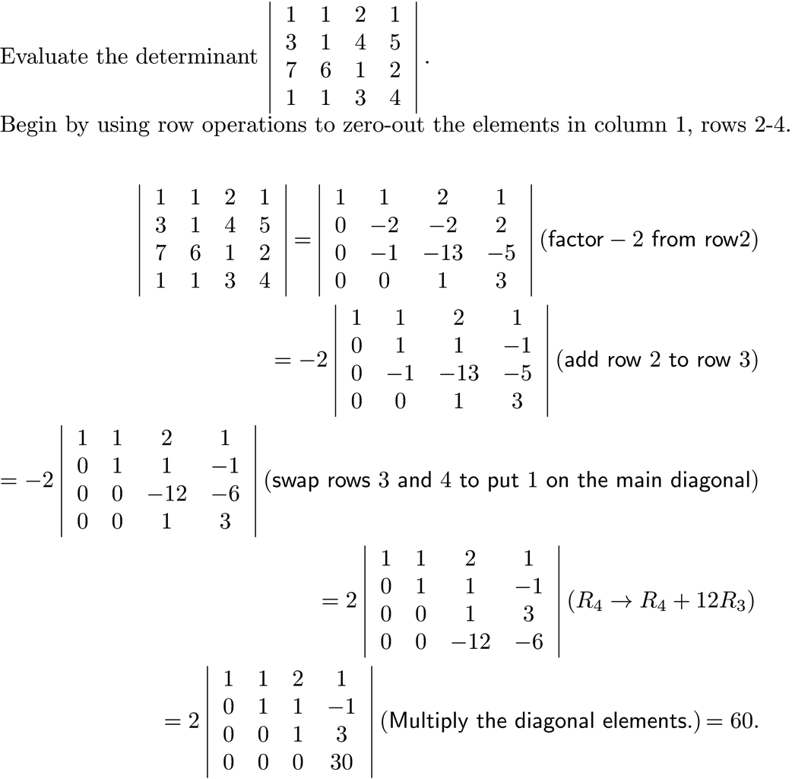
Example 5

Slide 20
NOTES
In actual applications, evaluation of a determinant should be avoided if possible. Expansion by minors is far too slow, so row reduction must be used. This process introduces errors that can be serious, as Chapter 8 will show.
The theorem on the next slide is of theoretical importance.

Slide 21
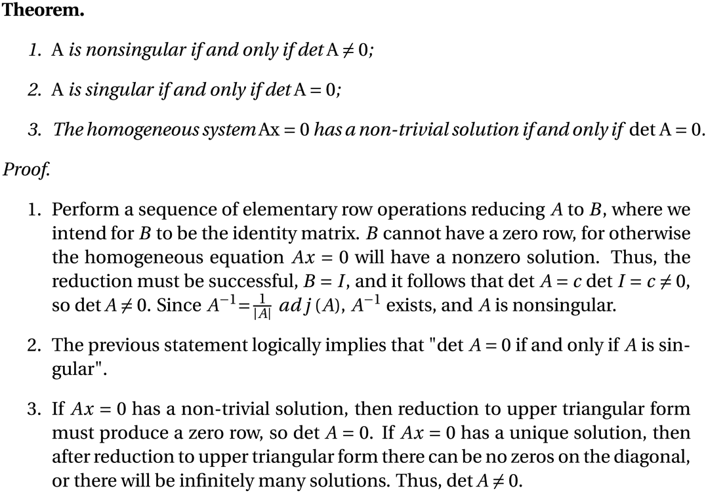
The Determinant and Invertibility

Slide 22
Example 6
Find a for which the following homogeneous system has a non-trivial solution.
The homogeneous system has a non-trivial solution for a = 5.

Slide 23
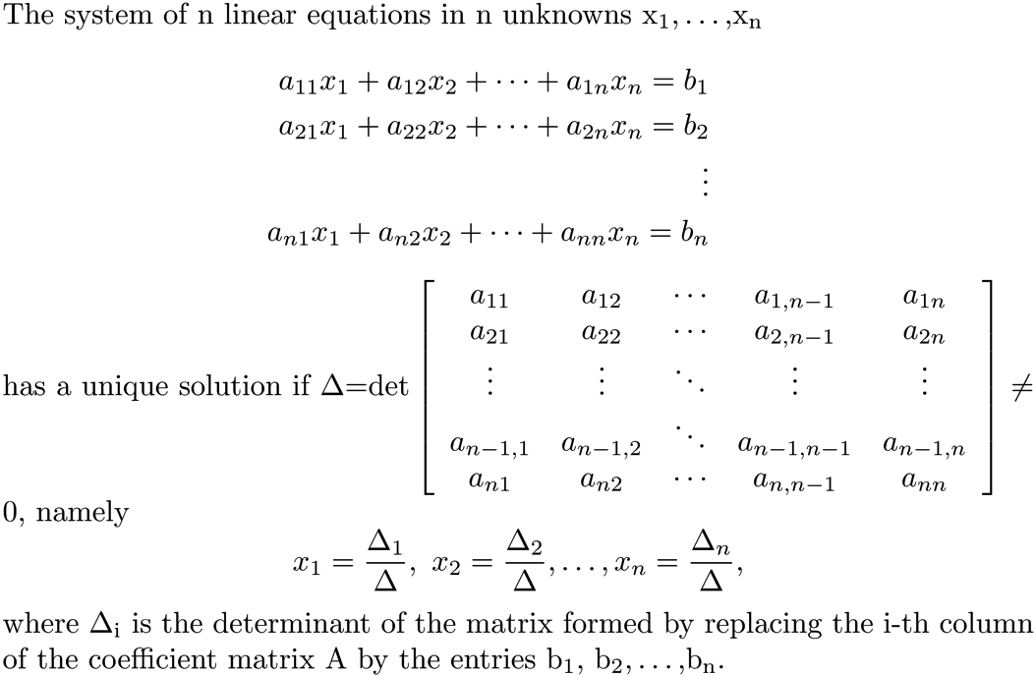
Cramer’s Rule

Slide 24
Cramer’s Rule
Never use Cramer’s rule for a matrix larger than 3 × 3.
2 × 2 Example

Slide 25
Encryption
In today’s world, encryption of data is of paramount importance. There are many schemes for encryption:
RSA for Internet transmission.
AES to protect files.
Blowfish to protect files.
There is a process that uses matrices for encryption, and it relies heavily on the theoretical result

Slide 26
Encryption Algorithm: Step 1
Want A and its inverse to have integer entries that can be changed easily.
Create an n x n upper triangular matrix A with all integer entries and a diagonal whose entries are 1 or .
det(A) = ±1, since the determinant of an upper triangular matrix is the product of its diagonal entries.
Change the matrix A by using a sequence of elementary row operations consisting of adding a multiple of one row to another and swapping rows. The multiples must be integers.
The formula guarantees that A⁻¹ has integer entries.

Slide 27
Encryption Algorithm Step 1 Example
Example of Constructing A:
Multiply row 1 by 3 and add the result to both rows 2 and 3.
Multiply row 2 by -8 and add the result to row 3.

Slide 28
Encryption Algorithm Step 1 Example
Multiply row 2 by -7 and and add to row 1 and then
multiply row 3 by 5 and add to the row 1.

Slide 29
Encryption Algorithm: Step 2
Code the message in matrix B using one of many possible codes. Choose the simple one.
Associate 0 to a blank or space, 1 to A, -1 to B, 2 to C, -2 to D, etc...

Slide 30
Encryption Algorithm Step 2 Example
Take message ORTHOGONAL MATRIX
This encodes to
O | R | T | H | O | G | O | N | A | L |  | M | A | T | R | I | X
8 | -9 | -10 | -4 | 8 | 4 | 8 | -7 | 1 | -6 | 0 | 7 | 1 | -10 | -9 | 5 | -12

Slide 31
Encryption Algorithm Step 2 Example
Our matrix A has 3 columns, so place the encoded message into a matrix B having 3 rows. In this way, the product AB is defined. Create our matrix B by sequencing the numbers in the code table by columns, adding zeros in the last column if necessary.

Slide 32
Encryption Algorithm: Step 3
Form the product AB.
Send the encrypted message
6768 -174 1127 -4664 116 -780 3757 -88 633 -2129 60 -350 6118 -157 1019 5689 -135 957

Slide 33
Encryption Algorithm Step 3 Example
Before beginning transmission of encrypted data, send the integer matrix A⁻¹ to the client end. The client now receives as many transmissions as necessary and for each one computes
There is cost in computing A⁻¹, but it only has to be computed once to encrypt and decrypt multiple transmissions.

