Slide 1
Introduction
In addition to many other applications, eigenvalues play a critical role in the study of vibrations, where they represent the natural frequencies of a system. A mathematical analysis of a general model for vibrating structures shows that when the system is excited by a harmonic force that depends on time, the system approaches a resonance state when the forces approach or reach a particular eigenvalue.

Slide 2
Introduction
Let A by an n × n matrix. For a large number of problems in engineering and science, it is necessary to find a vector v such that Av is a multiple, λ, of v; in other words, Av = λv. Av is parallel to v, and λ either stretches or shrinks v. The value λ is an eigenvalue and v is an eigenvector associated with λ.

Slide 3
Relationship between Eigenvalues and a Homogeneous System
λ and v must satisfy the relationship Av = λv that implies (A-λI)v = 0. This is a homogeneous system, and we want to find λ and v such that the system has a nontrivial solution. This will occur (Theorem 4.5) when det(A-λI) = 0.

Slide 4
Relationship between Eigenvalues and a Homogeneous System
p(λ) = det(A-λI) is a polynomial in λ of degree n. The eigenvalues are all values λ that are roots of p.
For example, let .
The roots of are
p(λ) is called the characteristic polynomial of A, and p(λ) = 0 the characteristic equation.

Slide 5
Roots of Polynomials
A polynomial of degree n has exactly n roots, and any complex roots occur in conjugate pairs. The polynomial may have one or more roots of multiplicity two or more. This means that the polynomial has a factor (λ-r)^{k}, 1 ≤ k ≤ n. The root r is counted k times. k is the multiplicity of the eigenvalue.
Thus, an eigenvalue can be complex, and can occur multiple times. As we will see, complex eigenvalues and eigenvalues with multiplicity two or more present computational challenges.

Slide 6
Action of a Matrix on an Eigenvector
Let . Then
Since , 2.0 is an eigenvalue of A with associated eigenvector v.

Slide 7
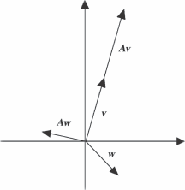
Action of a Matrix on an Eigenvector
The figure is a graph of w , Aw , and v , Av . Note how Aw has a different direction than w , but Av points in the same direction as v.

Slide 8
Computing Eigenvalues and Eigenvectors using the Characteristic Polynomial
The steps on the next page show how to use the definition to find the eigenvalues and eigenvectors of an n × n matrix.
Note that in the case of a root, λ , with multiplicity of two or more, there may be only one eigenvector associated with λ .
In practice, the accurate computation of eigenvalues and associated eigenvectors is a complex task and is not generally done this way for reasons explained later in the book.

Slide 9
Summary: Computing Eigenvalues and Eigenvectors using the Definition
Given an n × n matrix A :
Find the polynomial p( λ )= det (A- λ I).
Compute the n roots of p( λ )=0 . These are the eigenvalues λ₁ , λ₂ , … , λ_{n} of A .
For each distinct λ_{i} , find an eigenvector v_{i} such that
If λ_{i} is a multiple root, there may be only one associated eigenvector. If not, compute the distinct eigenvectors.

Slide 10
Example 1
Compute the eigenvalues and associated eigenvectors for
Find the characteristic polynomial

Slide 11
Example 1
The roots of the characteristic polynomial are λ₁ = 4, λ₂ = -1, λ₃ = 2 . We can find three distinct eigenvectors by solving three homogeneous linear systems.

Slide 12
Example 1
For λ₁ = 4, solve the system
Solution v₃₁ = 0, v₂₁ = 0, v₃₁ can be any value, so
is an eigenvector.

Slide 13
Example 1
For λ₂ = -1, solve the system
Exchange rows 2 and 3 to obtain
The second row of the system specifies that, so and .

Slide 14
Example 1
The first row of the system specifies that and , so This gives a general eigenvector of . Let and we have the eigenvector

Slide 15
Example 1
For λ₃ = 2, solve the system and
The first row requires that ,so
is a general eigenvector. Choose , and we have .

Slide 16
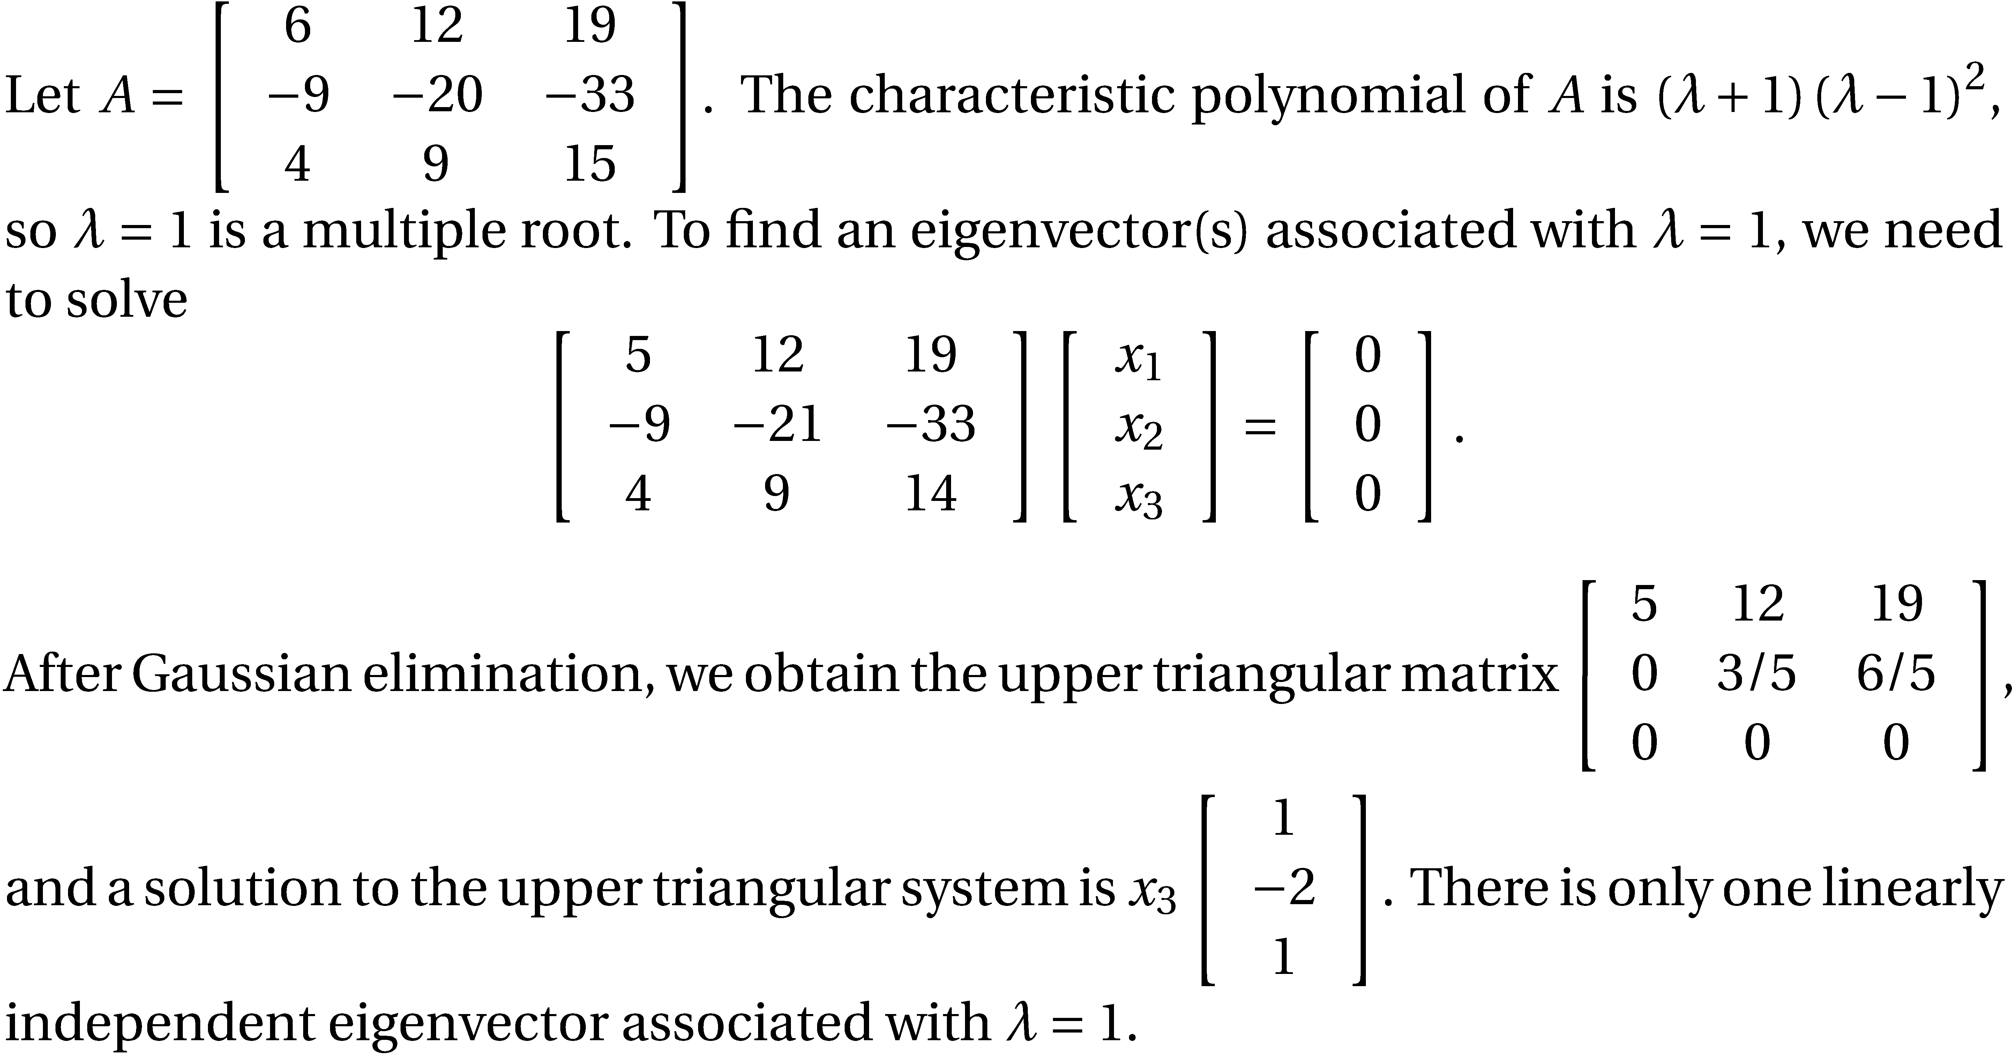
Example 2

Slide 17
Notes Concerning the Number of Linearly Independent Eigenvectors
If a matrix has n distinct eigenvalues, there will be n corresponding linearly independent eigenvectors.
If a general matrix has one or more repeated eigenvalues, there will not be n linearly independent eigenvectors.
Regardless of eigenvalue multiplicities, a symmetric matrix always has n linearly independent eigenvectors.

Slide 18
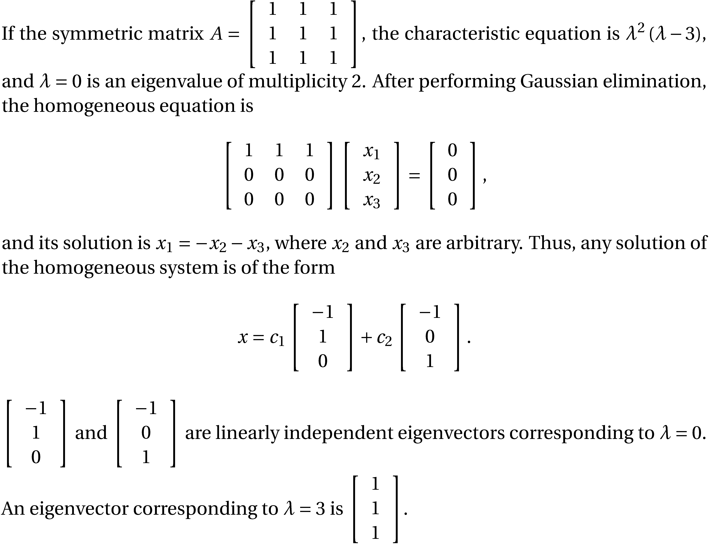
Example 3

Slide 19
Selected Properties of Eigenvalues and Eigenvectors
An n × n matrix A is singular if and only if it has a zero eigenvalue.
The matrix of Example 3 has a zero eigenvalue and is clearly singular.
Together with 0, the eigenvectors corresponding to λ form a subspace called an eigenspace.
If A is an n × n matrix, then
The matrix of Example 2 has eigenvalues -1, 1, 1 whose product is -1. The determinant of the matrix is -1.

Slide 20
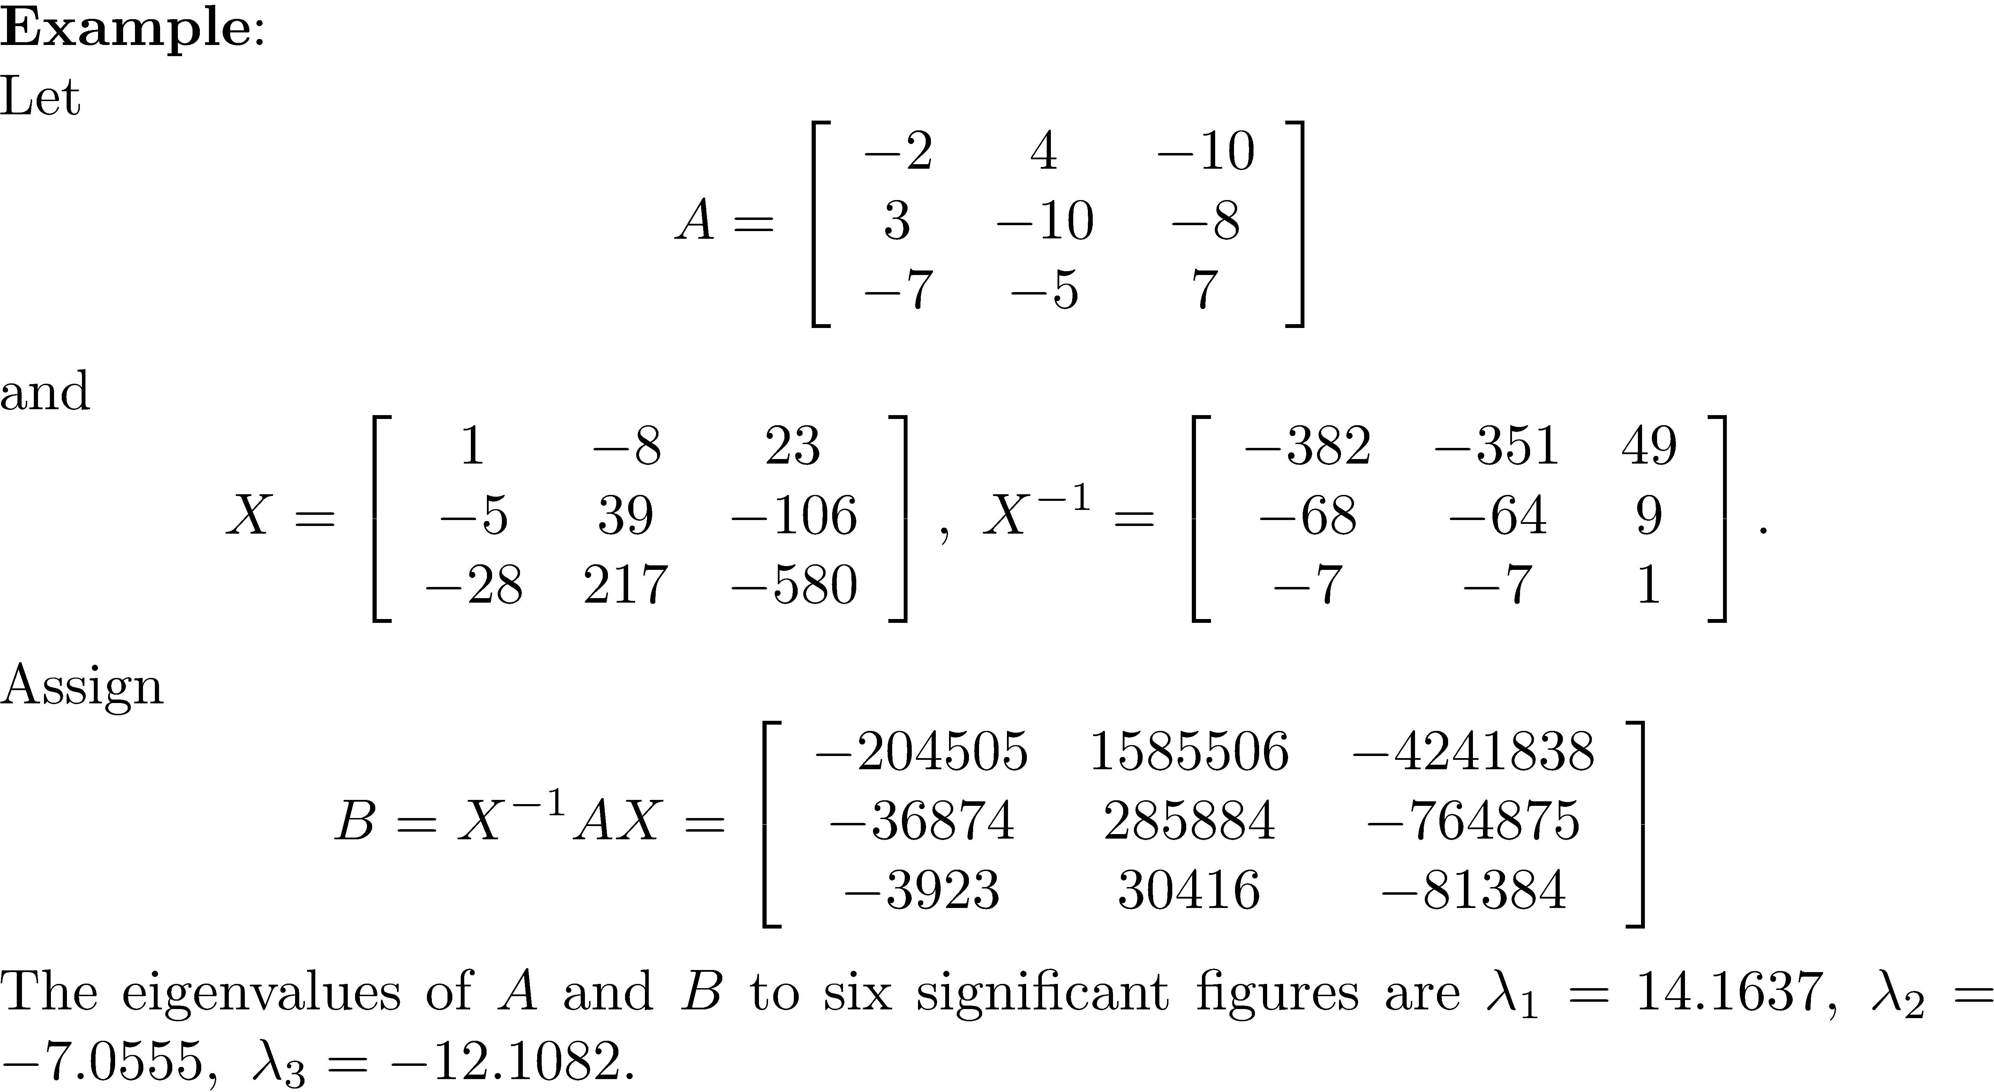
Similar Matrices

Slide 21
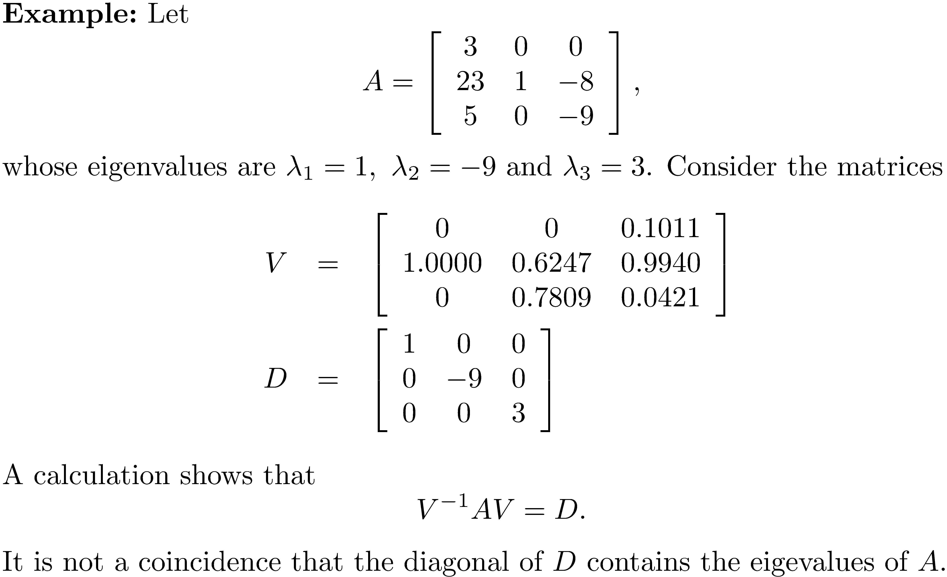
Diagonalizable Matrices

Slide 22
Results Leading to a Method of Diagonalizing a Matrix
Two similar matrices have the same eigenvalues.
Eigenvectors v₁ , v₂ , … , v_{i} that correspond to distinct eigenvalues are linearly independent.

Slide 23
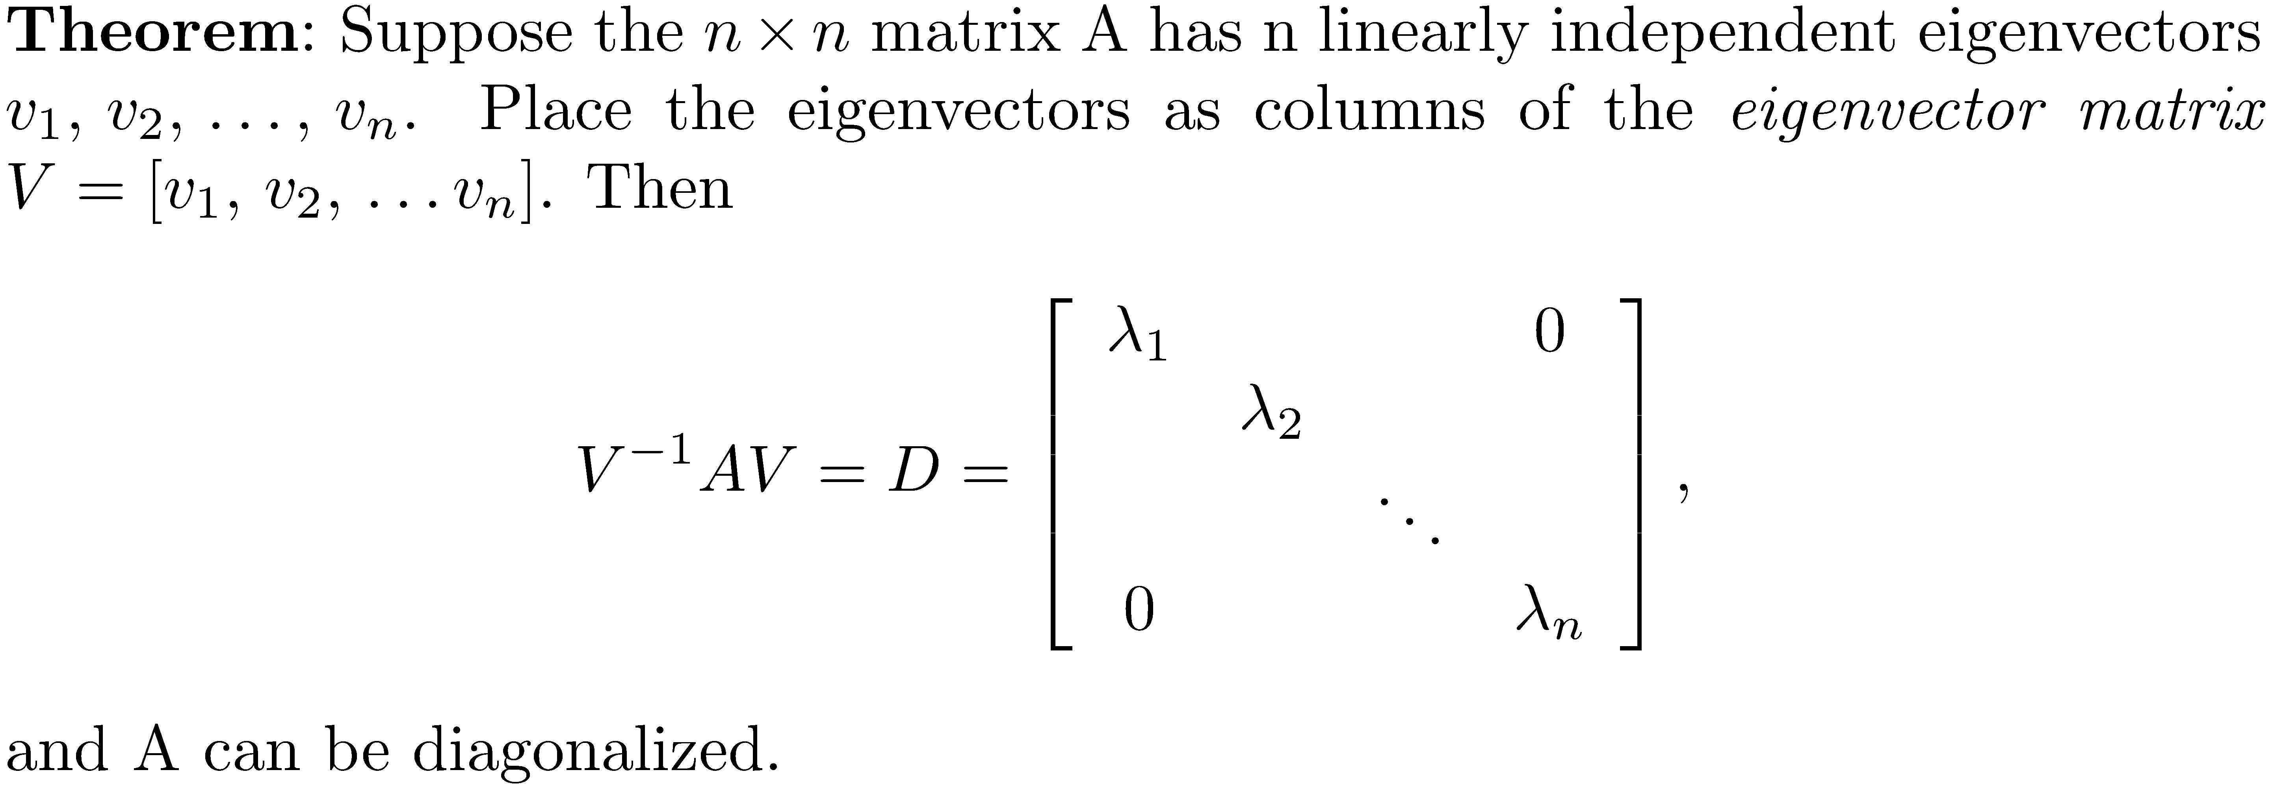
How to Diagonalize a Matrix if it is Possible

Slide 24
Important Result for Nonsymmetric Matrices
Since eigenvectors v₁ , v₂ , … , v_{n} that correspond to distinct eigenvalues are linearly independent, the previous theorem shows that A can be diagonalized.
Remark: If a matrix does not have n linearly independent eigenvectors, it cannot be diagonalized.

Slide 25
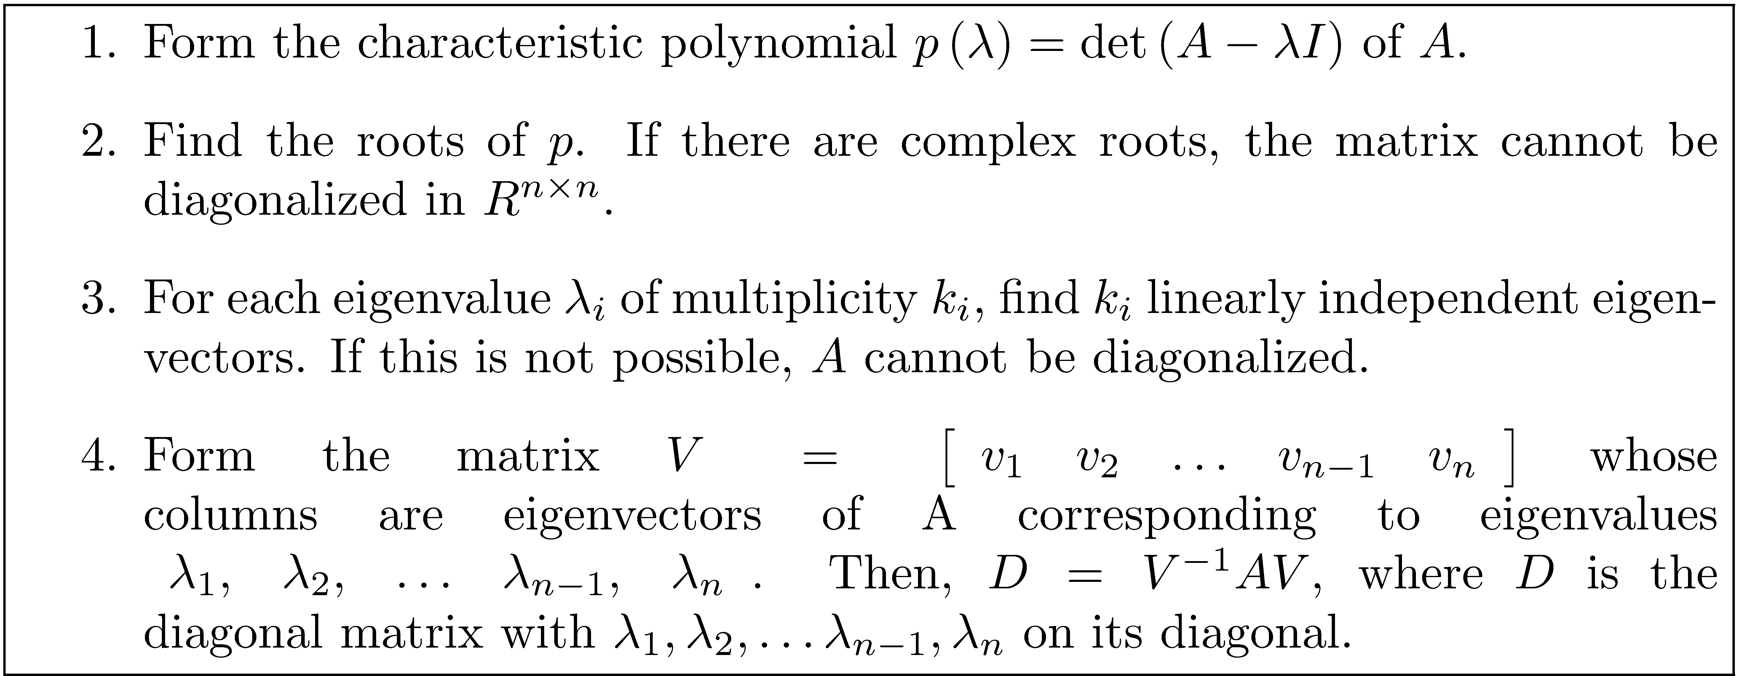
Diagonalization Sequence Steps

Slide 26
Example 4
If possible diagonalize the matrix
Characteristic polynomial .
The roots of p are λ = 1, 4, -7, 8. The eigenvalues are real and distinct, so A can be diagonalized.

Slide 27
Example 4
λ₁ = 1, ; λ₂ = 4, ; λ₃ =-7, ; λ₄ =8,
Form . Then , and

Slide 28
Example 5
If possible, diagonalize the matrix
The characteristic polynomial is .
The eigenvalues are λ₁ = 0, λ₂ = 0, λ₃ = , λ₄ =
Note the eigenvalue of multiplicity 2. This eigenvalue gives only one eigenvector , and so A cannot be diagonalized.

Slide 29
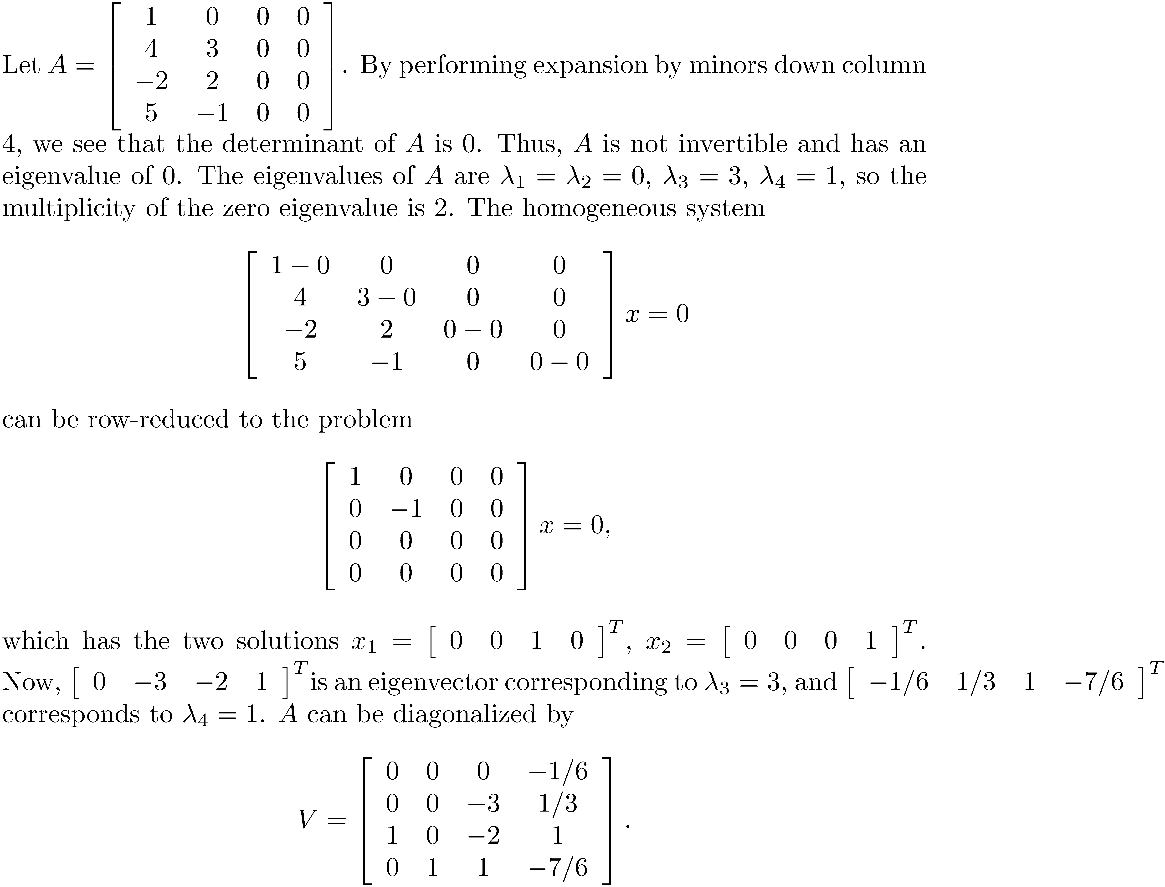
Example 6

Slide 30
Example 7
The matrix is singular with characteristic equation p(λ) = λ²(λ-3). The matrix is symmetric, so even though it has a multiple eigenvalue, there are thee linearly independent eigenvectors and A can be diagonalized as

Slide 31
Powers of Diagonalizable Matrices
For n ≥ 0, if matrix A can be diagonalized with matrix V, then where D is a diagonal matrix of eigenvalues.

Slide 32
Example 8
Using the matrix of Example 7, we have
For instance, A¹⁰ equals

Slide 33
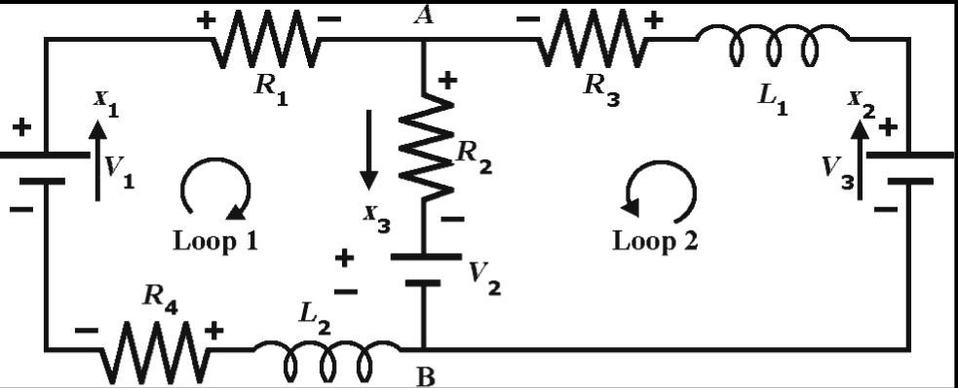
Application - Electric Circuit
Determine the currents in the RL circuit
Assume the component values

Slide 34
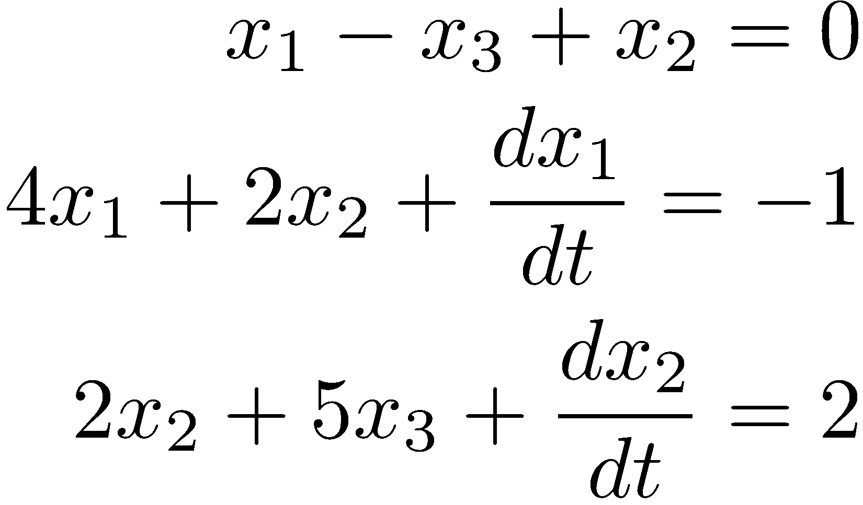
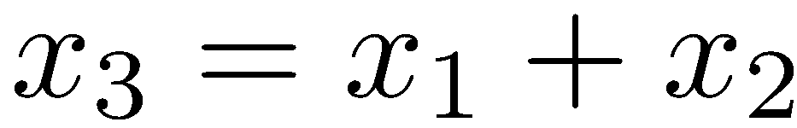
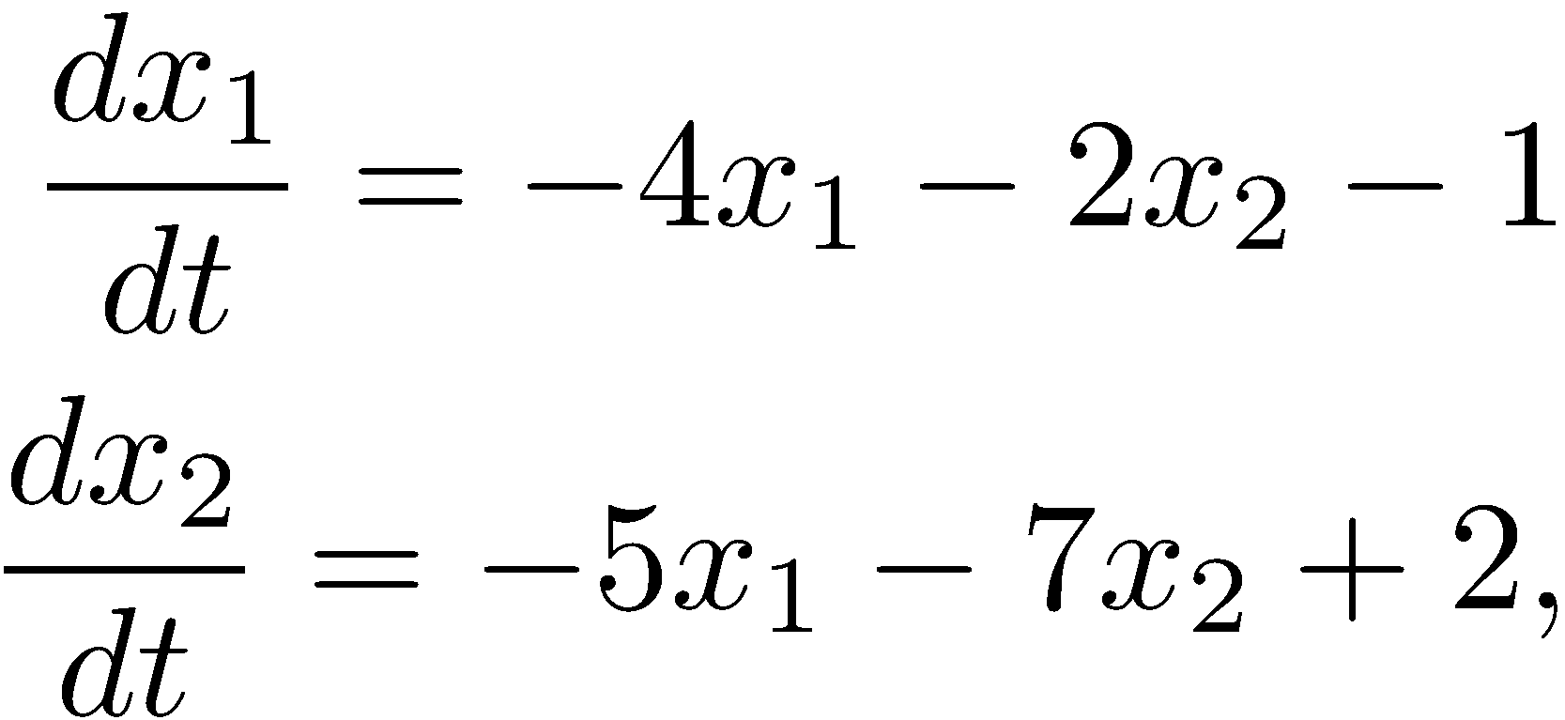
Application - Electric Circuit
Applying Kirchoff's laws, there results the system of differential equations: After using , we must solve the system of equations

Slide 35
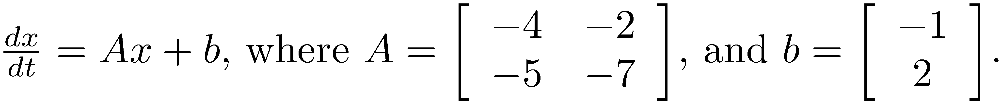
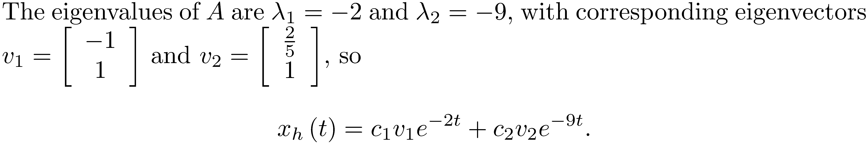
Application - Electric Circuit
After conversion of the system to matrix form there results
Find the eigenvalues and corresponding eigenvectors of A to determine the homogeneous solution.

Slide 36
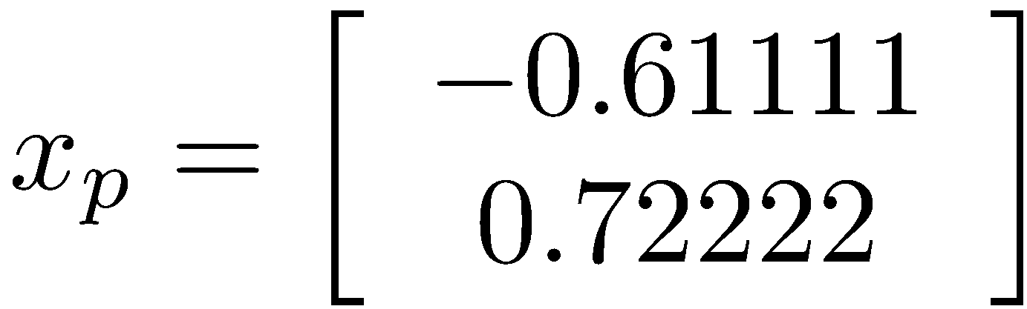
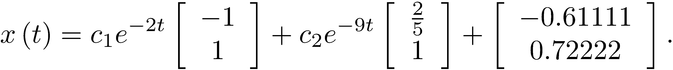
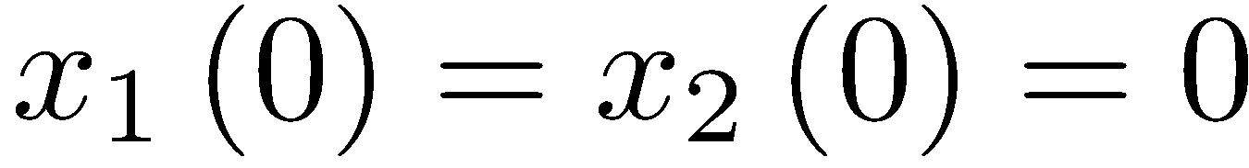
Application - Electric Circuit
Now find a particular solution
The general solution is
Apply the initial conditions at t = 0:

Slide 37
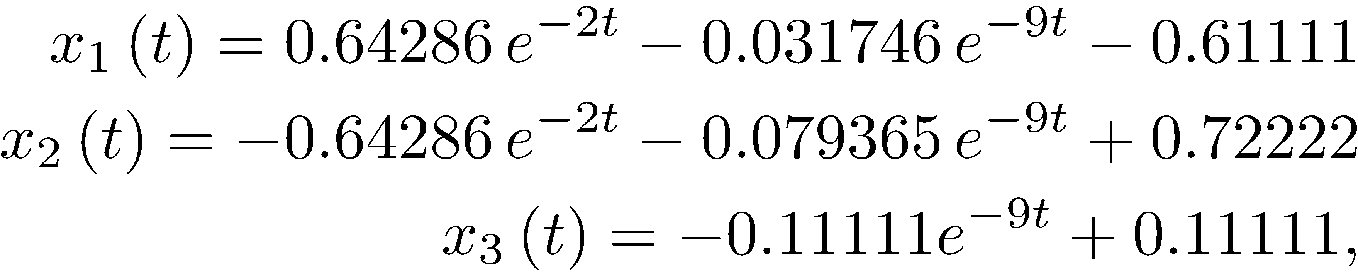
Application - Electric Circuit
After applying the initial conditions, the solution is
Recalling that , the complete solution is

Slide 38
Application - Electric Circuit
The following is the graph of the currents.

Slide 39
A Ranking Process
The Google matrix is a very large matrix used to determine the order of hits for a search. The eigenvalue/eigenvector problem is applied to the matrix and used to develop the ranking of search results.
We develop a simple process for ranking that uses the eigenvalue/eigenvector problem.
First we need to introduce an irreducible matrix.

Slide 40
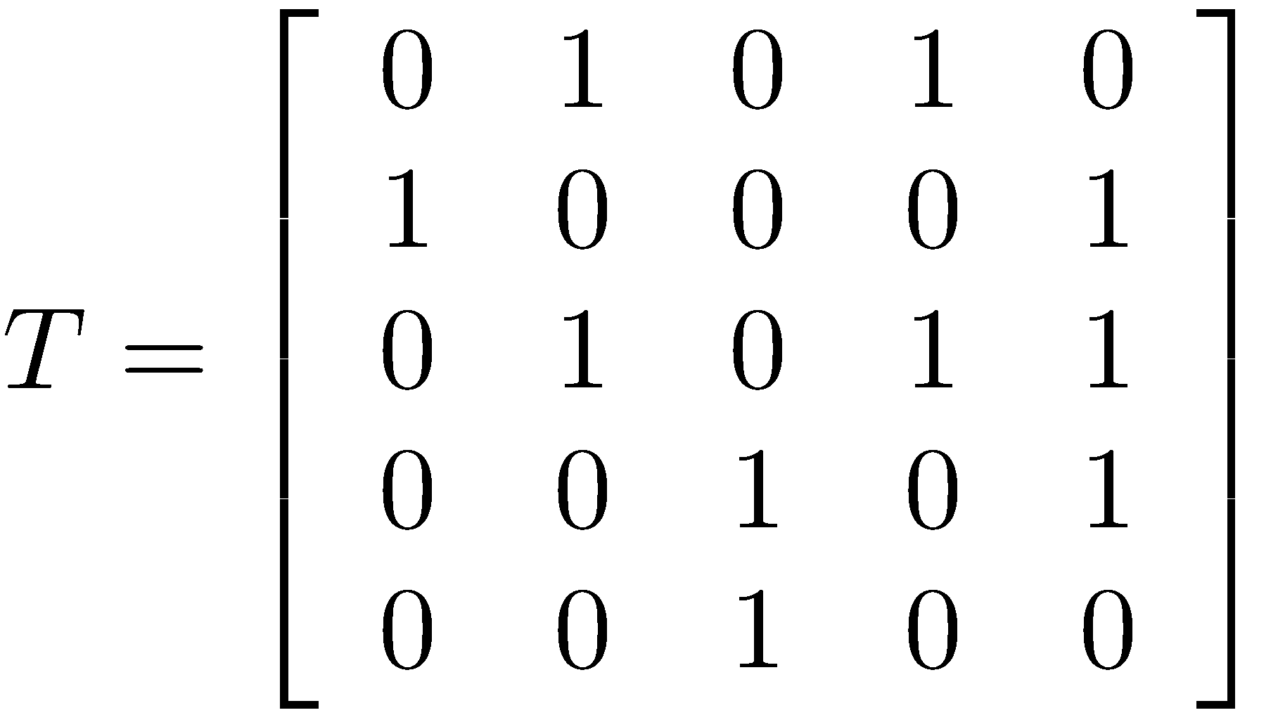
Irreducible Matrices
Treat an n × n matrix as a digraph by creating vertices with labels 1, 2, 3, …, n and joining two vertices i and j by a directed edge if a_{ij} ≠ 0.
For example, if , the corresponding digraph is

Slide 41

Irreducible Matrices
A matrix is irreducible if in its digraph form given any two vertices v_{i} and v_{j} there is a path from v_{i} to v_{j} and from v_{j} to v_{i}.
If all the elements of matrix A are nonnegative, we write A ≥ 0, and if all the entries are positive, the notation is A > 0.
An alternative test for irreducibility is given by

Slide 42
Perron-Frobenius Theorem
The Perron-Frobenius theorem forms the basis for the ranking scheme we develop. Before stating the theorem, note that a simple eigenvector is an eigenvector associated with an eigenvalue of multiplicity one.

Slide 43
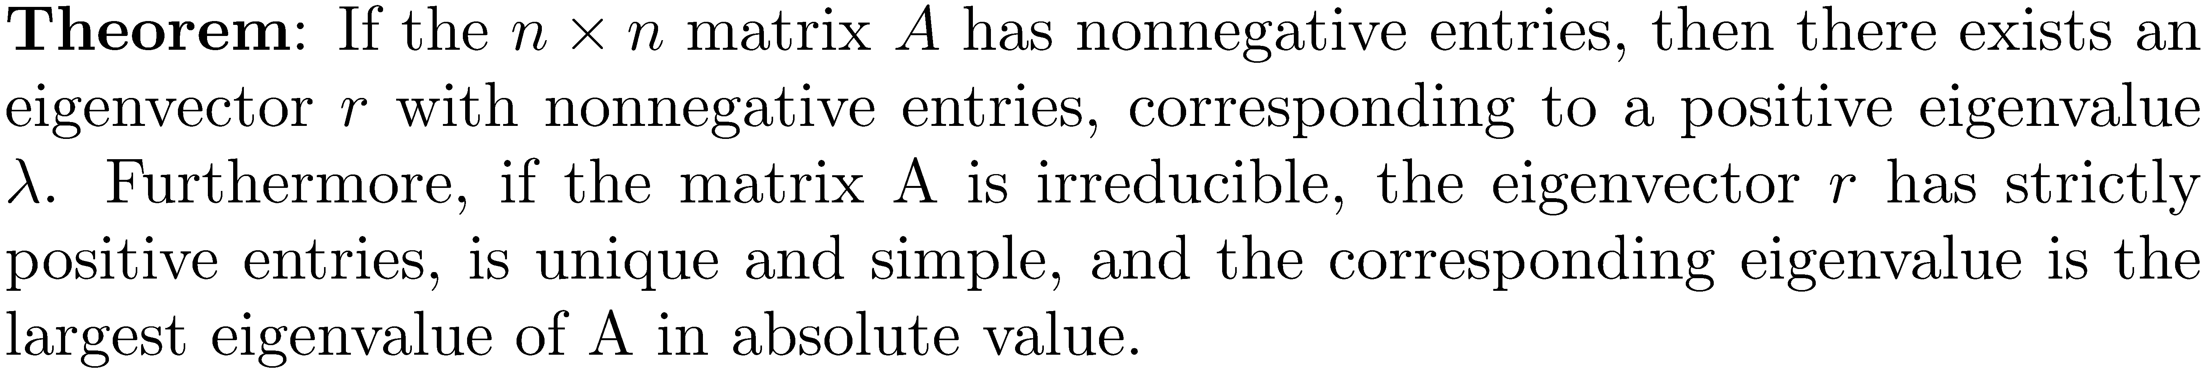
Perron-Frobenius Theorem

Slide 44
Computing the Eigenvector r
The largest eigenvalue of the irreducible matrix A in the Perron-Frobenius theorem can be computed by for any nonnegative vector r₀, where computes the length of a vector v.
NOTE: For the purposes of computing the ranking vector, the book software distribution contains a MATLAB function, perronfro, that takes the matrix as an argument and returns an approximation to r and the corresponding eigenvalue λ . This process of computing an eigenvector is called the power method and will be discussed in Chapter 18.

Slide 45
Ranking of Teams using Eigenvectors
The problem is to rank things in order of importance based on some measure of the influence that they have over each other. Suppose that a set of n football teams represented by variables x_{i} ,1 ≤ i ≤ n, are to be ranked. We assume that each team played every other team, and that elements {r_{ij}} are weights used in ranking, where i refers to team i , j to team j and r_{ii} = 0.

Slide 46
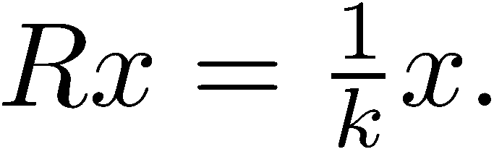
Ranking of Teams using Eigenvectors
The ranking of team i is proportional to the sum of the rankings of the remaining teams weighted by r_{ij} , so where k is the constant of proportionality.
Write this in the matrix form
This is an eigenvalue problem!

Slide 47
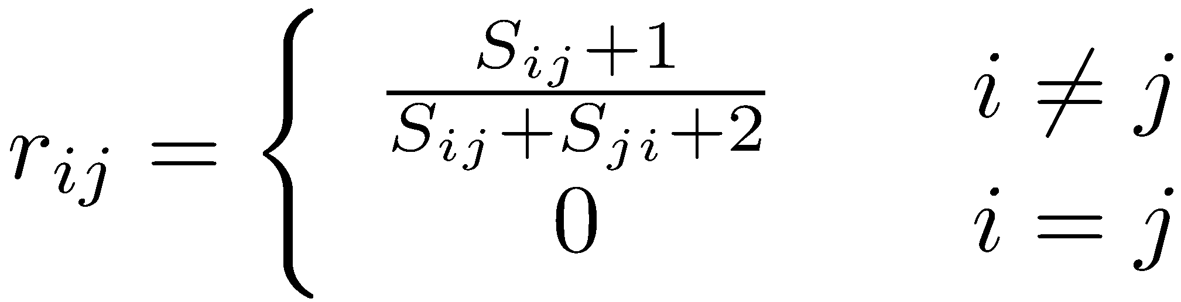
Defining the Weights
S_{ij} is the number of points scored by team i when it played team j.
The losing team gets some credit, there cannot be a zero row, and so R will be irreducible (full connectivity in the associated digraph).

Slide 48
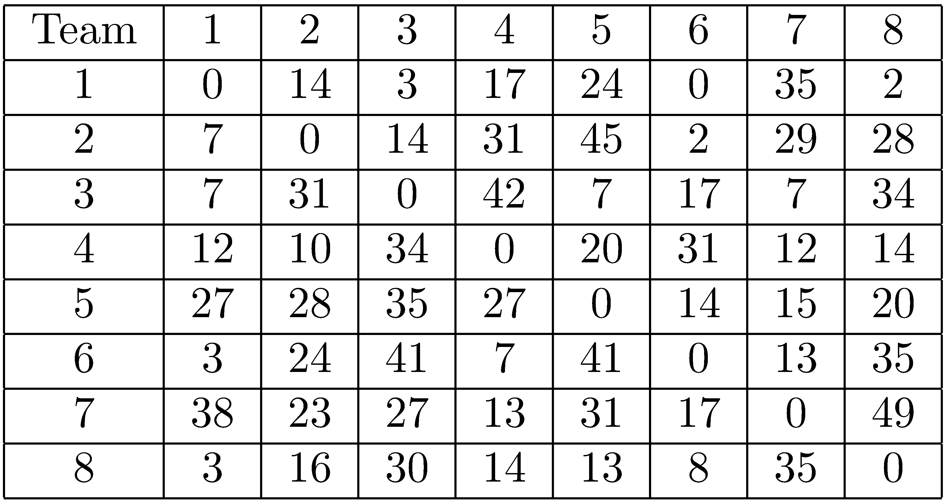
Example 9
The table gives scores for eight teams that all play each other once.

Slide 49
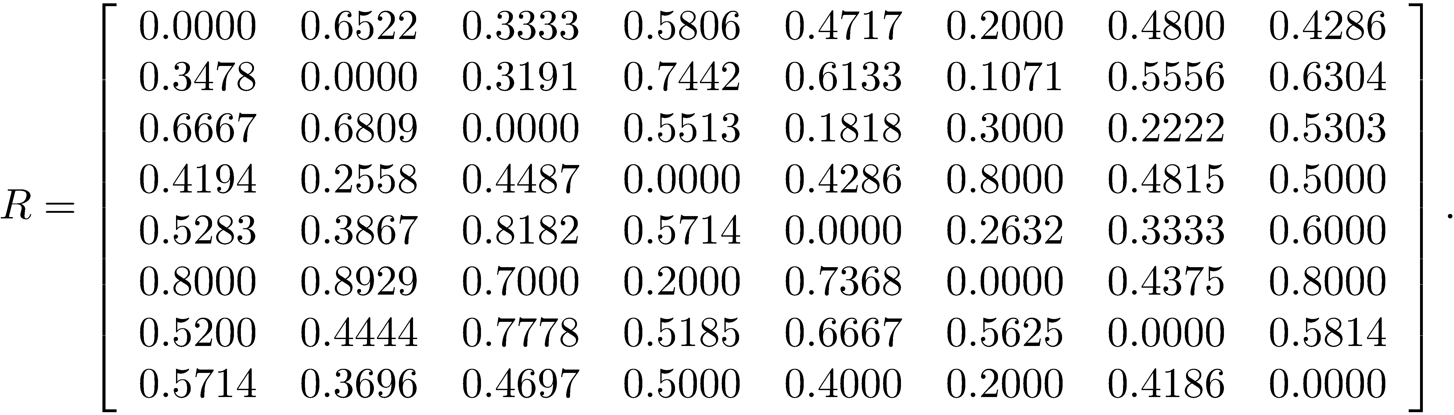
Example 9
Apply the ranking formula.
The book software distribution contains a function rankmatrix that takes the matrix S of scores and returns the ranking matrix R obtained by applying the formula. Then apply the function perronfro to R to obtain the ranking vector.

Slide 50
Example 9
The following command sequence finds the ranking vector. The largest component of the ranking vector is the top rated team, the second largest the second rated team, and so forth.
>> R = rankmatrix(S);
>> [r, lambda] = perronfro(R)
r =
0.3198
0.3330
0.3134
0.3506
0.3448
0.4404
0.4050
0.2981
lambda =
3.9342
By looking at the vector r , we see that the teams are
ranked from first to last as follows:

Slide 51
Computing Eigenvalues and Eigenvectors using MATLAB
[V,D] = eig(A); D is a diagonal matrix of the eigenvalues and, and V is a matrix whose columns are the corresponding eigenvectors.
E = eig(A); E is a column vector of the eigenvalues.
eig(A) Lists the eigenvalues.

Slide 52
Example 10
A =
14 -68 -67 38
-6 59 20 50
-98 -38 -48 -10
-33 6 31 -84
>> [V,D] = eig(A);
>> V
V =
0.6966 0.2130 0.0978 -0.5275
-0.6162 0.5811 -0.3758 -0.0099
-0.3050 -0.7306 0.7645 -0.7986
-0.2050 -0.2883 0.5145 0.2896
>> D
D =
92.3130 0 0 0
0 6.8544 0 0
0 0 -48.5889 0
0 0 0 -109.5785
>> E = eig(A);
>> E
E =
92.3130
6.8544
-48.5889
-109.5785
>> eig(A)
ans =
92.3130
6.8544
-48.5889
-109.5785

