Slide 1
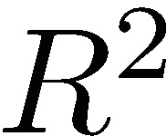
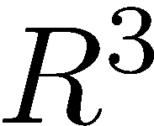

ORTHOGONAL VECTORS AND MATRICES
This chapter develops important properties of vectors and introduces the very important topic of orthogonal matrices. Orthogonal matrices are involved in most of the matrix decompositions so important in numerical linear algebra.
If we are discussing a property or operation that applies to all vectors, we can use vectors in and as illustrations, since we can visualize the results, whereas that is not possible for a vector in , n ≥ 4 .

Slide 2
Points and Vectors
In three dimensional space, points are defined as ordered triples of real numbers, and the distance between points P₁(x₁,y₁,z₁) and P₂(x₂,y₂,z₂) is
Directed line segments are represented as three dimensional column vectors.
If and , then

Slide 3
Points and Vectors

Slide 4
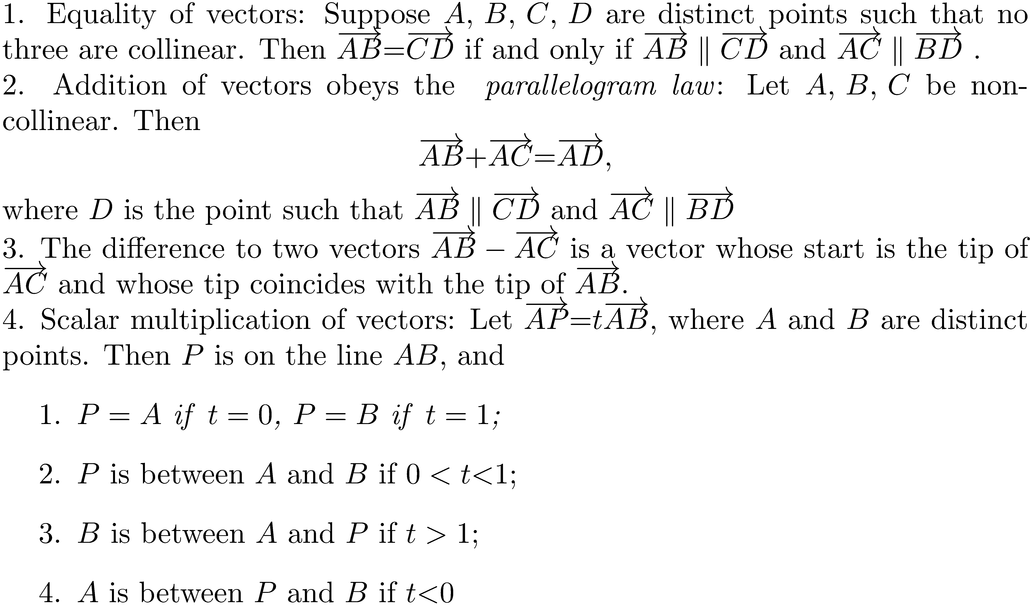
Geometrical Interpretations of Equality, Addition, Subtraction, and Scalar Multiplication of Vectors

Slide 5
Vector Addition, Subtraction, and Scalar Multiplication

Slide 6
The Inner Product
Along with matrix multiplication, the inner product is an important operator in linear algebra. It defines vector length, orthonormal bases, the matrix 2-norm, projections, and Householder reflections.

Slide 7
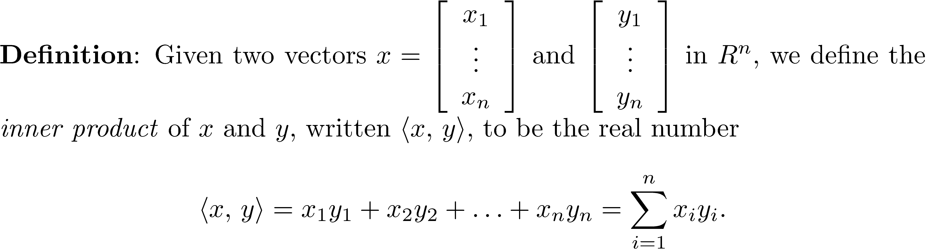
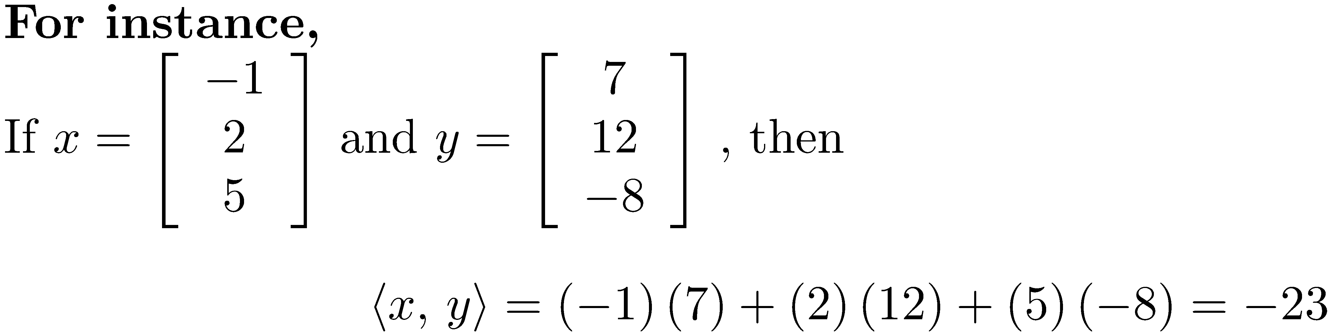
The Inner Product

Slide 8
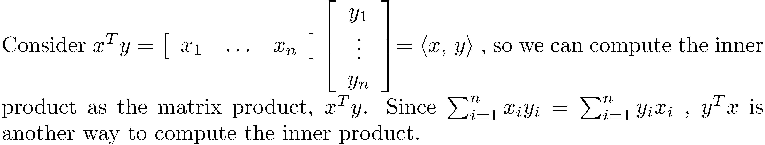
The Inner Product
NOTE: This notation will be used frequently in the book.

Slide 9
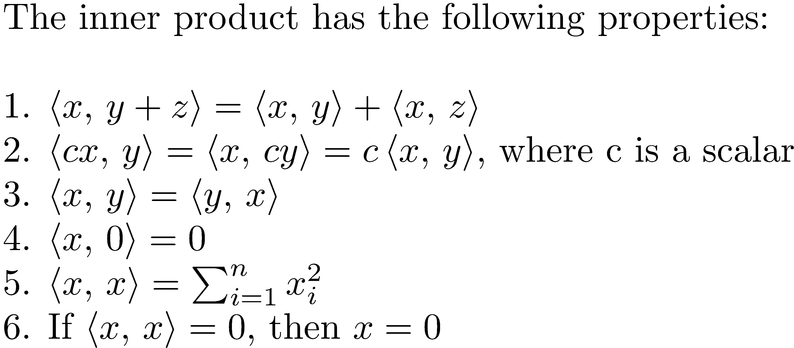
Properties of the Inner Product

Slide 10
Length of a Vector using the Inner Product
Note that .
The notation represents the length of vector u.

Slide 11
Useful Interpretation of the Inner Product in 2- and 3-dimensions

Slide 12
Useful Interpretation of the Inner Product in 2- and 3-dimensions
This formula is usually used to determine the angle between two vectors, not to compute the inner product.
It can be used to determine if two vectors are perpendicular (θ = π/2) or parallel (θ = 0 or π).

Slide 13
Orthogonal Matrices
Vectors u and v are called orthogonal if <u,v> = 0. Many of the most important results in numerical linear algebra involve orthogonal matrices, such as the QR factorization (introduced in Chapter 14), and the singular value decomposition (introduced in Chapter 15). We will see that orthogonal matrices are the most beautiful of all matrices, and that they have an intimate relation with orthogonal vectors.

Slide 14
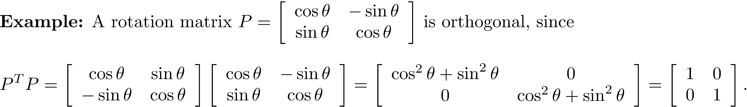
Orthogonal Matrices
Note that so that the columns of a rotation matrix are vectors of length one.

Slide 15
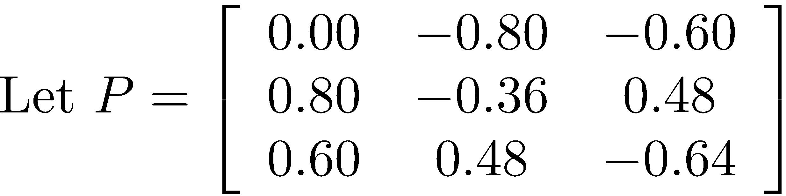
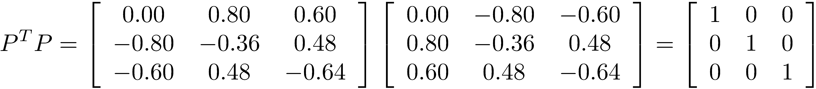
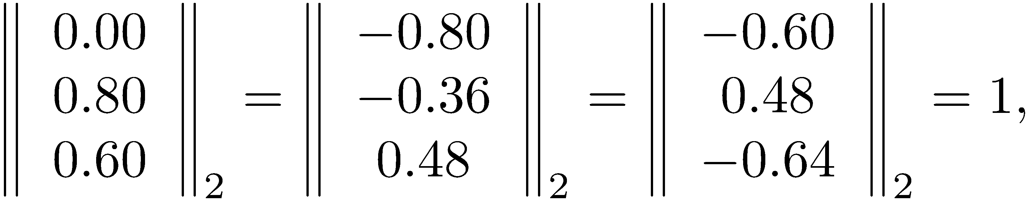
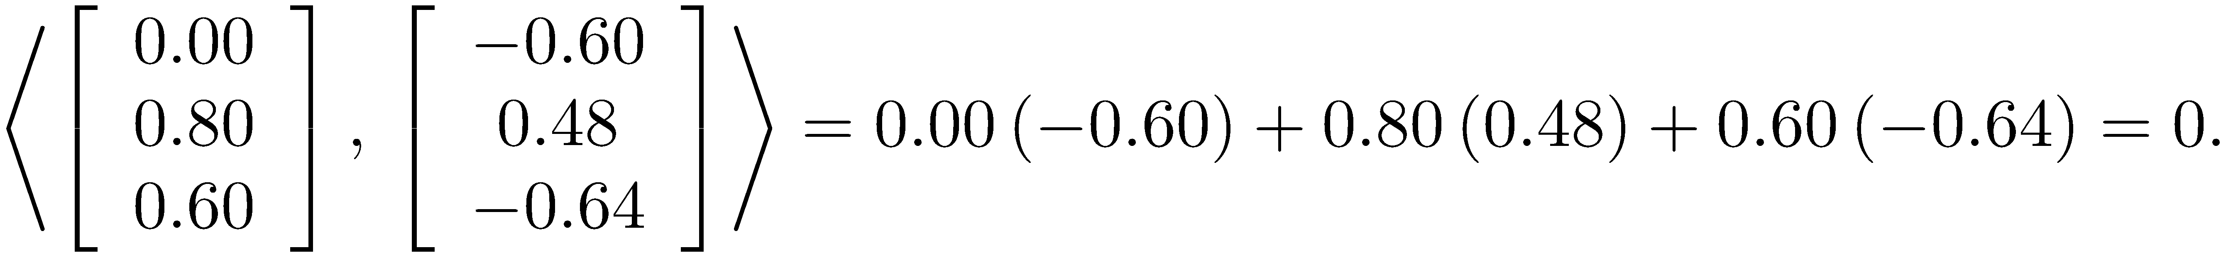
Orthogonal Matrix Example
P is orthogonal.
The columns have length 1.
The columns are orthogonal.

Slide 16
Orthogonal Matrix
The columns of an orthogonal matrix have unit length and are mutually orthogonal. They are said to be orthonormal.

Slide 17
Important Theorem Concerning Orthogonal Matrices

Slide 18
Symmetric Matrices and Orthogonality
There are many interesting and useful facts about symmetric matrices. For instance, the computation of eigenvalues, among other things, can be done faster and more accurately than the same computations can be done with nonsymmetric matrices. The theorem on the following slide gives a first insight into the eigenvalue problem for symmetric matrices.

Slide 19
Symmetric Matrices and Orthogonality

Slide 20
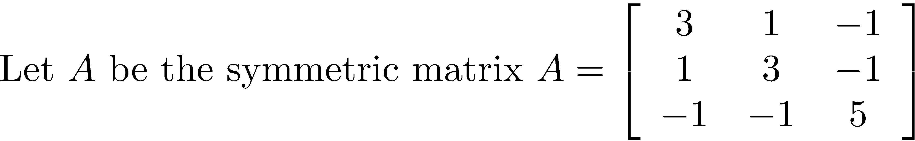
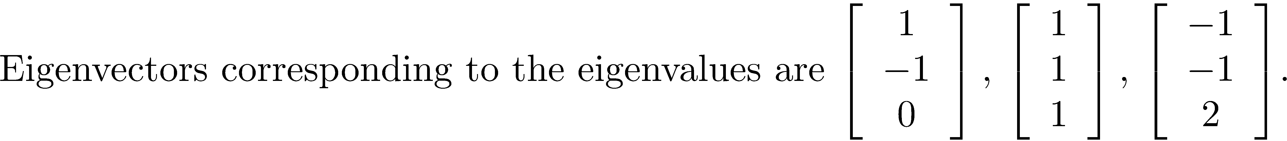
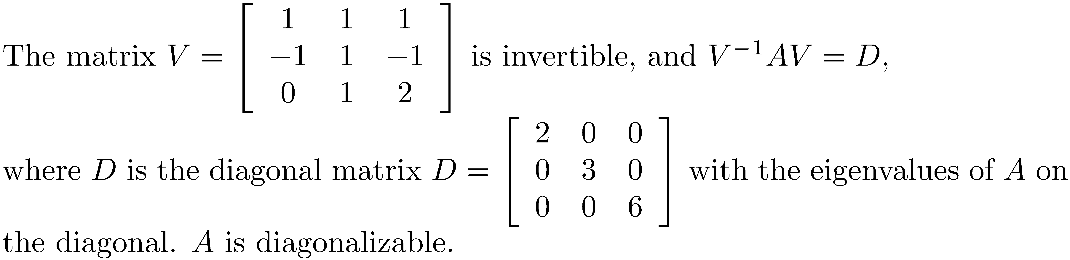
Example 1
1.
2.
3.
4.
5.

Slide 21
Example 1
Create the matrix P dividing each column of V by its length. The columns of P are orthogonal and have unit length, so P is an orthogonal matrix, and A is diagonalizable using an orthogonal matrix.

Slide 22
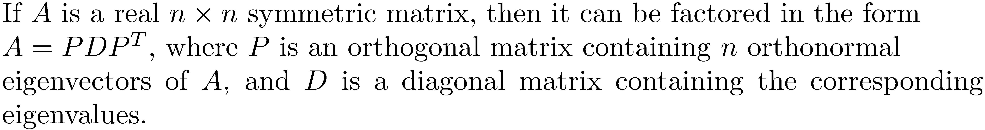
Spectral Theorem
The spectral theorem will be needed numerous times, but its proof will be delayed until Chapter 19.

Slide 23
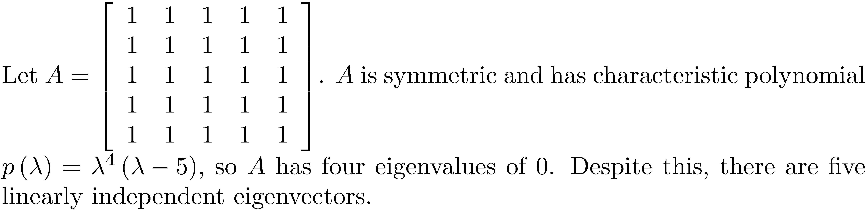
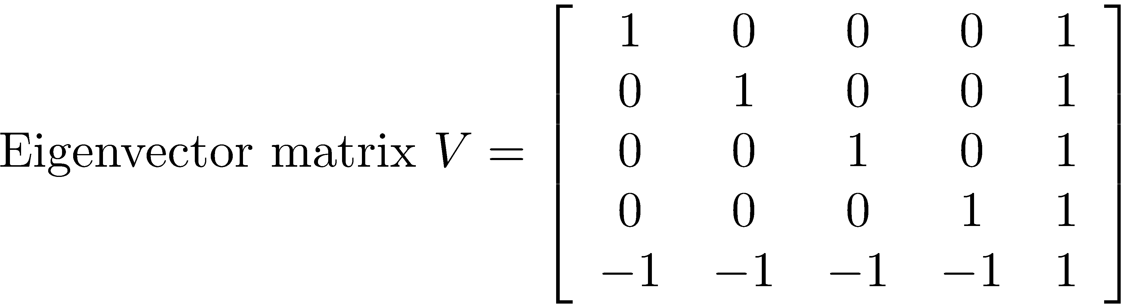

Example of the Spectral Theorem
The matrix V can be converted to an orthogonal matrix, P, with the same column space using
the Gram-Schmidt process described in Chapter 14. In that case,

Slide 24
Example of the Spectral Theorem
Use MATLAB to diagonalize A with an orthogonal matrix.
>> A = ones(5,5);
>> [P,D] = eig(A);
>> rank(P)
ans =
5
>> P'*P
ans =
1.0000 -0.0000 0 0 0
-0.0000 1.0000 -0.0000 0 0
0 -0.0000 1.0000 0 0
0 0 0 1.0000 0.0000
0 0 0 0.0000 1.0000
>> P*D*P'
ans =
1.0000 1.0000 1.0000 1.0000 1.0000
1.0000 1.0000 1.0000 1.0000 1.0000
1.0000 1.0000 1.0000 1.0000 1.0000
1.0000 1.0000 1.0000 1.0000 1.0000
1.0000 1.0000 1.0000 1.0000 1.0000

Slide 25
The L² Inner Product
We have presented the inner product for the vector space R^{n}. The general concept of an inner product extends beyond Euclidean space to any vector space for which an inner product can be defined. In particular, there are many applications for vector spaces whose elements are functions, and such vector spaces normally have infinite dimension. The Fourier series is one of the most useful topics in engineering and science. The applications of Fourier series include heat conduction, signal processing, analysis of sound waves, seismic imaging, and solving differential equations. The inner product used with Fourier series and many other vector spaces of functions is the L² inner product.

Slide 26
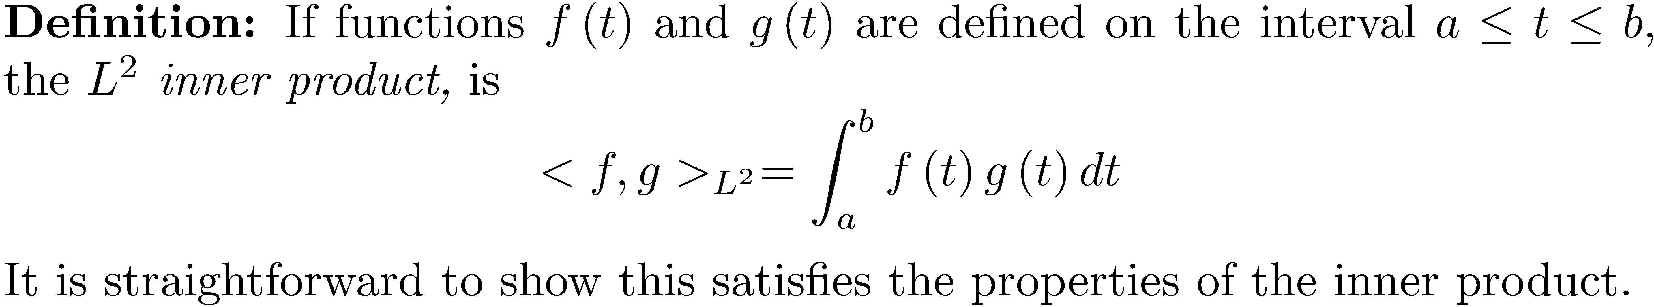
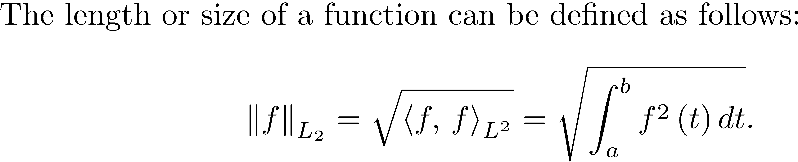
L² Inner Product

Slide 27
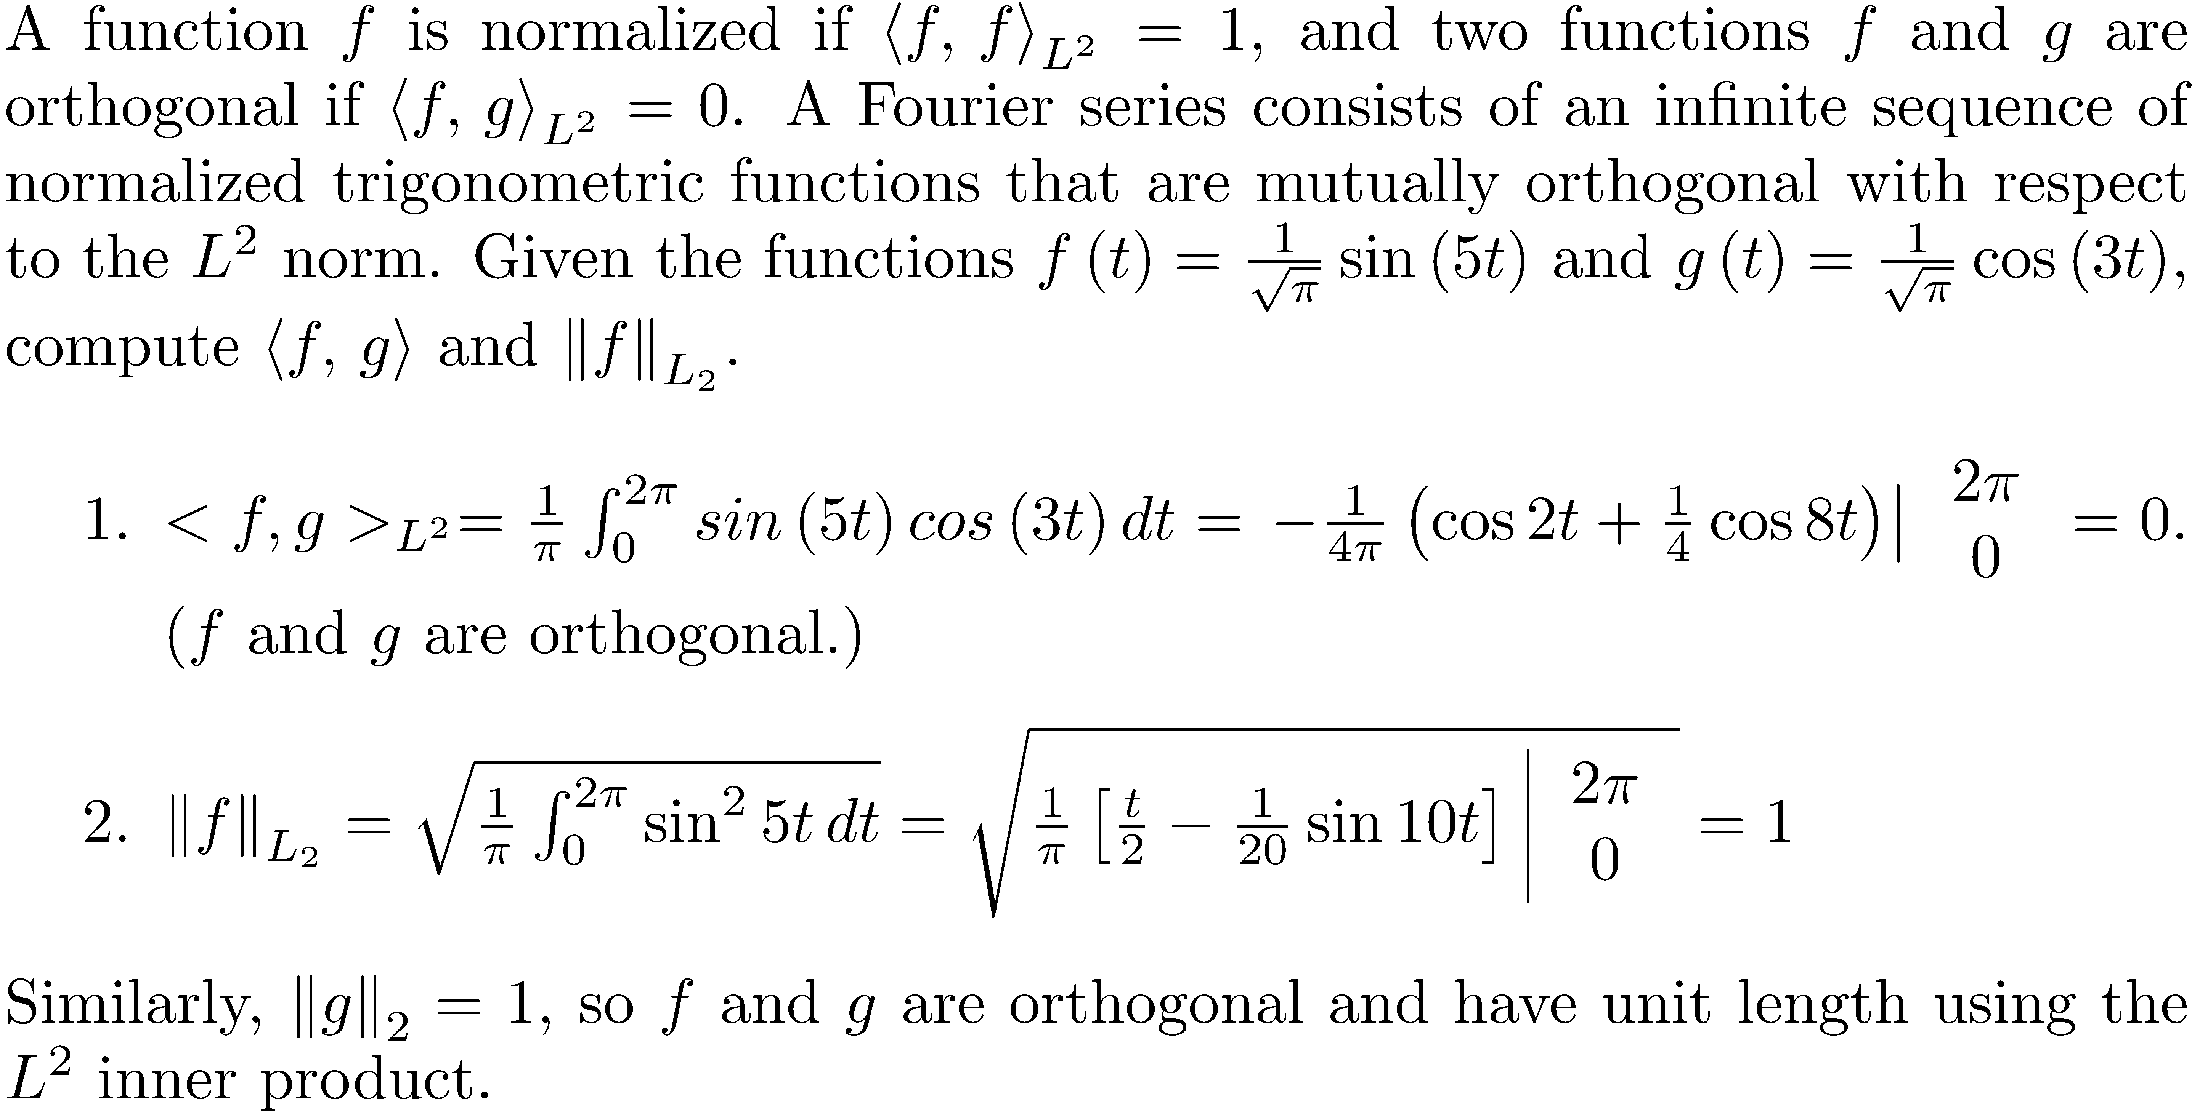
L² Inner Product Example

Slide 28
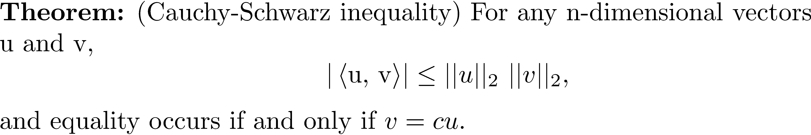
Cauchy-Schwarz Inequality
The Cauchy-Schwarz inequality is one of the most widely used inequalities in mathematics

Slide 29
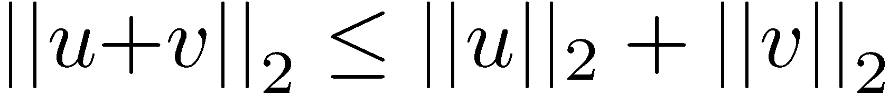
The Triangle Inequality
By applying the Cauchy-Schwarz inequality, there results the triangle inequality. Recall in high school you learned that the sum of the lengths of two sides of a triangle is greater than the third. For vectors u and v,

Slide 30
Triangle Inequality

Slide 31
Signal Comparison
The Cauchy-Schwarz inequality can be used for signal comparison. Use the L² inner product to compare functions, and the Cauchy-Schwarz inequality applies to the L² inner product.
For instance, the process will find that among the candidate signals (c) is the best match for f(t).

