Slide 1
Introduction
A digital computer stores values using the binary number system, where a number is represented by a string of 0's and 1's. Each binary digit is termed a bit.
Digital computers have a finite bit capacity (memory), so integers and real numbers are represented by a fixed number of binary bits.
Integers can be represented exactly as long as the integer value falls within the fixed number of bits.
Floating point numbers such as 2.67 cannot be represented exactly.
We will develop storage systems for both integers and floating point numbers and see the advantages and disadvantages of these systems.
Truncation errors occur when functions such as sin(x) must be evaluated by the partial sum of an infinite series.

Slide 2
Nonnegative Integer Representation
Suppose that p bits are available to represent an integer. A positive integer has a zero in the last bit and the p - 1 other bits contain the base-2 representation of the integer.
For example, if p = 8

Slide 3
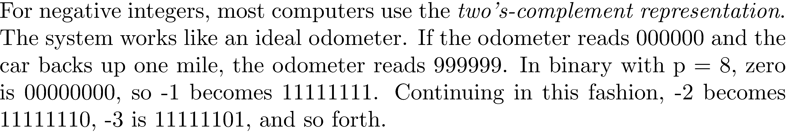
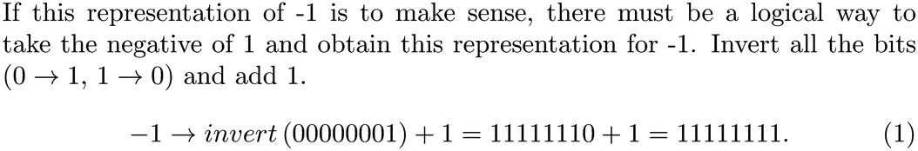
Negative Integer Representation

Slide 4
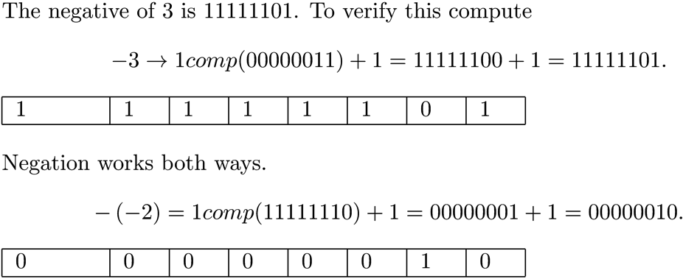
Example 1

Slide 5
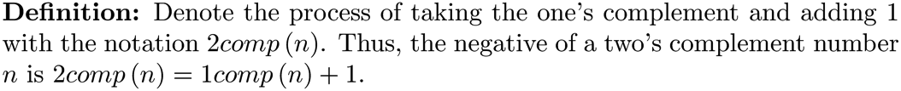
Twos Complement

Slide 6
Twos Complement and the Carry Bit
If we add 1 and -1 the result must be 0. 00000001 + 11111111 = 1 | 00000000 Discard the carry and the result is 0.
Carry

Slide 7
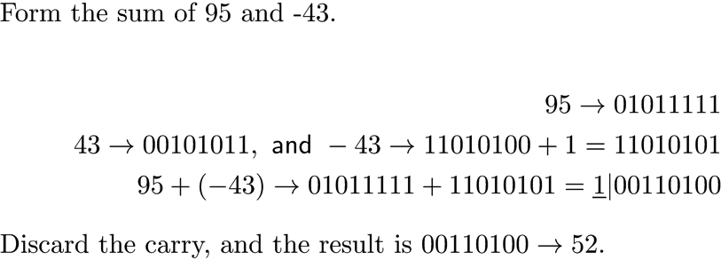
Twos Complement and the Carry Bit
Another example:

Slide 8
Example 2
Find the representation for -7 7 00000111 -7 11111000 + 1 = 11111001
Find the representation for -100 100 01100100 -100 10011011 + 1 = 10011100

Slide 9
Performing Twos Complement Addition and Subtraction
Given two p-bit integers m and n , form m + n by performing binary addition and discarding the carry.
The subtraction m-n is performed adding ( -n ) to m , so m – n = m + 2comp(n).

Slide 10
Integer Range
With p binary bits, the range is

Slide 11
Integer Overflow
There are only p bits to work with, 1/2 nonnegative and 1/ 2 negative. Overflow can occur.
0 | 1 | 1 | 0 | 1 | 0 | 0 | 1
+
0 | 0 | 0 | 1 | 1 | 1 | 1 | 0
=
1 | 0 | 0 | 0 | 0 | 1 | 1 | 1
-121
NOTE: Overflow has occurred when the sign bit is the opposite of what it should be.

Slide 12
Example 3
Assume b = 2 and p = 12.
The range of integers that can be represented is
Show that overflow occurs when computing 1870 + 675 011101001110 + = 100111110001 = - 1551 001010100011

Slide 13
Floating-Point Representation
For given integers b, p, n_{min} , and n_{max} , the floating-point numbers are real numbers of the form
with and .
b is the base. The most common bases are b=2 (binary base), b=10 (decimal base), and b=16 (hexadecimal base).
n is the exponent that defines the order of magnitude of the number to be encoded.
The integers are called the digits and p is the number of significant digits. The mantissa is the integer .

Slide 14
Floating-Point Representation
The smallest and largest floating-point numbers in magnitude are
Smaller numbers cause underflow, and larger numbers cause overflow.
Computers usually support single precision (i.e., representation with 32 bits) and double precision (i.e., representation with 64 bits). In our single-precision representation, 1 bit is used for the sign, 8 bits for the exponent, and 23 bits for the mantissa (for a total of 32 bits).

Slide 15
Floating-Point Representation
The exponent is encoded as an unsigned number by adding to it a "bias" (127 is the usual bias in single precision). Using this notation we write 81.625 as The exponent is , and 81.625 is stored as follows:
7+127 = 134 = 10000110₂
0 | 10000110 | 10100011010000000000000

Slide 16
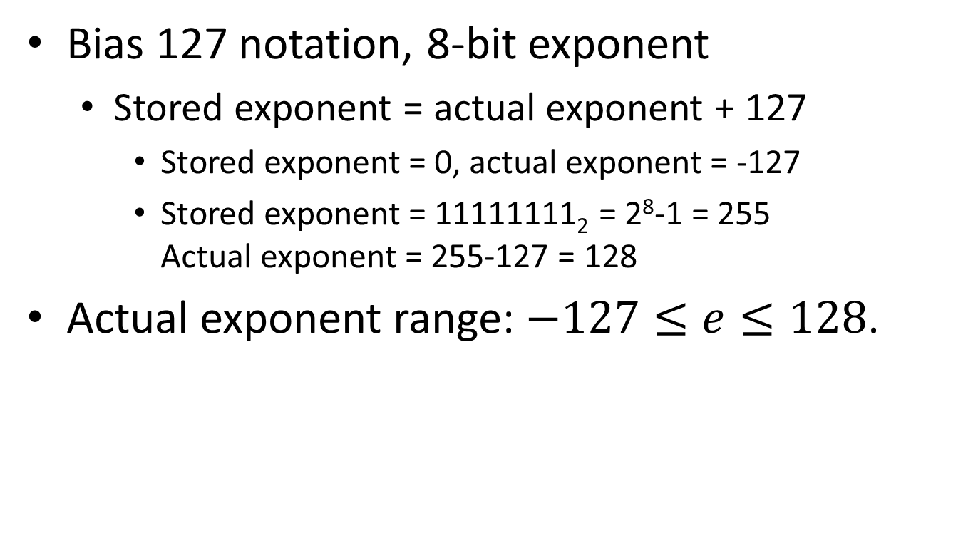
Exponent Range Accounting for the Bias
Bias 127 notation, 8-bit exponent
Stored exponent = actual exponent + 127
Stored exponent = 0, actual exponent = -127
Stored exponent = 11111111₂ = 2⁸-1 = 255 Actual exponent = 255-127 = 128
Actual exponent range: $−127≤e≤128$.

Slide 17
Example 4
Find the 32-bit single precision representation for -23.5625.
5 + 127 = 132 = 10000100₂
Floating point representation: 1|10000100|10111100100000000000000
sign
exponent
mantissa

Slide 18
Example 5
Find the floating point representation of
0.0390625
Exponent = 127+ (-4) = 123 = 1111011₂
Floating point representation: 0|01111011|10100000000000000000000
sign
exponent
mantissa

Slide 19
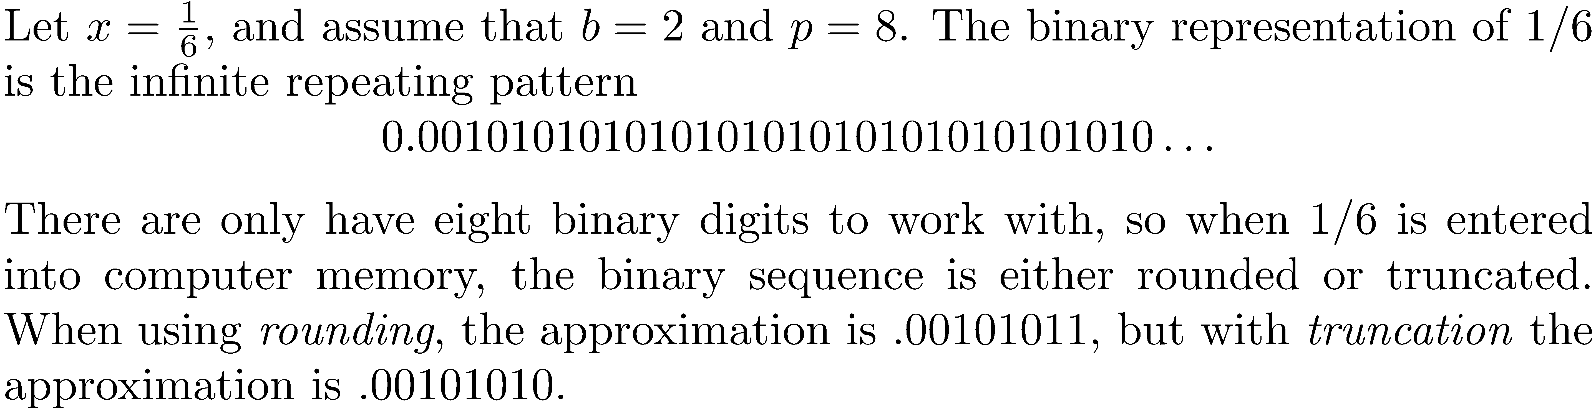
Rounding and Truncation
NOTE: Rounding is preferred.

Slide 20
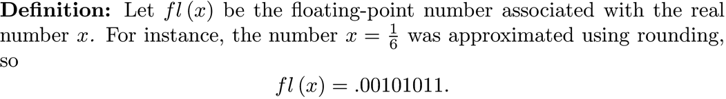
fl(x)

Slide 21
IEEE Format
The most widely used standard for floating-point computation is the IEEE Standard for Floating-Point Arithmetic.
A nonzero number is assumed to have a hidden 1 prior to the first digit of the mantissa.
Single precision uses 24 binary digits, and double precision 53.

Slide 22
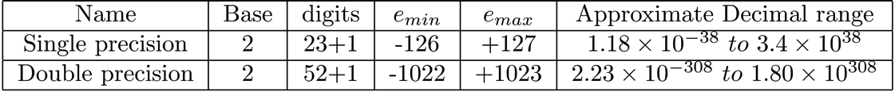
IEEE Format
The table lists the properties of single and double precision IEEE floating point.

Slide 23
Granularity of Floating Point
Floating point numbers are granular, which means there are gaps between numbers. The granularity is caused by the fact that a finite number of bits are used to represent a floating point number.
Most real numbers must be approximated because there is no exact conversion into binary.

Slide 24
Granularity of Floating Point
The distance from 1.0 to the next largest double-precision number is 2⁻⁵² in IEEE double precision, and this is called the machine precision, or eps.
If a number smaller than 2⁻⁵² is added to 1, the result will be 1.
The floating point numbers between 1.0 and 2.0 are equally spaced:

Slide 25
Granularity of Floating Point
The gap increases as the length of intervals become larger by a factor of 2. The numbers between 2.0 and 4.0 are separated by a gap of 2⁻⁵¹.
In general, an interval from 2^{k} to 2^{k+1} has a gap between values of 2^{k}(2⁻⁵²). As k increases, the gap relative to 2^{k} remains 2⁻⁵².

Slide 26
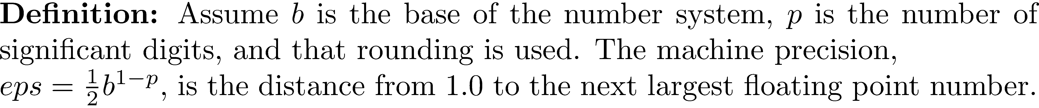
General Machine Precision
If b = 2 and p = 52, eps = (1/2)2⁻⁵¹ = 2⁻⁵².
If b = 2 and p = 23, eps = (1/2)2⁻²² = 2⁻²³.

Slide 27
Example 6
If b = 2 and p = 25, what is the machine precision?

Slide 28
IEEE Double Precision Range

Slide 29
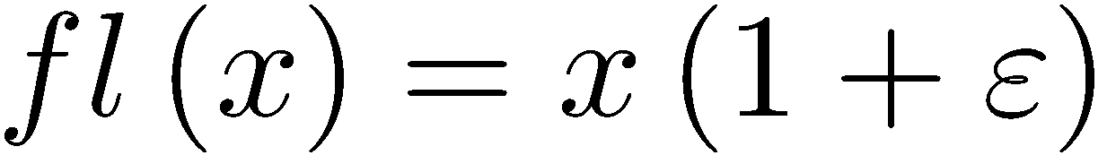
Floating-Point Accuracy
The mapping from real number to floating-point numbers is called the floating-point representation or rounding.
Let fl(x)be the floating-point number associated with the real number x. The following equality holds for all real numbers : where .

Slide 30
Floating-Point Accuracy
To analyze accuracy of floating point operations, just consider "+".
Let be the computer result of floating point addition.
Overflow
Underflow
NOTE: Similar notation applies for the other operations .

Slide 31
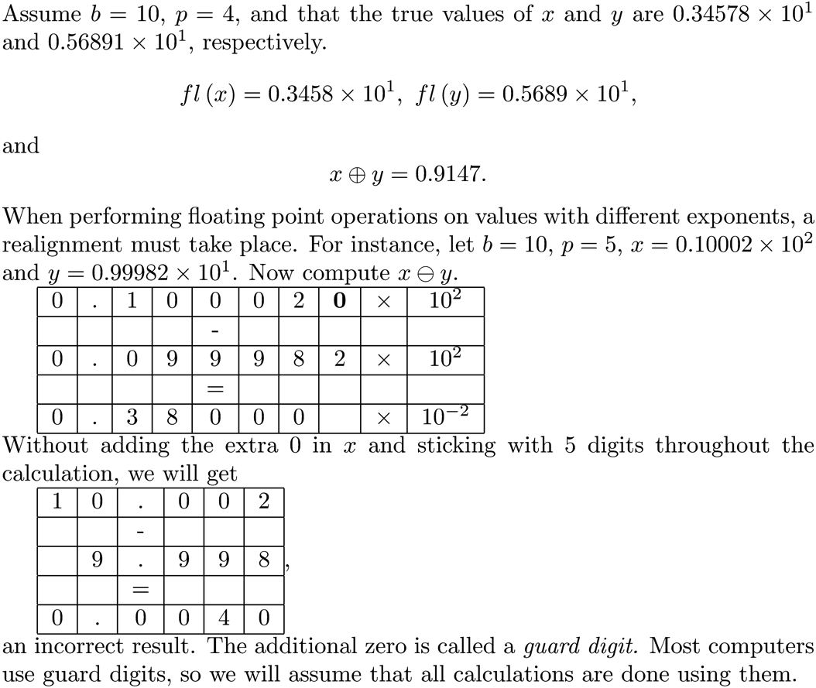
The Guard Digit

Slide 32
Ways of Measuring Error
Absolute error:
Relative error:

Slide 33
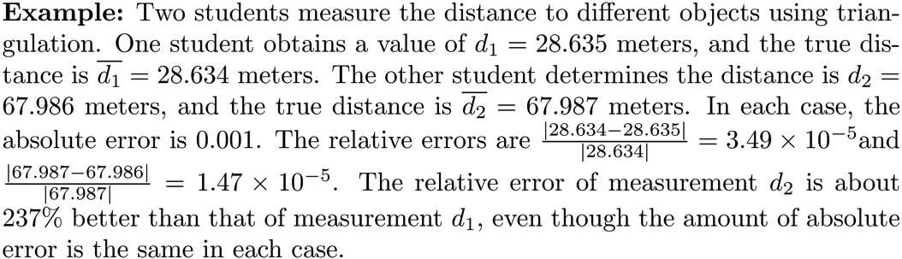
Measuring Relative Error is Best
Relative error gives an indication of how good a measurement is relative to the size of the thing being measured.

Slide 34
Measuring Relative Error is Best
This is particularly true for large or small floating point values.

Slide 35
Measuring Relative Error is Best
Relative error is generally the better measure of truncation error when summing a series. If s_{n} and s_{n+1} are the last two partial sums, estimate the relative error using where tol is the error tolerance.

Slide 36
MATLAB Example
Approximate the sum of the series
tol = 1.0e-12;
estrelerror = inf;
sn = 0.5;
i = 2;
while estrelerror >= tol
sn_plus1 = sn + 1/(i^2 + sqrt(i));
estrelerror = abs(sn_plus1 - sn)/abs(sn);
sn = sn_plus1;
i = i + 1;
end
fprintf('The approximate sum of the series is %g.\n',sn);
<Output>
The approximate sum of the series is 1.04615.

Slide 37
Rounding Error Bound for Addition
Most computer implementations of addition (including the widely used IEEE arithmetic) satisfy the property that the relative error is less than the machine precision:

Slide 38
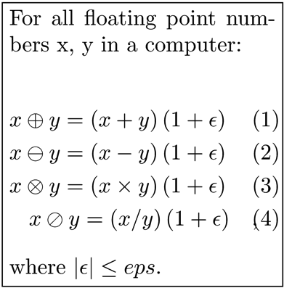
General Rounding Error
Once floating point numbers x and y are in computer memory, the basic arithmetic operations satisfy the following:

Slide 39
Performing Many Floating Point Operations
The relative error for one single operation is very small, but this is not always the case when a sequence of many operations is performed.

Slide 40

Rounding Error Bound for
When adding n floating point numbers, the result is the exact sum of the n numbers, each perturbed by a small relative error. The errors are bounded by K( n-1 )eps , where eps is the unit roundoff error and K is a constant that depends on x₁, x₂, …, x_{n}.

Slide 41
Rounding Error Bound for the Product of n Numbers
The relative error in computing the product of n floating point numbers is at most 1.06( n-1 )eps , assuming that ( n-1 )eps < 0.1 .

Slide 42

Matrix Error Bounds
For an m × n matrix M define ; that is is the matrix whose entries are the absolute value of those from M. Let A and B be two floating point matrices and c be a floating point number. Then,
If the product of A and B is defined,

Slide 43
Organizing Computations to Minimize Round Off Error
Often, carefully choosing the order in which computations are performed will improve results.

Slide 44
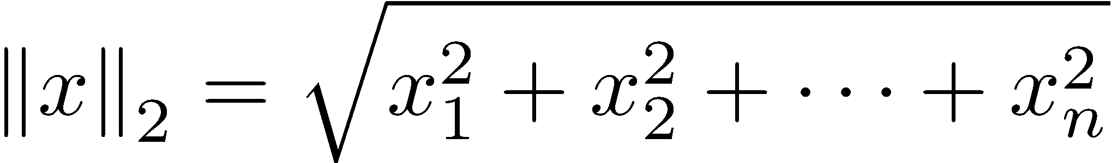
Organizing Computations to Minimize Round Off Error
Consider computing the 2-norm of a vector. If some x_{i} is too large, overflow can occur in computing the sum. There is a way to minimize errors.

Slide 45
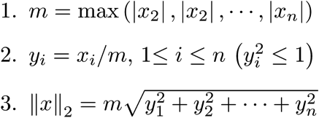
Organizing Computations to Minimize Round Off Error
To compute the 2-norm without the possibility of overflow, execute the following steps:

Slide 46

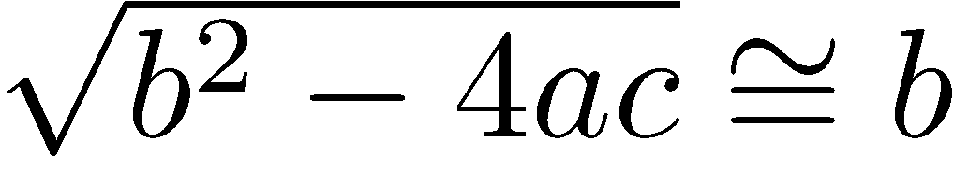
Cancellation Error
Subtracting numbers that are close can be disastrous.
Consider the quadratic formula
If the product 4ac is small, then , ,and when computing one of x₁ or x₂ we will be subtracting two nearly equal numbers. This can be a serious problem, since we know a computer maintains only a fixed number of significant digits.

Slide 47
Cancellation Error
If b > 0, cancellation error occurs when computing x₁.
If b < 0, cancellation error occurs when computing x₂.

Slide 48
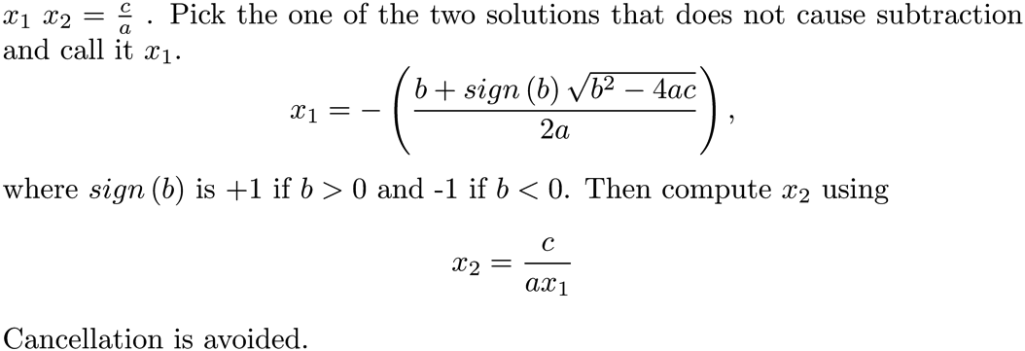
Cancellation Error
Fix for the quadratic equation cancellation error problem.

