Slide 1
Introduction
To this point, our presentation of algorithms was done informally and supported by examples.
Now we are beginning a rigorous presentation of algorithms in numerical linear algebra, and we need a more precise mechanism for describing how they work.
A formal presentation will aid in understanding an algorithm and in implementing it in a programming language.

Slide 2
Programming Languages used in Numerical Linear Algebra
FORTRAN is a programming language that was developed in the 1950's and that is especially suited to numeric computation and scientific computing. It has been in continuous use ever since. It generates machine code for many machine architectures.
It is one of the most popular languages in the area of high-performance computing.
The primary computational suite for computational linear algebra is LAPACK, and it is written in FORTRAN.

Slide 3
Programming Languages used in Numerical Linear Algebra
The C programming language was developed in the early 1970s as a "low-level high-level" language. It allowed the replacement of assembly language in many instances. It generates machine code for many machine architectures.
C is one of the most widely used programming languages of all time.
The C++ programming language extends C to allow object-oriented and generic programming.

Slide 4
Programming Languages used in Numerical Linear Algebra
MATLAB is a general purpose system for numerical computation. It can be used by issuing commands or by using the powerful MATLAB programming language.
The design of the MATLAB programming language was influenced by C and C++.
A program is interpreted rather than compiled into machine code.

Slide 5
Algorithm
Before a program can be solved by using a programming language, an algorithm must be developed.

Slide 6
Pseudocode
It is important to have a means of describing an algorithm without having to code it in a particular programming language. For this purpose, we will use pseudocode.
It allows the algorithm designer to focus on the logic of the algorithm without being distracted by details of programming language syntax, such as variable declarations, the correct placement of semicolons and braces, and so forth.

Slide 7
Pseudocode
The pseudocode used will be similar to but simpler and less formal than the MATLAB programming language.

Slide 8
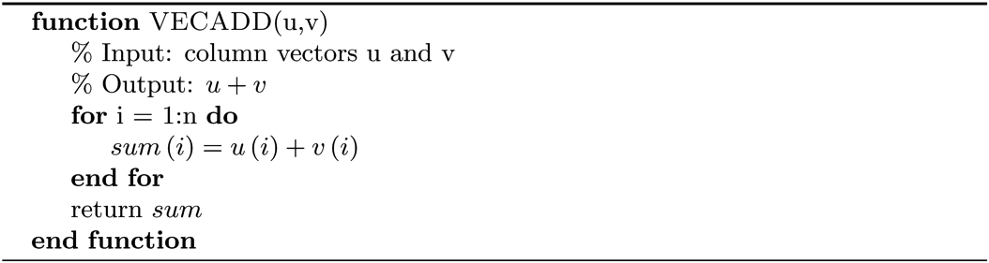
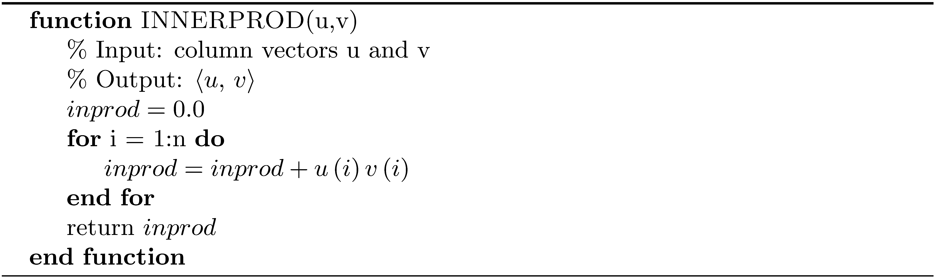
Pseudocode Examples

Slide 9
Computing the Frobenius Norm of a Matrix
The algorithm for the computation of the inner product involved a single loop. The Frobenius norm requires that we cycle through all matrix entries, add their squares, and then take the square root. This involves an outer loop to traverse the rows and an inner loop that forms the sum of the squares of the entries of a row.

Slide 10
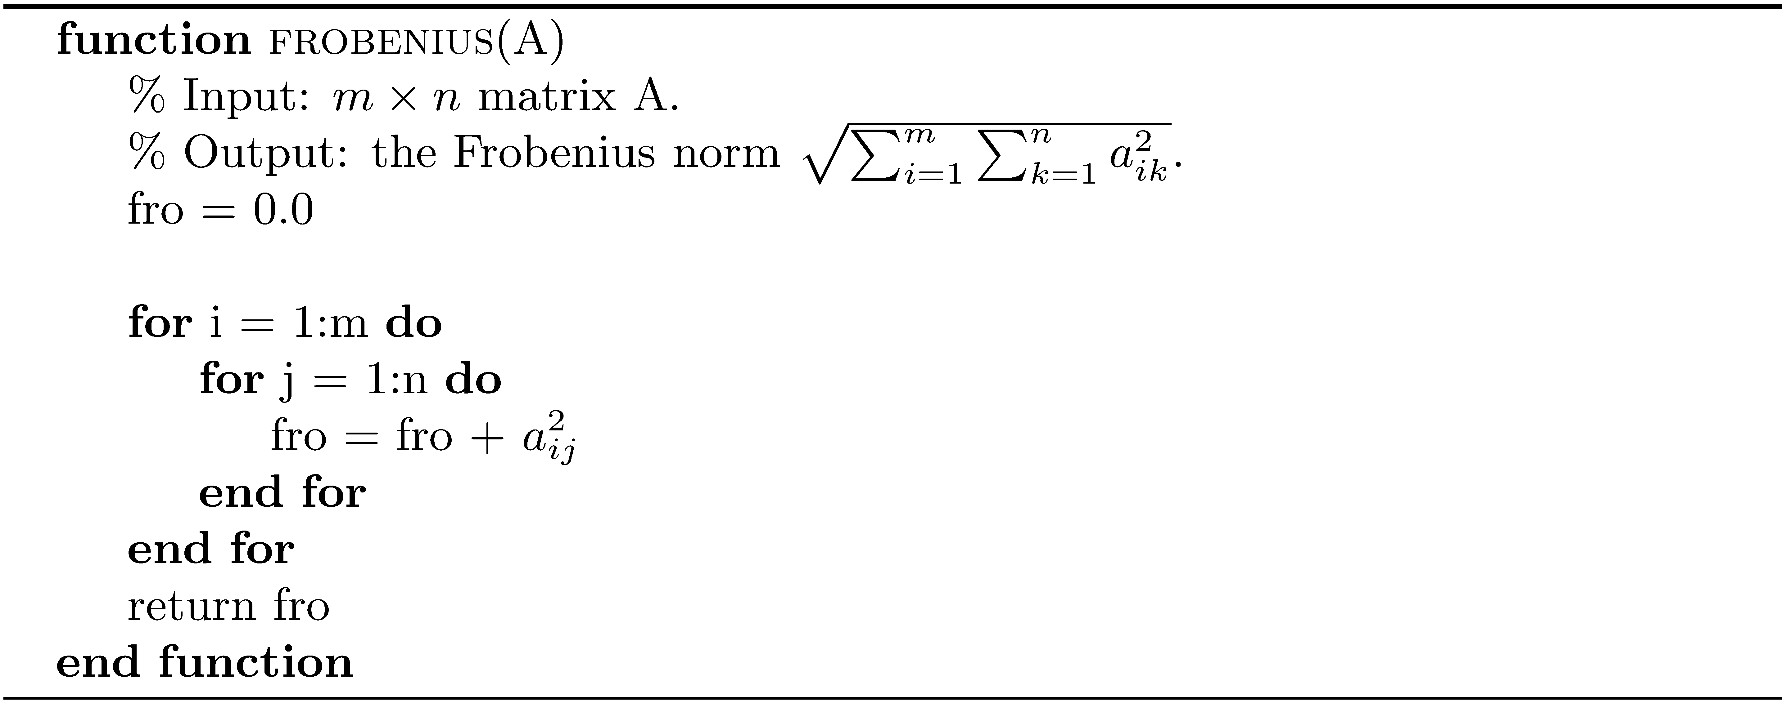
Computing the Frobenius Norm of a Matrix

Slide 11

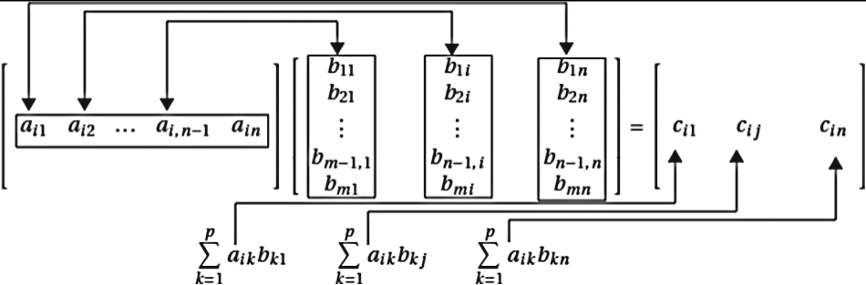
Matrix Multiplication
If A is an m × p matrix and B is a p × n matrix, the product is an m × n matrix C whose elements are
This is essentially the inner product of row i of A and row j of B.
For each row 1, 2, …, m of A, form the sum of p products for each column 1, 2, …, n of B. Requires a triply nested loop.

Slide 12
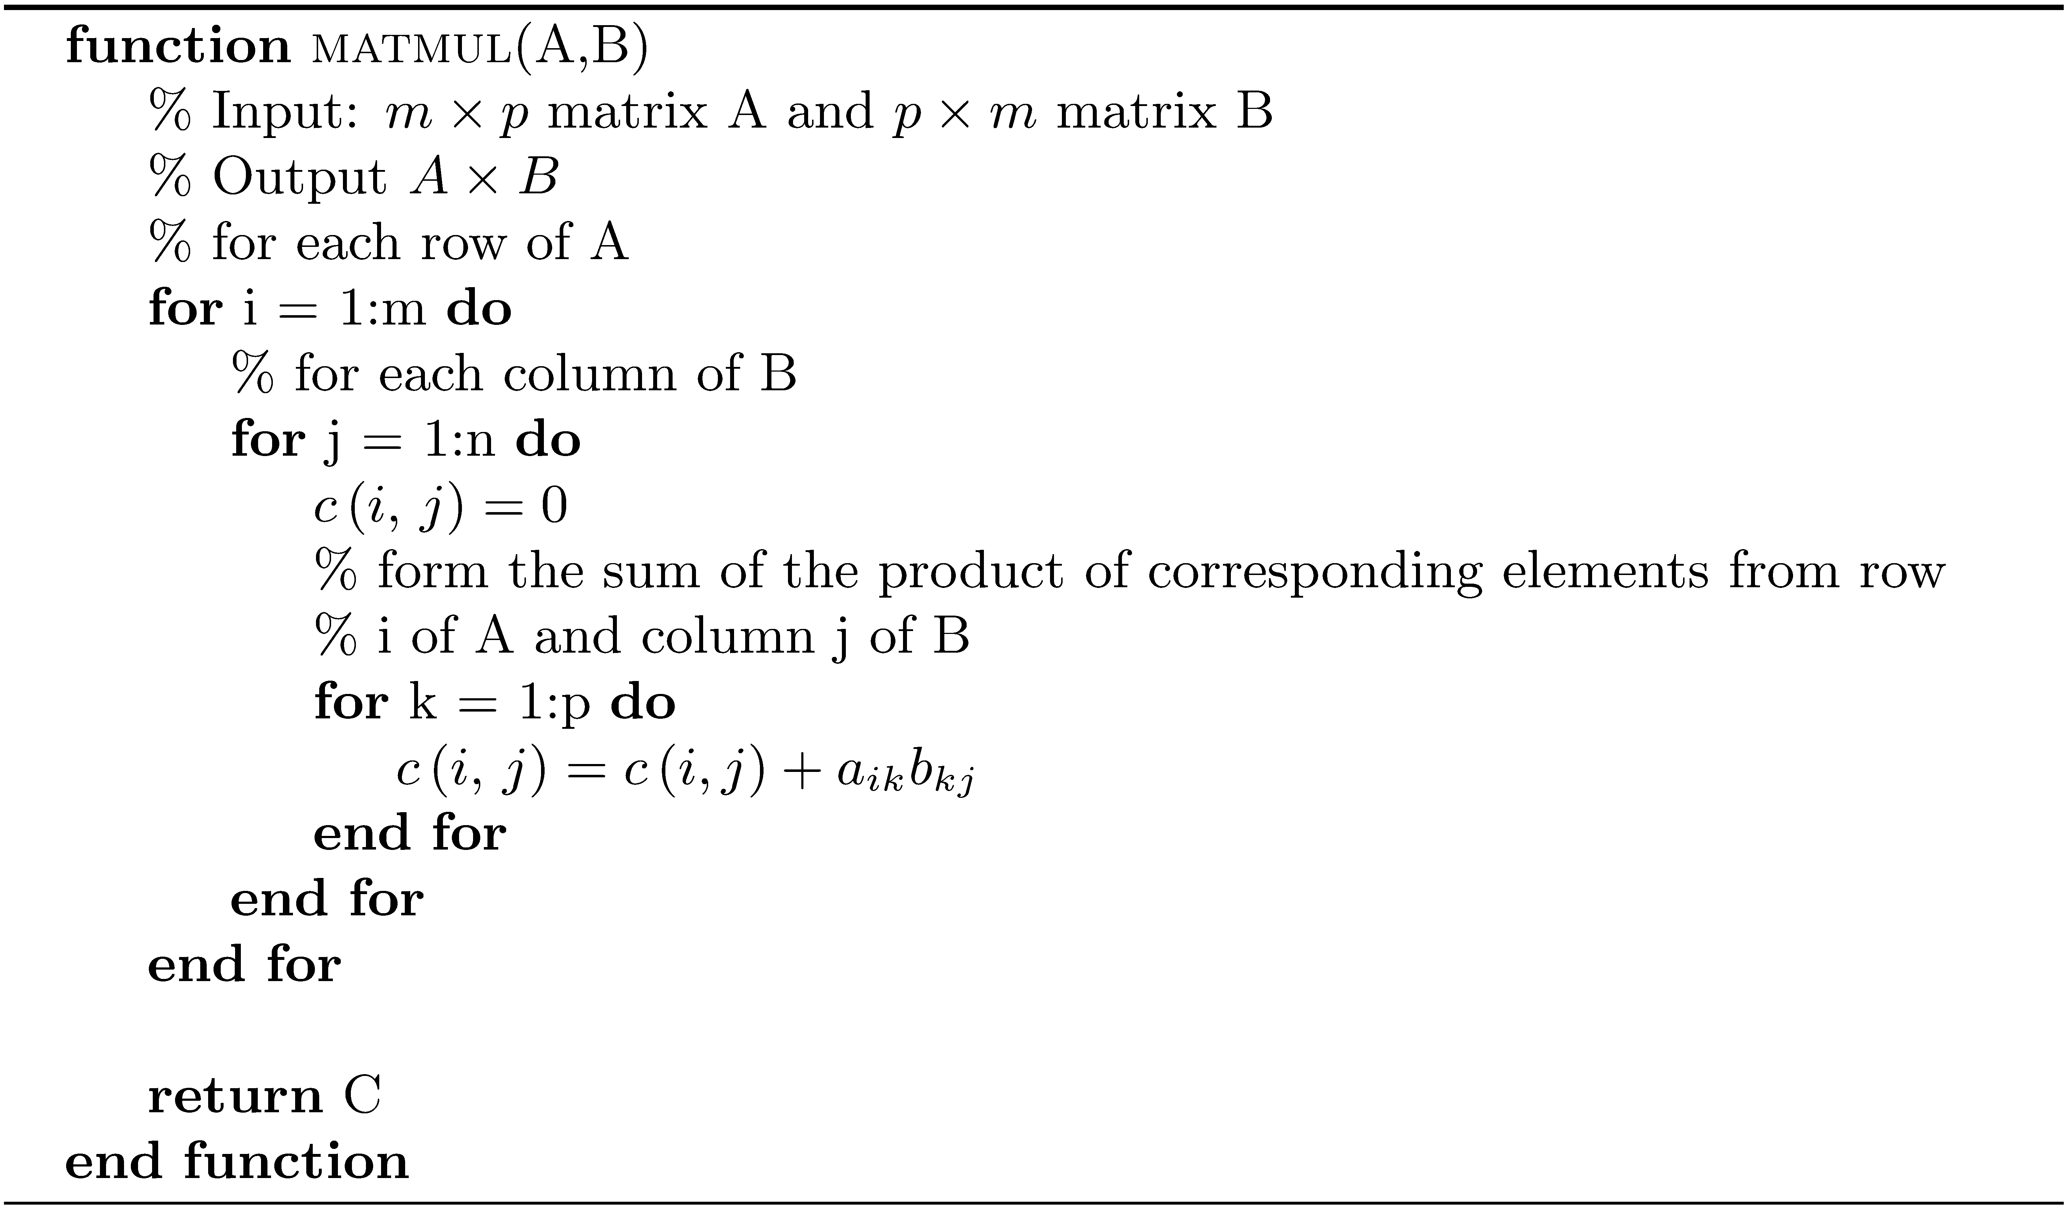
Matrix Multiplication

Slide 13
Algorithm Complexity
Some computations take longer than others.
If A and B are n x n matrices and x is an n x 1 vector, A*B takes longer than A*x.
When there are two or more algorithms that solve the same problem, how do we choose the best one for our purposes?
Develop a way of measuring the computational effort required.

Slide 14
Algorithm Complexity
There are many factors that come into play:
The number of floating-point arithmetic operations required
The amount of memory needed
The overhead of array subscripting
The maintenance of control variables in for loops
Floating-point operations are slow compared to many other operations, so counting them exactly or approximately is one thing that helps us compare algorithms.

Slide 15
Flop Count
Big-O notation.
Given an expression for the number of flops, we say the algorithm is O(n^{k}) if the dominant term in the flop count expression is Cn^{k}, where C is a constant. We are saying that for large n , the terms involving n^{i} for i < k are negligible in comparison to n^{k} .

Slide 16
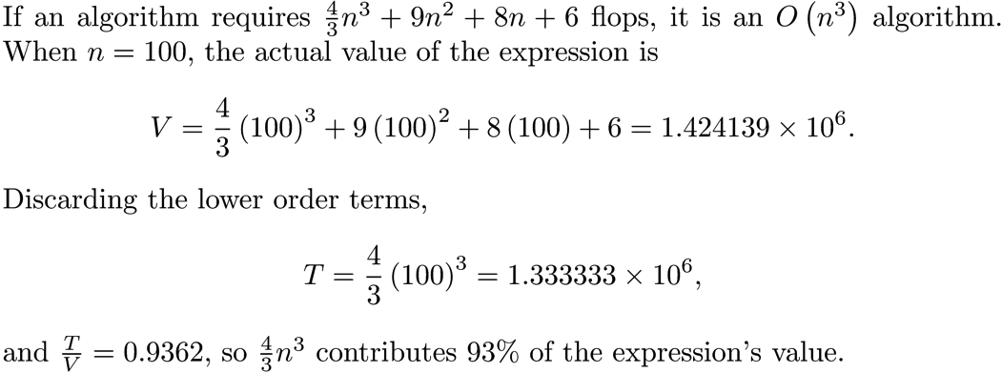
Flop Count Example

Slide 17
More Flop Count Examples
Given two n × 1 vectors u and v , the inner product requires n multiplications and n-1 additions, a total of n+( n-1 )=2n-1 flops. Computing the inner product is an O(n) or a linear algorithm.
Computing the Frobenius norm requires one flop for each square , and there are mn squares to compute, for a total of mn flops. The addition of the squares requires mn-1 flops, so the flop count for the algorithm is 2mn-1 , and computing the Frobenius norm is an O(mn) algorithm. If the matrix A is square, the flop count is O(n²) . We call this a quadratic algorithm.

Slide 18
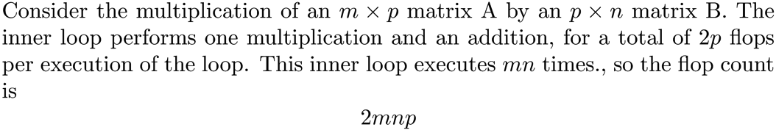
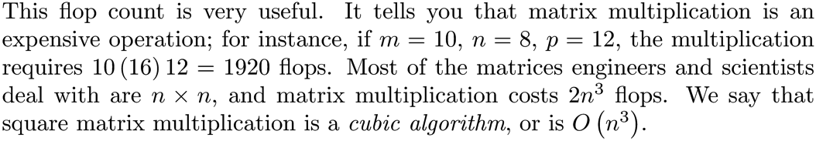
Matrix Multiplication

Slide 19
Smaller Flop Count Is Not Always Better
An algorithm with a larger flop count may be more accurate.
An algorithm with a larger flop count may be more readily parallelized.
An algorithm with a smaller flop count may require much more memory.

Slide 20
Truncation Error
When approximating a value using a finite sum of terms from a series, truncation error occurs.
Example
For |x| < 1,
Using the first three terms, the truncation error is

Slide 21
Special Matrices
For the sake of speed and efficiency, one must take advantage of special matrix structure. For example, matrices that are
Symmetric
Tridiagonal
Upper or lower triangular
Sparse

Slide 22
updmul
The following MATLAB function updmul computes the product of two upper triangular matrices.
function P = updmul(A,B)
% UPDMUL Multiply upper triangular matrices A and B.
[n m ] = size(A);
P = zeros(n, n);
for i = 1:n
for j = i:n
sum = 0.0;
for k = i:j
sum = sum + A(i,k)*B(k,j);
end
P(i,j) = sum;
end
end

Slide 23
updmul Flop Count
The flop count for updmul is and the flop count for the product of two general square matrices is 2n³.
For n = 500
updmul flop count = 41917000
matmul flop count = 250000000
Ratio updmul/matmul = 0.167668 ≅ 17% the number of flops

Slide 24
updmul MATLAB Example
matmul.m is a MATLAB function that computes the product of two matrices. Generate two random 500 × 500 upper triangular matrices and time the product using matmul and updmul.
A = rand(500,500);
A = triu(A);
B = rand(500,500);
B = triu(B);
tic;C1 = updmul(A,B);
updmul_time = toc;
tic;C2 = matmul(A,B);
matmul_time = toc;
fprintf('matmul time = %f, updmul_time = %f, ratio updmul/matmul = %f\n',...
matmul_time, updmul_time, updmul_time/matmul_time);
fprintf('norm(C1-C2) = %g\n',norm(C1-C2));
<Run>
matmul time = 0.954984, updmul_time = 0.384528, ratio updmul/matmul = 0.402654
norm(C1-C2) = 0

Slide 25
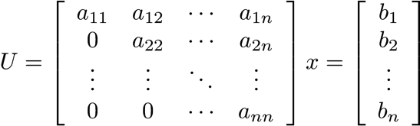

Solution to an Upper Triangular System
Recall that back substitution is the last phase of Gaussian elimination.

Slide 26
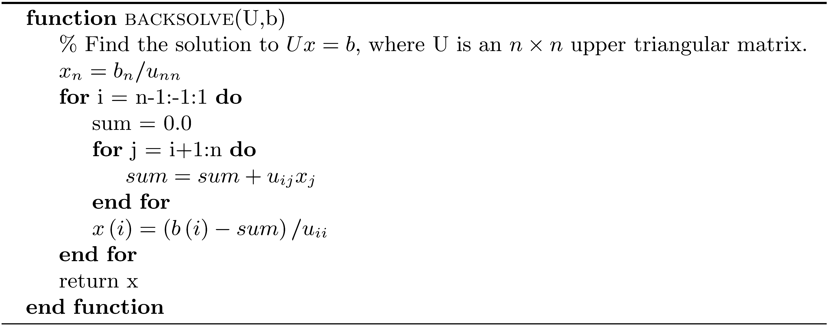
Solution to an Upper Triangular System
Requires n² + n + 1 flops (O(n²) quadratic) .

Slide 27
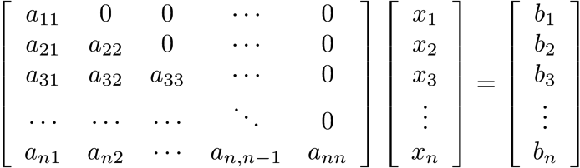
Solution to a Lower Triangular System
Requires n² + n + 1 flops (O(n²) quadratic) .

Slide 28
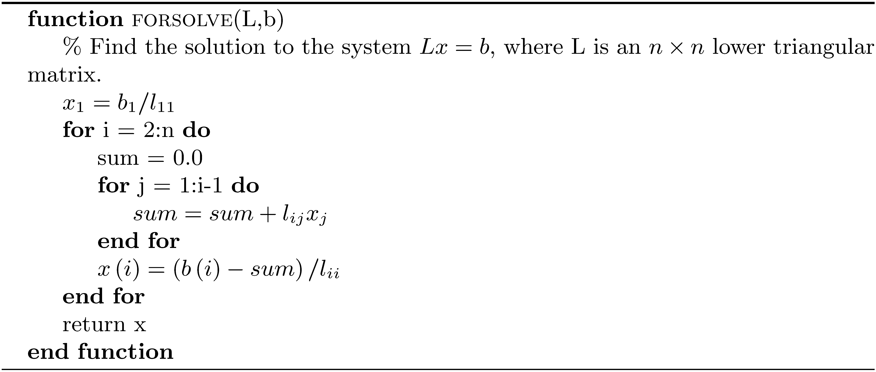
Solution to a Lower Triangular System

Slide 29
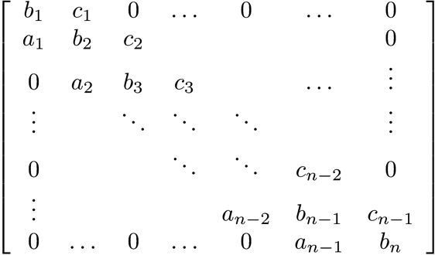
The Thomas Algorithm
A tridiagonal matrix is square, and the only nonzero elements are those on the main diagonal, the first subdiagonal, and the first superdiagonal.
Diagonal
First superdiagonal
First subdiagonal

Slide 30
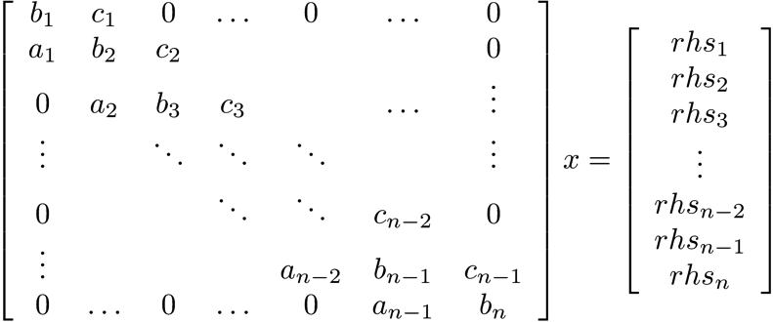
The Thomas Algorithm
Solve a tridiagonal linear system. These occur often in applications such as the numerical solution of ordinary and partial differential equations and cubic spline interpolation.

Slide 31
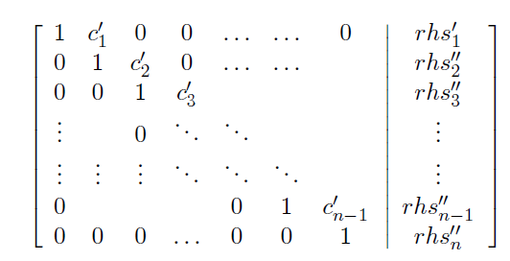
The Thomas Algorithm
Modified form of Gaussian elimination.
Work your way down the diagonal. First divide the current row by the pivot to obtain a 1 on the diagonal, and use it to eliminate the subdiagonal element. Use only the nonzero entries. The process ends with an upper bidiagonal matrix having 1’s on the diagonal. Then do back substitution.

Slide 32
NOTE
It is not efficient to store all the zeros in a sparse matrix. In the case of the Thomas algorithm, pass only the diagonals to the function.

Slide 33
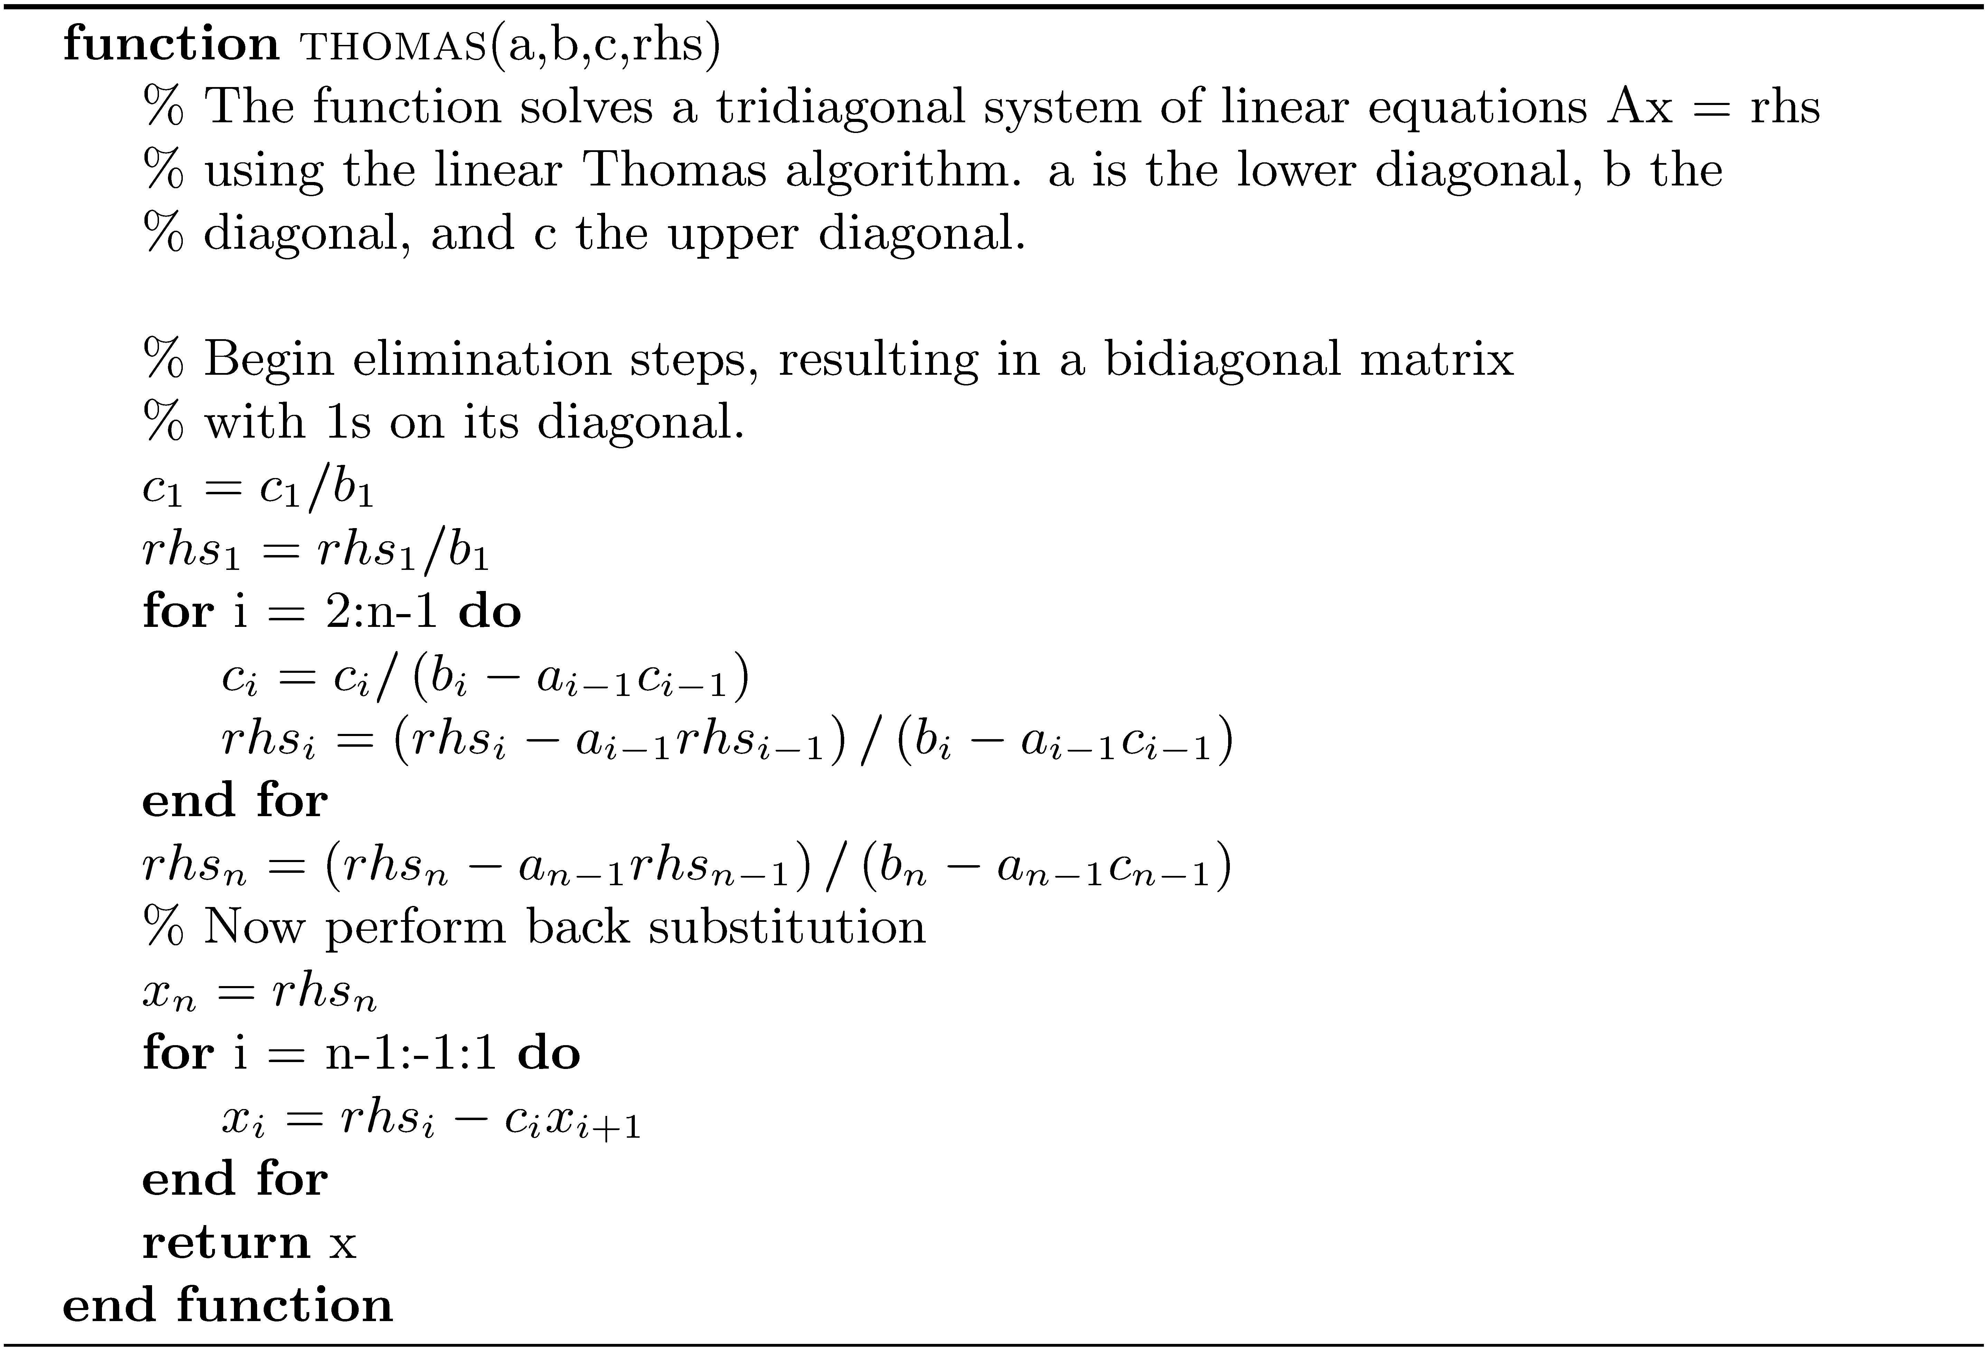
The Thomas Algorithm

Slide 34
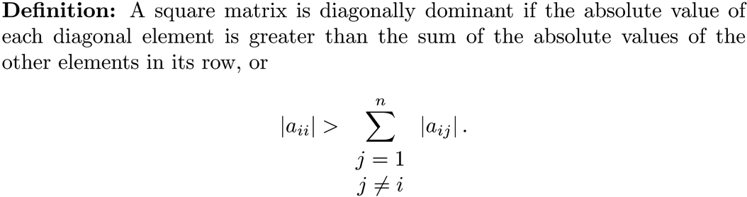
Possible Failure of the Thomas Algorithm
The algorithm fails if a diagonal element is zero.
If A is a diagonally dominant tridiagonal matrix with diagonals a, b, and c, the Thomas algorithm never encounters a division by zero.

Slide 35
Efficiency Analysis for the Thomas Algorithm
Flop count
Linear efficiency (O(n)). Gaussian elimination for a general matrix requires approximately flops.

Slide 36
MATLAB Example
a = randn(4999,1);
b =randn(5000,1);
c = randn(4999,1);
rhs = randn(5000,1);
tic;x1 = thomas(a,b,c,rhs);toc;
T = trid(a,b,c);
tic;x2 = T\rhs;toc;
% check the accuracy of x1 and x2
fprintf('norm(T*x1-rhs) = %g\n',norm(T*x1-rhs));
fprintf('norm(T*x2-rhs) = %g\n',norm(T*x2-rhs));
<Run>
Elapsed time is 0.000471 seconds.
Elapsed time is 0.304455 seconds.
norm(T*x1-rhs) = 2.31973e-12
norm(T*x2-rhs) = 3.15514e-12

