Slide 1
Why Do We Need Numerical Linear Algebra?
Can we always use theoretical results for computation? The answer is "no", for a number of reasons. Here are some.
Solving a linear algebraic system using Cramer's Rule.
A 50 x 50 matrix involves computing 51 determinants of 50 x 50 matrices. If we use expansion by minors for each determinant, it will take approximately 51(50!) = 1551118753287382280224243016469303211063259720016986112000000000000 ≅ 0.15511x 10⁶⁷ multiplications to solve the system. Even on a super computer, this computation would take millions of years.

Slide 2
Why Do We Need Numerical Linear Algebra?
Computing the solution to a linear system Ax = b by first finding A⁻¹ and then computing x = A⁻¹b.
This is not practical, since computing A⁻¹ takes about two-and-a-half times as many operations as using Gaussian elimination; furthermore, some inverses are very hard to compute accurately.

Slide 3
Why Do We Need Numerical Linear Algebra?
Computing the eigenvalues of a matrix by finding the roots of its characteristic polynomial.
The computation of the characteristic polynomial can introduce round-off errors, and those errors are compounded by possible error in the root finding process. It is known that the roots of certain polynomials change significantly if its coefficients are perturbed only slightly. If such a polynomial is the characteristic polynomial for a matrix, the results can be disastrous.

Slide 4
Why Do We Need Numerical Linear Algebra?
Finding the singular values of a matrix A by computing the eigenvalues of A^{T}A.
The singular values of A are the square roots of the eigenvalues of A^{T}A . Direct computation of the singular values is not a good idea. Errors introduced by matrix multiplication, followed by errors in computing the eigenvalues may be serious.

Slide 5
Computation Error
Our aim is to define criteria that help us decide what algorithm to use for a particular problem, or when the data may cause computational problems.
Consider the problem to be solved by an algorithm as a function f mapping the input data x to the solution y=f(x) . However, due to inaccuracies during floating point computation, the computed result is .

Slide 6
Forward Error
The forward error is a natural quantity to measure but, in general, we do not know the true value f(x) so we can only get an upper bound on this error.

Slide 7
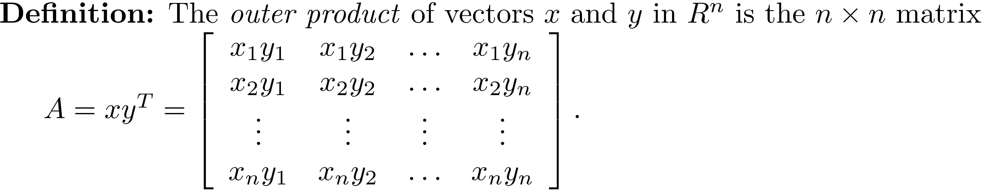
Forward Error of the Outer Product
The forward error is bounded by

Slide 8
Forward Error of the Inner Product
If x and y are n × 1 vectors and n × eps ≤ .01 , then

Slide 9
Backward Error
In Chapter 8, it was shown that the addition of n floating point numbers x₁, x₂, …, x_{n} satisfies the relation where the η_{i} are small.
This says that the result is the exact sum of the data perturbed by small errors, η_{i} . In other words, the result shows how errors in the data affect errors in the result.

Slide 10
Backward Error

Slide 11
Backward Error Example
Use the first three terms of the McLaurin series for tan⁻¹x to approximate tan⁻¹(0.20). Evaluate at x = 0.20 to approximate tan⁻¹(0.20). Forward error = 1.000000 × 10⁻⁷ Backward error:

Slide 12
Backward Error Result for the Computation of the Inner Product
The computed inner product is the exact inner product for a perturbed set of data Alternatively, we could perturb the x_{i} and leave the y_{i} fixed.

Slide 13
Algorithm Stability
It is possible that an algorithm is unstable. This means that it is sensitive to errors in its input or errors during its execution. A classic example of such an algorithm is solving the quadratic equation . When ac is small compared to b² one root suffers from cancellation error.

Slide 14
Algorithm Stability
One algorithm that solves a problem may be stable and another algorithm unstable.
Chapter 8 presented two algorithms for solving the quadratic equation, one stable and the other unstable.
Gaussian elimination with pivoting (Chapter 11) is stable except for types of coefficient matrices that have little probability of occurring in practice.

Slide 15
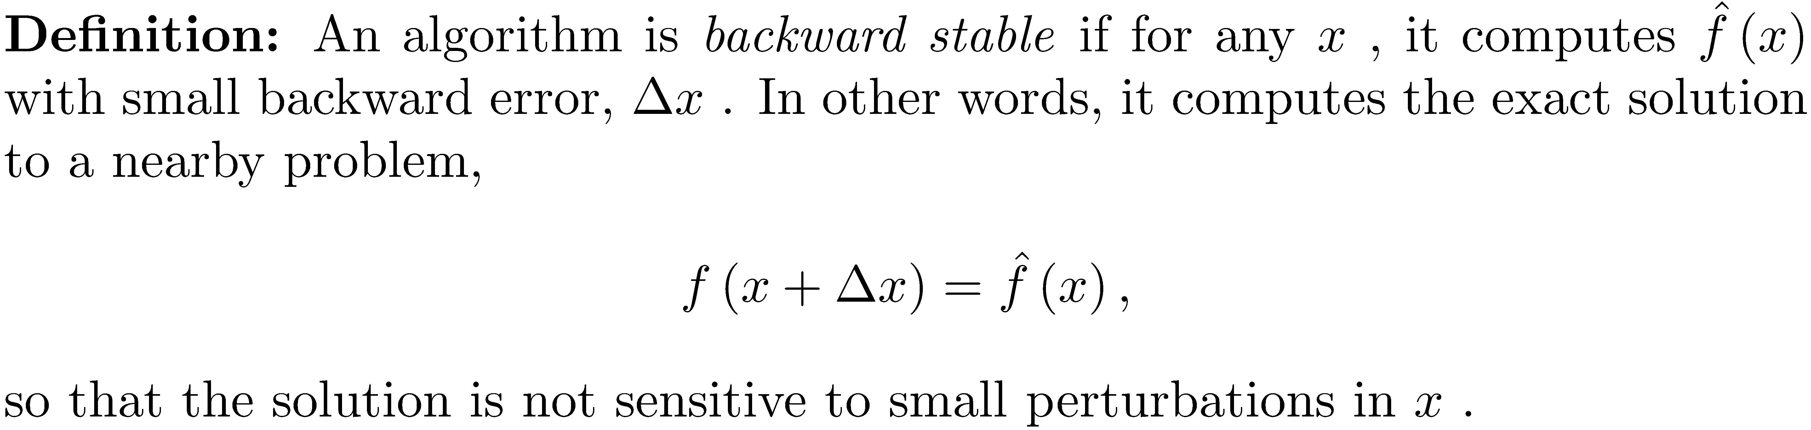
Backward Stable Algorithm
Forward and back substitution are backward stable.

Slide 16
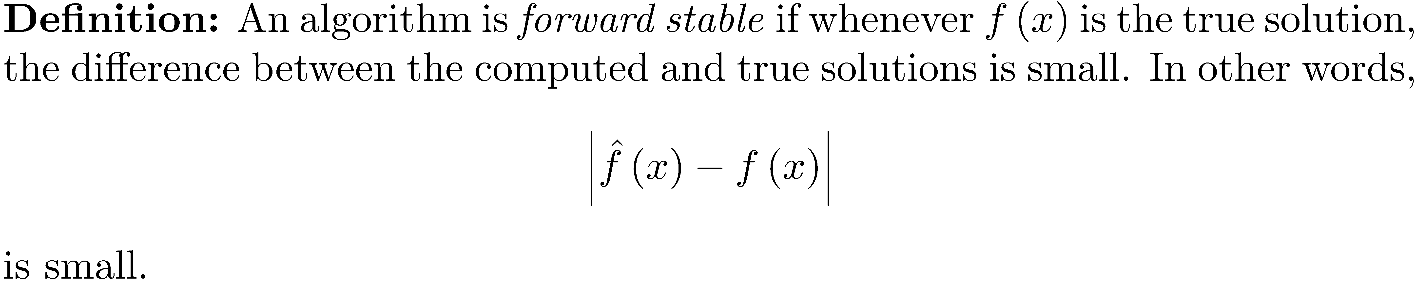
Forward Stable Algorithm
The computation of the inner and outer product is forward stable.

Slide 17
Backward Error Analysis is Generally Preferred
Floating-point arithmetic does not follow the laws of real arithmetic. This can make forward error analysis difficult.
In backward error analysis, real arithmetic is employed, since it is assumed that the computed result is the exact solution to a nearby problem.
This is one reason why backward error analysis is often preferred, so we will refer to stability to mean backward stability.

Slide 18
Examples of Unstable Algorithms
Computing the outer product is forward stable but not backward stable.
We commented that one should not compute eigenvalues by finding the roots of the characteristic equation.

Slide 19
Examples of Unstable Algorithms
When a polynomial has a multiple root or roots close together, computing the roots can be unstable.
Example: Let with characteristic polynomial Suppose roundoff error causes the coefficient of λ² to become 5.99999. The roots are now
2.016901481104199 + 0.029955270323774i
2.016901481104199 - 0.029955270323774i
1.966187037791599

Slide 20
The Wilkinson Polynomial
Let whose roots are 1, 2, …, 20.

Slide 21
The Wilkinson Polynomial
Perturb the coefficient of x¹⁹ by -2⁻²³. The roots at x = 16 and x = 17 become approximately 16.73 ± 2.81i.
Round-off errors when computing the coefficients of the characteristic polynomial may cause large errors in the determination of the roots.

Slide 22
Conditioning of a Problem
Even when using a stable algorithm to solve a problem, the problem may be sensitive to small perturbations in the data. The perturbations can come from roundoff error, small measurement errors when collecting experimental data, noise that is not filtered out of a signal, or truncation error when approximating the sum of an infinite series. If a problem falls in this category, we say it is ill-conditioned.

Slide 23
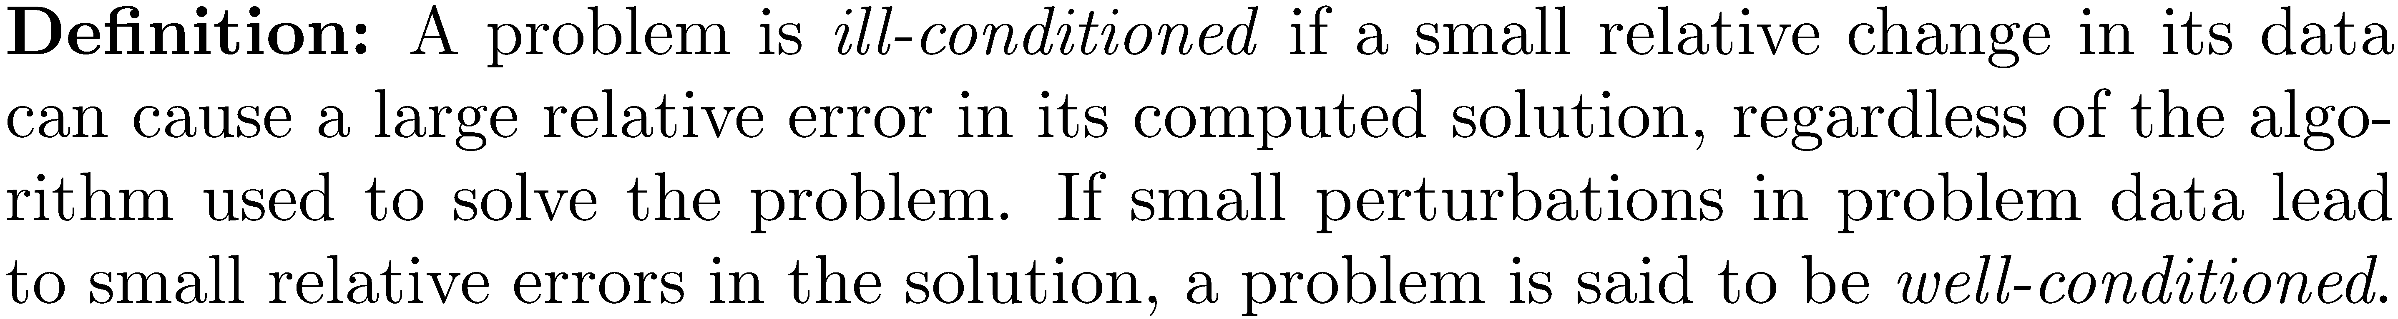
Conditioning of a Problem

Slide 24
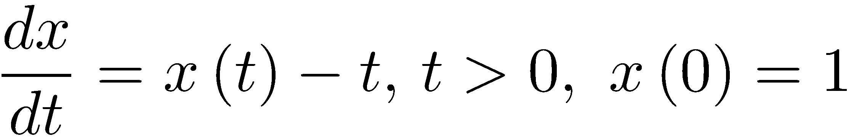
Conditioning of a Problem
The Cauchy problem has solution .
The Cauchy problem has solution Let ε = 10⁻¹⁰. A very small change in the initial condition creates a very different solution for x>20 .

Slide 25
Conditioning of a Problem

Slide 26
Distinction between Stability and Conditioning
Stable or unstable refers to an algorithm.
Well or ill-conditioned refers to the particular problem, not the algorithm used.

Slide 27
Conditioning of a Linear System
The concept of conditioning is very important for the problem of solving a linear system Ax = b.
There are three cases to consider:
The right-hand side is perturbed so the problem to solve is .
The matrix is perturbed so the problem to solve is .
Both the matrix and the right-hand side are perturbed, and the problem is .

Slide 28
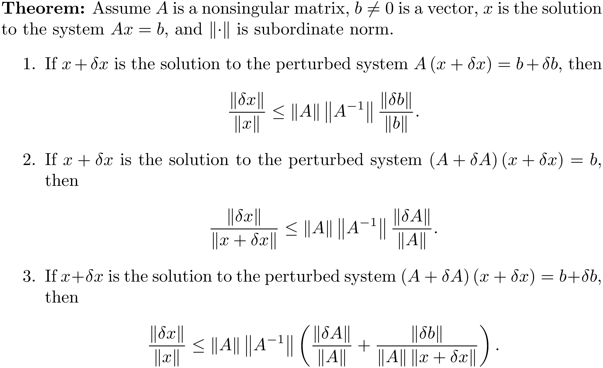
Pertubation Theorem for the Solution of a Linear System

Slide 29
Pertubation Theorem for the Solution of a Linear System
Note that the number appears in each each case of the theorem.
A relative change in the solution is bounded above by the product of and another factor that will be small if and are small.
If is small, the relative change in the solution will be small.
if is large, then even small changes in A or b might drastically change the solution.

Slide 30
Condition Number Notation
refer to the condition number of A using the infinity-, 1-, and Frobenius norms.
refers to the condition number of A using the 2-norm.

Slide 31
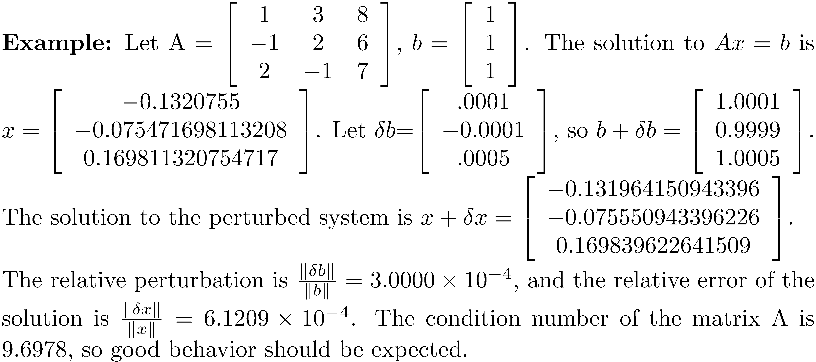
Example 1

Slide 32
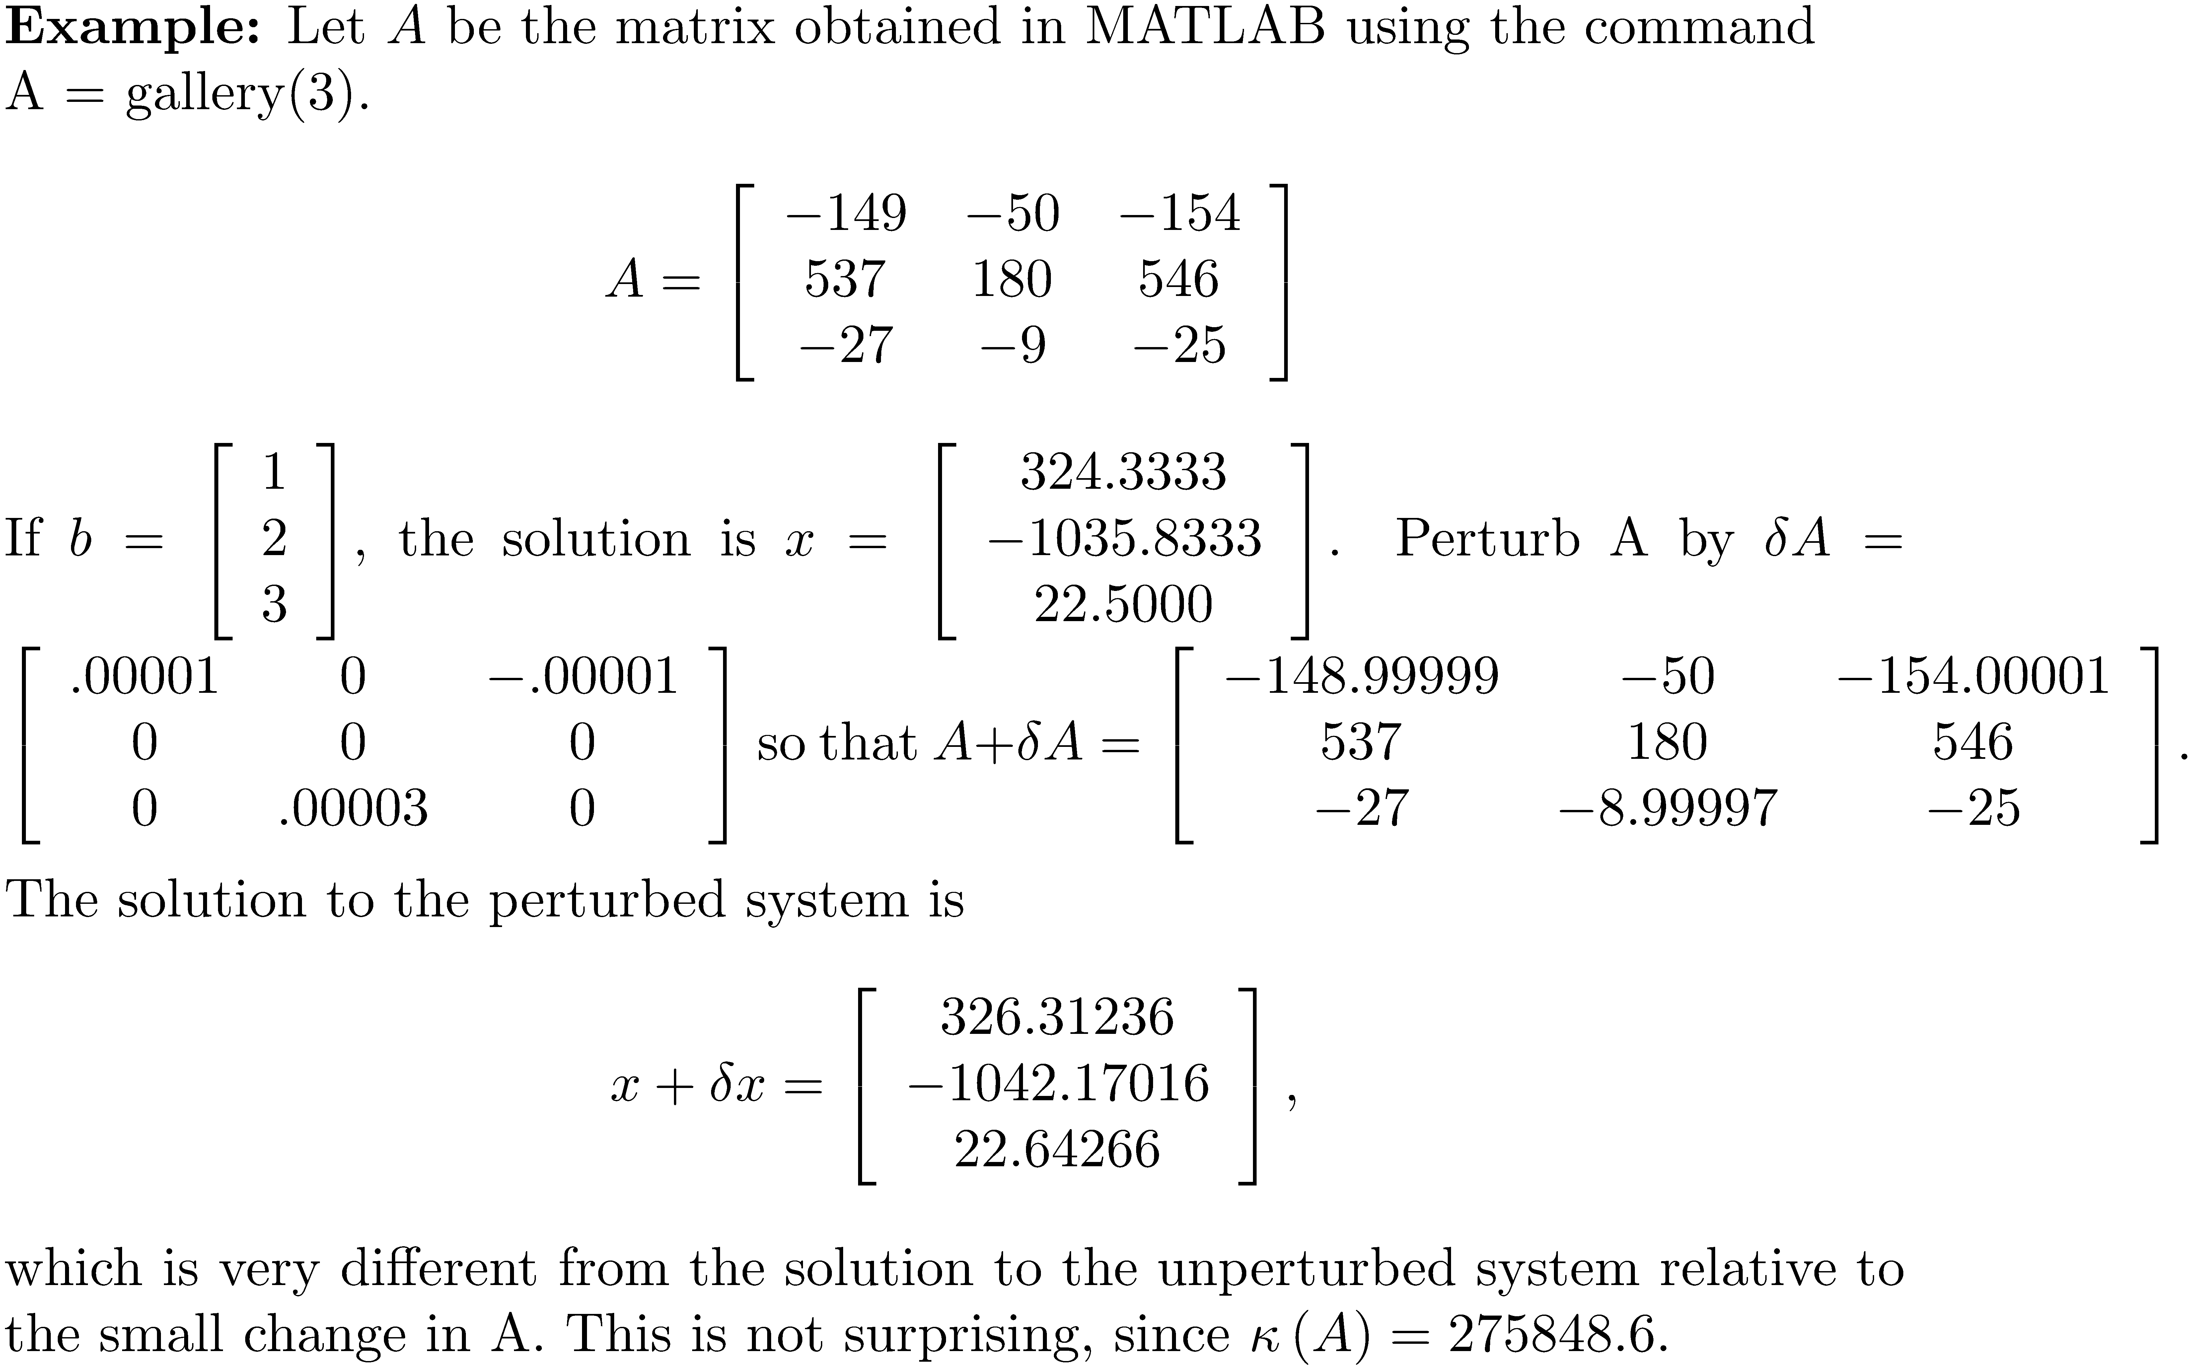
Example 2

Slide 33
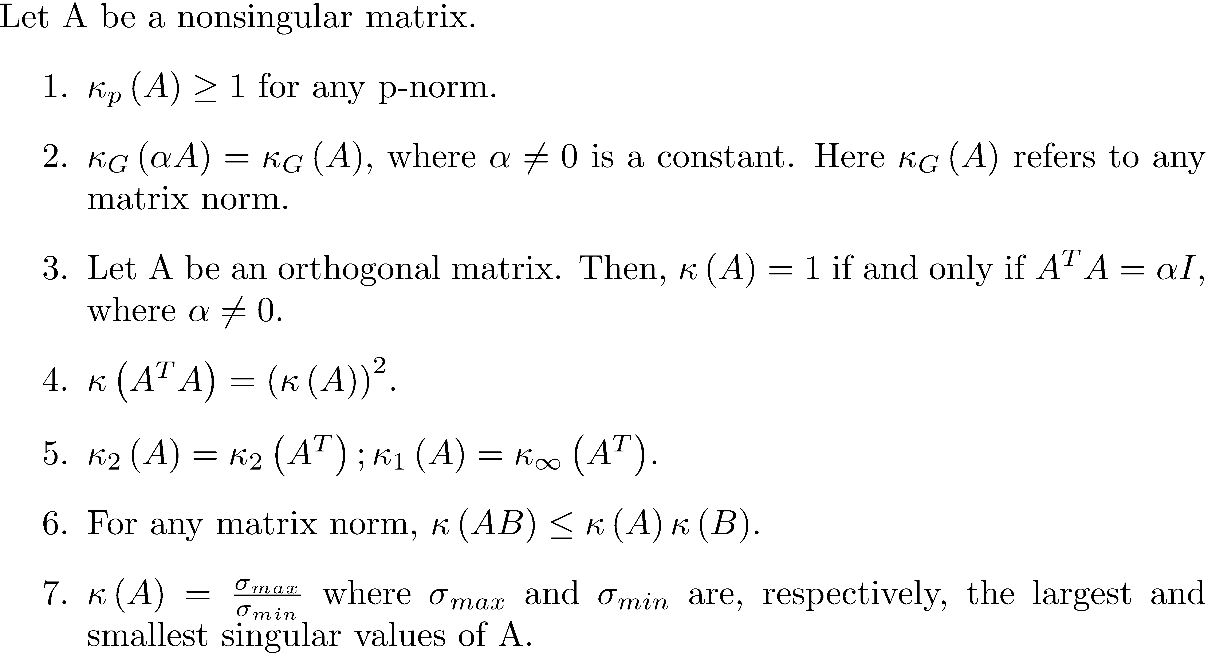
Properties of Matrix Condition Numbers

Slide 34
Condition Number of an Orthogonal Matrix
If P is an orthogonal matrix, then
Proof: By part (7) of the previous theorem, since the singular values of P are the square roots of the eigenvalues of P^{T}P = I.

Slide 35
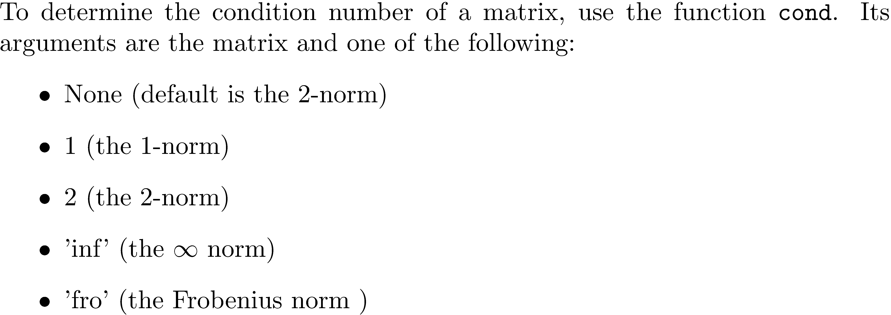
MATLAB Computation of a Matrix Condition Number

Slide 36
MATLAB Computation of a Matrix Condition Number
A =
-1 4 5 7
-3 4 1 0
12 -10 5 3
1 -4 2 9
>> cond(A)
ans =
37.457357527767179
>> cond(A,inf)
ans =
58.850574712643684
>> cond(A,1)
ans =
78.011494252873575
>> cond(A,'fro')
ans =
46.064705759921438

Slide 37
Estimating the Condition Number
Use the MATLAB function condest.
>> H = hilb(35); % the Hilbert matrices are notoriously ill-conditioned
>> condest(H)
ans =
7.181296008864331e+18
>> cond(H)
ans =
2.735715209742145e+18

Slide 38
Perturbation Analysis of Eigenvalue Problems
Consider the 20 × 20 bidiagonal matrix. Its condition number is 26.03, so it is not ill-conditioned.
Its eigenvalues all have value 1. Having 20 equal eigenvalues should cause suspicion as to the conditioning of its eigenvalues.
Let A(10,1) = 1.0e-10 and compute the eigenvalues of the perturbed matrix.

Slide 39
Perturbation Analysis of Eigenvalue Problems
0.9000 + 0.0000i
0.9191 + 0.0588i
0.9191 - 0.0588i
0.9691 + 0.0951i
0.9691 - 0.0951i
1.0309 + 0.0951i
1.0309 - 0.0951i
1.1000 + 0.0000i
1.0809 + 0.0588i
1.0809 - 0.0588i
1.0000 + 0.0000i
1.0000 + 0.0000i
1.0000 + 0.0000i
1.0000 + 0.0000i
1.0000 + 0.0000i
1.0000 + 0.0000i
1.0000 + 0.0000i
1.0000 + 0.0000i
1.0000 + 0.0000i
1.0000 + 0.0000i
Eigenvalues of the 20 × 20
bidiagonal matrix with
A(10,1) = 1.0 × 10⁻¹⁰.
Clearly, the eigenvalues of the bidiagonal matrix are ill-conditioned. The condition number of an eigenvalue is defined in Chapter 18.

