Slide 1
GAUSSIAN ELIMINATION AND THE LU DECOMPOSITION
We studied the process or Gaussian elimination in Chapter 2. The process used the elementary row operations:
Multiplying a row by a scalar.
Subtracting a multiple of one row from another
Exchanging two rows

Slide 2
THE LU DECOMPOSITION
In many applications where linear systems appear, one needs to solve Ax = b for many different vectors b. For instance, a structure must be tested under several different loads, not just one. As in the example of a truss (Section 2.7), the loading in such a problem is usually represented by the vector b. If we need to solve several different systems with the same A, and A is large, then we would like to avoid repeating the steps of Gaussian elimination on A for every different b. This can be accomplished by the LU factorization, which in effect records the steps of Gaussian elimination.

Slide 3
The LU DECOMPOSITION Idea
The main idea of the LU factorization is to record the steps used in Gaussian elimination on A in the places where the zero is produced. This forms the lower triangular matrix L having a unit diagonal. U is simply the upper triangular matrix we are used to generating.

Slide 4
Example of the LU Decomposition
Begin with and .
Use the diagonal element 1 to eliminate the 2 and 3 in column 1. The multipliers required are 2 and 3, respectively. Store these multipliers in the positions of A that were eliminated.

Slide 5
Example of the LU Decomposition
Now use the -1 on the diagonal in column 2 to eliminate 5. The required multiplier is -5. Place -5 in the position of A that was eliminated. We now have .

Slide 6
Example of the LU Decomposition
Place the stored multipliers in the same positions of the identity matrix. This is L.

Slide 7
Using LU to Solve Ax = b
Perform the decomposition of A into LU.
Ax = (LU)x = L(Ux) = b. Find the value of y = Ux by solving Ly = b. This is a lower triangular system, so use forward substitution to find y.
Find x by solving the upper triangular system Ux = y using back substitution.

Slide 8
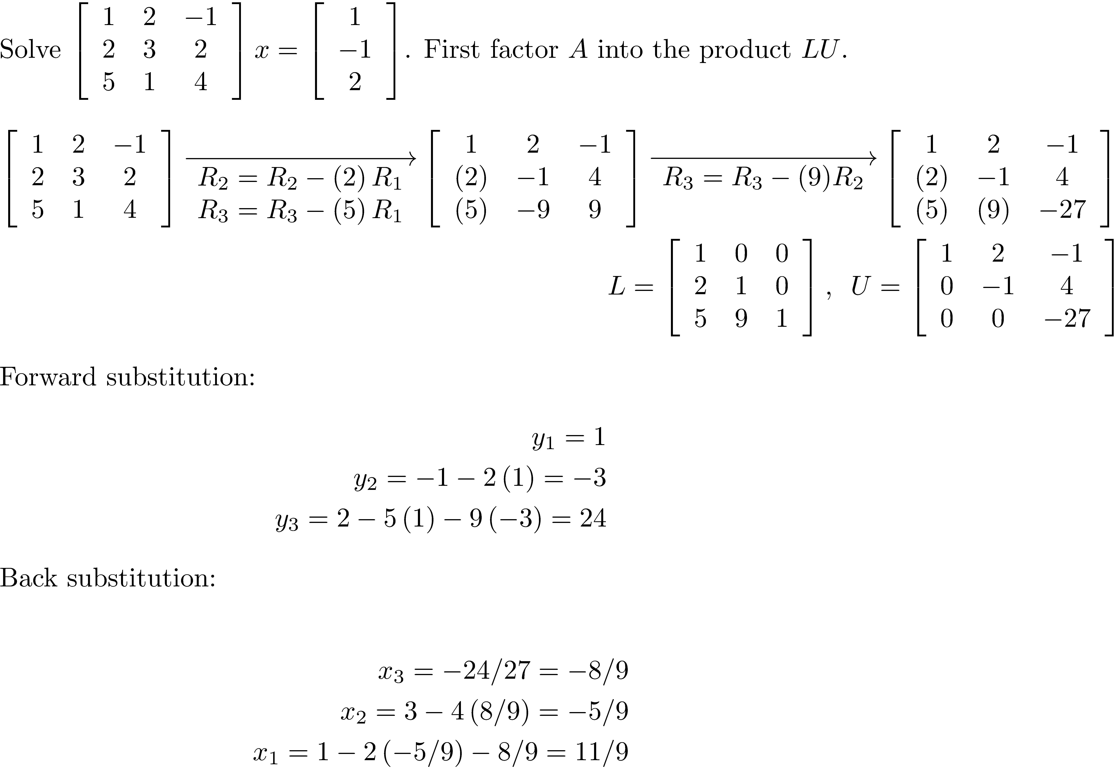
Example of Using LU to Solve Ax = b

Slide 9
Elementary Row Matrices
An important class of nonsingular matrices is the elementary row matrices. Multiplication by one of these matrices performs an elementary row operation. These matrices are important in understanding why the LU decomposition works.

Slide 10
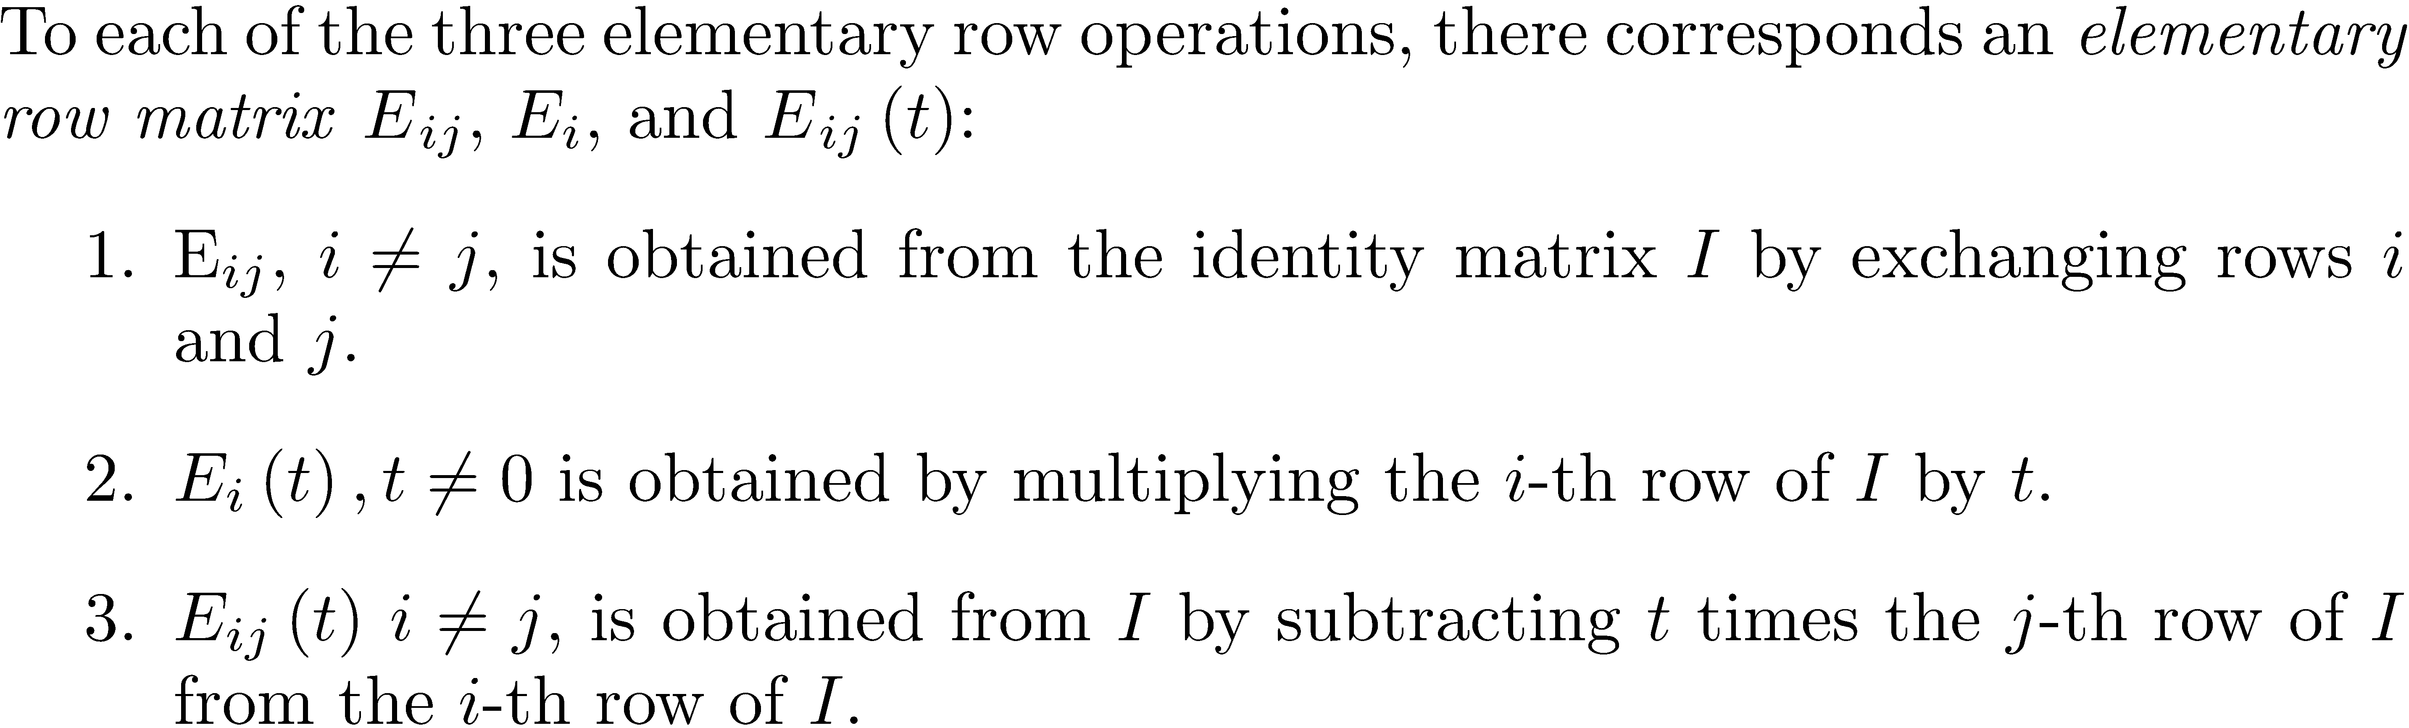
Elementary Row Matrices

Slide 11
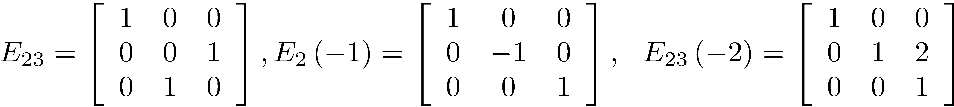
Elementary Row Matrices Example

Slide 12
Elementary Row Matrix Theorem

Slide 13
The Elementary Matrices are Nonsingular
Multiply row j by t and subtract from row i ,
then reverse the operation by multiplying row j by –t
and subtract from row i .

Slide 14
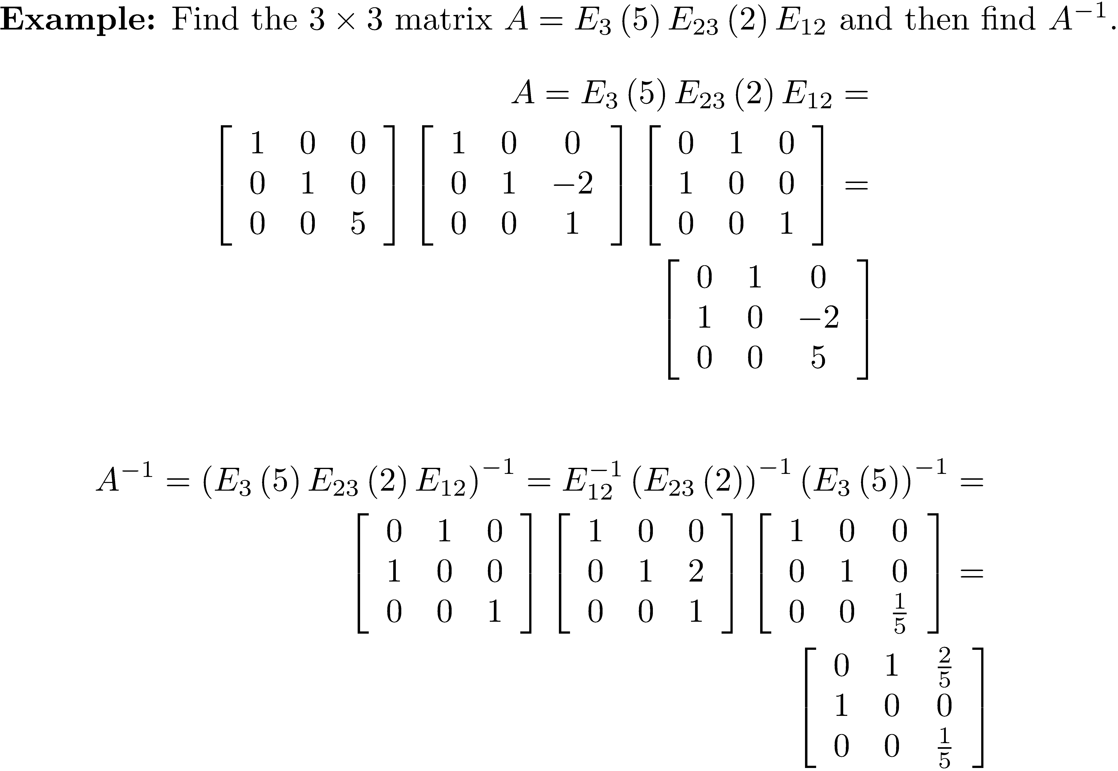
The Elementary Matrices are Nonsingular

Slide 15
Row Equivalence and Elementary Row Matrices
If B is row-equivalent to A , then A is row equivalent to B .
Let A be a nonsingular n × n matrix. Then,
A is row-equivalent to I.
A is the product of elementary row matrices.
Let A be an n × n matrix and suppose that A is row-equivalent to I . Then A is nonsingular, and A⁻¹ can be found by performing the same sequence of elementary row operations on I as were used to convert A to I . This justifies the method of computing A⁻¹ presented in Chapter 2.

Slide 16
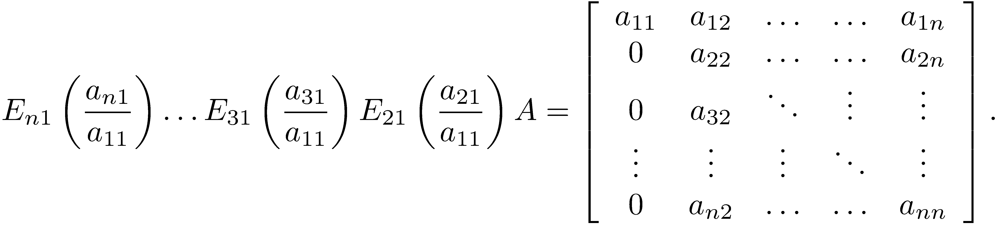
Overview of the LU Decomposition Derivation
While the details of the derivation require care, it is intuitively straightforward.
Elimination of elements a₂₁, a₃₁, …, a_{n1} corresponds to the application of a sequence of n-1 products of elementary matrices as follows:

Slide 17
Overview of the LU Decomposition Derivation
Elimination of elements a₃₂, a₄₄, …, a_{n2} corresponds to the product of elementary matrices , and the row reduction now looks like this:

Slide 18
Overview of the LU Decomposition Derivation
Continuing in this way, the result is
The matrix is the product of invertible matrices and so is invertible. This gives

Slide 19
Overview of the LU Decomposition Derivation
It can be shown that M⁻¹ = L is a lower triangular matrix with ones on its diagonal, and A = LU
Note that this analysis assumes no diagonal element a_{ii} = 0. If so, the algorithm does not work because a row exchange is required.

Slide 20
NOTE
The LU decomposition of a nonsingular matrix A is unique.

Slide 21
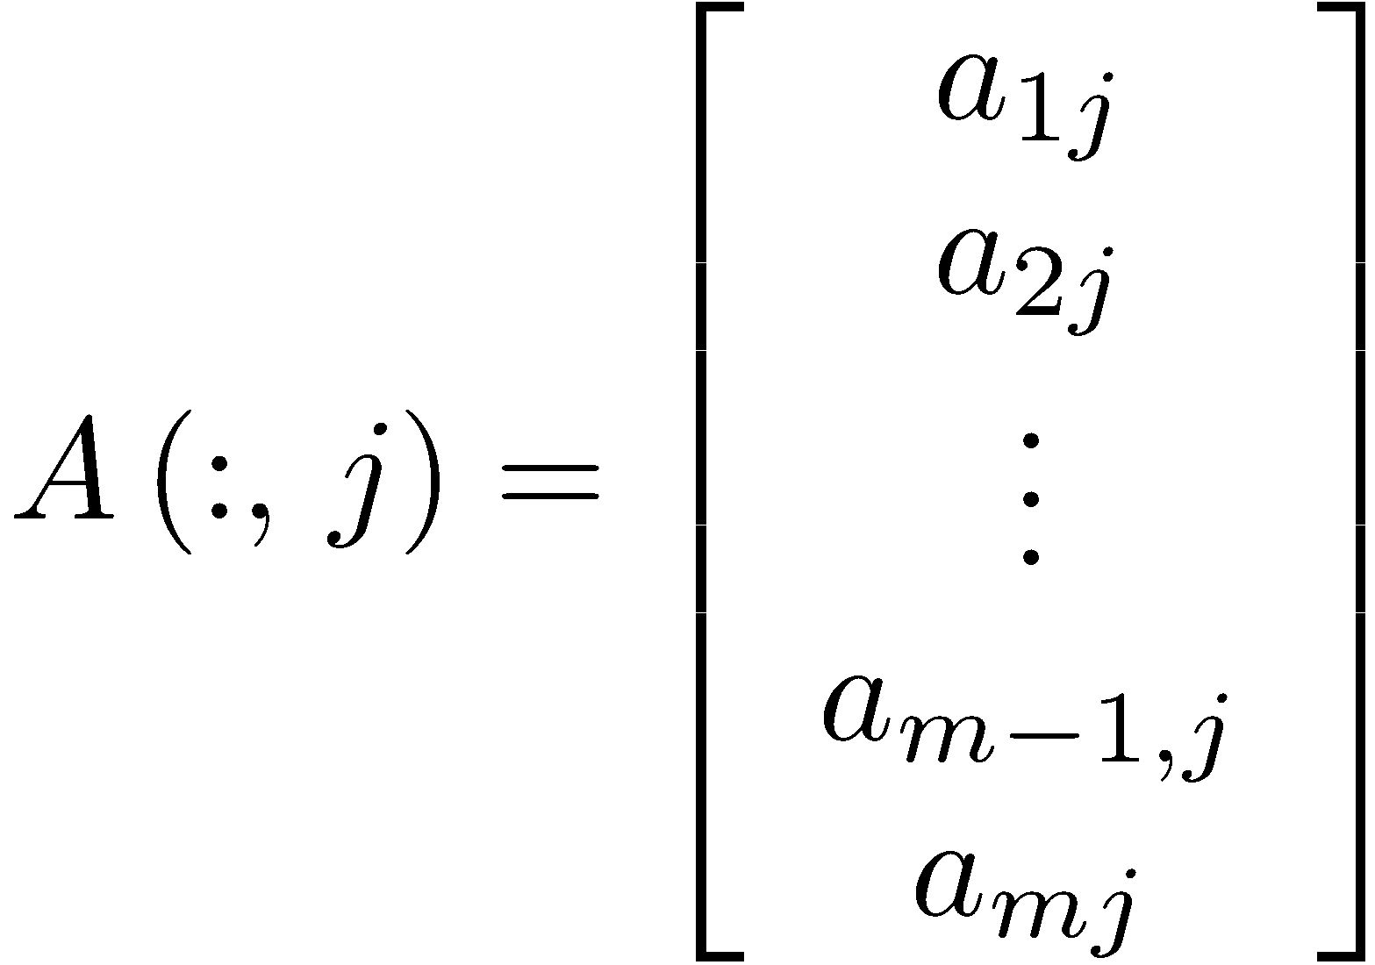
Colon Notation for an m × n Matrix
The notation A( :,j ) references column j of A.
The notation A( i,: ) references row i of A.
To multiply row j by constant t and subtract from row i, use

Slide 22
Colon Notation for an m × n Matrix
The colon notation can reference both rows and columns. For instance, if A is an n × n matrix, A( 1:k,1:k ) is the k × k submatrix beginning in the upper left-hand corner of A.

Slide 23
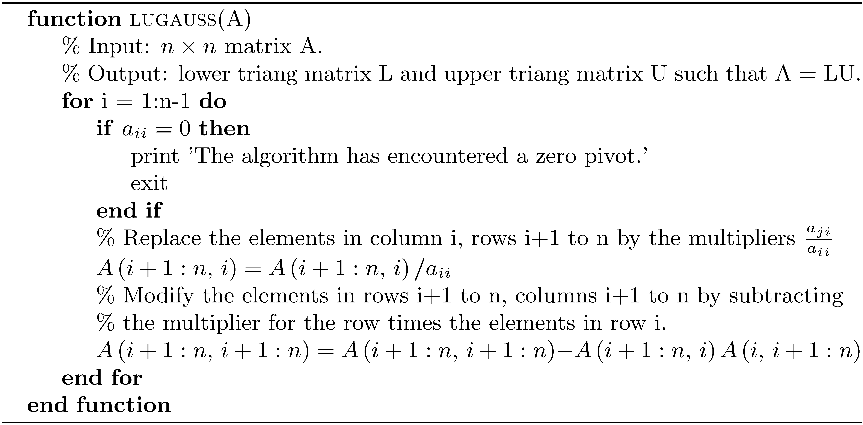
Algorithm lugauss

Slide 24
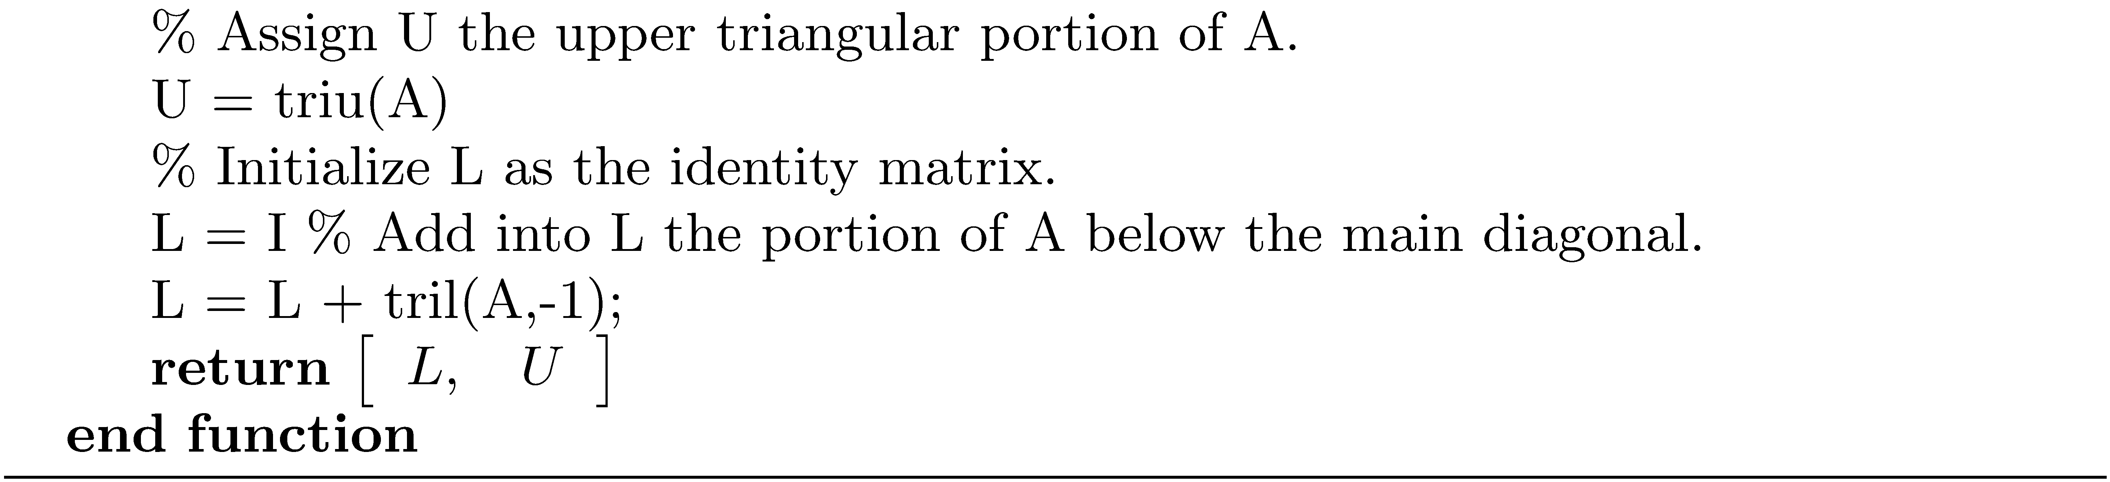
Algorithm lugauss

Slide 25
MATLAB Example using lugauss
>> A = randi([-10 10],5,5)
A =
5 4 7 -1 0
5 -10 4 -2 -1
-2 -5 -4 6 3
3 -10 9 6 4
-7 -8 -10 -7 5
>> [L,U] = lugauss(A)
L =
1.0000 0 0 0 0
1.0000 1.0000 0 0 0
-0.4000 0.2429 1.0000 0 0
0.6000 0.8857 -15.8182 1.0000 0
-1.4000 0.1714 -0.6667 -0.0434 1.0000
U =
5.0000 4.0000 7.0000 -1.0000 0
0 -14.0000 -3.0000 -1.0000 -1.0000
0 0 -0.4714 5.8429 3.2429
0 0 0 99.9091 56.1818
0 0 0 0 9.7701
>> norm(A-L*U)
ans =
8.8818e-16

Slide 26
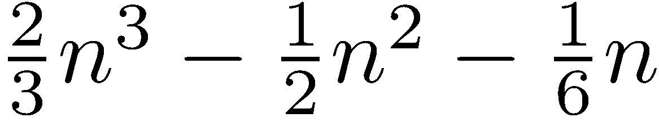
LU Decomposition Flop Count
The flop count is
Since is the dominant term, the flop count is .
The LU decomposition, being a cubic algorithm, is relatively slow. Fortunately, only one decomposition is required to solve k systems Ax_{i} = b_{i} , 1 ≤ i ≤ k.

Slide 27
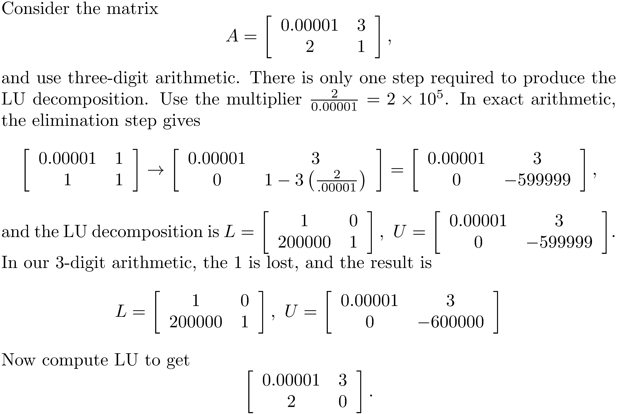
Gaussian Elimination with Partial Pivoting
Without row exchanges, Gaussian elimination is an unstable algorithm.

Slide 28
Gaussian Elimination with Partial Pivoting
The problem arose when we divided by a small pivot element and obtained a large multiplier. The large multiplier resulted in the addition of a very large number to a much smaller number. The result was loss of any contribution from the small number.
The solution is to use partial pivoting.

Slide 29
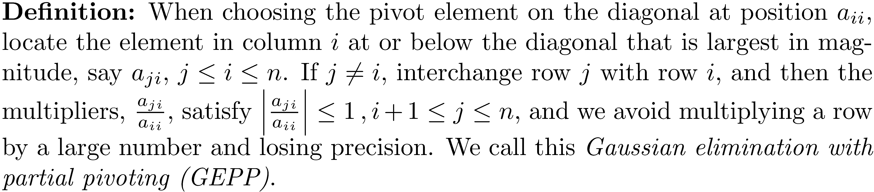
Partial Pivoting

Slide 30
Partial Pivoting
Apply this strategy to the 2 × 2 matrix, rounding to 3 digit precision.
A with its rows exchanged (permuted)
Let , and then

Slide 31
Partial Pivoting
A permutation matrix is the identity matrix with rows swapped. The product PA exchanges the corresponding rows of A.
When partial pivoting is used, the result consists of three matrices, L, U, and P such that PA = LU.

Slide 32
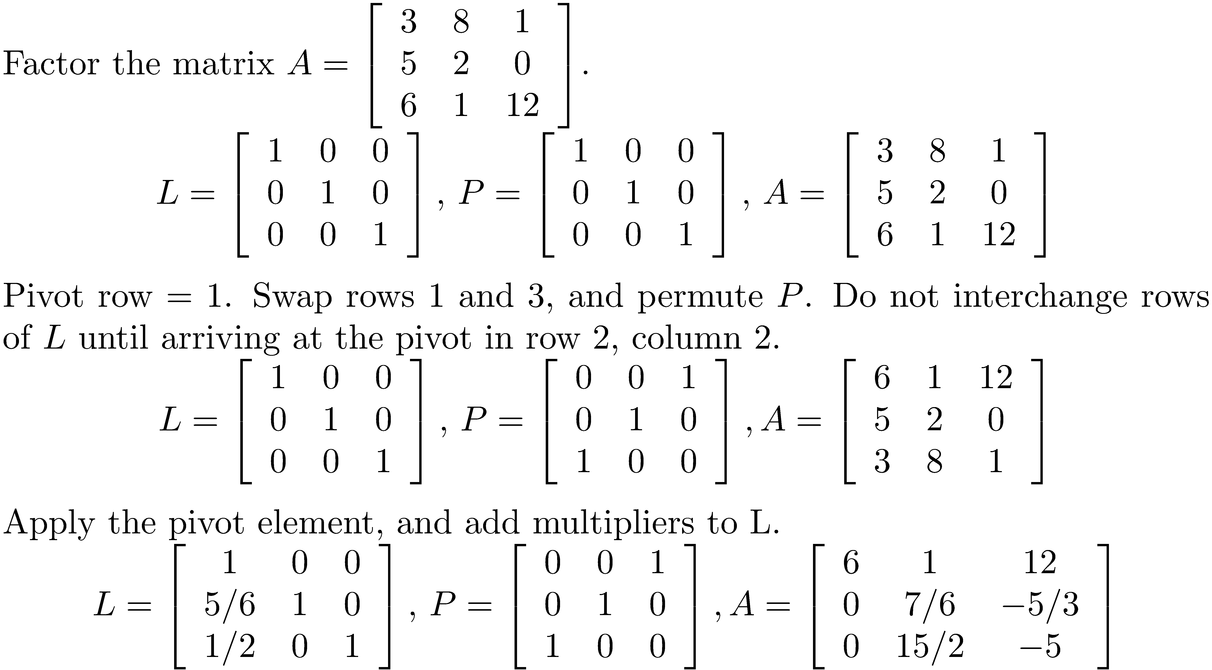
Partial Pivoting Example

Slide 33
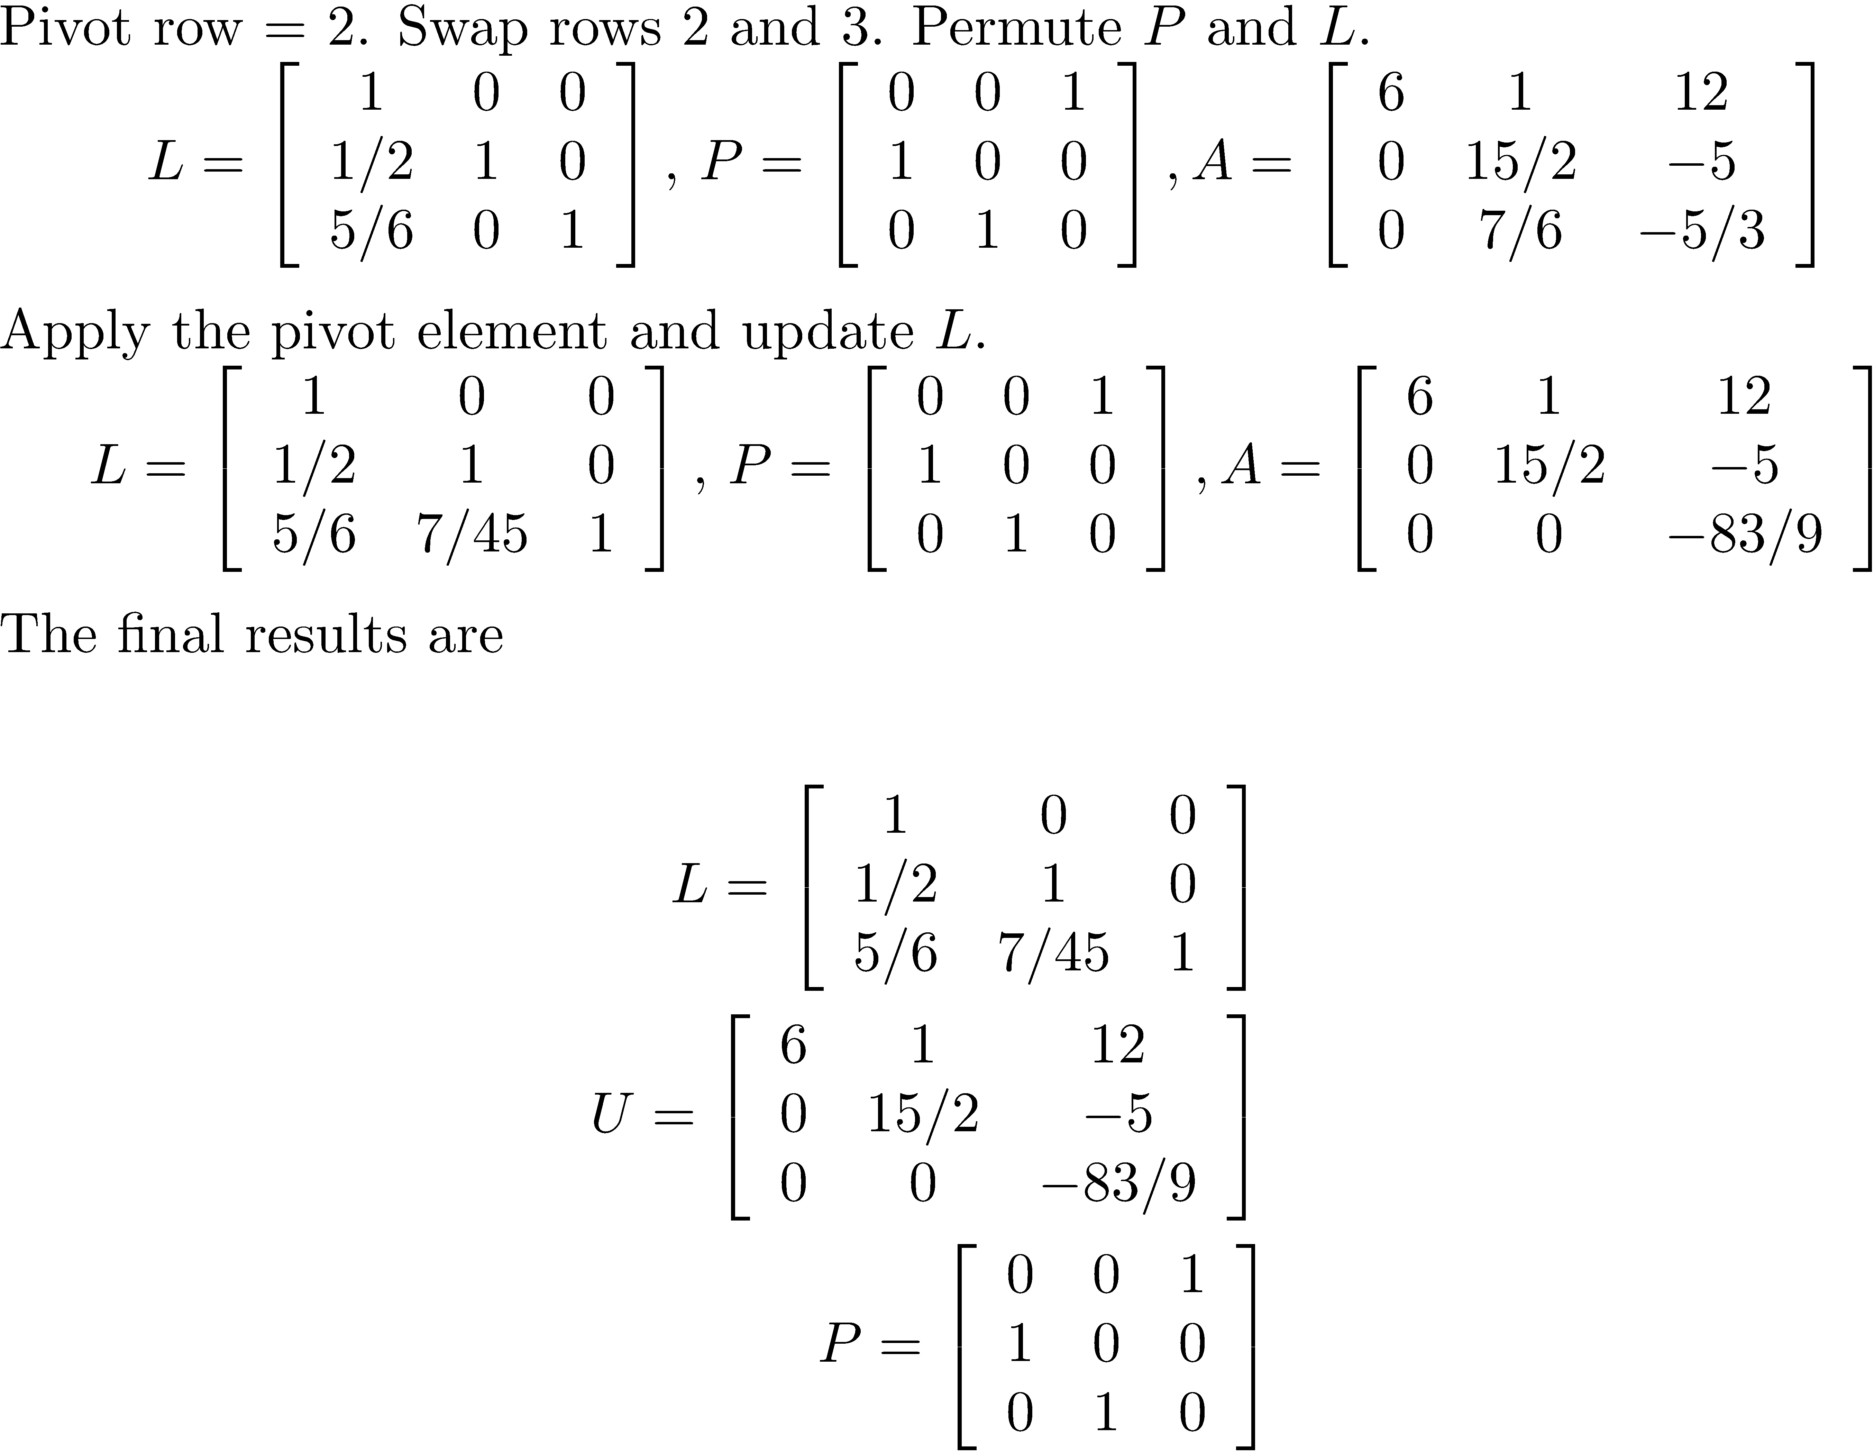
Partial Pivoting Example

Slide 34
Partial Pivoting Example
Even if a row interchange occurs when dealing with column 1, do not interchange the corresponding rows of L until moving to column 2. Think of it this way. The matrix A after a row swap defines the starting configuration. The elements in the first column of L correspond to the multipliers after the row interchange involving pivot position ( 1,1 ), if any.

Slide 35
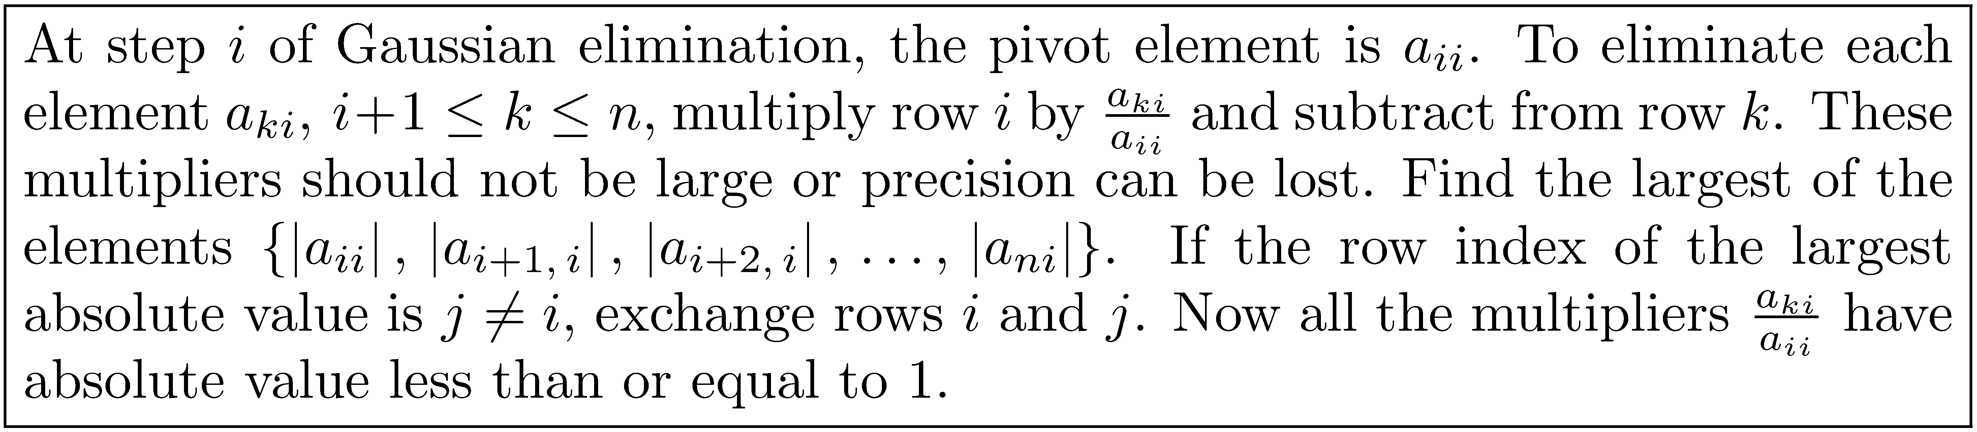
Partial Pivoting Summary

Slide 36
Derivation of PA = LU
The derivation is similar to the sequence of steps when pivoting is not used.
To deal with column i, first multiply by the permutation matrix (I if no row exchange is required) and then apply the elimination steps.
Let E_{i} be the product of the elementary row matrices that eliminate a_{j+1,i}, a_{j+2,i}, …, a_{ni}.
E_{i}P_{i} performs the elimination step for column i.

Slide 37
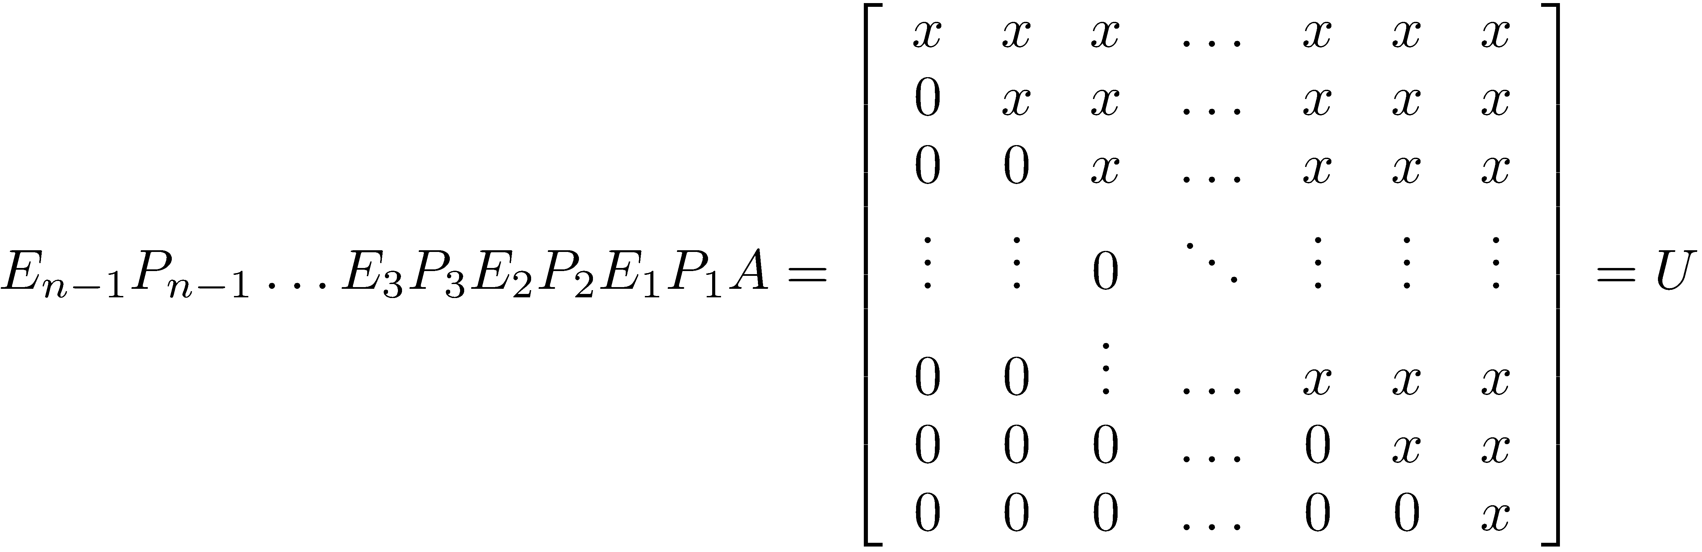
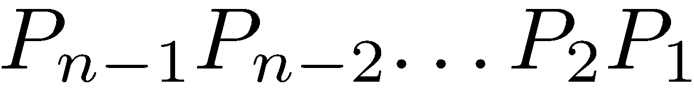
Derivation of PA = LU
The final configuration is
The product must be manipulated in order to isolate the permutation matrices in the order so that PA = LU.

Slide 38
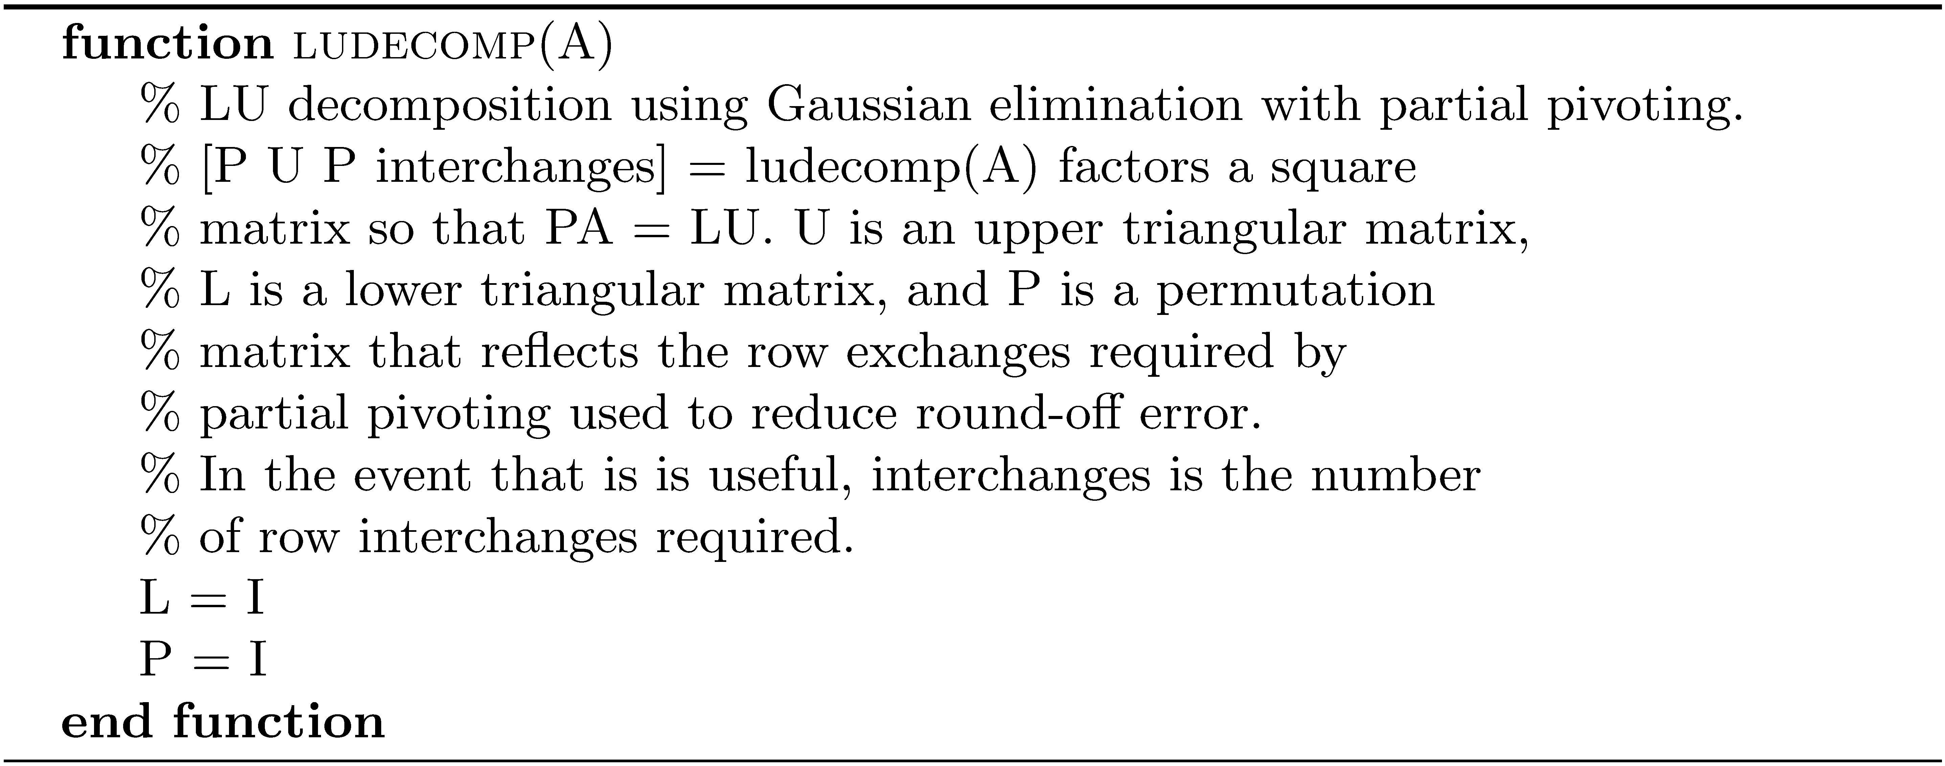
Algorithm ludecomp

Slide 39
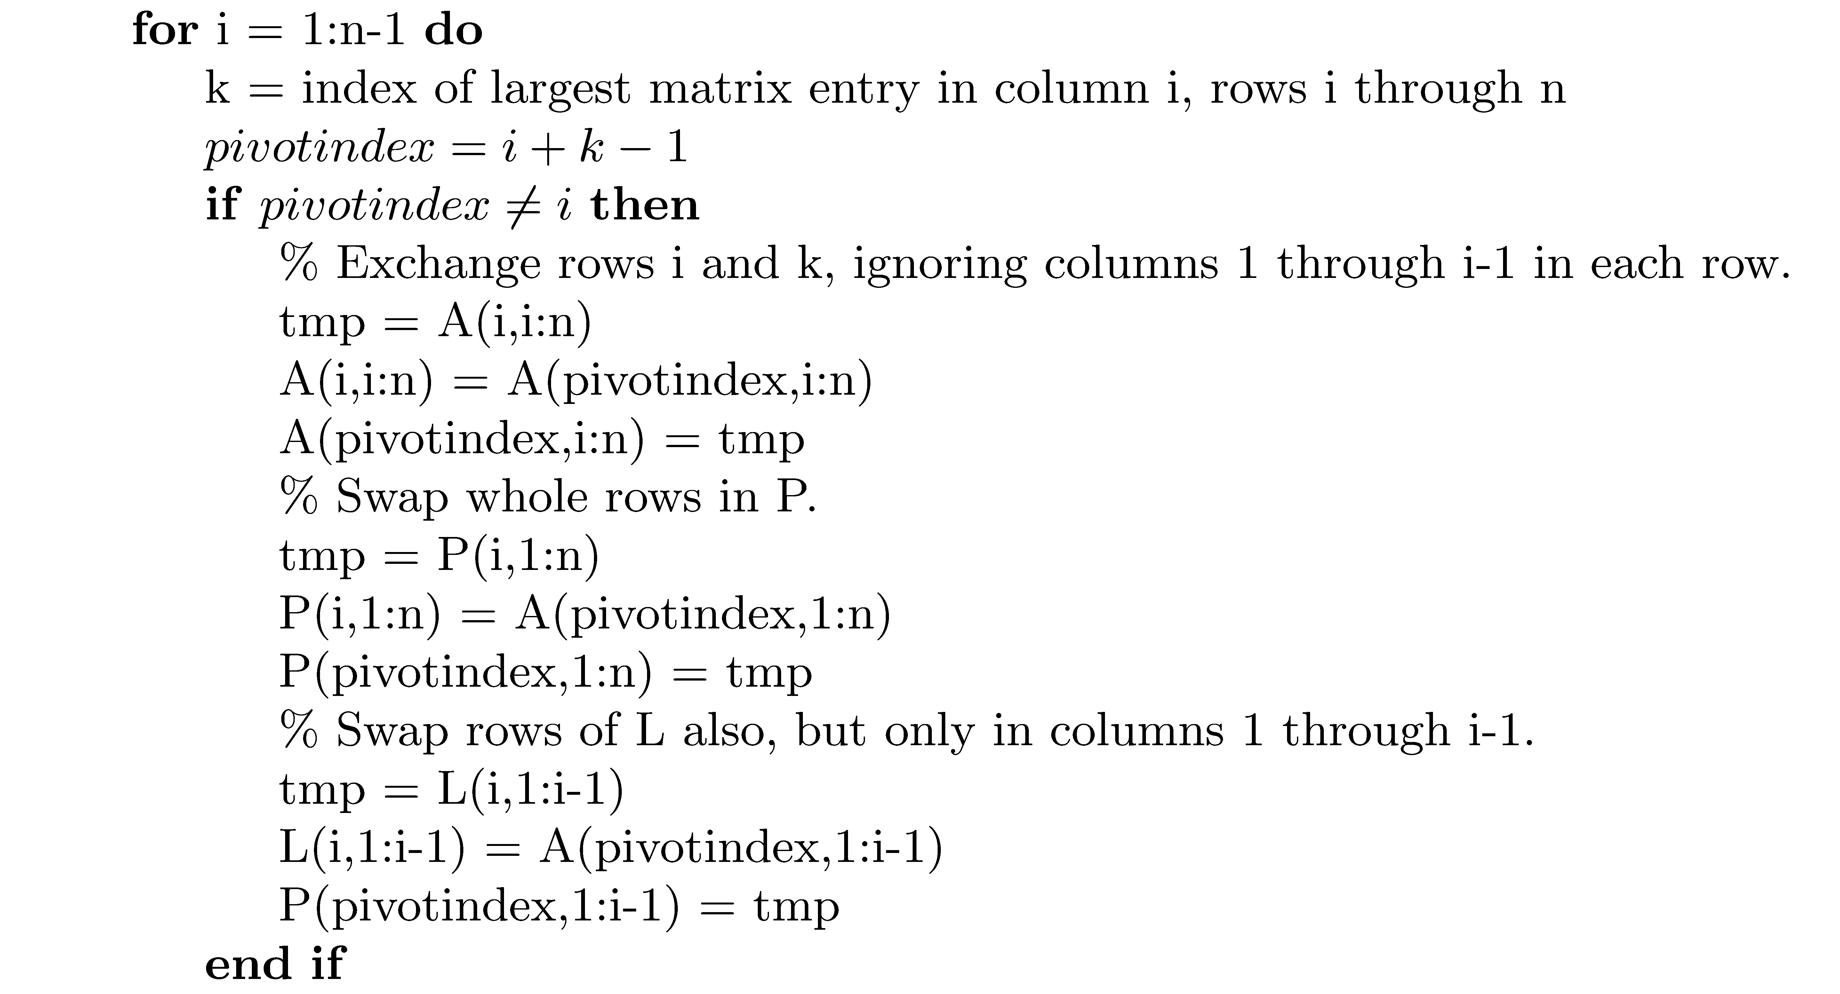
Algorithm ludecomp

Slide 40
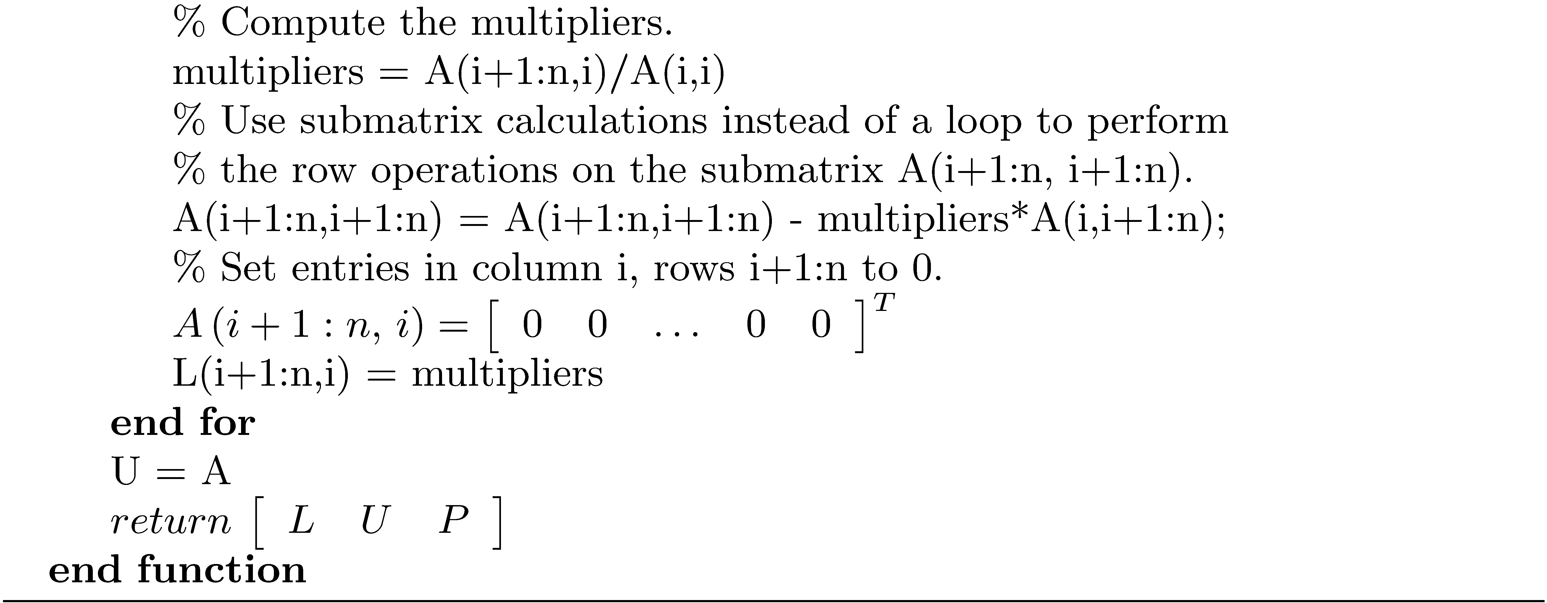
Algorithm ludecomp

Slide 41
MATLAB Example
The singular, ill-conditioned, 8 × 8 Rosser matrix is used to test algorithms for eigenvalue computation. The function ludecomp can be used to factor a singular matrix.

Slide 42
MATLAB Example using ludecomp
>> A = rosser
A =
611 196 -192 407 -8 -52 -49 29
196 899 113 -192 -71 -43 -8 -44
-192 113 899 196 61 49 8 52
407 -192 196 611 8 44 59 -23
-8 -71 61 8 411 -599 208 208
-52 -43 49 44 -599 411 208 208
-49 -8 8 59 208 208 99 -911
29 -44 52 -23 208 208 -911 99
>> [L,U,P] = ludecomp(A);
>> norm(P*A - L*U)
ans =
1.2872e-13
>> cond(A)
ans =
4.5866e+15

Slide 43
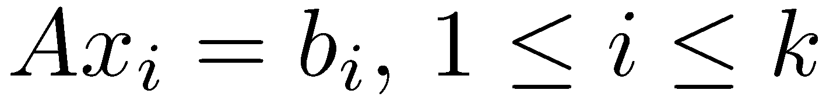
Using the LU Decomposition To Solve
After obtaining the decomposition PA = LU, the following steps solve Ax = b in O(n²) flops. Solve Ly = Pb using forward substitution, followed by solving Ux = y with back substitution.

Slide 44
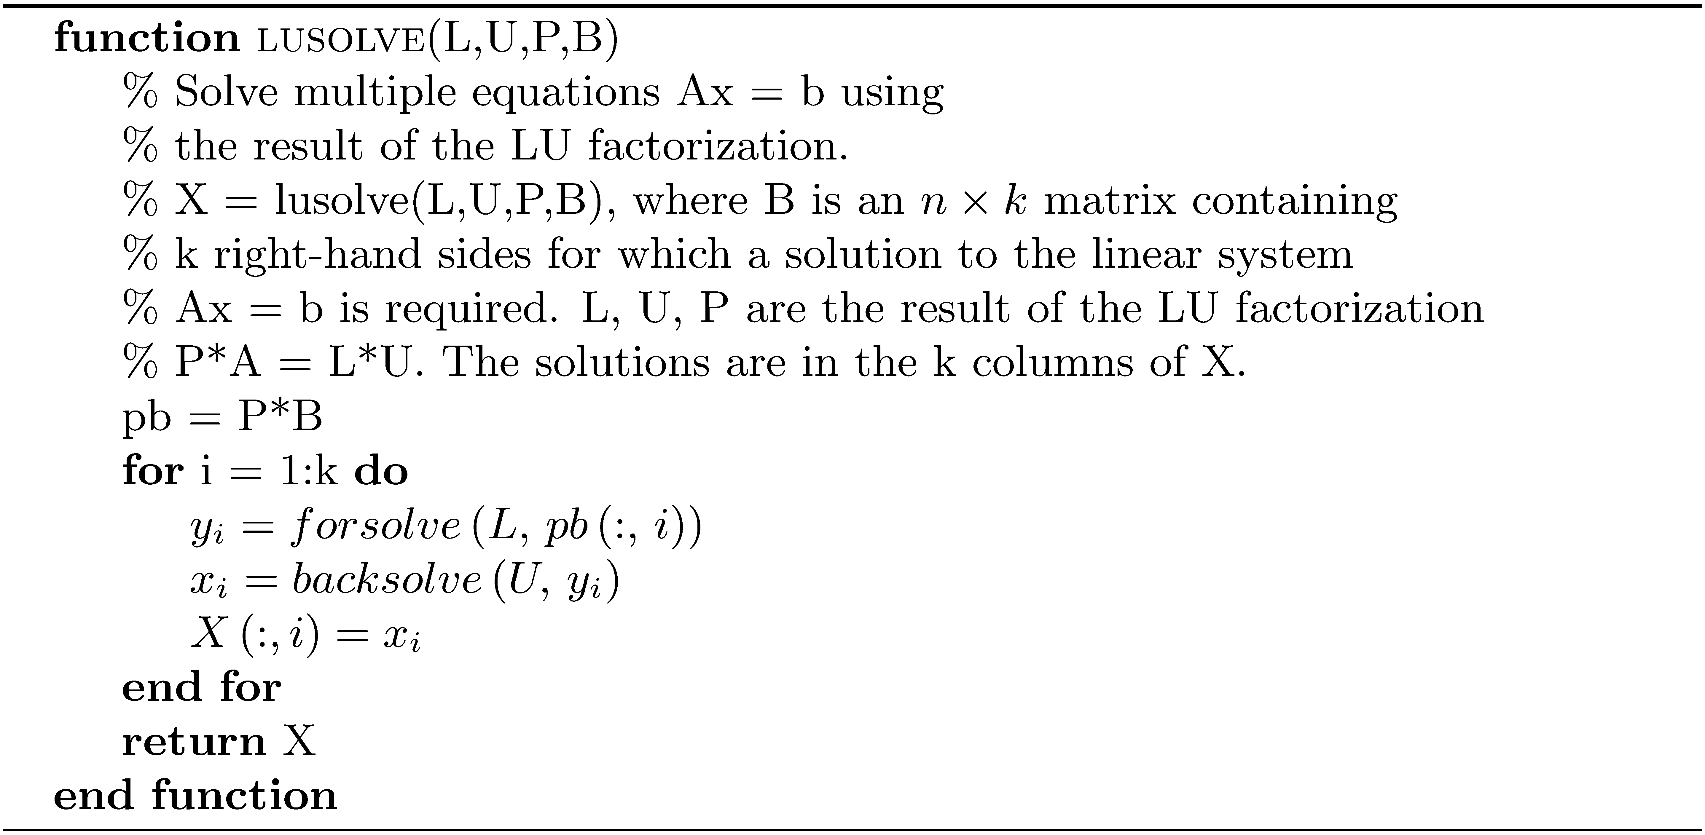
Algorithm lusolve

Slide 45
Using MATLAB to compute the Inverse with ludecomp and lusolve
Find the inverse of the matrix
>> A = [-9 1 3;1 5 2;-6 12 3];
>> B = eye(3);
>> [L,U,P] = ludecomp(A);
>> C = lusolve(L,U,P,B);
>> C
C =
-0.0469 0.1719 -0.0677
-0.0781 -0.0469 0.1094
0.2187 0.5312 -0.2396
>> norm(C*A – B)
ans =
5.8443e-16

Slide 46
Flop Count for Computing A⁻¹
Computing the inverse is expensive and should be done sparingly.

Slide 47
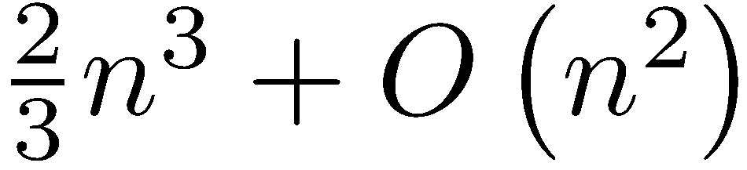
Flop Count for GEPP
The search for a pivot at each of the n-1 steps requires comparisons, or O(n²) comparisons, so GEPP has a flop count of , or flops.

Slide 48
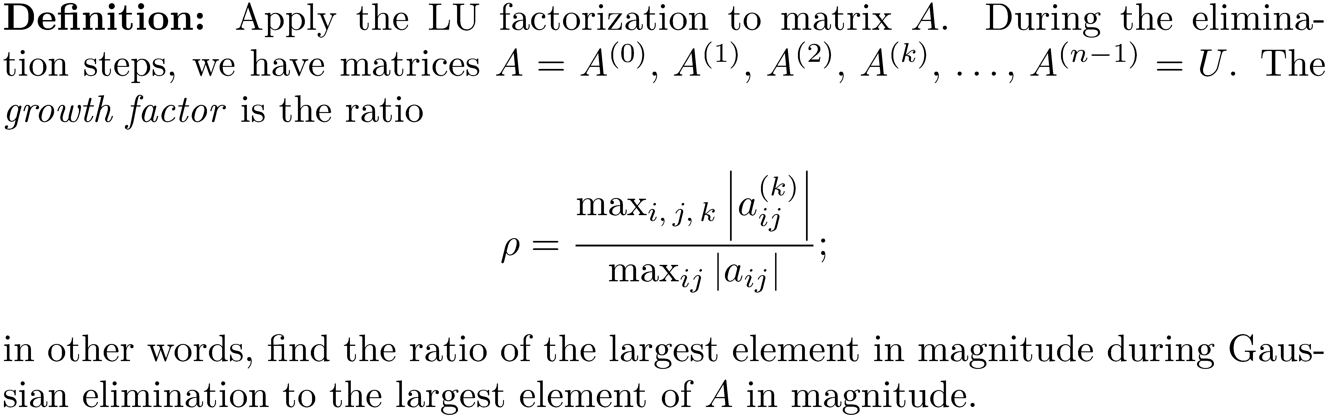
Stability of GEPP

Slide 49
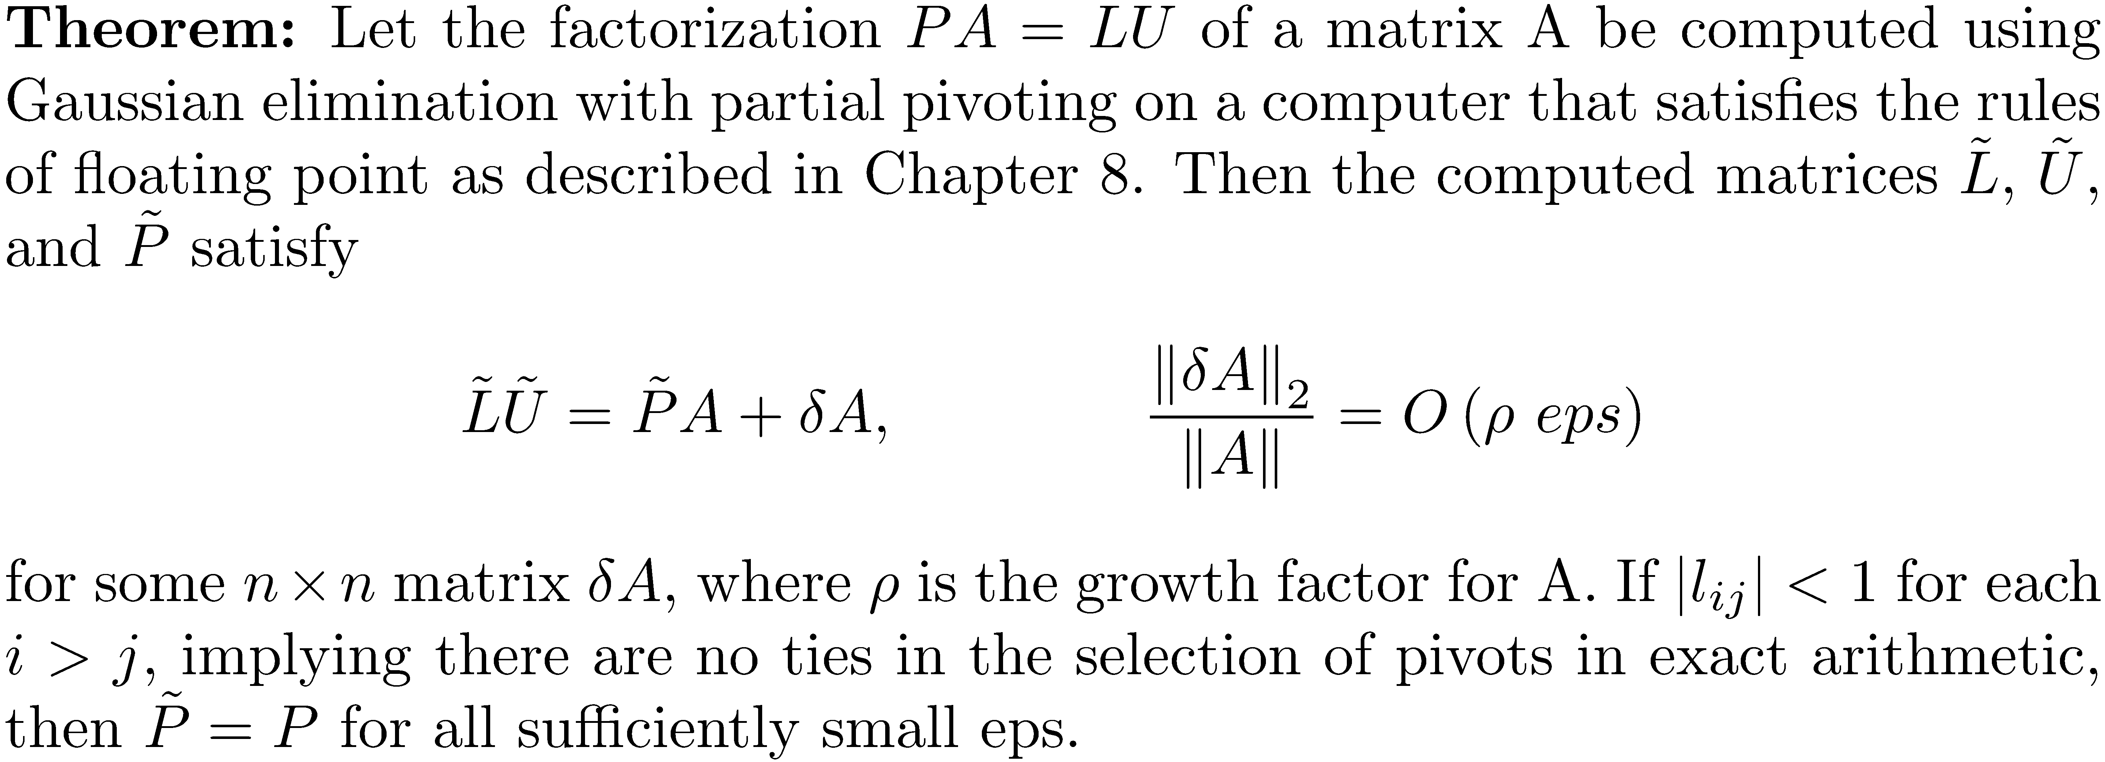
Stability of GEPP

Slide 50
Stability of GEPP
If the growth factor, ρ, grows large, then Gaussian elimination with partial pivoting becomes unstable. There are matrices for which ρ does become large, but these and other matrices with large growth factors have never occurred in practice.

Slide 51
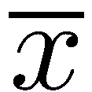
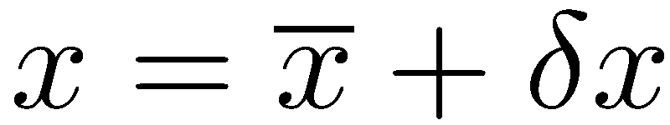
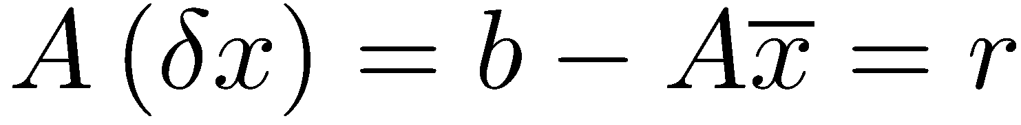
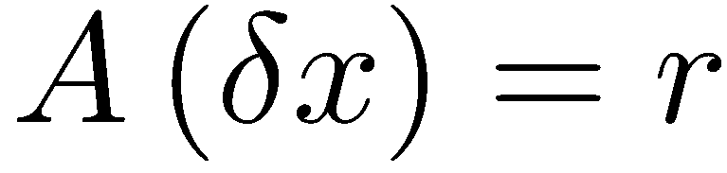
Iterative Refinement
If the solution to a linear system Ax = b is not accurate enough, it is possible to improve the solution using a process known as iterative refinement. Here are the steps:
Let be the computed solution to Ax = b. The exact solution is .
, and , where r is the residual.
Solve the system for , and
It is hoped that is an improved solution.

Slide 52
Iterative Refinement
Compute the residual r using twice the precision of the original computations .
Unless the matrix is ill-conditioned, only a few iterations are normally necessary. There may be little improvement if the matrix is ill-conditioned.

Slide 53
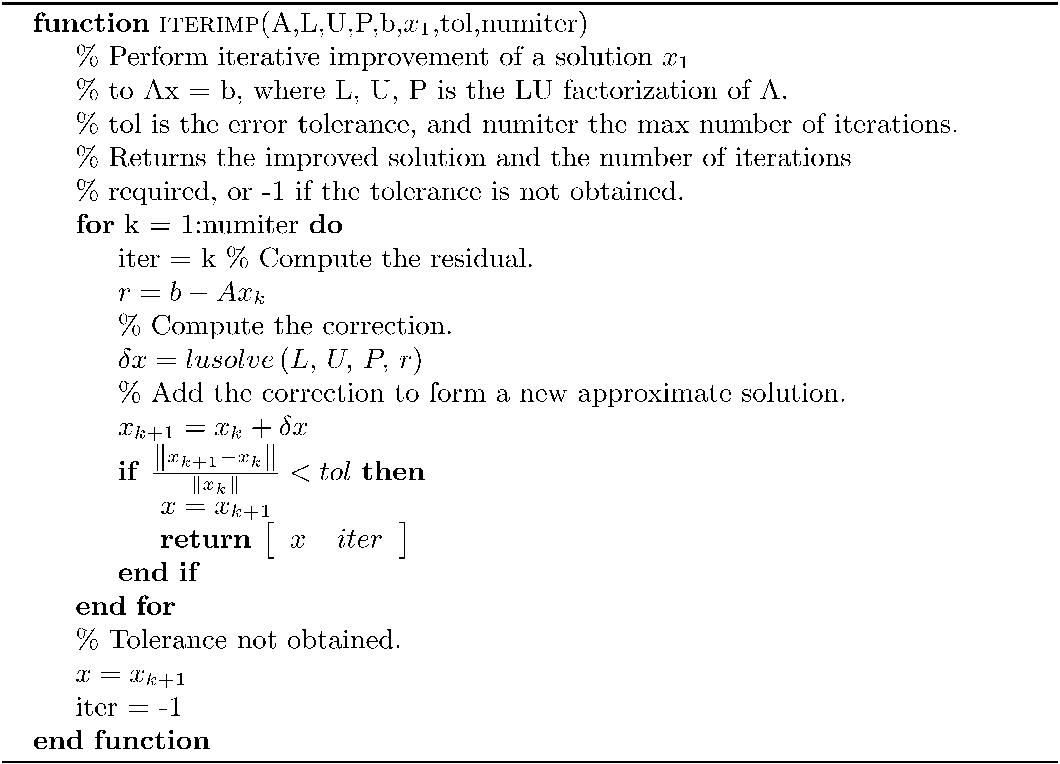
Algorithm iterimp

Slide 54
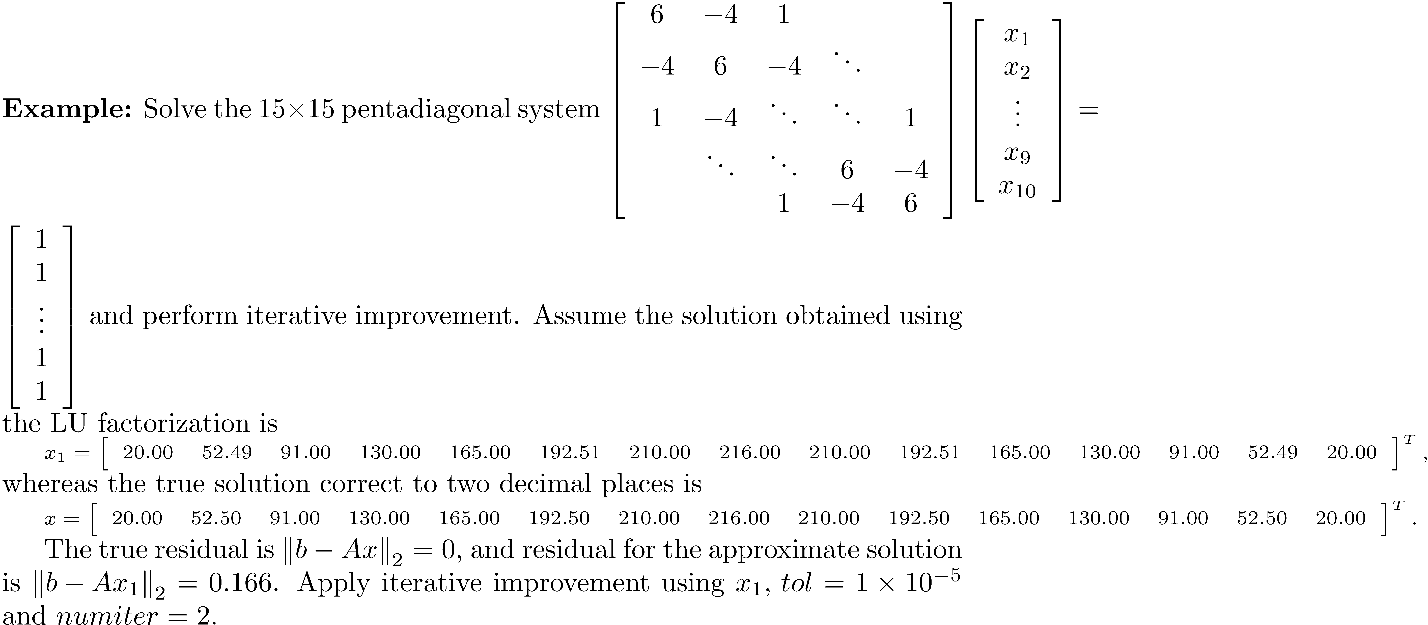
Iterative Improvement Example

Slide 55
Iterative Improvement Example
>> al = ones(13,1);
>> bl = -4*ones(14,1);
>> d = 6*ones(15,1);
>> bh = bl;
>> ah = al;
>> A = pentd(al,bl,d,bh,ah);
>> cond(A)
ans =
2.6113e+03
>> x1 = [20.00,52.49,91.00,130.00,165.00,192.51,...
210.00,216.00,210.00,192.51,165.00,130.00,91.00,52.49,20.00]';
>> x = [20.00,52.50,91.00,130.00,165.00,192.50,210.00,216.00,...
210.00,192.50,165.00,130.00,91.00,52.50,20.00]';
>> b = ones(15,1);
>> norm(b-A*x1)
ans =
0.1661
>> norm(b-A*x)
ans =
0
>> [L,U,P] = ludecomp(A);
>> [xnew iter] = iterimp(A,L,U,P,b,x1,1.0e-5,5);
>> norm(b - A*xnew)
ans =
3.2132e-13

