Slide 1
Introduction
In the discussion of cubic splines, it was determined that a system of equations of the form must be solved in order to determine the fit.
This matrix is symmetric, diagonally dominant , and tridiagonal.
In addition, the matrix is positive definite, an extremely important property that occurs frequently in engineering and science applications.

Slide 2
Tridiagonal Matrices
When a matrix T is tridiagonal and nonsingular, its LU factorization yields bidiagonal matrices L and U. L has 1's on the main diagonal as usual, but the superdiagonal entries of U are the same as those of T.

Slide 3
Tridiagonal Matrices
>> a = 1:4;
>> b = 7*ones(5,1);
>> c = -4:1:-1;
>> A = trid(a,b,c)
A =
7 -4 0 0 0
1 7 -3 0 0
0 2 7 -2 0
0 0 3 7 -1
0 0 0 4 7
>> [L,U] = lugauss(A)
L =
1.0000 0 0 0 0
0.1429 1.0000 0 0 0
0 0.2642 1.0000 0 0
0 0 0.3850 1.0000 0
0 0 0 0.5148 1.0000
U =
7.0000 -4.0000 0 0 0
0 7.5714 -3.0000 0 0
0 0 7.7925 -2.0000 0
0 0 0 7.7700 -1.0000
0 0 0 0 7.5148
Superdiagonal of A.

Slide 4
Tridiagonal Matrices
Investigate the general problem using a 4 × 4 matrix. Doing this will make it clear how to factor a general tridiagonal matrix.

Slide 5
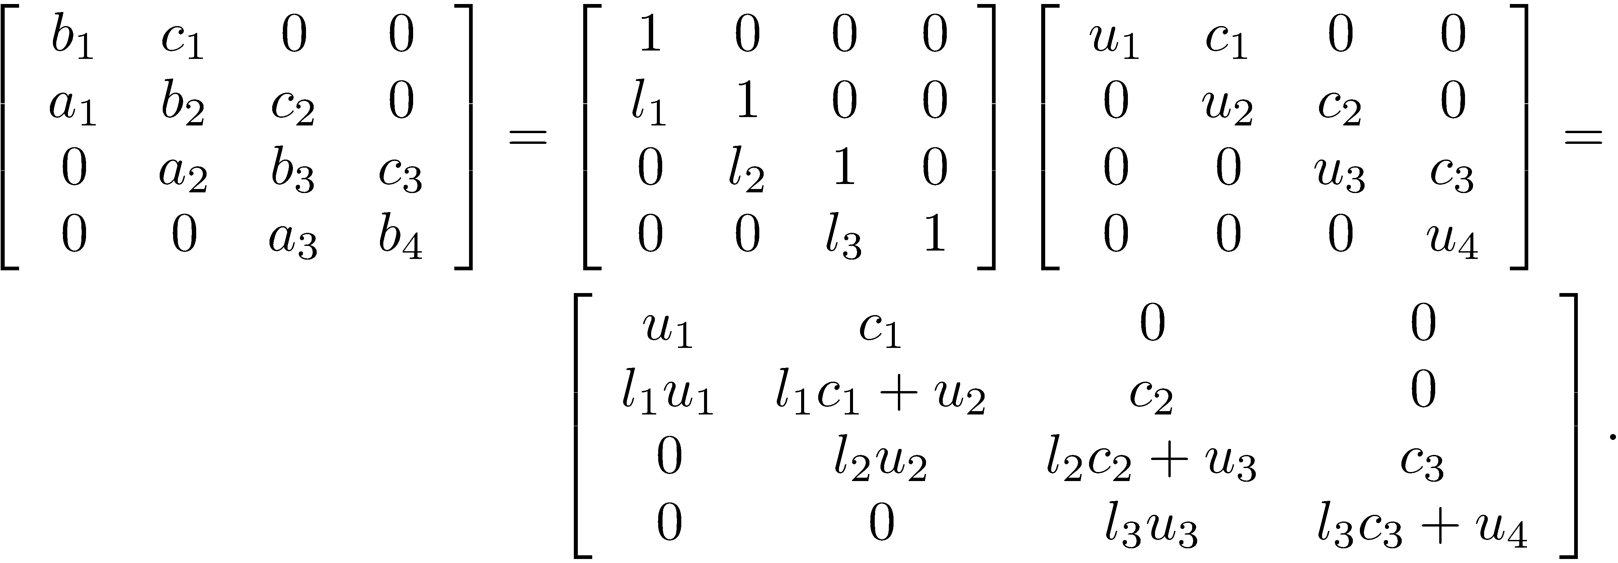
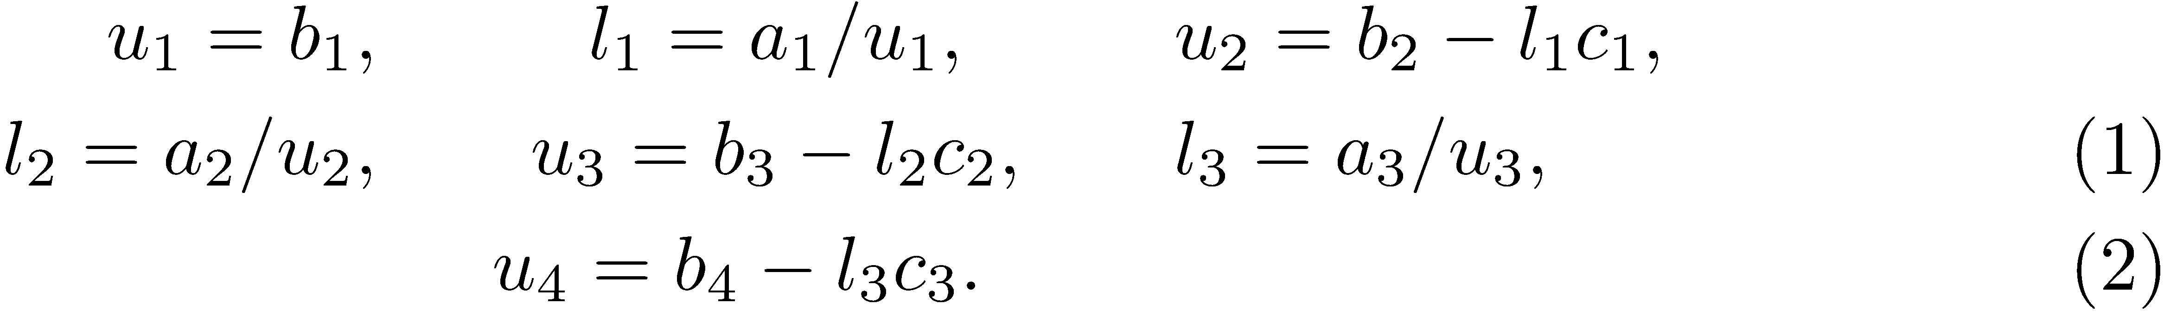
Tridiagonal Matrix Decomposition
Consider the equation
Equate both sides and it follows that

Slide 6
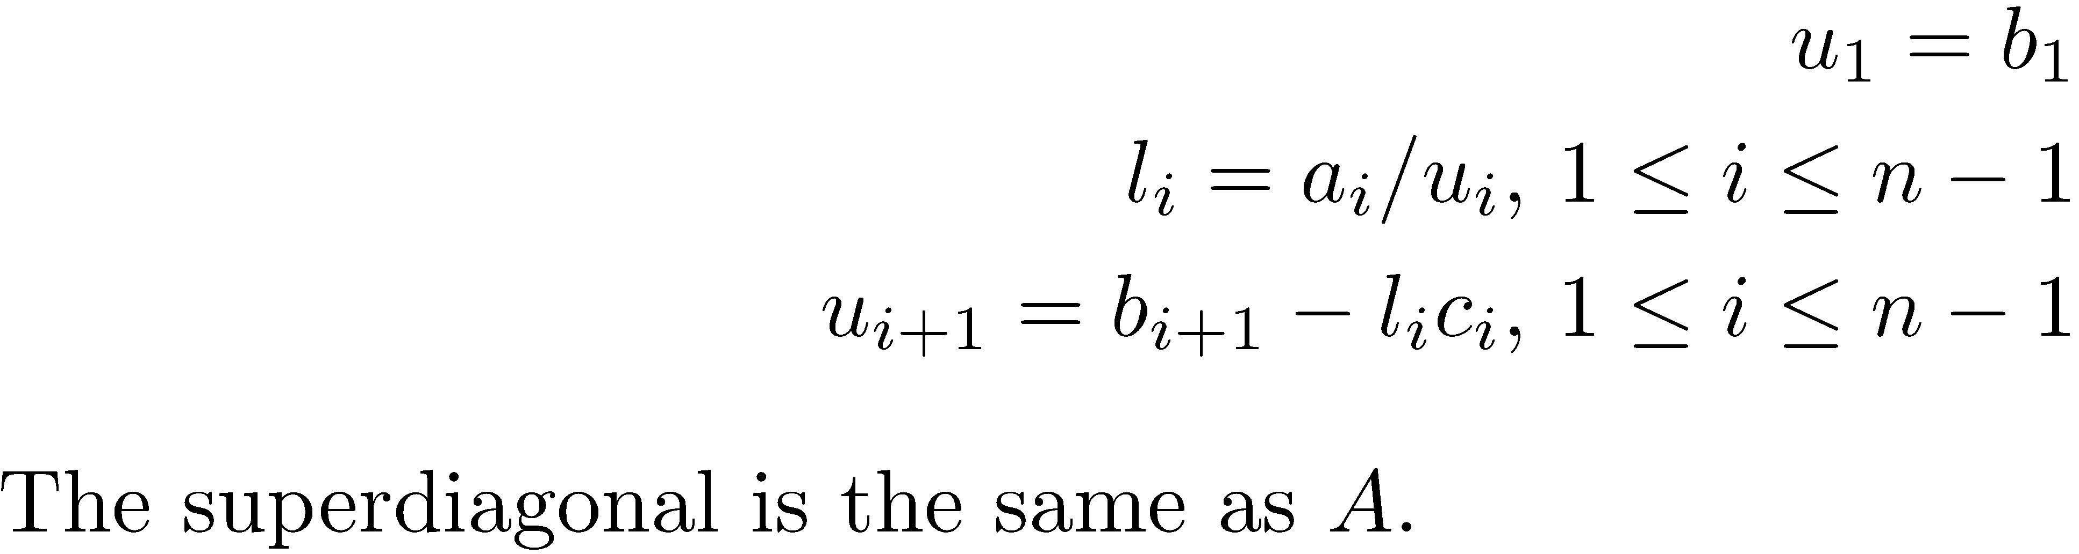
Tridiagonal Matrix Decomposition
General equations for the LU decomposition of a tridiagonal matrix.

Slide 7
Tridiagonal Matrix Decomposition
This algorithm is very inexpensive. Its running time is O(n) or linear running time.
This algorithm does not work if any u_{i} = 0 , but this occurs very seldom occurs in practice.
NOTE: There are issues with stability.

Slide 8
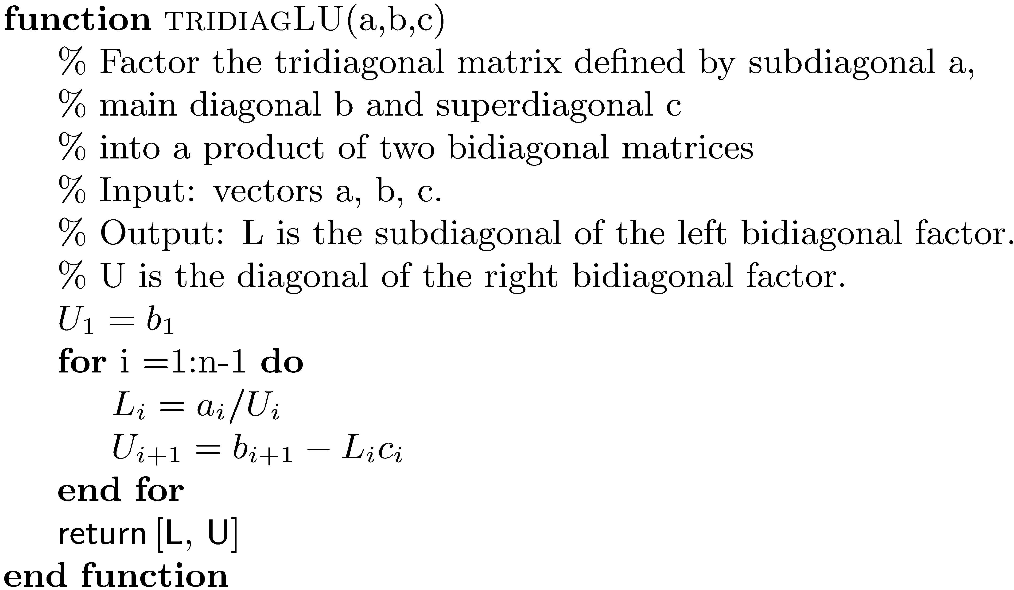
Algorithm for Tridiagonal Matrix Decomposition

Slide 9
Solving a Tridiagonal System
After running the algorithm, the bidiagonal systems must be solved in the order (i) Ly = b and (ii) Ux = y .
The bidiagonal structure of L and U allow very fast forward and back substitution.

Slide 10
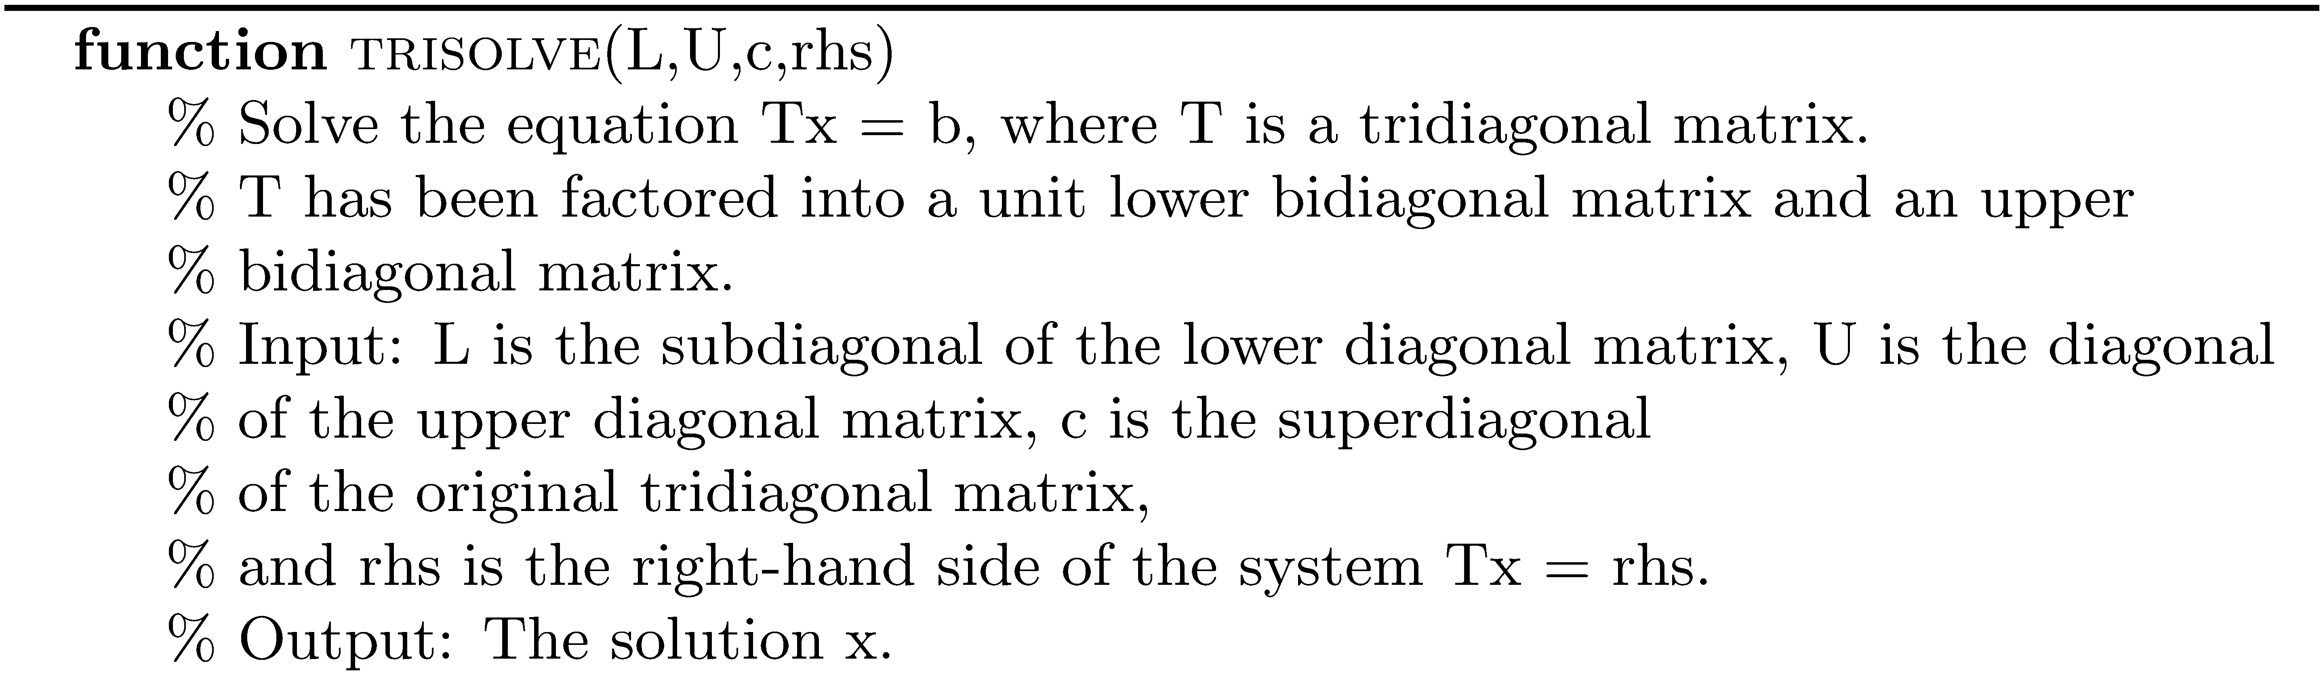
Solve a Factored Tridiagonal System

Slide 11
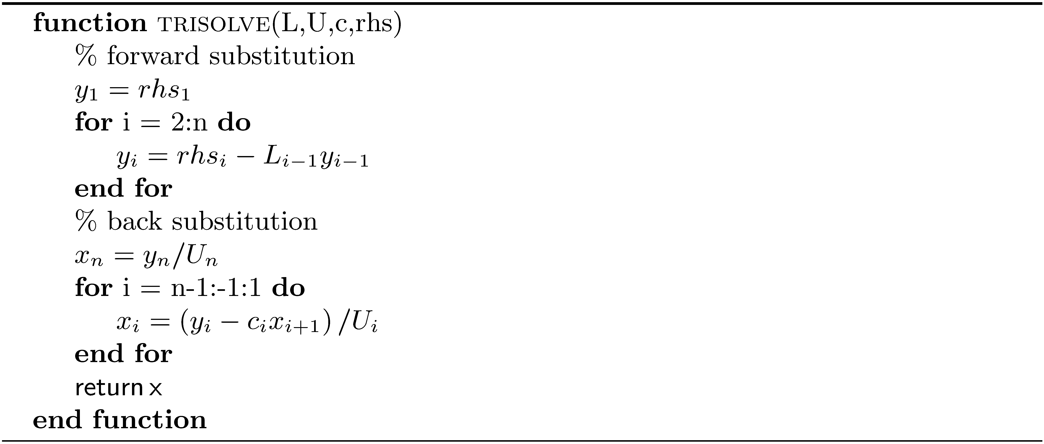
Solve a Factored Tridiagonal System (concluded)

Slide 12
Example 1
>> A = wilkinson(21);
>> [L U] = trifact(A);
>> rhs = rand(21,1);
>> x = trisolve(diag(L,-1), diag(U), diag(A,1), rhs);
>> norm(A*x - rhs)
ans =
2.6185e-16

Slide 13
Symmetric Positive Definite Matrix
Let and form for .

Slide 14
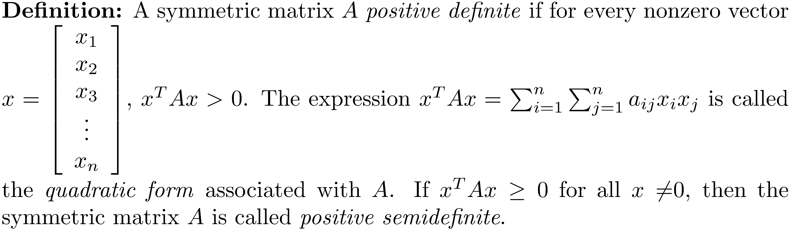
Definition of a Positive Definite Matrix
NOTE: It is possible for a nonsymmetric matrix to satisfy
x^{T}Ax > 0, all x ≠ 0. For our purposes, it is assumed that
positive definite means the matrix is symmetric.

Slide 15
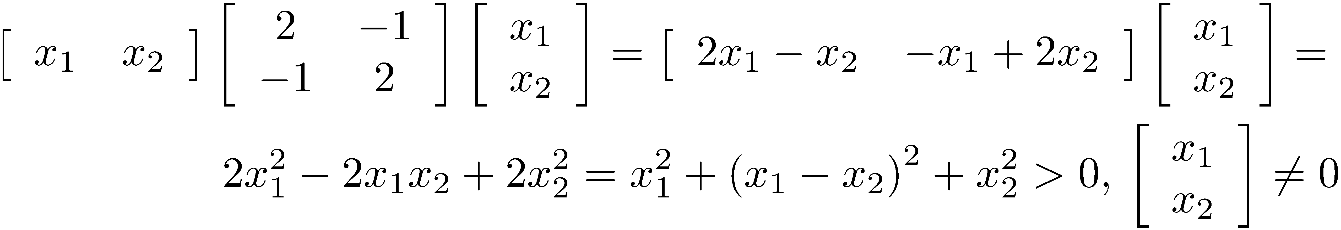
Example 2

Slide 16
Showing that an n × n Matrix is Positive Definite
Presented with a general symmetric matrix A, using the definition is nearly impossible. There must be other conditions that will guarantee A is positive definite.

Slide 17
Conditions Associated with a Positive Definite Matrix
A symmetric matrix A is positive definite if and only if all its eigenvalues are positive. Proof: Assume A is positive definite, x ≠ 0 is an eigenvector and λ is an eigenvalue so that . Then, and

Slide 18
Conditions Associated with a Positive Definite Matrix
Assume that all the eigenvalues of A are positive and that , and

Slide 19
Conditions Associated with a Positive Definite Matrix
If A is positive definite, then a_{ii} > 0 for all i.
If A is positive definite, then the largest element in magnitude of all matrix entries must lie on the diagonal.
A symmetric matrix A is positive definite if and only if all its leading principle minors are positive; that is . This called Sylvester's criterion.

Slide 20
A Positive Definite Matrix is Nonsingular
A singular matrix has a 0 eigenvalue. Proof: Ax = 0(x) has a nontrivial solution, so A is singular.
A positive definite matrix A is nonsingular.

Slide 21
Question
Can A or B be positive definite?

Slide 22
The Cholesky Decomposition
Determining whether a symmetric matrix is positive definite by showing its eigenvalues are positive or testing Sylvester's criterion is too computationally intensive. The French engineer Andre-Louis Cholesky discovered the Cholesky factorization for a positive definite matrix.

Slide 23
Cholesky Theorem
Let A be a real positive definite n x n matrix. Then there is exactly one upper triangular matrix with such that A = R^{T}R (the Cholesky decomposition).

Slide 24
Cholesky Decomposition
It is sufficient to develop the decomposition by considering the 3 × 3 case. The general case follows precisely the same pattern.

Slide 25
Cholesky Decomposition
Find the matrix R by equating both sides of A = R^{T}R and demonstrating how to compute the entries of R.

Slide 26
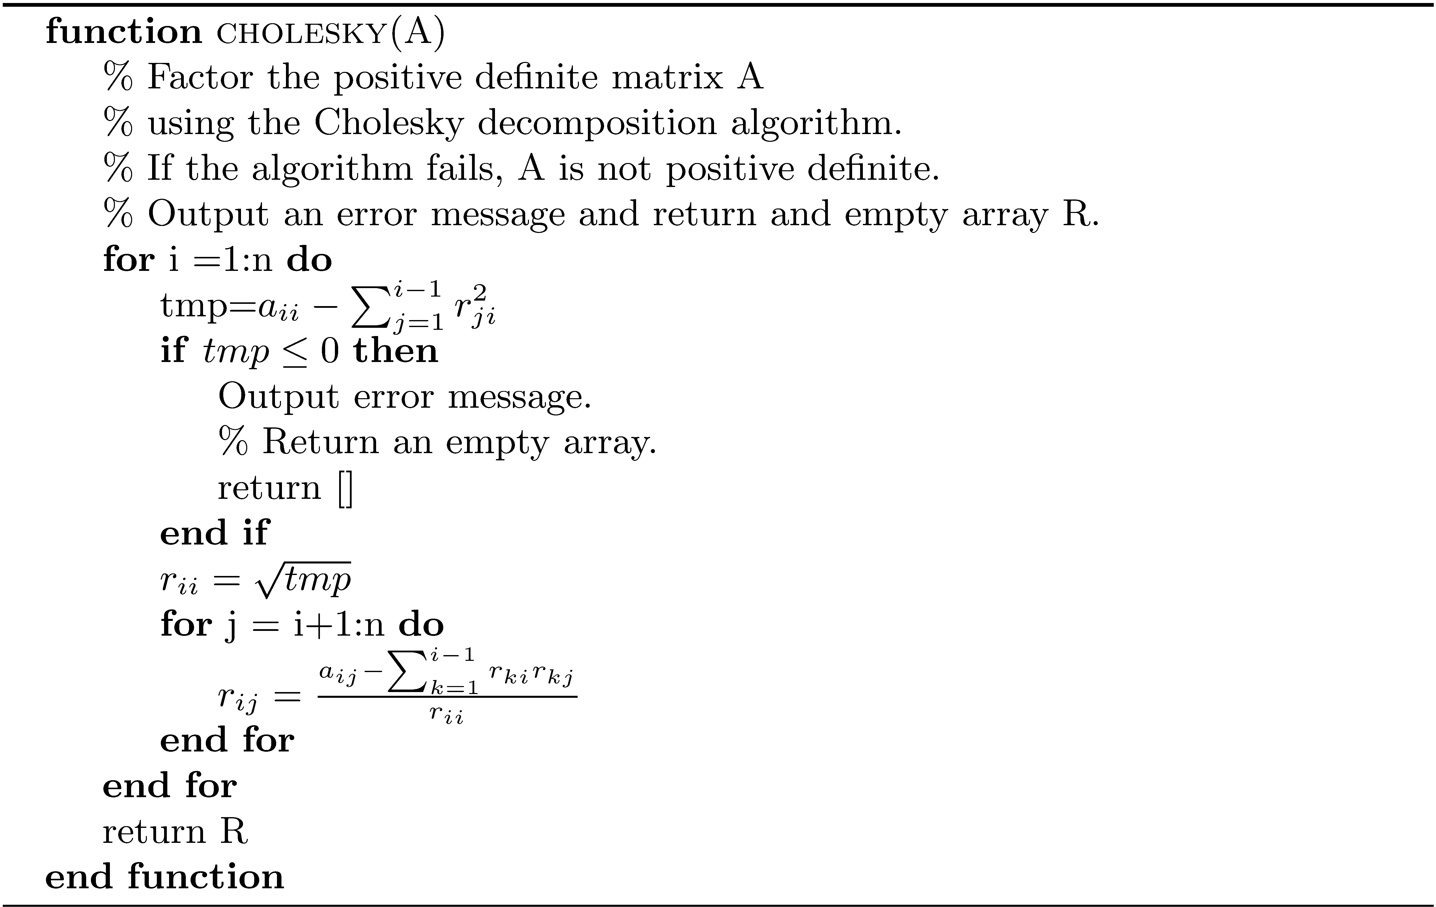
Cholesky Decomposition Algorithm

Slide 27
Determining if A is Positive Definite
If is less than or equal to zero, A is not positive definite.

Slide 28
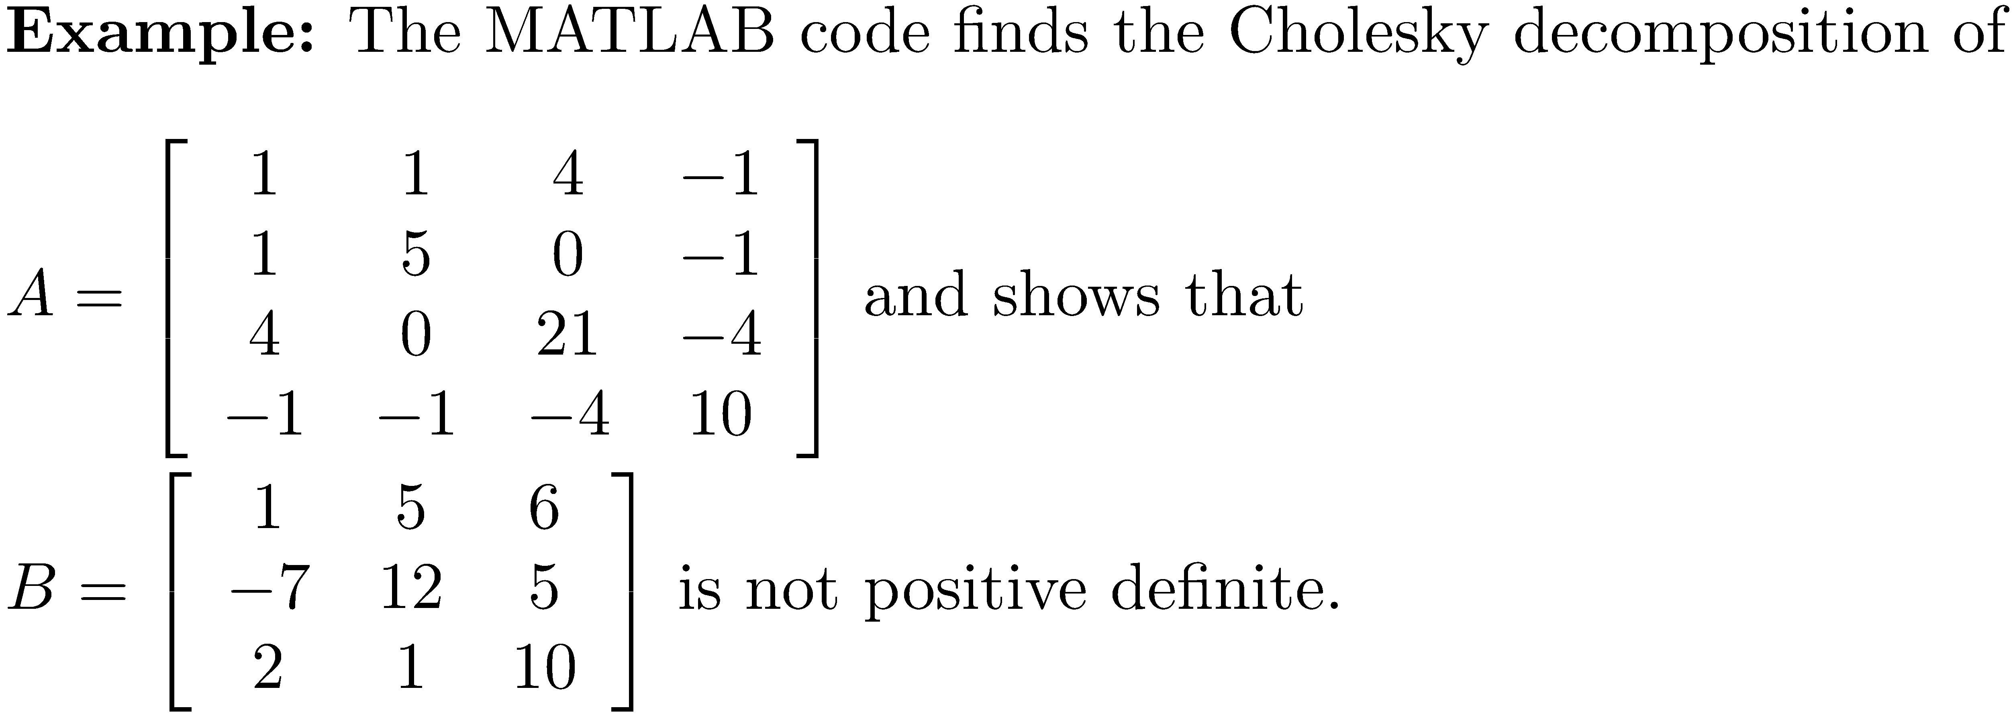
Example 3
>> R1 = cholesky(A)
R1 =
1 1 4 -1
0 2 -2 0
0 0 1 0
0 0 0 3
>> R1'*R1
ans =
1 1 4 -1
1 5 0 -1
4 0 21 -4
-1 -1 -4 10
>> R2 = cholesky(B);
The matrix is not positive definite.

Slide 29
Cholesky Decomposition Flop Count
The standard LU decomposition requires flops. Because of its increased speed, Cholesky decomposition is preferred for a large positive definite matrix.

Slide 30
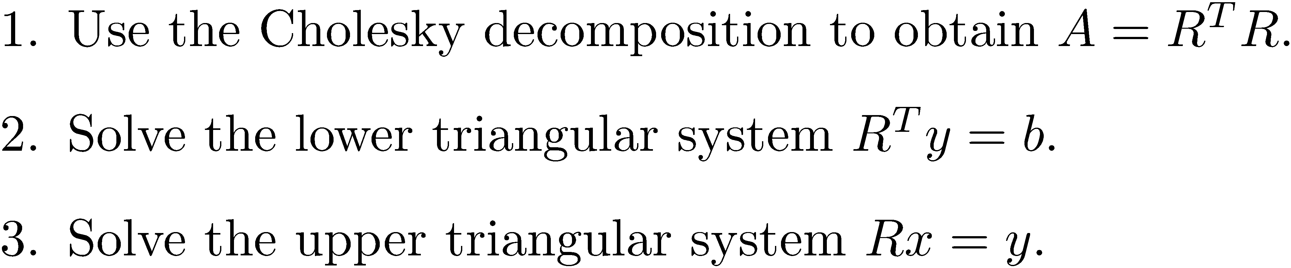
Solving Ax = b when A is Positive Definite

Slide 31
cholsolve
function x = cholsolve(R,b)
% CHOLSOLVE Solve a system after cholesky decomposition.
%
% x = cholsolve(R,b) solves the system Ax = b, given
% upper triangular matrix R obtained from the Cholesky
% decomposition of positive definite matrix A.
[m, n] = size(R);
if m ~= n
disp('The system is not square.');
return;
end
% Solve the lower triangular system R'y = b
y = forsolve(R', b);
% Solve the upper triangular system Rx = y
% by back substitution
x = backsolve(R, y);

Slide 32
A^{T}A is Positive Definite

Slide 33
Example 4
>> B = A'*A
B =
27 24 14
24 26 26
14 26 62
>> R = cholesky(B); % no complaint. R is positive definite
>> b = [25 3 35]';
>> cholsolve(R,b)
ans =
15.0455
-18.8409
5.0682
>> B\b
ans =
15.0455
-18.8409
5.0682

Slide 34
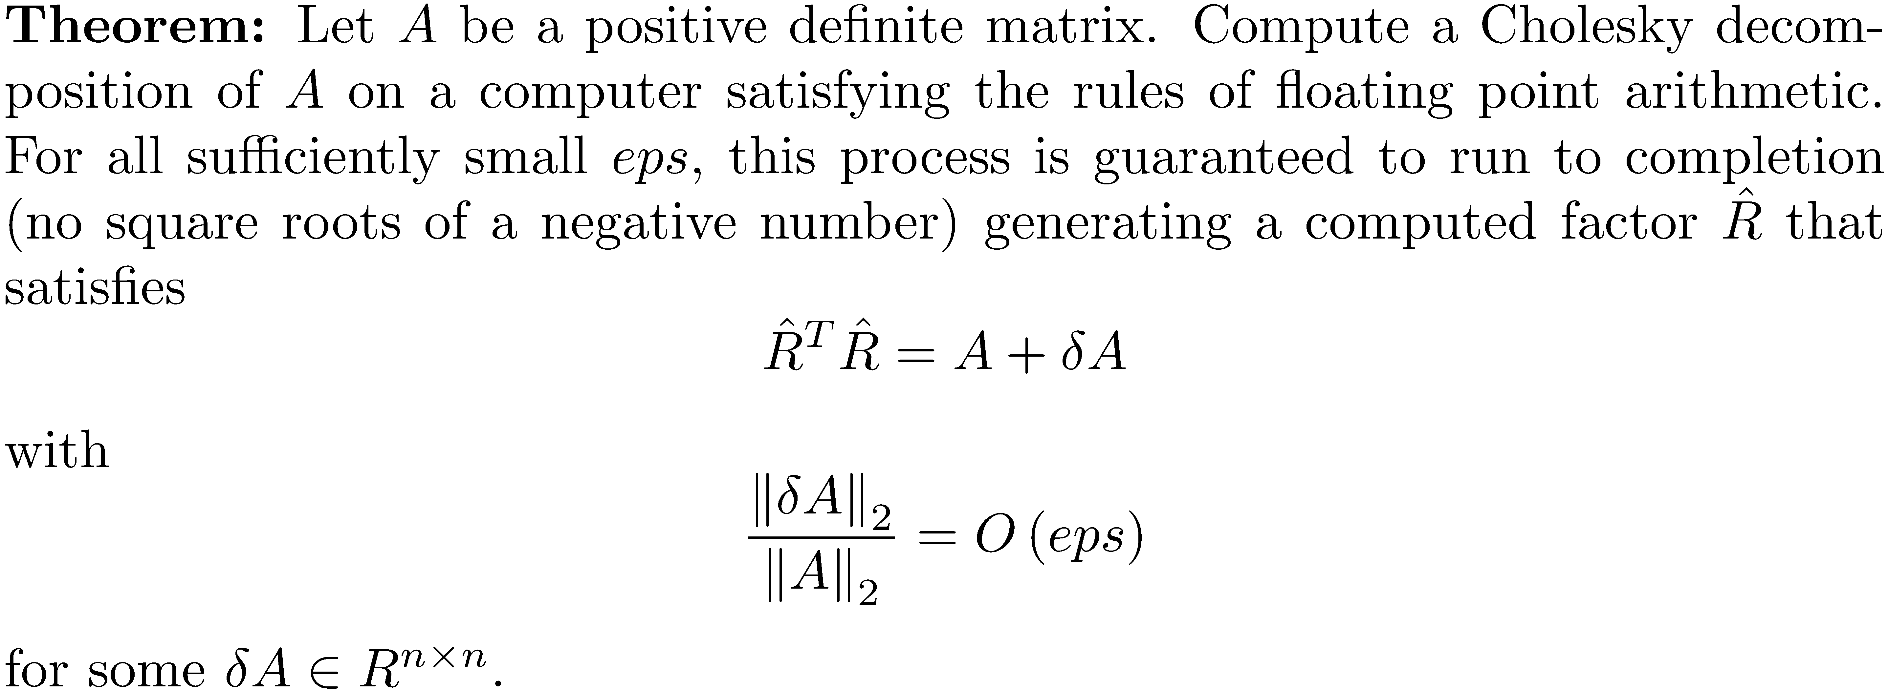
Stability of the Cholesky Decomposition
The Cholesky algorithm is backward stable.

Slide 35

Stability of the Cholesky Decomposition
It can be shown that solving Ax=b when A is positive definite is also backward stable and that pivoting is not necessary for stability.

