Slide 1
Introduction
Orthogonal vectors and matrices are of great importance in many fields of science and engineering.
Play an important role in least squares problems.
Used in the analysis of waves.
Applied in the finite element method for the numerical solution of partial differential equations.
Play a role in financial engineering.
Important in quantum mechanics.
Used in computer graphics to rotate an image without altering its size.
Used for a change of basis, such as constructing a basis for spherical or cylindrical coordinates.

Slide 2
Important Properties of Orthogonal Vectors and Matrices
If x₁ , x₂ , … , x_{k} are orthogonal, they are linearly independent.
If A is a real symmetric matrix, then any two eigenvectors corresponding to different eigenvalues are orthogonal.
If P is an orthogonal matrix, then P⁻¹ = P^{T} .
If P is an orthogonal matrix, then .
Let A be a real matrix n × n matrix. Then P is an orthogonal matrix if and only if the columns of P are orthogonal and have unit length.
For orthogonal matrices U and V ,

Slide 3
Gram-Schmidt Orthogonalization
The Gram-Schmidt algorithm takes a set of linearly independent vectors and transforms it into an orthonormal basis for the same subspace as the original vectors. Applications include
Building the QR decomposition.
Proving the Singular Value Decomposition theorem.
Developing the Arnoldi and Lanczos decompositions used in solving sparse systems and computing a few eigenvalues of sparse matrices.
TexPoint fonts used in EMF.
Read the TexPoint manual before you delete this box.: AAAAAAAAAA

Slide 4
The Projection Operation
Development of the Gram-Schmidt algorithms depends on the concept of projecting one vector onto another.

Slide 5
The Projection Operation
The figure depicts a projection.

Slide 6
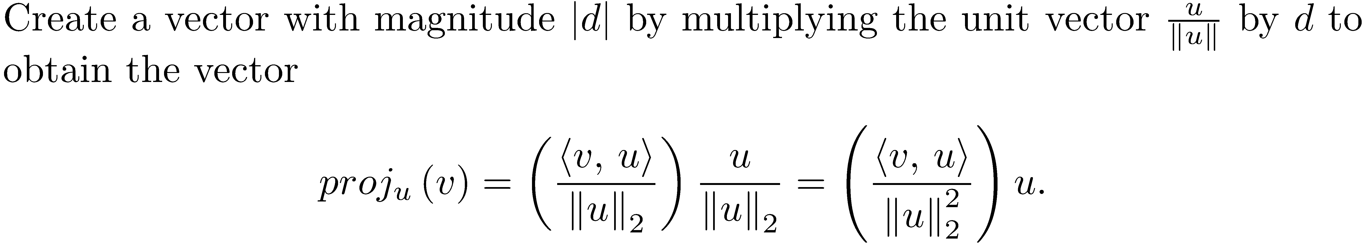
The Projection Operation Derivation

Slide 7
The Projection Operation
Remove the orthogonal projection of v onto u from by computing v - proj_{u}(v). This is a vector orthogonal to u.
Algebraic derivation.

Slide 8
The Gram-Schmidt Algorithm
The Gram-Schmidt algorithm starts with a linearly independent set of vectors v₁, v₂, ..., v_{n} and works by successively removing the orthogonal projection of v_{i} from the orthonormal vectors e₁ , e₂ , …, e_{i-1} already built from v₁ , v₂ , … , v_{i-1} . This will produce a vector orthogonal to e₁ , e₂ , … , e_{i-1} .

Slide 9
Gram-Schmidt Step 1
Normalize v₁ by computing and then assign .
In the steps that follow, define a set While not strictly necessary for building an orthonormal basis from v₁ , v₂ , … , v_{k} , these values will be used to form the upper triangular matrix used in the QR decomposition.

Slide 10
Gram-Schmidt Step 2
Define r₁₂ as the inner product <v₂, e₁>. Define a vector, u₂, normal to e₁, by removing the orthogonal projection of v₂ onto e₁.Then normalize u₂ to obtain e₂.

Slide 11
Gram-Schmidt Step 2
The first two steps of the Gram-Schmidt process.

Slide 12
Gram-Schmidt Step 3
Define r₁₃ and r₂₃, and obtain a vector u₃ normal to both e₁ and e₂ by removing the orthogonal projections of v₃ onto e₁ and e₂. Compute r₃₃ and normalize u₃ to get e₃.

Slide 13
Gram-Schmidt Steps 4-n
Continue in this fashion until all the vectors up to e_{n} are determined.

Slide 14
Gram-Schmidt General Formula
Let .
Compute . (u_{i} orthogonal to e₁,…,e_{i-1})
Let .
Normalize u_{i} to obtain

Slide 15
Example 1

Slide 16
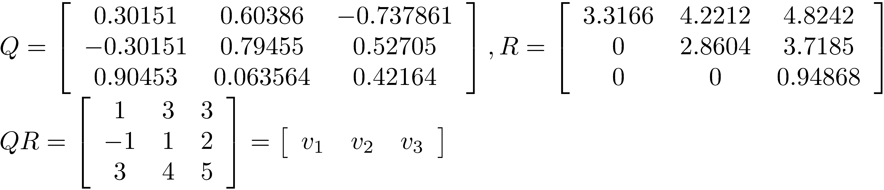
Example 1
Let Q be the matrix formed by the orthonormal vectors and form Q*R. This is a taste of the QR decomposition of a matrix.

Slide 17
The Classical Gram-Schmidt Algorithm
The algorithm name, clgrsch, reflects the fact that the process we have described is called classical Gram-Schmidt. Classical Gram-Schmidt has numerical stability problems, and we normally use a simple modification of the classical process.
NOTE: It is important to understand that there are n vectors to be orthonormalized, and the dimension of each vector is m ; however, the function does not compute the values r_{ij} . The are needed when developing the QR decomposition of a matrix.

Slide 18
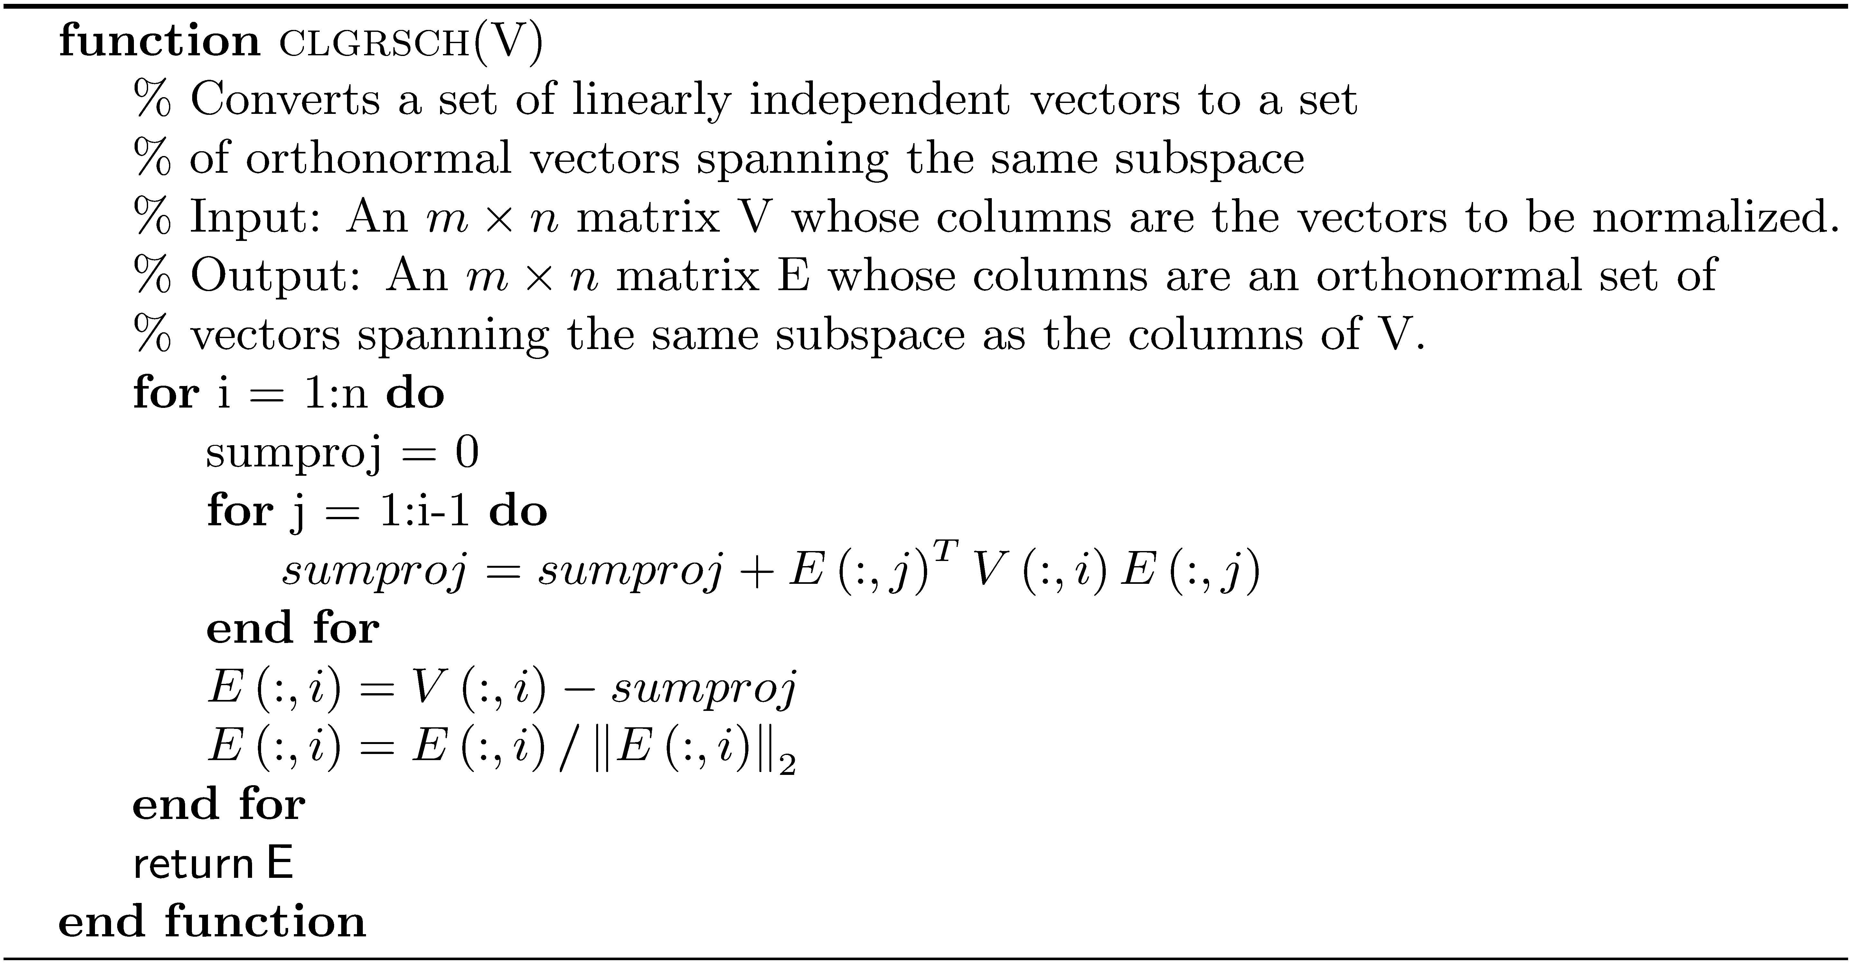
Classical Gram-Schmidt

Slide 19
Numerical Stability of Gram-Schmidt
During the execution of the Gram-Schmidt algorithm, the vectors u_{i} are often not quite orthogonal, due to rounding errors.
The computation also yields poor results when some of the vectors are almost linearly dependent.
The classical Gram-Schmidt process is numerically unstable

Slide 20
The Modified Gram-Schmidt Process
The computation of u_{i} using the formula subtracts off all the projections at once, which creates more errors.

Slide 21
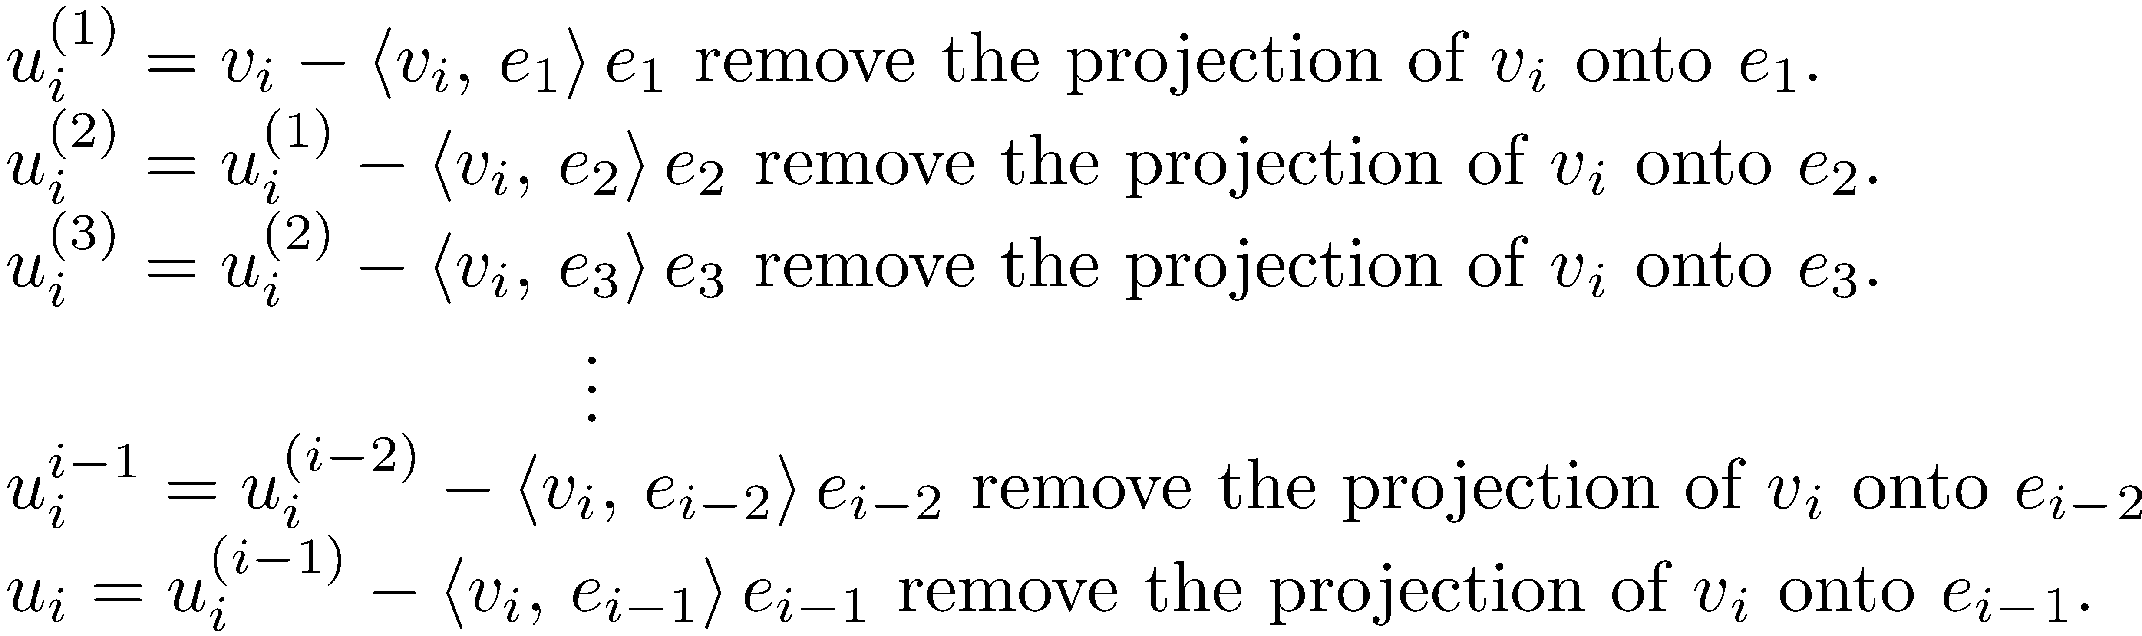
The Modified Gram-Schmidt Process
Split the computation into smaller parts by removing the projections one at a time.

Slide 22
The Modified Gram-Schmidt Process
This modified Gram-Schmidt process (MGS) gives the same result as the original formula in exact arithmetic, but it introduces smaller errors in finite-precision arithmetic.

Slide 23
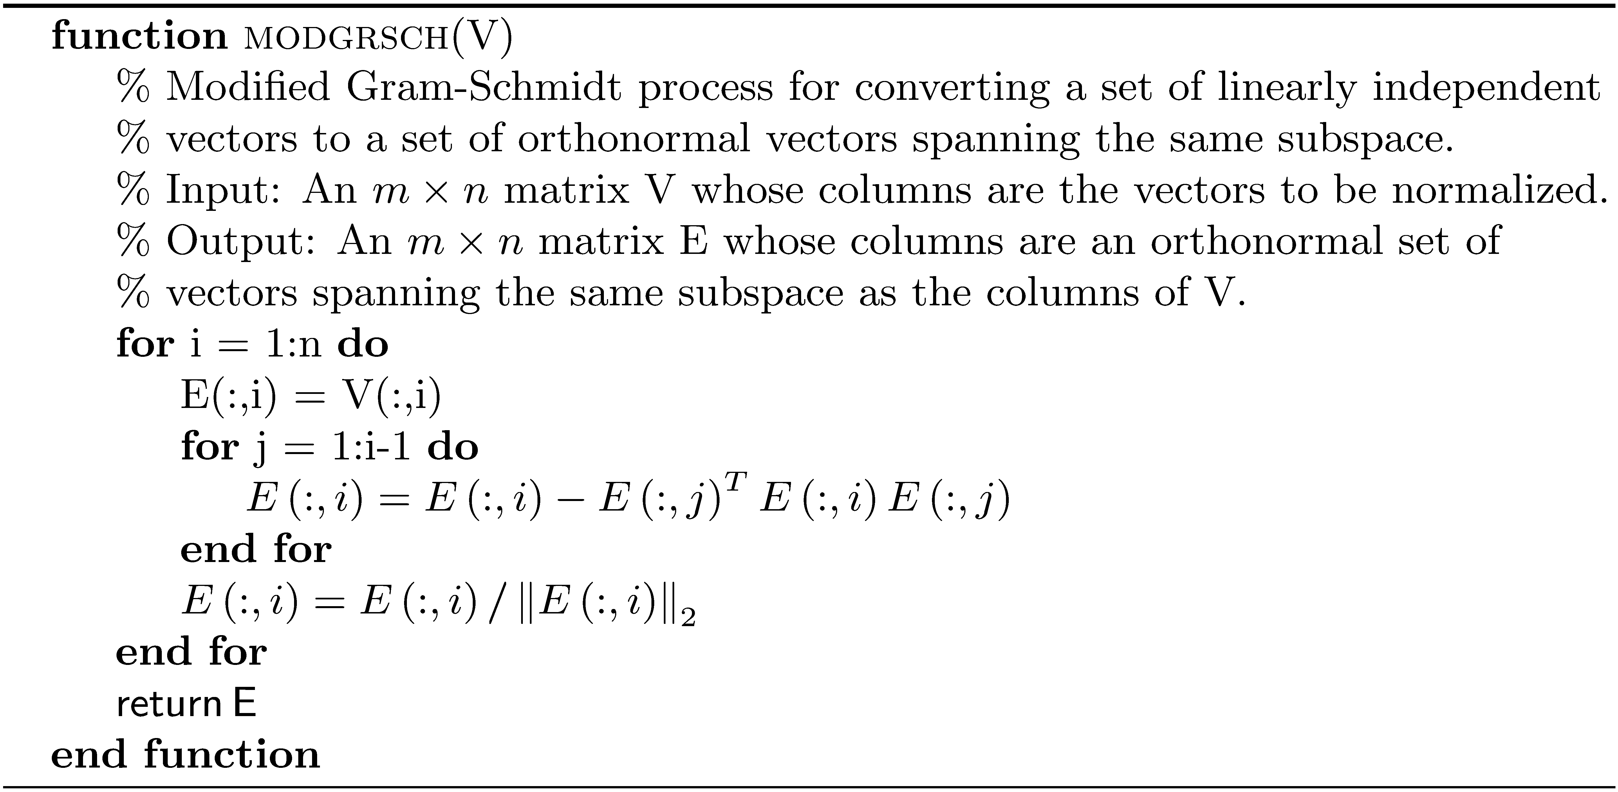
Modified Gram-Schmidt

Slide 24
Example 2
Find an orthonormal basis for the subspace spanned by the vectors
>> A = [1 2 9;0 -1 12;-1 3 3;6 0 2];
>> rank(A)
ans =
3
>> E = modgrsch(A)
E =
0.1622 0.5421 0.4311
0 -0.2675 0.8995
-0.1622 0.7955 0.0124
0.9733 0.0422 -0.0698
>> norm(E)
ans =
1.0000
Orthonormal basis:
The columns of E are orthonormal.

Slide 25
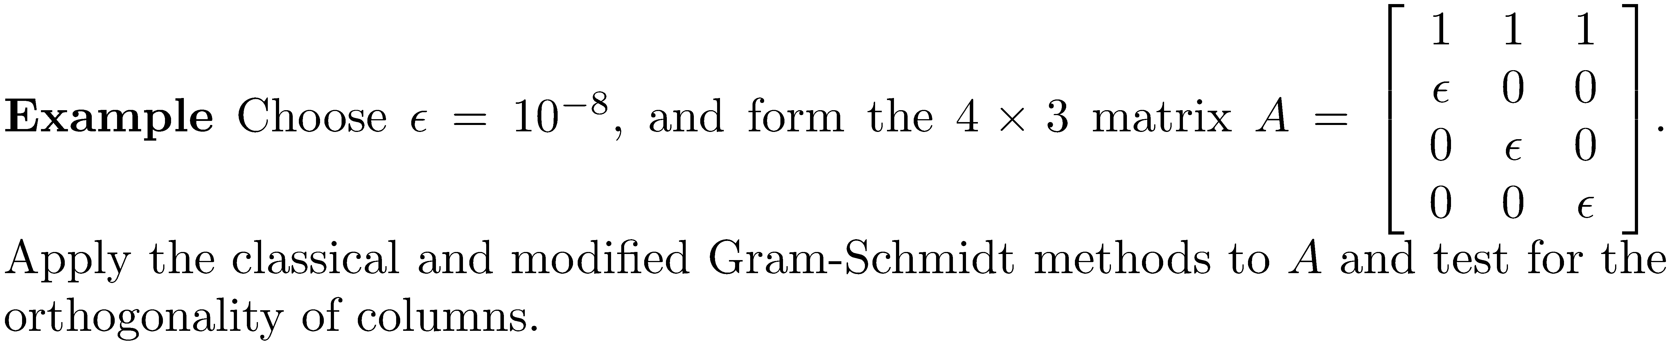
Example 3
>> epsilon = 1.0e-8;
>> A = [1 1 1;epsilon 0 0;0 epsilon 0;0 0 epsilon];
>> E1 = clgrsch(A);
>> E2 = modgrsch(A);
>> E1(:,2)'*E1(:,3)
ans =
0.500000000000000
>> E2(:,2)'*E2(:,3)
ans =
1.1102e-016
Columns 2 and 3 and not orthogonal.
Columns 2 and 3 and orthogonal to machine precision.

Slide 26
Example 3
The huge difference between the results is caused by the fact that the columns are almost equal, and cancellation errors occur when using the classical method.

Slide 27
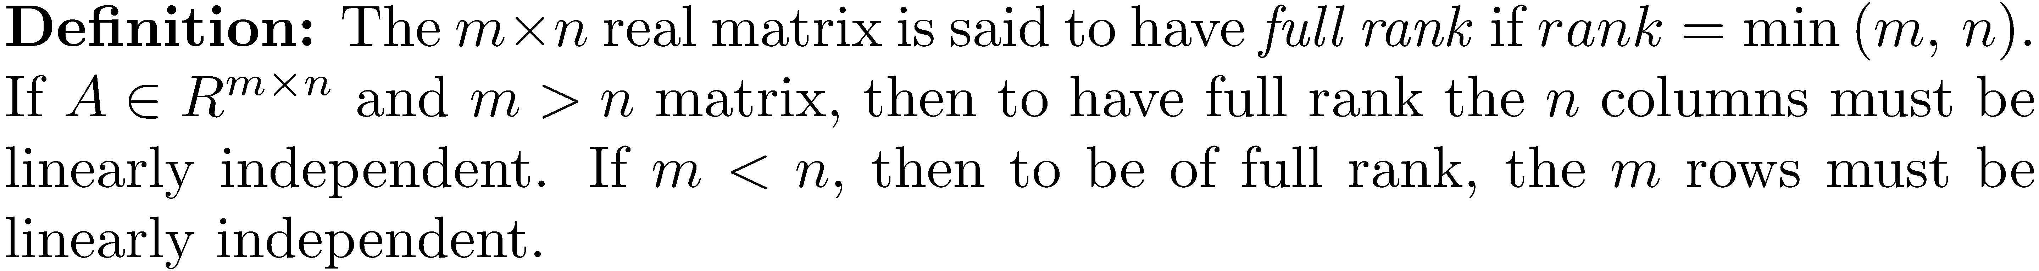
Full Rank Matrix

Slide 28
The QR Decomposition
The application of the Gram-Schmidt process to the column vectors of an m x n full column rank matrix A (the columns are linearly independent) yields the QR factorization. The matrix A is decomposed into an m x n matrix with orthonormal columns and an n x n upper- triangular matrix. Stated formally, we have

Slide 29
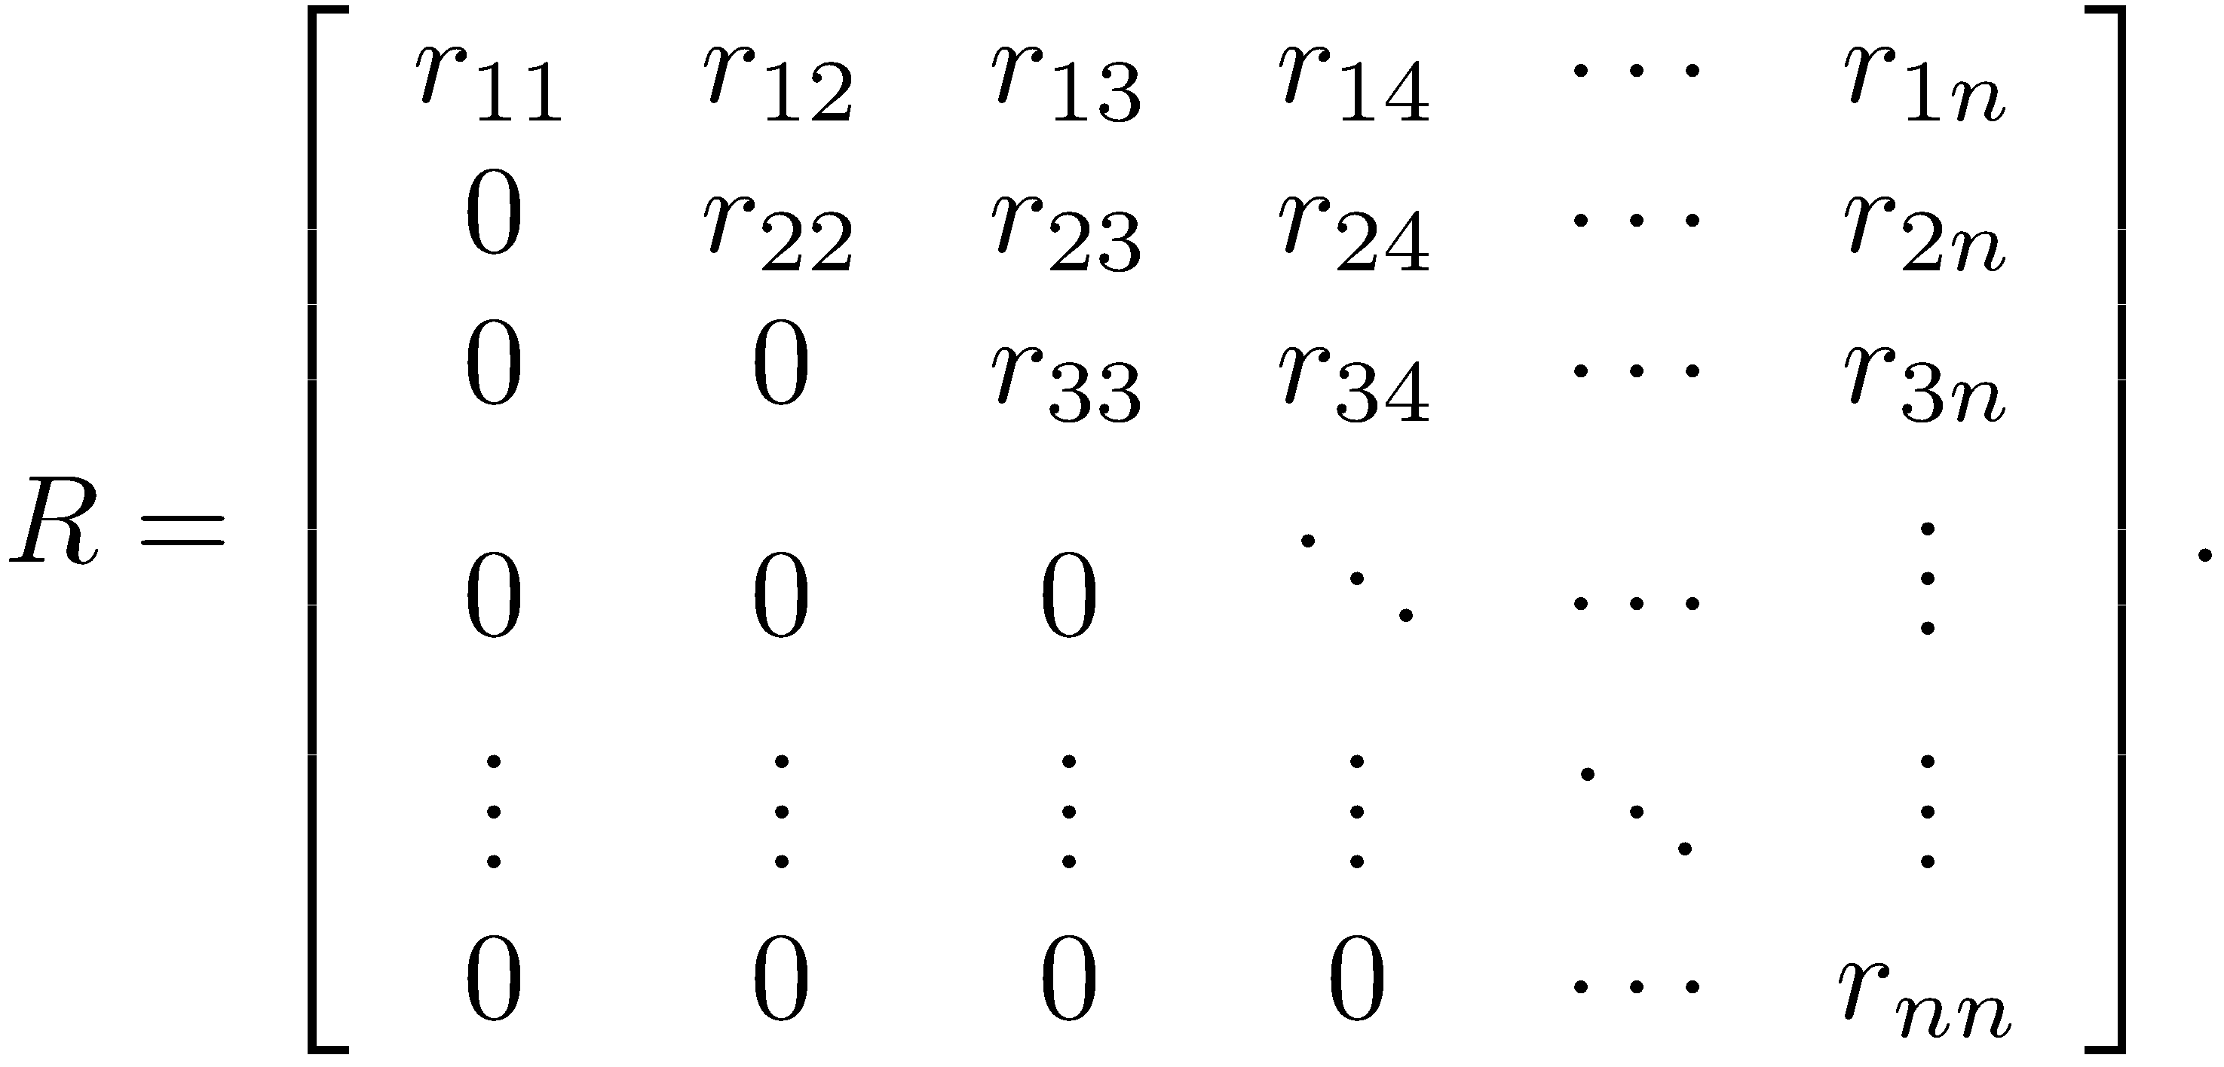
The QR Decomposition
Arrange the equations for Gram-Schmidt so the v's are on the left-hand side.
Form the matrix Q whose columns are the orthonormal vectors e₁, e₂, …, e_{n}, and let
It is straightforward to show that A = QR using the formula for the v_{k}.

Slide 30
The QR Algorithm
Use the modified Gram-Schmidt process to compute the e_{i} and the r_{ij}.

Slide 31
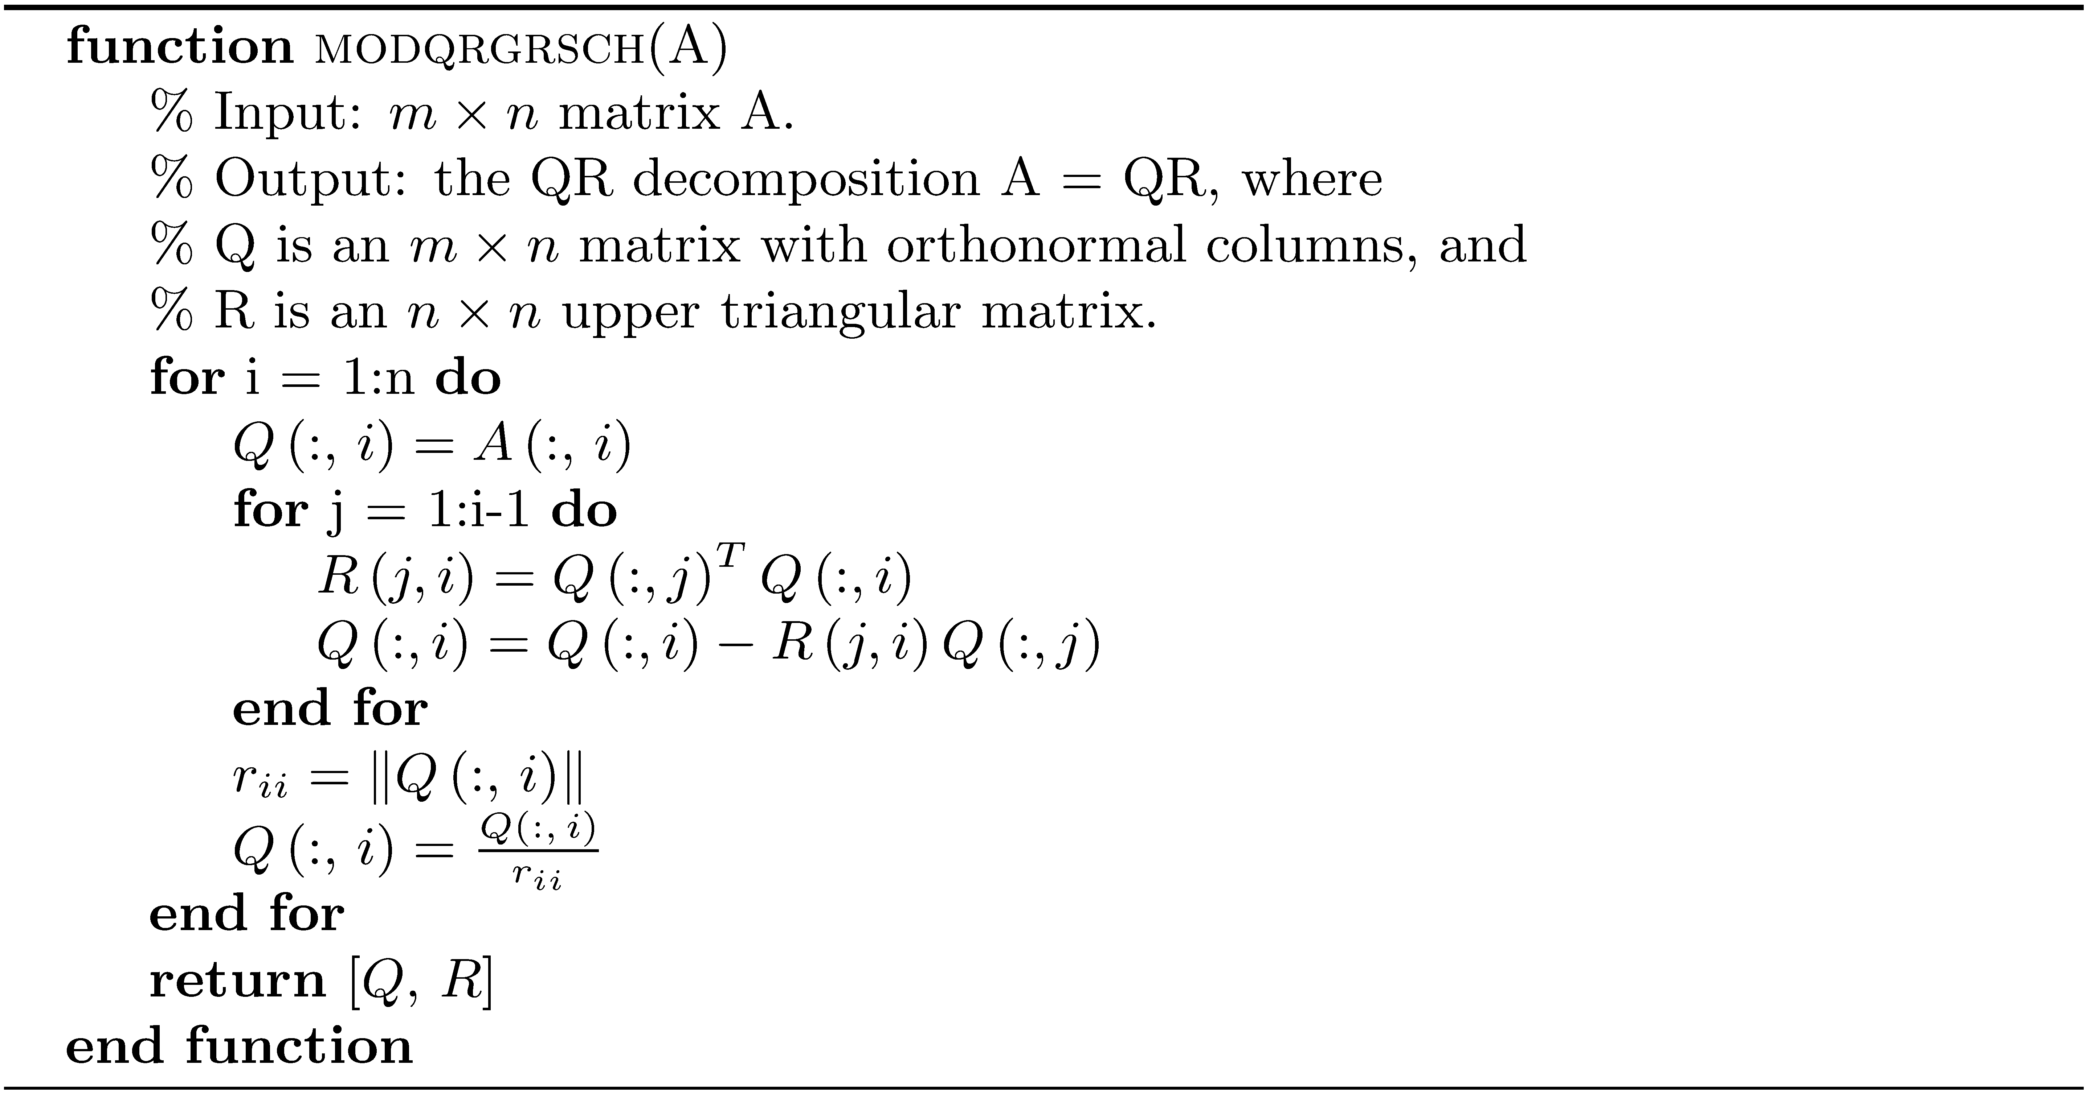
Modified Gram-Schmidt QR Decomposition

Slide 32
Example 4
Find the QR decomposition of the full-rank matrix
>> rank(A)
ans =
4
>> [Q,R] = modqrgrsch(A)
Q =
0.4419 -0.3516 -0.4105 0.5408
0.4419 -0.0391 0.8360 0.1442
-0.1768 -0.7344 -0.0464 -0.0369
0.2652 -0.3359 0.1279 0.1048
-0.6187 0.0547 0.2314 0.7437
0.3536 0.4688 -0.2461 0.3482
R =
11.3137 -9.8995 7.0711 -1.1490
0 16.0000 11.4375 0.5391
0 0 7.5620 -8.7332
0 0 0 5.7550
>> norm(Q)
ans =
1.0000
>> norm(A-Q*R)
ans =
8.8818e-16

Slide 33
Example 5
There are algorithms (Chapter 17) that compute a QR decomposition of any m × n matrix, even if m < n when the maximum rank of A is m. Using Gram-Schmidt, find a decomposition for A of some type.

Slide 34
Example 5
A has rank 3, so it is a full-rank matrix. The matrix A^{T} is a full-rank 5 × 3 matrix, so Gram-Schmidt applies. Proceed as follows: A^{T} = Q*R A = R^{T}*Q^{T} This is an LQ decomposition of A.

Slide 35
Example 5
>> B = A';
>> [Q,R] = modqrgrsch(B)
Q =
0.518562978841732 0.450598450069787 -0.101969284831130
-0.518562978841732 -0.260452295607714 -0.489700460588686
0.453742606486515 -0.477229564140105 0.392571880195899
-0.324101861776082 0.684952253888589 0.336419708711123
-0.388922234131299 -0.179493708833946 0.694625670646022
R =
15.427248620541512 5.574552022548614 6.482037235521643
0 15.777337219819419 -4.001591200206040
0 0 5.474528394642274
>> norm(A - R'*Q')
ans =
9.930136612989092e-16
>> norm(Q')
ans =
1
3 × 5 matrix with
orthonormal columns
3 × 3 lower-triangular
matrix

Slide 36
The Reduced and Full QR Decomposition
Gram-Schmidt produces an m × n matrix Q with orthonormal columns and an n × n upper triangular matrix R. This called the reduced QR decomposition.
The full QR decomposition produces an m × m orthogonal matrix Q and an m × n upper triangular matrix R. The full QR decomposition provides more information about the matrix A. The reduced decomposition requires less space.

Slide 37
The Reduced and Full QR Decomposition
The MATLAB function qr finds the QR decomposition of a matrix.
qr(A) returns the full QR decomposition.
qr(A,0) returns the reduced QR decomposition. If m ≤ n, the result is the same as qr(A) (an m × m matrix Q and an m × n matrix R).

Slide 38
Flop Count for MGS
The flop count for MGS is

Slide 39
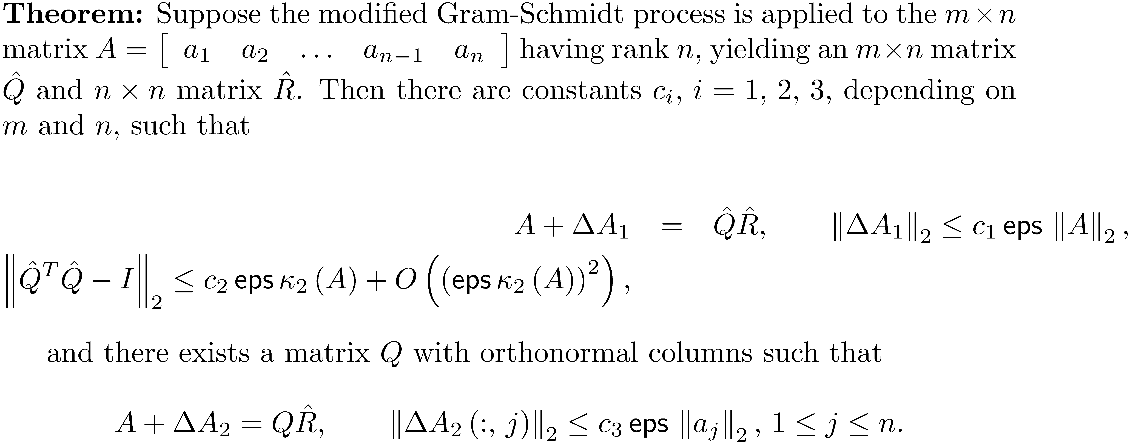
Stability of MGS

Slide 40
Stability of MGS
Conclusions from the stability theorem for MGS.
The residual is small.
How close is to having orthonormal columns depends on the condition number of A . If A is well conditioned, then has close to orthonormal columns.
is the exact upper triangular factor of a matrix near to A .

Slide 41
Computing the Determinant of a Matrix
The QR factorization can be used to compute the absolute value of a determinant.

Slide 42
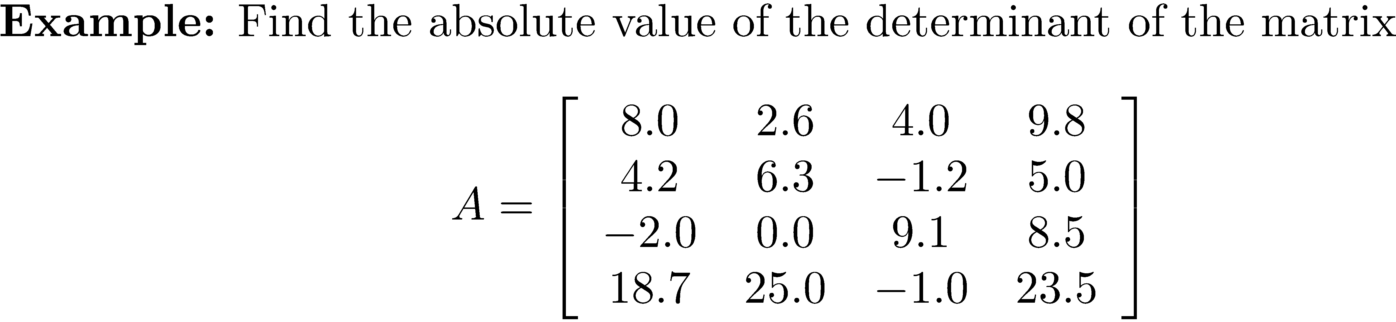
Example 6
>> [Q R] = modqrgrsch(A);
>> abs(prod(diag(R)))
ans = 519.8238
>> det(A)
ans = -519.8238

Slide 43
Finding an Orthonormal Basis for the Range of a Matrix
Recall that

Slide 44
Example 7
From Example 2, is an orthonormal basis for the range of

