Slide 1
Introduction
Section 12.3 discusses the determination of a degree n polynomial that fits m data points. The solution involves solving an (n+1) × (n+1) linear system for the polynomial coefficients a₀, a₁, …., a_{n}.
In many areas such as curve fitting, statistics, and geodetic modeling A is either singular or has dimension m × n, m ≠ n.
If m > n, the system has more equations than unknowns and is said to be overdetermined.
If m < n, the system has more unknowns than equations and is said to be underdetermined.

Slide 2
Introduction
m > n Overdetermined system. Usually no solution.
m < n Undetermined system. Usually infinitely many solutions.
Overdetermined system
Underdetermined system

Slide 3
Linear Systems
If there exists an n x 1 vector x that satisfies the system
Ax = b, we say it is consistent; otherwise, it is inconsistent.
The system Ax = b is consistent if and only if , i.e. b can be written as a linear combination of the rows of A.
If the system is consistent and the rows of A are linearly independent, then the solution is unique.
If the system is consistent and the rows of A are linearly dependent, then there are an infinite number of solutions.

Slide 4
Linear Systems
Singular, and over- or under-determined systems either have no solution or infinitely many solutions in the exact sense, so Gaussian elimination is normally not useful.
Find an x such that Ax is close to b in the least-squares sense.
Find vector x such that is minimum. It is possible that the solution x will not be unique.

Slide 5
Geometric Interpretation of Least-Squares
Assume m > n. A is a linear transformation from R^{n} to R^{m}, so the range of A, R(A), is a subset of R^{m}. If b is contained in R(A), there is a solution; otherwise, project b onto R(A) to obtain vector u = Ax. The vector b – Ax is orthogonal to R(A) and is the minimum value we want.

Slide 6
Geometric Interpretation of Least-Squares

Slide 7
The Normal Equations
R(A) is a linear combination of the columns of A and b - Ax is perpendicular to every vector in R(A), so b - Ax is perpendicular to every column of A. If v_{i} are the columns of A,
x must satisfy the n × n normal equations
n × m
m × n
n × 1
n × n
n × 1
NOTE: This geometrical argument is not a proof.

Slide 8
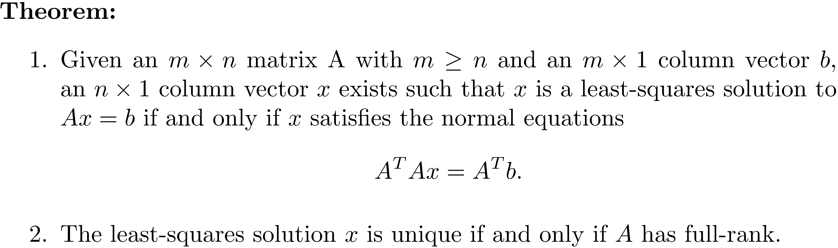
Existence and Uniqueness of Least-Squares Solutions, m ≥ n

Slide 9
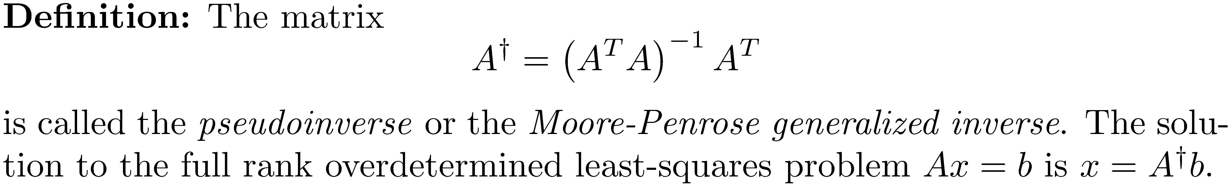
The Pseudoinverse, m ≥ n
If m ≥ n and A has full rank, then A^{T}A is nonsingular, and is defined, so
If m = n and A has full rank, then

Slide 10
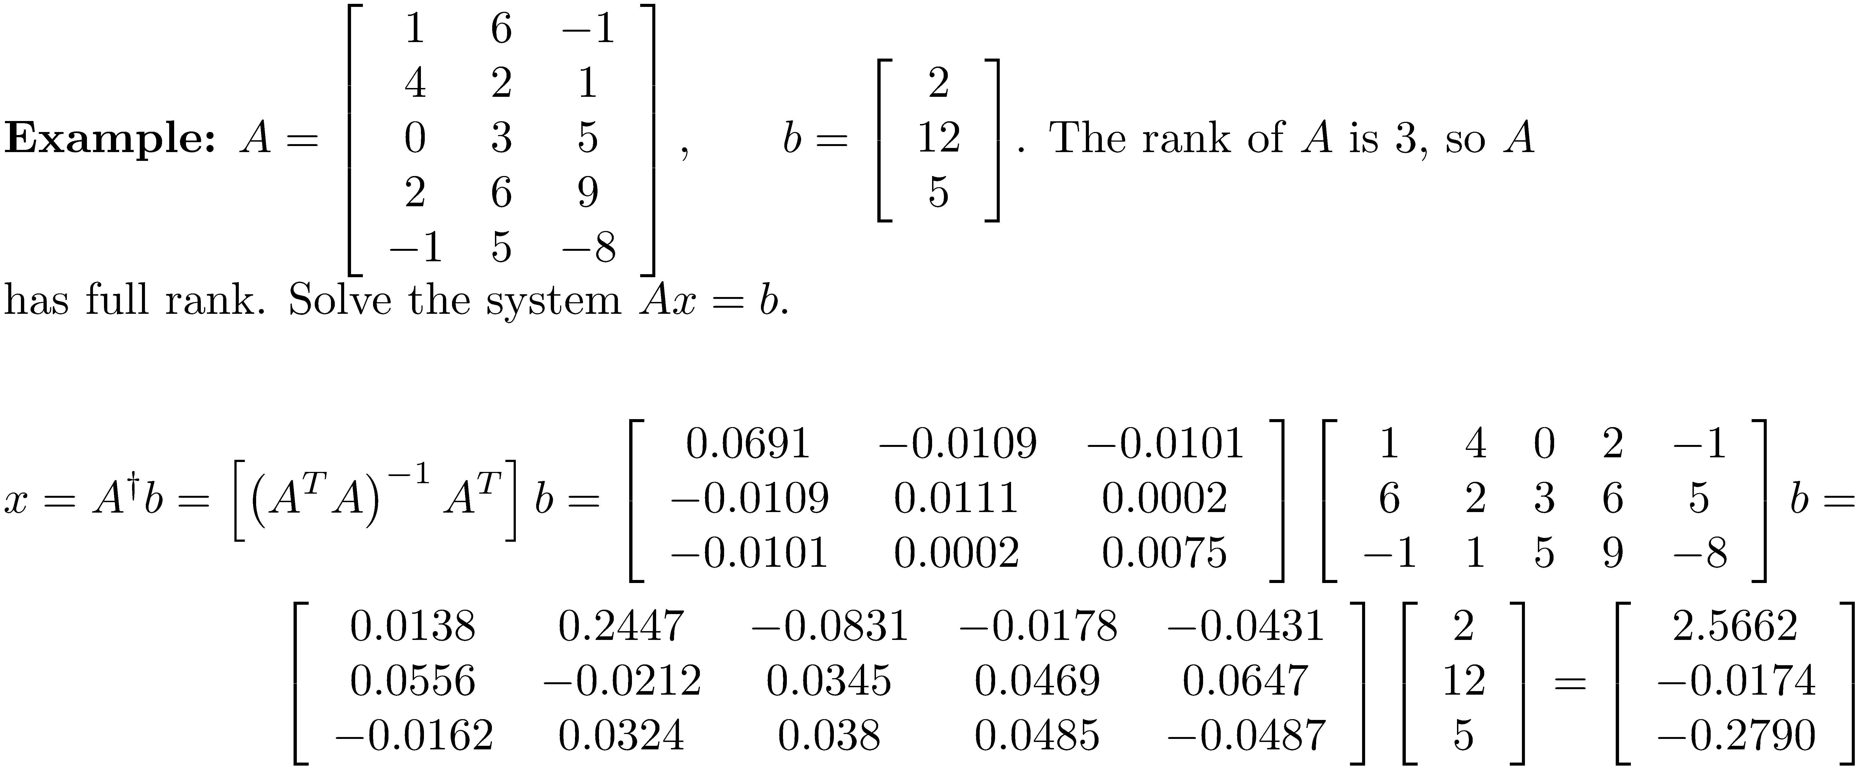
Example 1

Slide 11
Condition Number of a General Matrix
Since for a square invertible matrix, the following definition makes sense.
It can be shown that , where r is the rank of A, so .

Slide 12
Example 2
A Vandermonde matrix is ill-conditioned.
>> x = [1.1 1.9 2.0 2.1 2.5 3.0 3.5 3.8 4.0]'
x =
1.1000
1.9000
2.0000
2.1000
2.5000
3.0000
3.5000
3.8000
4.0000
>> V = vandermonde(x,3);
>> norm(inv(V'*V)*V')*norm(V)
ans =
1.3420e+03
>> cond(V)
ans =
1.3420e+03

Slide 13
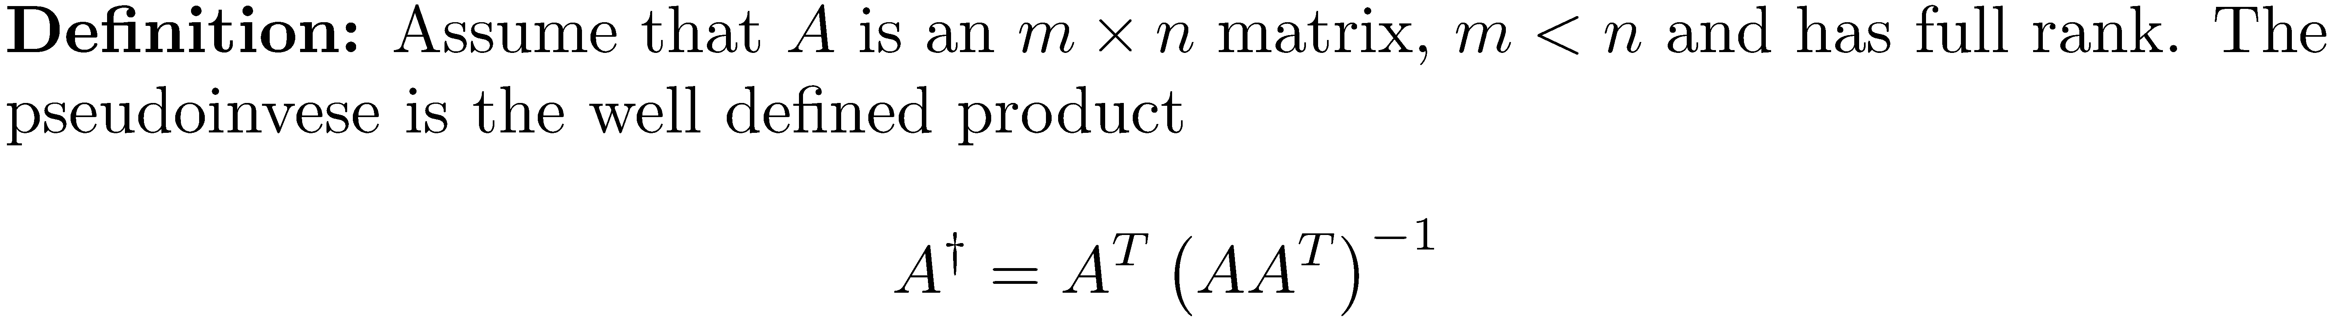
The Pseudoinverse, m < n
Find the pseudoinverse of A^{T} and transpose back.

Slide 14
Solving Overdetermined Least-Squares Problems
Three basic methods for solving full rank overdetermined least-squares problems:
Solve the normal equations.
Use the QR decomposition.
Use the SVD.

Slide 15
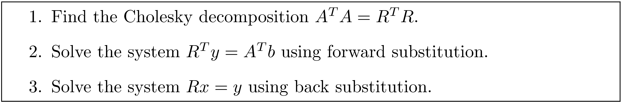
Solving the Least-Squares Problem using the Normal Equations
If A has full-rank, then the A^{T}A is positive definite and the Cholesky factorization applies. A^{T}A = R^{T}R where R is an upper-triangular matrix. Solve the normal equations as follows:

Slide 16
Example 3
There are 3 mountains m₁ ,m₂ ,m₃ that from one site have been measured as 2474 ft., 3882 ft., and 4834 ft. But from m₁ , m₂ looks 1422 ft. taller and m₃ looks 2354 ft. taller, and from m₂ , m₃ looks 950 ft. taller. This data gives rise to an overdetermined set of linear equations:
m₁ |  |  |  | 2474
 | m₂ |  | = | 3882
 |  | m₃ | = | 4834
-m₁ | + m₂ |  | = | 1422
-m₁ |  | + m₃ | = | 2354
 | - m₂ | + m₃ | = | 950

Slide 17
Example 3

Slide 18
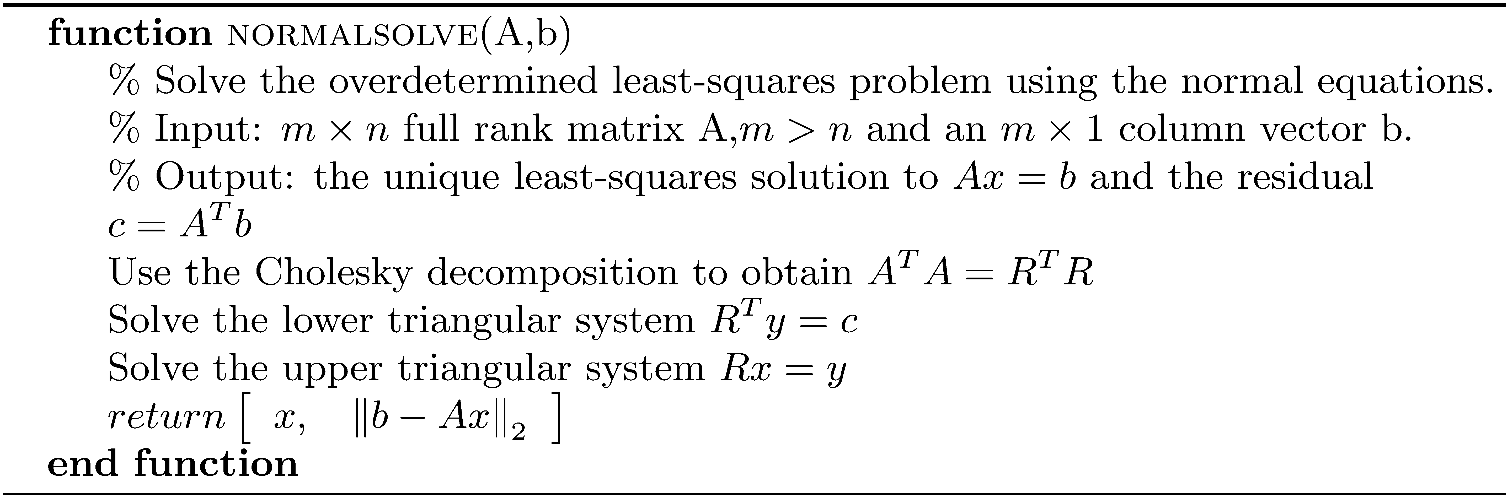
Algorithm normalsolve
Approximate flop count:

Slide 19
Example 4
>> format shortg
>> M = [1 0 0;0 1 0;0 0 1;-1 1 0;-1 0 1;0 -1 1];
>> b = [2474 3882 4834 1422 2354 950]';
>> m = normalsolve(M,b)
m =
2472
3886
4832

Slide 20
Reasons Not to Use the Normal Equations
There may be some loss of significant digits when computing A^{T}A. It may even be singular to working precision.
The accuracy of the solution using the normal equations depends on the square of condition number of the matrix. If κ(A) is large, the results can be seriously in error.

Slide 21
Solving the Least-Squares Problem using the Reduced QR Decomposition, m ≥ n
Find the reduced QR decomposition
The diagonal entries of R are all greater than 0, so R^{T} is invertible.
Use the QR decomposition in the normal equations
Compute x using back substitution.

Slide 22
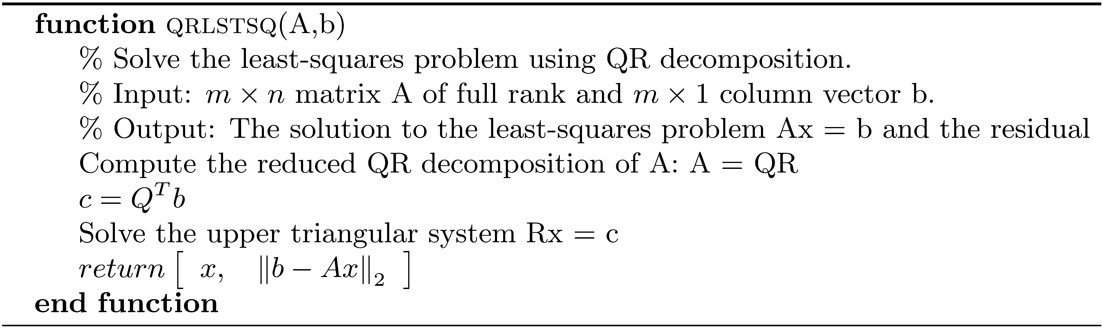
Algorithm qrlstsq
Using Householder reflections introduced in Chapter 17, the flop count is approximately

Slide 23
Example 5
The table shows the length-weight relation for a species of salmon. Find a power function that best fits the data.
L | 0.5 | 1.0 | 2.0
W | 1.77 | 10 | 56.6

Slide 24
Example 5
Take the natural logarithm of both sides to obtain ln(W) = ln(α) + βln(L).
Perform a change of variable. Let y=ln(W) , x=ln(L) , b=ln( α ), and m= β.
Then we have the equation y = mx + b
We want the line which best fits the data.
u | -0.6931 | 0.0000 | 0.6931
w | 0.5710 | 2.3026 | 4.0360

Slide 25
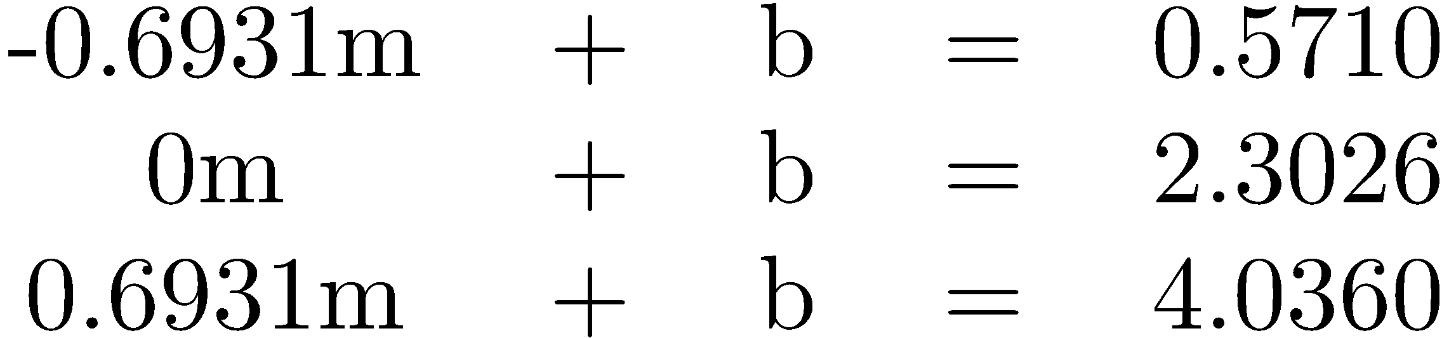
Example 5
Find b and m such that Solve the least-squares problem for b and m.

Slide 26
Example 5
Solve the least-squares problem using the MATLAB function qrlstsq.
Find the corresponding power function. The power function that best fits the data is
>> A = [-0.6931 1;0 1;0.6931 1];
>> b = [0.5710 2.3026 4.0360]';
>> x = qrlstsq(A,b)
x = 2.4996
2.3032

Slide 27
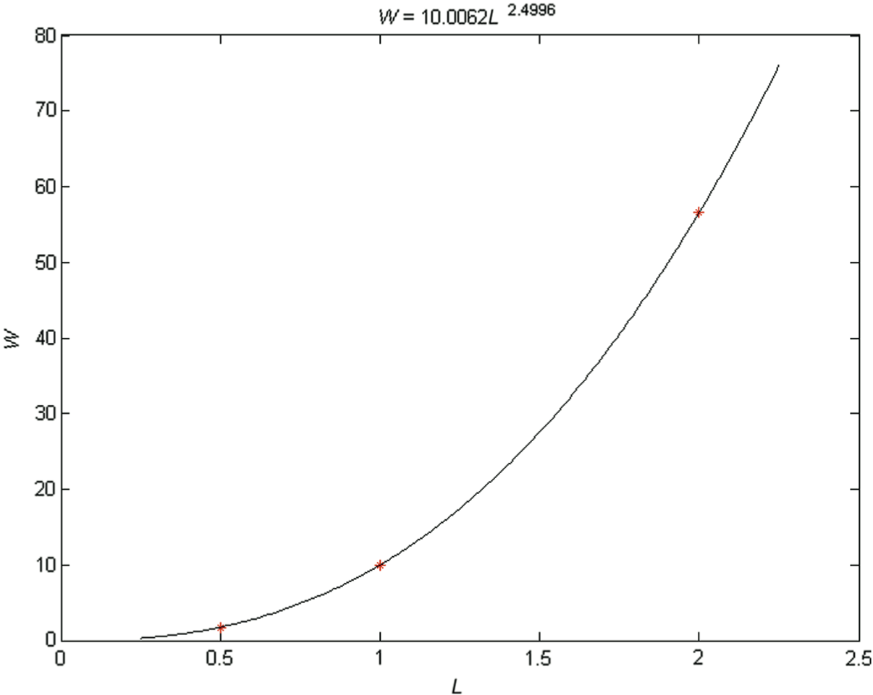
Example 5

Slide 28
The Reduced SVD
Just like the QR decomposition, there is a reduced SVD, and it has the form This reduced form of the SVD is faster to calculate and is sufficient for many applications. In MATLAB, use the command svd(A,0) to obtain a reduced form of the SVD.

Slide 29
The Reduced SVD

Slide 30
Solving the Least-Squares Problem using the Reduced SVD, m ≥ n
Apply the reduced SVD to A and obtain where , are orthogonal and
Inserting the SVD into the normal equations, we have and so
V is invertible and, since the diagonal elements of are nonzero is invertible, and

Slide 31
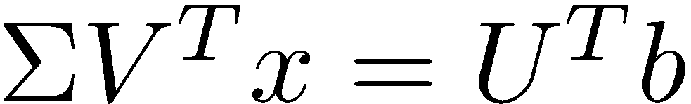
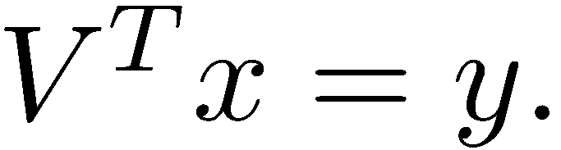
Solving the Least-Squares Problem using the Reduced SVD, m ≥ n
Solve
Solve
Let

Slide 32
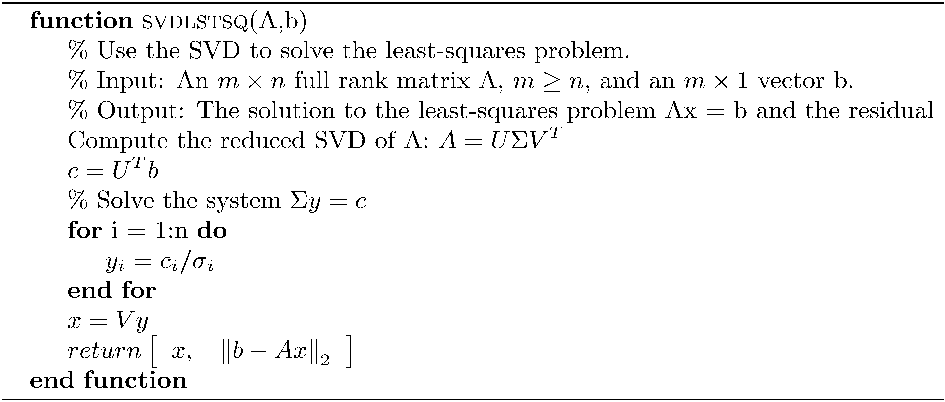
Algorithm svdlstsq
Flop count:

Slide 33
Example 6
The velocity of an enzymatic reaction with Michaelis-Menton kinetics is given by Find the Michaelis-Menton equation which best fits the data:
s | 1 | 4 | 6 | 16
v | 4 | 10 | 12 | 16

Slide 34
Example 6
Inverting the equation gives the Lineweaver-Burke equation:

Slide 35
Example 6
Perform the change of variables and let , The Lineweaver-Burke equation then becomes Recompute the table to reflect the change of variables.
x | 1.0000 | 0.2500 | 0.1667 | 0.0625
y | 0.2500 | 0.1000 | 0.0833 | 0.0625

Slide 36
Example 6
Solve the following 4 x 2 set of equations: that correspond to the matrix equation
1.0000m + b = 0.2500
0.2500m + b = 0.1000
0.1667m + b = 0.0833
0.0625m + b = 0.0625

Slide 37
Example 6
>> A = [1.0000 1.0000;0.2500 1.0000;0.1667 1.0000;0.0625 1.0000];
>> b = [0.2500 0.1000 0.0833 0.0625]';
>> x = svdlstsq(A,b);
>> m = x(1);
>> b = x(2);
>> alpha = 1/m
alpha = 4.9996
>> beta = alpha*b
beta = 0.2499

Slide 38
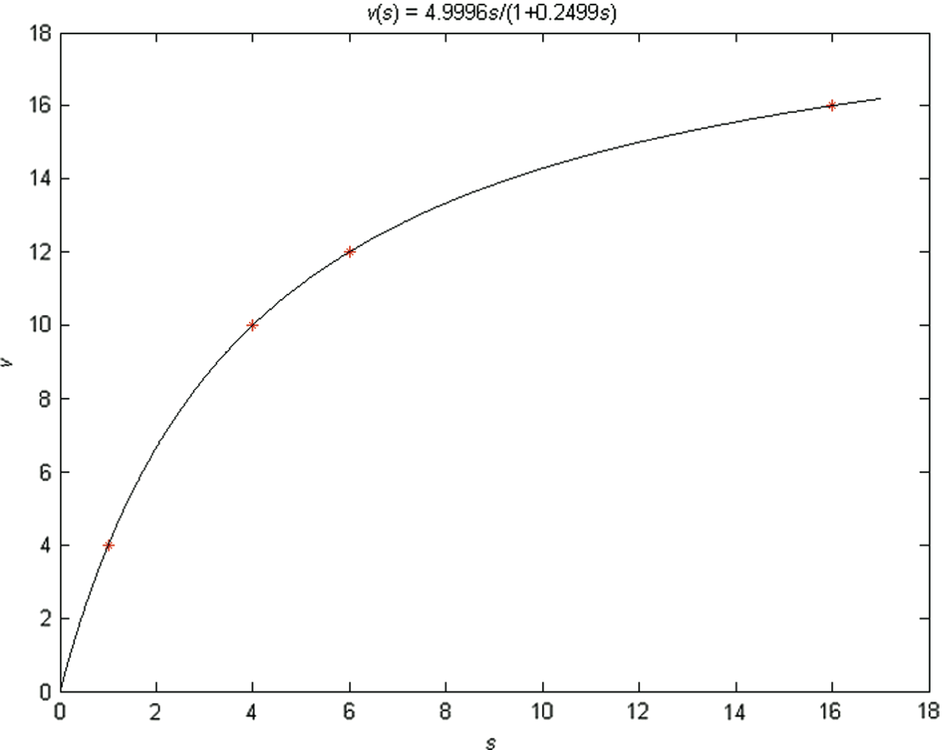
Example 6

Slide 39
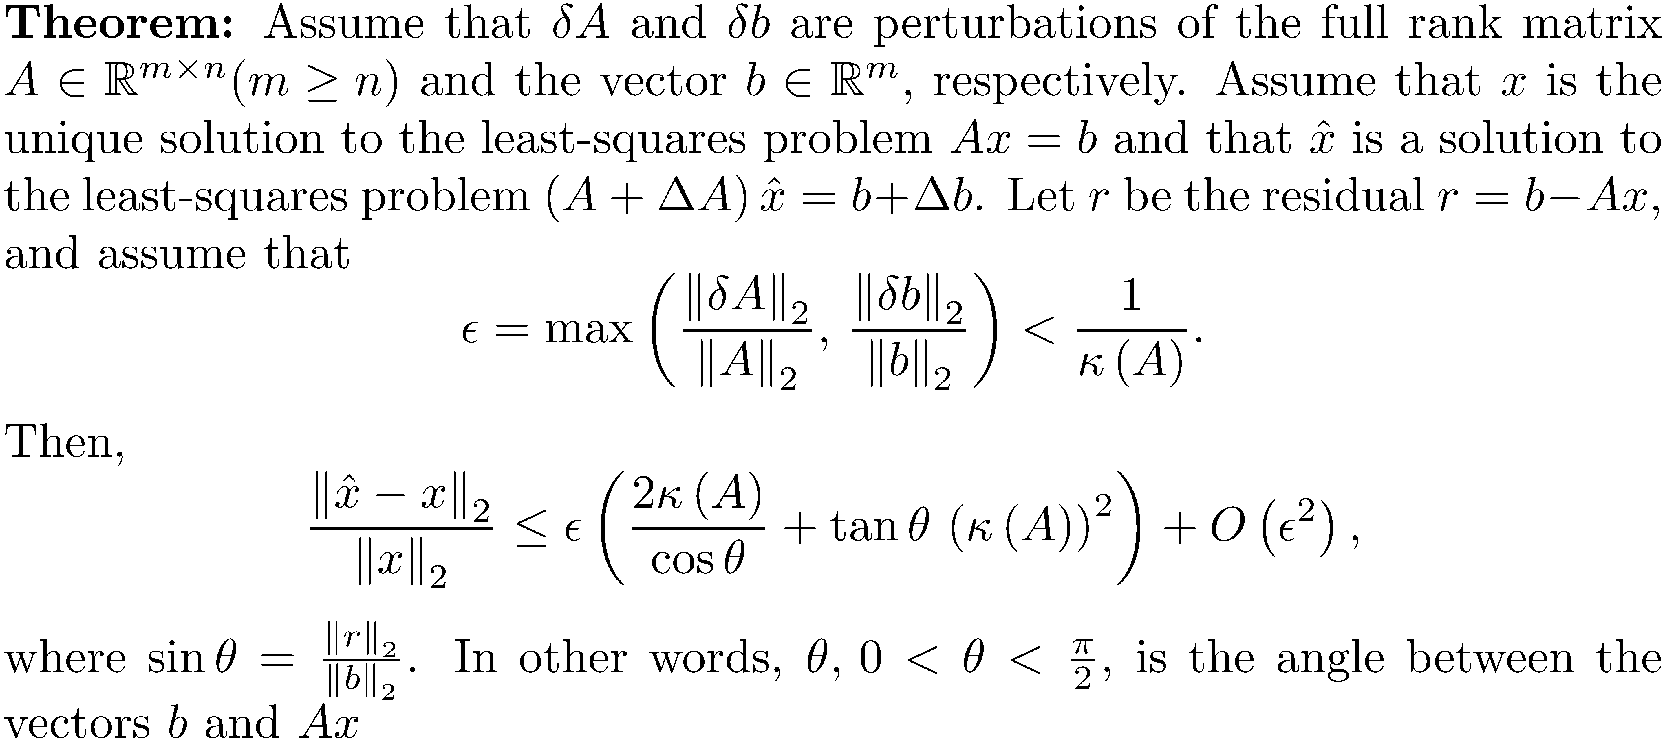
Conditioning of Least-Squares Problems

Slide 40
Conditioning of Least-Squares Problems
Consequences of the theorem:
If θ is small, the residual is small, and the sensitivity to perturbations depends on κ (A) .
If θ is not close to π/2 , but κ (A) is large, then the sensitivity depends on ( κ (A) )² .
If θ is near π/2 , the solution is nearly zero, but the solution to the least-squares problem, , produced by perturbations in A and b will not be zero, and will be very large.

Slide 41
Example 7
Let A be the matrix with ε = 0.01. Let and solve the least-squares problem Ax = b using the SVD. Then perturb the nonzero elements of A by the same random value in the range and perturb b by random values in the range . Compute the solution to the new problem.
Condition number = 223.6090

Slide 42
Example 7
Run the m-file example7.m.
epsilon = .01;
A = [1 1 1 1 1;epsilon 0 0 0 0;0 epsilon 0 0 0;
0 0 epsilon 0 0;0 0 0 epsilon 0;0 0 0 0 epsilon];
b = ones(6,1);
B = .00001*rand*A + A;
c = b + .001*rand(6,1);
x = svdlstsq(A,b);
y = svdlstsq(B,c);
fprintf('norm(x-y) = %g\n',norm(x-y));
<Run>
norm(x-y) = 0.06251
The error can be bounded by the
square of the condition number.

Slide 43
Sensitivity when using the Normal Equations
When using the normal equations, the relative error is always bounded by the square of the condition number of A.
Use of the normal equations can lose twice as many digits of accuracy compared to the use of the QR or SVD algorithms. Use only when the condition number of A is small.

Slide 44
Rank-Deficient Least-Squares Problems
Assume m ≥ n and rank(A) < n. A is said to be rank-deficient.
The solution to rank-deficient or nearly rank-deficient problems is to make a wise choice among the solutions, and the choice is to pick the solution with the smallest 2-norm, the minimum norm solution.

Slide 45
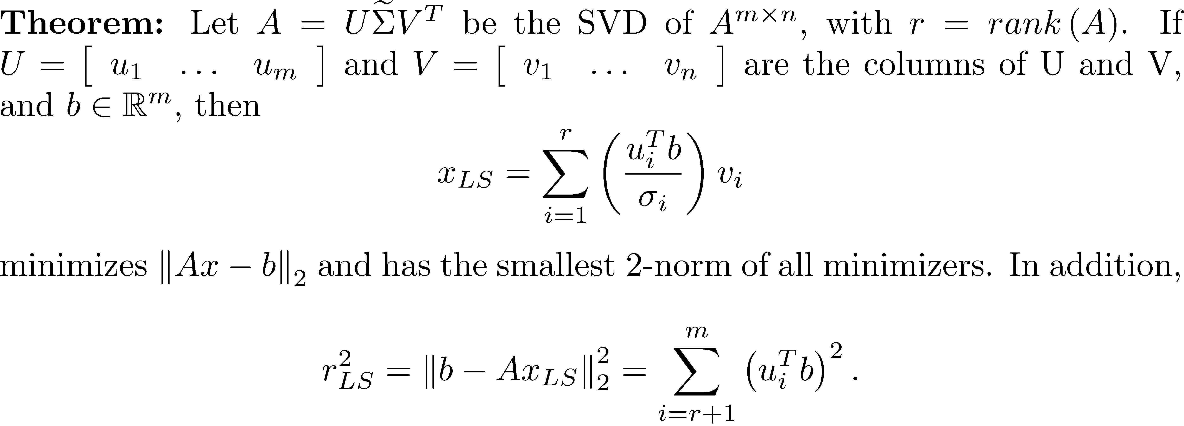
Rank-Deficient Least-Squares Problems

Slide 46
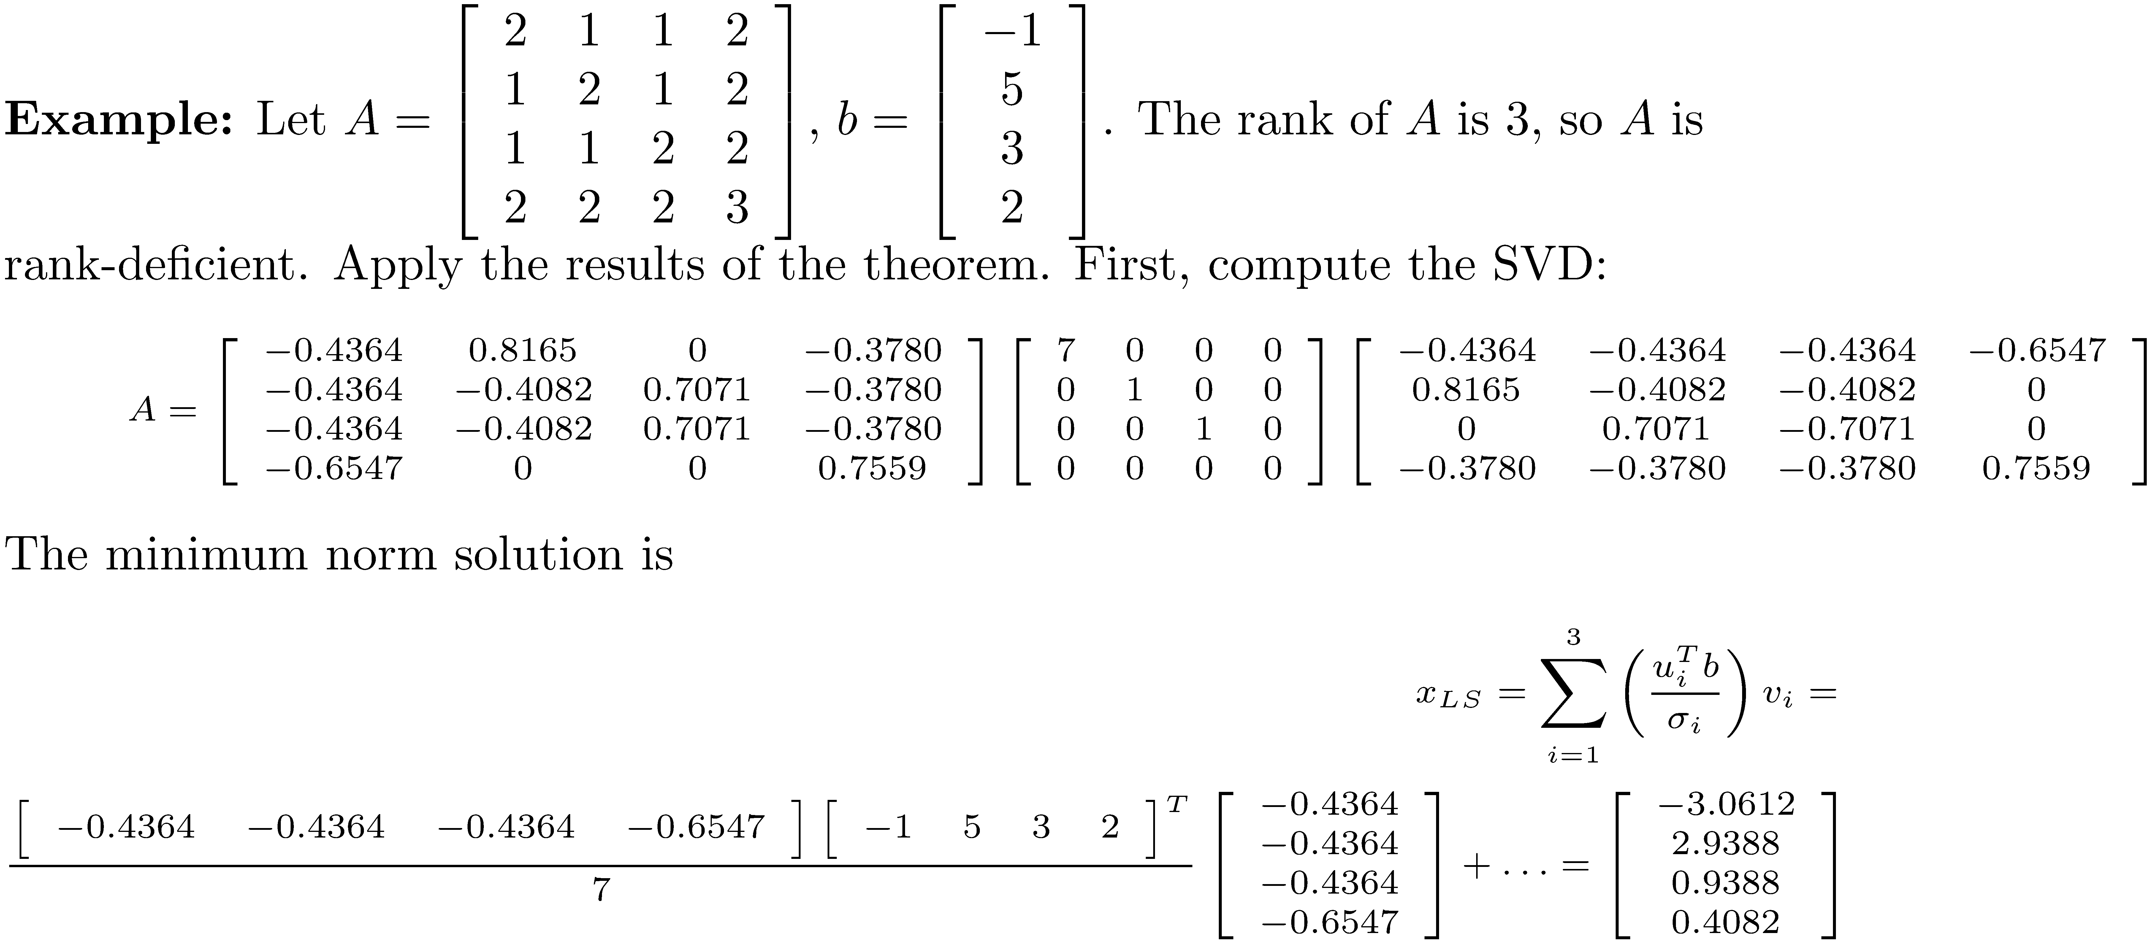
Example 8

Slide 47
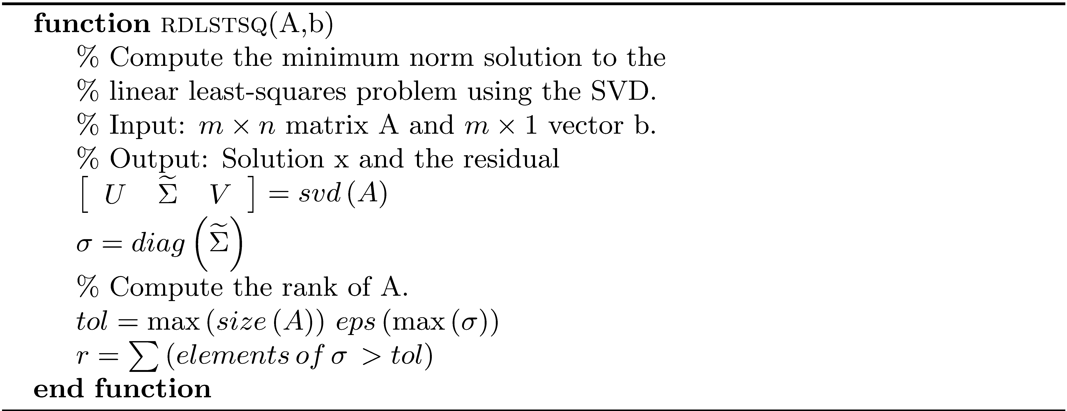
Algorithm rdlstsq

Slide 48
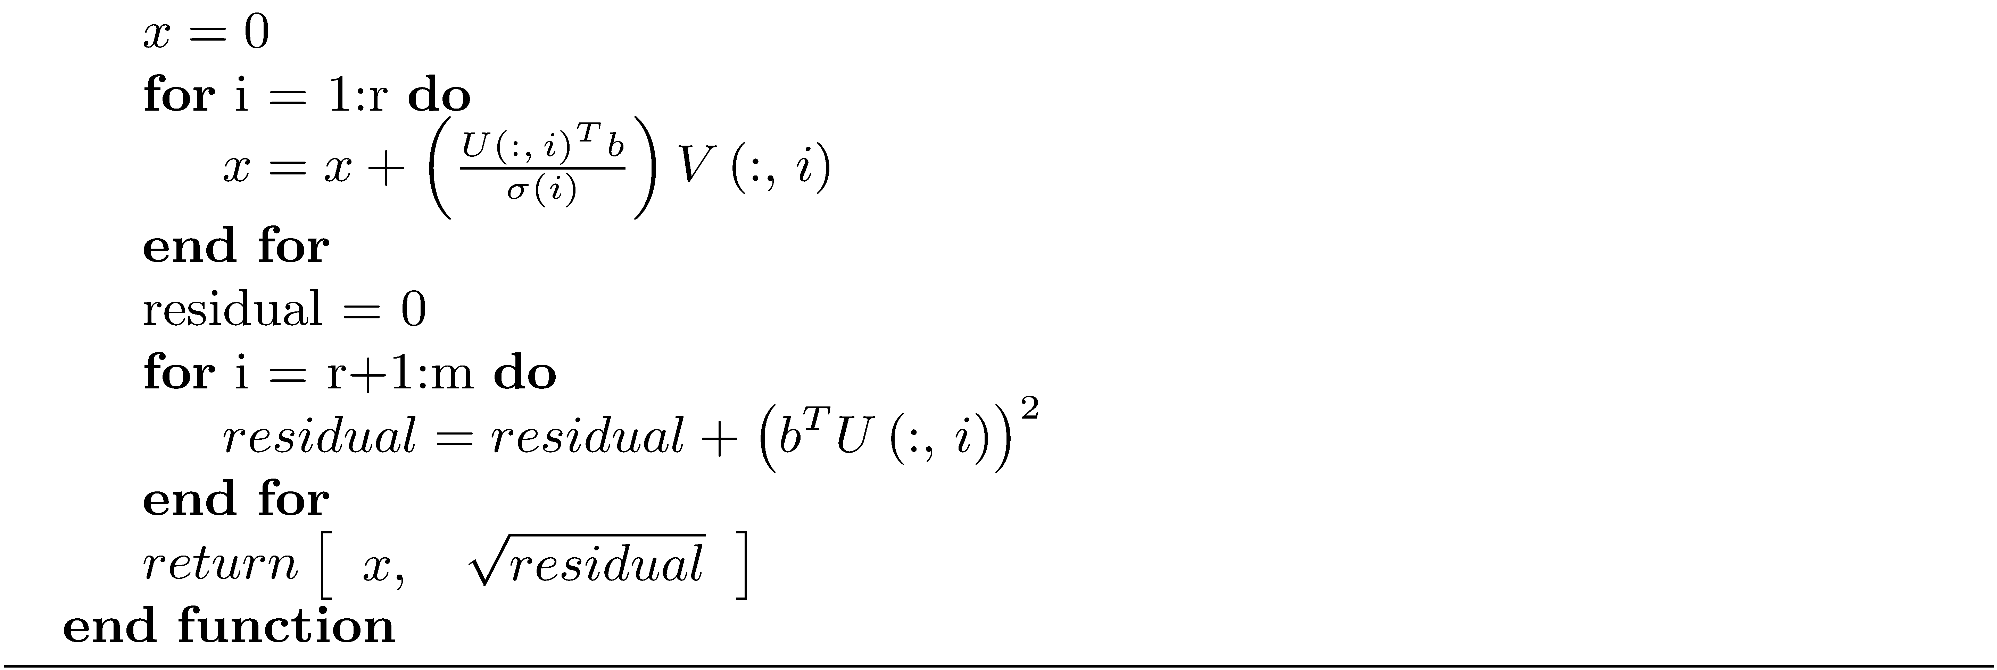
Algorithm rdlstsq
The flop count is approximately

Slide 49
Example 9
Find a least-squares solution for
>> [x_ls, residual] = rdlstsq(A,b)
x_ls =
-0.5897
-0.2660
0.1041
residual =
1.2217

Slide 50
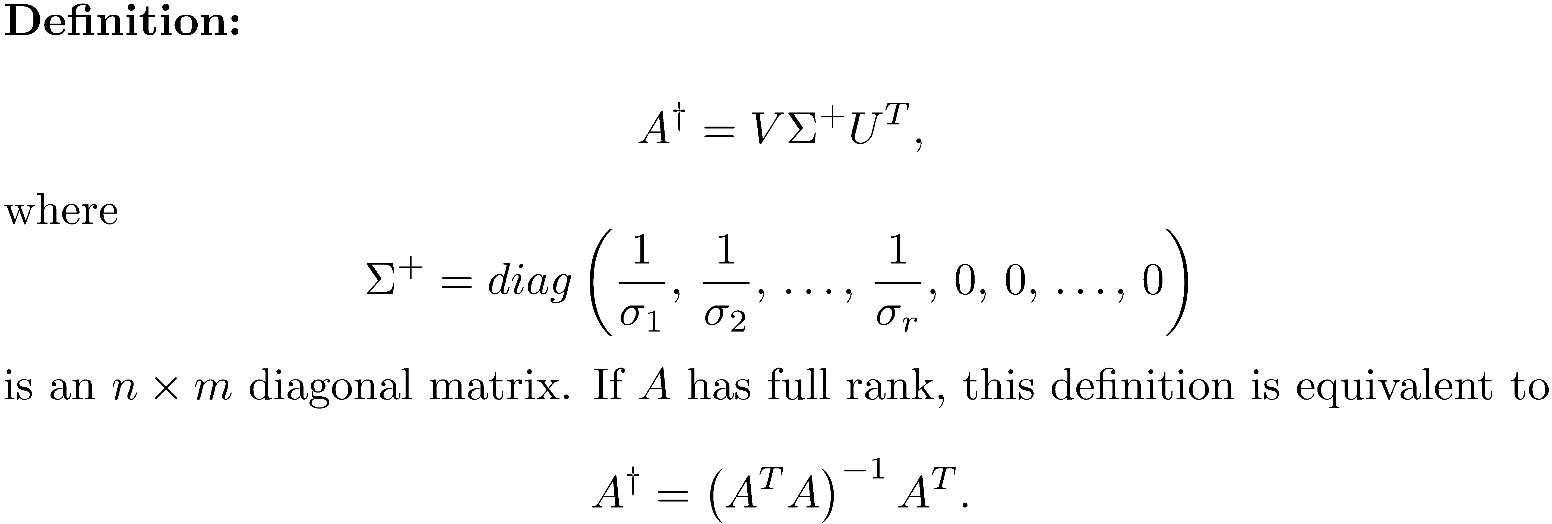
Alternate Definition of the Pseudoinverse, m ≥ n

Slide 51
Underdetermined Linear Least-Squares
An underdetermined system has either no solution
or infinitely many solutions.

Slide 52
QR Method for the Underdetermined Problem
If rank(A) = m, apply the full QR decomposition to the n × m full rank matrix A^{T}.
(normal equations)
Solve

Slide 53
QR Method for the Underdetermined Problem
Solve
Must execute these
steps efficiently.

Slide 54
QR Method for the Underdetermined Problem
Using block matrix notation, the algorithm for computing x is
Solve
where R₁ is the upper m × m submatrix of R.
Solve
where Q₁ is the upper n × m submatrix of Q.

Slide 55
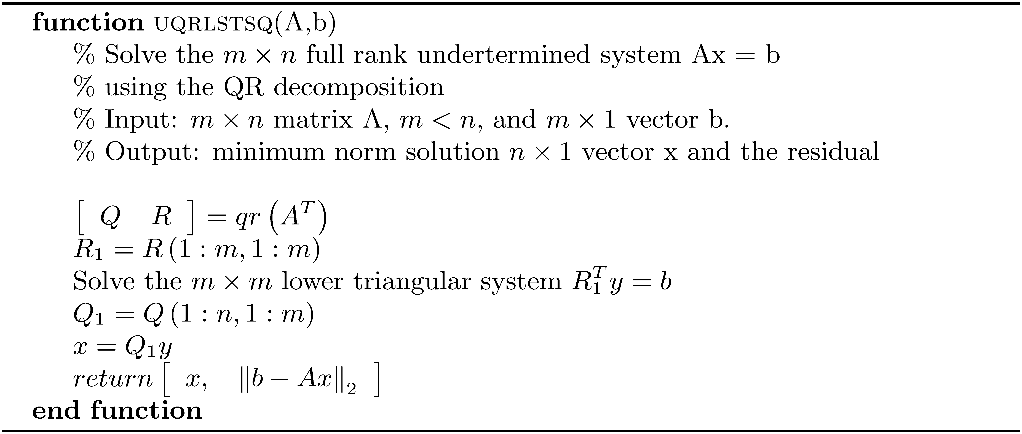
Solution of a Full Rank Underdetermined System using the QR Decomposition
The flop count is approximately

Slide 56
Example 10
Solve the full rank underdetermined system
>> x = uqrlstsq(A,b)
x =
0.1255
0.0066
-0.0282
0.0261
0.0014
-0.0176
0.0201

Slide 57
Example 11
Solve rank deficient underdetermined system Use rdlstsq. The function uqrlstsq fails because A does not have full rank.
rank(A) = 2
>> [x_ls, residual] = rdlstsq(A,b)
x_ls =
0.2974
-0.0155
0.0687
-0.0309
residual =
0.9623

