Slide 1
Iterative Methods
When using finite difference methods for the solution of partial differential equations, the matrix may be extremely large, in the 500 x 500 range. The use of general Gaussian elimination is far to slow because the matrices are most often sparse, such as a tridiagonal, bidiagonal or more complex. Standard Gaussian elimination will turn zeros into non-zeros, reducing the sparcity. We must make use of the fact that there are many zero entries.
TexPoint fonts used in EMF.
Read the TexPoint manual before you delete this box.: AAAAAAAAAAAAAA

Slide 2
Iterative Methods
For very large, sparse matrices, the preferred method of solution is to use an iterative method. An iterative method generates a sequence that converges to the solution, so the results are not exact; however, the iteration can be continued until a desired error tolerance is satisfied. Iterative methods do not alter the matrix, but use only a few vectors of length n at one time, so they use far less storage than working directly with the matrix.

Slide 3
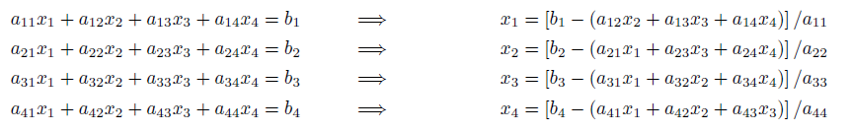
Classical Iterative Methods
Equations are written in a form where each unknown is written in terms of the other unknowns.

Slide 4
Jacobi Method
Given initial values for x₁, x₂, x₃, ..., x_{n}, insert them in the right-hand side of the equations and compute a second set of approximate values for the unknowns. These new values are then substituted into the right-hand side of the equations to obtain a third set of approximate solutions, and so forth, until the iterations have been carried out enough that the relative error estimate has become small enough.

Slide 5
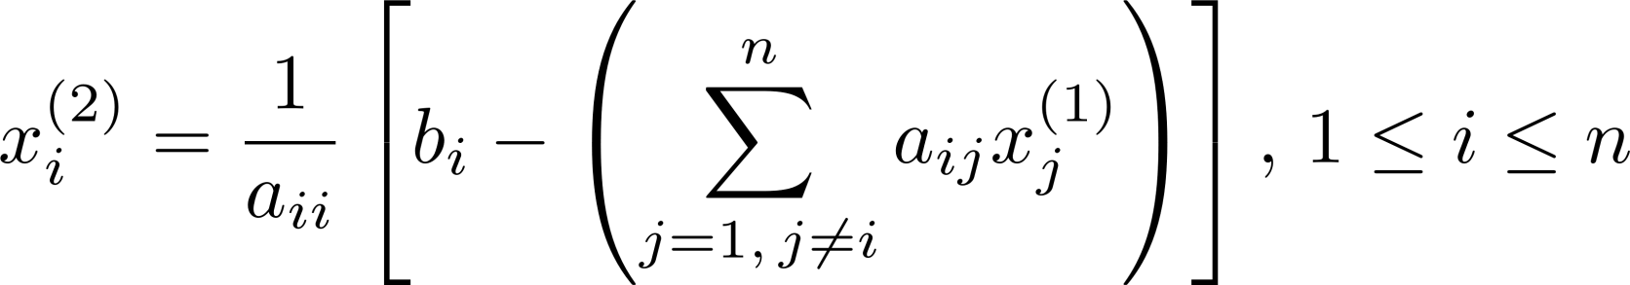
Jacobi Method
Use an initial estimate for the unknowns if one is available; otherwise, use x⁽¹⁾ = 0.

Slide 6
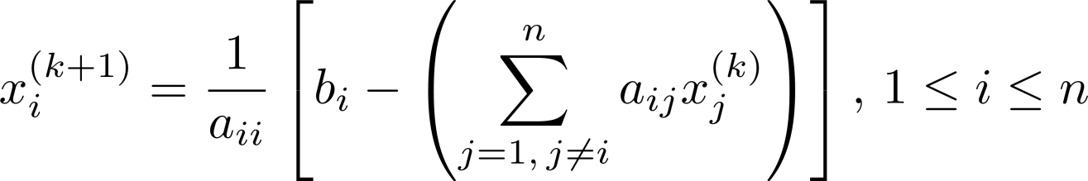
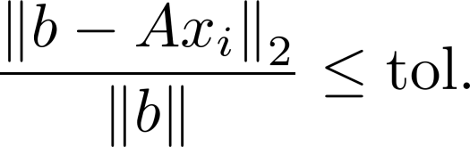
Jacobi Method
The (k+1)^{th} estimate for the solution is calculated from the (k)^{th} by:
Continue until the relative residual norm is sufficiently small.

Slide 7
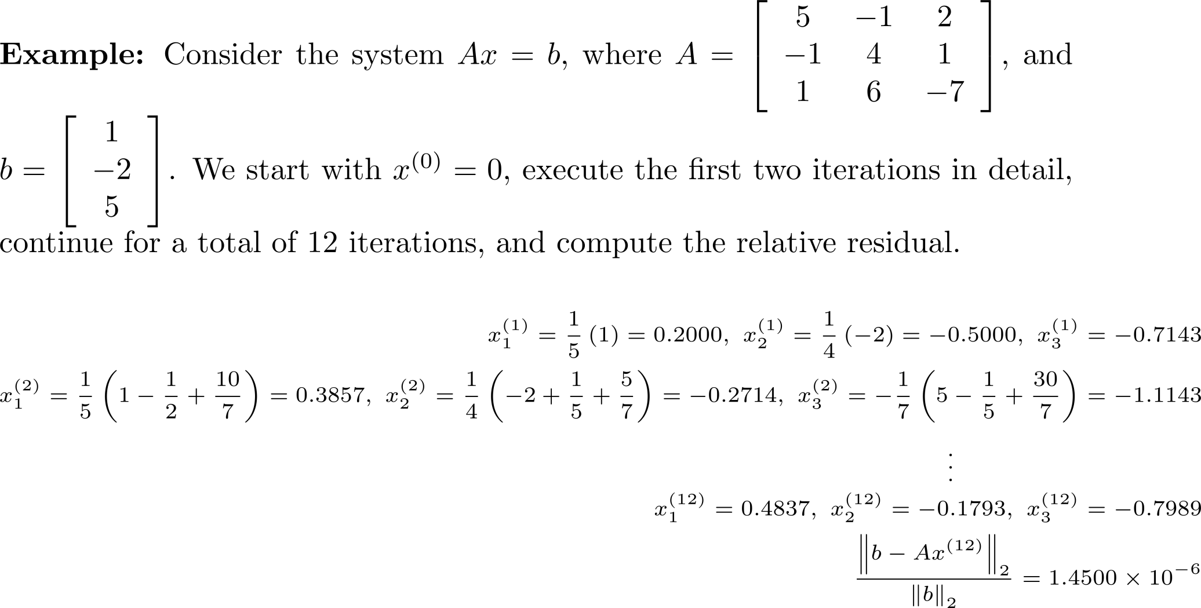

Example 1

Slide 8
The Gauss-Seidel Iterative Method
Start with approximate values if known; otherwise use 0. Use these values to calculate .. Use and to calculate and so forth.
Unlike the Jacobi method, the most recently computed values are used.

Slide 9
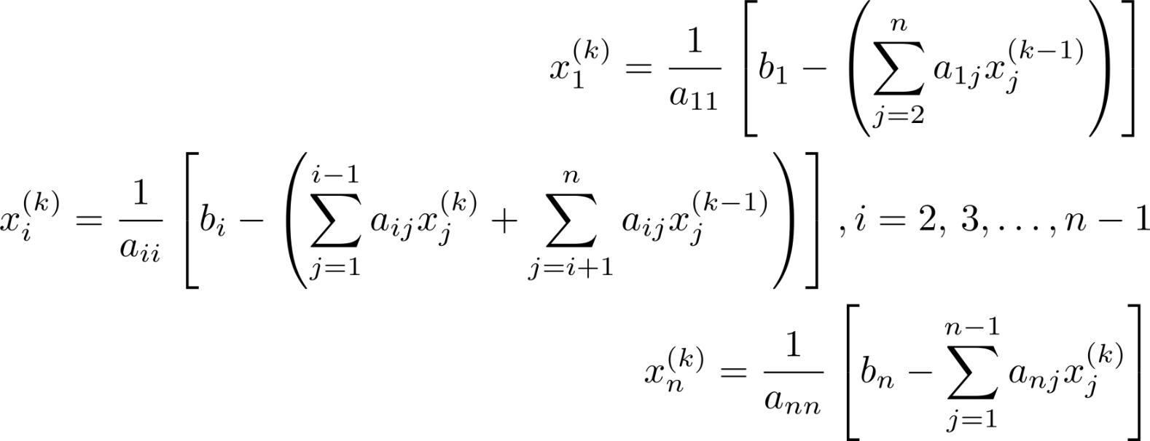
The Gauss-Seidel Iteration Formula

Slide 10
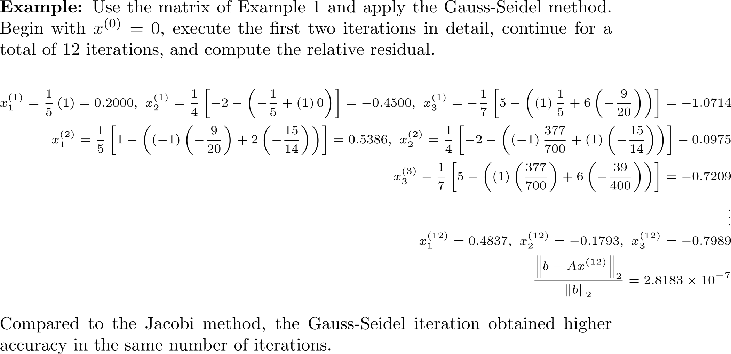
Example 2

Slide 11

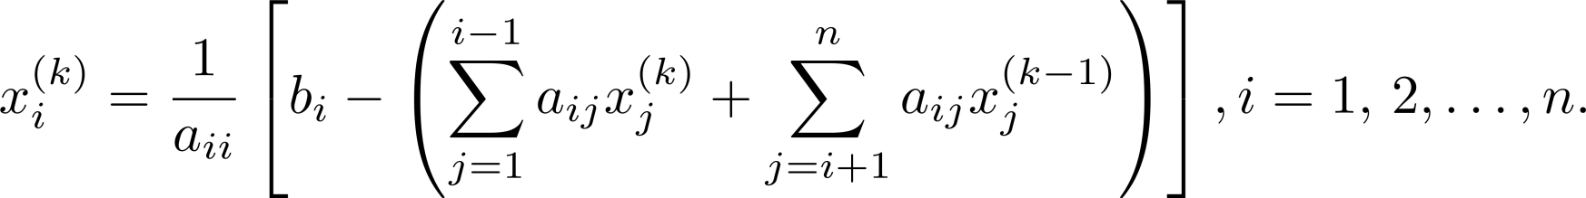
Successive Overrelaxation (SOR)
SOR was developed to accelerate the convergence of the Gauss-Seidel method. Successively form a weighted average between the previously computed value and the new value Weight the newly computed value by ω and the previous value by ( 1- ω ).

Slide 12


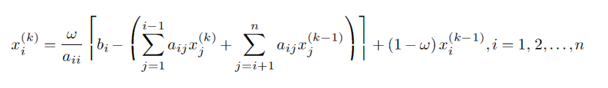
SOR
Ignore and when i = 1 and n, respectively.
The relaxation parameter ω must be chosen carefully. If ω =1 , the SOR method and the Gauss-Seidel method are identical. If ω >1 , we are said to be using overrelaxation and if ω <1 we are using underrelaxation.

Slide 13
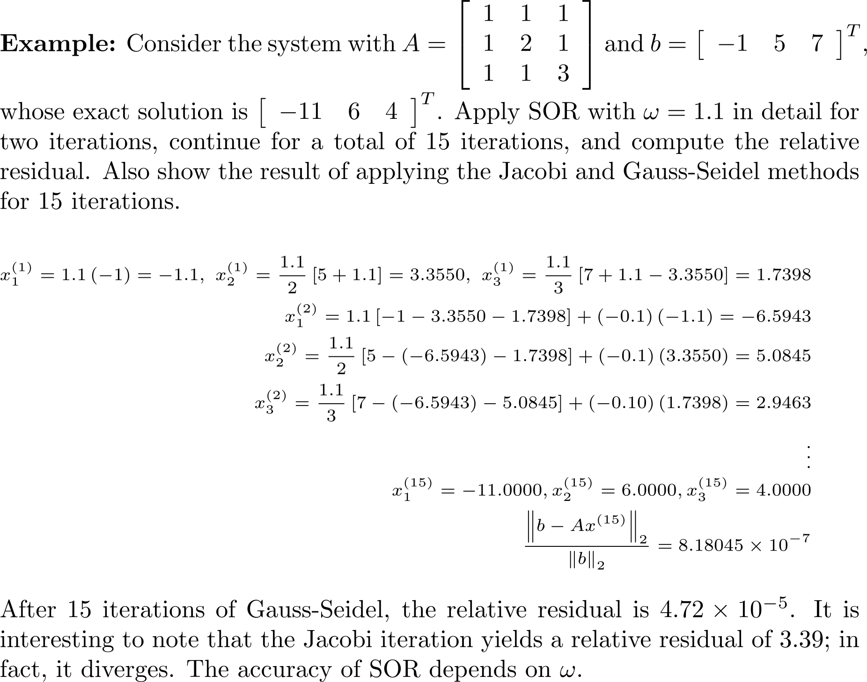
Example 3

Slide 14
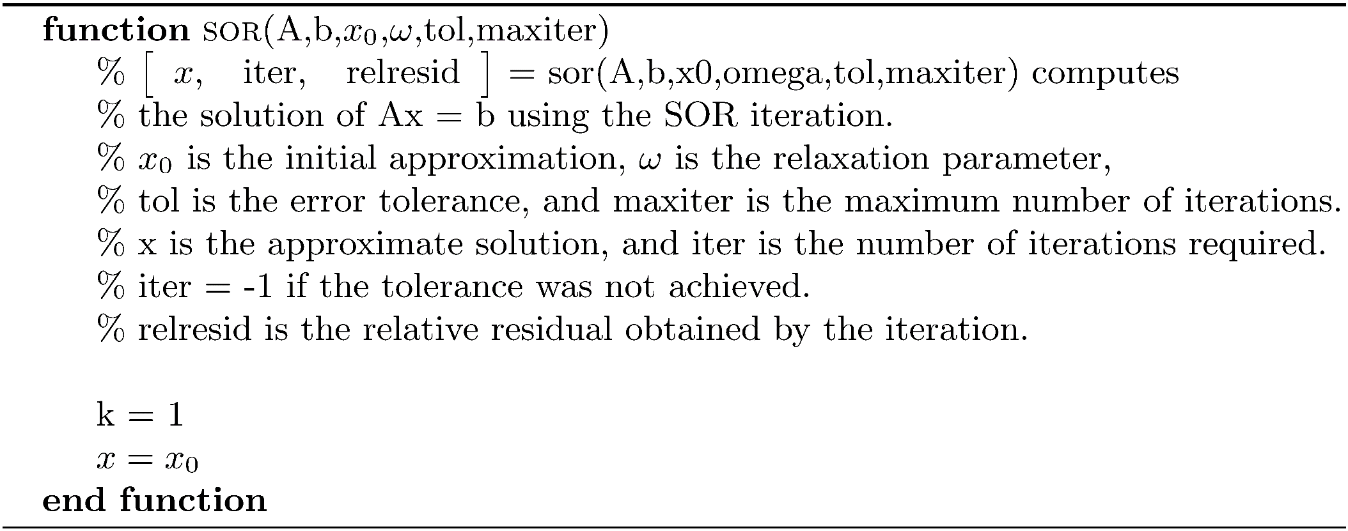
SOR Algorithm

Slide 15
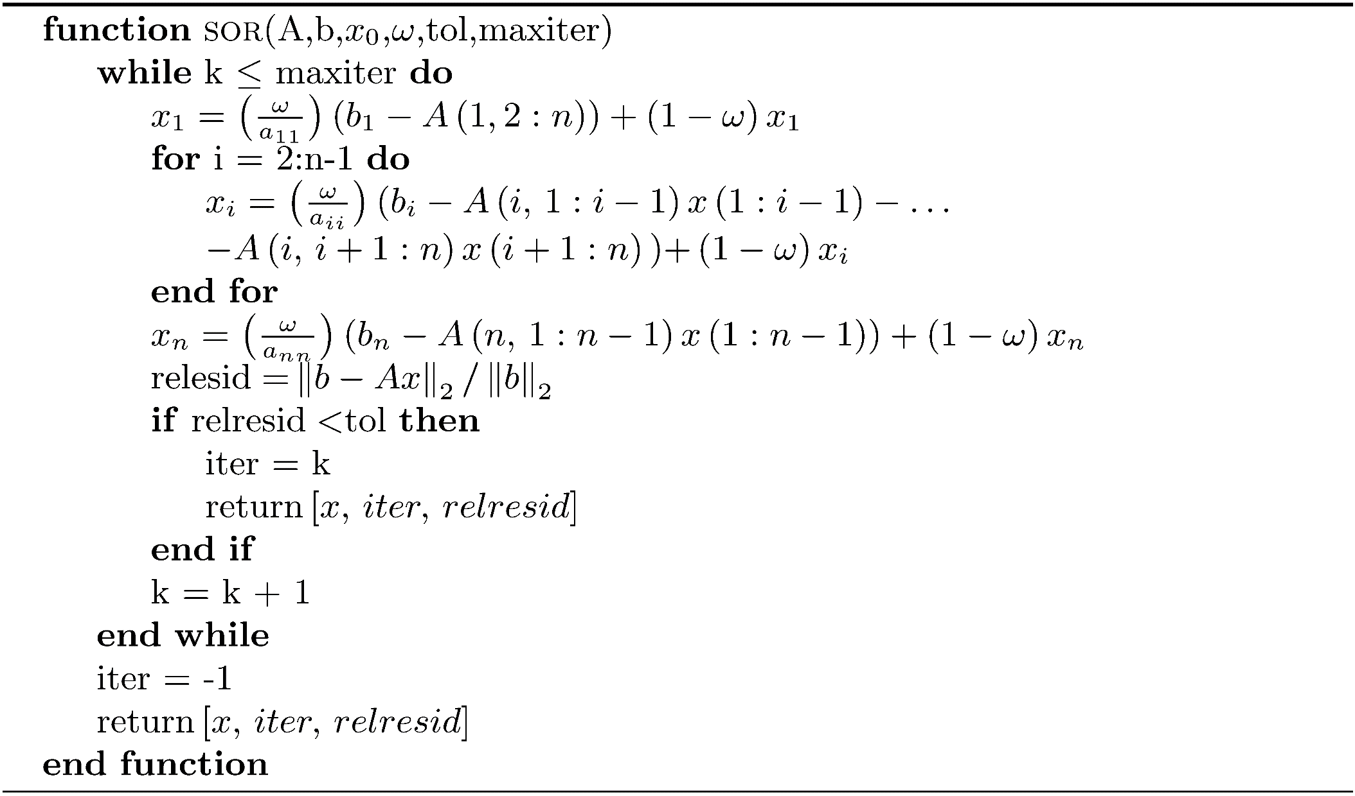
SOR Algorithm

Slide 16

Convergence of the Basic Iterative Methods
Jacobi, Gauss-Seidel and SOR iterations do not always converge. We must investigate conditions that will guarantee convergence and enable the comparison of convergence rates.
Express the iterations in the matrix form where B is called the iteration matrix. This makes the tools of matrix theory available.

Slide 17
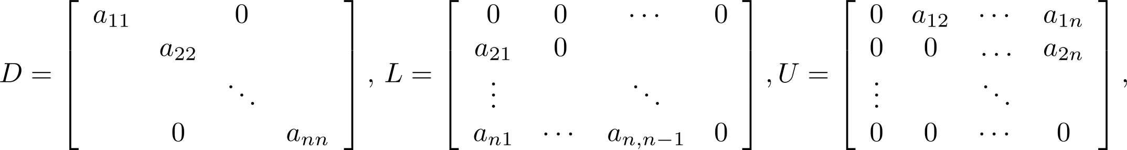
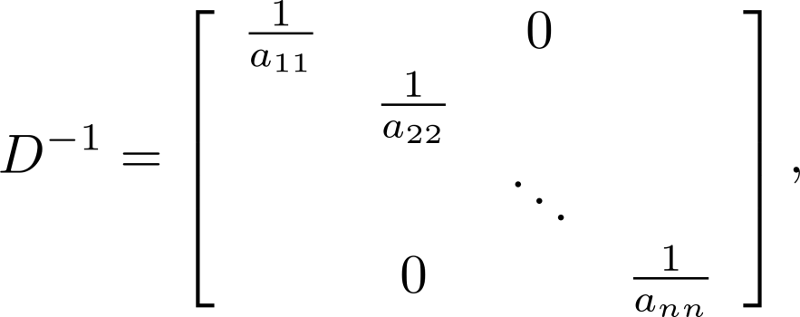
Matrix Form of the Jacobi Method
Define so that A = L + D + U, and If a_{ii} 0, i = 1, 2,..., n then and

Slide 18
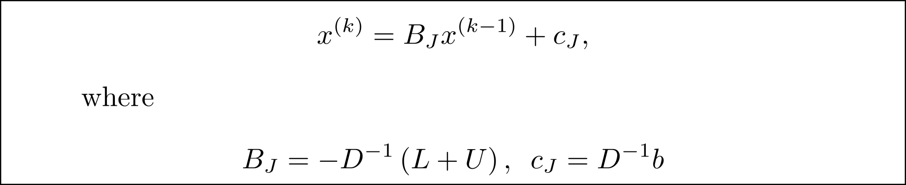
Matrix Form of the Jacobi Method

Slide 19
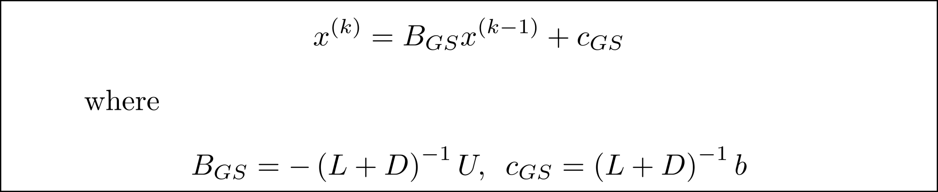
Matrix Form of the Gauss-Seidel Method

Slide 20
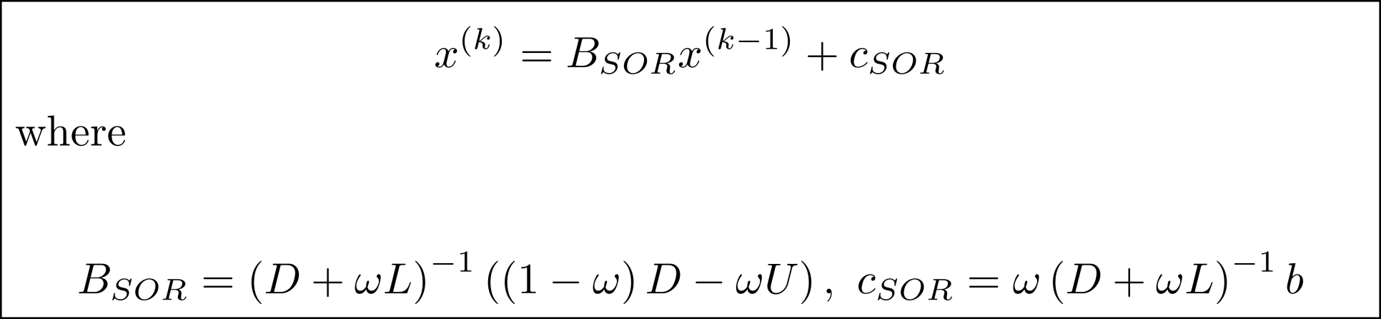
Matrix Form of SOR

Slide 21

Conditions Guaranteeing Convergence
NOTE: If , the iteration may still converge.
NOTE: The spectral radius is a good indicator for the rate of convergence.

Slide 22
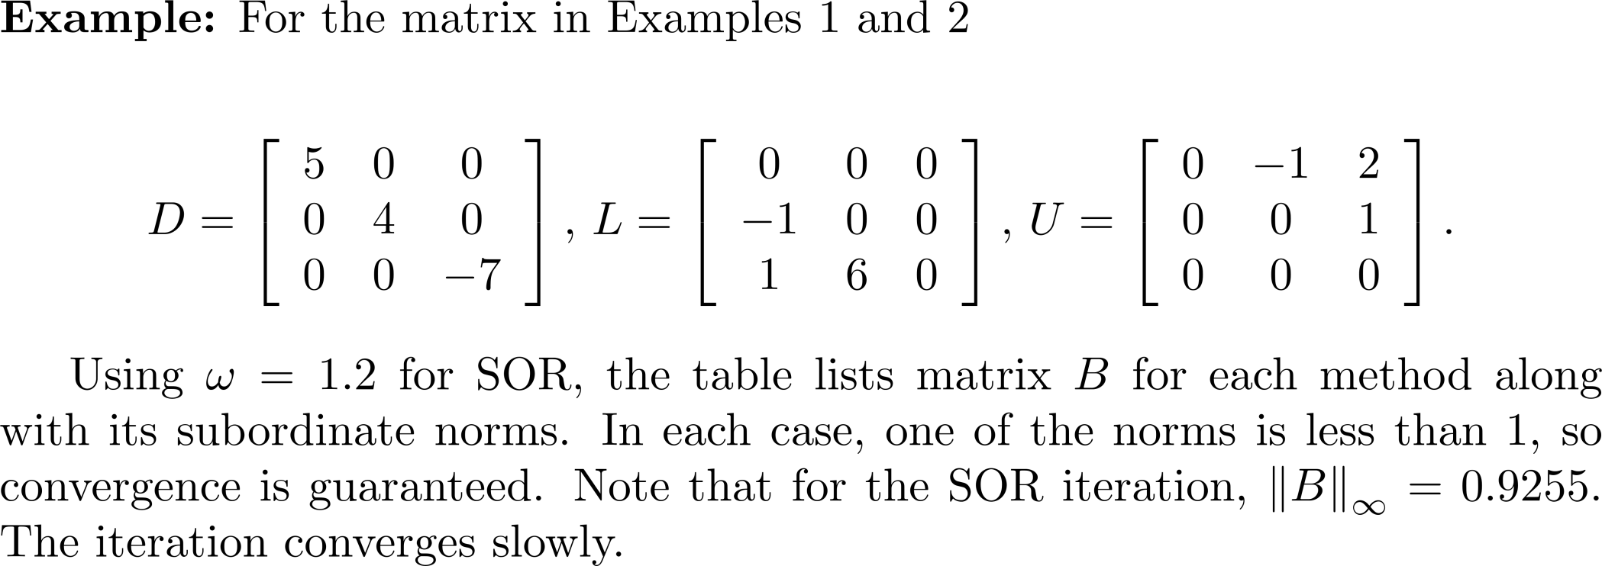
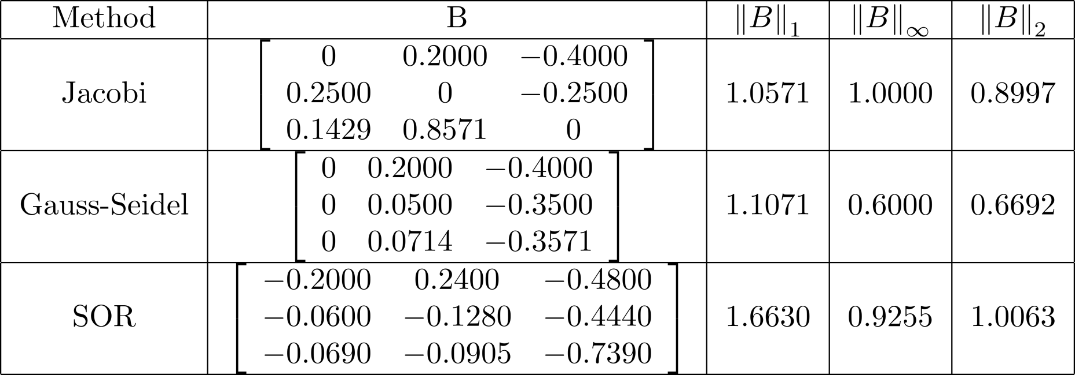
Example 4

Slide 23
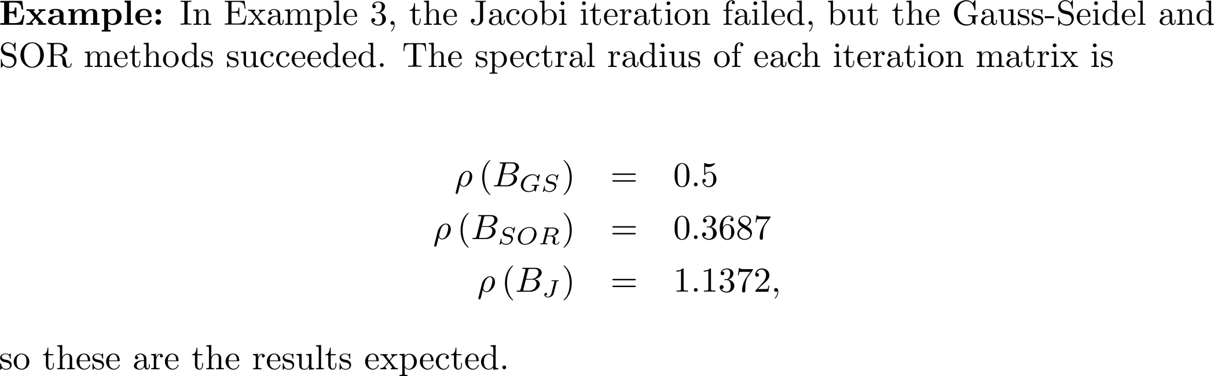
Example 5

Slide 24
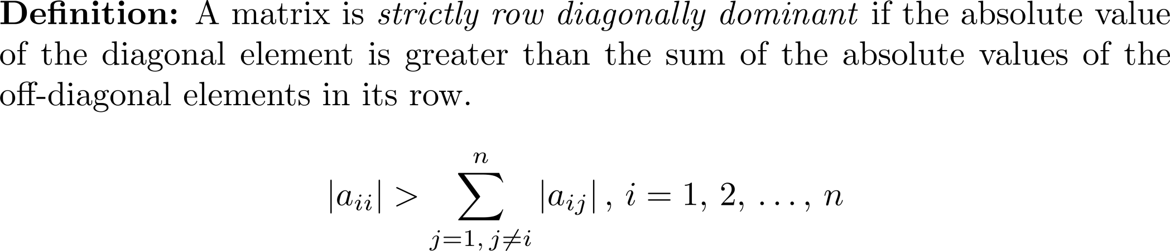
Strict Diagonal Dominance
The Jacobi and Gauss-Seidel methods converge for any choice of
initial approximation when A is strictly diagonally dominant.
They may converge if A is not diagonally dominant.

Slide 25
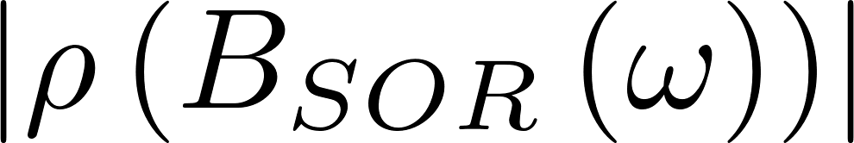
Choosing  for SOR
A poor choice of the relaxation parameter ω can lead to poor convergence rates.
A good choice of ω can lead to very fast convergence compared to the Jacobi or Gauss-Seidel methods.
Ideally choose ω so that is a minimum.
Optimal value of ω is known only for special types of matrices. It is known, however, that ω must satisfy 0< ω <2

Slide 26
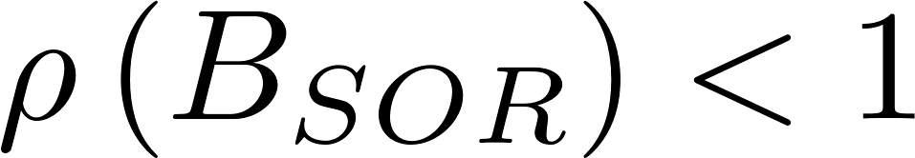
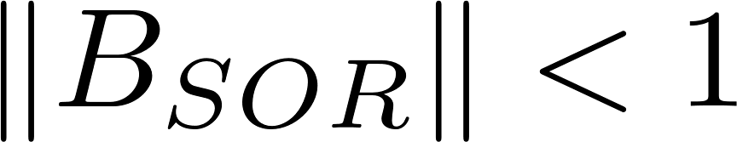
Choosing  for SOR
If or , the SOR iteration converges.

Slide 27
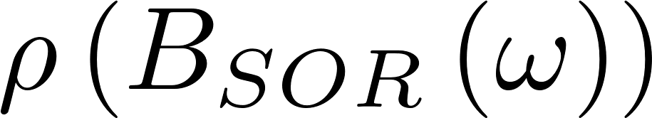
Choosing  for SOR
The function optomega in the book software distribution approximates the optimal ω for a matrix and graphs as a function of ω ,0 < ω < 2.

Slide 28
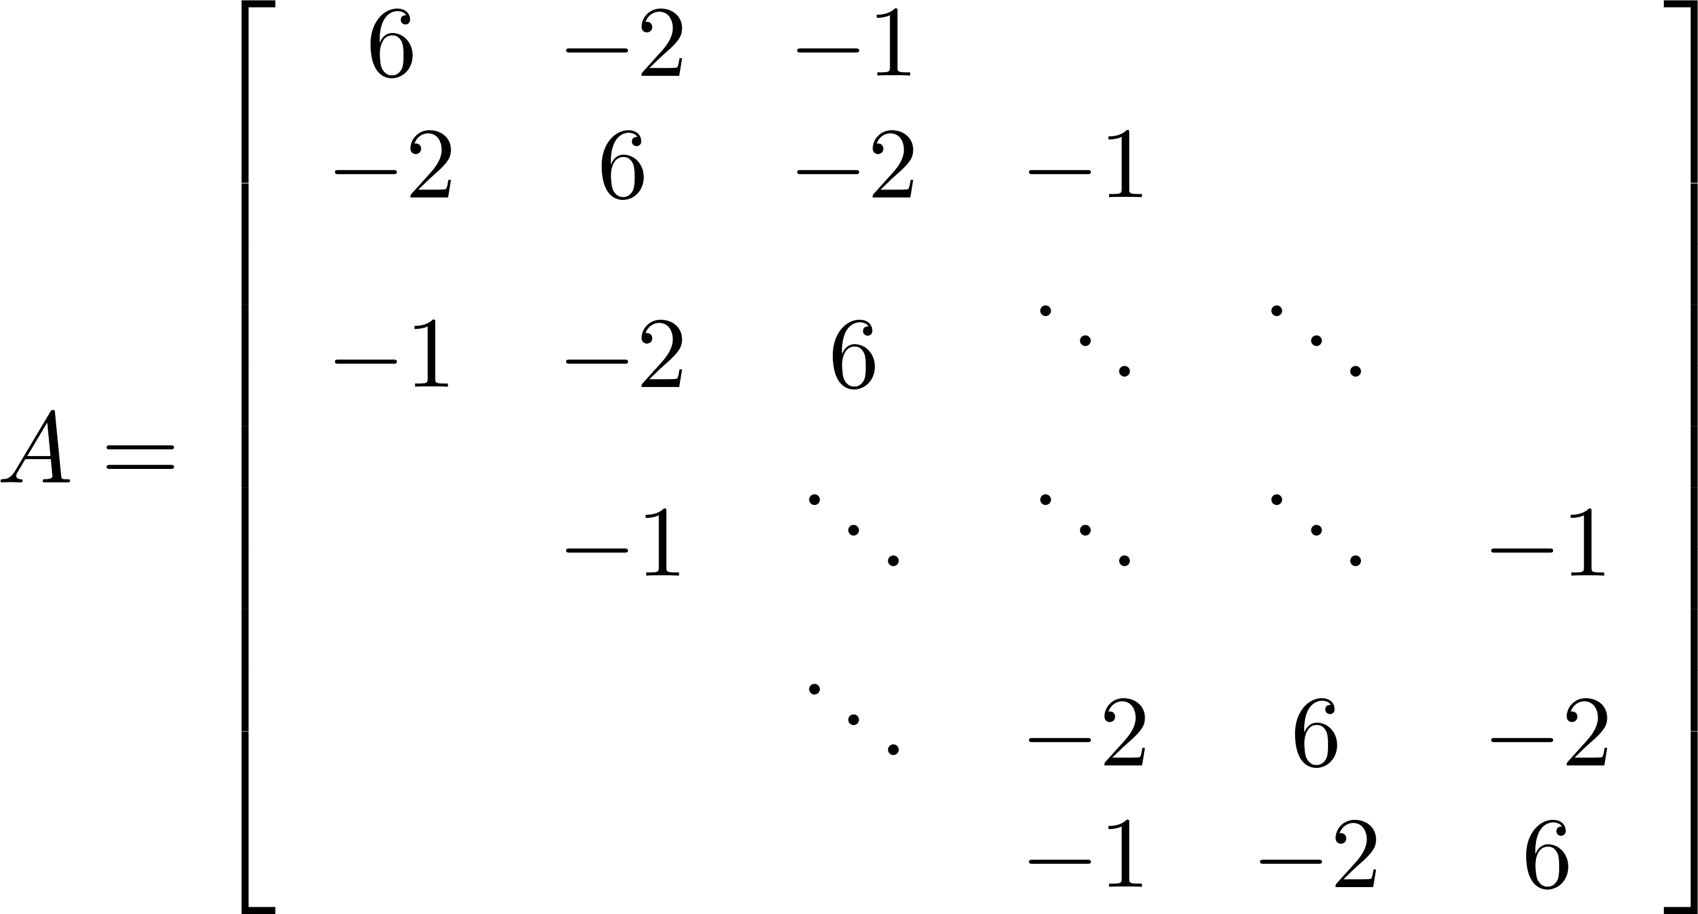
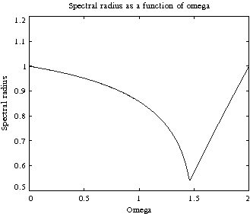
Example 6
>> x0 = zeros(10,1);
>> rhs = ones(10,1);
>> woptimal = optomega(A)
woptimal =
1.4600
>> [x,iter,relresid] = sor(A,rhs,x0,woptimal,1.0e-14,100);
>> iter
iter =
54
>> relresid
ans =
9.2334e-015
Pentadiagonal
matrix.

Slide 29
Poisson's Equation
Poisson's equation is one of the most important equations in applied mathematics.
Applications include astronomy, heat flow, fluid dynamics, and electromagnetism.

Slide 30
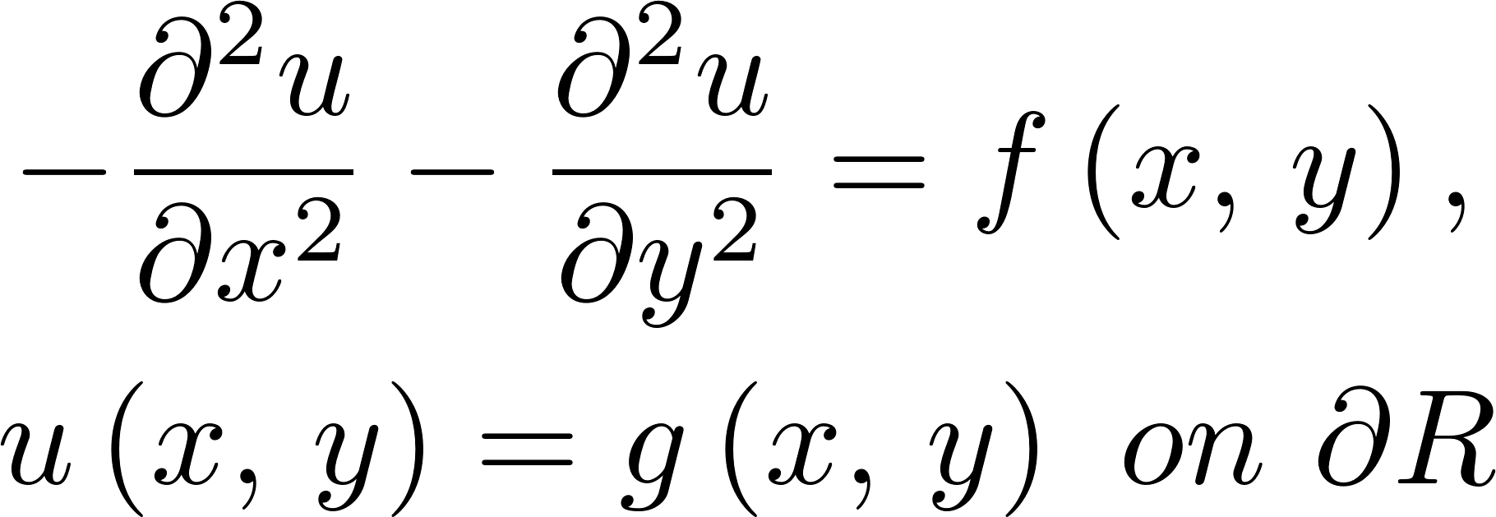
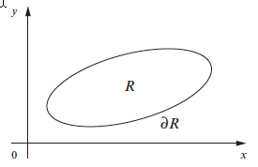
Poisson's Equation
Let R be a bounded region in the plane with boundary ∂R, g(x,y) be defined on ∂R , and f(x,y) be a function defined in R . Find a function u(x,y) such that

Slide 31
Poisson's Equation
Rarely is an analytical solution known, so approximation techniques must be used.
Use finite difference methods.
Assume for simplicity that the region R is the unit square 0 ≤ x ≤ 1, 0 ≤ y ≤ 1. The difference equations are

Slide 32
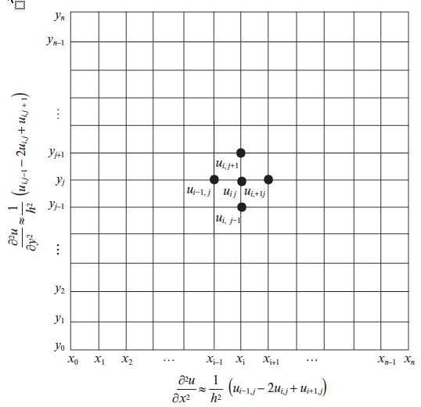
Poisson's Equation
Five-point stencil

Slide 33
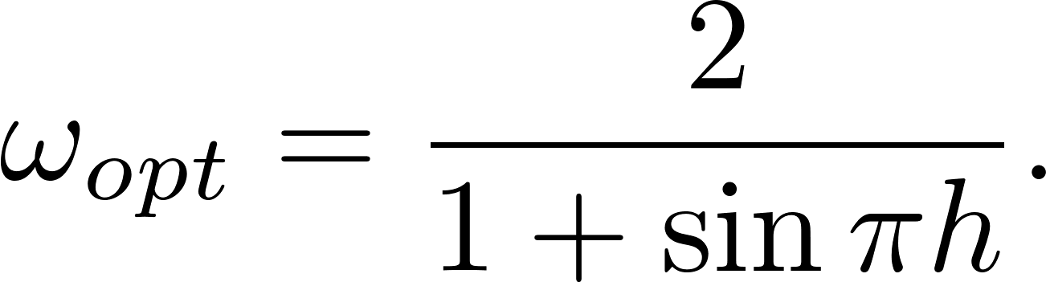
Poisson's Equation
When one or two of the four points around the center touch the boundary, the boundary condition must be used.
SOR iteration
The optimal value of ω is

Slide 34
Poisson's Equation
The matrix form of the finite difference approximation is positive definite, so the iteration converges.
The function sorpoisson in the software distribution assigns the boundary values, assigns values of f(x,y) in the interior, and executes the SOR iteration.

Slide 35
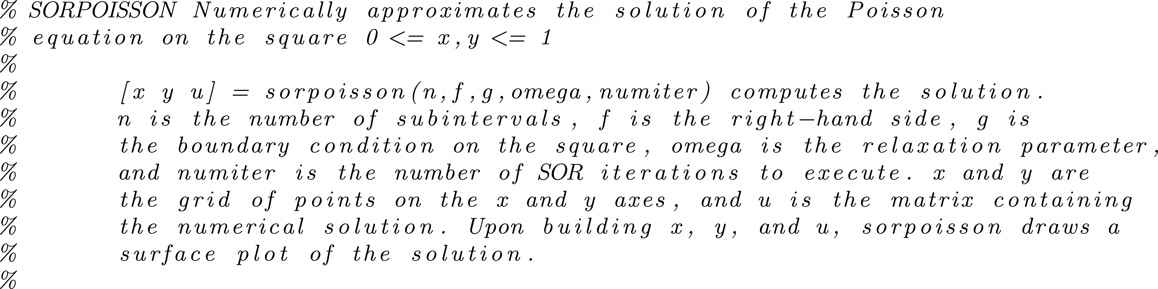
sorpoisson

Slide 36
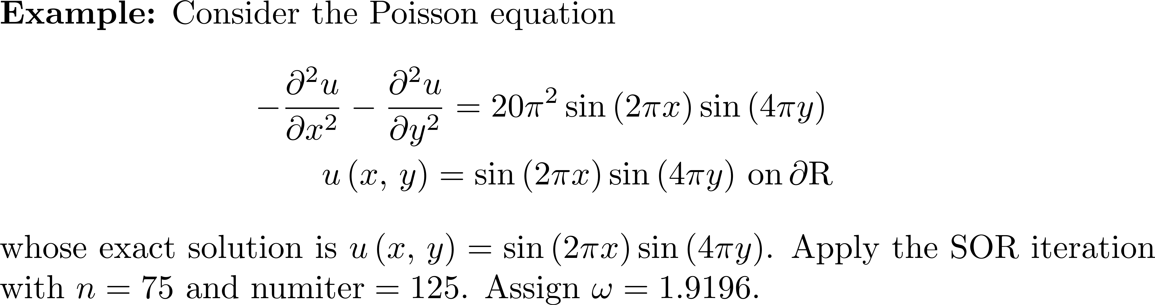
Example 7

Slide 37
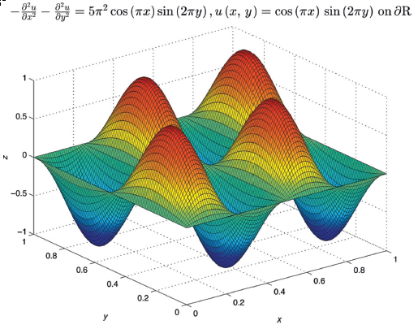
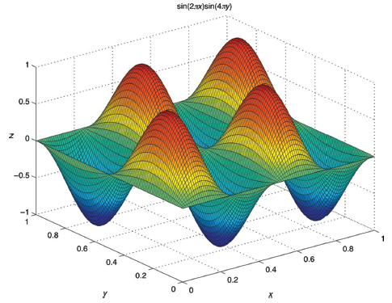
Example 7
Approximate solution
Analytical solution

