Slide 1
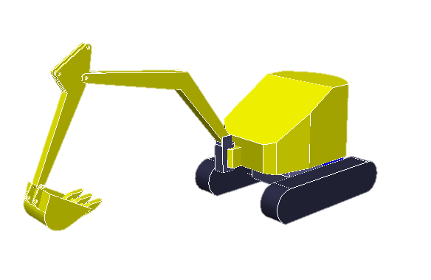
②
④
③
1.36 m
①
1.6 m
1.25 m
Failure

