Slide 1
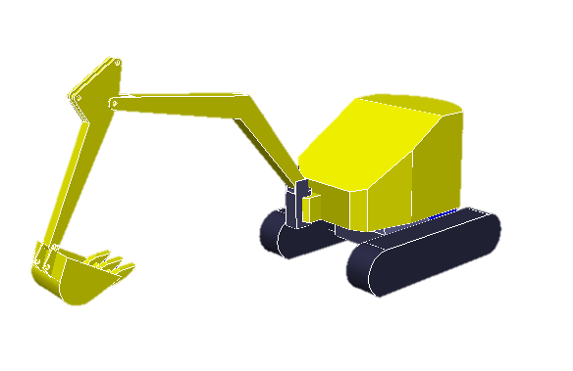
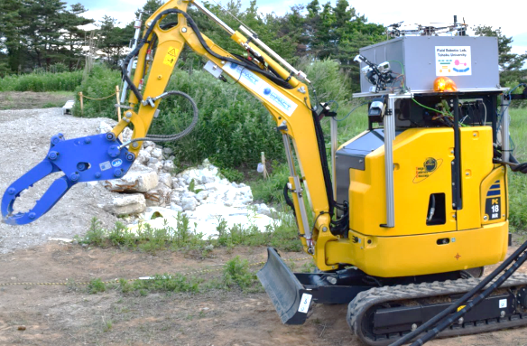
Robot in failure
Detect the failure
Learning on simulator
Learned recovery motion
②
③
Start recovery motion
Input state
Output recovery motion
①
Controller input
Straight
Turn

Slide 2
①
Control output
③
②
Output joint torque
for recovery motion
Input the state
Learned knowledge
of recovery motion

