Slide 1
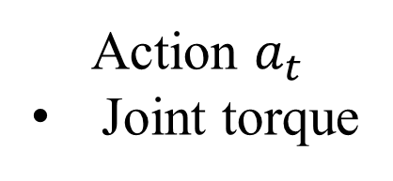
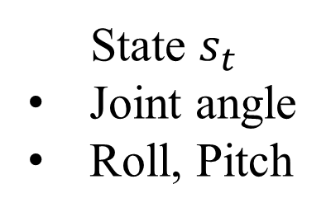
3D simulator Choreonoid
Robot
State $s_{t}$
Joint angle
Roll, Pitch
Action $a_{t}$
Joint torque
Reinforcement Learning
System

