Slide 1
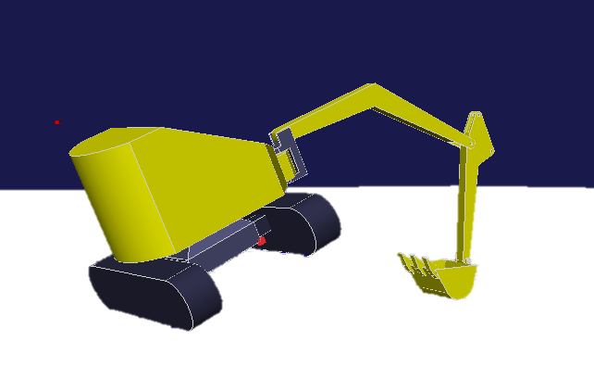






Rolled over
$$S_{1}$$
$$G$$
$$Z_{1}$$
$$A_{3}$$
$$A_{1}$$
$$A_{2}$$
Contact point

