Slide 1


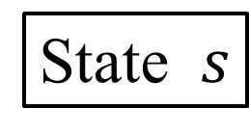








・・・・・・
$$Q(s,a_{2})$$
$$Q(s,a_{n−1})$$
$$Q(s,a_{1})$$
$$Q(s,a_{3})$$
$$Q(s,a_{n})$$
$$a_{2}$$
$$a_{3}$$
$$a_{n−1}$$
$$a_{1}$$
$$a_{n}$$
Choose action
State $s$

