Slide 1
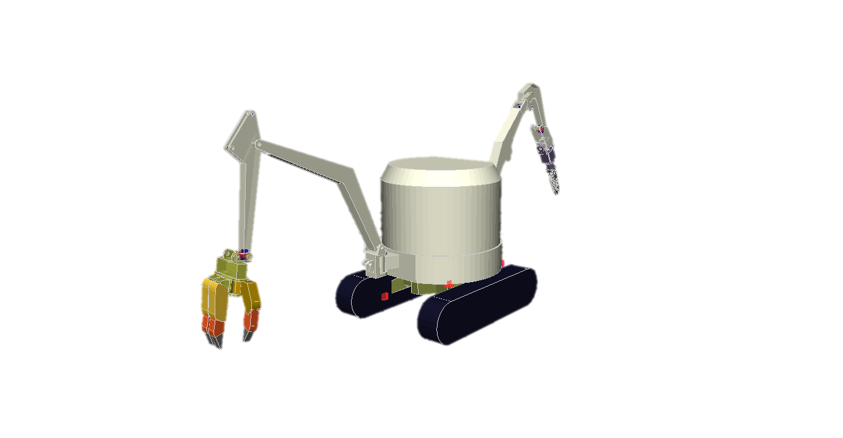
④
⑦
②
1.7 m
⑥
⑤
①
2.0 m
1.4 m
Failure

