Slide 1
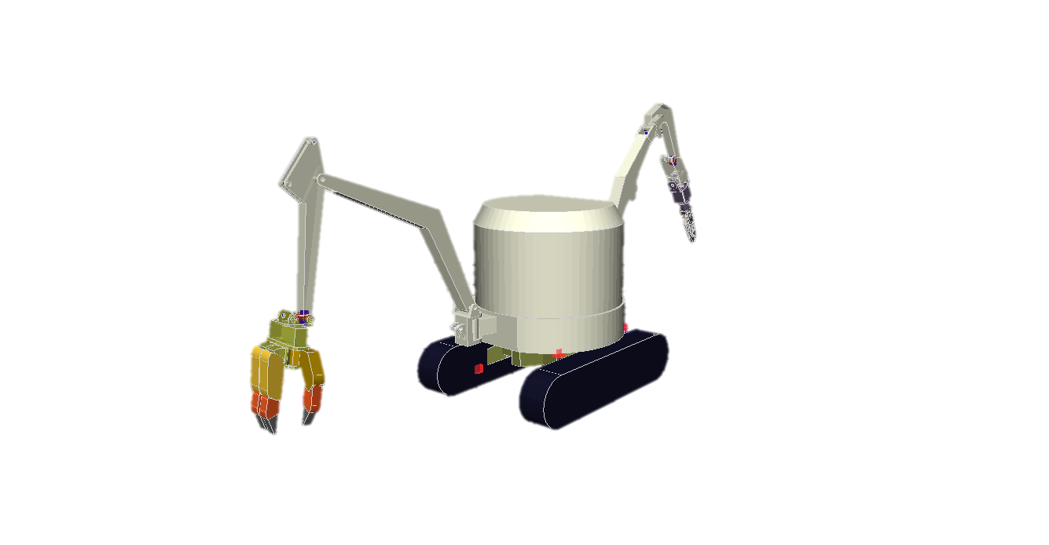
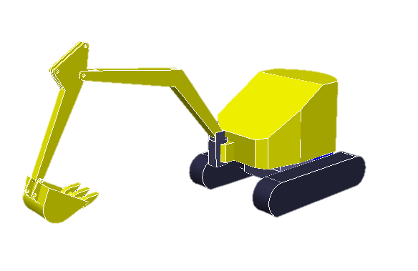
(a)
(b)
Single-armed crawler robot
Double-armed crawler robot

