Slide 1
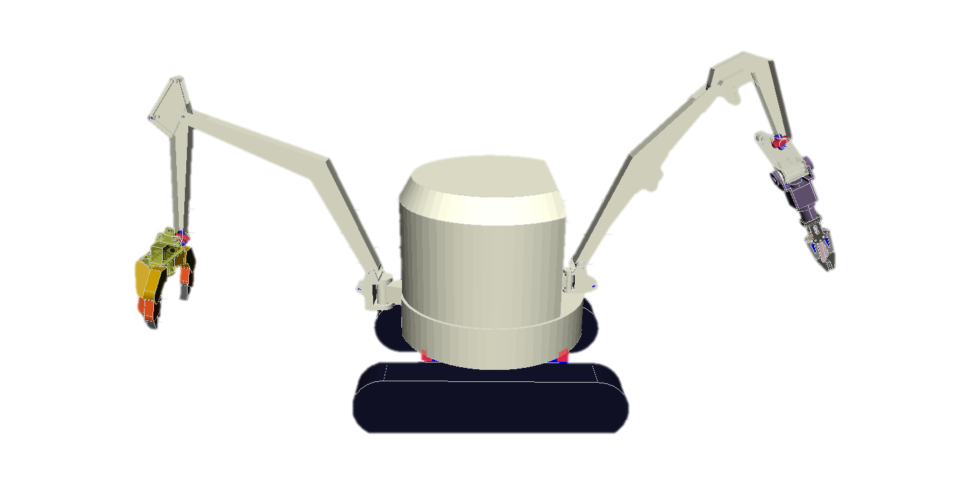
④
⑦
②
⑥
③
⑤
②
Failure

