Slide 1
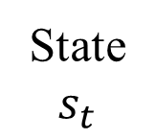
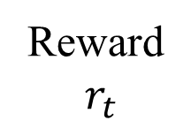
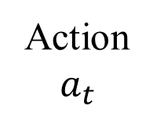
Agent
①
②
③
State
$$s_{t}$$
Reward
$r_{t}$
Action
$$a_{t}$$
Environment

