Slide 1
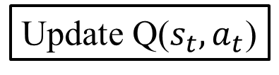
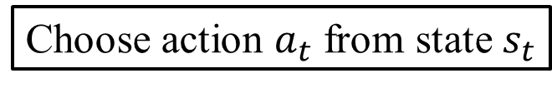
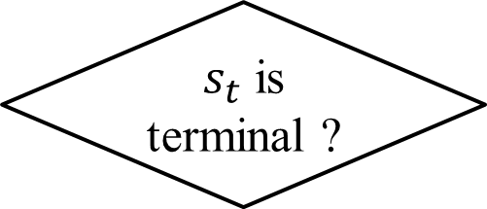
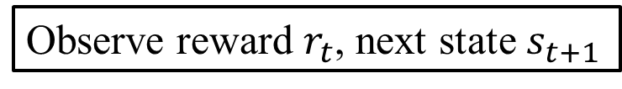
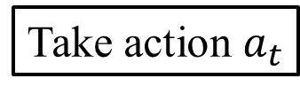
Choose action $a_{t}$ from state $s_{t}$
Take action $a_{t}$
Observe reward $r_{t}$, next state $s_{t+1}$
1 step
Update Q($s_{t},a_{t}$)
$s_{t}$ is terminal ?
No
Yes
Next episode

