Slide 1
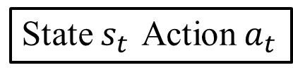
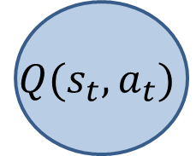

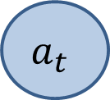

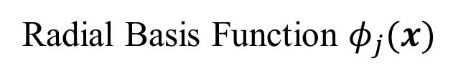
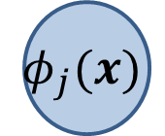
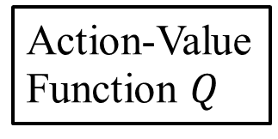
Radial Basis Function $φ_{j}(x)$
Input
$$s_{t}$$
Output
$$Q(s_{t},a_{t})$$
$$φ_{j}(x)$$
$$a_{t}$$
$$w_{j}$$
State $s_{t}$ Action$a_{t}$
・・・・・・・
Action-Value
Function $Q$

