Slide 1
CLASSIFICATION OF SIGNALS

Slide 2

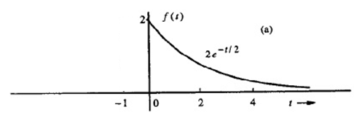
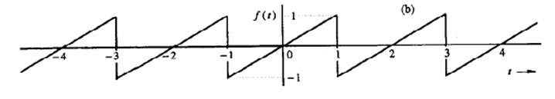
Causal and Non-causal Signals

Slide 3
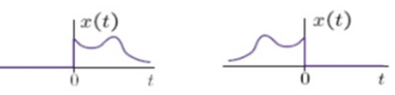
Anti-causal Signals
(a) Causal signal
(b) Anti-causal signal

Slide 4
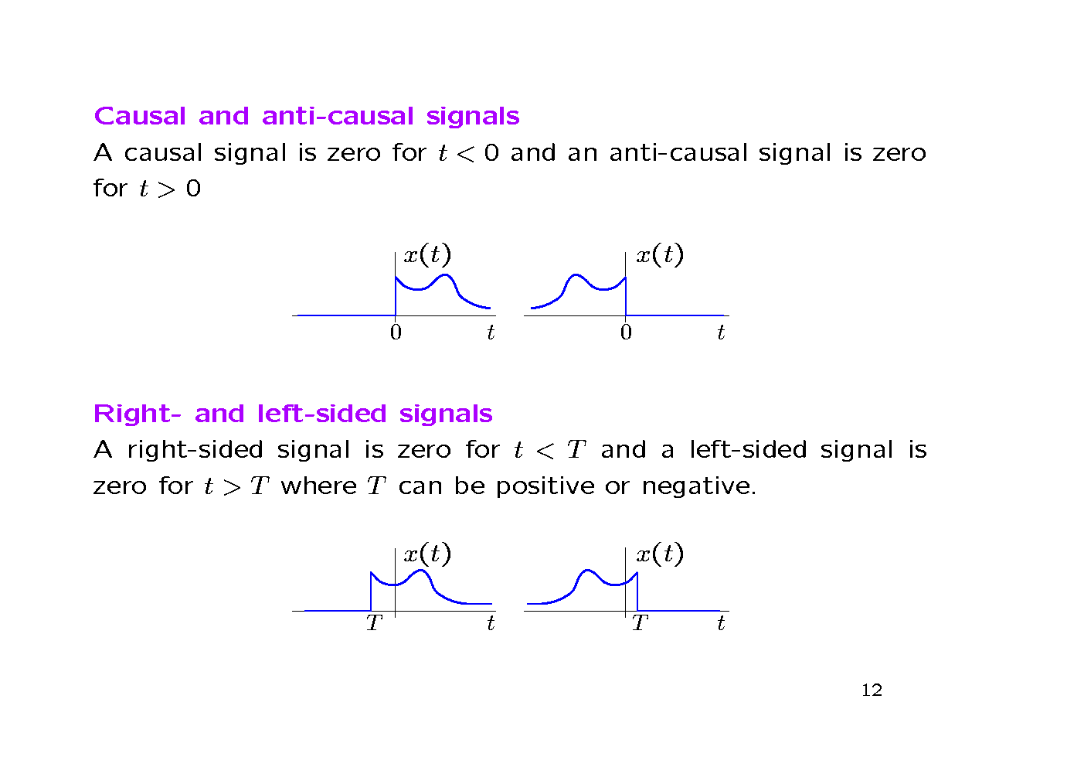
Right-sided and Left sided Signals

Slide 5
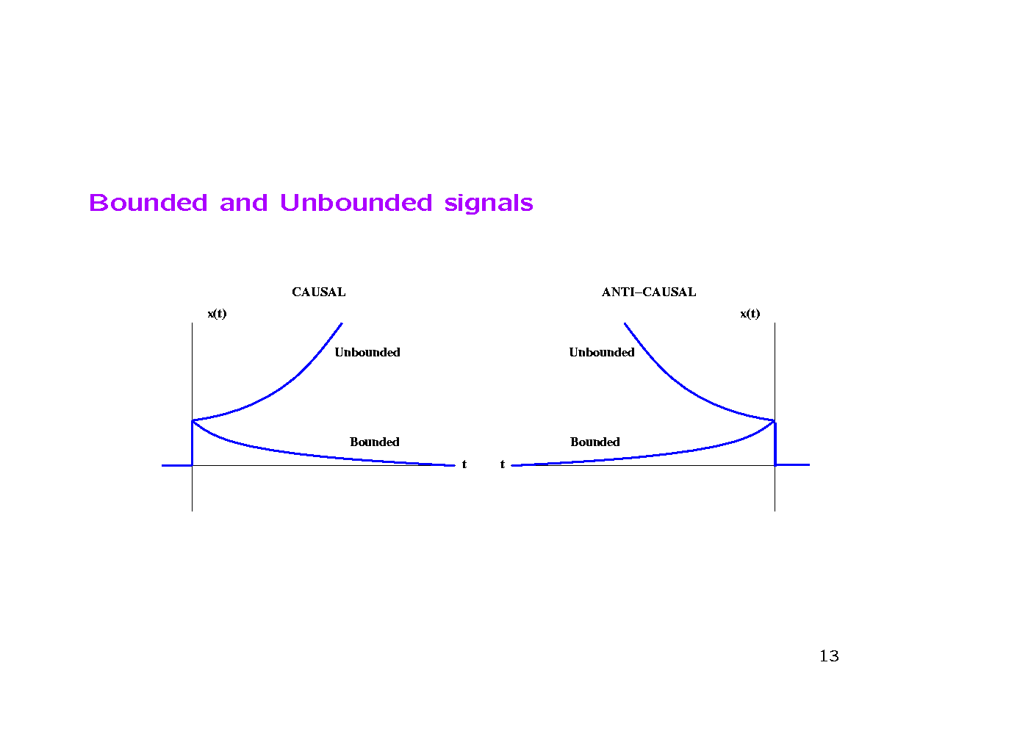
Bounded and Unbounded Signals

Slide 6
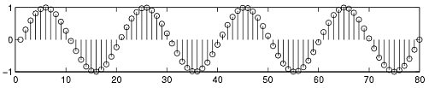
Deterministic & Non Deterministic Signals
Deterministic signals
Behavior of these signals is predictable w.r.t time
There is no uncertainty with respect to its value at any time.
These signals can be expressed mathematically.
Example x(t) = sin(3t) is a deterministic signal.

Slide 7
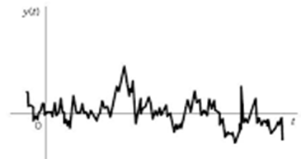
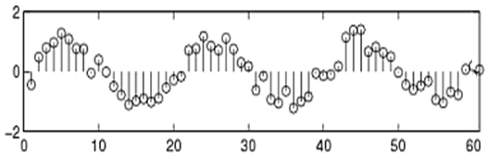
Non Deterministic or Random signals
Behavior of these signals is random i.e. not predictable w.r.t time.
There is an uncertainty with respect to its value at any time.
These signals can’t be expressed mathematically.
Example: Thermal Noise

Slide 8
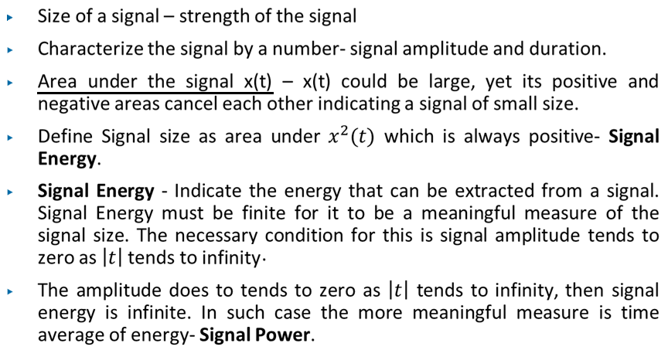
Size of a Signal

Slide 9

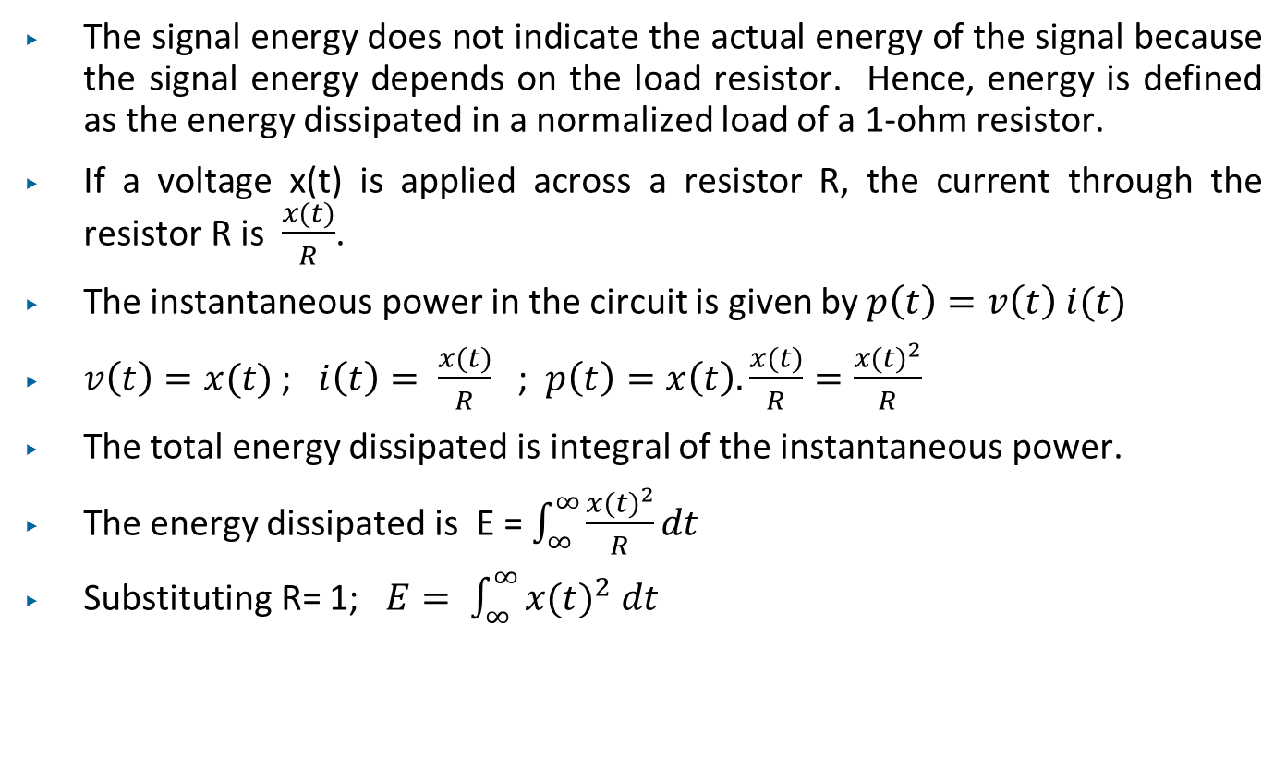
Energy Signal and Power Signal contd…
The signal energy does not indicate the actual energy of the signal because the signal energy depends on the load resistor. Hence, energy is defined as the energy dissipated in a normalized load of a 1-ohm resistor.
If a voltage x(t) is applied across a resistor R, the current through the resistor R is $\frac{x(t)}{R}$.
The instantaneous power in the circuit is given by $p\left(t\right)=v\left(t\right) i(t)$
$v\left(t\right)=x(t)$ ; $i\left(t\right)= \frac{x(t)}{R}$ ; $p\left(t\right)=x\left(t\right). \frac{x(t)}{R}=\frac{{x(t)}^{2}}{R}$
The total energy dissipated is integral of the instantaneous power.
The energy dissipated is E = $\int_{∞}^{∞}{\frac{{x(t)}^{2}}{R}dt}$
Substituting R= 1; $E= \int_{∞}^{∞}{{x(t)}^{2} dt}$
The units of signal energy depends on the unit of the signal.
For a complex signal

Slide 10
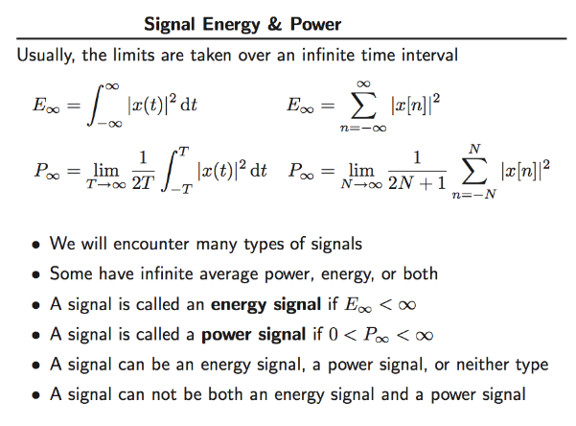

Slide 11
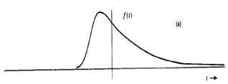
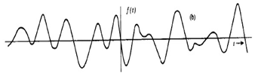
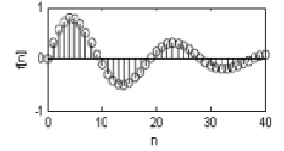
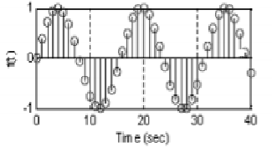
Energy Signal and Power Signal contd...
Energy Signal : ENERGY will be FINITE and average POWER will be ZERO.
Example: Finite duration signals.
Power Signal : ENERGY will be INFINITE and average POWER will be FINITE.
Example: Periodic signals.
(a) Energy signal
(b) Power signal

Slide 12
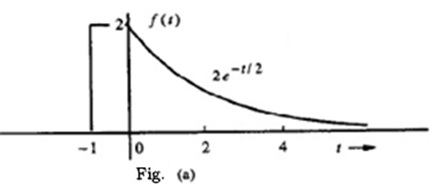
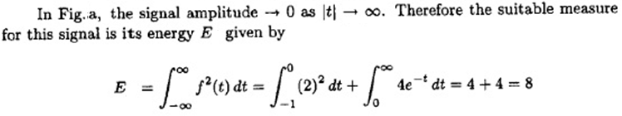
Signal Energy and Power contd…
Energy Signal
A signal with finite energy and zero power is called Energy Signal i.e.for energy signal
0 < E < ∞ and P =0
Energy of a signal is defined as the area under the square of the magnitude of the signal.

Slide 13
Energy Signal and Power Signal contd…
Power Signal
Some signals have infinite signal energy. In that case it is more convenient to deal with average signal power.
For power signals
0 < P < ∞ and E = ∞
Average power of the signal is given by

Slide 14
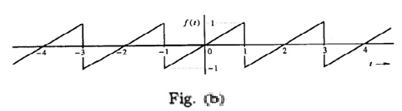
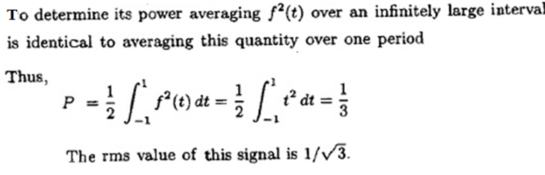
Signal Energy and Power contd…
Power Signal

Slide 15

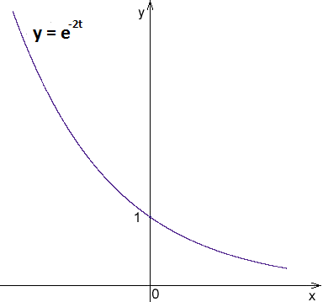
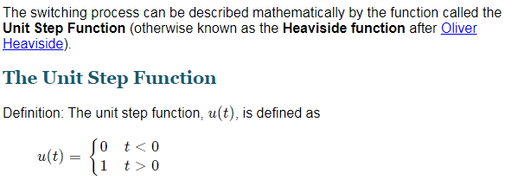
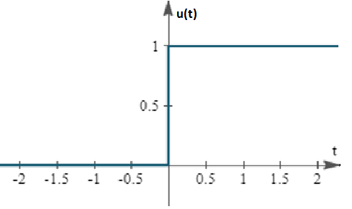
Check whether energy signal or power Signal

Slide 16

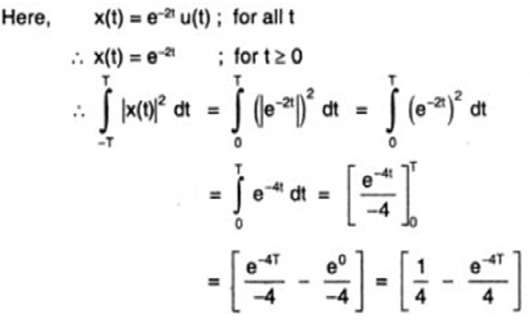
Check whether energy signal or power Signal

Slide 17
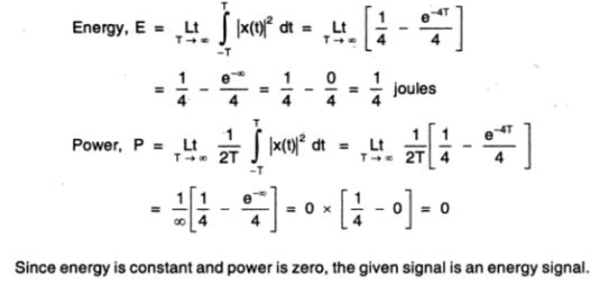
Contd….

Slide 18
DT Energy Signal and Power Signal
A discrtet time signal with finite energy and zero power is called Energy Signal i.e.for energy signal
0 < E < ∞ and P =0
The signal energy of a for a discrete time signal x[n] is

Slide 19
DT Energy Signal and Power Signal
The average signal power of a discrete time power signal x[n] is
For a periodic signal x[n] the average signal power is

Slide 20
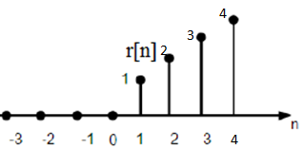
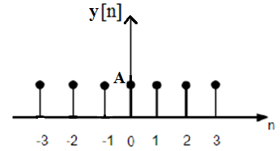
DT Energy Signal and Power Signal
Compute the total energy and average power of the given discrete time signals.
(a) x[n] = ramp[n]
x[n] = 0 n < 0
= n n ≥0
Ans → Neither energy signal nor power signal.
(b) y[n] = A
Ans → Power signal

Slide 21
Thank You!

