Slide 1
ECT 206 COMPUTER ARCHITECTURE AND MICROCONTROLLERS Lecture-3 Date: 06-05-2021
Prepared By
RAFEEK T,
Assistant Professor, ECE,
TKMCE, Kollam

Slide 3
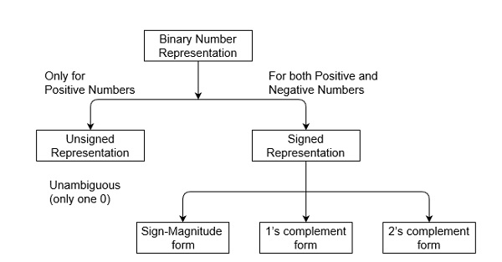
Signed numbers use sign flag or can be distinguish between negative values and positive values.
Whereas unsigned numbers stored only positive numbers but not negative numbers.

Slide 4
Multiplicand B
10111
Multiplicand B
-
10111
E
A
Q
SC
Multiplier in Q
0
00000
10011
101
=
1
; add B
10111
First partial product
0
10111
Shift right EAQ
0
01011
1100
1
100
=
1
; add B
10111
Second Partial Product
1
00010
Shift right EAQ
0
10001
0110
0
011
=
0
Shift right EAQ
0
01000
1011
0
010
=
0
;
Shift right EAQ
0
00100
0101
1
001
=
1
; add B
0
10111
11011
Shift right EAQ
0
01101
10101
000
Final Product available in AQ
01101
10101

Slide 5
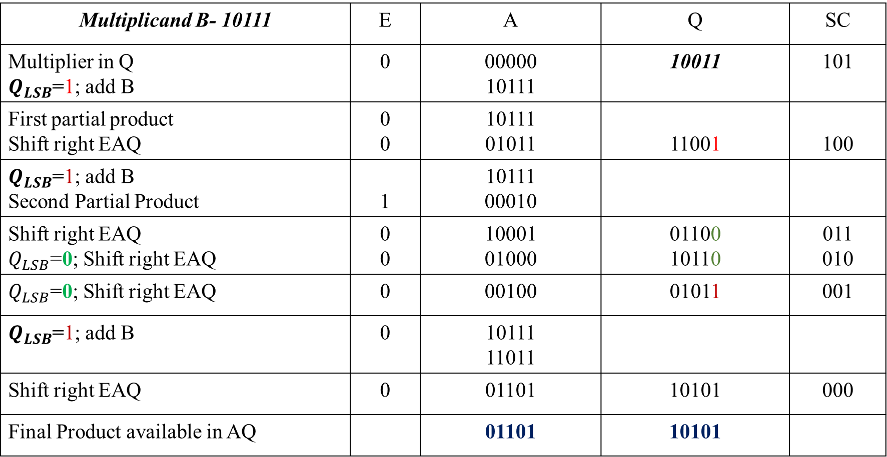
Numerical Example
Multiplicand B- 10111 | E | A | Q | SC
Multiplier in Q $Q_{LSB}$=1; add B | 0 | 00000 10111 | 10011 | 101
First partial product Shift right EAQ | 0 0 | 10111 01011 | 11001 | 100
$Q_{LSB}$=1; add B Second Partial Product | 1 | 10111 00010
Shift right EAQ $Q_{LSB}$=0; Shift right EAQ | 0 0 | 10001 01000 | 01100 10110 | 011 010
$Q_{LSB}$=0; Shift right EAQ | 0 | 00100 | 01011 | 001
$Q_{LSB}$=1; add B | 0 | 10111 11011
Shift right EAQ | 0 | 01101 | 10101 | 000
Final Product available in AQ |  | 01101 | 10101

Slide 6
Example 2: 11011 X 10101

Slide 7
ECT 206 COMPUTER ARCHITECTURE AND MICROCONTROLLERS Lecture-4 Date: 07-05-2021
Prepared By
RAFEEK T,
Assistant Professor, ECE,
TKMCE, Kollam

Slide 8
Sign-Magnitude Form
1111 | -7
1110 | -6
1101 | -5
1100 | -4
1011 | -3
1010 | -2
1001 | -1
1000 | -0
0000 | +0
0001 | +1
0010 | +2
0011 | +3
0100 | +4
0101 | +5
0110 | +6
0111 | +7
5+ (-5)=0
0101+
1101
10010 →2
6+ (-2)=4
0110+
1010
10000 →0

Slide 9
One’s Complement Form
1000 | -7
1001 | -6
1010 | -5
1011 | -4
1100 | -3
1101 | -2
1110 | -1
1111 | -0
0000 | +0
0001 | +1
0010 | +2
0011 | +3
0100 | +4
0101 | +5
0110 | +6
0111 | +7
5+ (-5)=0
0101+
1010
1111 →-0
6+ (-2)=4
0110+
1101
10011 →3

Slide 10
Two’s Complement Form
1000 | -8
1001 | -7
1010 | -6
1011 | -5
1100 | -4
1101 | -3
1110 | -2
1111 | -1
0000 | +0
0001 | +1
0010 | +2
0011 | +3
0100 | +4
0101 | +5
0110 | +6
0111 | +7
5+ (-5)=0
0101+
1011
10000 →0
6+ (-2)=4
0110+
1110
10100 →4

Slide 11
Representation of Unsigned Binary Numbers:
Since there is no sign bit in this unsigned binary number, so N bit binary number represent its magnitude only.
Zero (0) is also unsigned number. This representation has only one zero (0), which is always positive. Every number in unsigned number representation has only one unique binary equivalent form, so this is unambiguous representation technique. The range of unsigned binary number is from 0 to (2^{n}-1). Example-1: Represent decimal number 92 in unsigned binary number.
Simply convert it into Binary number, it contains only magnitude of the given number. = (92)₁₀
= (1x2⁶+0x2⁵+1x2⁴+1x2³+1x2²+0x2¹+0x2⁰)₁₀
= (1011100)₂
It’s 7 bit binary magnitude of the decimal number 92.

Slide 12
2. Signed Numbers:
Signed numbers contain sign flag, this representation distinguish positive and negative numbers. This technique contains both sign bit and magnitude of a number.
A) Sign-Magnitude form:
For n bit binary number, 1 bit is reserved for sign symbol.
If the value of sign bit is 0, then the given number will be positive, else if the value of sign bit is 1, then the given number will be negative.
Remaining (n-1) bits represent magnitude of the number. Since magnitude of number zero (0) is always 0, so there can be two representation of number zero (0), positive (+0) and negative (-0), which depends on value of sign bit.
Hence these representations are ambiguous generally because of two representation of number zero (0).

Slide 13
Generally sign bit is a most significant bit (MSB) of representation. The range of Sign-Magnitude form is from (2^{(n-1)}-1) to (2^{(n-1)}-1).
For example, range of 6 bit Sign-Magnitude form binary number is from (2⁵-1) to (2⁵-1) which is equal from minimum value -31 (i.e., 1 11111) to maximum value +31 (i.e., 0 11111).
Zero (0) has two representation, -0 (i.e., 1 00000) and +0 (i.e., 0 00000).

Slide 14
B) 1’s complement form:
Since, 1’s complement of a number is obtained by inverting each bit of given number.
So, we represent positive numbers in binary form and negative numbers in 1’s complement form. There is extra bit for sign representation.
If value of sign bit is 0, then number is positive and you can directly represent it in simple binary form, but if value of sign bit 1, then number is negative and you have to take 1’s complement of given binary number.
Therefore, in this representation, zero (0) can have two representation, that’s why 1’s complement form is also ambiguous form. The range of 1’s complement form is from (2^{(n-1)}-1) to (2^{(n-1)}-1) .
For example, range of 6 bit 1’s complement form binary number is from (2⁵-1) to (2⁵-1) which is equal from minimum value -31 (i.e., 1 00000) to maximum value +31 (i.e., 0 11111).
And zero (0) has two representation, -0 (i.e., 1 11111) and +0 (i.e., 0 00000).

Slide 15
C) 2’s complement form:
Since, 2’s complement of a number is obtained by inverting each bit of given number plus 1 to least significant bit (LSB).
So, we represent positive numbers in binary form and negative numbers in 2’s complement form. There is extra bit for sign representation.
If value of sign bit is 0, then number is positive and you can directly represent it in simple binary form, but if value of sign bit 1, then number is negative and you have to take 2’s complement of given binary number.
If value of most significant bit (MSB) is 1, then take 2’s complement from, else not.
The range of 2’s complement form is from (2^{(n-1)}) to (2^{(n-1)}-1).
For example, range of 6 bit 2’s complement form binary number is from (2⁵) to (2⁵-1) which is equal from minimum value -32 (i.e., 1 00000) to maximum value +31 (i.e., 0 11111).

Slide 16
ECT 206 COMPUTER ARCHITECTURE AND MICROCONTROLLERS Lecture-5 Date: 10-05-2021
Prepared By
RAFEEK T,
Assistant Professor, ECE,
TKMCE, Kollam

Slide 17
Booth Algorithm for Multiplication

Slide 18
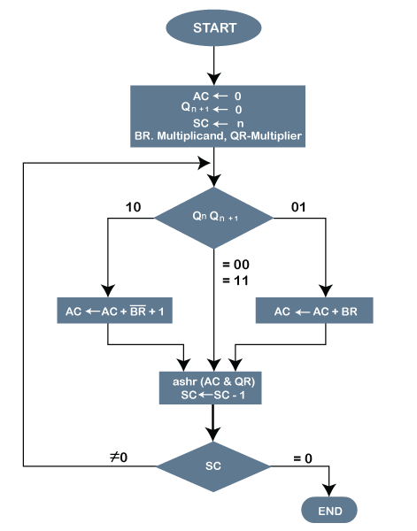
Booth Algorithm:
It gives a procedure for multiplying binary integers in signed-2’s complement representation.
The multiplicand is subtracted from the partial product upon encountering the first least significant 1 in a string of 1’s in the multiplier.
The multiplicand is added to the partial product upon encountering the first 0 (provided that there was a previous 1) in a string of 0’s in the multiplier.
The partial product does not change when the multiplier bit is identical to the previous multiplier bit.
The hardware implementation is similar to previous one except the sign bit are not separated from the rest of the registers.

Slide 19
Working on the Booth Algorithm:
Set the Multiplicand and Multiplier binary bits as M and Q, respectively.
Initially, we set the AC and Qn + 1 registers value to 0.
SC represents the number of Multiplier bits (Q), and it is a sequence counter that is continuously decremented till equal to the number of bits (n) or reached to 0.
A Qn represents the last bit of the Q, and the Qn+1 shows the incremented bit of Qn by 1.
On each cycle of the booth algorithm, Qn and Qn + 1 bits will be checked on the following parameters as follows:
When two bits Qn and Qn + 1 are 00 or 11, we simply perform the arithmetic shift right operation (ashr) to the partial product AC. And the bits of Qn and Qn + 1 is incremented by 1 bit.
If the bits of Qn and Qn + 1 is shows to 01, the multiplicand bits (M) will be added to the AC (Accumulator register). After that, we perform the right shift operation to the AC and QR bits by 1.
If the bits of Qn and Qn + 1 is shows to 10, the multiplicand bits (M) will be subtracted from the AC (Accumulator register). After that, we perform the right shift operation to the AC and QR bits by 1.
The operation continuously works till we reached n - 1 bit in the booth algorithm.
Results of the Multiplication binary bits will be stored in the AC and QR registers.

Slide 20
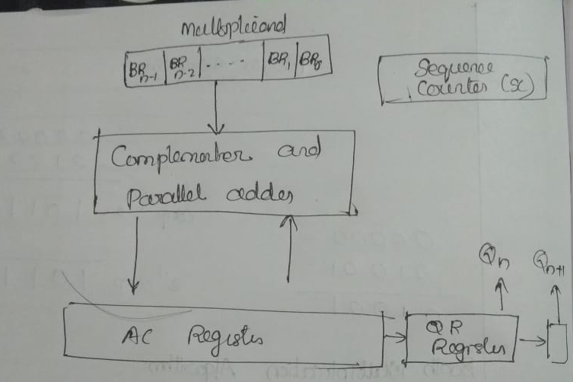
Hardware for Booth algorithm

Slide 21
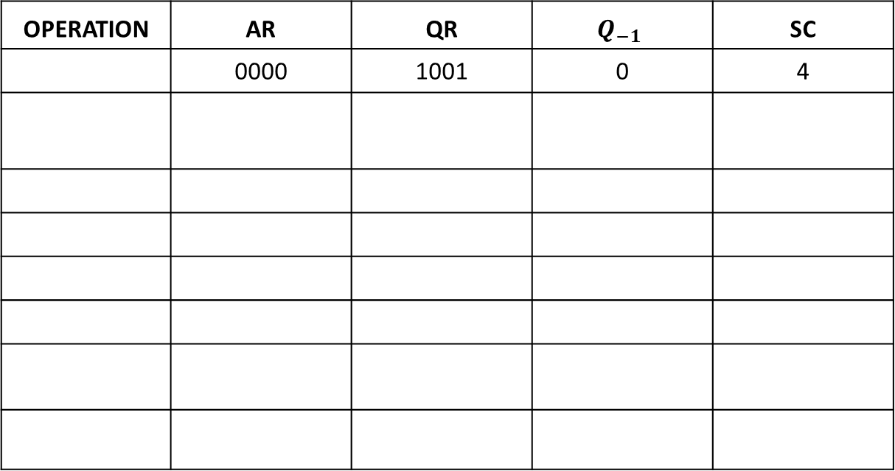
Example 1: Compute -3 ×-7 using the Booth’s algorithm. The 2’s complement representations for them are 1101 and 1001, respectively.
Multiplicand, BR=1101
OPERATION | AR | QR | $$Q_{−1}$$ | SC
 | 0000 | 1001 | 0 | 4
BR’ =0010 +
1
2’s → 0011
A + BR’ + 1
0011
1001
0
ASHR
0001
1100
1
3
A+BR
1110
1100
1
ASHR
1111
0110
0
2
ASHR
1111
1011
0
1
A + BR’ + 1
0010
1011
1
0
ASHR
0001
0101
1

Slide 22
Example 2: Compute -9 ×-13 using the Booth’s algorithm.
Example 3: Compute 7 × 3 using the Booth’s algorithm.

