Slide 1
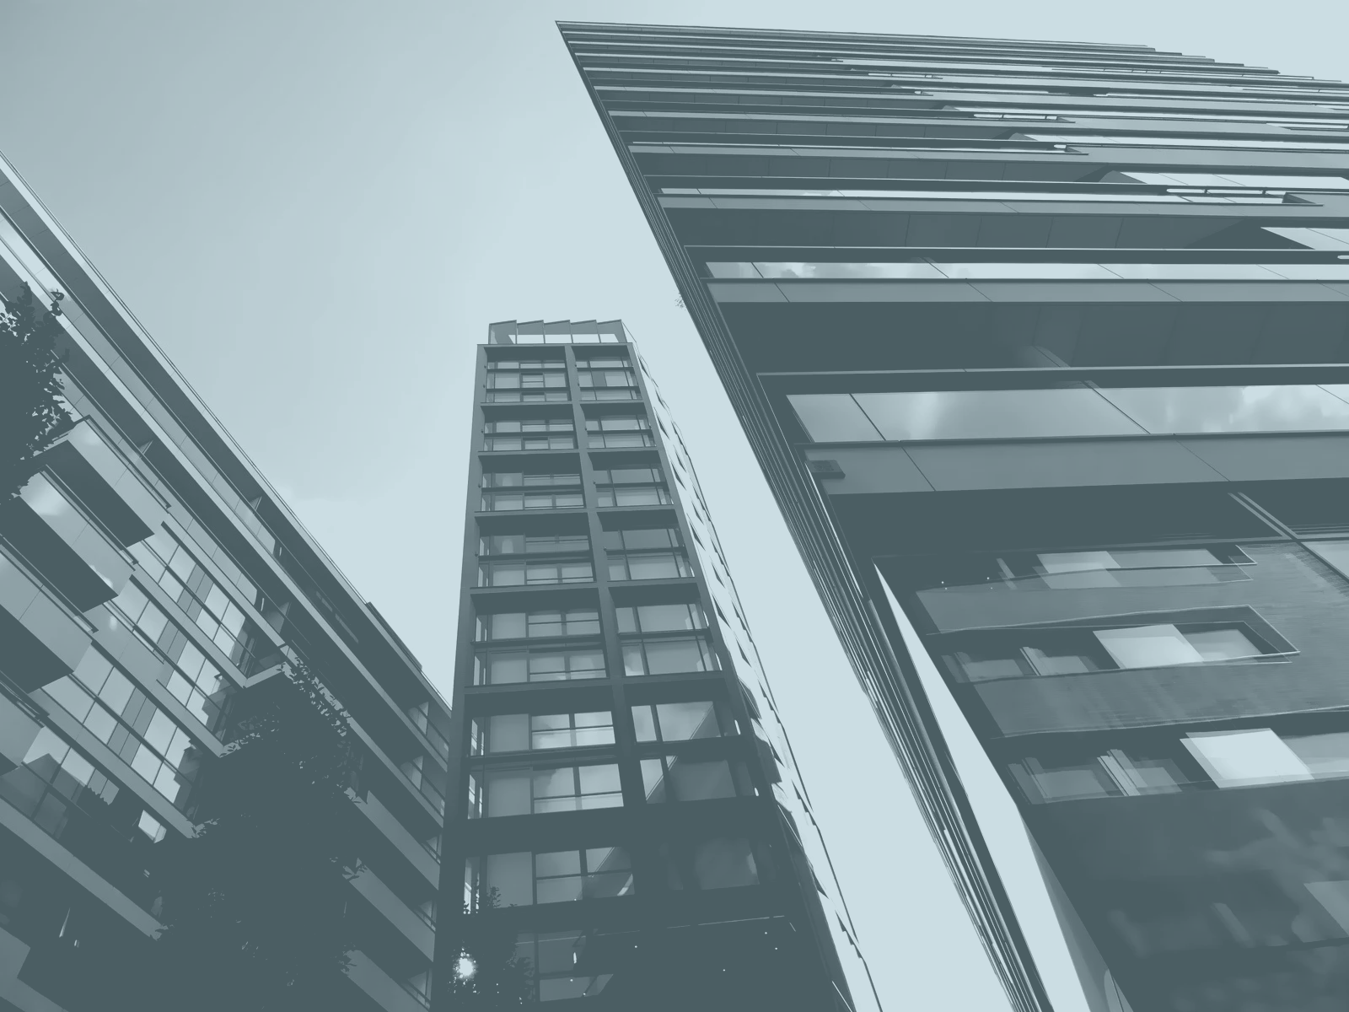
HIBIR
Android App

Slide 2
Contents
Contents
1. Statement of problem
2 . Objective of the project
3 . Design

Slide 3
Ethiopia's culture lacks global recognition, even within its own borders. Despite its richness, there is a noticeable absence of effective platforms for showcasing and educating individuals about our diverse cultural aspects, which perpetuates stereotypes and hinders comprehensive understanding
To address these challenges, Hibir has emerged as a promising solution. It offers a comprehensive and user-friendly application that not only promotes cultural awareness but also dispels stereotypes and centralizes cultural information.
1. Statement of problem

Slide 4
GENERAL OBJECTIVE:
The main objective of this project is to bridge cultural gaps and promote cross-cultural understanding by providing a platform for users to explore, learn, and engage with the cultural heritage of Ethiopia.
SPECIFIC OBJECTIVE
Create a comprehensive database of Ethiopian cuisines. Showcase the diverse range of Ethiopian traditions, including traditional food, languages, festivals, and cultural clothing.
2. Objective of the project

Slide 5
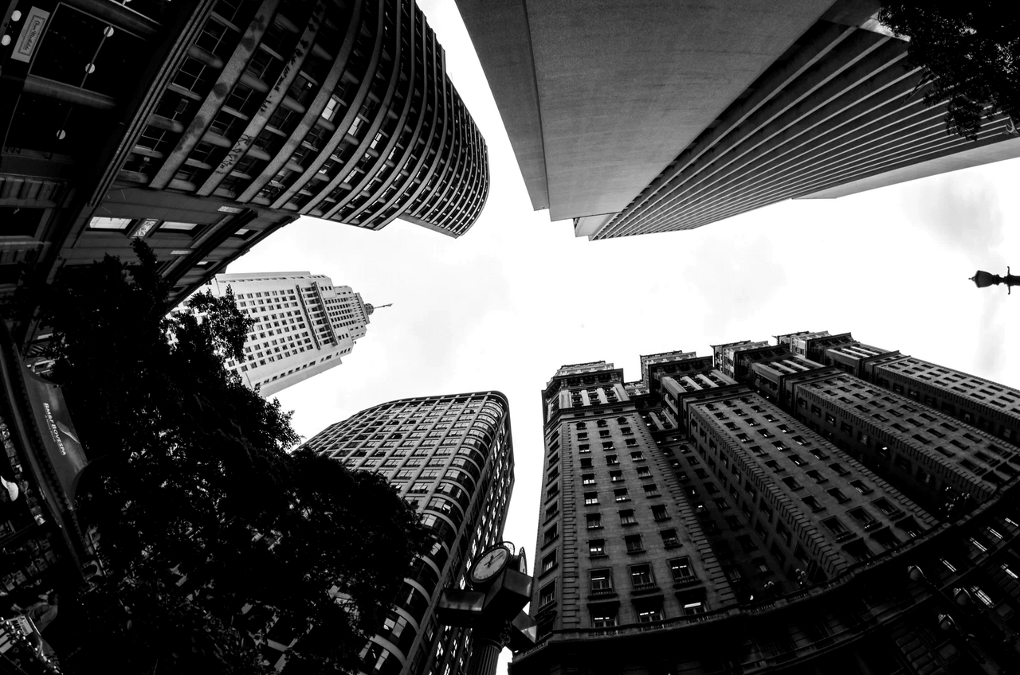
3. System Design
System Design: is the process of determining how the Hibir app will be constructed.
it serves as a blueprint, outlining the various parts of the system, their interactions, and data flows.

Slide 6
User Interface Layer:This layer is where users interact with the Hibir app.
Persistence Layer: is responsible for the permanent storage, retrieval, and deletion of objects/data within the Hibir app.
Business/Domain Layer: This layer encompasses the core concepts relevant to the Hibir app’s business domain. System Layer: System classes in this layer provide functionality specific to the operating system (OS) on which the Hibir app runs.
Class type architecture

Slide 7
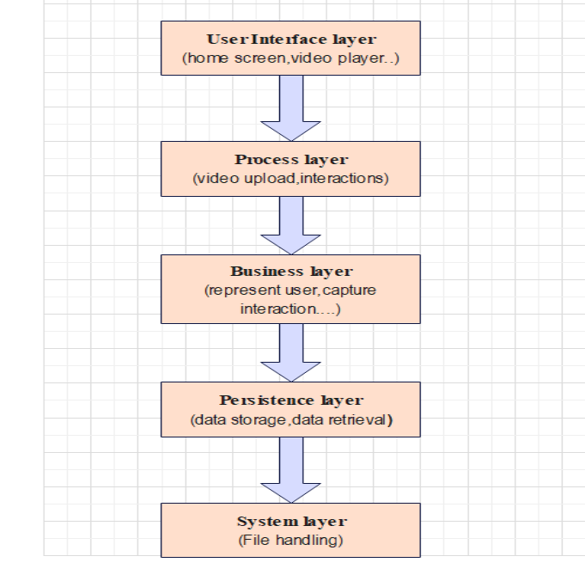
Class type architecture

Slide 8
Class modeling
Class modeling A class diagram is a visual representation of a system's structure in the realm of object-oriented programming, using the Unified Modeling Language (UML). It is like a blueprint that shows the building blocks and how they connect.
key elements of a class diagram are classes, attributes, operations and relationships.

Slide 9
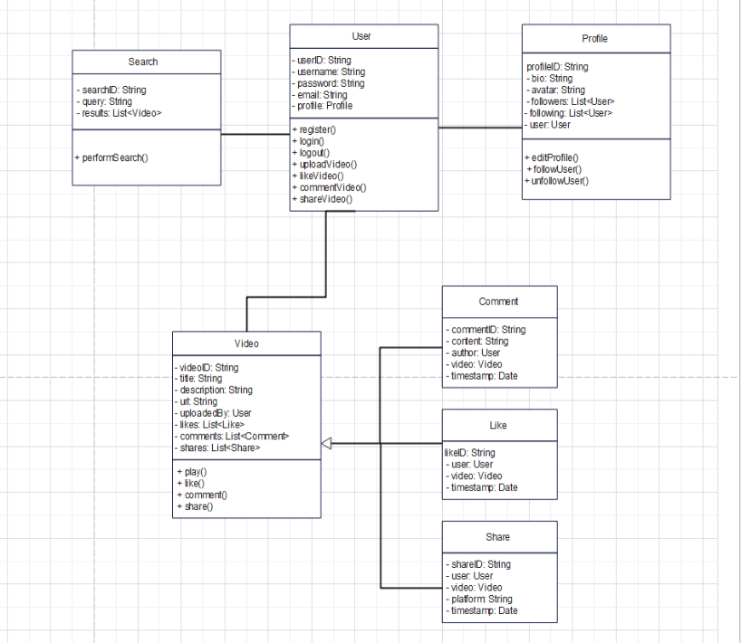
Class diagram

Slide 10
State chart modeling
State chart modeling is used to show the sequence of states that an object goes through, the events that cause the transition from one state to the other and the actions that result from a state change. State chart diagram shows the change of an object through time from one state to another state.

Slide 11
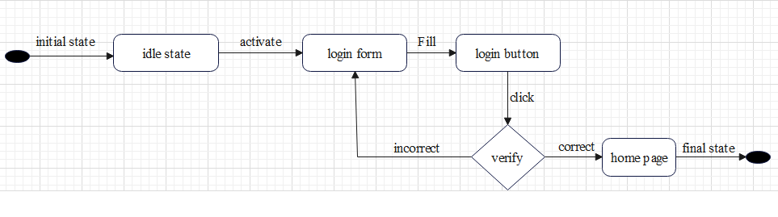
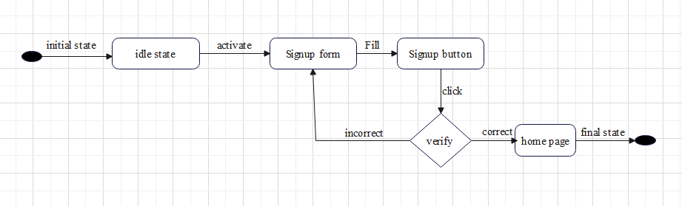
State chart diagram for Login
State chart diagram for Register

Slide 12
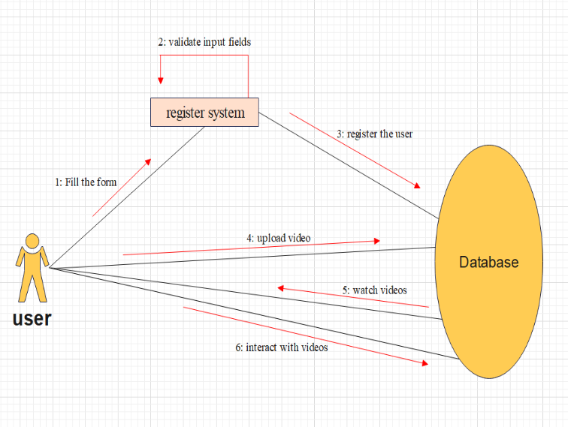
Collaboration Modeling Collaborative modeling involves stakeholders working together to design and develop the application.
Collaboration Modeling for Register

Slide 13
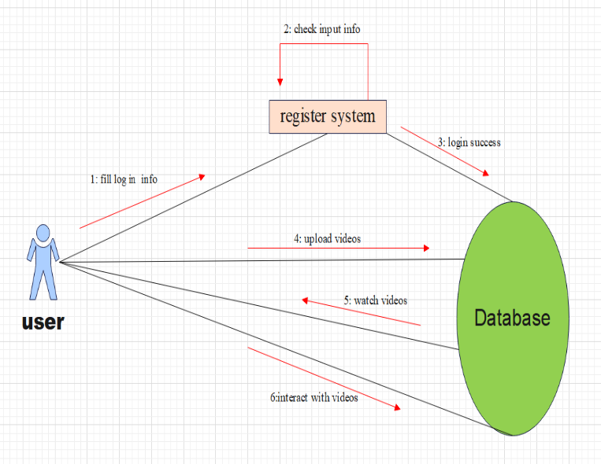
Collaboration Modeling Collaborative modeling involves stakeholders working together to design and develop the application.
Collaboration Modeling for Login

Slide 14
Component modeling Component modeling is a technique used to break down a complex system into manageable parts, each responsible for a specific functionality. Creating a component model for the Hibir app involves visualizing the major components and their interactions.

Slide 15
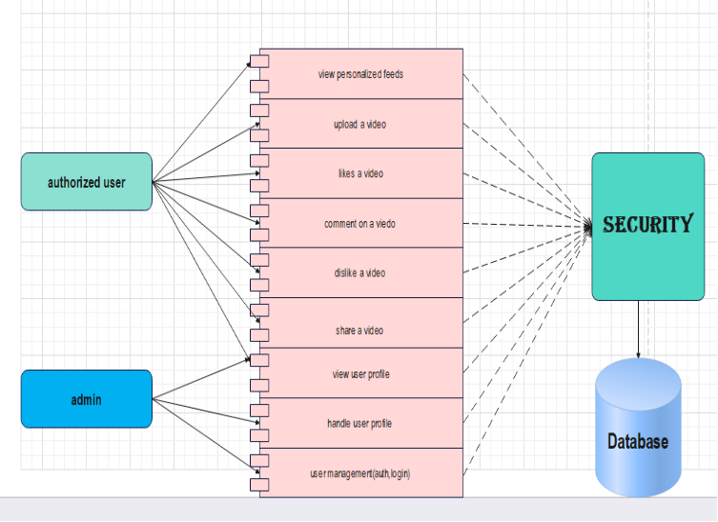
Component modeling

Slide 16
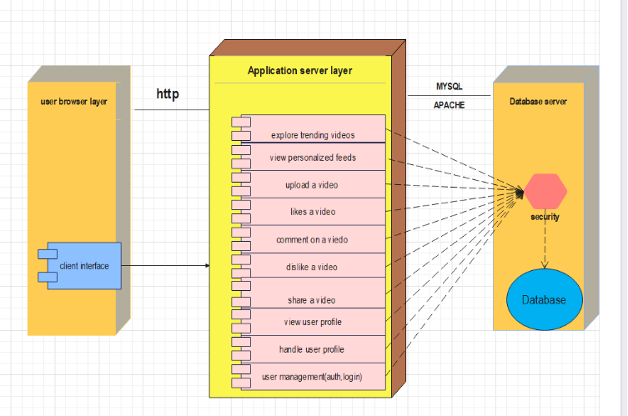
Deployment modeling provides a high-level overview of how the Hibir app's components are deployed across different infrastructure elements, ensuring scalability, reliability, and performance.

Slide 17
Persistent Modeling
it documents the normalized database schema for the Hibir application, detailing the tables, their attributes, data types, and relationships, ensuring data integrity and efficient data management.

Slide 18
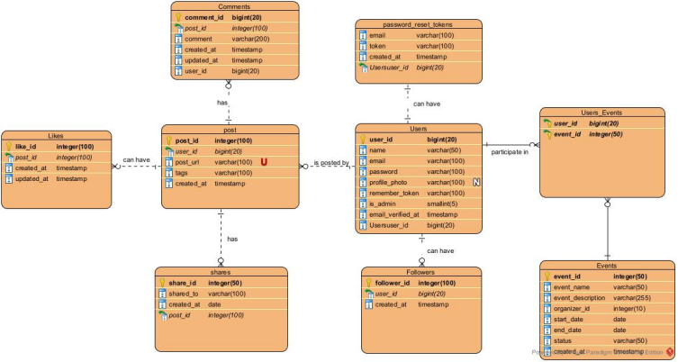
Persistent modeling

Slide 19
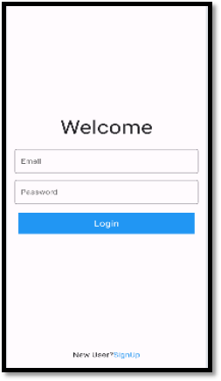
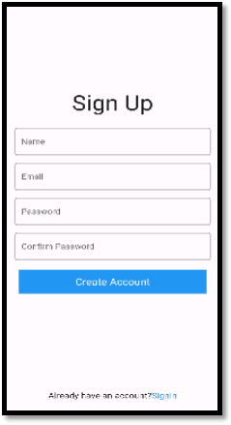
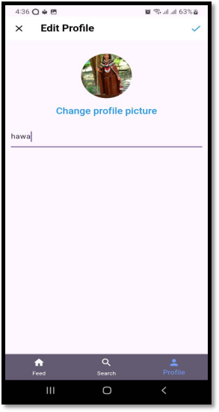
User Interface design
User interface modeling is to indicate the surface that can be used by user and the system to communicate to each other. In this system users will interact with the system through the above user interfaces.

Slide 20
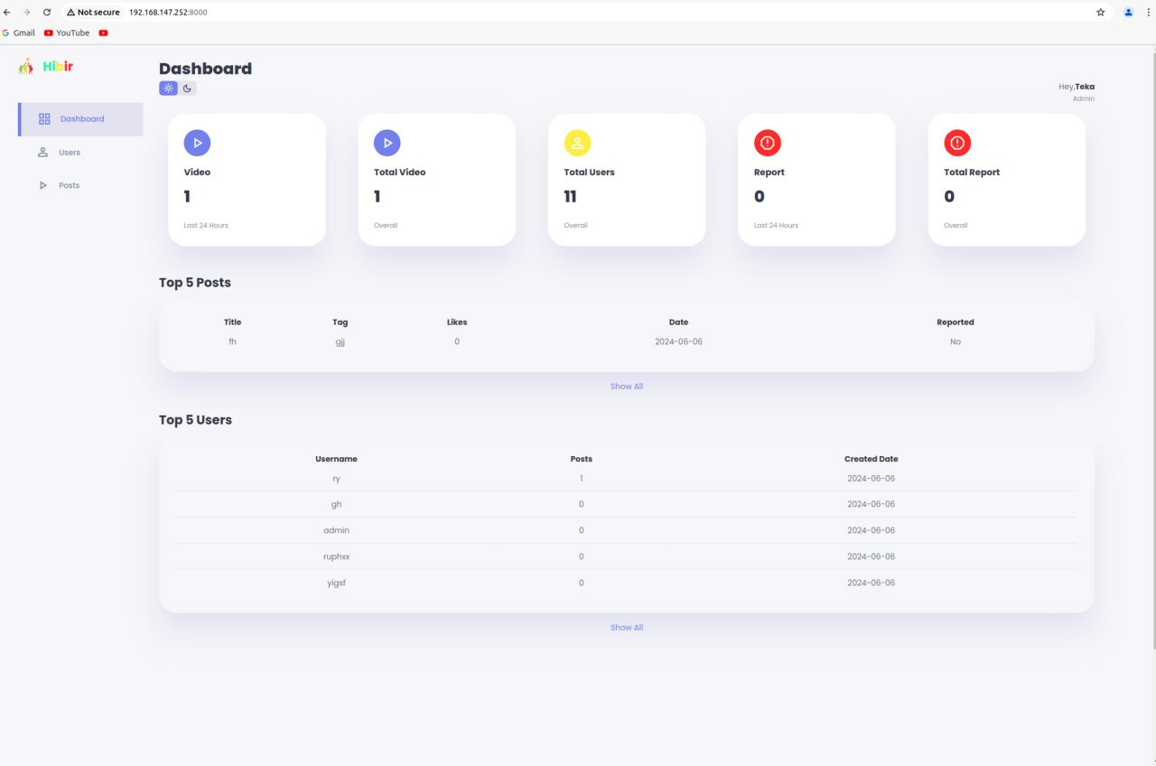

Slide 21
Hardware software acquisitions
involves selecting and procuring hardware components and acquiring software tools such as databases and applications, essential for coding, testing, and deployment.
For the project implementation, we used the following hardware’s and software’s.
ANNUAL COMPANY OUTING
Presentations are communication tools that can be used
as demonstrations, lectures, speeches, and more.

Slide 22
hardware’s we used are:
Computers
mobile phones
Flash
software’s we used are:
Flutter Framework for front-end development.
Laravel for back-end development
SQL for handling a database operation
MS word 2019:for preparing documentation
Power point: for preparing presentation

Slide 23
THANK YOU

