Slide 1


Slide 2

We are moving your candidature forward!

Slide 3

Let’s get started. . .

Slide 4


Navigate to the India Jobs Portal

Slide 5
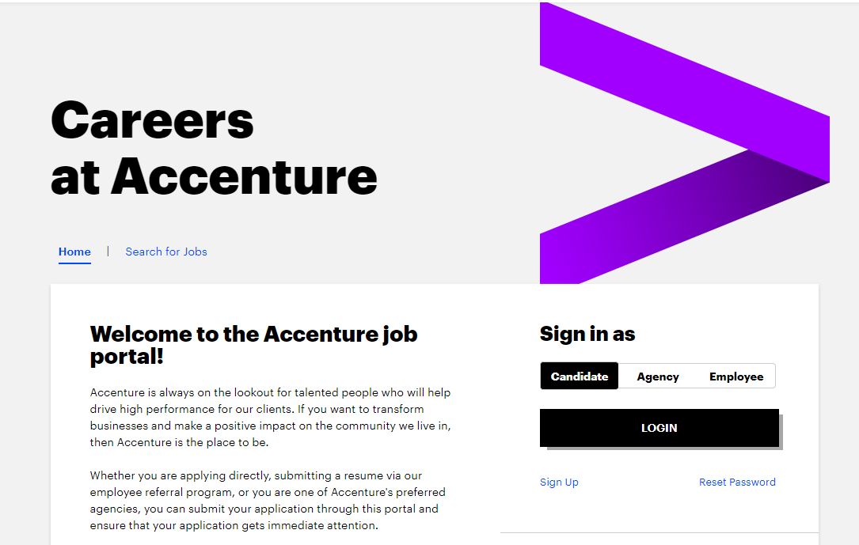
Navigate to the India Jobs Portal

Slide 6
Do you have a Login ID and Password?

Slide 7
Navigate to Reset Password

Slide 8
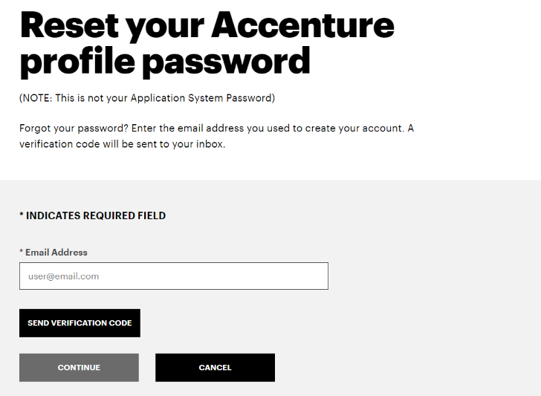
Generating Verification Code
ENTER EMAIL ADDRESS

Slide 9
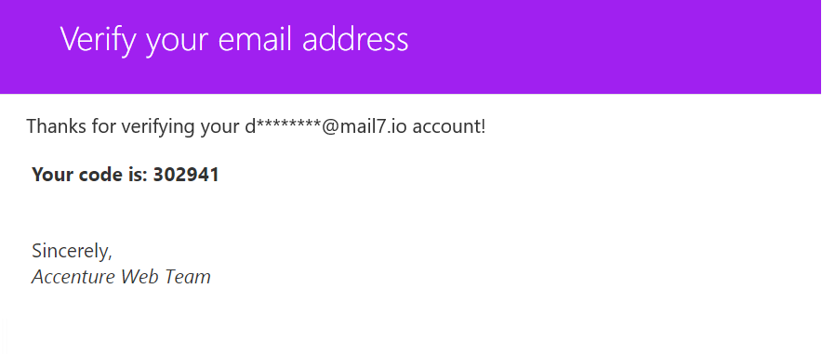
Check your Email for Verification code

Slide 10
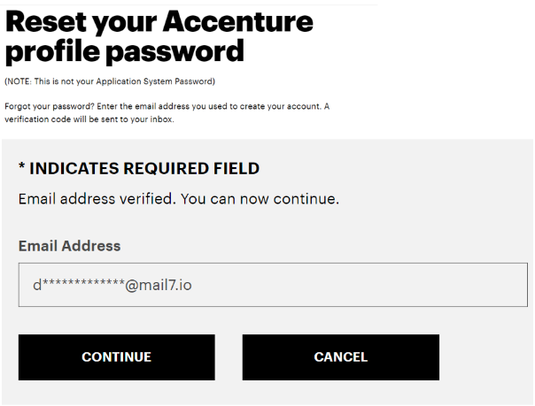

Validate the mail with verification code

Slide 11
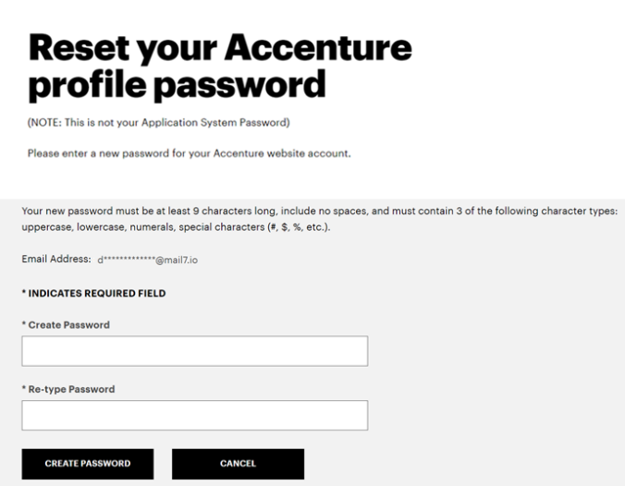
Reset Your Password

Slide 12
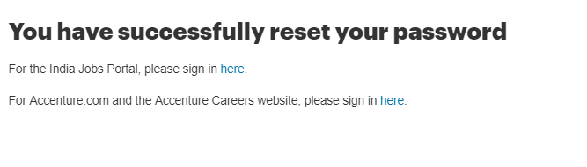
Password is Set.
Navigate to the India Jobs Portal

Slide 13
Navigate to the India Jobs Portal

Slide 14

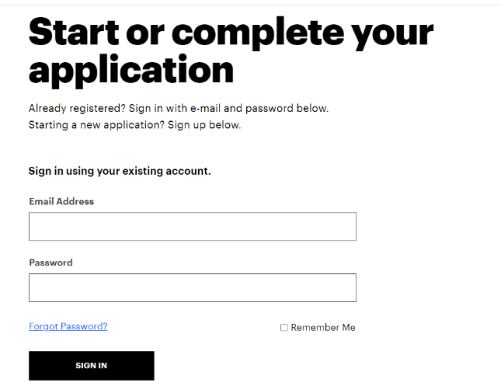
Signing in to the India Jobs Portal
ENTER EMAIL
ENTER PASSWORD

Slide 15
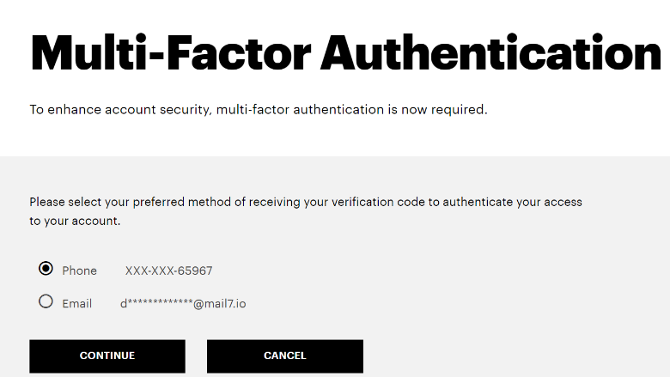
Do an MFA through Mobile or Mail ID
CHOOSE PHONE OR EMAIL ID

Slide 16
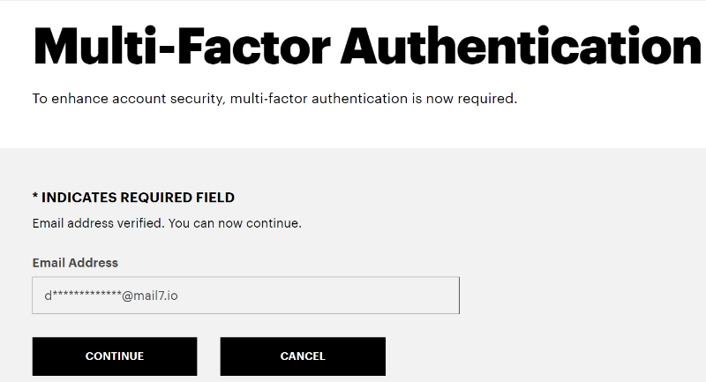
Complete the MFA on Mobile or Mail ID

Slide 17
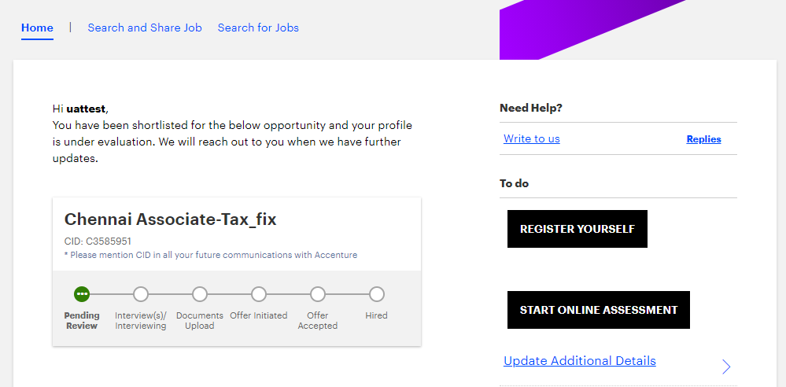
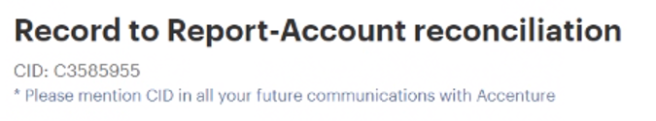
Opening the Skills form

Slide 18
Thank you . . .

