Slide 1
Requirements Tracker
1
present by:
Team. Matrix
Cheng, Qibing(2077594)
Kim, Sangwoo (2052923)
Li,Yan(2097753)
Takemura, Ryu (2095717)
Yuan, Wen (2014090)

Slide 2
2
Outline
Goals and Objectives
Wireframes
User Persona
User needs matrix
Specification
System Architecture Diagram
ER-Diagram
URLs and Site map
Stand out features

Slide 3
3
Goal and Objective
This system provides a platform to manage shared-events.
Users can create subject requirements list, capture and trace the ongoing process of the requirements.

Slide 4
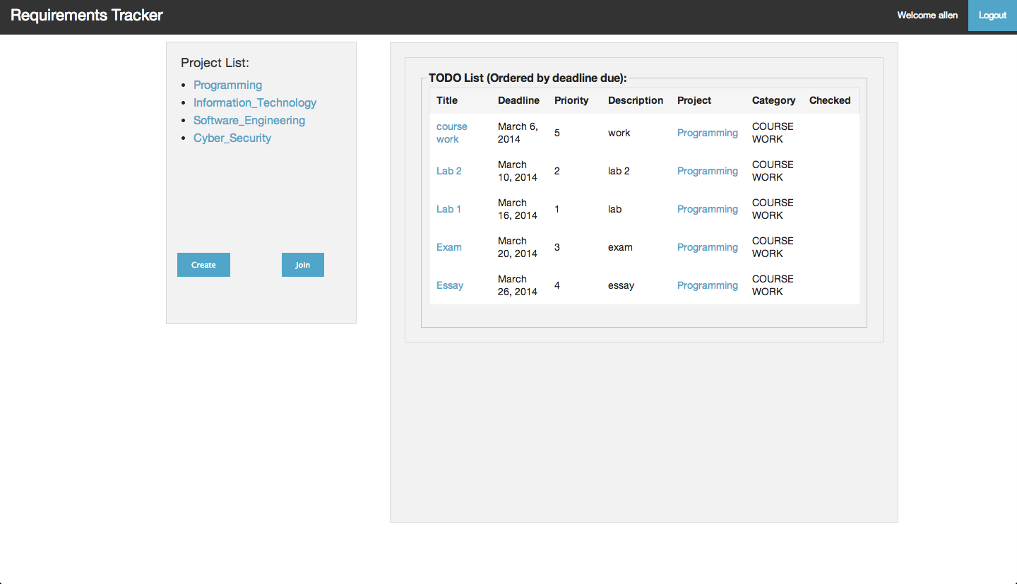
Wireframes 1
4
User Interface(The TODO list shows the five most urgent events.User can click the project from the list , to see the detail of the project.)

Slide 5
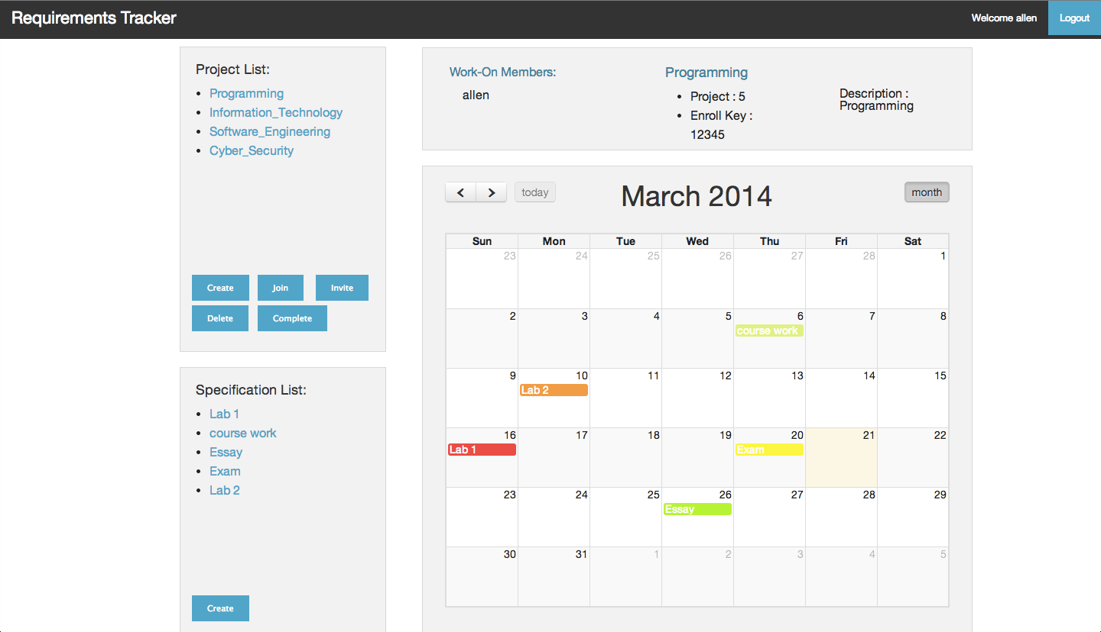
Wireframes 2
5
Project Detail(This calendar shows the all events of the project. Only the project leader can see the enrol key ,and delete/complete the project)

Slide 6
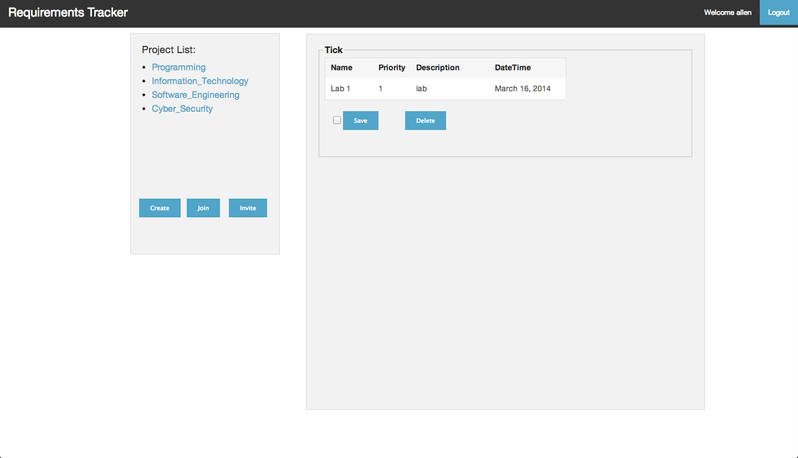
Wireframes 3
6
Detail TODO Attribute(By clicking a specification,User can see the detail of the specification , and tick it, if he/she thinks the event is done. )

Slide 7
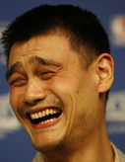
User Persona (1)
7
Jacky , Yao
Age : 19
2nd Year University Student
  Jacky is a project leader of a team research.
  Doing research a project which can be split into sub-missions.
  He needs a scheduler to manage the whole project.
  He want to trace his event by using application.
  The purpose of each event in the project can be explained by application.

Slide 8
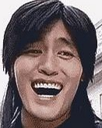
User Persona (2)
8
Alex , Kim
Age : 27
Business man
    Alex is on business trip very frequently.Alex needed to report to his mother company and his colleagues in order to let them know his working progress during the trip.
    He needs a software/application that to be able to share the work progress between colleagues to manage his works.

Slide 9
User needs matrix
9
1
Requirements | University Student | Business man
Priority
Login/Register
Create/Join/Share a Project
Project Description
Leader System
Trace a project
Time Marker
Attribute Description
Definitely necessary
Highly necessary
Barely Necessary

Slide 10
Specification
10
Done
  Login system
  Create events
  Share events
  Join events
  Events should be divided into different categories.
  Each event should have Date/Time
  Each event should have a short description.
  Event has priority level.
  Specifications can be ordered.
Not done
  A way to track or mark version.
  Specification can be dragged down between categories

Slide 11
System Architecture Diagram
11
USER
Web pages
M/W
DB
Technologies used:
Webpage: HTML 5, CSS，JavaScript
Middleware: Python, XML
Database: Sqlite3

Slide 12
ER-Diagram
12
User name
Email
Surname
Password
Users
Forename
Date/Time
State
Priority
1
M
Lead
Join
SpecTitle
Specification
SpecID
N
N
N
Description
Belong to
N
1
Sort of
1
Enrollment Key
Project
Category
ProjID
Description
ProjName
CateID
Category

Slide 13
URLs and Site map
13
Requirement Tracker: http://rt.com
Login
http://rt.com/login
User Interface
http://rt.com/user_interface
Create Project
http://rt.com/user_interface/create_project
Join Project
http://rt.com/user_interface/join_project
Project Detail
http://rt.com/project_detail
Invite Member
http://rt.com/project_detail/invite_member
Create TODO Attribute
http://rt.com/project_detail/create_todo_attr
Detail TODO Attribute
http://rt.com/project_detail/detail_todo_attr
Notes:
1,2,3 (not very difficult)
4,5 (a bit difficult)
6,7,8 ()
9,10,11 (very hard)
12,13 (a bit hard)
14 together
1,2,3,4
1,2,3
4,5

Slide 14
Stand out features
14
Open resources
  Provide free sharing platform to public.
Eidetic webpage design.
  Easy to understand and use
Uncomplicated system architecture
  Easy maintenance

Slide 15
The app can be run at :
http://takemura.pythonanywhere.com
3

