Slide 1
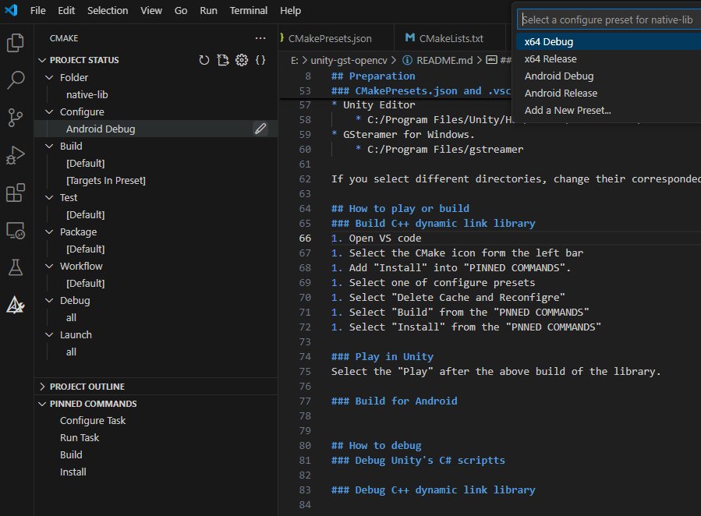
Delete Cache and Reconfigure
Select a Configure Preset
Run and Debug
(See the following debug section)
CMake Extension
PINNED COMMANDS

Slide 2
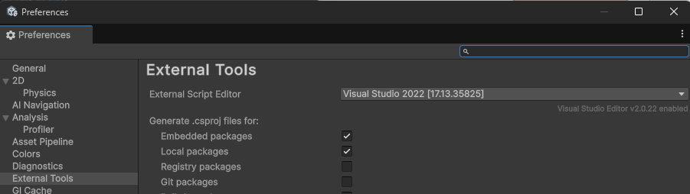

Slide 3
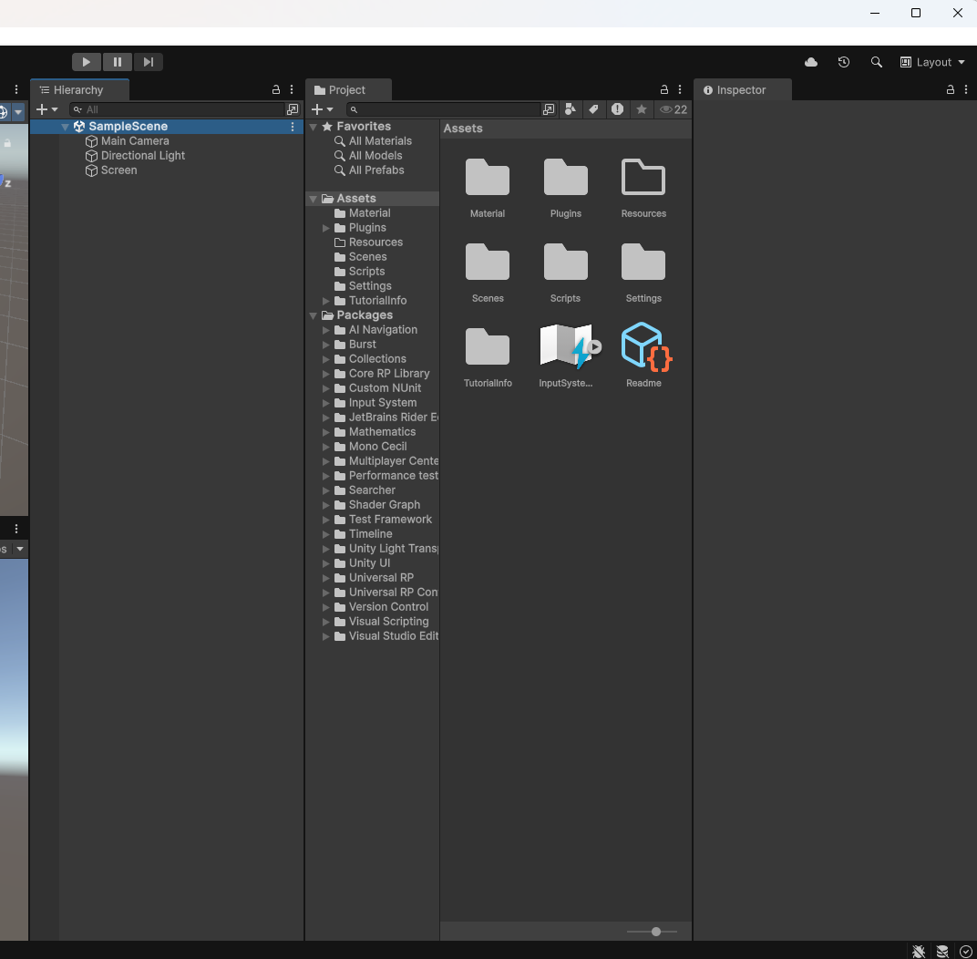

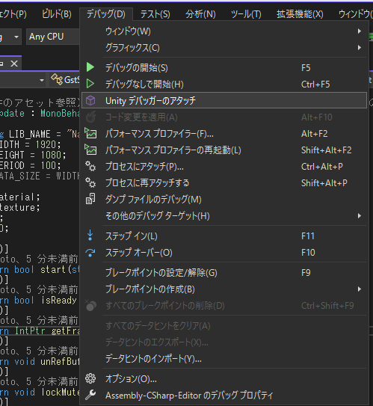
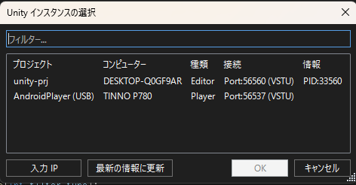

Slide 4
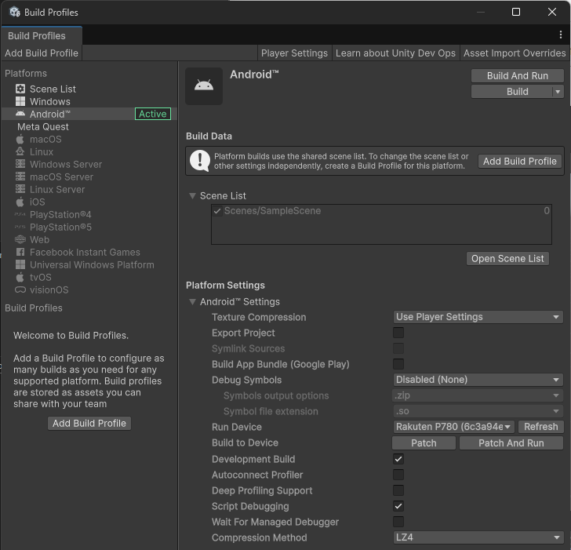
Only for debugging with Android device
(See the following debug section)

