Slide 1

Overcoming Throughput Degradation in Multi-Radio Cognitive Radio Networks
M.Sc. Thesis Proposal
by
Tanvir Ahmed Khan
Student ID: 1014052013
Supervised by:
A. B. M. Alim Al Islam, Assistant Professor.
Dept. of CSE, BUET.

Slide 2
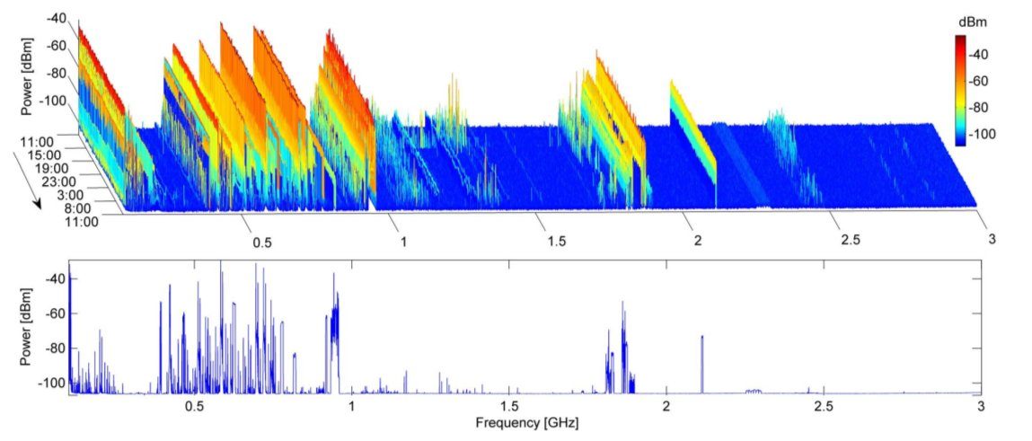
Preliminaries
Licensed frequency spectrums are mostly under-utilized!

Slide 3
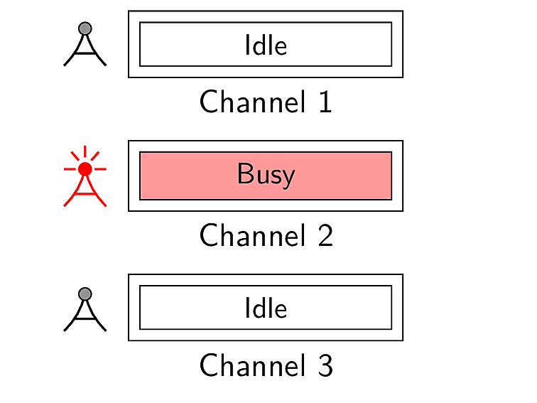
Preliminaries
How to increase the spectrum utilization?

Slide 4
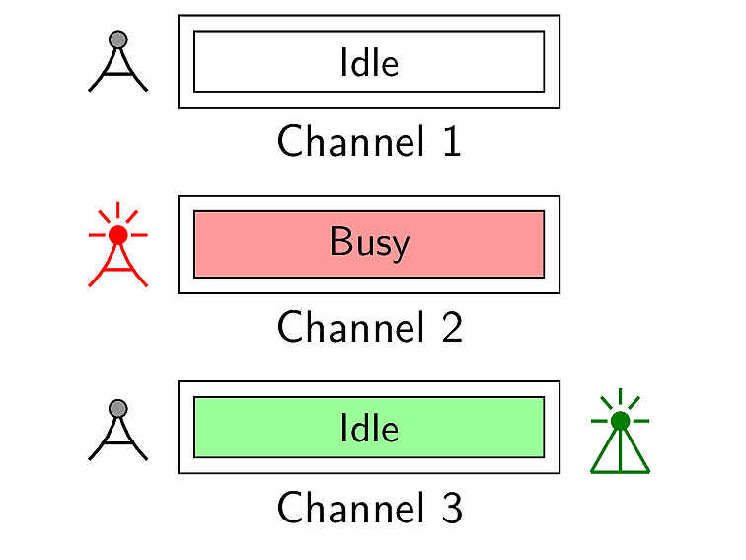
Preliminaries
Cognitive radio networks (CRNs)
comprises of two different types of users
Primary users
Secondary users

Slide 5
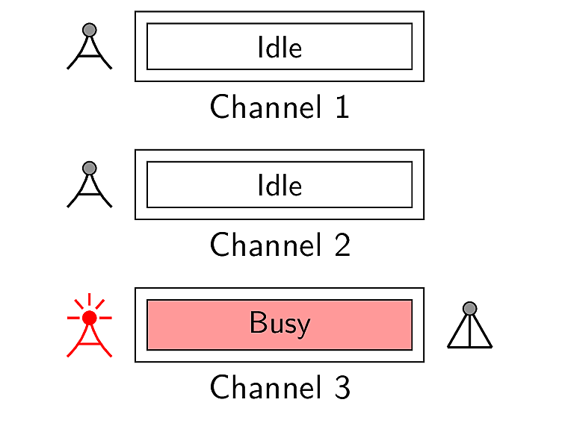
Preliminaries
Cognitive radio networks (CRNs)
comprises of two different types of users
Primary users
Secondary users

Slide 6
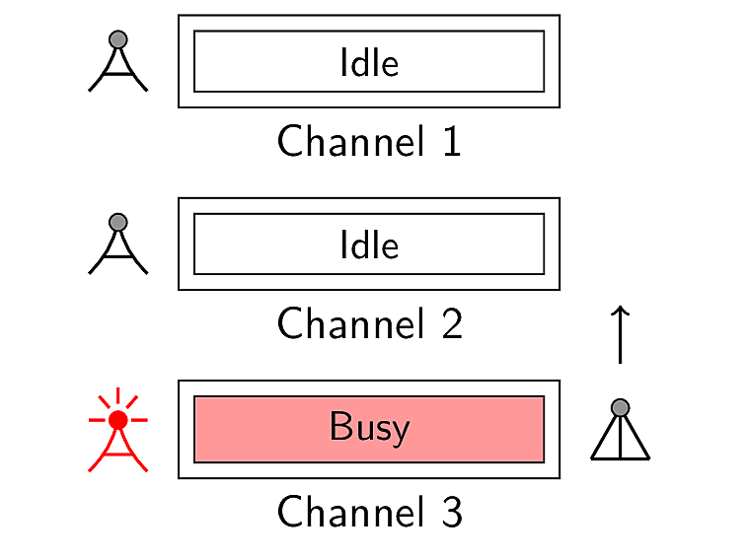
Preliminaries
Cognitive radio networks (CRNs)
comprises of two different types of users
Primary users
Secondary users

Slide 7
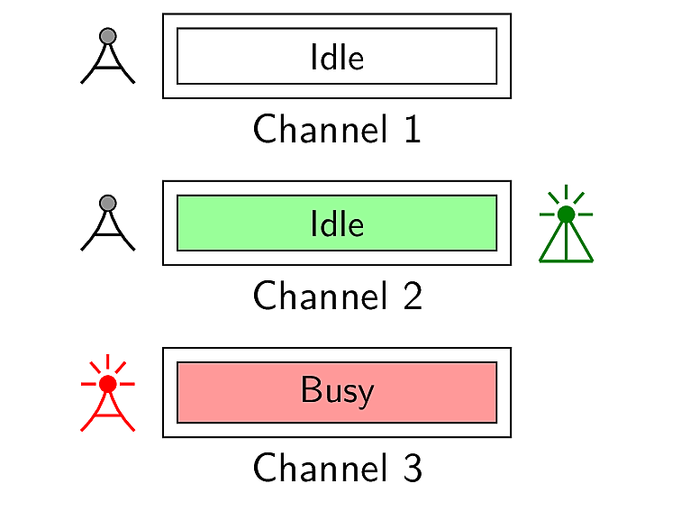
Preliminaries
Cognitive radio networks (CRNs)
comprises of two different types of users
Primary users
Secondary users

Slide 8

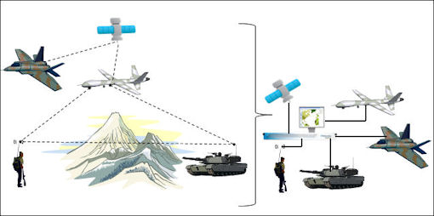
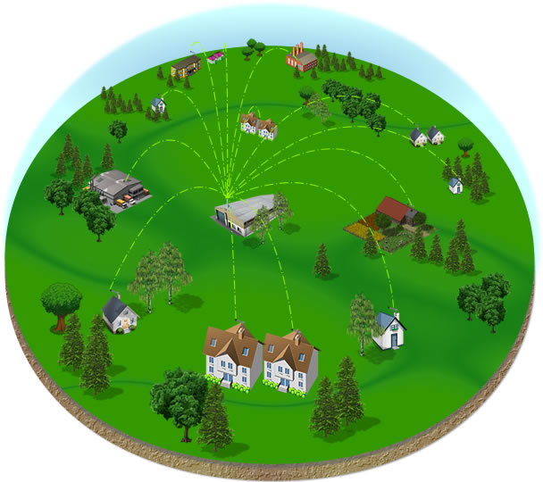
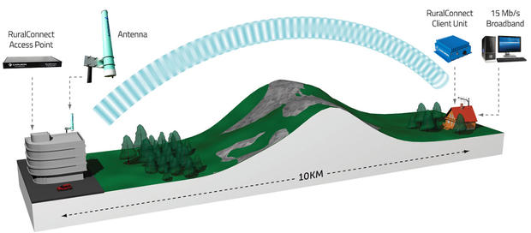
Preliminaries
Applications of cognitive radio networks

Slide 9
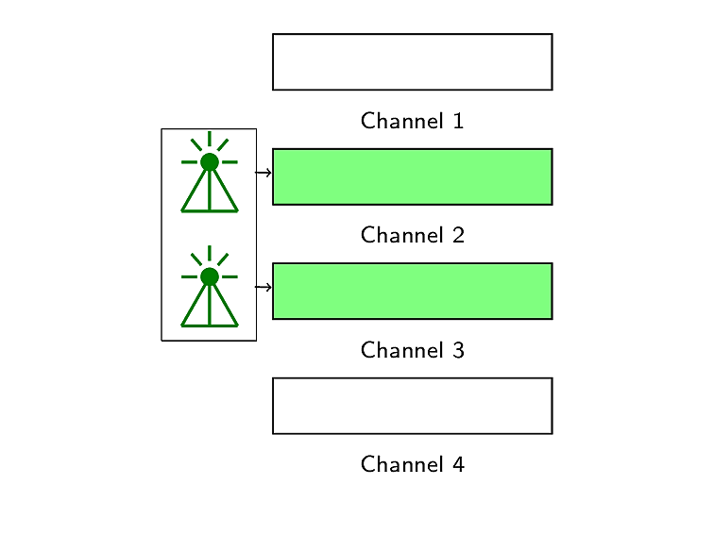
Preliminaries
Multi-radio networks
improves network capacity

Slide 10
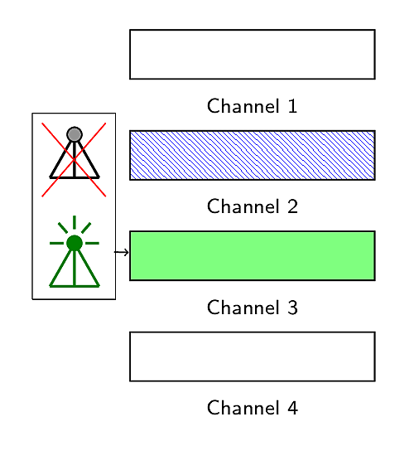
Preliminaries
Multi-radio networks
enhances transmission reliability

Slide 11
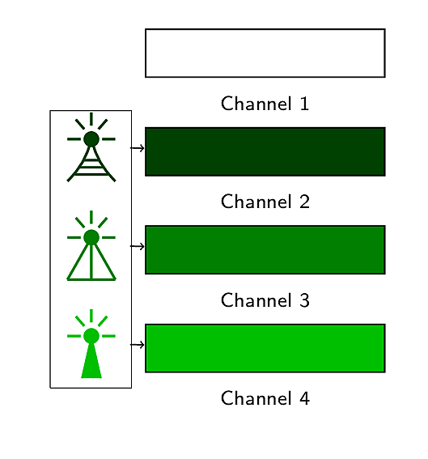
Preliminaries
Multi-radio networks
enables heterogeneous wireless access

Slide 12
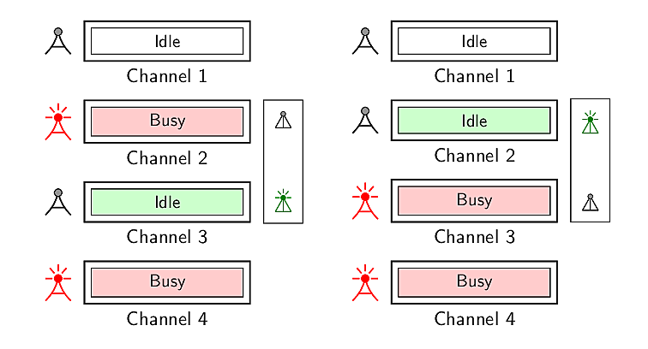
Preliminaries
Multi-radio cognitive radio networks

Slide 13
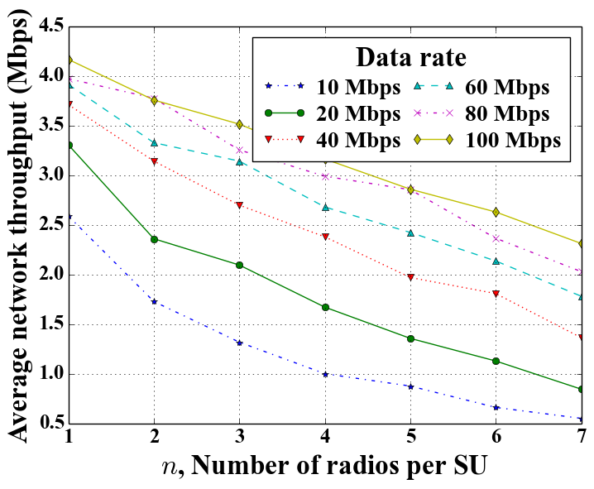
Motivation Behind Our Work
Throughput degradation in multi-radio CRNs

Slide 14
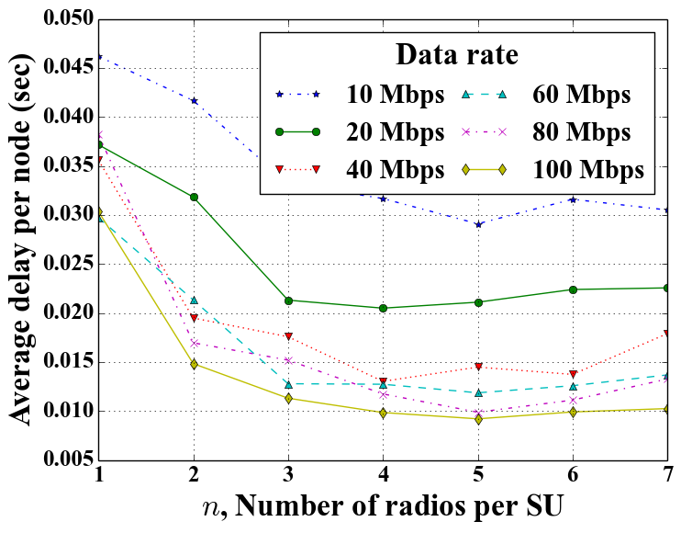
Motivation Behind Our Work
Throughput degradation in multi-radio CRNs
at the benefit of delay improvement

Slide 15
Our Research Problem
How to overcome this throughput degradation in multi-radio CRNs?

Slide 16
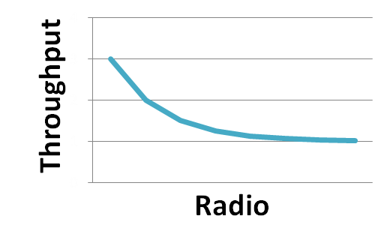
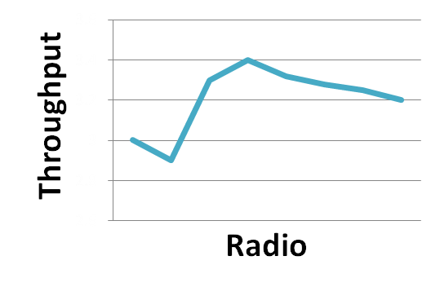
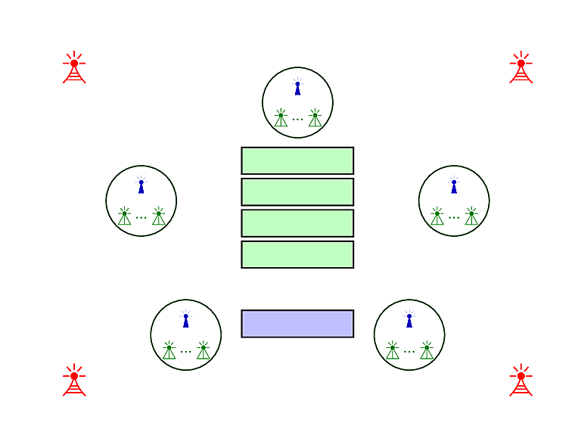
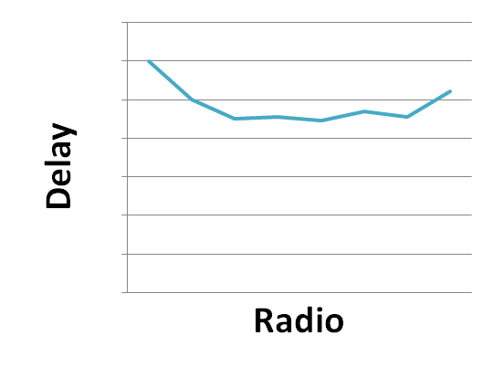
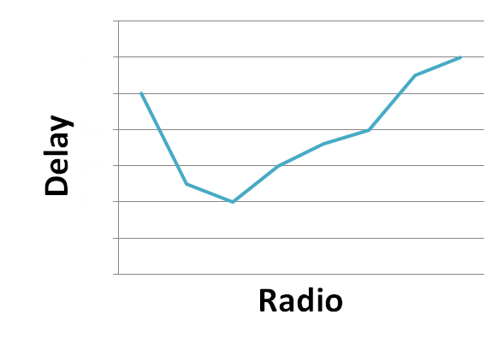
Objectives & Outcome
Propose a approach to improve throughput
Feedback-based multi-radio exploitation approach
Propose a new approach
Feedback-based multi-radio exploitation approach

Slide 17
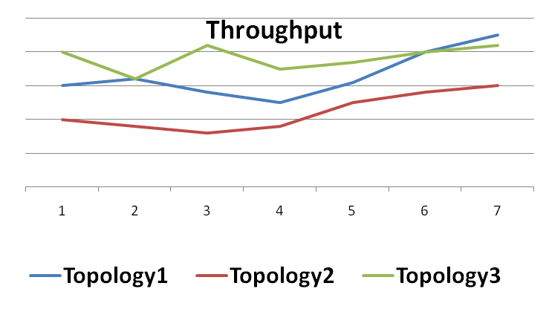

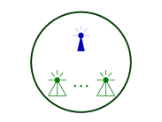
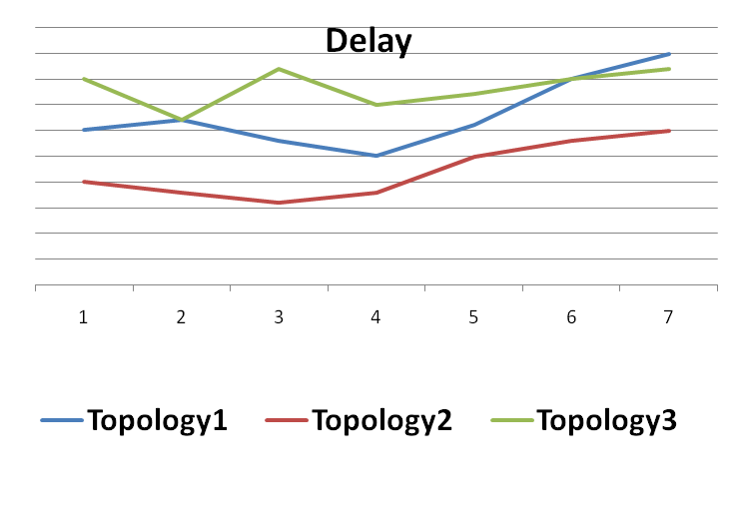
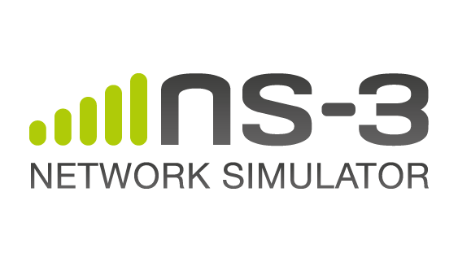
Objectives & Outcome
Performance evaluation of our proposed approach
Topology1
Implementation of our proposed approach
Topology2
Topology3

Slide 18
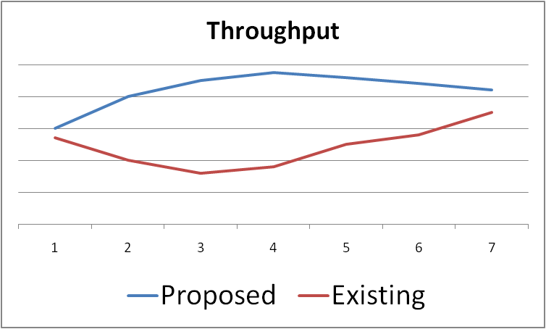

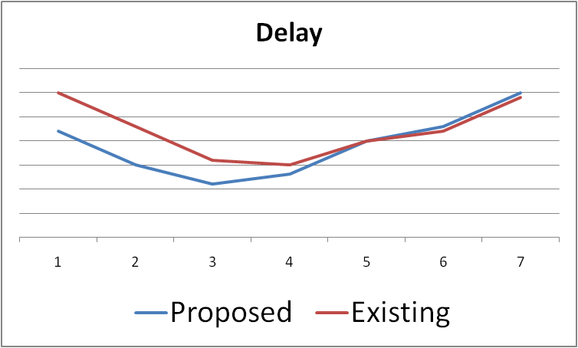
Objectives & Outcome
Performance comparison of our proposed approach with that of other existing approaches
Our proposed approach
Existing approaches

Slide 19
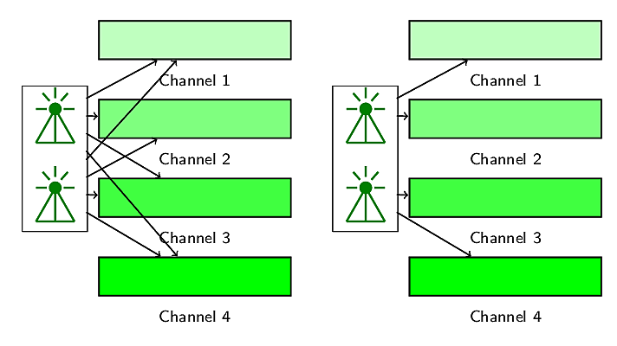
Methodology
Radio-channel assignment with intra-user collision avoidance

Slide 20


Methodology
Radio-channel access based on radio and channel statistics
feedback based multi-radio exploitation
Packet
Packet
Radio
Packet
Packet
Packet
Channel
Packet
Packet
queued
transmitted
delivered
transmitted
delivered
0
1
1
1
0
1
1
1
1
1
0
1
1
0

Slide 21
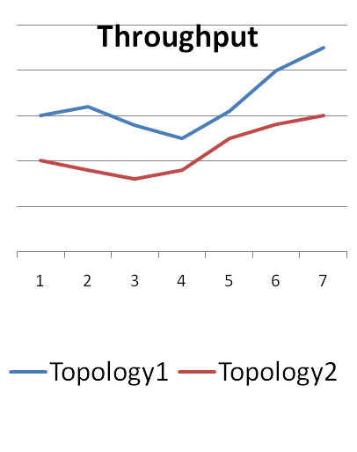
Methodology
Performance analysis of the proposed approach
Our proposed approach
Topology1
Existing approaches
Topology2

Slide 22
Conclusion
We will propose a feedback-based multi-radio exploitation approach for cognitive radio networks to improve network throughput.
We will evaluate the performance of our proposed approach through experimentation.
We will compare the performance of our proposed approach with that of other contemporary approaches.

Slide 23
Thank you!

