Slide 1
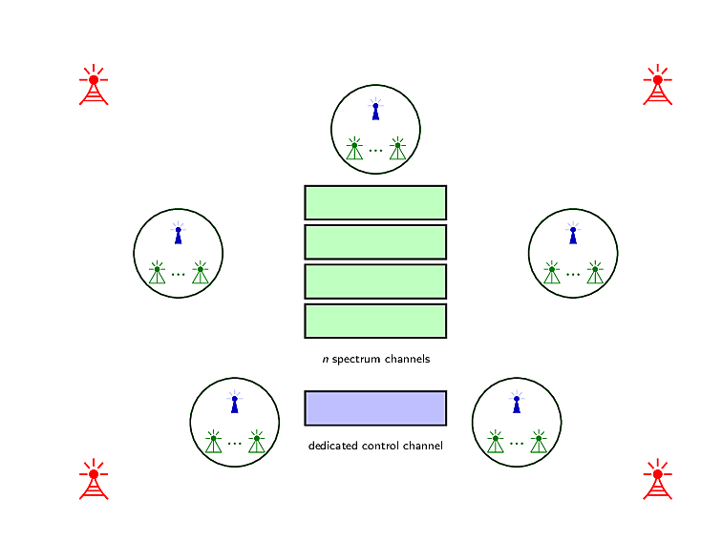

Slide 2
Propose a new approach

Slide 3
Propose a new approach

Slide 4
Propose a new approach

Slide 5
Propose a new approach

Slide 6
Propose a new approach
Feedback-based Multi-radio exploitation approach

Slide 7
Propose a new approach
Feedback-based Multi-radio exploitation approach

Slide 8

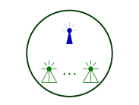
Our proposed Approach

Slide 9
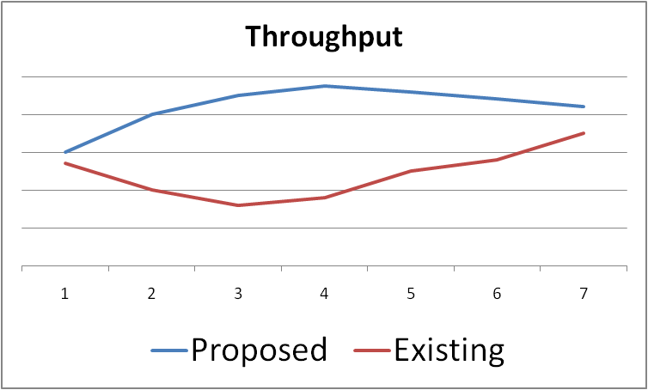
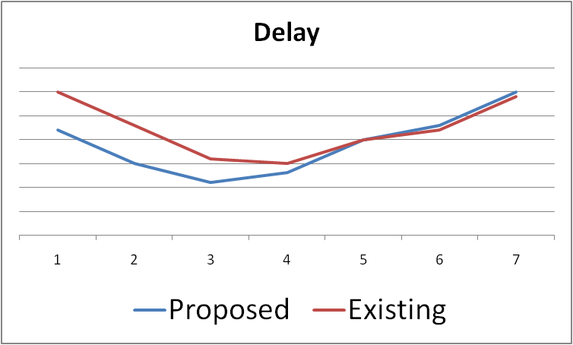
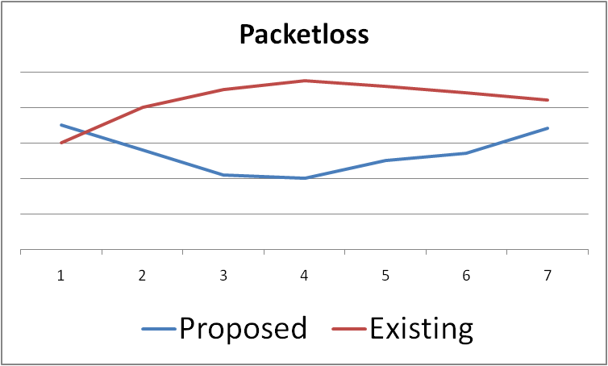
Our proposed Approach
Existing Approaches

Slide 10
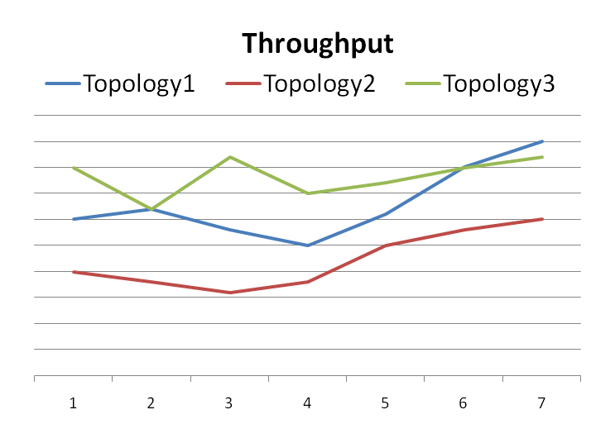
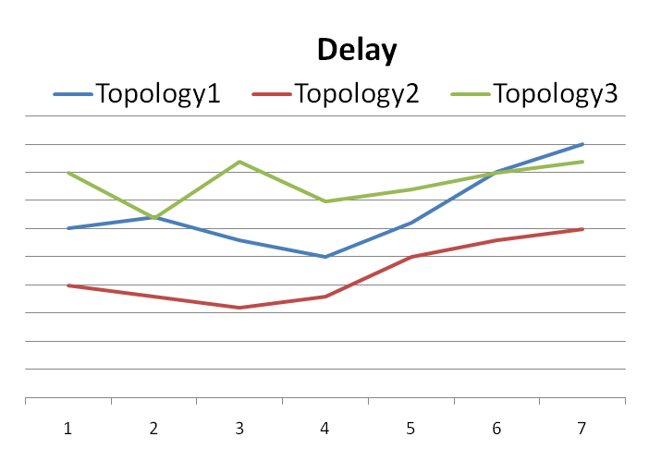

Slide 11
