Slide 1

Overcoming Throughput Degradation in Multi-Radio Cognitive Radio Networks
Pre-defense Examination of M.Sc. Thesis
by
Tanvir Ahmed Khan
Student ID: 1014052013
Supervised by:
A. B. M. Alim Al Islam, Associate Professor
Dept. of CSE, BUET
Notes:
Hi, I am Tanvir Ahmed Khan. Traditional Spectrum Management System is largely underutilized and CRNs improves this utilization. However, employing multiple radios on CRNs degrades the throughput. Today I will show you an approach to overcome this throughput degradation.

Slide 2
Outline
Background and research problem
Proposed methodology
Experimentation and evaluation
Conclusion
Notes:
I will describe the approach in this order.

Slide 3
Related work
Background of our study
Notes:
Let’s first look at the background of our work

Slide 4
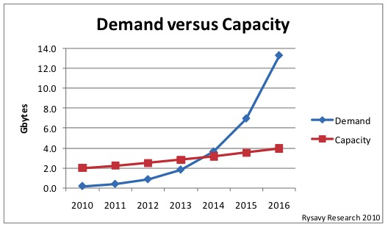
Spectrum Scarcity Problem
Peter Rysavy, Information Week Magazine, 2009. [10]
Notes:
Since 2014 the mobile spectrum demand has surpassed the capacity of wireless spectrum. So, there is a Spectrum scarcity problem.

Slide 5
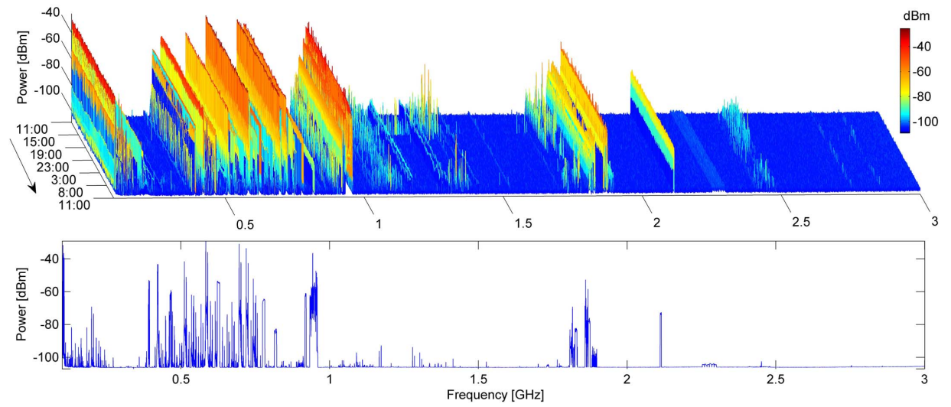
Spectrum Under-utilization
Licensed frequency spectrums are mostly under-utilized!
Valenta et al., CROWNCOM, 2009 [8]
Notes:
Moreover, traditionally spectrum are licensed in a fixed manner, resulting in spectrum under-utilization.

Slide 6
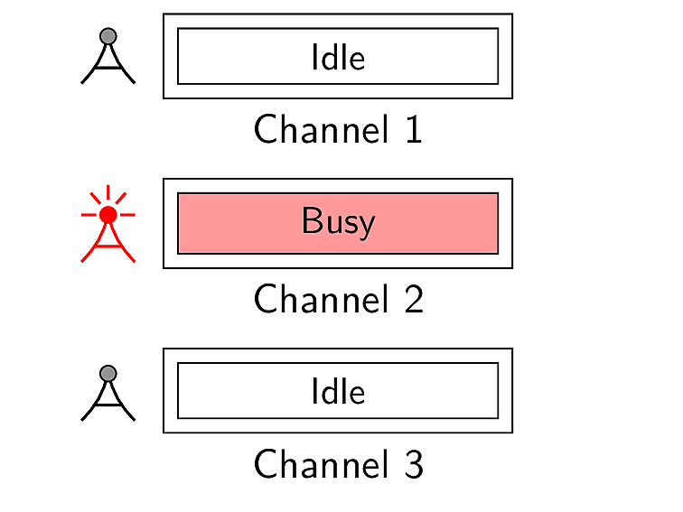

How to Increase Spectrum Utilization?
Notes:
Now, let us see how can we increase this spectrum utilization.

Slide 7
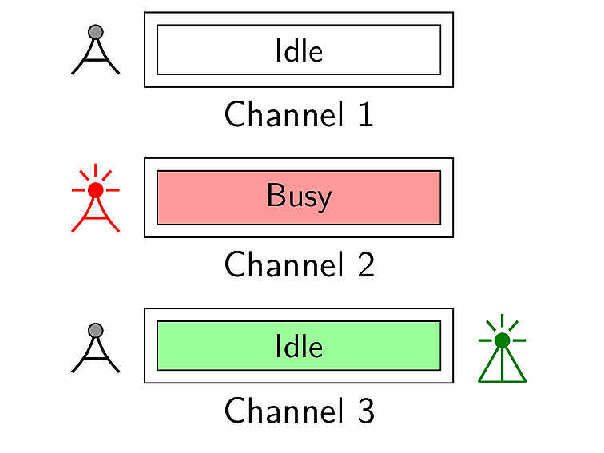
CRNs and Different Types of Users
Primary users
(licensed)
Secondary users
(unlicensed)

Slide 8
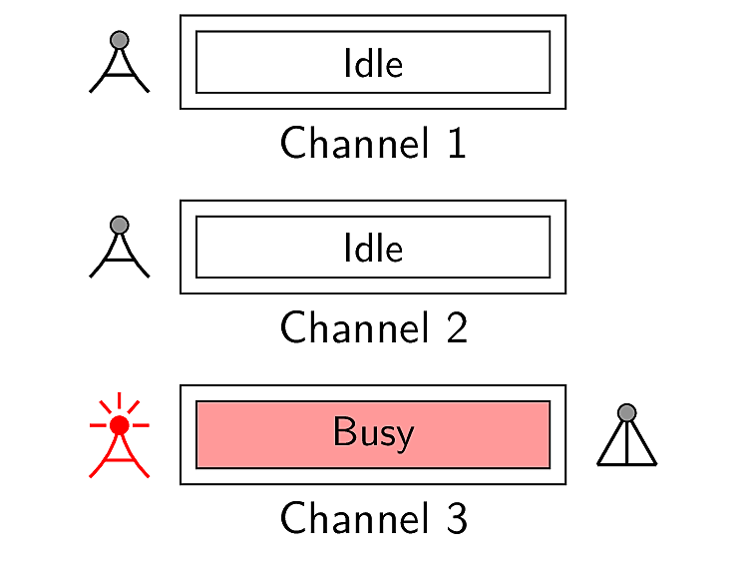
Opportunistic Switching by An SU
Primary users
(licensed)
Secondary users
(unlicensed)

Slide 9
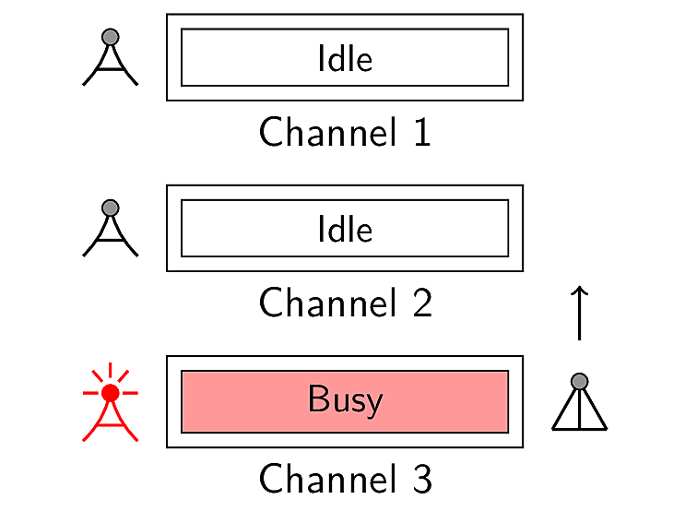
Opportunistic Switching by An SU
Primary users
(licensed)
Secondary users
(unlicensed)

Slide 10
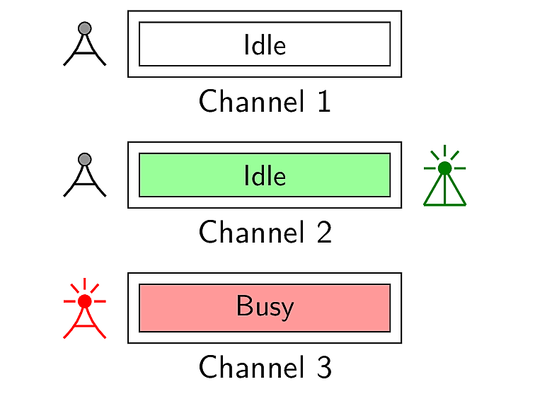
Opportunistic Switching by An SU
Primary users
(licensed)
Secondary users
(unlicensed)

Slide 11

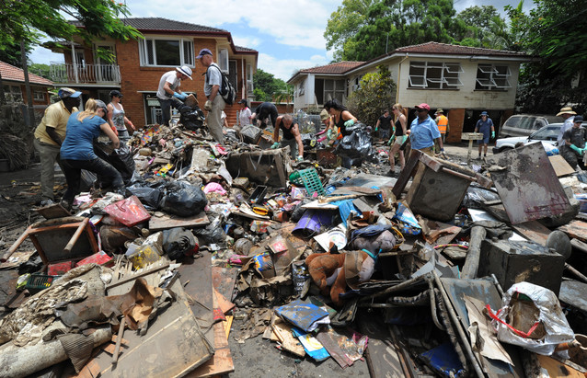
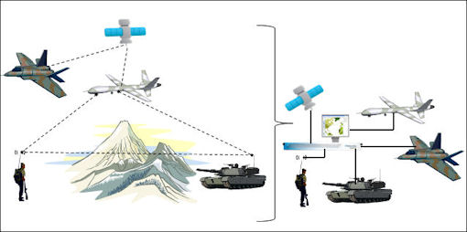
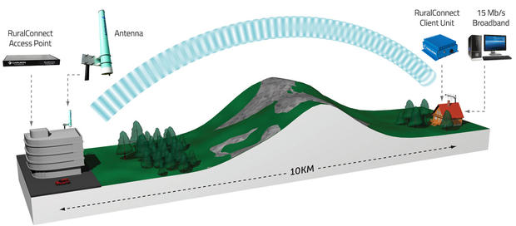

Applications of CRNs
Military Networks
Emergency Networks
High-Speed Rural Internet
Multimedia
_{CRNs}

Slide 12
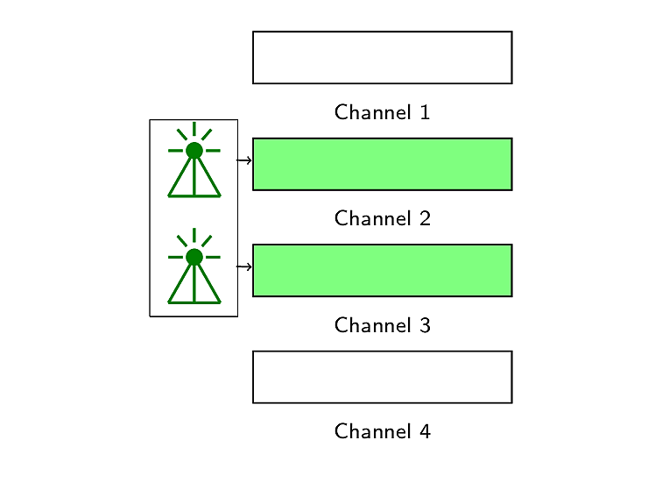
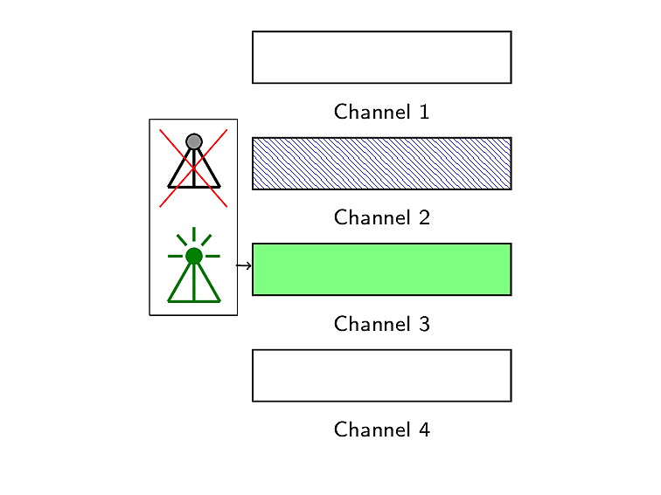
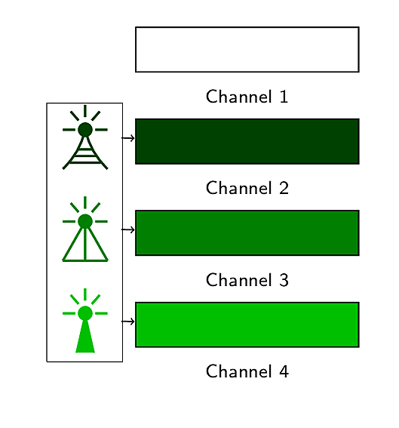
Another Way of Increasing Spectrum Utilization: Multi-radio Networks
user
user
user
Improves network capacity [2,3]
Decreases the number of retransmission per packet [6]
Enables heterogeneous wireless access [7]

Slide 13
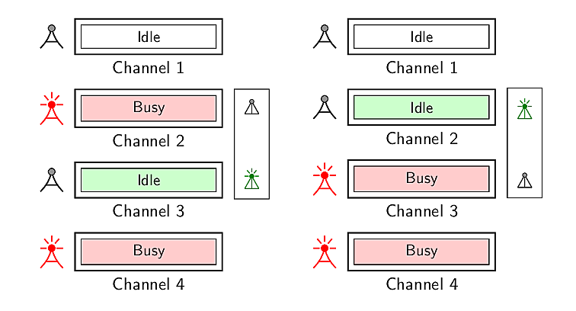
Multi-radio Cognitive Radio Networks
Secondary user
Secondary user

Slide 14
Related Research Work
Ahmadi et al., Vehicular Technology Conference (VTC) Fall, 2012 [1]
Solves channel assignment problem for the single receiver radio cases
Considers only two sender radios
Does not investigate the performance of the network while varying the number of radios

Slide 15
Related Research Work [contd.]
Zhong et al., Wireless Personal Communications (WPC), 2014 [9]
Presents a channel assignment algorithm for multi-radio cognitive radio networks
Assigns channels among available radios through ranking only the available channels
Does not consider conditions of radios
No analysis on throughput with an increase in the number of radios

Slide 16
Related Research Work [contd.]
Li et al., ACM MSWiM, 2014 [5]
Presents a rendezvous channel establishment algorithm for multi-radio cognitive radio networks
Shows that maximum time to rendezvous reduces with an increase in the number of radios
Does not provide any approach on how these radios will be used for data transmission
No analysis on network throughput
No analysis on impact of varying number of radios

Slide 17
Related Research Work [contd.]
Khan et al., IEEE WiMob, 2015 [4]
Employs multiple radios for data transmission
Reduces delay with an increase in the number of radios
Decreases throughput with an increase in the number of radios
Notes:
Does not consider intra-user radio interference in case of omnidirectional antenna

Slide 18
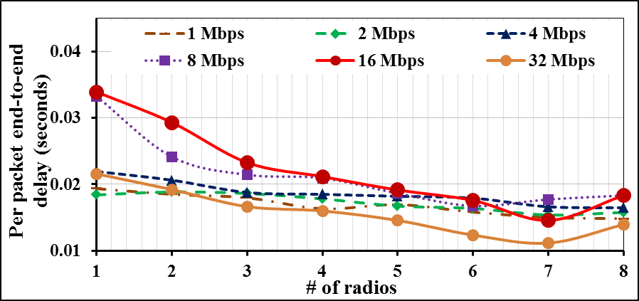
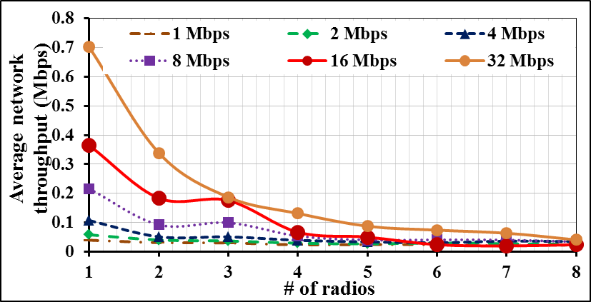
Motivation Behind Our Work
Improvement in delay at the cost of throughput degradation (Khan et al., IEEE WiMob, 2015)

Slide 19
research problem

Slide 20
Our Research Problem
How to overcome the throughput degradation in multi-radio CRNs?

Slide 21
Proposed Methodology

Slide 22
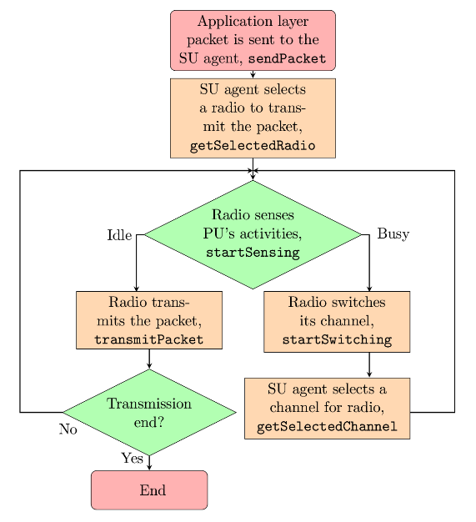
Overview of Our Proposed Methodology

Slide 23
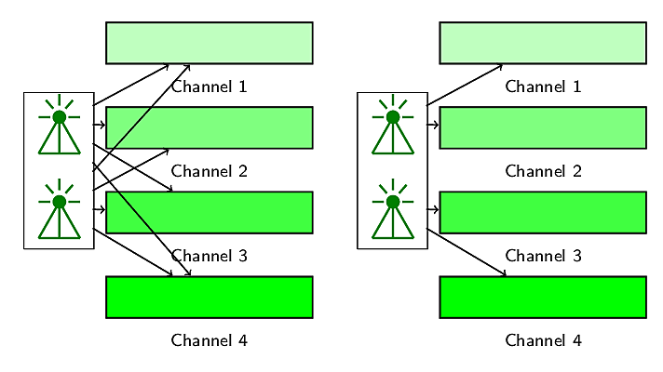
Our Proposed Methodology: Intra-user Collision Avoidance

Slide 24




Radio And Channel Selections in Our Proposed Methodology
Feedback based multi-radio exploitation
Packet
Packet
Radio
Packet
Packet
Packet
Channel
Packet
Packet
queued
sent
delivered
transmitted
received
0
1
1
0
0
1
1
1
1
1
1
1
1
0

Slide 25
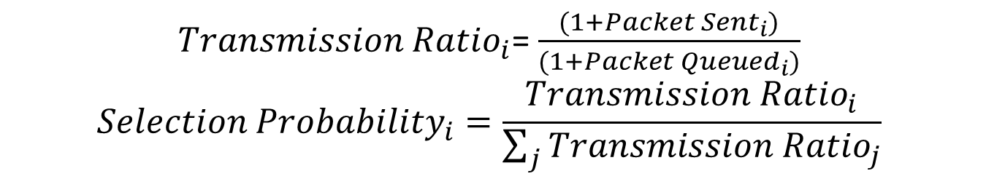
Radio Selection
Un-weighted lottery
Weighted lottery based on radio transmission ratio
Radio
Selection
Radio
Packet
Packet
Transmission
Selection
Probability
Queued
Sent
Ratio
Probability
0
0.25
0
75
52
0.70
0.29
1
0.25
1
81
45
0.56
0.23
2
0.25
2
37
30
0.82
0.34
3
0.25
3
52
17
0.34
0.14
${Transmission Ratio}_{i}$= $\frac{(1+{Packet Sent}_{i})}{(1+{Packet Queued}_{i})}$
$${Selection Probability}_{i}=\frac{{Transmission Ratio}_{i}}{\sum_{j}{{Transmission Ratio}_{j}}}$$

Slide 26
Variants of Our Proposed Methodology
Variant Name | Radio Selection Policy | Channel Selection Policy
Radio feedback | Weighted lottery based on radio transmission ratio | Un-weighted lottery
Channel feedback | Un-weighted lottery | Weighted lottery based on channel utilization ratio
Radio channel feedback | Weighted lottery based on radio transmission ratio | Weighted lottery based on channel utilization ratio

Slide 27
Experimentation and evaluation

Slide 28
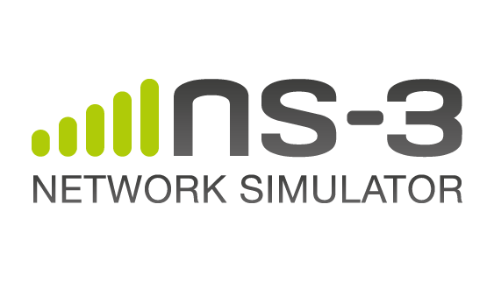
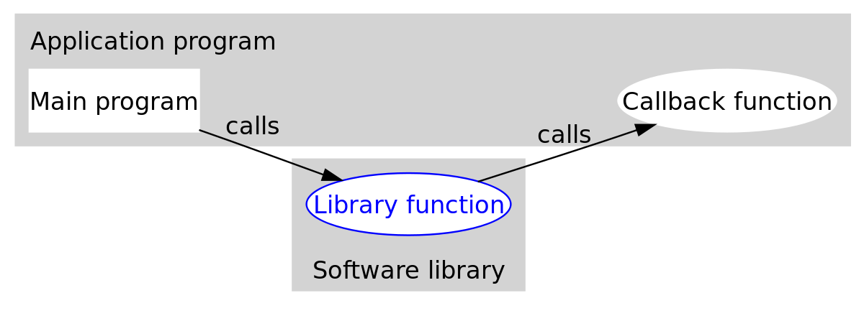
Simulator Modifications
pktQueued
pktSent
pktTransmitted
pktReceived
FlowIdTag
Radio reference
Packet
DelayJitterEstimationTimestampTag
YansWifiPhy, YansWifiChannel, WifiPhyStateHelper, RegularWifiMac, WifiNetDevice

Slide 29
Simulation Settings
Parameter | Value
Area | 500m×500m
Application data transmission rate | 1 Mbps – 32 Mbps
Channel code rate | OFDM 18 Mbps
Number of channels | 11
Number of primary users | 11
Number of secondary users | 12 – 40 with a granularity of 4
Radio transmission range | 130 m
Radio sensing range | 250 m
Simulation time | 50 seconds
Iteration count | 99 (95% confidence interval is less than 0.001)

Slide 30
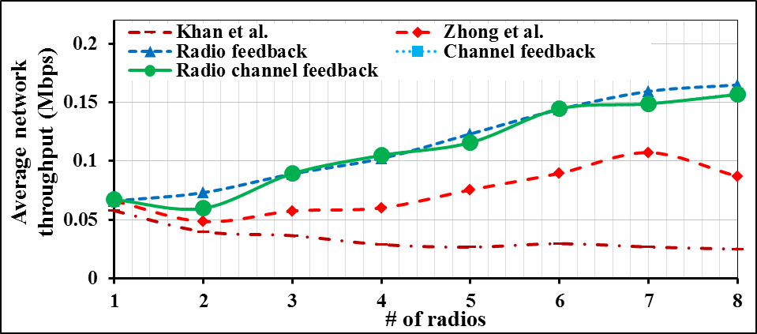
Simulation Results
Constant throughput degradation is no longer present

Slide 31
Simulation Results [contd.]
Delay remains almost constant

Slide 32
Throughput with Different Data Rates
1 Mbps
2 Mbps
4 Mbps
8 Mbps
16 Mbps
32 Mbps

Slide 33
Delay with Different Data Rates
1 Mbps
2 Mbps
4 Mbps
8 Mbps
16 Mbps
32 Mbps

Slide 34
Summary of Simulation Results
Application data rate | % of improvement in performance
 | Throughput w.r.t. |  | End-to -end delay w.r.t. |  | Packet drop ratio w.r.t. |  | Packet delivery ratio w.r.t.
 | Khan et al. | Zhong et al. | Khan et al. | Zhong et al. | Khan et al. | Zhong et al. | Khan et al. | Zhong et al.
1 Mbps | 55 | 15 | -18 | 49 | 58 | 58 | 42 | 42
2 Mbps | 63 | 31 | -15 | 49 | 51 | 51 | 58 | 58
4 Mbps | 66 | 44 | -17 | 42 | 40 | 41 | 57 | 57
8 Mbps | 63 | 49 | -17 | 31 | 29 | 30 | 49 | 50
16 Mbps | 68 | 55 | -14 | 27 | 21 | 20 | 53 | 52
32 Mbps | 64 | 43 | -13 | 23 | 15 | 15 | 73 | 73
Average | 63 | 40 | -16 | 37 | 36 | 36 | 55 | 55

Slide 35
Conclusion
Throughput degradation in multi-radio cognitive radio networks is a well-known problem
We propose a feedback-based multi-radio exploitation approach to solve the problem
We compare the performance of our proposed approach with that of other contemporary approaches
Our proposed approach significantly improves network throughput

Slide 36
References I
Maryam Ahmadi, Yanyan Zhuang, and Jianping Pan. Distributed robust channel assignment for multi-radio cognitive radio networks. In Vehicular Technology Conference (VTC Fall), 2012 IEEE, pages 1-5. IEEE, 2012.
Paramvir Bahl, Atul Adya, Jitendra Padhye, and Alec Walman. Reconsidering wireless systems with multiple radios. ACM SIGCOMM Computer Communication Review, 34(5):39-46, 2004.
Richard Draves, Jitendra Padhye, and Brian Zill. Routing in multi-radio, multi-hop wireless mesh networks. In Proceedings of the 10th annual international conference on Mobile computing and networking, pages 114-128. ACM, 2004.
Tanvir Ahmed Khan, Chowdhury Sayeed Hyder, and ABM Islam. Towards exploiting a synergy between cognitive and multi-radio networking. In Wireless and Mobile Computing, Networking and Communications (WiMob), 2015 IEEE 11th International Conference on, pages 370-377. IEEE, 2015.
Guyue Li, Zhaoquan Gu, Xiao Lin, Haosen Pu, and Qiang-sheng Hua. Deterministic distributed rendezvous algorithms for multi-radio cognitive radio networks. In Proceedings of the 17th ACM international conference on Modeling, analysis and simulation of wireless and mobile systems, pages 313-320. ACM, 2014.
Allen Miu, Hari Balakrishnan, and Can Emre Koksal. Improving loss resilience with multi-radio diversity in wireless networks. In Proceedings of the 11th annual international conference on Mobile computing and networking, pages 16-30. ACM, 2005.

Slide 37
References II
Wei Song and Weihua Zhuang. Performance analysis of probabilistic multipath transmission of video streaming traffic over multi-radio wireless devices. Wireless Communications, IEEE Transactions on, 11(4):1554-1564, 2012.
Vaclav Valenta, Roman Marsalek, Genevieve Baudoin, Martine Villegas, Martha Suarez, and Fabien Robert. Survey on spectrum utilization in europe: Measurements, analyses and observations. In Cognitive Radio Oriented Wireless Networks & Communications (CROWNCOM), 2010 Proceedings of the Fifth International Conference on, pages 1-5. IEEE, 2010.
Xiaoxiong Zhong, Yang Qin, and Li Li. Capacity analysis in multi-radio multi-channel cognitive radio networks: A small world perspective. Wireless Personal Communications, 79(3):2209-2225, 2014.
Peter Rysavy. Spectrum crisis? Information Week Magazine, pages 23-30, 2009.
Ian F. Akyildiz, Won Yeol Lee, Mehmat C. Vuran, & Shantidev Mohanty. NeXt generation/dynamic spectrum access/cognitive radio wireless networks: A survey. Computer networks, 50(13), 2127-2159, 2006.

Slide 38
Thank You!

Slide 39
Back-up Slides

Slide 40
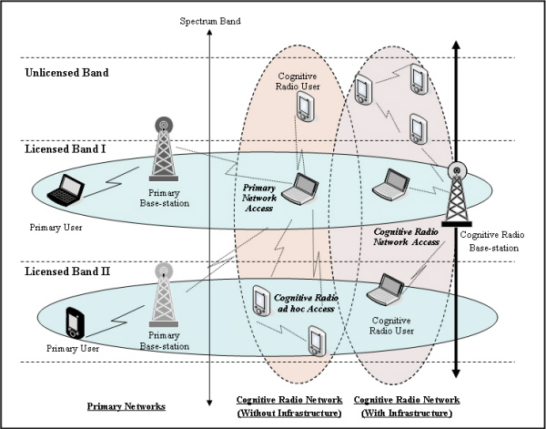
Cognitive Radio Networks (CRNs)
Akyildiz et al., Computer Networks, 2006 [11]
Notes:
That’s exactly what CRNs do.

