Slide 1

Overcoming Throughput Degradation in Multi-Radio Cognitive Radio Networks
M.Sc. Thesis
by
Tanvir Ahmed Khan
Student ID: 1014052013
Supervised by:
A. B. M. Alim Al Islam, Associate Professor.
Dept. of CSE, BUET.

Slide 2
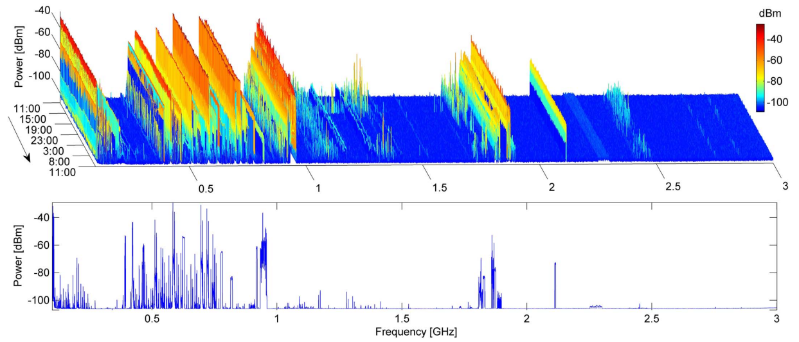
Background of Our Study
Licensed frequency spectrums are mostly under-utilized! [8]

Slide 3
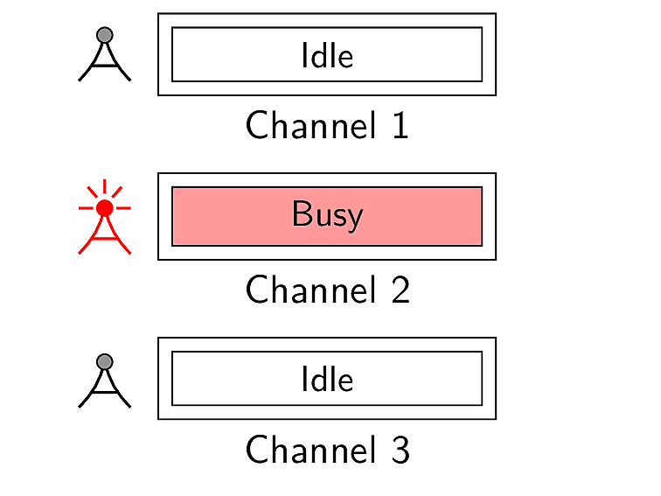

Background of Our Study
How to increase the spectrum utilization?

Slide 4
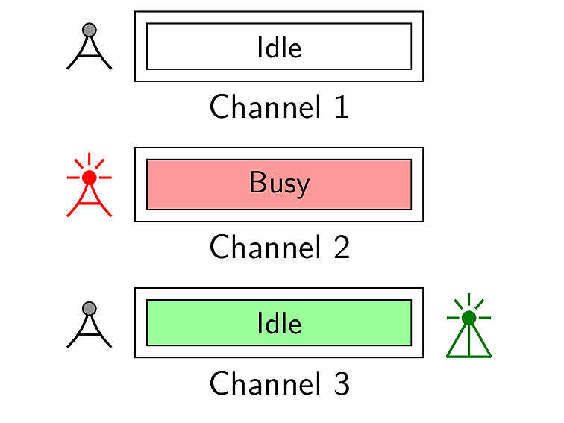
Cognitive Radio Networks (CRNs)
Comprises of two different types of users
Primary users
(licensed)
Secondary users
(unlicensed)

Slide 5
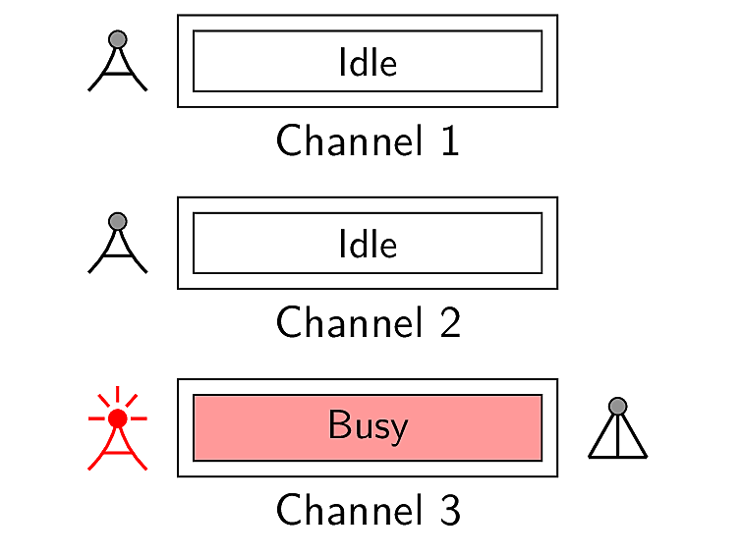
Cognitive Radio Networks (CRNs)
Comprises of two different types of users
Primary users
(licensed)
Secondary users
(unlicensed)

Slide 6
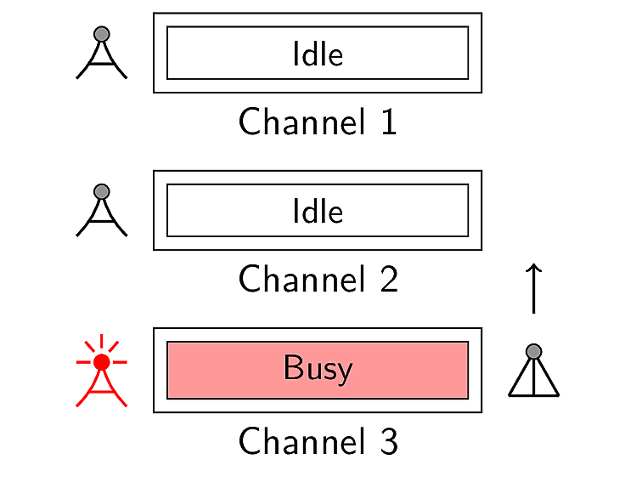
Cognitive Radio Networks (CRNs)
Comprises of two different types of users
Primary users
(licensed)
Secondary users
(unlicensed)

Slide 7
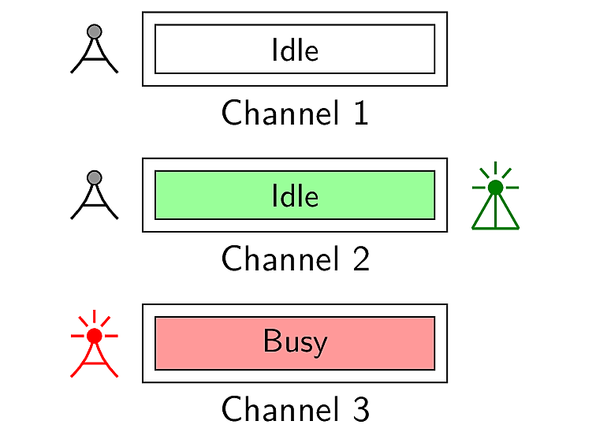
Cognitive Radio Networks (CRNs)
Comprises of two different types of users
Primary users
(licensed)
Secondary users
(unlicensed)

Slide 8

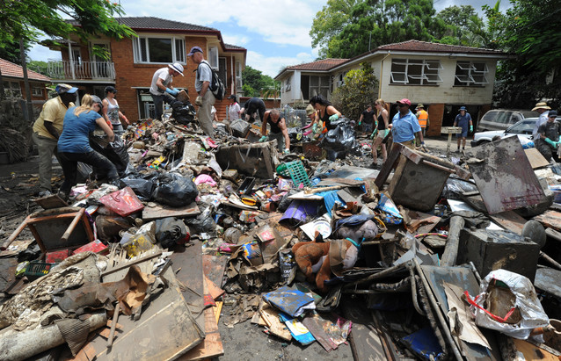
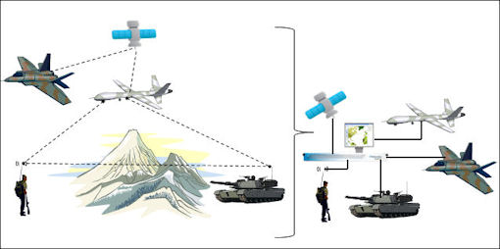
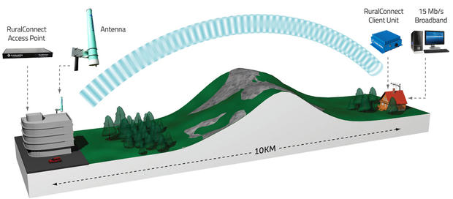

Applications of Cognitive Radio Networks
CRN Applications
High-Speed Rural Internet
Military Networks
Emergency Networks
Multimedia

Slide 9
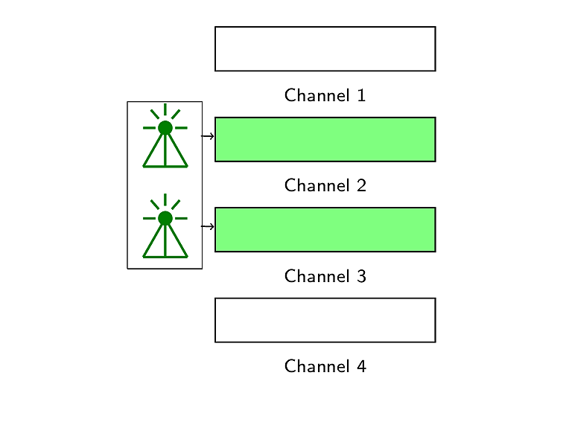
Multi-radio Networks
Improves network capacity [2, 3]
user

Slide 10
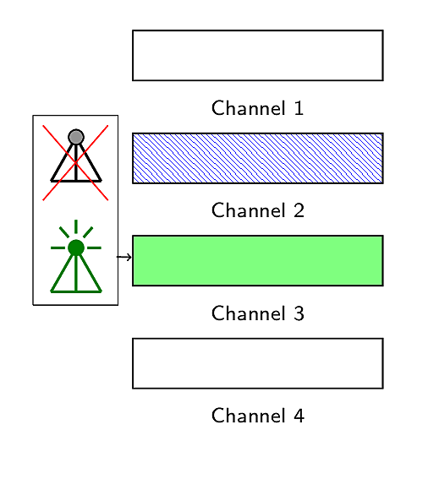
Multi-radio Networks
Enhances transmission reliability [6]
user

Slide 11
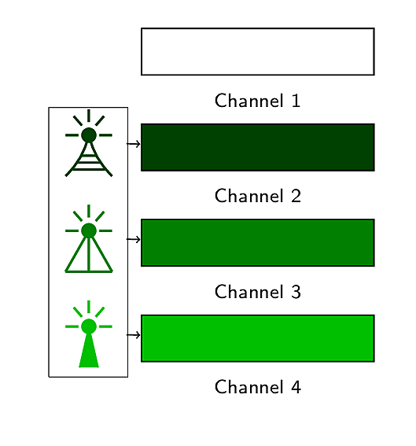
Multi-radio Networks
Enables heterogeneous wireless access [7]
user

Slide 12
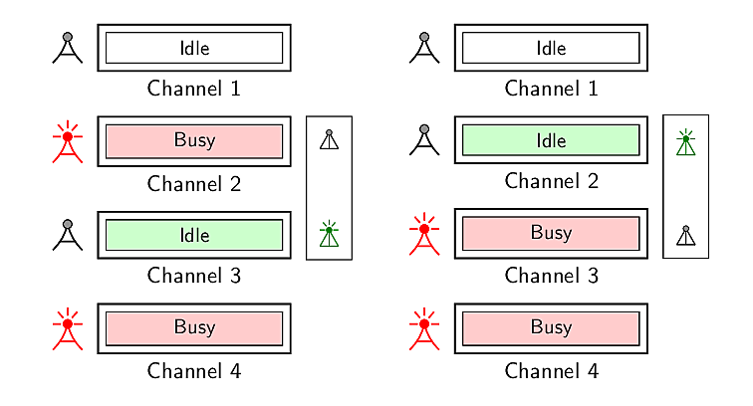
Multi-radio Cognitive Radio Networks
Secondary user
Secondary user

Slide 13
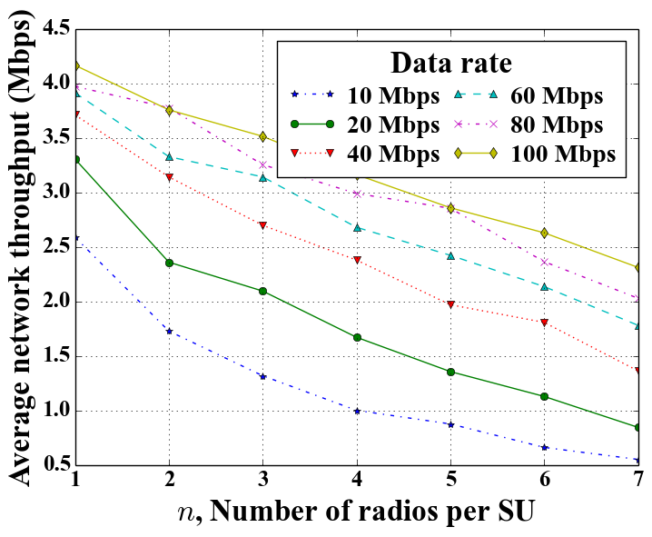
Motivation Behind Our Work
Throughput degradation in multi-radio CRNs

Slide 14
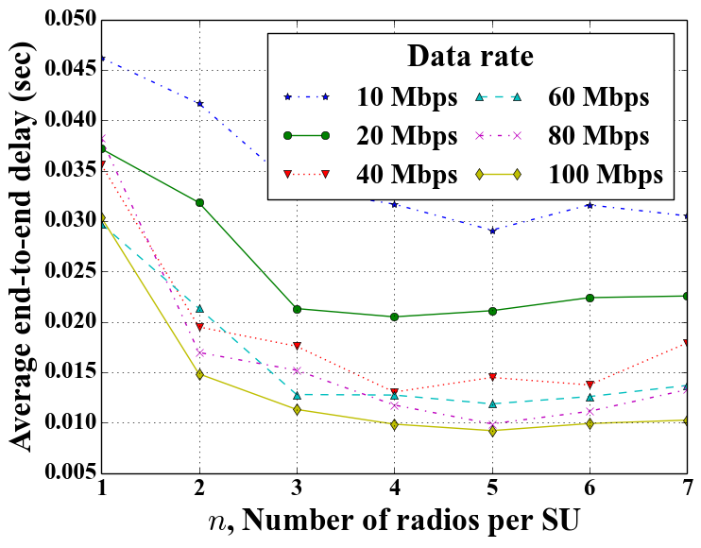
Motivation Behind Our Work
Throughput degradation in multi-radio CRNs
at the benefit of delay improvement [4]

Slide 15
Our Research Problem
How to overcome this throughput degradation in multi-radio CRNs?

Slide 16
Related Research Work
Ahmadi et al., Vehicular Technology Conference (VTC) Fall, 2012 [1]
Solves the channel assignment problem for the single receiver radio
Considers only two sender radios
Does not investigate the performance of the network varying the number of radios

Slide 17
Related Research Work [contd.]
Zhong et al., Wireless Personal Communications (WPC), 2014 [9]
Presents a channel assignment algorithm for multi-radio cognitive radio network
While assigning channels among available radios only channels are ranked
Does not consider conditions of radio
No analysis on throughput with an increase in number of radios

Slide 18
Related Research Work [contd.]
Li et al., ACM MSWiM, 2014 [5]
Presents a rendezvous channel establishment algorithm for multi-radio cognitive radio networks
Shows that maximum time to rendezvous reduces with an increase in number of radios
However, does not provide any approach on how these radios will be used for data transmission

Slide 19
Related Research Work [contd.]
Khan et al., IEEE WiMob, 2015 [4]
Employs multiple radios for data transmission
Shows that delay gets improved at the cost of throughput degradation with an increase in number of radios
Does not consider intra-user radio interference in case of omnidirectional antenna

Slide 20
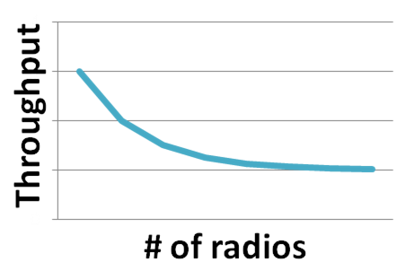
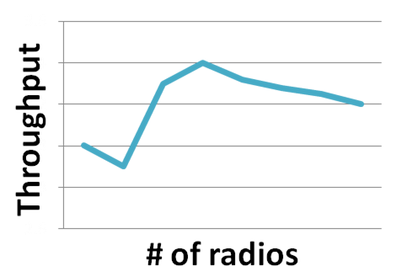
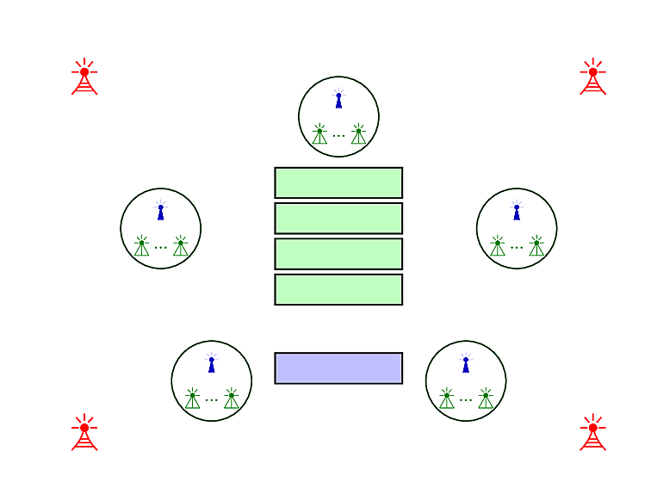
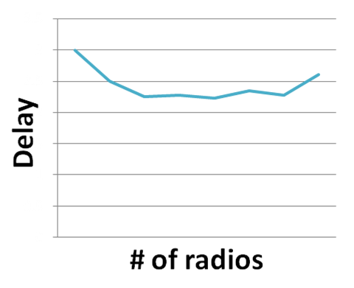
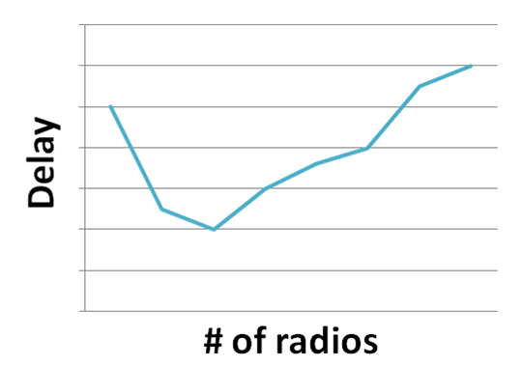
Objectives & Outcomes
Propose an approach to improve throughput
Feedback-based multi-radio exploitation approach
Propose a new approach
Feedback-based multi-radio exploitation approach

Slide 21
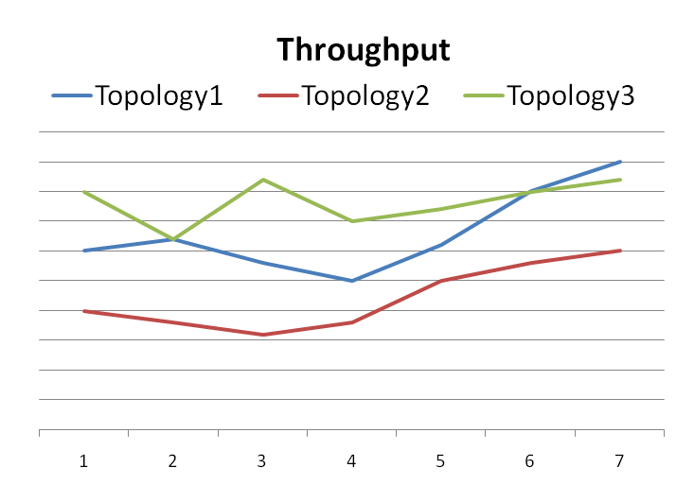

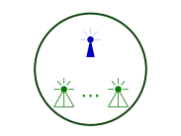
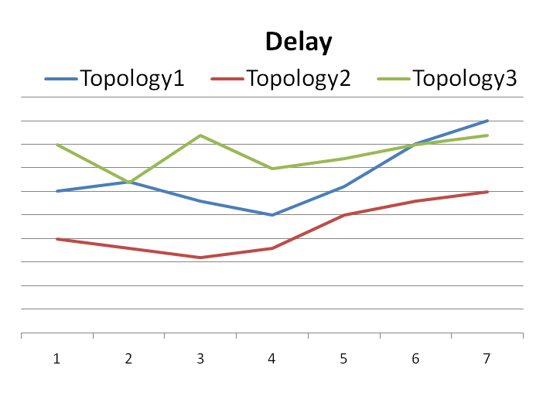
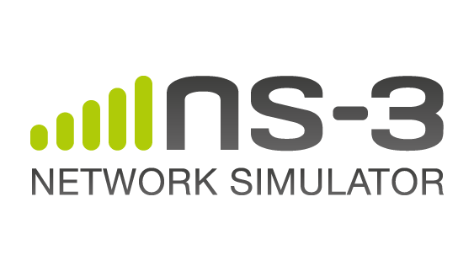
Objectives & Outcomes [contd.]
Performance evaluation of our proposed approach
Topology1
Implementation of our proposed approach
Topology2
Topology3

Slide 22
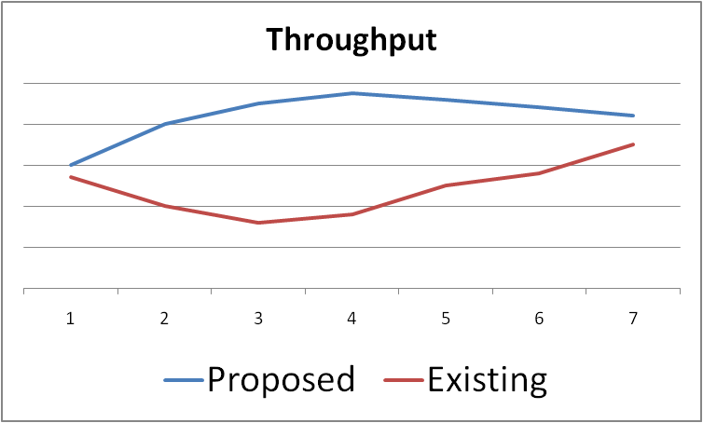

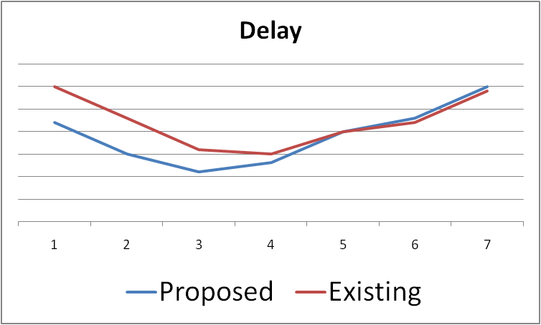
Objectives & Outcomes [contd.]
Performance comparison of our proposed approach with that of other existing approaches
Our proposed approach
Existing approaches
Ahmadi et al. [1] Khan et al. [4] Zhong et al. [9]

Slide 23
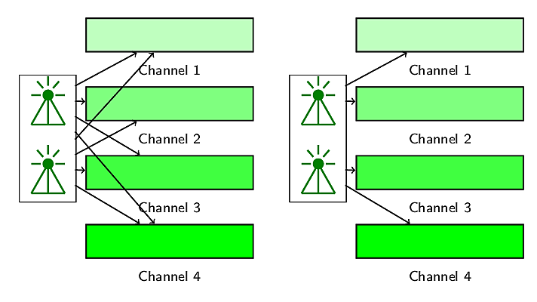
Methodology of Our Study
Radio-channel assignment with intra-user collision avoidance

Slide 24




Methodology of Our Study [contd.]
Radio-channel access based on radio and channel statistics
Feedback based multi-radio exploitation
Packet
Packet
Radio
Packet
Packet
Packet
Channel
Packet
Packet
queued
transmitted
delivered
transmitted
delivered
0
1
1
0
0
1
1
1
1
1
1
1
1
0

Slide 25
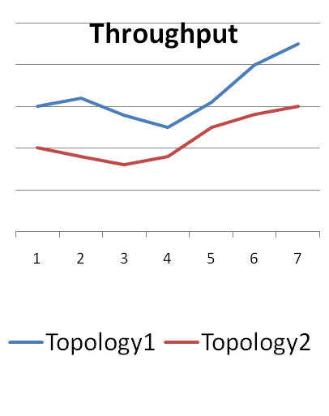
Methodology of Our Study [contd.]
Performance analysis of the proposed approach
Our proposed approach
Topology1
Existing approaches
[1, 4, 9]
Topology2

Slide 26
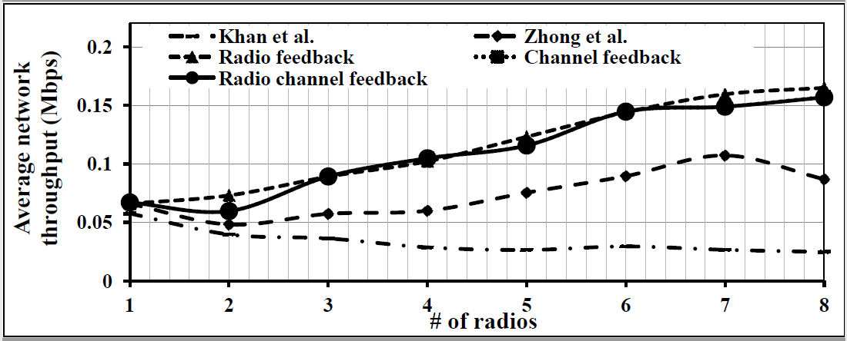
Results Obtained So Far
Constant throughput degradation is no longer present

Slide 27
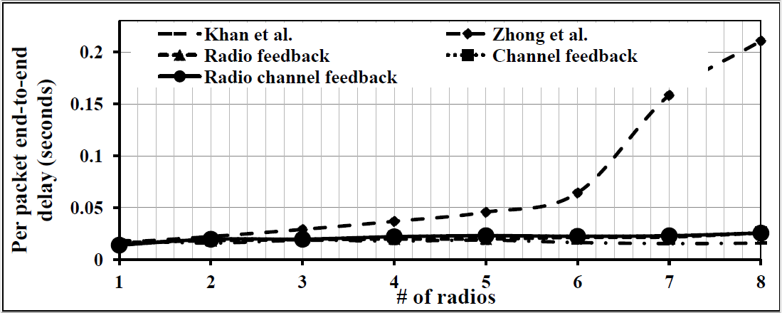
Results Obtained So Far [contd.]
Constant throughput degradation is no longer present
delay is almost constant

Slide 28
Delay
1 Mbps
2 Mbps
4 Mbps
8 Mbps
16 Mbps
32 Mbps

Slide 29
Throughput
1 Mbps
2 Mbps
4 Mbps
8 Mbps
16 Mbps
32 Mbps

Slide 30
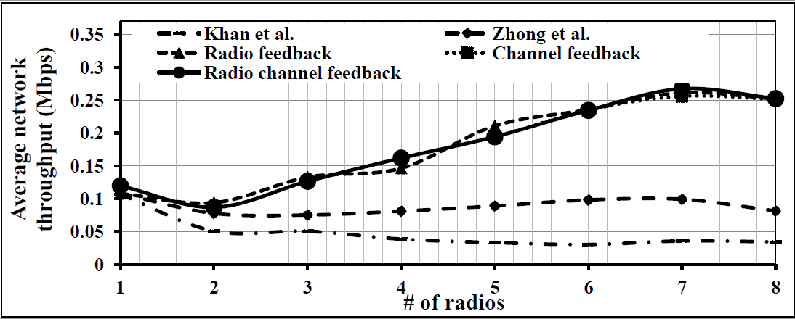
Results Obtained So Far
Constant throughput degradation is no longer present

Slide 31
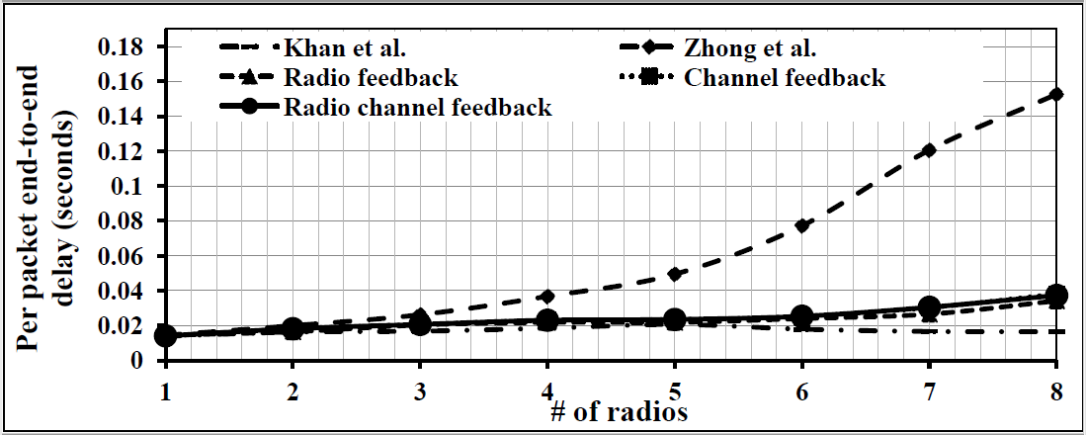
Results Obtained So Far [contd.]
Constant throughput degradation is no longer present
Delay is almost constant

Slide 32
Conclusion
Throughput degradation in multi-radio cognitive radio networks is a well-known problem.
We proposed a feedback-based multi-radio exploitation approach to solve the problem.
We evaluated the performance of our proposed approach through experimentation.
We compared the performance of our proposed approach with that of other contemporary approaches.

Slide 33
Thank you!

Slide 34
References I
Maryam Ahmadi, Yanyan Zhuang, and Jianping Pan. Distributed robust channel assignment for multi-radio cognitive radio networks. In Vehicular Technology Conference (VTC Fall), 2012 IEEE, pages 1-5. IEEE, 2012.
Paramvir Bahl, Atul Adya, Jitendra Padhye, and Alec Walman. Reconsidering wireless systems with multiple radios. ACM SIGCOMM Computer Communication Review, 34(5):39-46, 2004.
Richard Draves, Jitendra Padhye, and Brian Zill. Routing in multi-radio, multi-hop wireless mesh networks. In Proceedings of the 10th annual international conference on Mobile computing and networking, pages 114-128. ACM, 2004.
Tanvir Ahmed Khan, Chowdhury Sayeed Hyder, and ABM Islam. Towards exploiting a synergy between cognitive and multi-radio networking. In Wireless and Mobile Computing, Networking and Communications (WiMob), 2015 IEEE 11th International Conference on, pages 370-377. IEEE, 2015.
Guyue Li, Zhaoquan Gu, Xiao Lin, Haosen Pu, and Qiang-sheng Hua. Deterministic distributed rendezvous algorithms for multi-radio cognitive radio networks. In Proceedings of the 17th ACM international conference on Modeling, analysis and simulation of wireless and mobile systems, pages 313-320. ACM, 2014.

Slide 35
References II
Allen Miu, Hari Balakrishnan, and Can Emre Koksal. Improving loss resilience with multi-radio diversity in wireless networks. In Proceedings of the 11th annual international conference on Mobile computing and networking, pages 16-30. ACM, 2005.
Wei Song and Weihua Zhuang. Performance analysis of probabilistic multipath transmission of video streaming traffic over multi-radio wireless devices. Wireless Communications, IEEE Transactions on, 11(4):1554-1564, 2012.
Vaclav Valenta, Roman Marsalek, Genevieve Baudoin, Martine Villegas, Martha Suarez, and Fabien Robert. Survey on spectrum utilization in europe: Measurements, analyses and observations. In Cognitive Radio Oriented Wireless Networks & Communications (CROWNCOM), 2010 Proceedings of the Fifth International Conference on, pages 1-5. IEEE, 2010.
Xiaoxiong Zhong, Yang Qin, and Li Li. Capacity analysis in multi-radio multi-channel cognitive radio networks: A small world perspective. Wireless Personal Communications, 79(3):2209-2225, 2014.

