Slide 1

Overcoming Throughput Degradation in Multi-Radio Cognitive Radio Networks
M.Sc. Thesis
by
Tanvir Ahmed Khan
Student ID: 1014052013
Supervised by:
A. B. M. Alim Al Islam, Associate Professor.
Dept. of CSE, BUET.
Notes:
Hi, I am Tanvir Ahmed Khan. Traditional Spectrum Management System is largely underutilized and CRNs improves this utilization. However, employing multiple radios on CRNs degrades the throughput. Today I will show you an approach to overcome this throughput degradation.

Slide 2
Outline
Related work
Our research problem
Our proposed methodology
Experimentation
Evaluation
Conclusion
Notes:
I will describe the approach in this order.

Slide 3
Related work
Background of our study
Notes:
Let’s first look at the background of our work

Slide 4
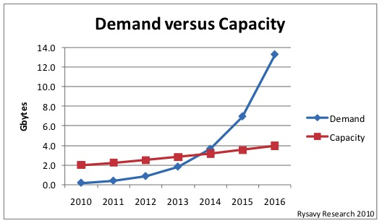
Spectrum Scarcity Problem
Notes:
By, 2014 the mobile spectrum demand has surpassed the capacity of wireless spectrum. So, there is a Spectrum scarcity problem.

Slide 5
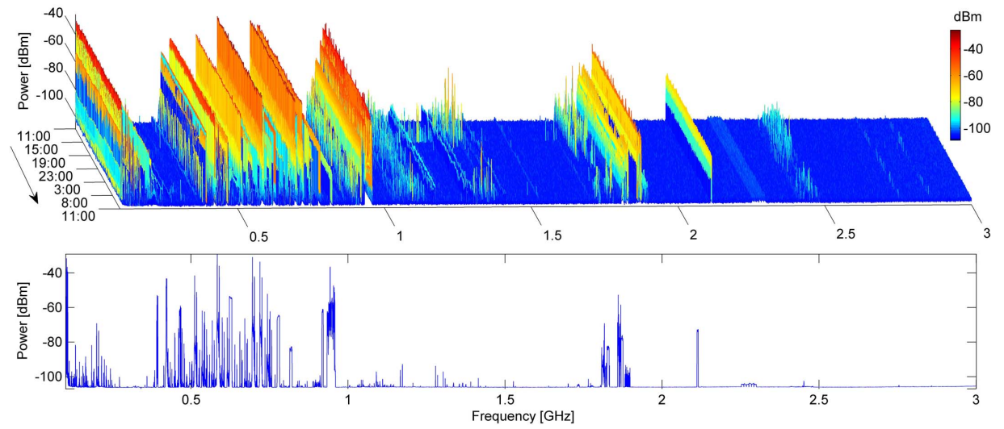
Spectrum Under-utilization
Licensed frequency spectrums are mostly under-utilized! [8]
Notes:
Moreover, traditionally spectrum are licensed in a fixed manner, resulting in spectrum under-utilization.

Slide 6
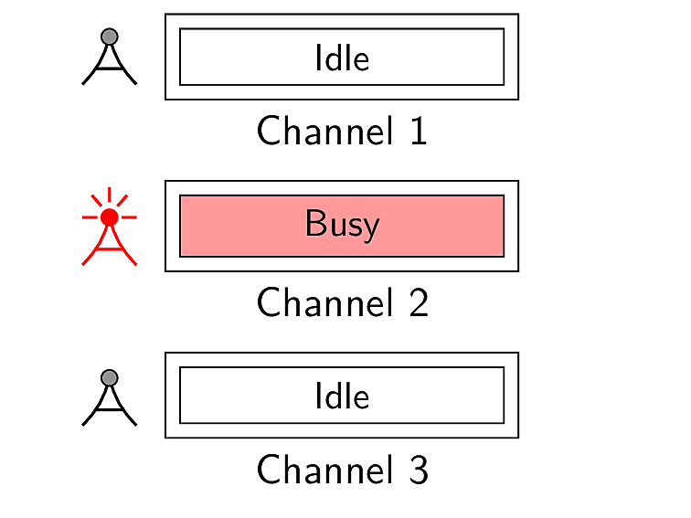

How to Increase Spectrum Utilization
Notes:
Now, let us see how can we increase this spectrum utilization.

Slide 7
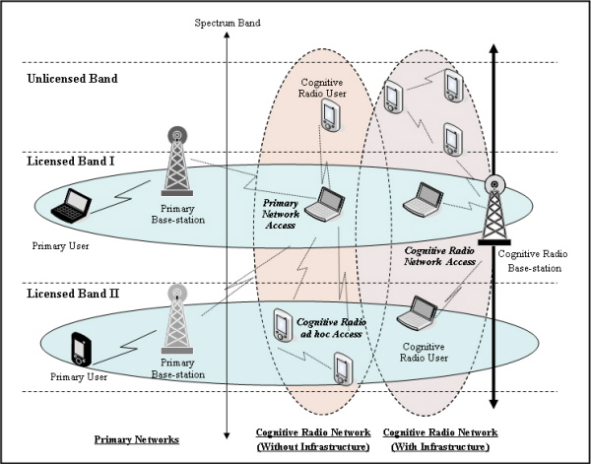
Cognitive Radio Networks (CRNs)
Notes:
That’s exactly what CRNs do.

Slide 8
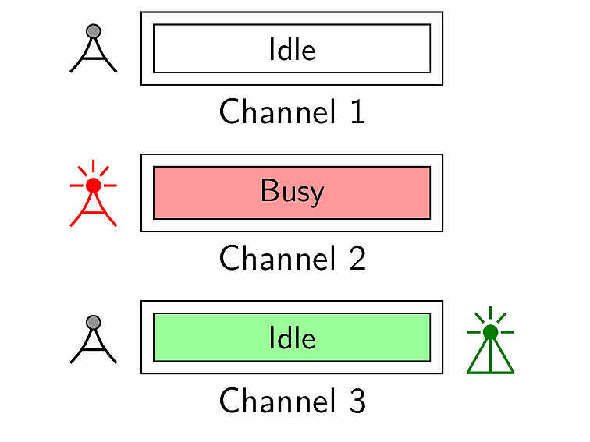
Cognitive Radio Networks (CRNs)
Comprises of two different types of users
Primary users
(licensed)
Secondary users
(unlicensed)

Slide 9
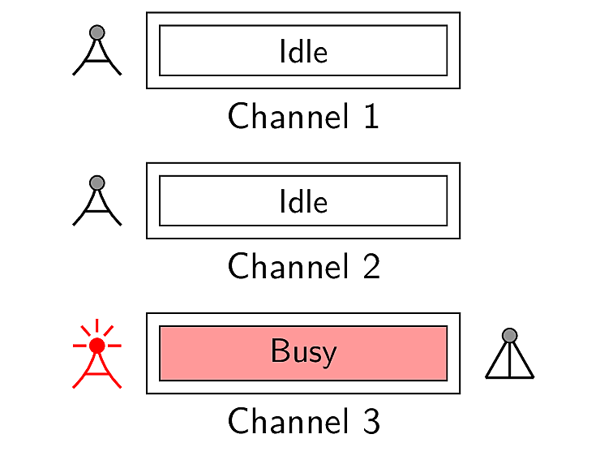
Cognitive Radio Networks (CRNs)
Comprises of two different types of users
Primary users
(licensed)
Secondary users
(unlicensed)

Slide 10
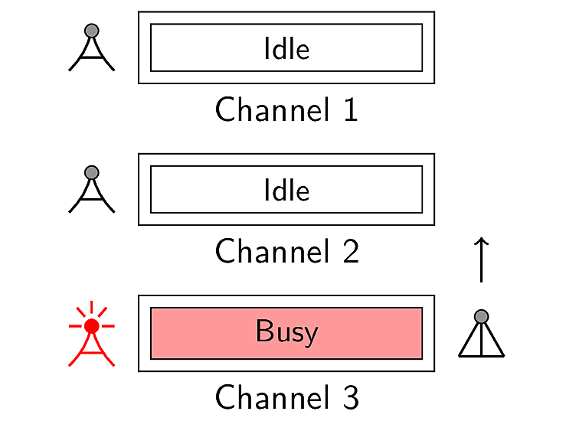
Cognitive Radio Networks (CRNs)
Comprises of two different types of users
Primary users
(licensed)
Secondary users
(unlicensed)

Slide 11
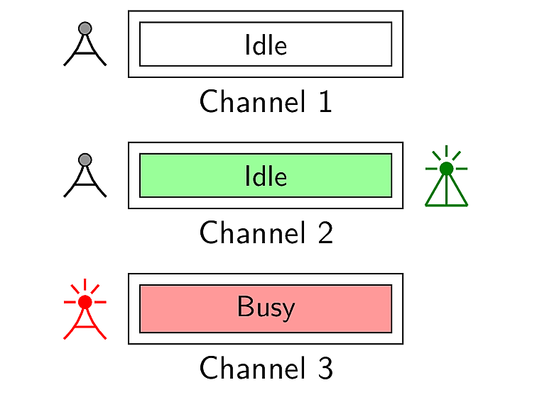
Cognitive Radio Networks (CRNs)
Comprises of two different types of users
Primary users
(licensed)
Secondary users
(unlicensed)

Slide 12

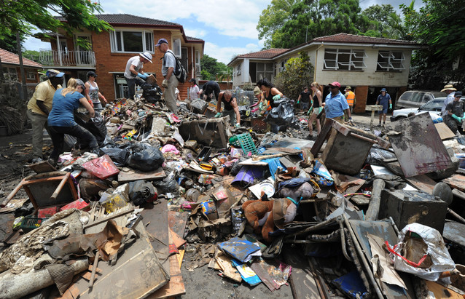
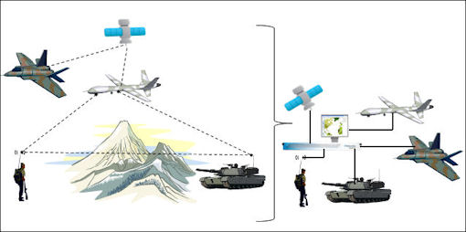
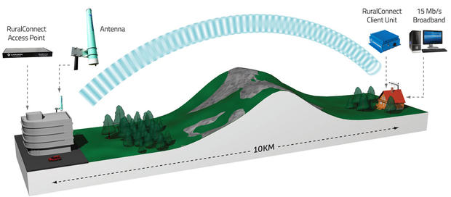

Applications of Cognitive Radio Networks
CRN Applications
High-Speed Rural Internet
Military Networks
Emergency Networks
Multimedia

Slide 13
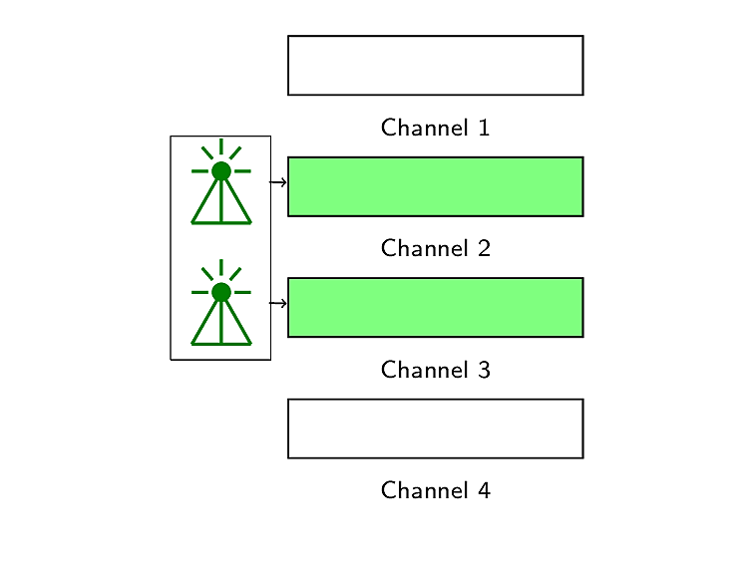
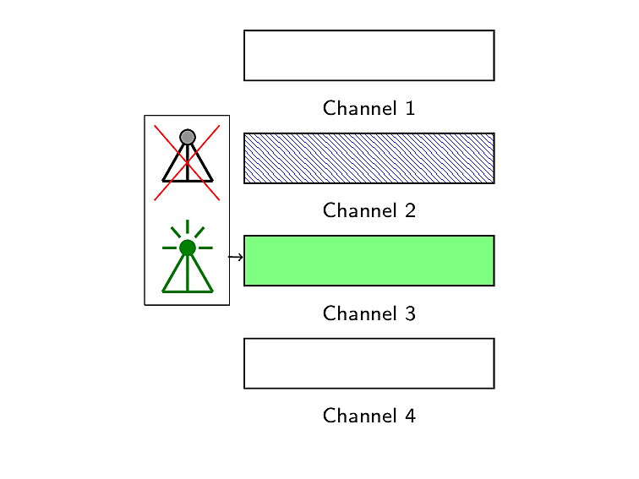
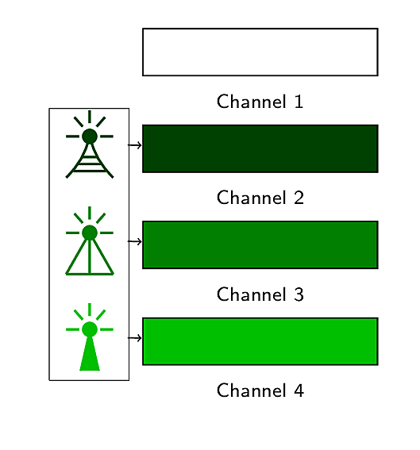
Multi-radio Networks
user
user
user
Improves network capacity [2,3]
improves no. of retransmission per packet [6]
enables heterogeneous wireless access [7]

Slide 14
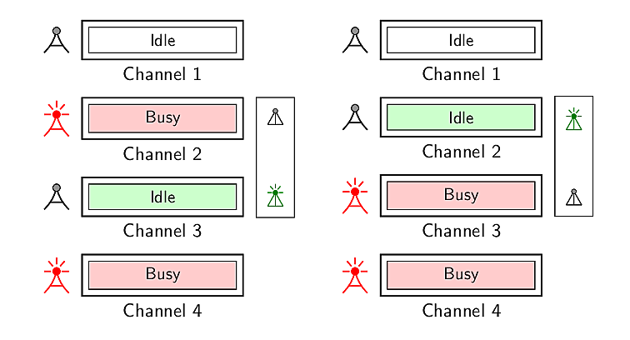
Multi-radio Cognitive Radio Networks
Secondary user
Secondary user

Slide 15
Related Research Work
Ahmadi et al., Vehicular Technology Conference (VTC) Fall, 2012 [1]
Solves the channel assignment problem for the single receiver radio
Considers only two sender radios
Does not investigate the performance of the network varying the number of radios

Slide 16
Related Research Work [contd.]
Zhong et al., Wireless Personal Communications (WPC), 2014 [9]
Presents a channel assignment algorithm for multi-radio cognitive radio networks
While assigning channels among available radios only channels are ranked
Does not consider conditions of radio
No analysis on throughput with an increase in number of radios

Slide 17
Related Research Work [contd.]
Li et al., ACM MSWiM, 2014 [5]
Presents a rendezvous channel establishment algorithm for multi-radio cognitive radio networks
Shows that maximum time to rendezvous reduces with an increase in number of radios
However, does not provide any approach on how these radios will be used for data transmission

Slide 18
Related Research Work [contd.]
Khan et al., IEEE WiMob, 2015 [4]
Employs multiple radios for data transmission
Shows that delay gets improved at the cost of throughput degradation with an increase in number of radios
Does not consider intra-user radio interference in case of omnidirectional antenna

Slide 19
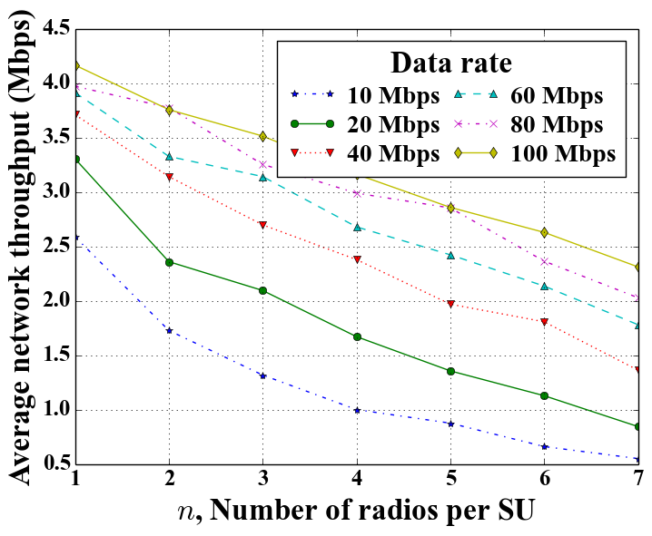
Motivation Behind Our Work
Throughput degradation in multi-radio CRNs

Slide 20
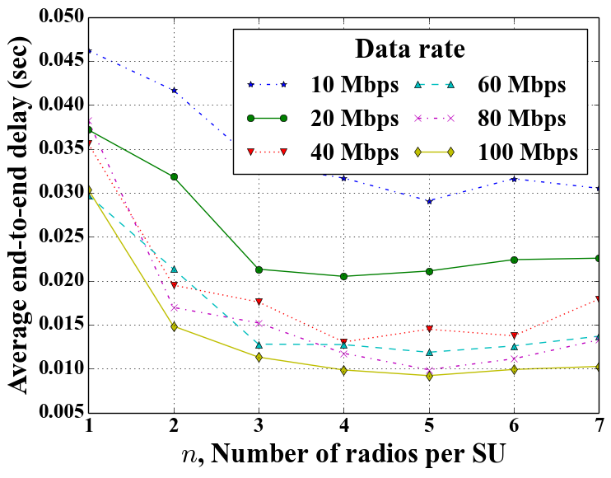
Motivation Behind Our Work
Throughput degradation in multi-radio CRNs
at the benefit of delay improvement [4]

Slide 21
Our research problem

Slide 22
Our Research Problem
How to overcome this throughput degradation in multi-radio CRNs?

Slide 23
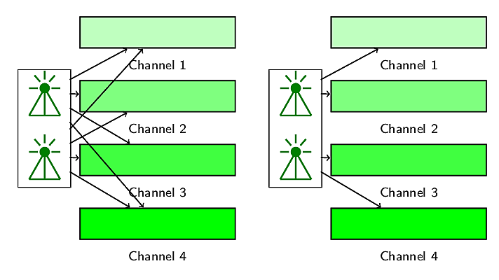
Our Proposed Methodology
Radio-channel assignment with intra-user collision avoidance

Slide 24
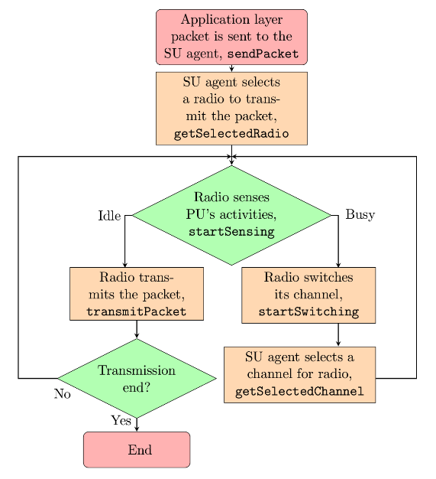
Our Proposed Methodology [contd.]

Slide 25




Our Proposed Methodology [contd.]
Radio-channel access based on radio and channel statistics
Feedback based multi-radio exploitation
Packet
Packet
Radio
Packet
Packet
Packet
Channel
Packet
Packet
queued
sent
delivered
transmitted
received
0
1
1
0
0
1
1
1
1
1
1
1
1
0

Slide 26
Our Proposed Methodology [contd.]
Variant name | Radio selection policy | Channel selection policy
Radio feedback | Weighted lottery based on radio transmission ratio | Unweighted lottery
Channel feedback | Unweighted lottery | Weighted lottery based on channel utilization ratio
Radio channel feedback | Weighted lottery based on radio transmission ratio | Weighted lottery based on channel utilization ratio

Slide 27
Experimentation

Slide 28
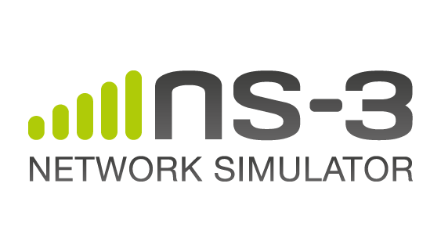
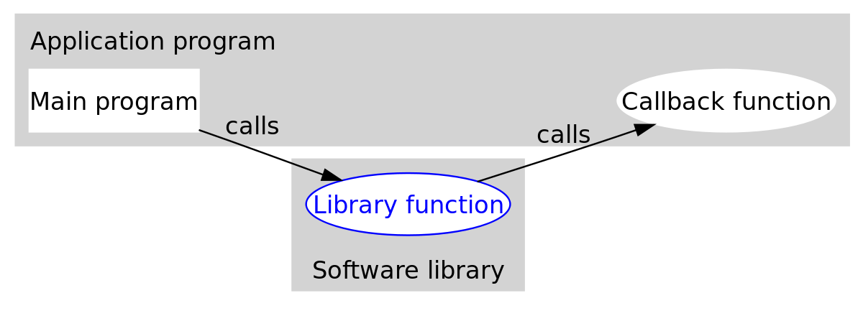
Simulator Modifications
pktQueued
pktSent
pktTransmitted
pktReceived
FlowIdTag
Radio reference
Packet
DelayJitterEstimationTimestampTag
YansWifiPhy, YansWifiChannel, WifiPhyStateHelper, RegularWifiMac, WifiNetDevice

Slide 29
Simulation Settings
Application data rate is varied from 1 Mbps to 32 Mbps
Nodes are placed randomly in an area of 500m×500m
The number of secondary users is varied from 12 to 40 with a granularity of 4
For each such settings, we perform 99 simulation iterations, each of 50 seconds

Slide 30
Evaluation

Slide 31
Results
Constant throughput degradation is no longer present

Slide 32
Results [contd.]
Constant throughput degradation is no longer present
delay is almost constant

Slide 33
Throughput
1 Mbps
2 Mbps
4 Mbps
8 Mbps
16 Mbps
32 Mbps

Slide 34
Delay
1 Mbps
2 Mbps
4 Mbps
8 Mbps
16 Mbps
32 Mbps

Slide 35
Results Summary
Application Data Rate | % increase in throughput with respect to |  | % decrease in end-to-end delay with respect to
 | Khan et al. | Zhong et al. | Khan et al. | Zhong et al.
1 Mbps | 55 | 15 | -18 | 49
2 Mbps | 63 | 31 | -15 | 49
4 Mbps | 66 | 44 | -17 | 42
8 Mbps | 63 | 49 | -17 | 31
16 Mbps | 68 | 55 | -14 | 27
32 Mbps | 64 | 43 | -13 | 23

Slide 36
Conclusion
Throughput degradation in multi-radio cognitive radio networks is a well-known problem.
We proposed a feedback-based multi-radio exploitation approach to solve the problem.
We evaluated the performance of our proposed approach through experimentation.
We compared the performance of our proposed approach with that of other contemporary approaches.

Slide 37
Thank you!

Slide 38
References I
Maryam Ahmadi, Yanyan Zhuang, and Jianping Pan. Distributed robust channel assignment for multi-radio cognitive radio networks. In Vehicular Technology Conference (VTC Fall), 2012 IEEE, pages 1-5. IEEE, 2012.
Paramvir Bahl, Atul Adya, Jitendra Padhye, and Alec Walman. Reconsidering wireless systems with multiple radios. ACM SIGCOMM Computer Communication Review, 34(5):39-46, 2004.
Richard Draves, Jitendra Padhye, and Brian Zill. Routing in multi-radio, multi-hop wireless mesh networks. In Proceedings of the 10th annual international conference on Mobile computing and networking, pages 114-128. ACM, 2004.
Tanvir Ahmed Khan, Chowdhury Sayeed Hyder, and ABM Islam. Towards exploiting a synergy between cognitive and multi-radio networking. In Wireless and Mobile Computing, Networking and Communications (WiMob), 2015 IEEE 11th International Conference on, pages 370-377. IEEE, 2015.
Guyue Li, Zhaoquan Gu, Xiao Lin, Haosen Pu, and Qiang-sheng Hua. Deterministic distributed rendezvous algorithms for multi-radio cognitive radio networks. In Proceedings of the 17th ACM international conference on Modeling, analysis and simulation of wireless and mobile systems, pages 313-320. ACM, 2014.

Slide 39
References II
Allen Miu, Hari Balakrishnan, and Can Emre Koksal. Improving loss resilience with multi-radio diversity in wireless networks. In Proceedings of the 11th annual international conference on Mobile computing and networking, pages 16-30. ACM, 2005.
Wei Song and Weihua Zhuang. Performance analysis of probabilistic multipath transmission of video streaming traffic over multi-radio wireless devices. Wireless Communications, IEEE Transactions on, 11(4):1554-1564, 2012.
Vaclav Valenta, Roman Marsalek, Genevieve Baudoin, Martine Villegas, Martha Suarez, and Fabien Robert. Survey on spectrum utilization in europe: Measurements, analyses and observations. In Cognitive Radio Oriented Wireless Networks & Communications (CROWNCOM), 2010 Proceedings of the Fifth International Conference on, pages 1-5. IEEE, 2010.
Xiaoxiong Zhong, Yang Qin, and Li Li. Capacity analysis in multi-radio multi-channel cognitive radio networks: A small world perspective. Wireless Personal Communications, 79(3):2209-2225, 2014.

Slide 40
Appendices
Backup slides

