Slide 1
GPU Acceleration of
Masked Template Matching
A Cross-Platform Study in OpenCV
Tak Hogan · takhogan@gmail.com · May 2026

Slide 2
Masked Template Matching
For every offset (x,y), correlate template T against image I, weighted per-pixel by mask M:
R(x,y) = Σ M(u,v)² · I(x+u, y+v) · T(u,v)
(TM_CCORR; analogous for TM_SQDIFF and the normed variants)
Why GPUs should be a great fit
Every output pixel is independent
Inner loop is a small dense dot product
Inputs fit comfortably in modern GPU memory
Tak Hogan · GPU Masked Template Matching · 3

Slide 3
Objective
Implementing masked version of matchTemplate on the GPU
Motivation
Current OpenCV Library Coverage
Masked matchTemplate is useful when the template is not rectangular
Useful in general when looking for a low-power computer vision solution
Can be used for UI navigation
Specific example: testing for business visibility in google maps
GPU version could speedup this operation
Unmasked matchTemplate has a GPU/CUDA implementation
OpenCV's masked matchTemplate has only a CPU implementation
Tak Hogan · GPU Masked Template Matching · 2

Slide 4
Project Implementation
Modified modules/imgproc/src/templmatch.cpp — added two direct OpenCL kernels for masked TM_CCORR and TM_SQDIFF (and their normed variants) and an CUDA kernel.
Naive kernel
Tiled kernel
CUDA kernel
One work-item per output pixel
Computes masked dot product directly from global memory
Vectorized loads
__local-memory variant
Stages a slab of the image into local memory
Reuses the slab across an output stripe
Similar approach using FFT or taking the naive approach depending on template size
Dispatcher ocl_matchTemplateMask routes very small templates to the naive kernel; everything else falls through to the existing FFT path.
Tak Hogan · GPU Masked Template Matching · 5

Slide 5
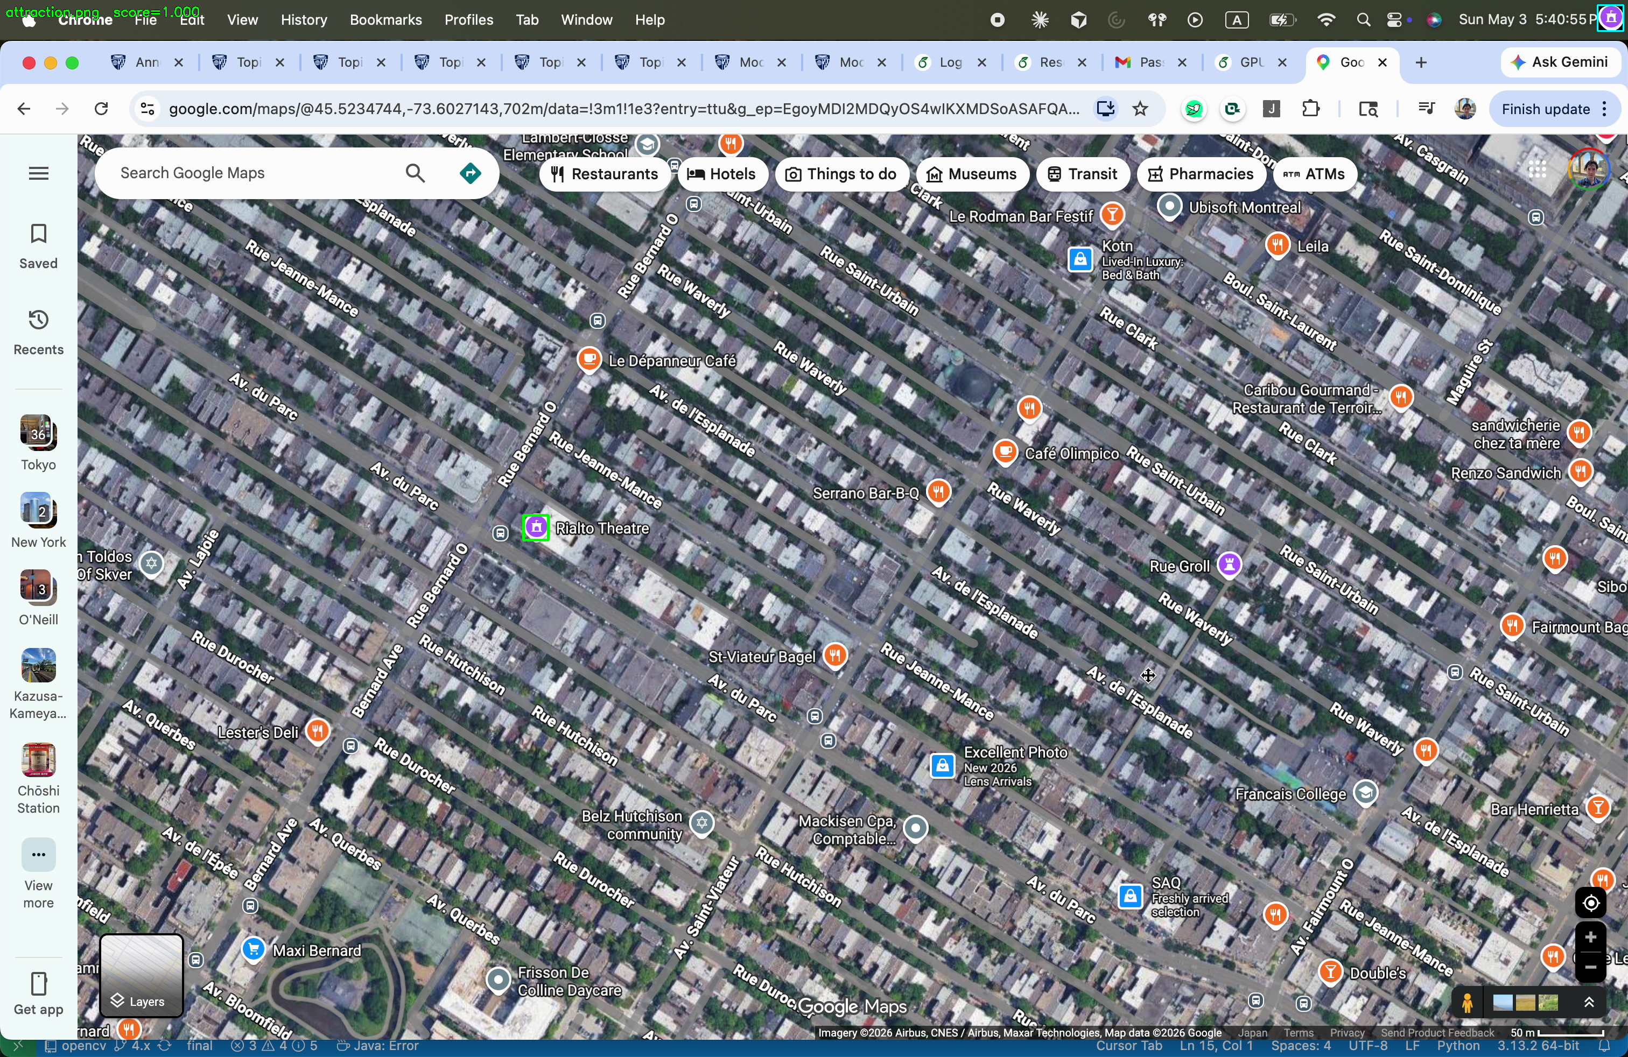








Benchmark Method
Testing Module
masked_template_match.py spawns a fresh subprocess per cv2 build (original vs. new) — no library state leaks
Worker runs each (scenario, method, backend): 1 warm-up + 10 timed iterations; reports mean and stddev
Raw outputs written to disk so the orchestrator verifies numerical agreement between builds
Scenarios
Synthetic: 2048×2048 random image, 128×128 template, circular mask
Real: Cartesian product of 5 map screenshots × 11 POI icon templates with hand-drawn masks
Methods measured: TM_CCORR_NORMED and TM_SQDIFF_NORMED
Map screenshot — green box marks the 'attraction' POI icon located via TM_CCORR_NORMED
POI icon templates (each with a hand-drawn alpha mask)
Tak Hogan · GPU Masked Template Matching · 6

Slide 6
Three Machines
Mac
CUDA Workstation
Windows Desktop
2021 Apple M1, macOS
Google Colab Linux Instance
2016-era Dell OptiPlex 7020 SFF
Integrated GPU exposed via Apple's deprecated OpenCL stack.
NVIDIA discrete GPU; OpenCL via NVIDIA runtime, plus cv2.cuda backend.
Intel Core i5-4590 @ 3.30 GHz, 16 GB RAM, AMD Radeon discrete GPU via vendor OpenCL runtime.
Tak Hogan · GPU Masked Template Matching · 7

Slide 7
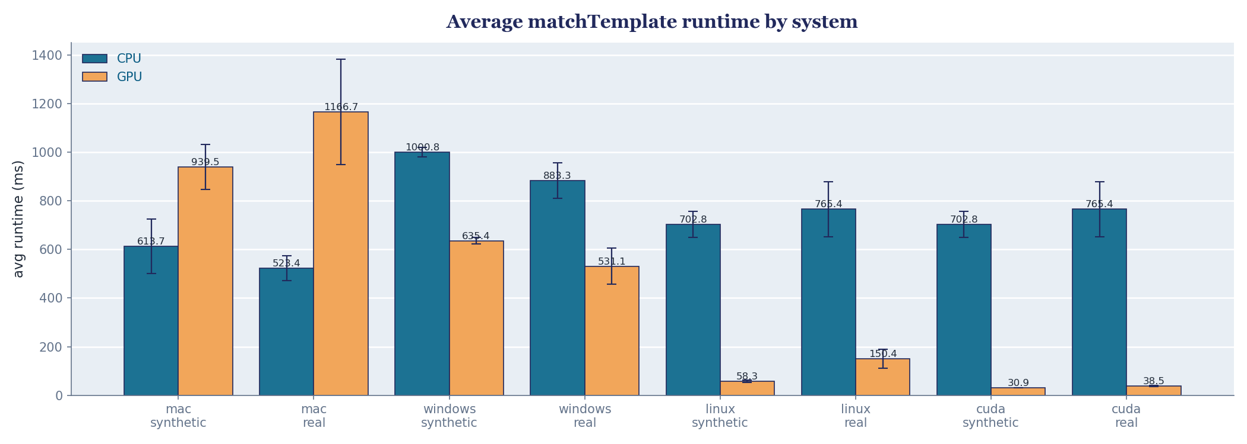
Results: Machine Dependent
Tak Hogan · GPU Masked Template Matching · 12

Slide 8
When and Why the GPU Wins (or Doesn't)
Driver / runtime maturity
NVIDIA CUDA & OpenCL well tuned. Windows OpenCL tuned for the device. Apple's deprecated OpenCL runs poorly despite good hardware.
Kernel launch & setup overhead
Each call runs in milliseconds — JIT compile, buffer alloc, memory transfer & allocation
Workload size
Synthetic 2048×2048 / 128×128: GPU dominates everywhere except macOS. Small POI templates: gap narrows but trend holds.
Tak Hogan · GPU Masked Template Matching · 9

Slide 9
Conclusion
GPU can improve performance where the runtime is healthy.
Modern NVIDIA discrete GPU: speedup over CPU baseline – OpenCL performs well, CUDA performs best
2016-era Windows discrete GPU: speedup over CPU baseline – OpenCL still optimized and performs well
Apple Silicon: slowdown - OpenCL is deprecated and does not perform well
Future work
Metal backend for the masked path on macOS

Slide 10
Reproducibility & References
Reproducibility
Mac / Linux: ./setup.sh followed by ./run.sh
Windows: ./setup.ps1 followed by ./run.ps1
Requirements: cmake on PATH, numpy installed via pip
Repository
github.com/takhogan/opencv-masked-matchtemplate-benchmarking
Reference
OpenCV — Object Detection: cv::matchTemplate (4.x reference docs)
Tak Hogan · GPU Masked Template Matching · 11

