Slide 1
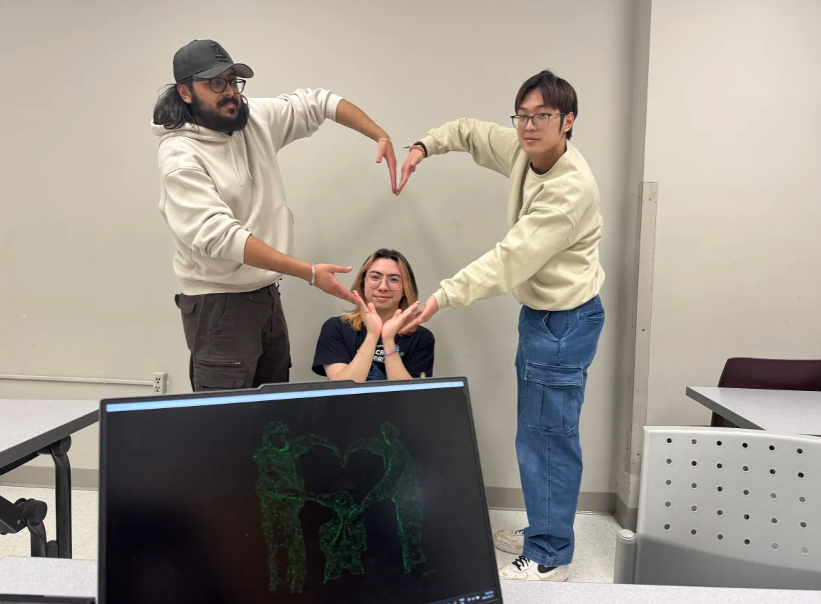
P.C.D.
Partially Covered Detection
(Team 14)
1/20

Slide 2
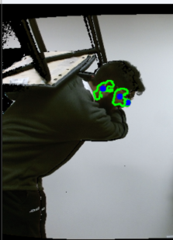


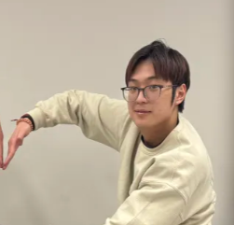
Tarnveer Takhtar
Harman Bassi
Software Engineering
(4th Year)
Software Engineering
(4th Year)
Matthew Bradbury
Kyen So
Software Engineering
(4th Year)
Software Engineering
(4th Year)
2/20

Slide 3
Table of contents
01
02
03
04
05
Problem Statement
Live Demo
Methodology
Next Step
Questions?
3/20

Slide 4
01
Problem Statement
4/20

Slide 5
Problem Statement
Our project aims to design software that can reliably detect people using point cloud data. Specifically, our product will be able to accurately and consistently detect people whether they are visually obstructed or not.
5/20

Slide 6
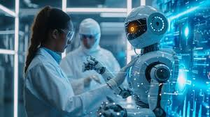
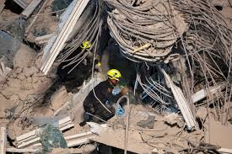
Use Cases
Robotics Research
Assistive Robots
Furthers research in robot and human interactions
Assist humanitarian aid and domestic robot development
6/20

Slide 7
Requirements/Constraints
Functional
Nonfunctional
Human Detection
Location Estimation *
Offline Processing
Body Pose Variation Handling
Integration with Kinect Sensor
Real-Time Processing
Usability *
Reliability
Accuracy
Constraints
No Machine Learning
Using Kinect Sensor
7/20

Slide 8
02
Live Demo
8/20

Slide 9
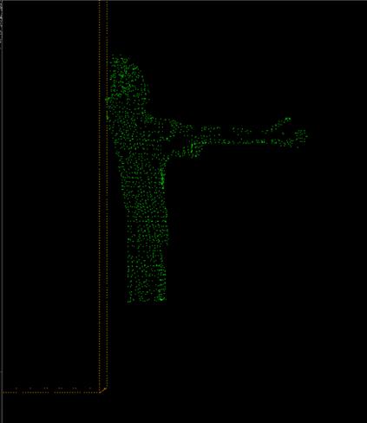
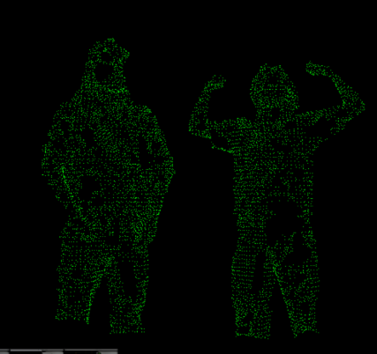
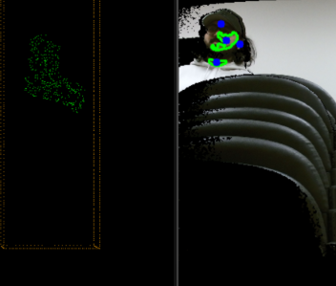
Demo
Fully Visible
Partially Obstructed
Partially Out of Frame
9/20

Slide 10
03
Methodology
10/20

Slide 11
Process Overview
2D Filtering
Seed Point Aquisition
3D Filtering
3D Cluster Extraction
Region Estimation
11/20

Slide 12
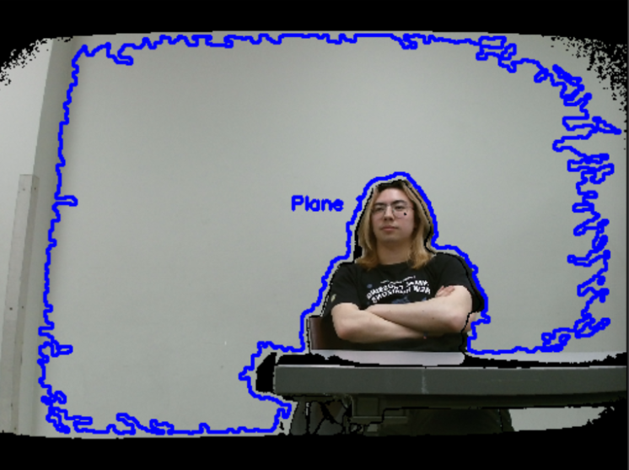
2D Filtering
Done in OpenCV
Custom Plane Detection
Plane Filtering/Removal
12/20

Slide 13
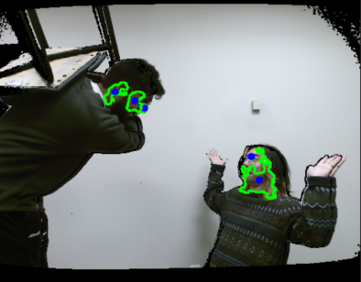
Seed Point Acquisition
Done in OpenCV
Skin Point Detection
  Initial Skin Mask
  Skin Mask Filtering
  Skin Confidence Mask
13/20

Slide 14
3D Filtering
Done in PCL
Voxel Down Sampling
Noise Removal
PCL Plane Removal (RANSAC)
14/20

Slide 15
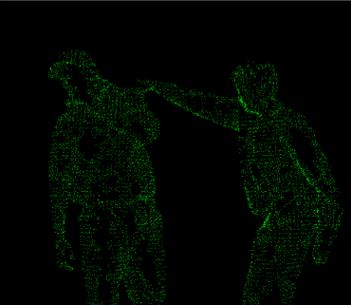
3D Cluster Extraction
Start from Detected Seed Points
Region Growing From Seed Point
  Conditional On:
    Max Neighbour Distance
    Growth Radius
Track Growth Directions
Enhance Cluster Resolution
15/20

Slide 16
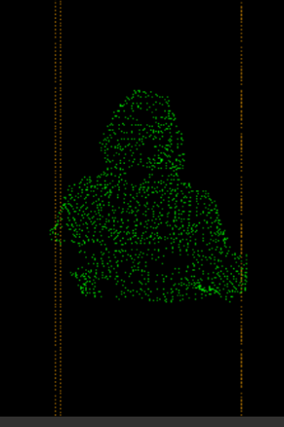
Region Estimation
Cluster Neighbor Centroids
Compute Growth Direction/Clustering Pattern
Determine Region Centroid/Offset
16/20

Slide 17
04
Next Steps
17/20

Slide 18
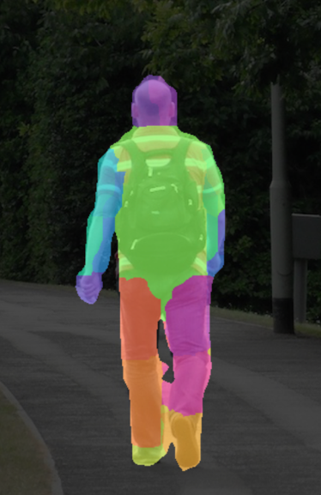
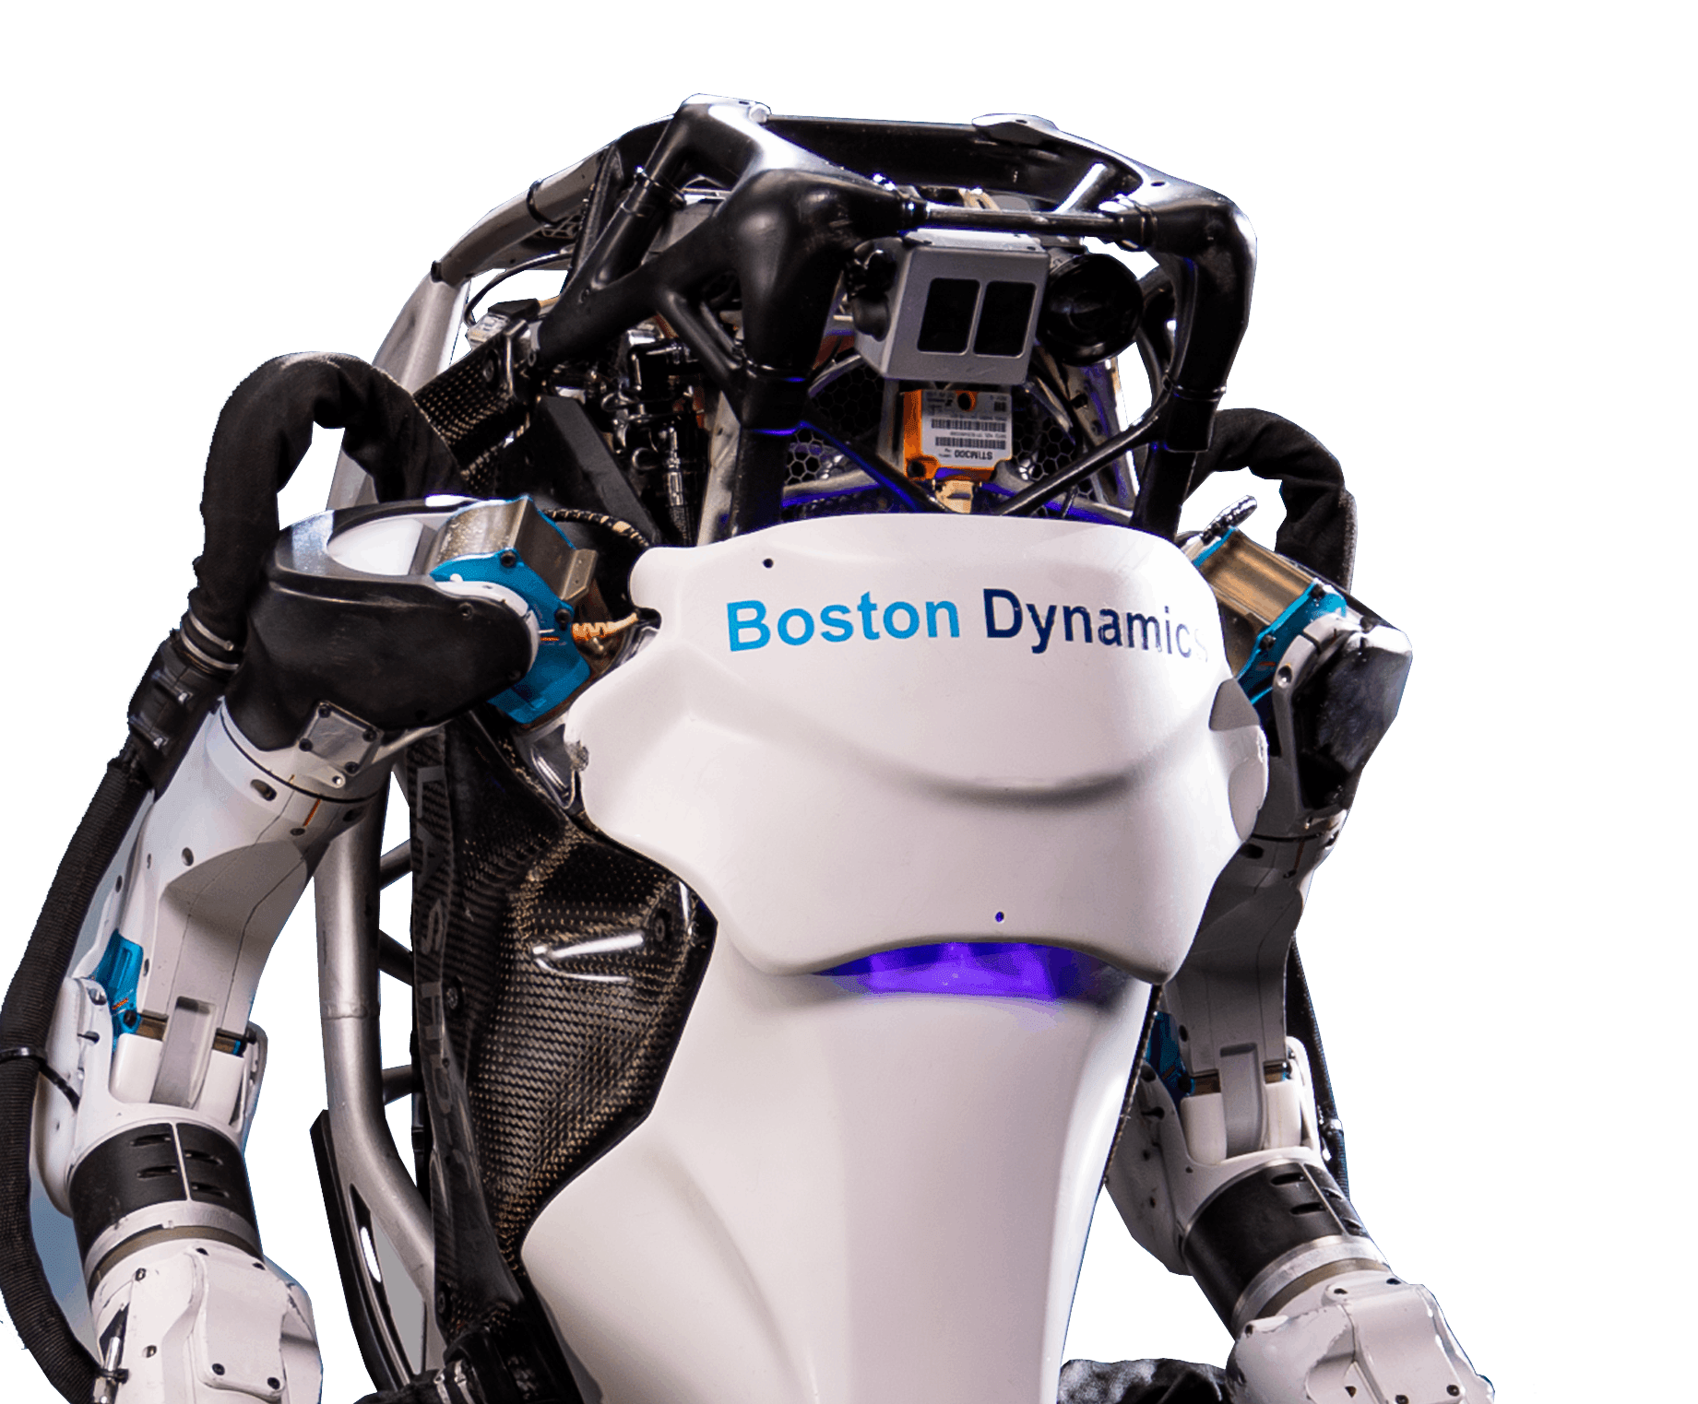

Body Part Segmentation
Robot Integration
Improvements
Specific Body Part Identification
Refine Region Estimation
Adapting for Different Environments
Adapt Sensor to Robot Input
Output to Robot Action
More Detection Methods
Reduce False Positives
Reliability/Consistency
18/20

Slide 19
05
Questions?
19/20

Slide 20
Thank You!
20/20

