Slide 1
Course Code: IRE 216
Course Title: Sensor Technology Sessional

Slide 2
Project Title: Fire Alert & Avoidance System Using Smart Robot with Plant Care
Presented by:
Joya Rani Saha
ID: 2201008
Rawnak Mahzabin Jyoti ID: 2201010
Takia Yasmin
ID: 2201049
Presented to:
Sadia Enam
Lecturer, Gazipur Digital University

Slide 3
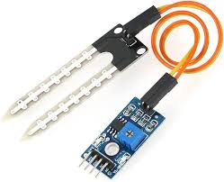
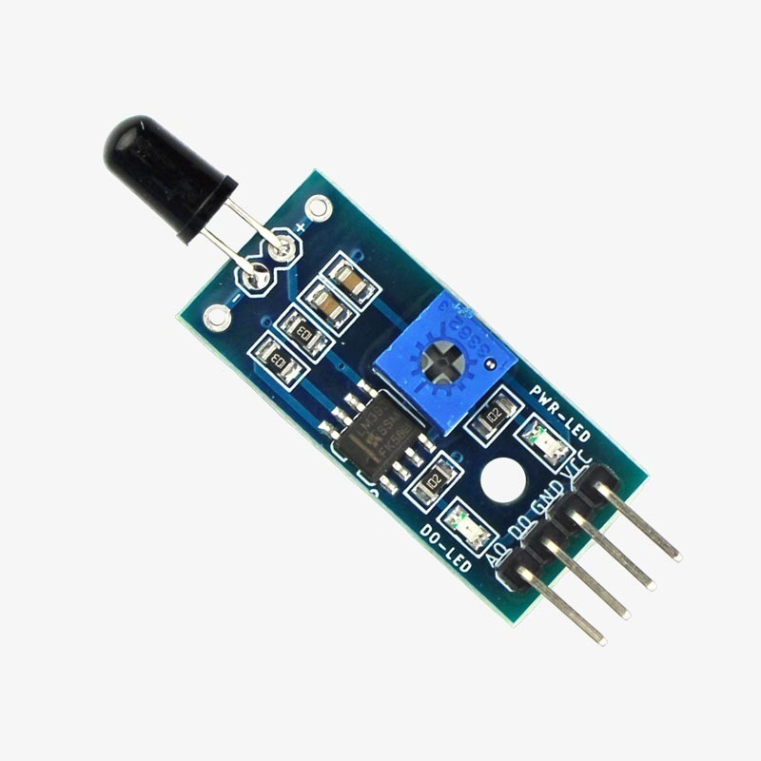
Introduction
This project is developed using Arduino and various sensors. It continuously monitors key environmental factors such as soil moisture, temperature, humidity, gas levels, flame, and human movement using sensors like DHT22, MQ-2, flame sensor, ultrasonic sensor, and more. When any abnormal condition is detected—such as fire, gas leak, or intrusion—the system triggers a buzzer alert and displays real-time sensor data on the Serial Monitor. This low-cost and reliable system is suitable for applications in smart agriculture, home safety, and environmental monitoring.

Slide 4
Objectives
To develop a sensor-based system using Arduino for real-time environment and safety monitoring.
To measure soil moisture for better irrigation planning.
To monitor temperature and humidity using the DHT22 sensor.
To detect fire using a flame sensor and give immediate alerts.
To sense harmful gas or smoke using the MQ-2 sensor.
To detect nearby human or object movement with an ultrasonic sensor.
To trigger a buzzer when any danger is detected.
To show all sensor readings live on the Serial Monitor.
To create a low-cost, energy-efficient system for farming, safety, and smart environments.

Slide 5
Components Required
Arduino UNO – Main microcontroller to control all sensors and process data
Soil Moisture Sensor – To detect the moisture level of soil
DHT22 Sensor – To measure temperature and humidity
Flame Sensor – To detect the presence of fire or flame
MQ-2 Gas Sensor – To detect gas leakage or smoke in the environment
HC-SR04 Ultrasonic Sensor – To detect movement or intruder nearby
Active Buzzer – To give sound alerts when danger is detected
Breadboard – For easy wiring and prototyping
Jumper Wires – To connect all components
USB Cable – To program and power the Arduino
Power Supply (Optional) – 9V battery or adapter for external power

Slide 6
Literature Review
Krishnaraj R, Divya Dharshini S, Sandhya A K, and Sanjala N M
Anas Tukur Balarabe
Alejandro Lezcano Sirre
Adam Benson
Developed an Arduino UNO-based system for real-time monitoring of temperature, humidity, and CO₂ levels using DHT11 and MQ135 sensors.
developed an IoT-based environmental monitoring system using Arduino Mega and ESP8266 Node MCU to collect and transmit data from sensors like MQ-2, MQ-135, DHT11, and BMP180.
Adam Benson developed an Arduino-based system that monitors room conditions and detects intrusions, and displaying data on an LCD
Krishnaraj R, Divya Dharshini S, Sandhya A K, and Sanjala N M developed an IoT-based smart environment monitoring system that uses sensors to track air quality & temperature.

Slide 7

Key Features
Real-time monitoring of 6 different parameters (soil, temp, humidity, gas, flame, motion)
Buzzer alert system for fire, gas leak, and intrusion
All sensors integrated in one Arduino-based system
Low-cost and easy to build with common components
Live output viewable on Arduino Serial Monitor
Useful for smart farming, home safety, greenhouses, etc.
Can be extended or upgraded easily (e.g., IoT, GSM)
01
07
02
06
03
05
04

Slide 8
Methodology
01
Parameter Selection
Key factors like soil moisture, temperature, humidity, gas, flame, and motion were chosen for monitoring.
02
Component Selection
Appropriate sensors (DHT22, MQ-2, flame sensor, ultrasonic sensor, etc.) and Arduino UNO were selected.
03
Circuit Setup
Sensors were connected to the Arduino using a breadboard and jumper wires based on their input types.
04
Programming
Arduino was coded in the Arduino IDE using required libraries. Thresholds were set for each sensor, and buzzer logic was added.
05
Testing
Each sensor was tested and calibrated to ensure accurate readings.
06
Final Integration
All sensors were combined into one working system. The buzzer was tested, and live data was observed via the Serial Monitor.

Slide 9
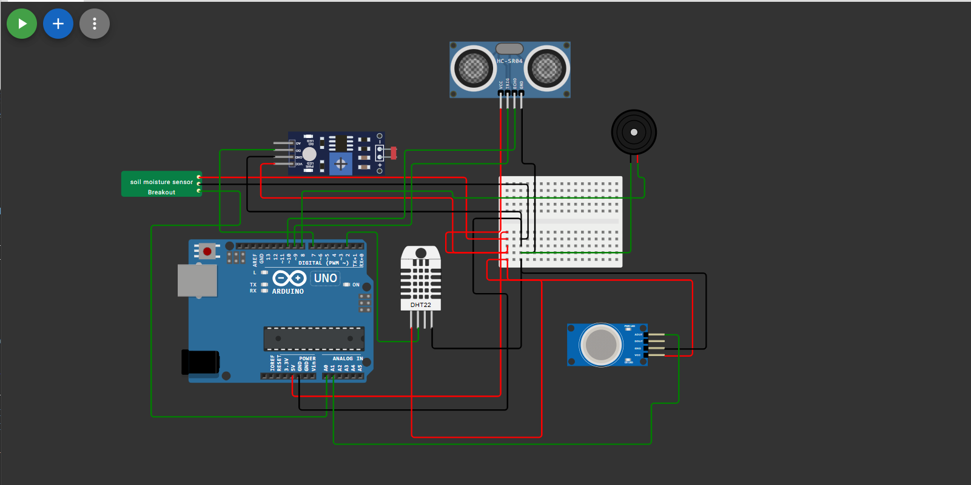
Circuit Diagram

Slide 10
Applications
Smart Agriculture
01
Helps monitor soil moisture, temperature, and humidity for better crop management.
Home Safety Systems
02
Detects fire, gas leaks, and intrusions to prevent accidents.
Greenhouse Monitoring
03
Maintains optimal conditions for plant growth.
Industrial Safety
04
Can be used to detect gas leaks or overheating in factories.
Environmental Monitoring
Useful for real-time tracking of basic environmental conditions.

Slide 11
Limitations & Challenges
No remote notifications
No data storage
The system only gives local alerts via a buzzer (no SMS or app notification).
Sensor data is not saved for later analysis.
Limitations & Challenges
Power dependency & Environmental sensitivity
Limited range of sensors
Ultrasonic and gas sensors have short detection ranges.
System needs constant power; no battery backup included. Sensors may need recalibration in different conditions (humidity, dust, etc.).

Slide 12
Future Scope
IoT Integration
Mobile App Interface
Adding WiFi or GSM modules to send alerts to mobile devices or cloud platforms.
Building an app to control and view sensor data remotely.
Solar Power Support
Making the system energy-efficient and usable in remote areas.
LCD/OLED Display
Machine Learning
Displaying sensor data directly on a screen for easier monitoring.
Using data patterns to predict environmental risks or automate decisions.

Slide 13
TimeLine
February
March
April
May
June
July
Identified the project topic and its real-life importance
Finalized project idea: multi-sensor system using Arduino
Practiced wiring on breadboard and reading values on Serial Monitor
Successfully tested the full system in real-time conditions
Developed and tested the Arduino code with thresholds
Final testing and integration of all components

Slide 14
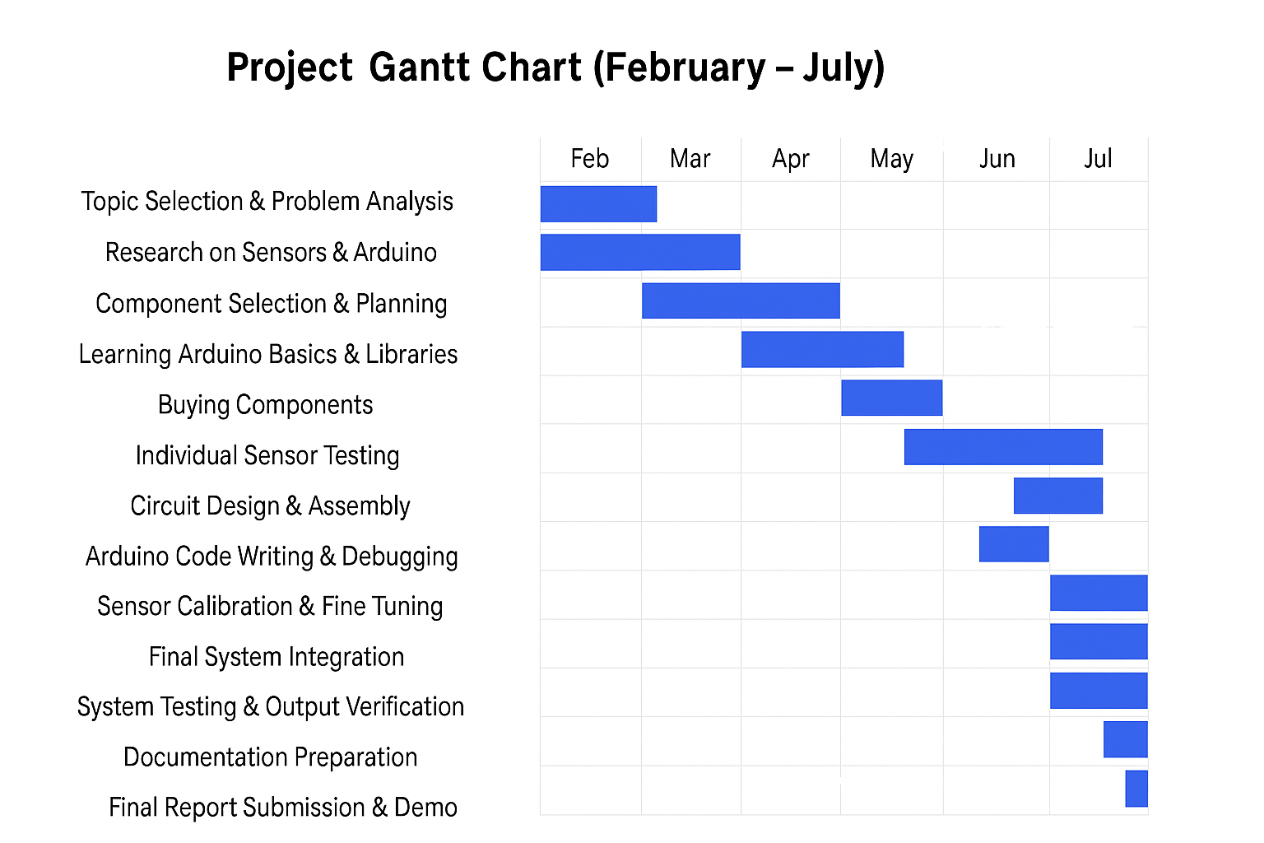

Slide 15
Functional prototype with multiple integrated sensors.
Real-time monitoring of soil moisture, fire, gas, temperature, humidity, and intrusion.
Automatic detection of abnormal conditions and safety threats.
Immediate audible alert through buzzer for quick response.
Enhanced safety and security for labs, farms, and homes.
Reduced need for manual monitoring.
Cost-effective and easy to install.
Possible future expansion with wireless alerts and data logging.

Slide 16
Conclusion
The Smart Environment and Safety Monitoring System was successfully developed using Arduino and various sensors. It effectively monitors soil moisture, temperature, humidity, gas levels, fire, and movement, and provides real-time feedback with an automatic buzzer alert for any danger. The system is low-cost, easy to use, and suitable for real-life applications like smart farming, home safety, and environmental monitoring. It also provides a solid base for future development with IoT and mobile integration.

Slide 17
Reference
[1] R. Kaur and M. Singh, "IoT Based Smart Agriculture Monitoring System," in Proc. IEEE Int. Conf. Electrical, Computer and Communication Technologies (ICECCT), Coimbatore, India, Feb. 2018, pp. 1-5. doi: 10.1109/ICECCT.2018.8474802.
[2] S. R. Jaiswal and P. K. Gupta, "Smart Fire Detection and Alert System using IoT," in Proc. IEEE Int. Conf. Communication and Electronics Systems (ICCES), Coimbatore, India, July 2019, pp. 1-5. doi: 10.1109/ICICICT46008.2019.8993270.
[3] H. Sharma and A. Ghosh, "IoT Based Home Security System with Smart Surveillance and Intruder Alert," in Proc. IEEE Int. Conf. Electrical, Computer and Communication Technologies (ICECCT), Coimbatore, India, Feb. 2018, pp. 1-5. doi: 10.1109/ICECA.2018.8474737.

Slide 18
Thank You!

