Slide 1
Beaglebone Black Tutorial
getting started

Slide 2
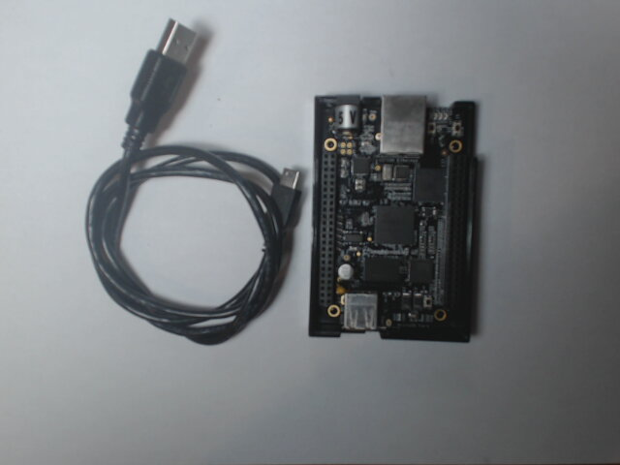
beaglebone kit comes with a USB-A to mini-USB cable
Beaglebone Black Rev. C

Slide 3
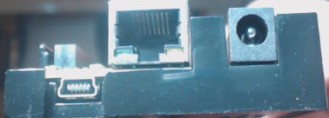
Ethernet connector
(home router)
5-V, 2-A power connector
USB mini connector (female)
adafruit BB case
(bottom)

