Slide 1

Jupyter Notebooks for Teaching and Learning
Thomas Kluyver

Slide 2















It’s not about me!
groups.google.com/d/forum/jupyter-education

Slide 3
Questions!
Should I use notebooks?
What can go wrong?
What extra tools can I use?
Hosted or local installs?

Slide 4
Why not notebooks?
Notebooks &
version control
Install
problems
Low-res
projectors
Technical
Large
output
Awkward/
limited undo

Slide 5
Why not notebooks?
Programming
Testing
Cogntive load
Don’t learn
common tasks
Pedagogical
Running code at command line
Markdown
Confusion
Offputting
errors
Accidental
deletion
Out-of-order
execution
Shared namespace
Invisible
variables

Slide 6
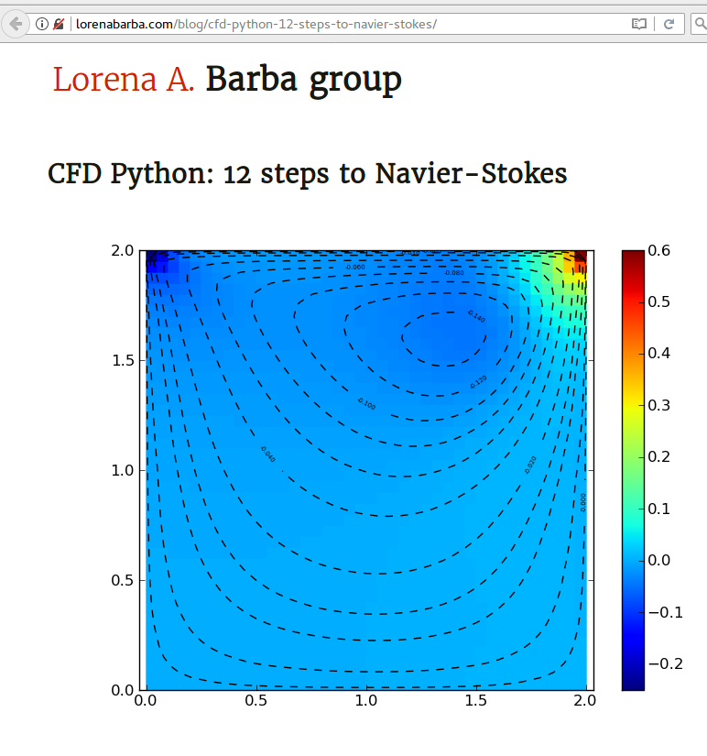
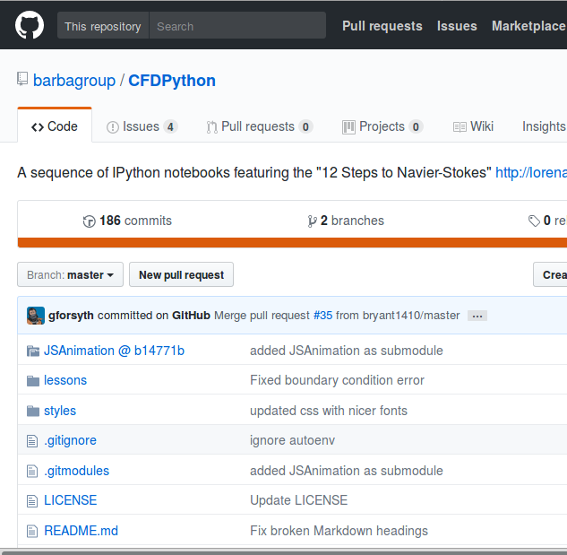
And yet...

Slide 7
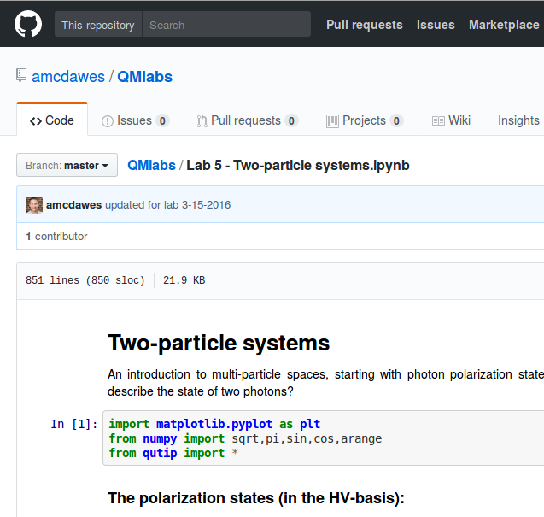
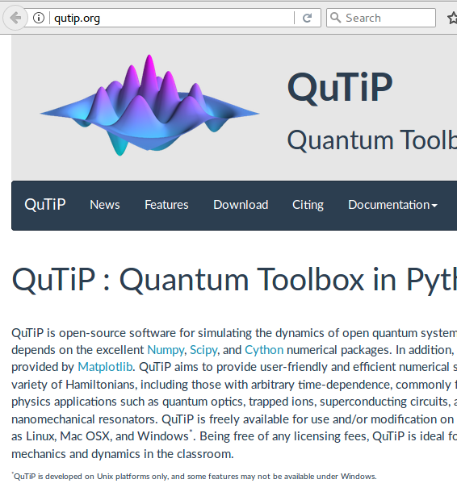
Quantum Mechanics

Slide 8
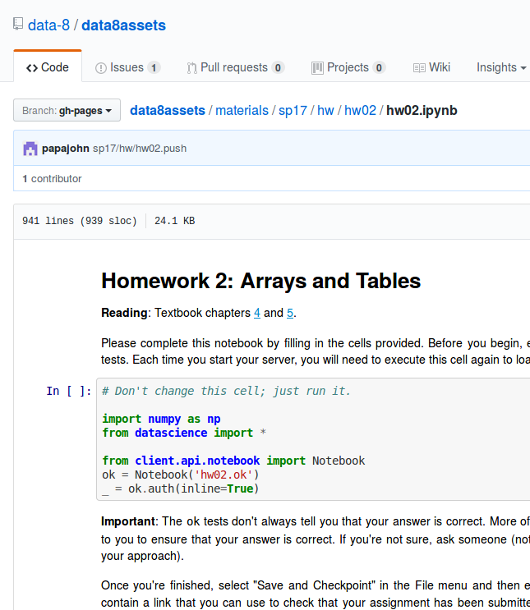
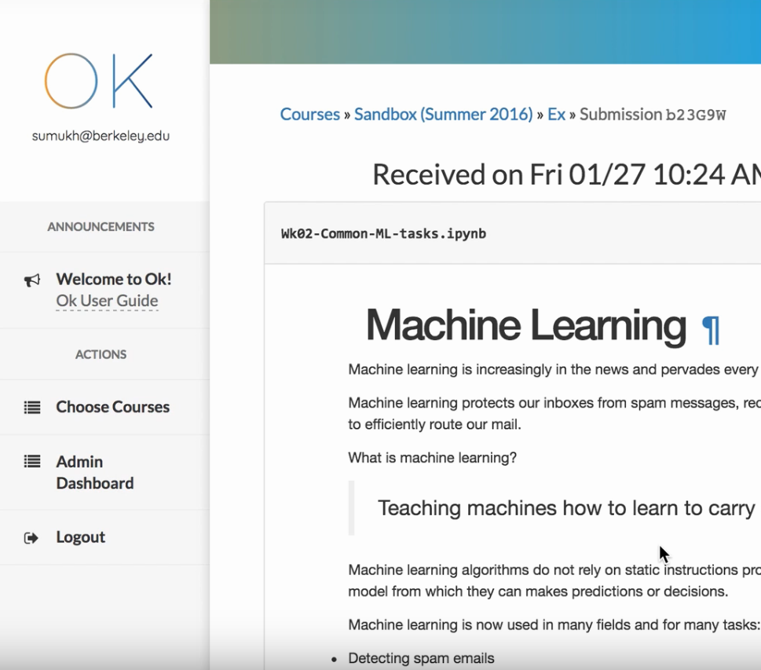
Data Science

Slide 9
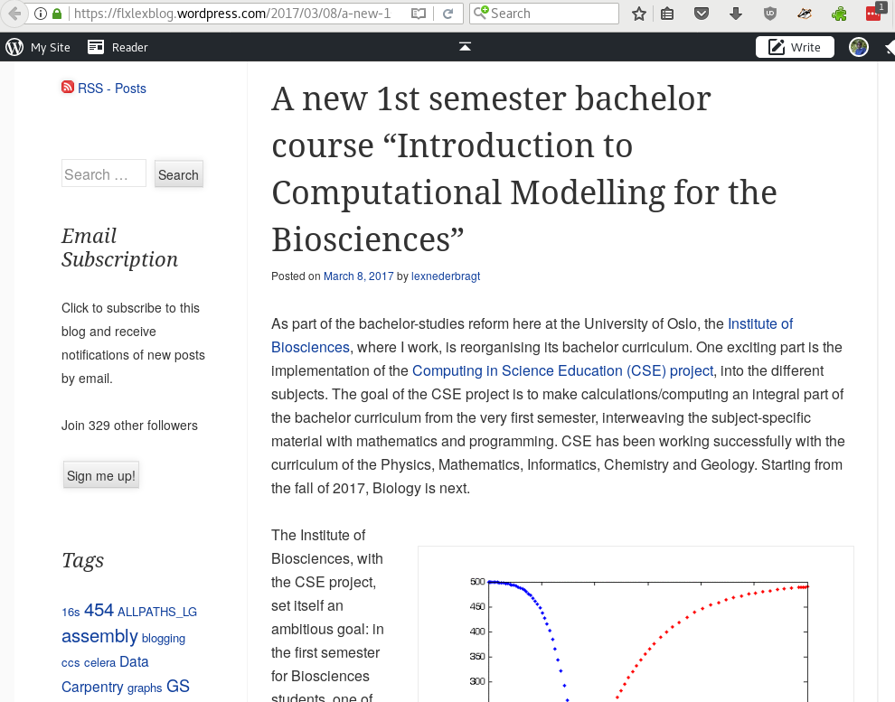

Python for biologists

Slide 10
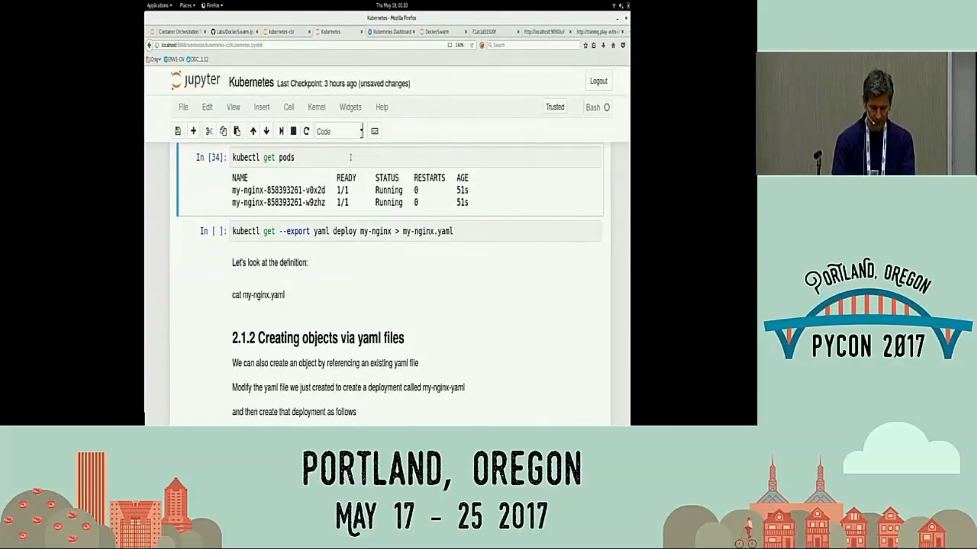
Container tutorials

Slide 11
Why notebooks?
Students tackle
harder problems
Follow lectures
interactively
Open source
Combine computation,
writing, mathematics
Engage with
material
Get corrections
on Github
NB exercises
record thought
process
Learn technical
computing skills
Zero-install
hosted service
More on
this soon

Slide 12


What can go wrong?
Slow down!
& leave blanks?

Slide 13
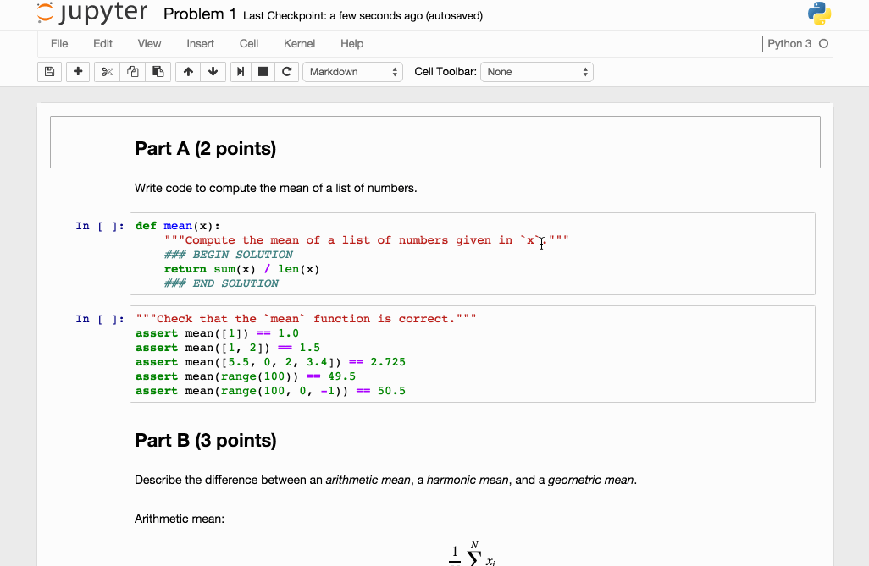
Nbgrader

Slide 14
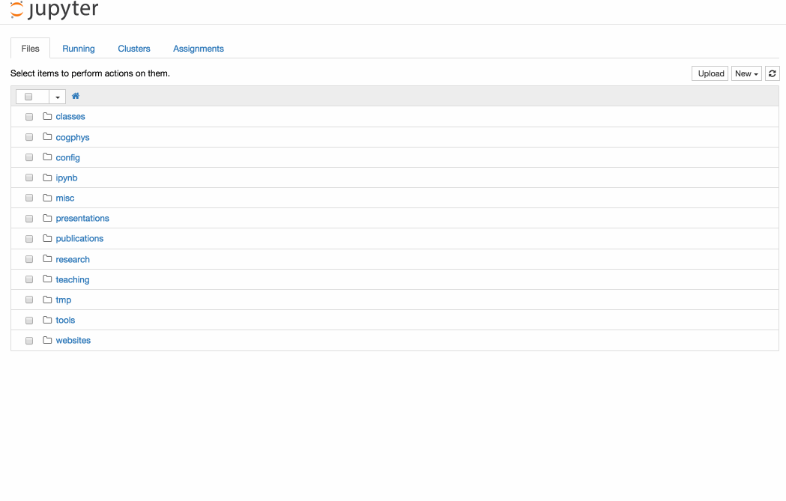
Nbgrader

Slide 15
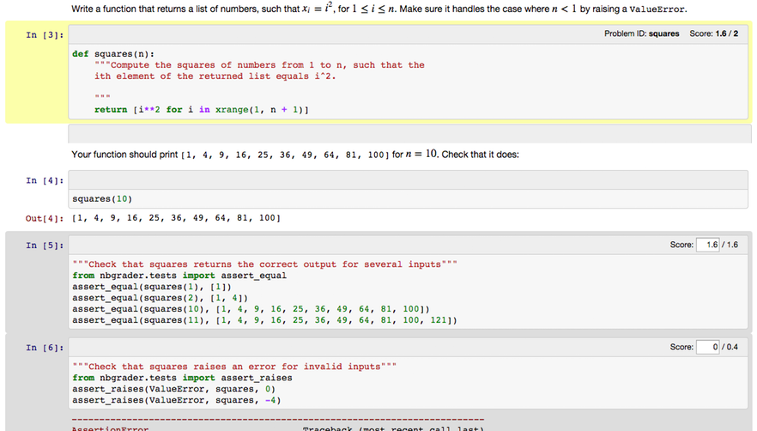
Nbgrader

Slide 16

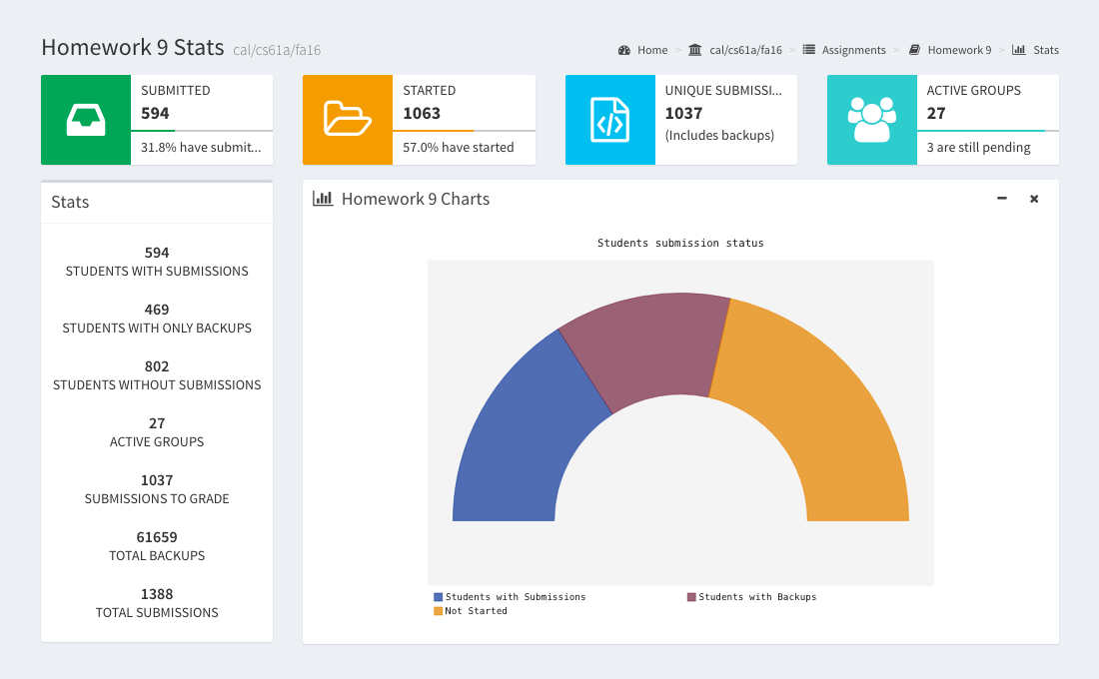
okpy.org

Slide 17


Tools: hosted notebooks
DIY
Login options
$4 – $20 per student
Course tools

Slide 18
Convert to/from notebooks
nbconvert · nbsphinx · bookbook · ipymd · rst2ipynb
Slideshows
nbconvert · RISE
Programatically generate notebooks

Slide 19


Hosted or local install
Managed desktops
Students’ computers

Slide 20

Hosted or local install
Free!
No network issues!
Nothing to install!
Use your tablet!

Slide 21
Hosted or local install
Tools & materials
for after course?
Auto-grading
Equity issues

Slide 22



Acknowledgements
jupyter-education mailing list
groups.google.com/d/forum/jupyter-education
Jupyter is funded by:

