Slide 1
Sprint 1 – EECS Database
Travis Takushi and Kaden Metzger

Slide 2
What we are making
EECS database for all the assets in the college
Needs to be similar to a library system with checkout requests and new asset requests
Using next.js – fullstack framework, nginx – web server for reverse proxy, postgresql – database, tailwindcss - styling

Slide 3
Sprint Objectives
Understand the problem (on going)
Collect functional and non-functional requirements
Split up features
Create UML use case diagrams
Overall sketch out a rough draft/plan of each feature and the overarching application

Slide 4
Gathering Requirements
Met with Client 2 times over sprint
First meeting mainly about getting logistics of project down
Figured out general overview of project
Went over functional requirements
Second meeting about seeing if our requirements and all documentation aligned with client vision
Discussed more requirements that could extend project like barcode scanning

Slide 5
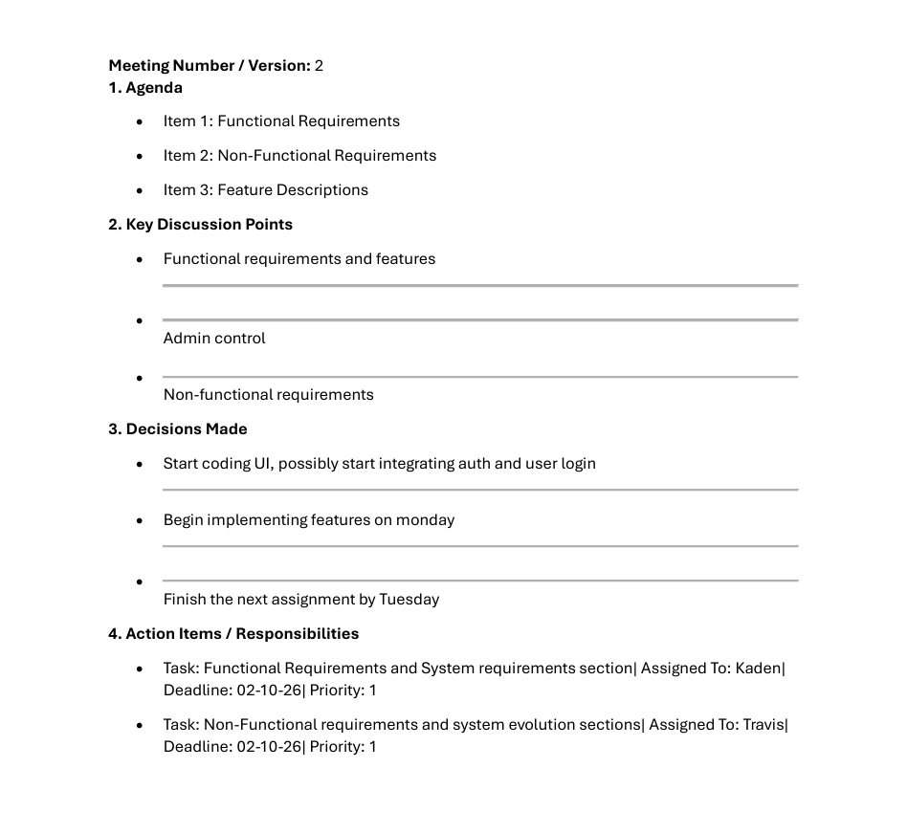
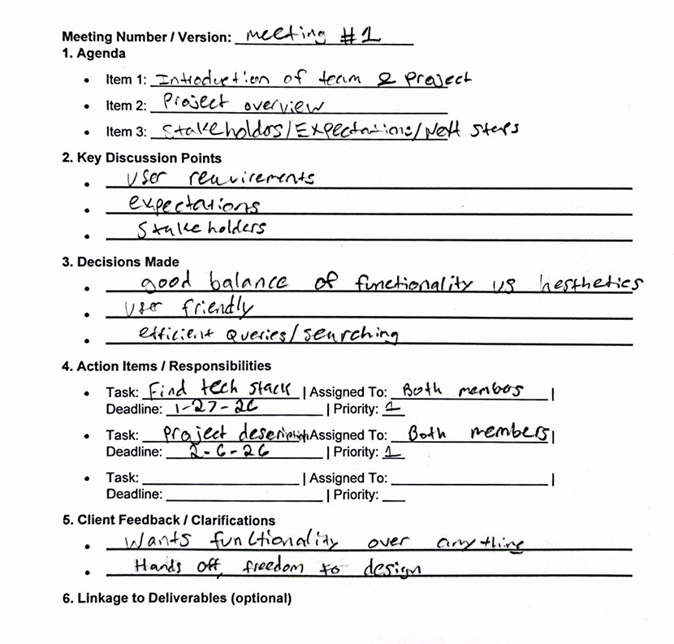
MEETING MINUTES EX

Slide 6
Functional/Non-Functional Requirements
Asset searching/filtering
Asset requests
Importing/exporting assets into CSV files
Bar code scanning
Basic web application requirements (database, UI, etc)
Basic non-functional requirements (security, scalability, preformance)

Slide 7
User Stories
US-3: User Login
As a User, I should be able to login to the dashboard.
Feature: User Login
Scenario: User presses login with the correct credentials on the login page
Given the user is on the login page,
And they have the correct credentials in the username and password fields,
And they press the login button,
Then the user should be redirected to the home page,
And their data should be updated.

Slide 8
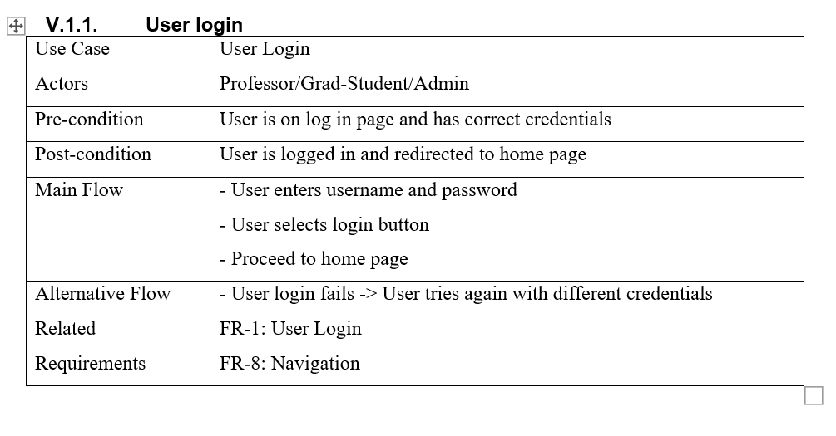
Use Cases

Slide 9
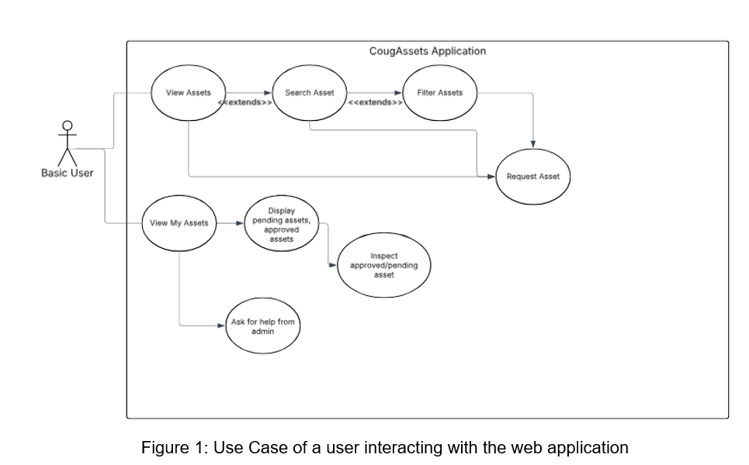
UML Diagrams

Slide 10
Integrating into WSU Systems
We are not working with an existing code base
Currently working with the WSU IT team to host our web application on WSU's servers
We also plan to integrate OKTA verify to allow WSU accounts to login
Full integration will likely be a 3rd sprint or second semester

Slide 11
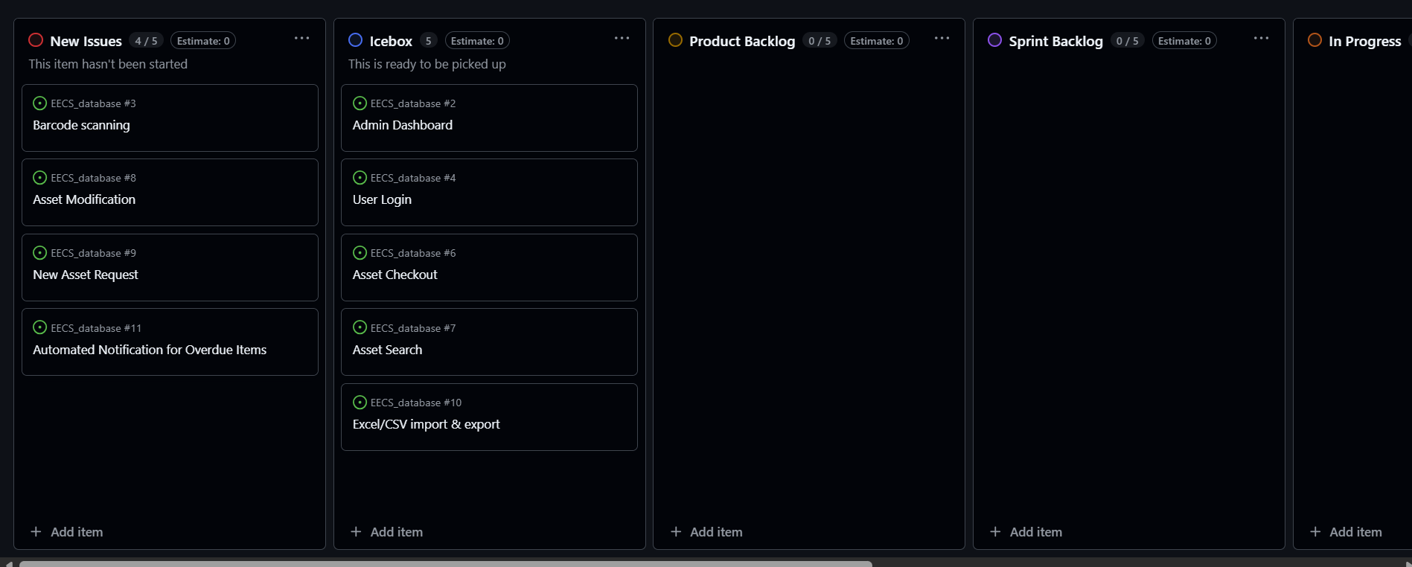
Current Kanban Board

Slide 12
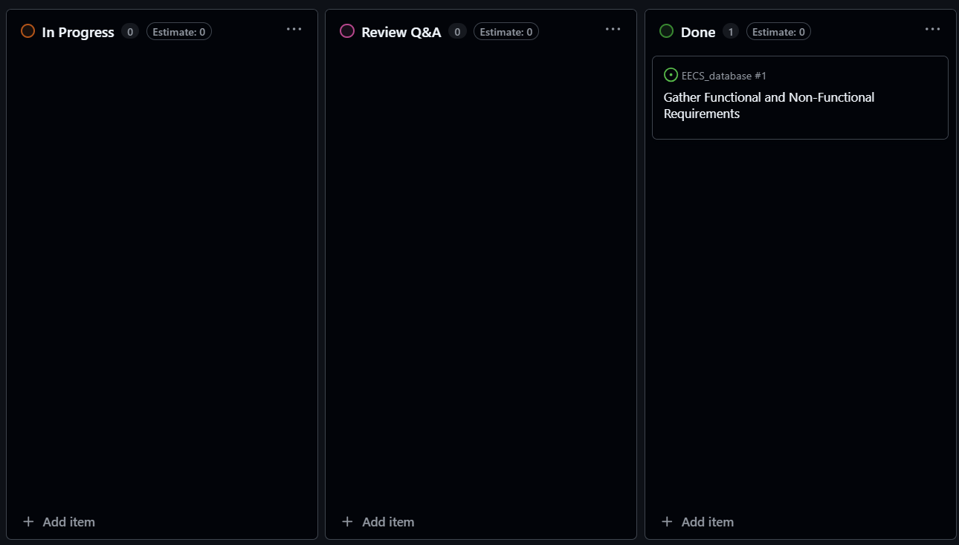
Current Kanban Board

Slide 13
Current Features
We have not completed any features this sprint
Only the skeleton of the program is complete
We will work on programming features very soon

Slide 14
Skill Identification
Travis's learning experience
Learned more about docker and VMs
Learned next.js and nginx
Learned more about schemas in sql
Kaden's learning experience
Had to learn Next.js basics through working on a project
Learn the basics of type script and java script
Brush up on HTML
Learn the basics of tailwind CSS

Slide 15
Achievements and Challenges
Gathered many functional and non-functional requirements from our client
We have a rough idea of what our web application will look like
Learned about the next.js framework
Fleshing out the applications functional requirements was a bit challenging
Integrating into the WSU system was a bit challenging as well

Slide 16
AI Use
We used AI to primarily research the tech stack that we are going to be using
We also used it to compare industry standard architectures to what we are going to make

Slide 17
Next Steps
We will start programming
We will check in with our client to check progress
Flesh out our UI design
Create a high-level overview of our system's architecture
For sprint 1 we were focused on completed tasks early
Next sprint we will work even harder!

Slide 18
Thank you

