Slide 1
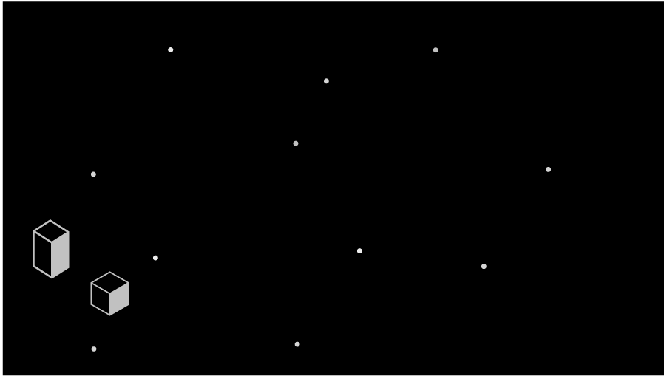

DATABASE INTRODUCTION
Notes:
Welcome to the Workshop template!
Please make a copy of this before you start creating your workshop,
Thank you and good luck!

Slide 2


What is a Database ?
Structured set of informations designed and produced to be easily accessed, managed and modified by several users.
Databases are used for storing, maintaining and accessing any sort of data.
They collect information on people, places or things. That information is gathered in one place so that it can be observed and analyzed.
Databases can be thought of as an organized collection of information.

Slide 3

What is a Database ?
Databases are regrouped in a big place or hall called Datacenters.

Slide 4
What are the types of Databases?

Slide 5



SQL DATABASES
This type of databases use Database Management Systems (DBMS) or Relational database management systems (RDBMS)
These systems serve as an interface between an end-user and a database, allowing users to create, read, update, and delete data in the database
It is based on normalizing data in the rows and columns of the tables.

Slide 6
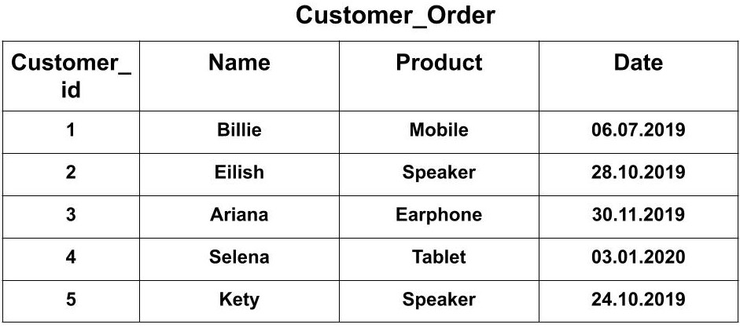
SQL DATABASES

Slide 7

NoSQL DATABASES
NoSQL databases (aka "not only SQL") are non-tabular databases and store data differently than relational tables.
NoSQL databases come in a variety of types based on their data model. The main types are document, key-value, and graph.

Slide 8
NoSQL DATABASES
{
"_id": 1,
"first_name": "Leslie",
"last_name": "Yepp",
"cell": "8125552344",
"city": "Pawnee",
"hobbies": ["scrapbooking", "eating waffles", "working"]
}

Slide 9
Databases (file system) drawbacks?

Slide 10
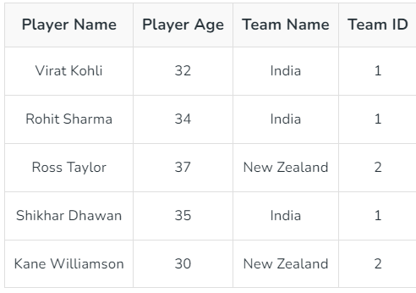
File system drawbacks?
Data Redundancy: Data redundancy occurs when the same piece of data exists in multiple places.

Slide 11
File system drawbacks?
Data Inconsistency : It means that different files contain different information about a particular object or person.
Exemple : If we have an address of someone in many tables and when we change it in only one table and in another table it may not be updated so there is the problem of data inconsistency may occur.
Data Isolation: Data isolation occurs in writing new applications when retrieving data which can be stored in different format and files

Slide 12
How to prevent these drawbacks?

Slide 13
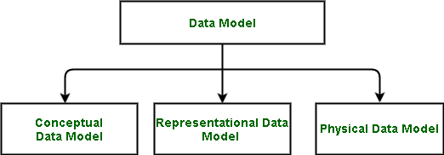
Database design

Slide 14
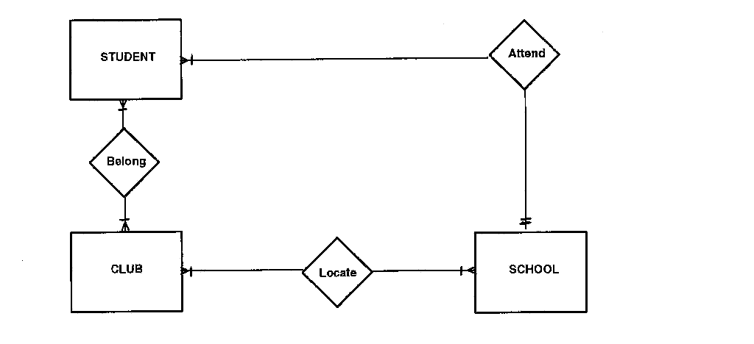
Database design
Conceptual model:

Slide 15
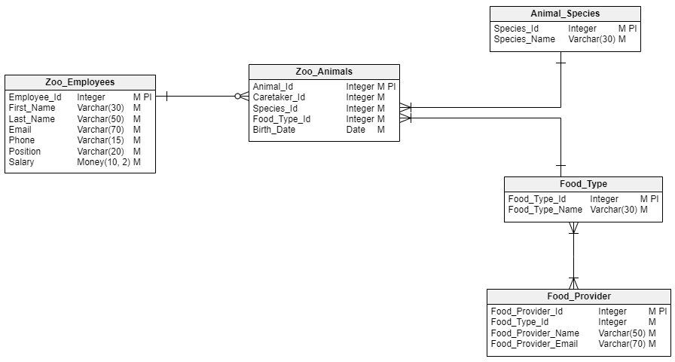
Database design
Logical model:

Slide 16
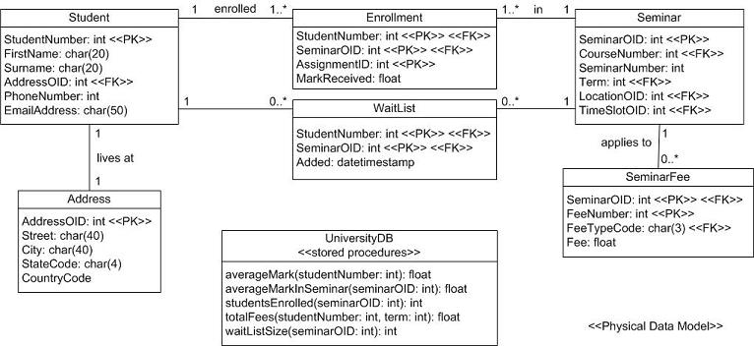
Database design
Physical model: It is an implementation of the logical data model in a specific RDBMS.

Slide 17
Notes:
Thank you for following the workshop template!
you’ve successfully finished creating your workshop out of many more. We try our best to improve courses and standardise them in a similar format to better the experience of the platform for everyone using it, thank you for helping us reach a greater education.

