Slide 1
EfficientNet vs. CBAM : Benchmarking attention for Ocular Disease Classification
by
Samiul Bashir
Takrim-Ul-Alam
Supervised By
Dr. Md. Matiqul Islam
Associate professor,
Information and Communication Engineering

Slide 2
Presenters
Takrim-Ul-Alam
ID: 1911177149
Session-2018-19
Samiul Bashir
ID: 2010277105
Session-2019-20

Slide 3
Outlines
Introduction
Project Objective
Methodology
Result & Discussion
Conclusion & Future Work
Q & A Session

Slide 4

Introduction

Slide 5
A Global Health Challenge
2.2 billion people have vision impairment, with 1 billion preventable cases. AI enables rapid, scalable screening for major ocular diseases.
AI reduces long waits for diagnosis, instantly analyzing fundus images to flag high-risk patients for timely intervention.

Slide 6
Project Objective

Slide 7
Project Objective
Analyzing the impact of integrating CBAM into EfficientNet for ocular disease classification.
To rigorously benchmark an attention-augmented model (EfficientNet+CBAM) against a strong baseline (EfficientNet) to determine if attention mechanisms can improve classification performance on the complex ODIR-5K dataset.

Slide 8
OIDR Dataset
Normal
Normal
Others (O)
Diabetes (D)
Diabetes (D)
Myopia (M)
Ocular Disease Intelligent Recognition Dataset
Contains fundus images of left and right eye from 5000 patients.
Patients are classified into eight categories
5000 Patients
Glaucoma (G)
Hyper-
tension (H)
Cataract (C)
AMD
Figure 1 : Classification of Fundus Images on OIDR Dataset

Slide 9
Methodology

Slide 10
Methodologies
Traditional Approach:
EfficientNet-B0 backbone
Standard classification head
Serves as the reference model
Proposed Approach:
EfficientNet-B0 backbone
CBAM (Convolutional Block Attention Module) integrated
Classification head
Our proposed models enhances focus on critical regions for better performance in ocular disease classification

Slide 11
Building Model From Scratch – A nightmare
Requires vast labeled data and heavy computation.
Large models require long GPU training.
Medical image labeling by experts is costly.

Slide 12
Selecting Pretrained Models – A Smart Choice
Pretrained architectures are already trained on large datasets
Reduces computation and training time while maintaining accuracy
Performs effectively with limited medical data

Slide 13
Choosing The Right Model – Why EfficientNet?
Introduced by Google AI Research
State-of-the-art CNN
Higher accuracy and lower computational Cost
Uses compound scaling to balance depth, width and resolution
Primarily trained on the ImageNet dataset

Slide 14
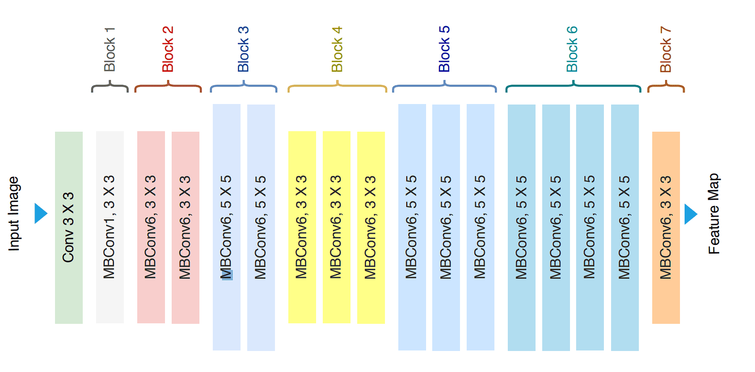
EfficientNet: Optimizing Efficiency & Accuracy
Figure 2: Layers and dimension of an EfficinetNet Model
Source: https://viso.ai/wp-content/uploads/2024/03/EfficientNet-Architecture-diagram.png

Slide 15
Attention Mechanisms: Focusing on What Matters
The Challenge
Equal weighting treats lesions and background as equally important, degrading diagnostic accuracy.
The Solution
Attention learns spatial and channel importance, directing computation to pathologically relevant regions.
The Impact
Interpretable predictions aligned with clinical practice and improved classification performance.

Slide 16
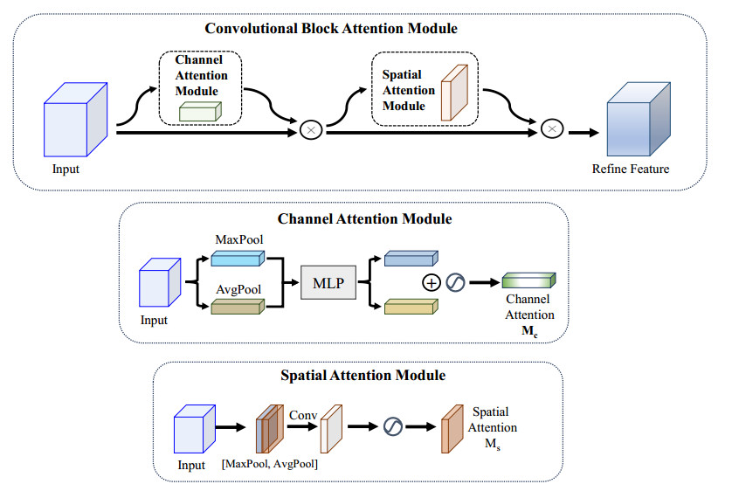
Convolutional Block Attention Module
Figure 3: The architecture of CBAM. CBAM is composed of CAM and SAM.
Source: https://www.aimspress.com/article/doi/10.3934/mbe.2024104

Slide 17
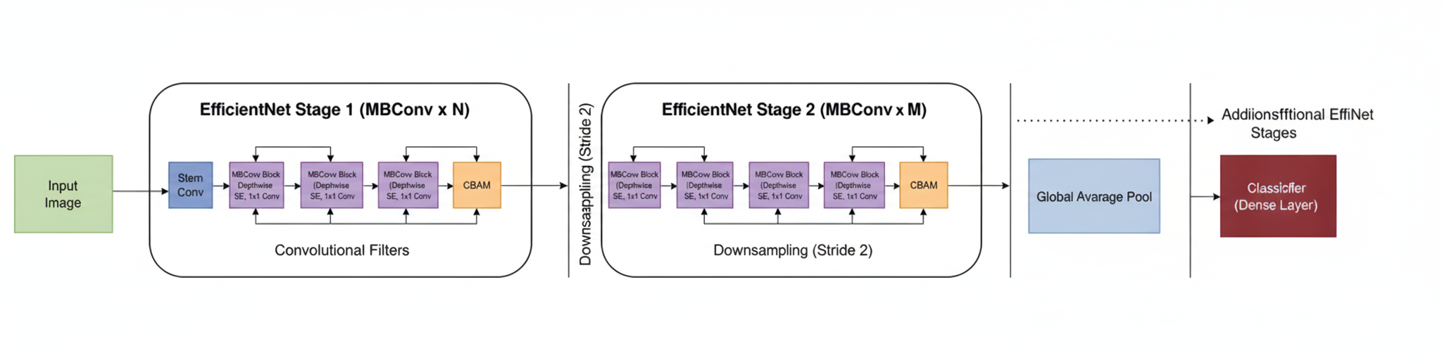
Proposed Architecture
Figure 4: EfficientNet placement with CBAM architecture (proposed architecture)
Source: https://www.aimspress.com/article/doi/10.3934/mbe.2024104

Slide 18
Result and Discussion

Slide 19
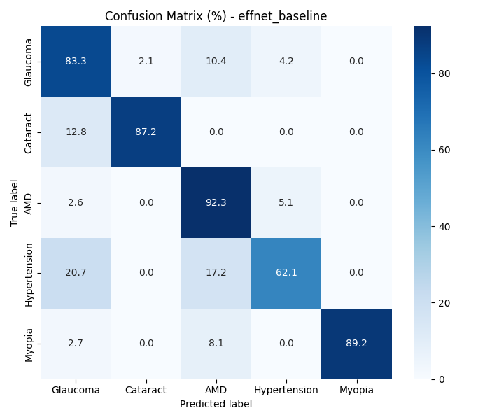
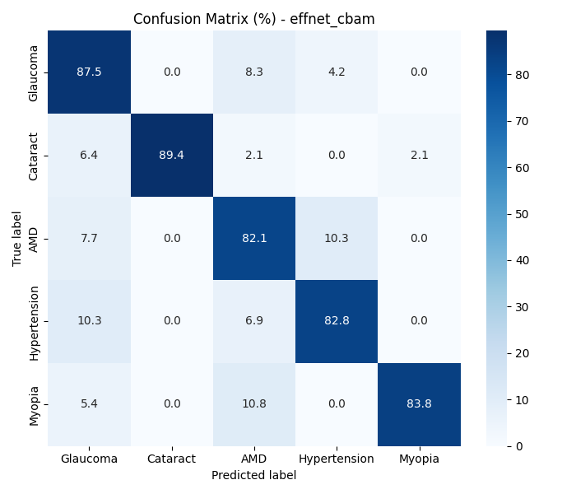
Result And Discussion
a) Without CBAM
b) With CBAM
Figure 6: Confusion Matrices

Slide 20
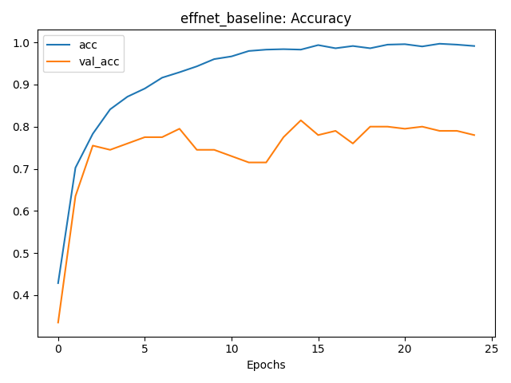
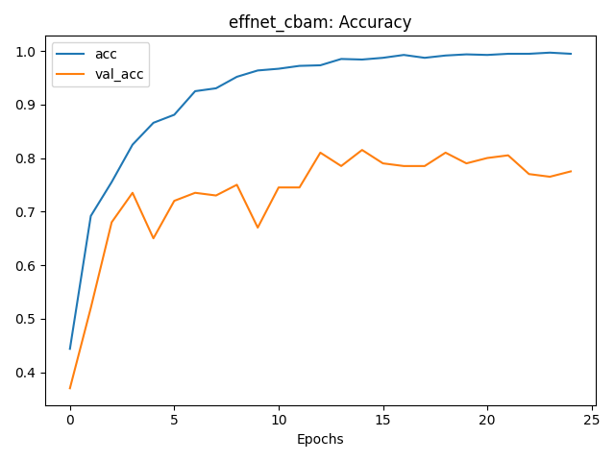
Result And Discussion Cont’d…
a) Without CBAM
b) With CBAM
Figure 7: Accuracy vs Epochs Curves

Slide 21
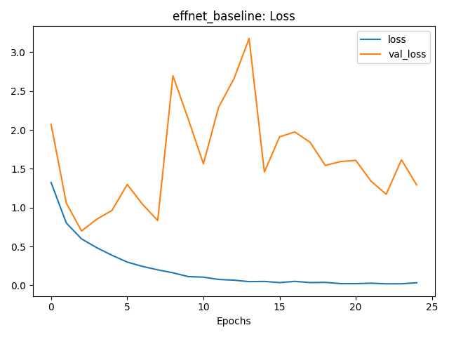
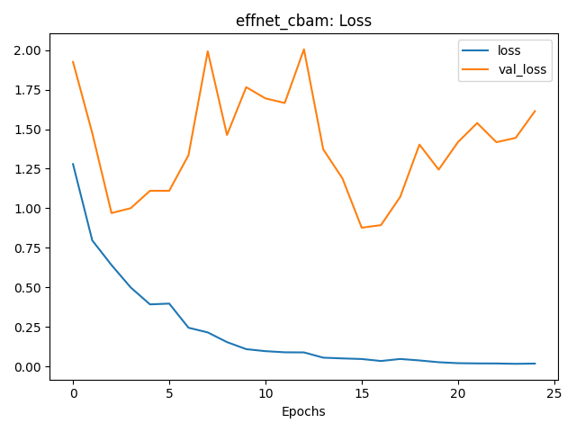
Result And Discussion Cont’d…
a) Without CBAM
b) With CBAM
Figure 8: Loss vs Epochs Curves

Slide 22
Result and Discussion
Model | Accuracy | Macro F1 | Weighted F1 | ROC – AUC (macro) | PR – AUC (macro)
EffiecientNet (Baseline) | 0.840 | 0.835 | 0.841 | 0.970 | 0.905
EfficientNet With CBAM | 0.855 | 0.854 | 0.858 | 0.974 | 0.921
∆(CBAM – Base) | +0.015 | +0.019 | +0.017 | +0.004 | +0.016
Table 1: Performance comparison between two approaches

Slide 23
Conclusion & Future Work

Slide 24
Outcomes
EfficientNet with CBAM outperforms baseline EfficientNet
Higher accuracy, macro F1, and ROC–AUC
Big recall gain for Hypertension (+20%)
More interpretable, reliable, and clinically meaningful predictions

Slide 25
Future Works
Multi-label classification – handle co-existing diseases
Explore advanced attention (ECA, Transformer-based)
Self-supervised and federated learning for better generalization
Real-world deployment – optimize for clinical or edge devices

Slide 26

Q & A Session

Slide 27
Thank You

