Slide 1
Santa Monica Haskell User Group:
Recreating Scala project in Haskell
Ryoichiro Oka

Slide 2

What's Scala?
http://www.scala-lang.org/
A JVM language that combines…
  Java
  Haskell
  Ruby
  …
“Extends(?)” Haskell, by putting OOP in it

Slide 3
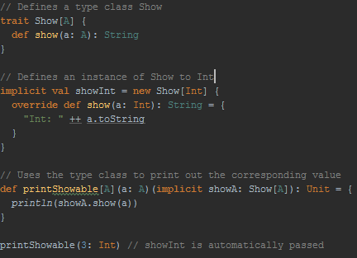
Implementing FP in different approach
Type class
  is still “class” and “object”, but “implicitly” passed as a parameter

Slide 4
What are we doing in this talk?
(Try to) recreate a Scala project in Haskell
Share knowledge about FP/OOP/Haskell/Scala with each other
Understand more about FP/Haskell in the process

Slide 5

Fujitask
http://www.slideshare.net/hexx/scalamatsuri-2016-scala
Implements PofEAA's "Unit of Work" in Monadic way
  http://martinfowler.com/eaaCatalog/unitOfWork.html
Prevents access permission errors at compile time
Used at Dwango

Slide 6
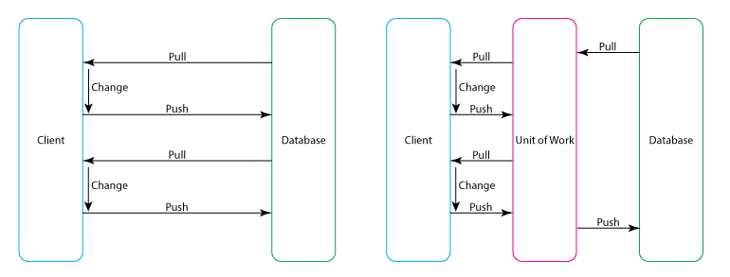
Unit of Work
A controller between client and database to reduce transactions

Slide 7
Access Permission
“Read” access and “Read/Write” access in master/slave system
Asking “Read/Write” to a slave causes a runtime error!

Slide 8
How Fujitask handles those?
Monadic approach
subtyping
(See the code)

Slide 9
Implementing in Haskell?
Fujitask:
  Monad, typeclass, subtyping
Haskell:
  ?

Slide 10
CollabEdit
http://collabedit.com/
Online collaborative coding.. could be helpful.
Ask the path to me!

