Slide 2
Sideline
An efficient communications application for coaches and players that's tailored for Soccer/Football
By HRZN

Slide 3
Roles
Tak – UI design and testing , Scrum master.
Tomi - API development, UI testing, security.
Amara- Backend, Frontend, team lead.
Mahaveer- Backend, Frontend, GitHub.
Michal- Frontend, coding, UI design.

Slide 4
USP
We are focused on the whole aspect of the game.
Allows us to effective communication with minimum effort for the User.

Slide 5
MSCW for Players
Must Have
Login system
Player Profile
Vitals
Goals/Assists
Training sessions that you’ve attended as a player
Chat System
Calendar/ Fixtures/ Training
Should Have
Social Feed
League Tables API

Slide 6
MSCW for Players
Could have
Weather Forecast
Would Have
Pitch Coverage

Slide 7
MSCW for Managers
Must Have
Login system
Player Profile
Chat System
Calendar/ Fixtures/ Training
Manager gets a list of players who have confirmed to go but its an editable list as he will be
the one to confirm
Should Have
Social Feed
Profile
Review System
Manager Stats
League Tables API
Manager UI

Slide 8
MSCW for Managers
Could have
Formation pre-sets
Team Lineup
Weather Forecast
Would Have
Pitch Coverage

Slide 9
Universal Design Principle
Perceptible Information - Displaying the necessary information effectively to the user.
Low physical Effort - An efficient and comfortable design.
Error Tolerance - Adhering to accidental actions performed when using the application.

Slide 10
The things that make us unique
Post game player analysis.
Fixtures and results.
More in depth stats in player profile.
Manager UI.
Team selection and formations.
Weather forecast for game days.

Slide 11
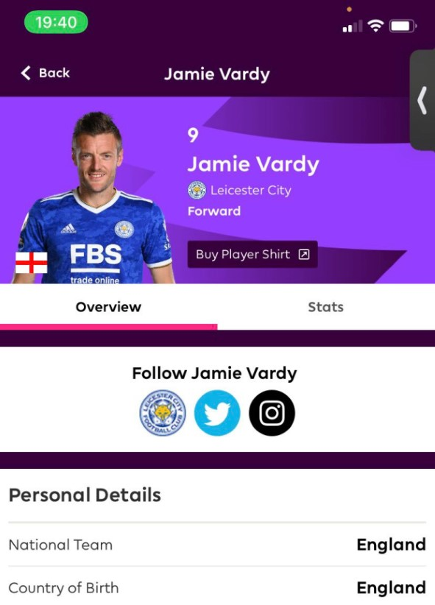
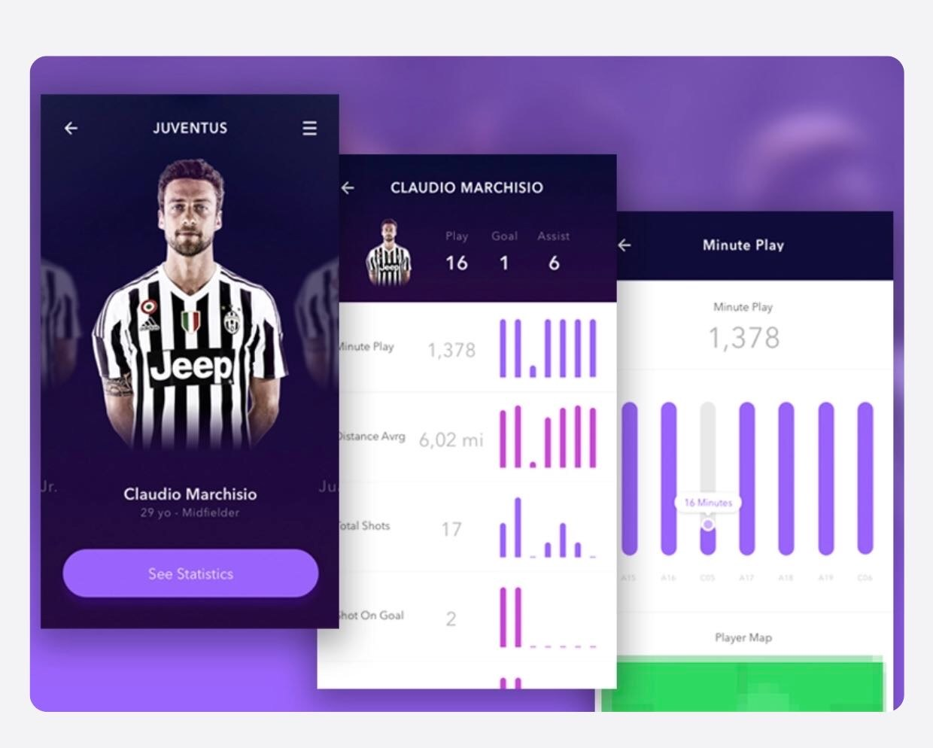
Player Statistics

Slide 12
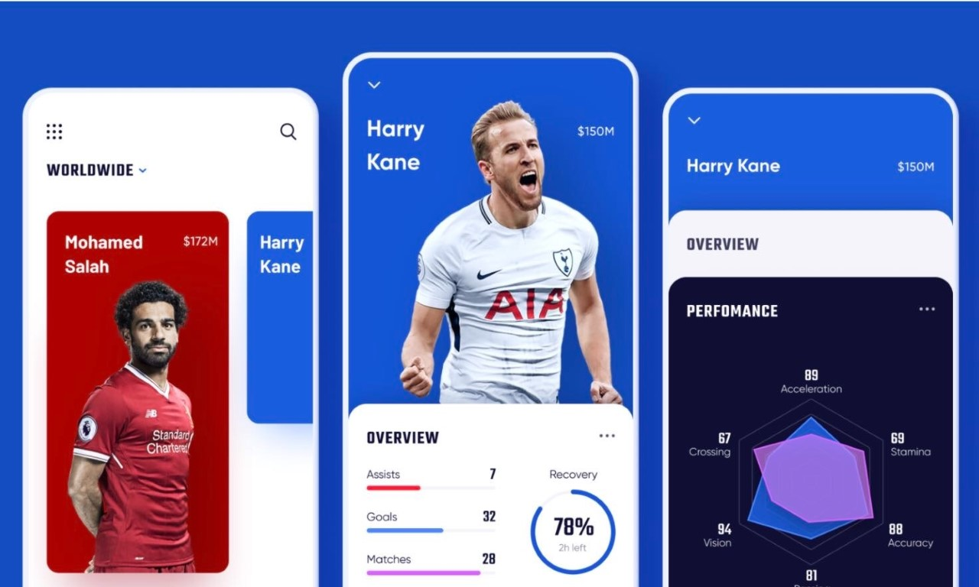

Slide 13
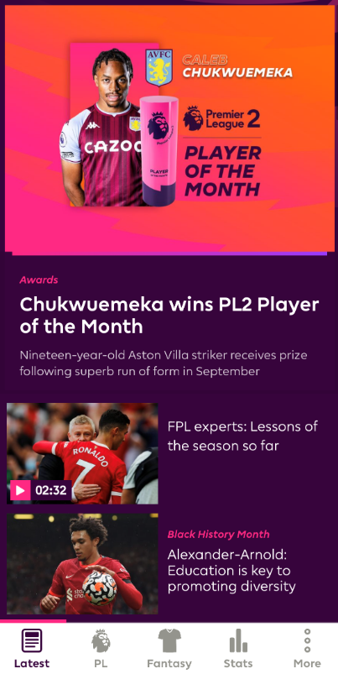
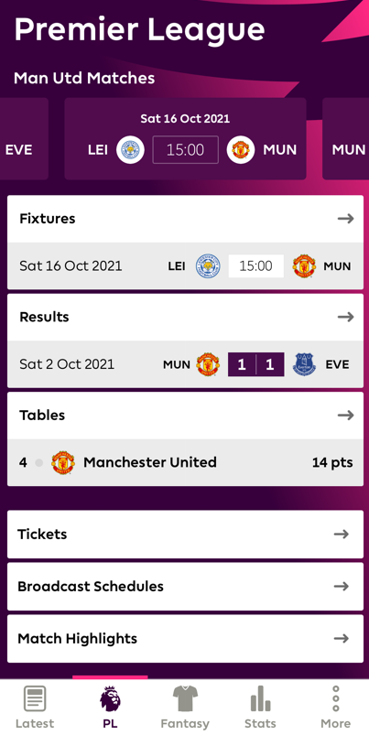
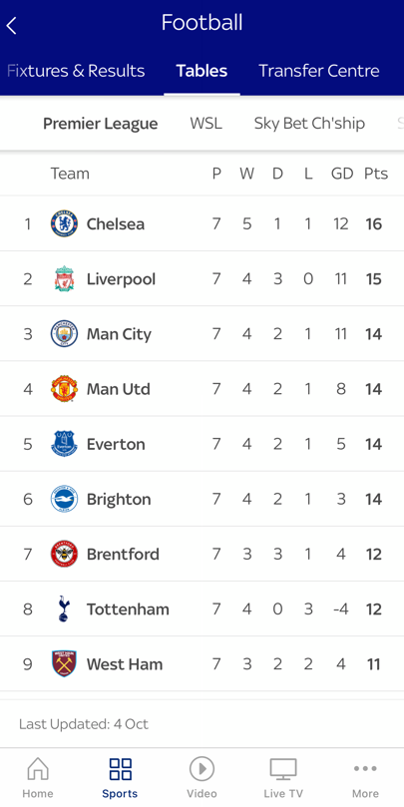
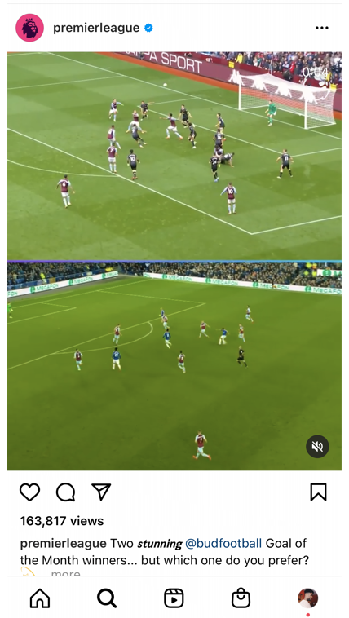
Similar Apps & UI Design
Premier League Fantasy Football
Sky Sports
Instagram
News feed-Latest league news
Upcoming fixtures & results of the league
Premier League table showing current live standings
Social feed posting videos and pictures w/ comments

Slide 14
