Slide 1
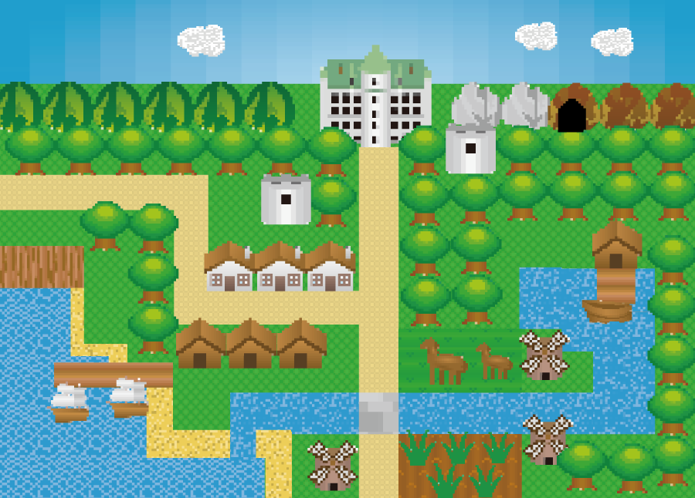
RPG
M24W0B08
Takuma Hosaka

Slide 2
Overview
What is RPG？
Diagram(Sequence and Class Diagram)
Program
１Login
２Main Menu
2-1.Fight algorithm flowchart
2-1-1 Before fight
2-1-2 During fight
2-1-3 After fight
2-2.Check Status
2-3.Go to Onsen
2-4.Save Data

Slide 3


What is RPG?
A role-playing game (RPG) is a game in which participants control characters assigned to them (player characters), to overcome challenges (such as adventures, exploration, combat, etc.) with the aim of achieving specific objectives.
Through battles with monsters, characters gain experience points, which allows them to grow. As they grow, their exploration and range of actions expand.

Slide 4
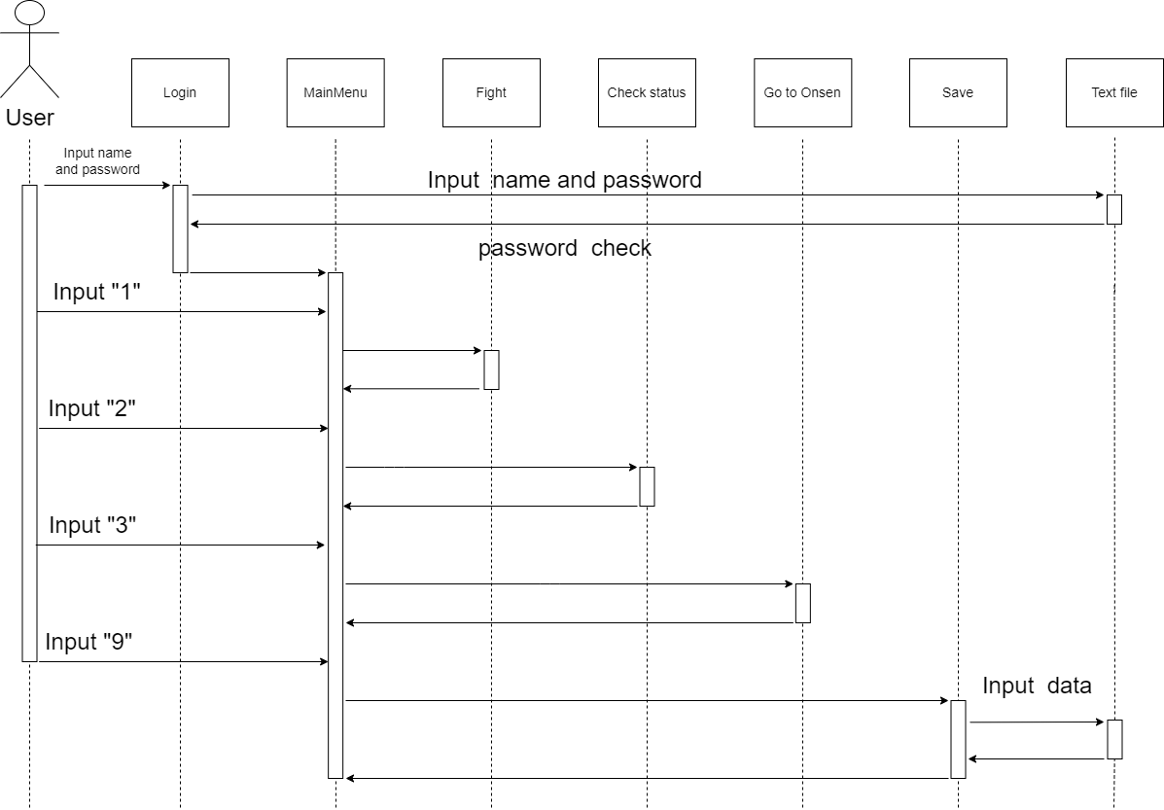
Sequence Diagram

Slide 5
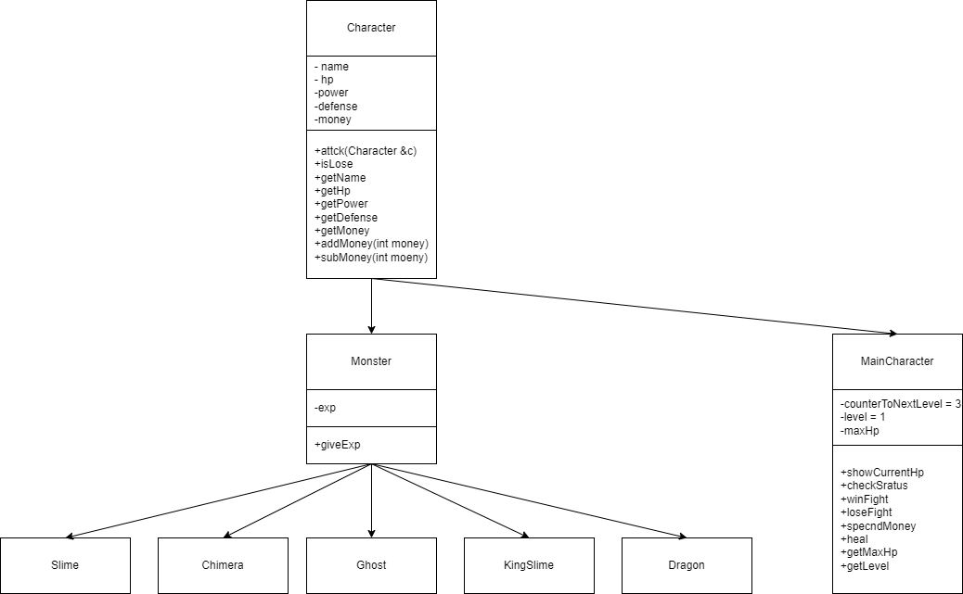
Class Diagram

Slide 6
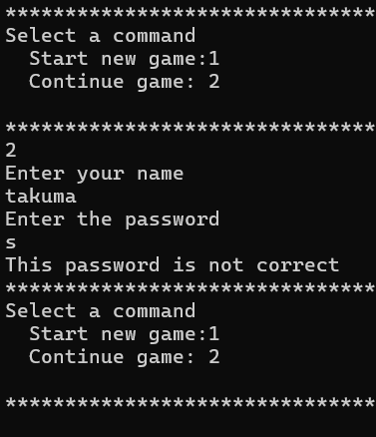
Program 1. Login
2 types login
1.Start game with new data
Input Name
2 Continue game with saved data
Input Name and Password
Get saved data from a text file
If password is wrong, trying again

Slide 7
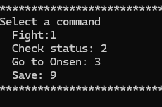
Program 2. Main Menu
Main section of this game
1.Fight
Move to select a monster to fight
2.Check status
Check character’s current status
3.Go to Onsen
Recover character’s HP
9. Save
Save current status on a text file
End program

Slide 8
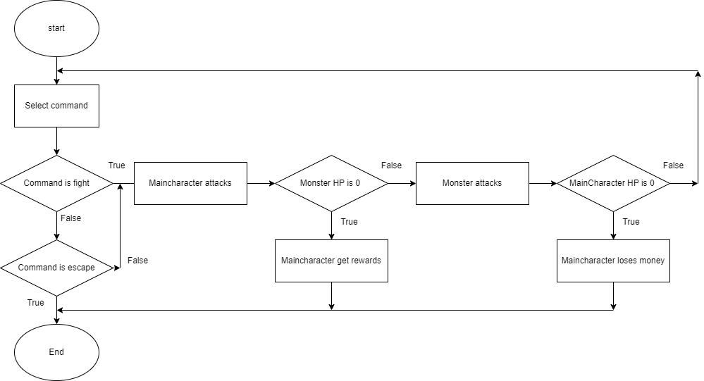
Program 2-1. Fight algorithm flowchart

Slide 9
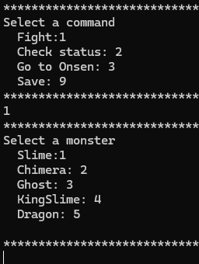



Program 2-1-1. Before Fight
Choose a monster to fight
1.Slime (very easy)
2.Chimera (easy)
3.Ghost (normal)
4.KingSlime (hard)
5.Dragon (Very hard)

Slide 10
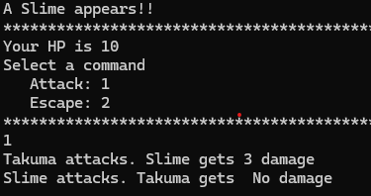

Program 2-1-2. During Fight
Choose a command
1.Attack to a monster
Fighting until when either of
main character or a monster
gets HP to be 0
Move to “after fight” (next slide)
2.Escape
Move back to main menu

Slide 11
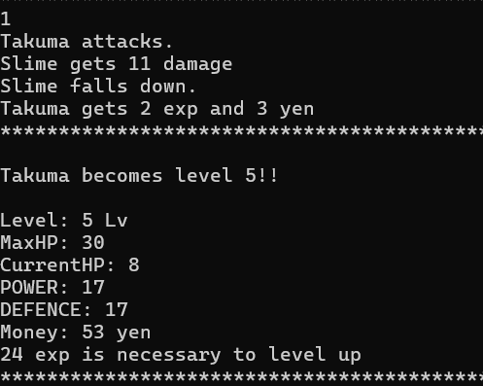
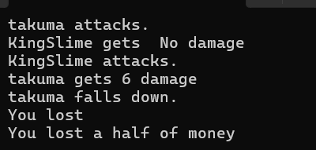
Program 2-1-3. After Fight
When user wins
Gain experience points(exp)
and money
Level up when exp reaches
to some amount
When user loses
Money becomes halved

Slide 12
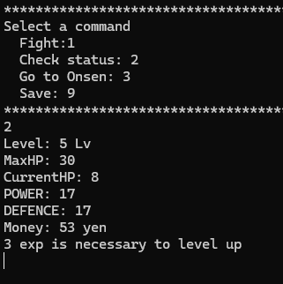
Program 2-2. Check Status
User can see current status
such as
How much money
How much HP remains
How exp to level up

Slide 13
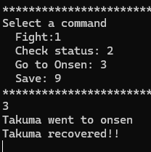
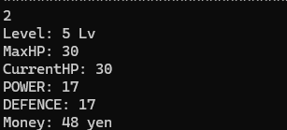
Program 2-3. Go to Onsen
Go to Onsen
Spend 5yen
Heal (make current HP MaxHP)
If user doesn’t have more than 5yen,
User can’t recover.

Slide 14
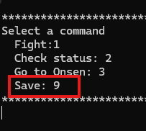
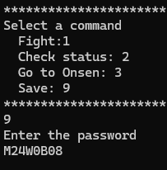
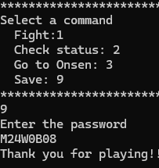
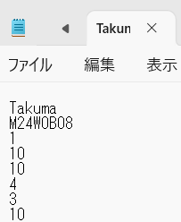
Program 2-4. Save Data
Enter password to save
Current status such as level, power etc. is stored in a file
The program ends after save

