Slide 1


Slide 2
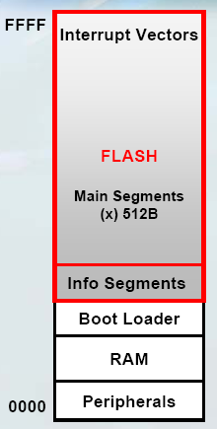
When Setting Registers
GPIO registers
  P1OUT = 0x80;
  P1IN, P1SEL ……
What are these P1IN, P1OUT ……
  Register and bit definitions
Registers are store here

Slide 3
msp430x16x.h
You see this
  #include <msp430x16x.h>
Things that other done to make your life easier
  Most embedded systems programs include a header file which describes the target processor.
Contains descriptions of
  interrupt vectors
  ROM and RAM sizes and locations
  register names and locations
  port names and locations
  register bit definitions
  macro definitions

Slide 4
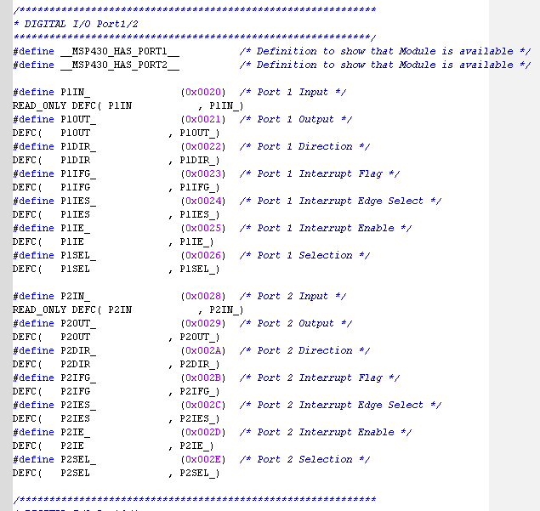
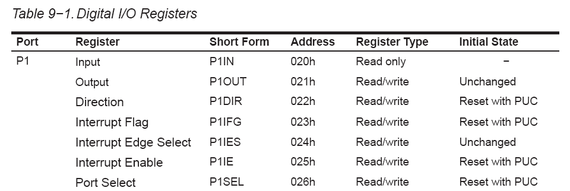
What’s Inside msp430x16x.h
This is why compiler understand P1IN, P1OUT, ……
Define this name at this address
DEFC –> 8-bit
DEFW → 16-bit

Slide 5
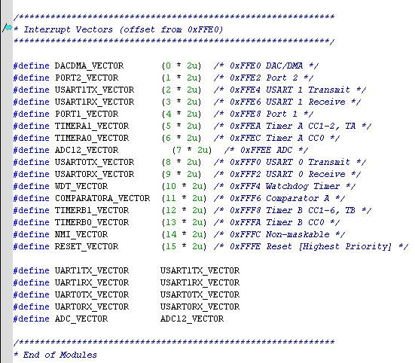


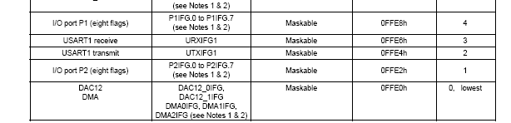
Interrupt Vectors
This is why compiler understand PORT2_VECTOR

Slide 6
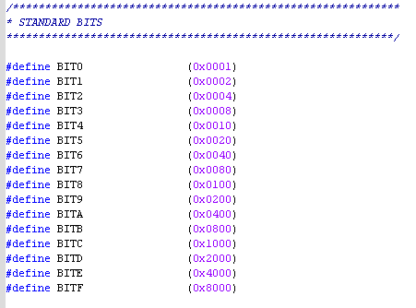
What’s Inside msp430x16x.h
You can do this
  Set bit 0 and bit 7
    P1SEL |= BIT0 + BIT7;
  Clear bit 0 and bit 7
    P1SEL &= ~(BIT0 + BIT7);
There are many others
  You will meet them soon

Slide 7
Things You Can Do
The above are things that other done to make your life easier
You can do something to make your life easier
  Hardware Abstraction Layer (HAL)
  Macros

Slide 8
Hardware Abstraction Layer (HAL)
An abstraction layer between software and hardware
  Implemented in software
  You can see it in Windows, Linux, embedded system, and etc.
  Provide application programming interfaces (APIs)
  Easily portable
  Intuitive name

Slide 9
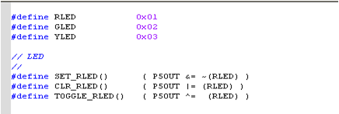
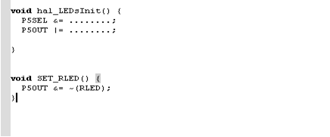
LEDs HAL
You want to have a HAL for LEDs
Example
  Filename: hal_LEDs.h
  Filename: hal_LEDs.c
Macros
Replace
For short expression
;
;
;
Functions
Branch
Need extra cycles

Slide 10
MSP430 Clock System
high-frequency oscillator (optional)
MSP430
digitally controlled oscillator
Clock Signals
Clock Modules
CPU
DCOCLK
MCLK:
Master Clock
XT2CLK
SMCLK:
Sub-main clock
Peripherals:
Timer, UART, …
LFXT1CLK
ACLK:
Auxiliary clock
32.768KHz fixed rate
Low-frequency/high-frequency oscillator

Slide 11
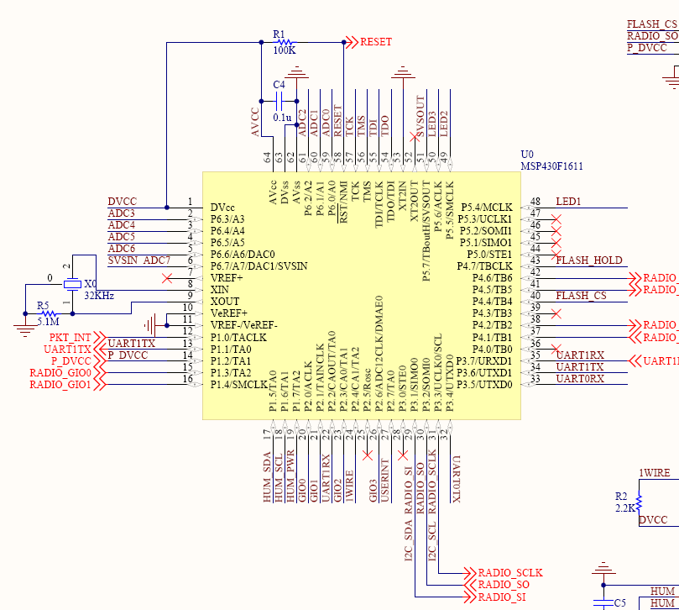
Schematic
No second oscillator (XT2CLK)
Connected to a 32.768KHz watch crystal

Slide 12
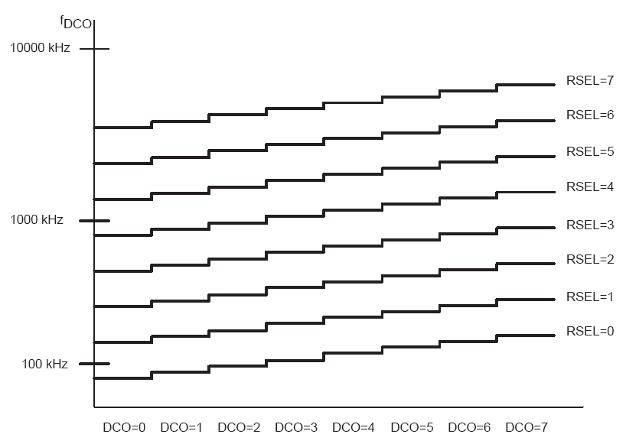
Adjusting DCO Frequency
current injected into the DCO defines the fundamental frequency
  internal or external resistor controls the current
three RSELx bits select one of eight nominal frequency ranges
three DCOx bits divide the DCO range selected by the RSELx bits
five MODx bits (modulation) further adjust the frequency

Slide 13
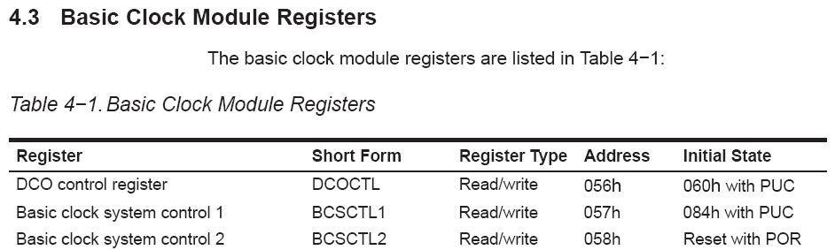
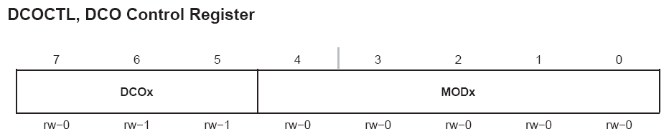
Clock Module Registers

Slide 14
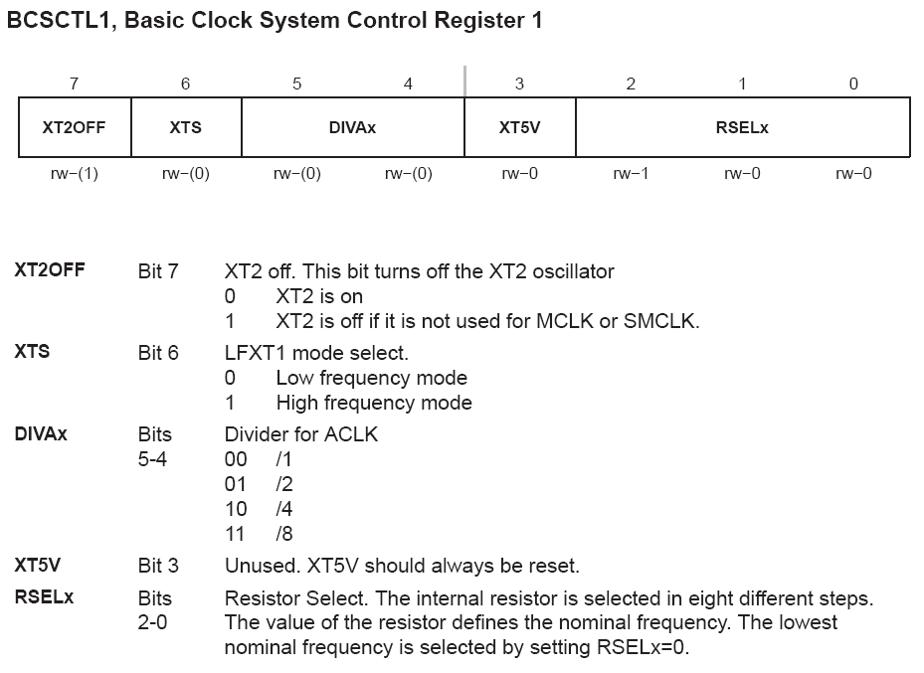
BCSCTL1
Low Freq. (32.768K)??
High Freq. (450K ~ 8M)??
32.768K
8192
ACLK
Divider = 4

Slide 15
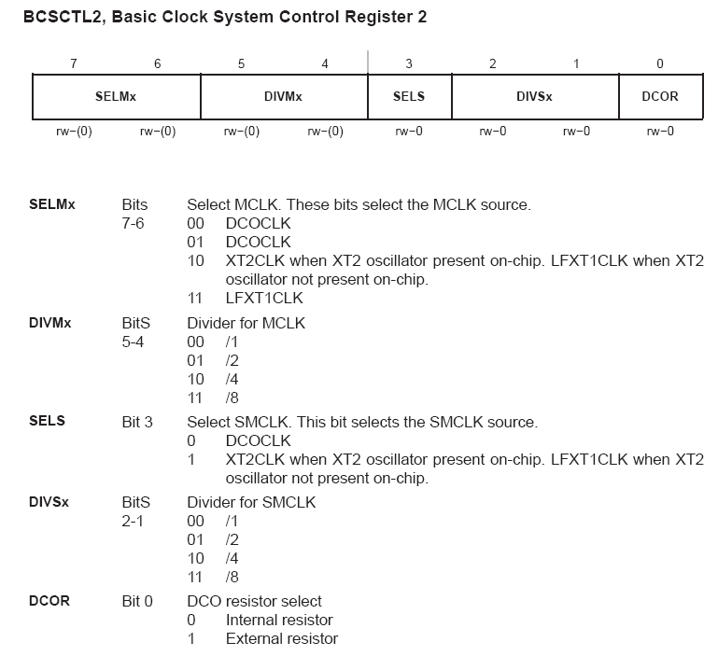
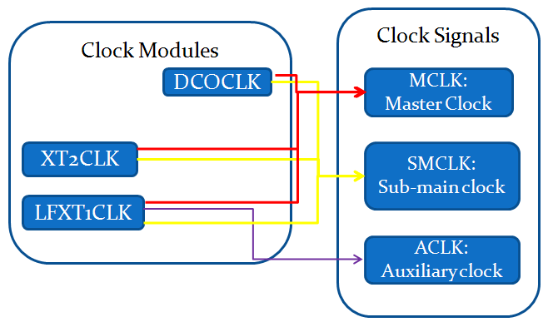
BCSCTL2
No external resistor on Taroko

Slide 16

Timer
A counter that is incremented/decremented when the clock pulses
Two timer on MSP430F1611
  Timer A3
    3 sets of configurable capture/compare registers
  Timer B7
    7 sets of configurable capture/compare registers
  16-bit timer
    at most count to 65535
+/-1
+/-1

Slide 17
Timer
Trigger
External/internal event trigger an timer interrupt and record current counter value
Outputs
Clock Signels
Timer Interval
when counts to a certain value, generate an interrupt
ACLK
Timer (counter)
0, 1, 2,…….,65534, 65535
SMCLK
PWM output
generate pulse width modulation (PWM)
External signals
eg. sensors, events

Slide 18
Clock Signals
ACLK (Watch Crystal 32.768KHz)
  fixed rate
  Much accurate timing
  Slow startup (mS)
SMCLK (DCO)
  Control its frequency in software
  less accurate
  Fast startup (< 6 μS)
External signals
  Any devices that can generate →
Its frequency changed by temperature and supply voltage
Temperature drift = -0.38 %/ºC
Vcc Variation = 5 %/V
(msp430f1611 datasheet)

Slide 19
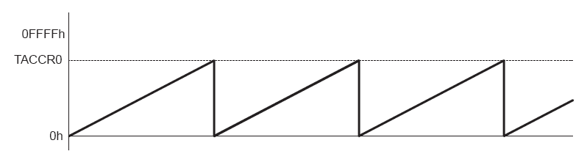
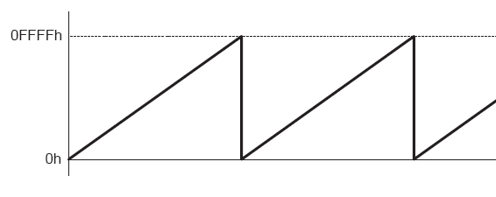
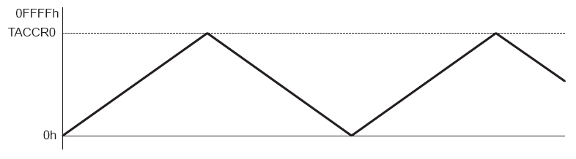
Counter
16-bit counter register TAR
  Increments/decrements with each rising edge of the clock signal
4 operating modes
  Stop
  Up – counts to TACCR0
  Continuous – counts to 0xFFFF (65535)
  Up/down – counts to TACCR0 and back to zero

Slide 20
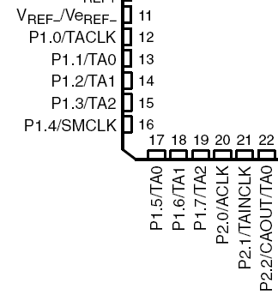
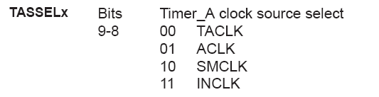
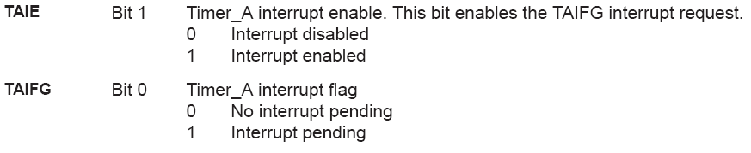
Timer_A Control Register
External clock sources
If set, an interrupt is generated when timer resets to 0x0000 from any other value. (Overflow)
There are many other interrupts that can be generate

Slide 21
Capture/Compare
Capture/compare register
Capture
  Catch an internal/external event
  Record the counter value to register (TACCRx)
  Generate an interrupt
Compare
  Set a value in TACCRx
  When counter value (TAR) = TACCRx
    Generate an interrupt
    Set/reset/toggle an output signal

Slide 22

Usage of Capture Mode
Record time event
  Speed computations
  Time measurements
Example: Timer source = 32.768KHz; Continuous Mode
  TAR increment every 1/32768 second
TAR (counter)
Events
TACCRx = 15000
TACCRx = 60000
t1 = (60000-15000) * (1/32768) seconds
= 1.373 second

Slide 23
Usage of Compare Mode
Usage
  Interrupts at specific time intervals.
  Generate PWM output signals
Example: flash a LED every second
  Timer source = 32.768KHz; Up Mode
  Set TACCR0 to 32767
  flash LED in the Timer_A0 ISR
Interrupts

Slide 24
Usage of Compare Mode
Example: flash a LED every ½ second, flash another every 1.25 seconds
  Timer source = 32.768KHz; Continuous Mode
  Set TACCR1 = 16383; TACCR2 = 40959
TACCR1
Overflow
TACCR2 += 40960 > 65535
TACCR2 = 40959 + 40960;
TACCR2 = 16383;
TACCR2
In ISR
TACCR1 += 16384
In ISR
TACCR2 += 40960

Slide 25
Notes
Continuous Mode
  Useful for generating multiple independent time intervals
Time intervals can be produced with other modes
  TACCR0 is used as the period register
  Overflow handling is more complex

Slide 26
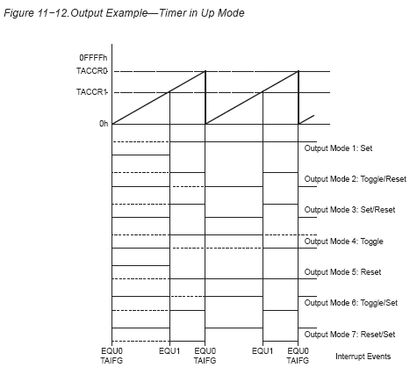
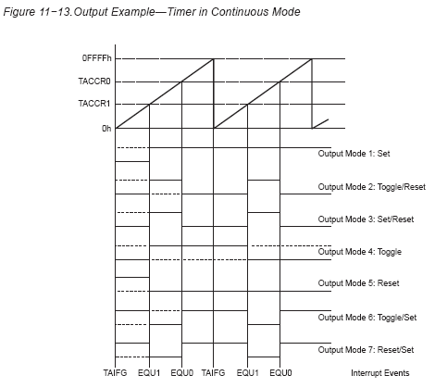
Timer Output
(Action 1)/(Action 2)
Counts to TACCRx, perform (Action 1)c
Counts to TACCRx, perform (Action 1)c
7 output modes
Control by TACCR0 and TACCRx

Slide 27
Timer Interrupts
Interrupt sources
  Timer_A3 has 4 interrupt sources
  Timer_B7 has 8 interrupt sources
Interrupt vectors
  There are two interrupt vectors for each timer
  (TA/TB)CCR0 interrupt vector for (TA/TB)CCR0 CCIFG
  TAIV interrupt vector for all other CCIFG flags and TAIFG
Interrupt flags
  TACCR0 CCIFG flag is automatically reset when the TACCR0 interrupt request is serviced
  Any access, read or write, of the TAIV register automatically resets the highest pending interrupt flag

Slide 28


Capture/Compare Control Register
TACCTLx
We use synchronous capture
second capture was performed before the value from the first capture was read
Where is the capture value?

Slide 29
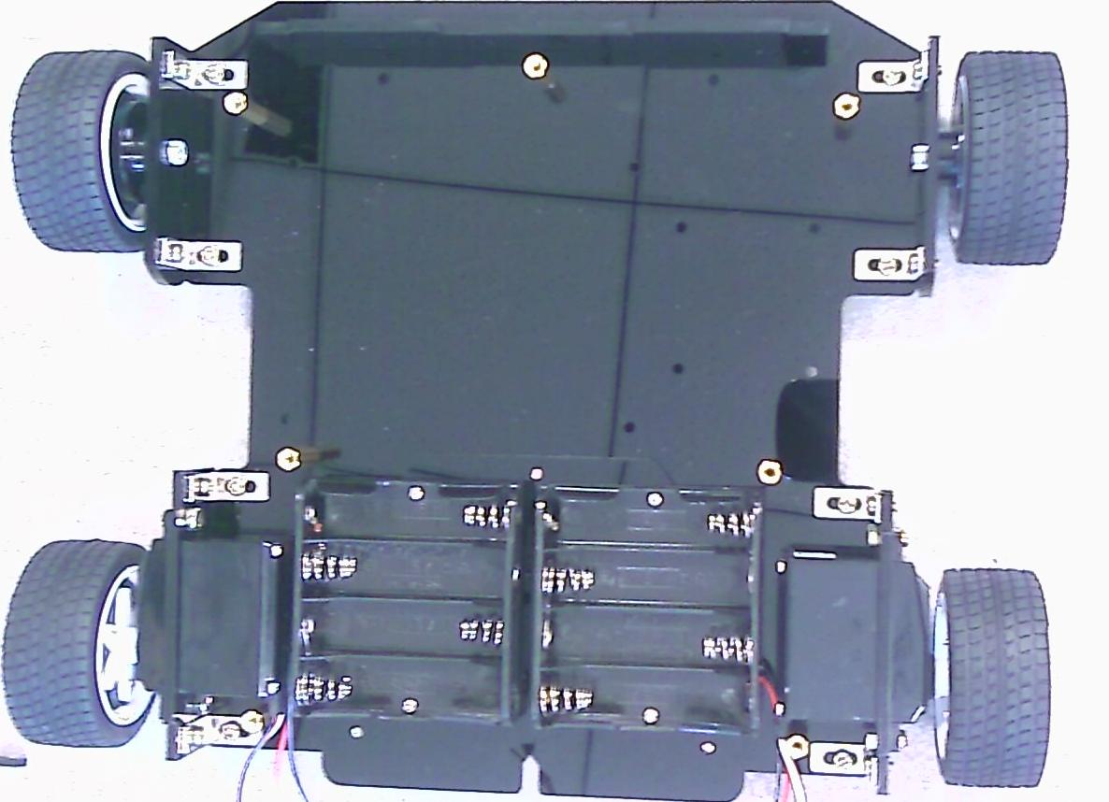
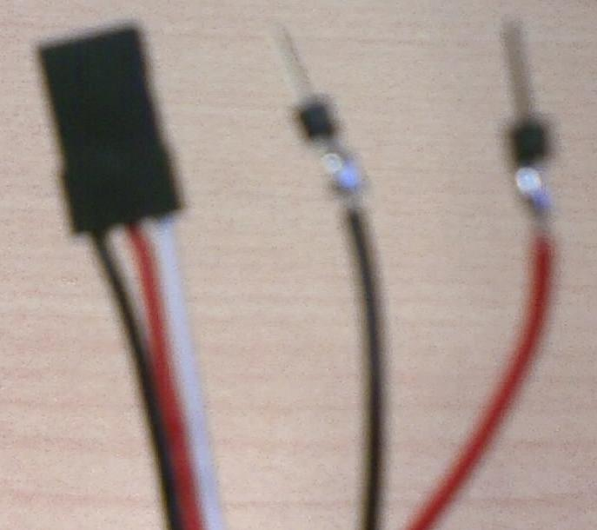
Robot Car
Servo motors
Robot Power (Vcc) Red
Robot Ground (GND) Black
Robot Signal
White
Battery Ground
Black
Battery Power
Red

Slide 30
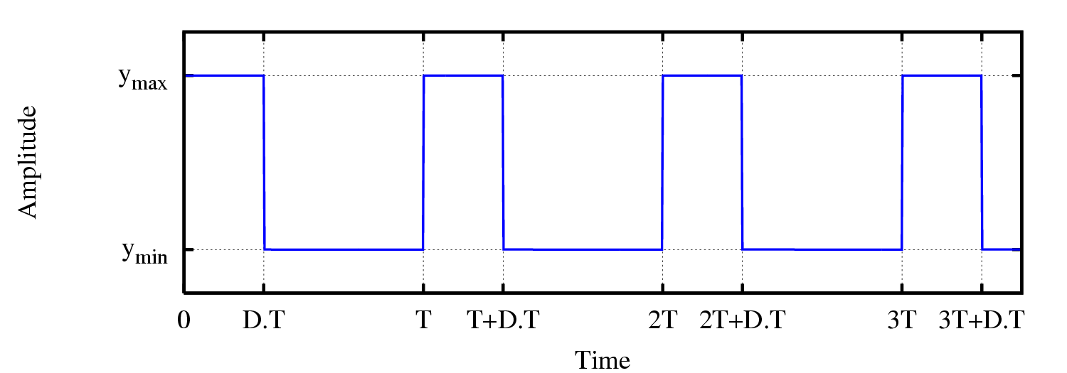
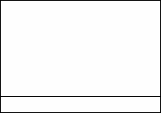
Pulse Width Modulation
Pulse width
Pulse Width Modulation (PWM)
  varying the pulse width
Usage of PWM
  Control motor, telecommunication, voltage regulation, and etc.
Pulse
Period

Slide 31
Servo Motor
A PWM input controls it angular position
  Pulse width = 1.5 ms; position = 90º (neutral)
  Example
    pulse width = 1.25 ms; position = 0º
    pulse width = 1.75 ms; position = 180º
  Varies between brands and models
The servo motor we used is Continuous Rotation model
  Other models will just move to the programmed position and stop
Pulse
Pulse width
Period ≈ 20 ms

Slide 32
Control Servo Motor
Pulse width
The servo motors we used are 1.5 ms neutral
  If pulse width = 1.5 ms → stop
  If pulse width > 1.5 ms → rotate in one direction
  If pulse width < 1.5 ms → rotate in another direction
Pulse
Period ≈ 20 ms

Slide 33
Generate PWM
Two ways
  Timer + GPIO
    Set/reset a GPIO pin inside timer ISR
    Controlled by software, need extra CPU cycles
  Timer output
    Use one of the timer output mode
    Totally controlled by hardware
      No interrupt required

Slide 34
Timer + GPIO
Use two timer interrupts to generate PWM
  Choose a GPIO pin to generate PWM control signal
  When TACCR0 generate interrupt, set this pin (period)
  When TACCRx generate interrupt, reset this pin (pulse width)
Pulse
Pulse width
Period ≈ 20 ms

Slide 35
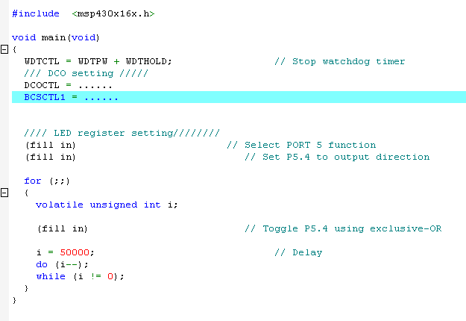
Today’s Labs
MSP430 Clock system
  Use DCO as MCLK clock source
  Use Lab1_1 program file, changing DCO frequency
    Max frequency
    Approximate 1 MHz
  Observe the LED flash in different rate
MCLK is used for CPU, When the speed of MCLK increase, this while loop will end faster

Slide 36
Today’s Labs
Flash a LED every second (sample file on website)
  You can use Timer_A3 or Timer_B7
  Read user guide, find out related timer registers
  Generate an interrupt every second, flash a LED in the ISR
  For registers setting
    Hexadecimal → 0x1234
    Bit definitions →
Check TI code examples to get some ideals
  http://www-s.ti.com/sc/techzip/slac015.zip
TASSEL_0
TASSEL_1
TASSEL_2
TASSEL_3

Slide 37
Today’s Labs
Generate multiple time interval
  Flash a LED every second, flash another every 1.5 seconds
  You need two interrupts
    add another ISR by yourself
  What mode should timer operate?
    Up mode? Continuous mode?
Control the servo motor on the robot car
  Move forward, move backward

