Slide 1
Difference in venues in Central America

Slide 2
An important amount of the Centro American economies depend on internal markets, either regional or country-specific.
Do countries share similar venue types or are they completely different?
Even if they share the same venue types, do customers differ in their reviews depending on the country?

Slide 3
Data Acquisition and Cleaning
Data about the Central American capitals was derived from Kaggle’s User Grecnik ‘World capitals gps’.
Avenue data was acquired from the Foursquare API, both with regular and premium calls.
Since premium calls are limited to 50 per day. Each time they were stored in a csv file and later joined together.

Slide 4
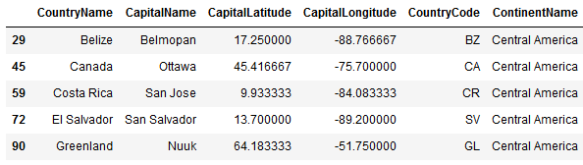
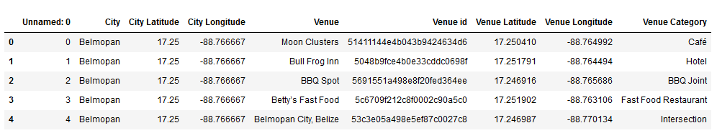
Data

Slide 5
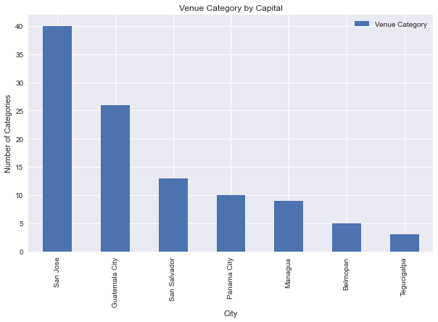
Amount of venue categories by capital.
San José, Costa Rica has the most diverse amount of avenue type, and Tegucigalpa Honduras is the least diverse of them all.

Slide 6
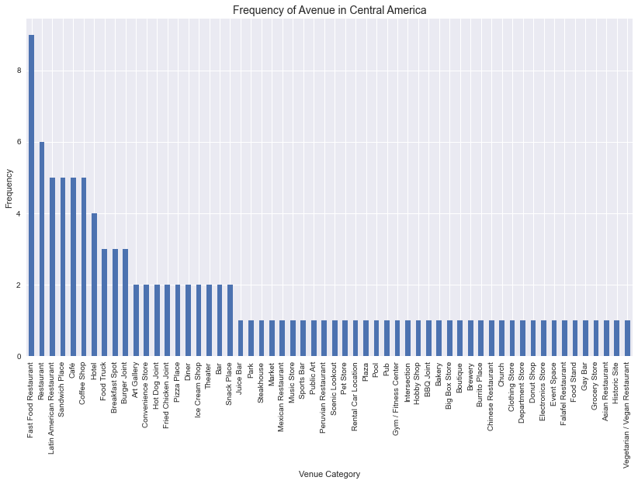

Slide 7
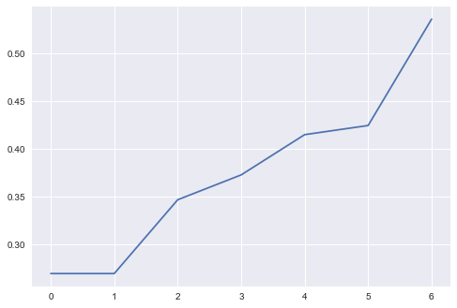
Since Epsilon value is the most importan
value for DBSCAN algorithms, we try
to calculate the most appropiate one for
this particular data set.
We do it by first running a Nearest Neighbor
algorithm and calculating the distances
between each point and the plotting it. Usually
the elbow in the graph shows what value to
use, but is not so clear here, so we used a 0.5
value for the venue category data.

Slide 8
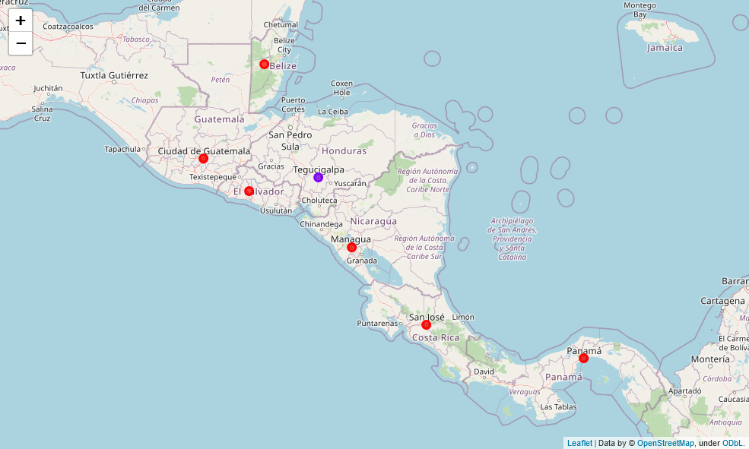
DBSCAN Clusters with only Venue Category

Slide 9
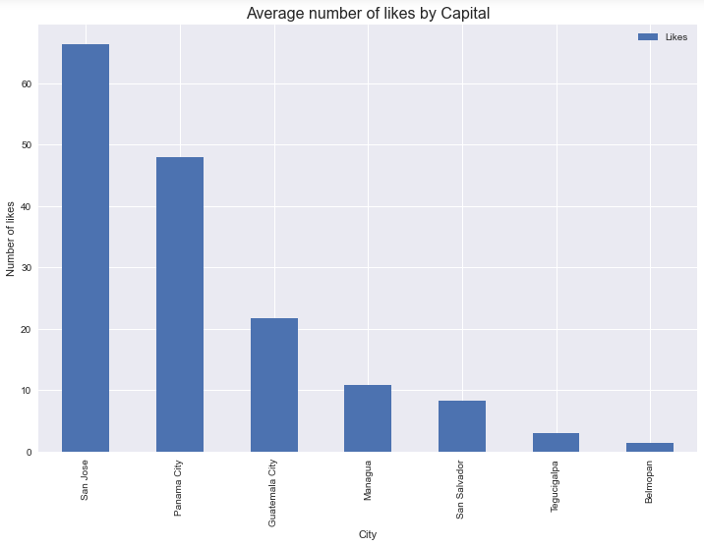
Average number of likes by Capital
San José, Costa Rica, seems to have the most liked venues in the region, followed by Panama City, Panama.

Slide 10
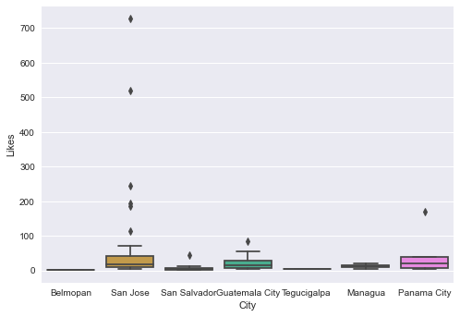
Boxplots of the likes distribution

Slide 11
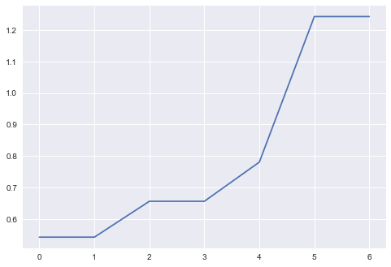
Venues with likes and price info.
As in the previous one, we first calculated
a nearest neighbor algorithm to know
which value of Epsilon would be better
for the DBSCAN algorithm.
As in the previous one, even with the new
data the curb is not clear, but it seams that
an eps value greater than 9 gives the best
results.

Slide 12

Clusters with likes and venue categories.

Slide 13
Conclusions
Costa Rica has the most well liked venues, making it a more competitive ground. Belmopán seems to be the opposite, although the low variaty of Honduras also makes it a lesser competitive market.
Costa Rica also seems to have the cheapest places, in contrast with Honduras.
All considered, all Central American capitals have a similar venue structure.

